Slide 1
K-12 COVID Response Update
January 19, 2022

Slide 2
Today’s Presentation
Department of Elementary and Secondary Education
Shah Foundation
Executive Office of Health and Human Services
Russell Johnston, Deputy Commissioner
Lauren Woo, Strategic Transformation Director
Ross Wilson, Executive Director
Eliza Novick, Project Manager
Marisa Meldonian, Associate Director
Lizzie Gordon, Project Associate
Jeremiah Hay, Deputy Chief of Staff, EoHHS
Sean Burpoe, Strategy Manager, EoHHS
Notes:
Russell

Slide 3
CONTENTS
01
Review of Statewide Testing Data Program in Schools
02
New COVID Testing Option to Optimize In-person Learning
03
Summary of Options
04
Additional Information Regarding At-Home Antigen Tests
05
Update to Quarantine Guidelines
06
Summary of Next Steps and Other Notes
Notes:
Lauren

Slide 4

Protecting In-Person Learning in Massachusetts
Thank you for your ongoing efforts to keep schools open and safe for our students!
You have implemented key COVID-19 mitigation strategies, such as vaccinations, mask wearing, and testing, and we commend you for your hard work.

Slide 5
Statewide Covid Testing Program in Schools
A strength of our statewide approach is its adaptability to meet the needs of our schools based upon their current conditions.
We have now adapted our program to further optimize in-person learning. We look forward to your feedback as we implement this new program.
Notes:
We began our statewide testing services in the fall of 2020 with mobile testing clinics and symptomatic testing.
Always looking to strengthen our response and supports, we added routine pooled testing about one year ago and during the summer of 2021 we introduced Test and Stay.

Slide 6

Data to Action
We have now had the opportunity to review available data about our testing program.
The purpose of this webinar is to share timely information from those data and offer an updated set of COVID testing options, including a weekly at-home test for participating staff and students, to optimize in-school learning.

Slide 7
Review of Statewide Testing Data Program in Schools
01

Slide 8
Our Schools Are Safe
Last fall, we initiated Test and Stay to keep close contacts in school using repeated daily testing.
We know how much work this was, and how much strain school health staff in particular have been under as they try to keep up with contact tracing and repeated daily testing.
Four and a half months later, with hundreds of thousands of results from across the state, more than 98% of those tests have been negative. We know it is overwhelmingly safe to keep students where they thrive – in school.
Notes:
The individual positivity rate in K-12 schools in the state’s pooled testing data reveal case rates significantly lower than the statewide positivity rate.
Students and staff individually identified as asymptomatic close contacts and repeatedly tested in school through the Test and Stay program test negative over 90% of the time. (As of January 9, 503,312 Test and Stay tests had been conducted; 496,440 of them were negative (98.6%).)

Slide 9
Secondary Transmission is Low
It’s also helpful to look at nationwide data related to Test and Stay to examine the extent to which secondary transmission (i.e., transmission to close contacts) is occurring in schools.
The evidence from California and Illinois cited by the CDC in their Test to Stay guidance noted secondary transmission rates of only 0.7-1.5%.¹
Test positivity rates in Test and Stay indicate that individuals identified as close contacts in school are very unlikely to contract or spread COVID-19.
¹ https://www.cdc.gov/media/releases/2021/s1217-Test-To-Stay.html
Notes:
A pre-publication study of the first 13 weeks of the Test and Stay program across all participating Massachusetts schools found that the secondary transmission rate was 2.9%, and that tertiary transmission was very low.

Slide 10
Changes in Other New England States
Other states, like Connecticut and Vermont, have recently transitioned from individualized contact tracing to the use of at-home tests and focusing school health efforts on symptomatic testing.

Slide 11
New COVID Testing Options to Optimize In-Person Learning
02

Slide 12
New COVID Testing Option to Optimize In-Person Learning
Districts and schools participating in symptomatic and/or pooled testing may choose to continue those testing strategies and discontinue contact tracing and Test and Stay.
Using their professional discretion, school health professionals may determine if specific situations warrant contact tracing.
As an additional resource, districts and schools that elect to make this change will be provided with rapid antigen at-home tests for all participating staff and students that can be used on a weekly basis.

Slide 13
The New Option
DESE and DPH recommend that districts and schools select this new option, and if they choose to implement it, they must notify their local boards of health.
Please note that this new option is only available to districts and schools that continue or start symptomatic and/or pooled testing.
Districts and schools that choose to maintain Test and Stay will continue contact tracing and will not be eligible to receive rapid antigen at-home tests.

Slide 14
CIC Health Support
CIC Health will continue to provide staffing and logistical support for the testing program (both the original program and the new option), including program coordination and on-site specimen collectors as needed. CIC Health will also continue to manage consent and reporting processes.

Slide 15
Will There Be Further Updates to the Testing Program?
Both options will remain in place from January 31 to April 22.
DESE and DPH will determine if any updates to the program are needed beyond April 22 and provide you with information throughout the early spring.

Slide 16
Summary of Options
03

Slide 17
Chart of Options
 | Updated K-12 Testing Options (effective 1/31) Discontinue contact tracing and Test and Stay <strongly recommended> | Original K-12 Testing Options Maintain contact tracing and Test and Stay
Symptomatic testing and/or pooled testing | Yes | Yes
Test and Stay | No | Yes
Individualized contact tracing for in-school exposures | Not required | Yes
Weekly at-home antigen testing (students and staff) | Yes, with initial shipment for participating staff during the week of January 24; initial shipment of at-home tests for participating students during the week of January 31 | No

Slide 18
Additional Information Regarding At-Home Antigen Tests
04

Slide 19
How Do I Switch to the New Program?
Districts and schools can elect to switch to the updated testing program between January 21, 2022 and April 1, 2022 by responding to the brief district/school survey at: https://survey.alchemer.com/s3/6697179/Updated-K-12-Testing-Program-District-Opt-in-Form.
Districts that respond by January 21 will begin receiving tests for staff during the week of January 24 and tests for students during the week of January 31.

Slide 20
How Do I Switch to the New Program?
Districts that are not currently enrolled in symptomatic and/or routine pooled testing must fill out the updated Authorized School Application.
  If you are already conducting symptomatic and/or routine pooled testing through the DESE program, you do not need to fill out this application again.
Districts that join our testing program now might not be ready to receive at-home tests starting during the week of Jan. 24 to allow for any necessary start up requirements.

Slide 21
How Will the At-Home Antigen Test Program Work?
Districts and schools that select the updated testing program will receive at-home antigen tests for all staff members who choose to participate and all students whose parents/guardians signify interest in participating by completing a brief opt-in form.
  An optional template opt-in form for staff and students can be found on the updated K-12 Testing Program page on the DESE website.
Schools and districts can distribute at-home tests to all participating staff and students regardless of vaccination status.
The tests will be shipped to the district for internal distribution, and they are packaged in kits containing two tests per kit.

Slide 22
Kit Distribution and Use
At-home antigen test provided: iHealth
Participating staff and students will receive one kit every two weeks so that they can test themselves weekly.
Districts and schools should maximize the utility of the at-home tests by determining which day of the week they recommend participating staff and students take the tests.
  For example, a school that conducts weekly routine pooled testing on Mondays would likely recommend students and staff to undertake at-home tests on Thursdays.

Slide 23
Kit Distribution and Use
For at least the next several weeks, distribution to staff and students will be staggered, with staff getting one kit (2 tests) the week of 1/24 and participating students getting one kit (2 tests) the week of 1/31.
Districts and schools that join after Jan. 21 will be added into the existing distribution schedule.

Slide 24
Results
When an individual tests positive on an at-home antigen test, they will be asked to inform their school of the positive result.
  An example template response form for this purpose can be found on the updated K-12 Testing Program page on the DESE website.
Schools will not be required to report the results of at-home tests to DPH, but districts and schools will continue to include positive at-home tests in their weekly testing reports to DESE.

Slide 25
DESE Materials and Support
DESE has provided the following materials (including necessary translations) you will need to launch at-home tests. All materials can be found on the updated K-12 COVID-19 Testing page of the DESE website:
  Optional template letter to staff and families, including
    Training information for at-home tests (video & paper)
    Information on reporting results
  Template Opt-in forms for staff and students
  Template Test result response form for individuals to report positive results to schools
  Test distribution tracking sheet for districts
  Updated CIC ordering form for at-home tests

Slide 26
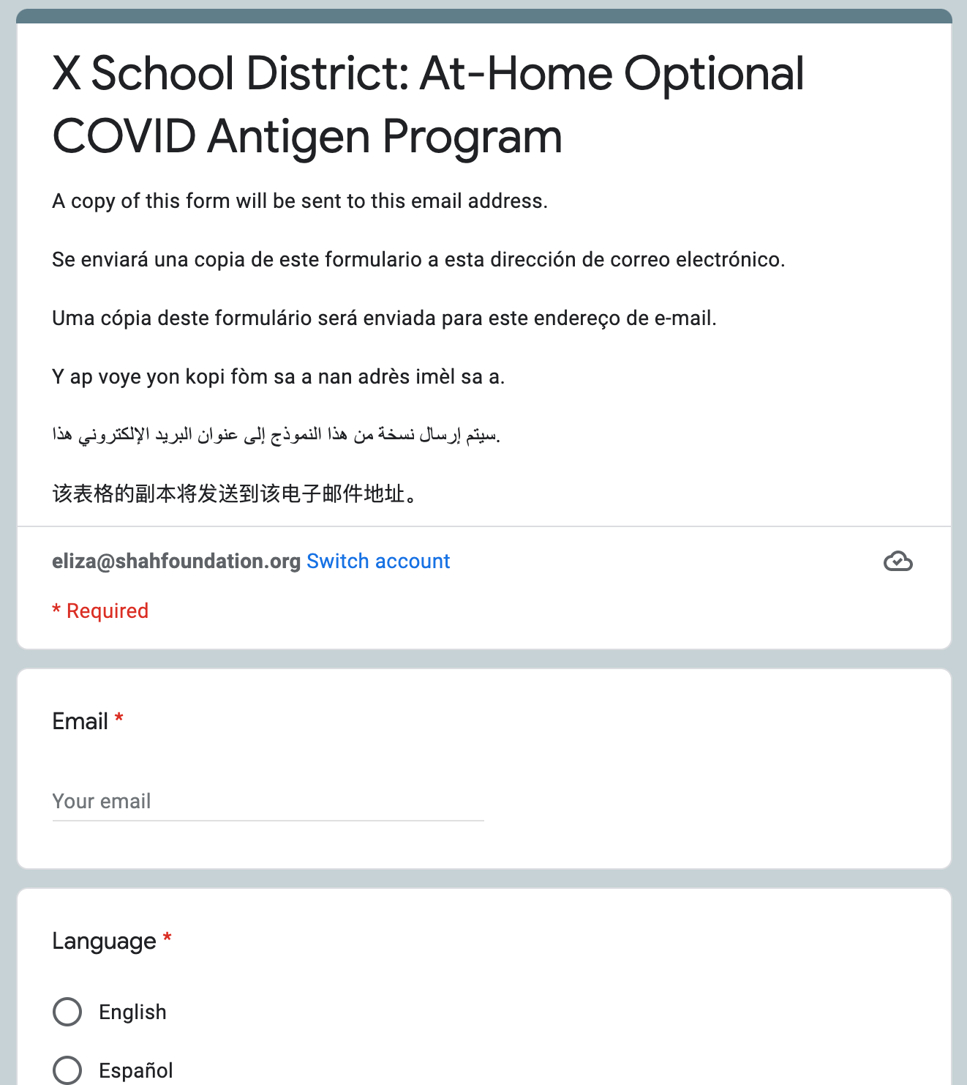
Collecting opt-in for at-home antigen tests with a Google form
Families can sign up for testing using a google form in multiple languages.
Create a folder and share with CovidEdTesting@ShahFoundation.org (instructions on next slide)
Shah Foundation will add a opt-in form and tracker for you
Distribute the opt-in form to families for sign-ups

Slide 27
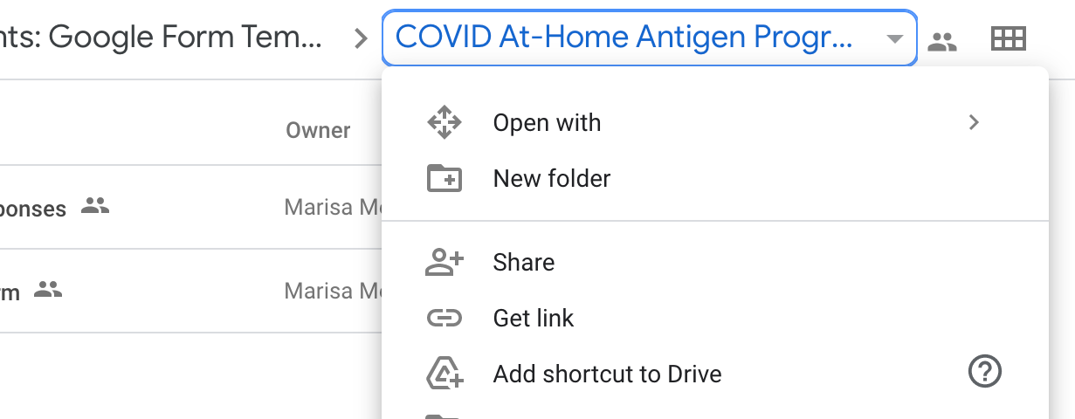
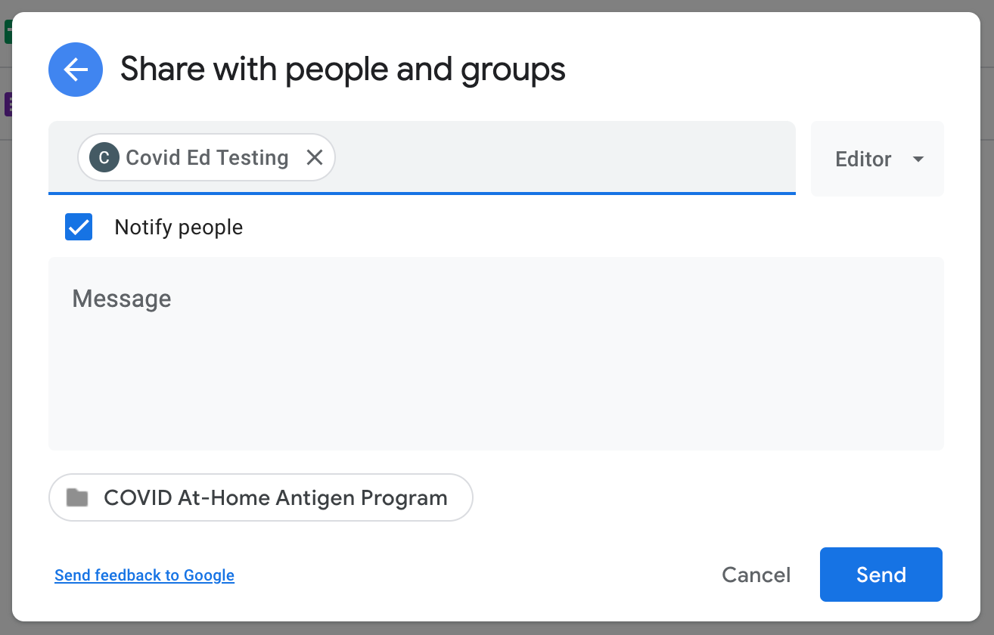
How to create and share a google folder for the opt-in forms
Step 1: Create a Google folder
On your computer, go to drive.google.com
On the left, click New > Folder
Name your folder: [District Name] At-Home Antigen Opt-In Forms
Click “Create”
Step 2: Share folder with CovidEdTesting@ShahFoundation.org (enter email & click Send, make sure “notify people” is checked)

Slide 28
Update to Quarantine Guidelines
05

Slide 29
Discontinuing Individualized Contact Tracing
Districts and schools that select the new testing program will discontinue individualized contact tracing.
As such, for these districts and schools, there is no longer the expectation that close contacts will be identified, and therefore, any potential in-school contacts do not need to quarantine. Instead, schools should shift their focus to monitoring symptomatic individuals.
DESE and DPH will soon update the “Protocols for Responding to COVID-19 Scenarios” guidance to reflect these changes.

Slide 30
Summary of Next Steps and Other Notes
06

Slide 31
Key Dates to begin new program during the week of 1/31
By January 21, interested districts and schools submit the brief survey (https://survey.alchemer.com/s3/6697179/Updated-K-12-Testing-Program-District-Opt-in-Form) to DESE.
During the week of January 24, districts that respond affirmatively to the survey will begin to receive tests for participating staff.
By January 28, districts will collect opt-in forms from interested families and submit request for at-home tests through CIC portal.
During the week of January 31, districts will begin to receive tests for participating students. Once the district or school distributes these tests, it will discontinue contact tracing and Test and Stay.
After January 31, districts will order additional at-home tests on an as needed basis using the CIC ordering portal.
Notes:
Between January 18-21, districts and schools determine how many staff will participate in the at-home antigen test option. The district or school will send this information to DESE in the survey.
By January 28, districts will report to DESE the number of participating students by ordering the requisite number of tests through the CIC ordering portal.

Slide 32
Important Reminders
Districts and schools may elect to switch to the new testing options by responding to the DESE survey anytime between January 21 and April 1, 2022.
DESE and EOHHS/DPH will incorporate districts and schools that opt into the updated testing program after January 21 into the existing distribution schedule.

Slide 33
Reminder: Mobile Vaccination Program Process
We are accepting mobile vaccination clinic requests, with priority given to clinics for 5-11 year-olds
Mobile vaccination clinic requests must be submitted:
  Through the online form (mass.gov/mobilevaccineform), and
  At least 14 business days before the desired clinic date
If a clinic request can be accommodated, an approval notification email will be sent to introduce the clinic requestor to the designated vaccination provider
If you previously worked with a provider and enjoyed that experience, please note that in the request
Once you are connected with a provider, they will provide consent forms and a scheduling platform. We encourage as much pre-registration as possible to streamline the process
Notes:
As the mobile vaccination team told us on our last webinar, priority is given to public school requests.

Slide 34
Important links on DESE website
Order supplies: cich-ma.zendesk.com
COVID-19 Testing Program: https://www.doe.mass.edu/covid19/testing/
  Authorized School Application
  COVID-19 Testing FAQs
  Webinar recordings and slides
  Consent forms and parent letters
On the Desktop: https://www.doe.mass.edu/covid19/on-desktop.html
  Protocols for Responding to COVID-19 Scenarios
  Protocols Flowcharts
General FAQs: https://www.doe.mass.edu/covid19/faq/
  Protocols and other reopening FAQs (also sent out in the Commissioner’s Weekly Update)

Slide 35
Have a question? Need help?
Here’s how to get in touch:
  First, contact your Program Coordinator
    They are your best first line of defense.
  If you don’t hear back, contact CIC support
    support@cic-health.com
    Please allow a few hours for a response during the next few weeks
  Still don’t have what you need? Send us a note!
    DESE: k12covid19testing@mass.gov
    Shah Foundation: CovidEdTesting@ShahFoundation.org
Please note:
If you need help, please reach out as early as possible. All teams are experiencing a high volume and the sooner we hear from you the better.

