Slide 1
K-12 COVID Response Update
February 9, 2022

Slide 2
Today’s Presentation
Department of Elementary and Secondary Education
Shah Foundation
Executive Office of Health and Human Services
Russell Johnston, Deputy Commissioner
Lauren Woo, Strategic Transformation Director
Ross Wilson, Executive Director
Eliza Novick, Project Manager
Marisa Meldonian, Associate Director
Lizzie Gordon, Project Associate
Jeremiah Hay, Deputy Chief of Staff, EoHHS
Notes:
Russell

Slide 3
CONTENTS
01
COVID Testing Data
02
Mask Requirement in Schools
03
Using At-Home Tests Over February Break
04
Updates on the K-12 Testing Program
Notes:
Lauren

Slide 4
COVID Testing Data
01

Slide 5
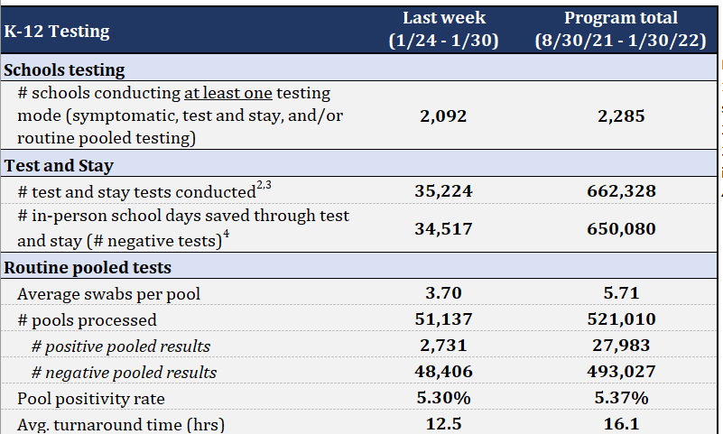
K-12 Testing COVID positive page view

Slide 6
Mask Requirement in Schools
02

Slide 7
Mask requirement will revert to local control effective February 28
Earlier today, Governor Baker and Commissioner Riley announced the state mask requirement in schools will be lifted effective February 28, 2022.
  Masking policies will revert to local control.
  Masking continues to be required on all school buses, per federal order.
Any individual who wishes to continue to mask, including those who face higher risk from COVID-19, should be supported in that choice.

Slide 8
Mask requirement will revert to local control effective February 28
Mask requirement will revert to local control effective February 28
In alignment with DESE/DPH Protocols for Responding to K-12 Scenarios, DESE and DPH guidance will continue to strongly recommend:
  After a five-day isolation and/or quarantine period, wear a mask around others for an additional five days, except when eating, drinking, or outdoors.
  Individuals who experience COVID-19 symptoms should stay home and obtain testing. If they receive a negative result and their symptoms improve (including remaining fever-free for a 24-hour period without fever-reducing medication), they can return to school but should also wear a mask until their symptoms fully resolve.
  Unvaccinated individuals should continue to wear masks in school settings.

Slide 9
Masks and School Health Offices
Schools and districts should follow the DPH Comprehensive PPE guidance to guide the proper PPE needed to care for students and staff in the school setting. School health offices and medical waiting rooms, as the health care practice locations of licensed clinical providers, are subject to the mask requirements for certain locations.^{[1]} Additionally, clinical staff providing care to students with presumed or confirmed COVID-19 should wear a fit-tested N-95 respirator, eye protection, gown, and gloves.^{[2]}
^{[1]} https://www.mass.gov/info-details/covid-19-mask-requirements#mask-requirements-in-certain-locations-
^{[2]} https://www.mass.gov/info-details/ppe-testing-and-vaccine-supply-resources-during-covid-19

Slide 10
Using At-Home Tests Over February Break
03

Slide 11
Testing over February break – for participating schools
To promote a safe return to in-person learning immediately after February vacation, DESE is making at-home tests for all interested staff available next week so that they can self-test before returning from vacation.

Slide 12
Testing over February break – for participating schools
Districts and schools participating in the at-home testing option must update their student and staff participation numbers by COB today (Wednesday, February 9).
  Tests will be shipped to districts during the week of February 14 for distribution prior to February break.
  Please estimate the number of tests you will need and consider ordering a small number of additional tests if more individuals opt in before February vacation.
  If you have already entered updated numbers, or you have no updates to make, you do not need to take further action.

Slide 13
Schools not participating in the at-home testing program
Districts and schools not participating in the at-home testing program are eligible to receive at-home tests for participating staff to be used prior to the return to school.
These districts and schools will receive additional information via email and must respond by noon Friday, February 11 to the survey located in the email.
  If you are not participating in the at-home testing option and do not receive the email by close of business today, please contact k12covid19testing@mass.gov

Slide 14
Testing over break – best practices
Interested staff are recommended to use one at-home test 24 hours prior to the return to school (i.e., Sunday, February 27 if returning on Monday, February 28).
  Staff must notify their school leaders if they test positive.
Testing prior to the return to school should be optional, not required.

Slide 15
Delivery schedule through 3/6
Sun | Mon | Tues | Weds | Thurs | Fri | Sat
16 | 17 | 18 | 19 | 20 | 21 Last day for staff delivery inputs for priority districts | 22
23 | 24 | 25 | 26 | 27 | 28 Last day for student delivery inputs for priority districts | 29
30 | 31 | 1 | 2 | 3 | 4 | 5
6 | 7 | 8 | 9 | 10 | 11 | 12
13 | 14 | 15 | 16 | 17 | 18 | 19
20 | 21 | 22 | 23 | 24 | 25 | 26
27 | 28 | 1 | 2 | 3 | 4 | 5
6 | 7 | 8 | 9 | 10 | 11 | 12
Staff deliveries
Student deliveries
Deadline for staff quantity (qty.) changes
Deadline for staff + student quantity changes
Staff deliveries
Staff + student deliveries
No deliveries (Feb. break)
Deadline for staff +student qty. changes
Staff + student deliveries
No deliveries
All received previous week
Deadline for staff +student qty. changes
January
February
March
Note: Staff will receive back-to-back deliveries during week of 2/6 and 2/13.

Slide 16
Test kit distribution
Next week (week of February 14), participating districts and schools will receive tests for staff and students.
  These tests are to be distributed during the week of February 14
  Staff and students should be directed to take one test during the week of February 21 (ideally, Sunday, February 27) and one test during the week of February 28.
During the week of February 28, participating districts and schools will receive tests for staff and students based on numbers inputted by February 23.
  These tests are to be distributed during the week of February 28 for administration during the weeks of April 7 and April 14.

Slide 17
Reminders
Staff and student numbers need to be added or updated by COB today
(5pm, 2/9)
If the numbers you have entered have not changed, you do not need to update them.
If your numbers have changed (increase or decrease in need), please update by the deadline

Slide 18
Updating participating student and staff numbers
Navigate to the CIC Health Supply Form for your school in CIC Health’s School and Consent Database
  If you do not have access to the supply form, please email support@cic-health.com to request access
Select the “At Home Antigen Test” button
A popup will appear. Select “Add/Update Opt-In Numbers”
  Complete all fields: District, Full Name, Staff Opted-In, Students Opted-In
  Click Submit
    You will not receive a confirmation email. Shipments occur automatically based on the numbers submitted.
Please note, you may also update the centralized shipping location in this area

Slide 19
Updated iHealth information and translations on DESE website
Some iHealth kits will have slightly different instructions for setup.
  "Test 1' instructions have been translated here: https://www.mass.gov/lists/covid-19-self-test-at-home-instructions-graphic
  "Test 2" contains an additional step (Step 1: Preparing Materials), that is not located in the translations above.
    See full set of instructions here: https://www.fda.gov/media/153924/download
We have provided additional translated instructions for Step 1: Preparing Materials on the DESE website.
We recommend districts send the Step 1: Preparing Materials instructions with all tests.
  Additional translations will be posted to our COVID-19 Testing website: https://www.doe.mass.edu/covid19/testing/default.html

Slide 20
Updates on the K-12 Testing Program
04

Slide 21
At-home antigen test updates
Using at-home antigen tests for symptomatic individuals
  All participating individuals will receive the equivalent of one test per week (reminder: each iHealth kit comes with two tests).
    Schools may determine the distribution cycle to participating staff and students
  Schools are encouraged to identify the day during the week that participating individuals should take the test at home.
  Schools can also inform participating individuals that they can use their one test per week earlier than expected, if they have symptoms.

Slide 22
Using at-home antigen tests for symptomatic individuals
Per Protocol C of the DPH/DESE COVID Protocols, return to school is based on symptom resolution
  It is also recommended that individuals receive a negative PCR or rapid antigen test.
  The once per week at-home antigen test may be used for this purpose, if available & desired.
Additional tests are not available if participating individuals use their at-home test for symptoms.
  Individuals that report positive at-home test results, should follow Protocol A for COVID positive individuals.

Slide 23
Important links on DESE website
Order supplies and update student/staff numbers: cich-ma.zendesk.com
COVID-19 Testing Program: https://www.doe.mass.edu/covid19/testing/
  District Opt-in Form for At-Home Testing Option
  Authorized School Application (for pooled and/or symptomatic testing)
  Webinar recordings and slides
  Template consent forms, opt-in forms, and parent/staff letters
On the Desktop: https://www.doe.mass.edu/covid19/on-desktop.html
  Protocols for Responding to COVID-19 Scenarios
General FAQs: https://www.doe.mass.edu/covid19/faq/
  Protocols and other reopening FAQs (also sent out in the Commissioner’s Weekly Update)

Slide 24
Have a question? Need help?
Here’s how to get in touch:
  First, contact your Program Coordinator
    They are your best first line of defense.
  If you don’t hear back, contact CIC support
    support@cic-health.com
    Please allow a few hours for a response during the next few weeks
  Still don’t have what you need? Send us a note!
    DESE: k12covid19testing@mass.gov
    Shah Foundation: CovidEdTesting@ShahFoundation.org
Please note:
If you need help, please reach out as early as possible. All teams are experiencing a high volume and the sooner we hear from you the better.

