Slide 1
COVID-19 Testing Update:
Updates and
Frequently Asked Questions
June 13, 2022

Slide 2
Today’s Presentation
Department of Elementary and Secondary Education
Executive Office of Health and Human Services
Russell Johnston, Deputy Commissioner
Lauren Woo, Strategic Transformation Director
Jeremiah Hay, Deputy Chief of Staff
Meg McEvoy, Strategy Manager
Notes:
Russell

Slide 3
CONTENTS
01
Updated COVID Testing Data
02
New FAQ Document
03
Toolkit to Help Schools and Districts Increase Vaccination Rates
Notes:
Lauren

Slide 4
Updated COVID Testing Data
01

Slide 5
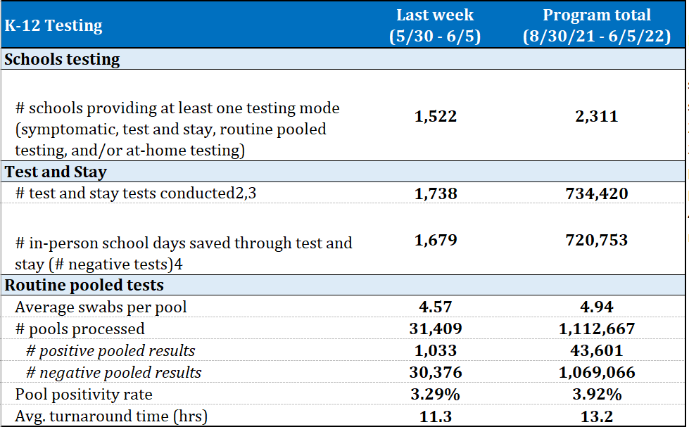
COVID-19 Testing data

Slide 6
New FAQ Document
(Released June 9, 2022)
02

Slide 7
Reminders
The June 9 FAQ document includes reminders of previously released information, including:
  The type of testing that will be offered to school-based summer programs during Summer 2022
  Required consents for Summer 2022
  How to obtain a summary of all individuals that consented to your testing program for 2021-2022
  Handling “expiring” BinaxNOW and iHealth tests
    Extended expiration dates and how to dispose of expired tests

Slide 8
What’s New in the FAQ
The June 9 FAQ document also includes information on:
  Requirements to run symptomatic testing in summer 2022 will be covered by the state.
  Requirements to run testing programs in fall 2022 and beyond will need to be met by districts, if necessary.
        Instructions on filling out new CLIA applications if needed
        Model Provider’s Order
        Reporting positive results registered at school
        Recommended elements of a consent form

Slide 9
Testing Requirements
Situation | CLIA Certificate of Waiver Required? | Reporting to DPH Required (Positives Only)? | Provider’s Order Required?
BinaxNOW “Professional” or other official point of care test, any testing reason | Yes | Yes | Yes
Self-test sent home, any testing reason | No | No | No
Self-test performed and result interpreted at school by the individual being tested, any testing reason | No | No | No
Self-test performed or result interpreted by third party (e.g., staff), any testing reason | Yes | Yes | Yes
For more information on when CLIA and other requirements apply, please see CMS guidance at https://www.cms.gov/files/document/over-counter-otc-home-testing-and-clia-applicability.pdf.

Slide 10
AASA Toolkit to Help Schools and Districts Increase Vaccination Rates
03

Slide 11
Addressing Vaccination Rates of U.S. Students: A Toolkit for Educational Leaders
On June 9, AASA, The School Superintendents’ Association and the Merck Foundation released a toolkit designed to help educational leaders address student vaccination rates.
Addressing the Decline of Vaccination Rates of U.S. Students: A Toolkit for Educational Leaders provides resources to support administrators and provide direction about how schools, districts and families can address this problem.

Slide 12
The Toolkit
The toolkit contains a series of modules that can be easily integrated into PD sessions for educational leaders as they facilitate the work of improving vaccination rates in their respective districts. The modules are:
Module 1: Understanding the Implications of Vaccination Declines Resulting from the COVID-19 Pandemic
Module 2: Strategies for Increasing Staff Understanding of Lower Vaccination Rates and Their Impact on Learning
Module 3: Addressing the Understanding and Needs of Parents
Module 4: Building Cross-Institutional Partnerships to Develop and Sustain School- and District-Level Vaccination
Module 5: Strategies for Engaging Community and District Support to Increase and Sustain Student Vaccination Rates
Module 6: A Comprehensive Planning Guide to Ensure Vaccination Equity and Student-Family Access to Health Services
The toolkit is available to superintendents, school boards, executive staff, school-based administration and teachers, as well as families and community members. It contains case studies, recommended action steps for building district- or school-based vaccination clinics and resources that integrate into ongoing discussions, professional development and outreach sessions.
For more information, contact Sasha Pudelski, AASA advocacy director at spudelski@aasa.org.

