Slide 1
CLIA and COVID Updates
Thursday, October 6, 2022

Slide 2
Today’s Presentation
Department of Elementary and Secondary Education
Executive Office of Health and Human Services/Department of Public Health
Russell Johnston, Deputy Commissioner
Anne Marie Stronach, LEA Operations Support, Commissioner’s Office
Jennifer Barrelle, Deputy Commissioner, DPH
Torey McNamara, Chief of Staff, DPH
Jeremiah Hay, Deputy Chief of Staff, EOHHS
Jennifer Robertson, Director of Strategic Initiatives, DPH
Karen Robitaille, Director, School Health Services, DPH
Notes:
Russell

Slide 3
CONTENTS
01
Memorandum for Schools Conducting On-Site Clinical Testing
02
New General Testing FAQ Document
(Released October 3, 2022)
03
COVID Response Update
Notes:
Lauren

Slide 4
Memorandum for Schools Conducting On-Site Clinical Testing
01

Slide 5
Memorandum for Schools Conducting On-Site Clinical Testing
On Monday, October 3, the Massachusetts Department of Public Health (DPH) released a memo to provide an update on the process and requirements for schools and districts conducting certain on-site clinical testing this year.
The Centers for Medicare & Medicaid Services Clinical Laboratory Improvement Amendments (CLIA) regulations require that any district or school administering CLIA-waived tests, including but not limited to certain glucose, ketone, and COVID-19 tests, must apply for a CLIA Certificate of Waiver.

Slide 6
CLIA Waivers
Districts and schools that were participating in the statewide COVID-19 testing program and did not have their own CLIA Certificate of Waiver had been doing so under a statewide Certificate of Waiver.
For districts and schools that would like to conduct COVID-19, glucose and ketone CLIA-waived testing, DPH has obtained a statewide waiver through the 2022-2023 school year.
  In order to be added to this waiver, schools and districts must complete this online form.
  Districts and schools that have already obtained or applied for their own CLIA waiver do not need to fill out the form or be added to the statewide waiver.

Slide 7
Fall 2023 and Beyond
All districts or schools administering or planning to administer CLIA-waived tests in and beyond fall 2023 must still apply for their own CLIA waiver by March 31, 2023 to ensure transition to their own waiver for the 2023-2024 school year.
  Applications should be submitted through the Department of Public Health (DPH) Clinical Laboratory Program by e-mailing the completed CMS-116 CLIA application to CLIALab@mass.gov.

Slide 8
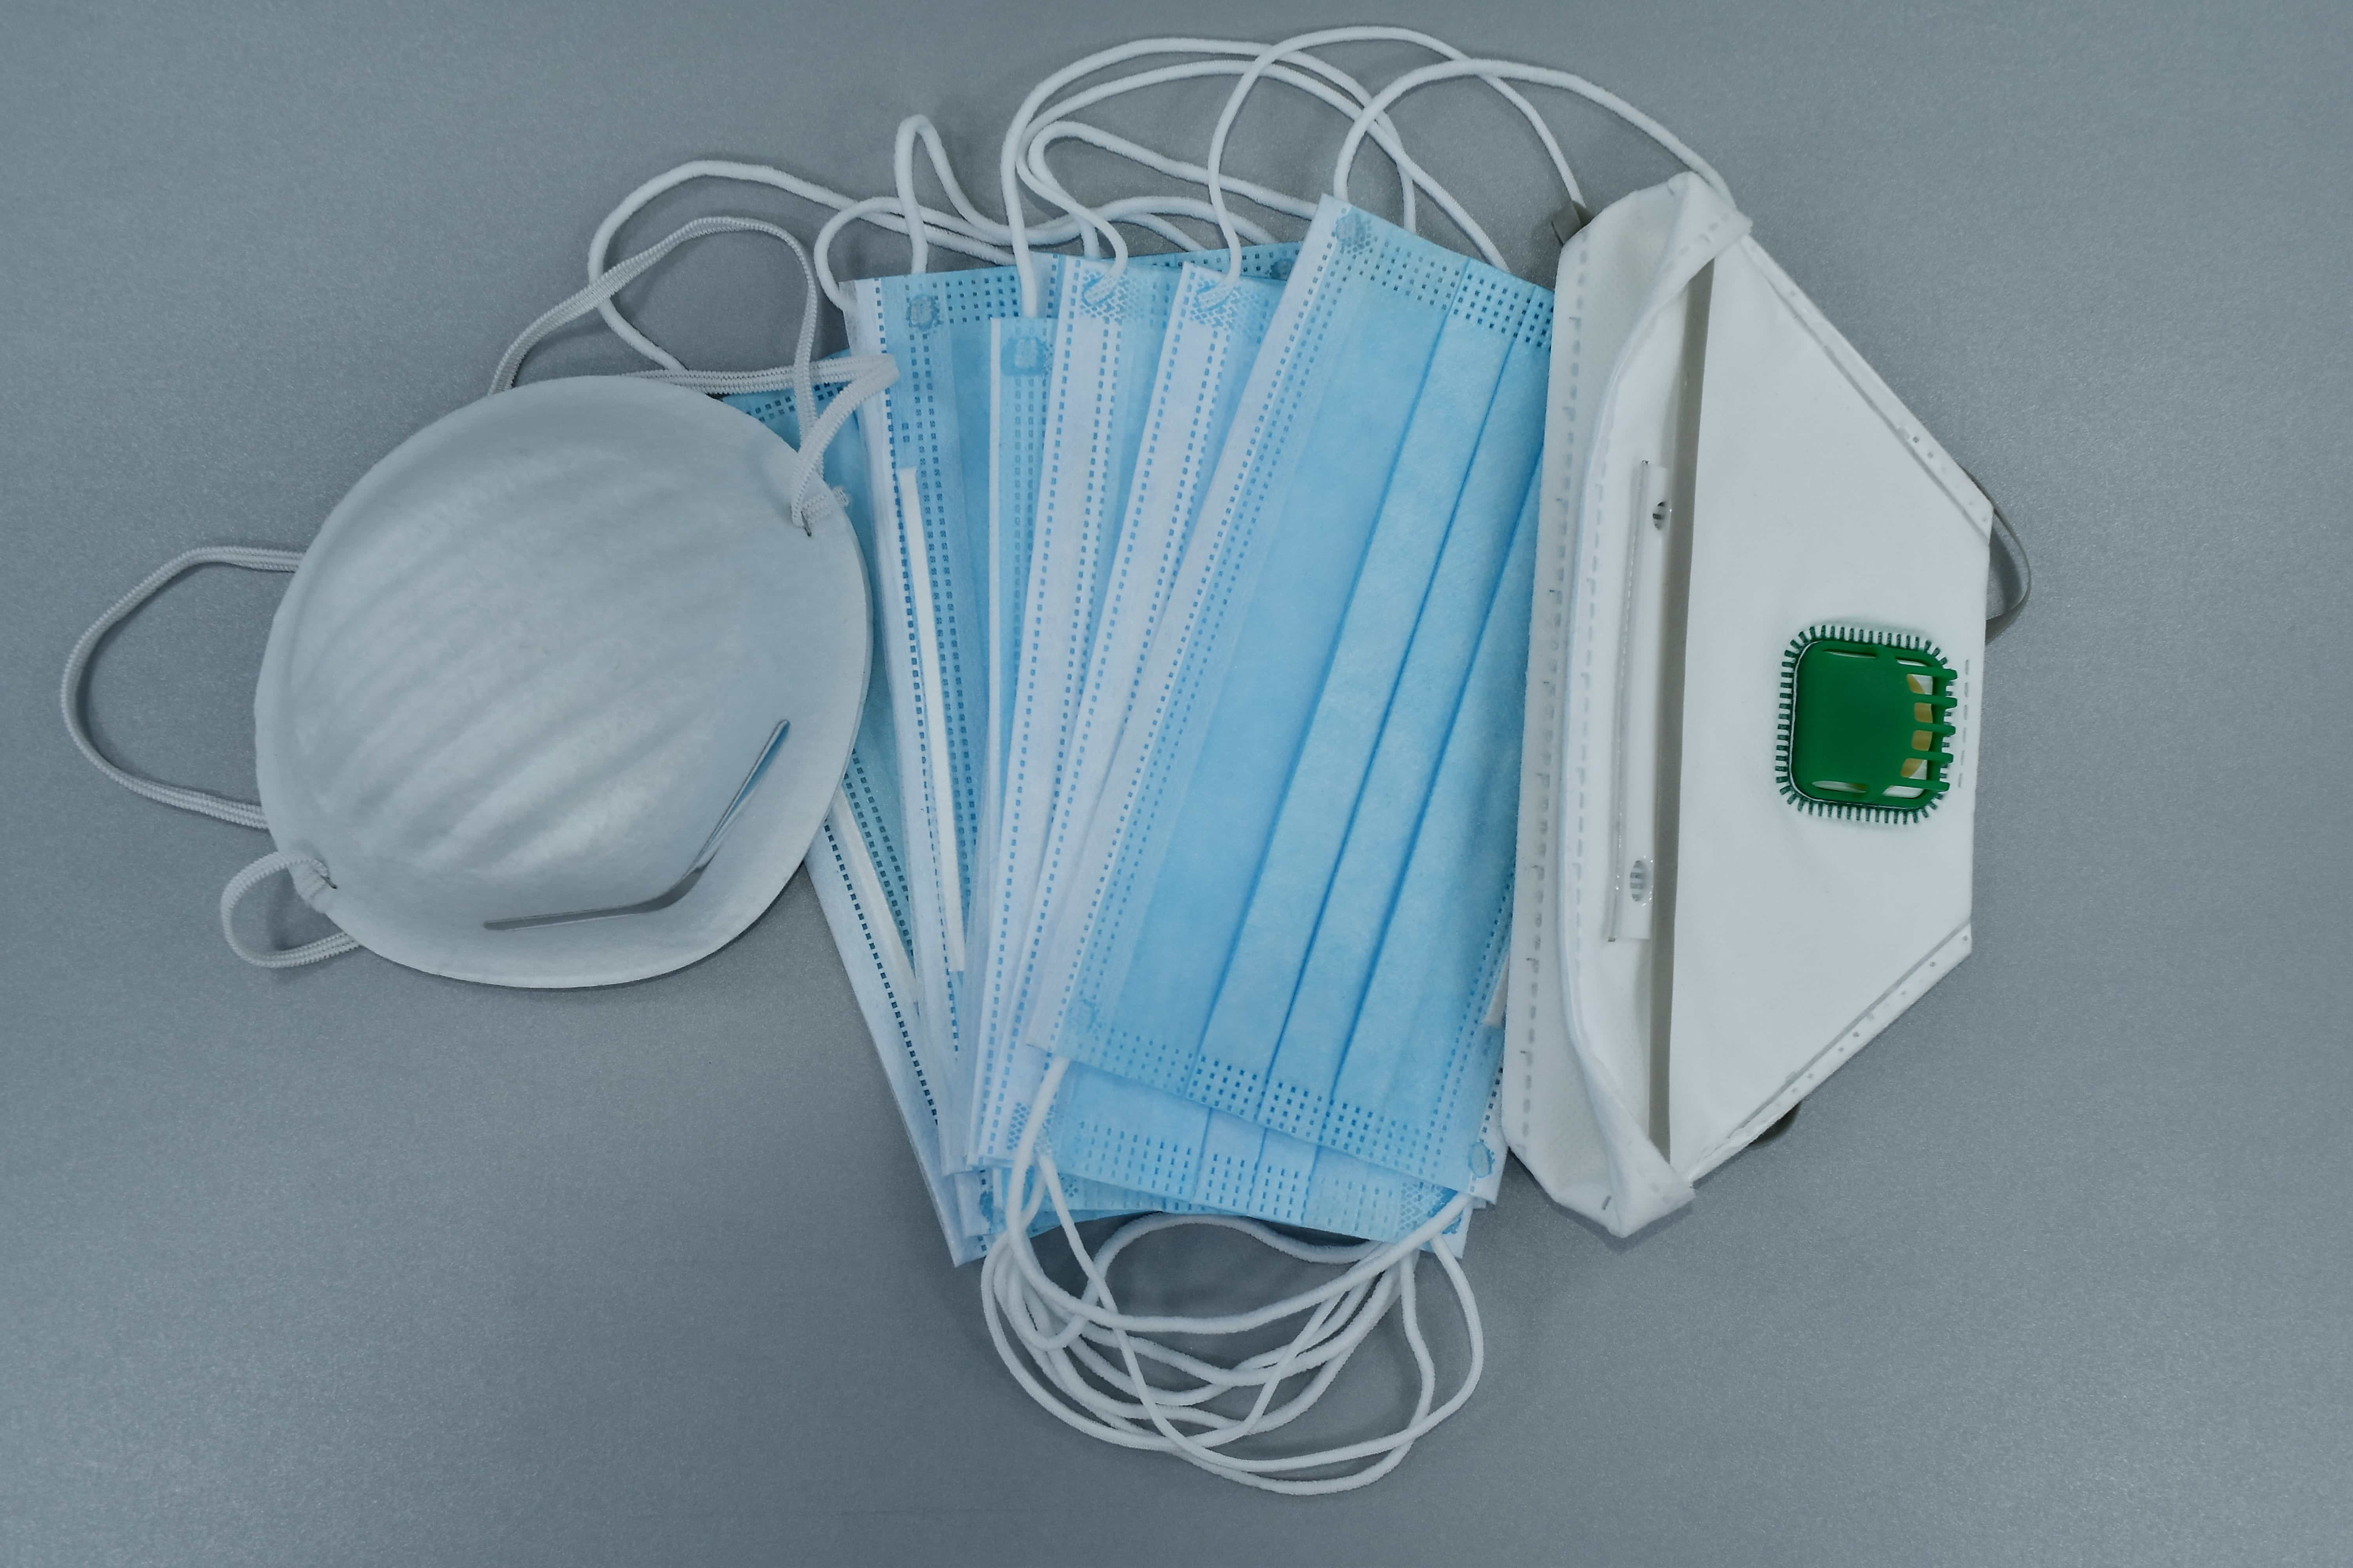
Resources
Frequently Asked Questions – General Testing Questions for Schools, Districts and School Nurses, June 9, 2022, updated October 3, 2022 https://www.doe.mass.edu/covid19/testing/faq.docx
CLIA Application - CMS-116 CLIA application
CMS CLIA Application Quick Start Guide
FAQ on the CLIA Certificate of Waiver Process

Slide 9
New General Testing FAQ Document (Released October 3, 2022)
02

Slide 10
New Testing FAQ Document
On October 3, we also released a new, updated version of our Testing FAQ
The document, entitled Frequently Asked Questions – CLIA & General Testing Questions for Schools, Districts and School Nurses, October 3, 2022 includes updated information for schools and districts on CLIA Certificates of Waiver and COVID Testing

Slide 11
COVID Response Update
03

Slide 12
Vaccine Resources
Family friendly, free COVID-19 Vaccine Resources
COVID-19 Vaccine Finder
COVID-19 In-Home Vaccination Program (for anyone who has difficulty getting to or using a community vaccination location)

Slide 13
Rapid Response Help Center
Please contact the Help Center at 781-338-3500 with any questions.
Districts and schools must contact the Help Center for guidance if they are experiencing a high volume of cases.
Notification should also be provided to local boards of health and district leadership.

Slide 14
Additional Topics
Planning for cold and flu season
  Fevers are associated with other illnesses, not just COVID-19
  Supporting school health professionals with their assessments of student symptoms
  Importance of flu shots

Slide 15
Thank you
Thank You

