Slide 1
Using Data to
Assess High Quality
Professional Development
Findings From Interviews
With Massachusetts Educators
May 2015
Notes:
Massachusetts Department of Elementary and Secondary Education
1

Slide 2
Background
The purpose of this set of three presentations to is to convey key findings from a study conducted by the American Institutes for Research and the Concord Evaluation Group on behalf of the Massachusetts Department of Elementary and Secondary Education.
These presentations are one component of a larger project to help Massachusetts educators envision what it takes to ensure that all educators have access to high quality professional development (HQPD).
The focus of this presentation is on how educators in four nominated sites in Massachusetts use data to plan HQPD.

Slide 3
About This Project
What is it?
Case profiles of four sites engaged in building systems to support HQPD. The case profiles are based on interviews and collected documents.
What are the goals of the project?
To highlight for professional learning leaders across the Commonwealth how some Massachusetts educators are working to establish HQPD in their schools and districts.
Please see ESE’s Resources for PD Leaders and Educators page for relevant PD resources, including the full case studies.
Which sites participated?
Cambridge Public Schools
Easthampton High School of Easthampton Public Schools
Lexington Public Schools
Melrose Public Schools

Slide 4
About the Project
How were sites selected?
Teacher and Principal Advisory Cabinet members nominated districts or schools that were making consistent use of the Massachusetts Standards for Professional Development to inform professional learning by doing things such as:
Building internal staff capacity to facilitate high quality, results-oriented professional development in creative ways
Doing an exceptional job coordinating/managing professional development and creating the conditions for educators to engage in deep learning
Thoughtfully using educator evaluation data to inform planning and delivery of professional development
ESE, in collaboration with AIR, selected four sites from among the many nominated based on the comprehensiveness of their approach.
What were the key themes observed across the sites?
Seven key themes were identified as important levers in ensuring HQPD;
they are listed on the next slide.

Slide 5
Seven Key Levers
Instilling a “growth mindset” among educators
Collaborating for change using data
Making time for learning
Embedding professional learning in educators’ daily work
Empowering teachers to choose their own path toward growth
Using data (including goals, evidence, and standards) to plan HQPD
Using data to assess HQPD

Slide 6
About This Presentation
Some useful definitions (Slides 7–11)
How the profiled sites use data to assess HQPD (Lever 7) (Slides 12–25)
Please see ESE’s Resources for PD Leaders and Educators page for relevant PD resources, including the full case studies.

Slide 7
What Is HQPD?
High Quality Professional Development (HQPD) is a set of coherent learning experiences that is systematic, purposeful, and structured over a sustained period of time with the goal of improving educator practice and student outcomes.
Source: http://www.doe.mass.edu/pd/standards.html

Slide 8
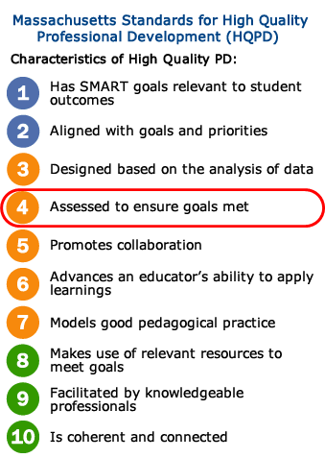
What Are the Massachusetts HQPD Standards?
Released in 2013, the Massachusetts Standards for Professional Development describe the research-based features of HQPD.
For more information visit: http://www.doe.mass.edu/pd/standards.html

Slide 9
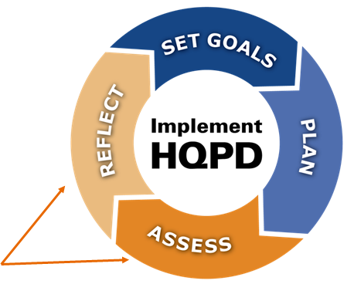
What Is HQPD Assessment?
Assess:
Examining the quality and impact of HQPD for the purposes of improvement and future planning.
Reflect:
Reflecting on the results of the assessment process to inform continuous improvement.
The HQPD Planning & Assessment Process

Slide 10
What HQPD Formats Are Used in the Profiled Sites?
Courses
Internally and externally led workshops and summer institutes
Multi-year induction programs
Professional Learning Communities
Action research
Lesson study
Coaching
* Some sites use some formats more than others depending on HQPD goals.

Slide 11
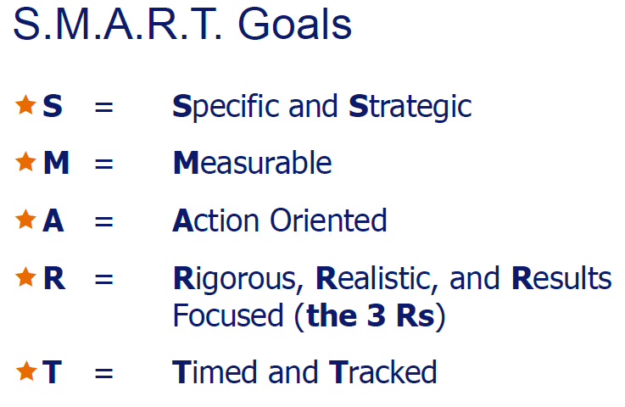
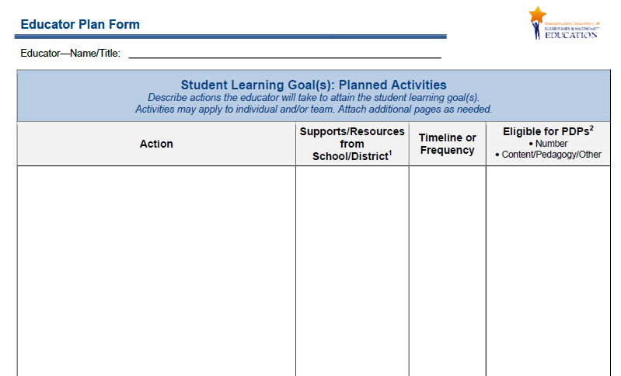
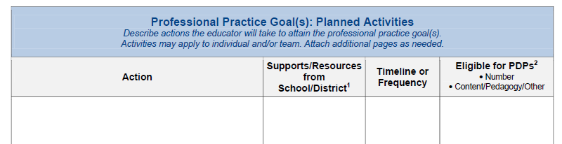
What Are Educator Plans?
Part of the 5-Step Cycle of evaluation, each educator develops an Educator Plan, which is differentiated based on experience and past performance, and includes individual or team S.M.A.R.T. goals for professional practice and student learning as well as key action steps for achieving the goals.

Slide 12
How Do the Profiled Sites Use Data to Assess the Quality and Impact of HQPD (Lever 7)?
Key Cross-Site Observations

Slide 13
Assessing HQPD: Key Observations
Site leaders use multiple data sources to assess and reflect on HQPD quality and impact
PD leaders in every site use student outcome data regularly to assess the overall impact of HQPD, together with the impact of curricular programs, interventions, and other initiatives
Reviews of student work (e.g., unit exams, essays) are used in some sites to assess the impact of HQPD
Course and feedback forms are used to assess the quality of individual PD courses, workshops, and events
Direct, “ad hoc” educator feedback to (and from) PD committee members is used regularly in assessing district-sponsored HQPD

Slide 14
Assessing HQPD: Key Observations
Sites have plans to use performance data from educator evaluations as one measure to assess HQPD
One site is working with a graduate student from a local university to design a program evaluation for the site’s teacher-driven courses
Each of these key observations is described more fully in the slides that follow.

Slide 15
1. Site leaders use multiple data sources to assess and reflect on HQPD quality and impact
Course or event feedback surveys
Ad hoc educator feedback
Student learning data
Learning Walkthrough data
Reviews of student work
Summative Performance Ratings

Slide 16
2. PD leaders in each site use student outcome data to assess the impact of HQPD
In all four sites, student outcome data used in HQPD assessment include:
  Student growth and achievement data (from large-scale and classroom-based assessments)
  Attendance data
  Discipline referrals
  These data are examined frequently in Data Team meetings at all sites to take stock of the overall impact of each site’s approach to HQPD, together with the impact of curricular programs, interventions, and other district and school initiatives. (Outcome data are also used to identify continuing HQPD needs and to set HQPD goals.)
Easthampton High School leaders rely in large part on data on student learning and engagement from their Learning Walkthroughs to gain insight into the success of HQPD efforts in yielding changes in teaching practice and student learning.

Slide 17
3. Reviews of student work are used to assess whether specific HQPD offerings meet goals
PD leaders in Melrose and Lexington report looking at student work together with HQPD participants to see if the HQPD offerings intended to address particular student needs are changing practice in ways that translate into demonstrated student learning. If desired improvements are not demonstrated, they revisit either the intervention or the professional learning about the intervention.

Slide 18
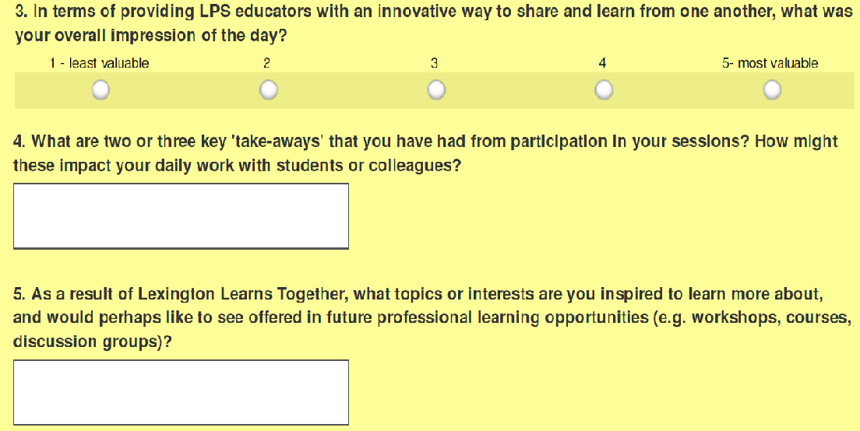
4. Course and event feedback forms are used to assess PD activities
For example, after the Lexington Learns Together event last November, Lexington Public Schools leaders administered a post-event evaluation survey to all participants and facilitators.
Lexington leaders also
provide customizable
templates for course
instructors to use to
assess educators’ current
knowledge and skill going
into the course, and then
reassess knowledge and
skills at the end to gauge
impact.
An excerpt from the Lexington Learns Together survey:

Slide 19
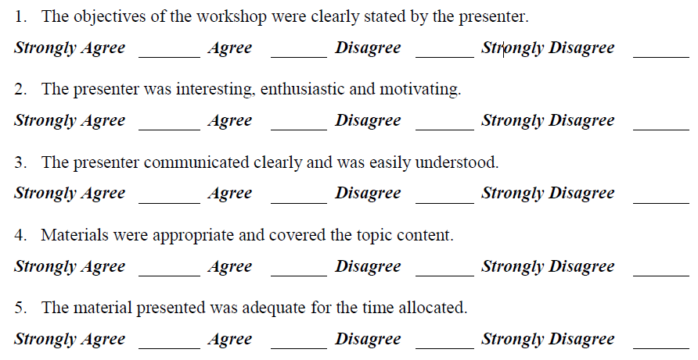
4. Course evaluation forms provide feedback to instructors as well
A Melrose Public Schools course survey provides feedback to instructors on how well participants thought the content was presented and whether objectives were met, and includes open-ended items on the strengths and weaknesses of the course.
A tally sheet is included on Page 30 of the Melrose Professional Development Handbook (2014–15):

Slide 20
4. Course feedback survey data inform continuous improvement decisions
For example, the positive results from the Lexington Learns Together feedback survey informed district leaders’ decision to repeat the unique format again.
  Lexington leaders are also adding sessions based on the suggestions educators provided in the survey on the educators’ desired content.

Slide 21
5. Direct educator feedback to (and from) PD Committee members are used regularly in assessing HQPD
Members of the PD Committees in several sites are participants themselves in the HQPD, so they report back informally on the quality of particular offerings, either verbally or in the form of written letters and email. These reflection discussions based on anecdotal data inform decisions about:
  Using the same instructor again
  Providing the offering again
  Changing the format
They also may discuss what feedback to provide the instructor for the next time.

Slide 22
6. Sites plan to use performance data from educator evaluations to assess HQPD impact
Performance ratings from educator evaluation are not yet used to evaluate the impact of HQPD on teaching practice in any of the sites, but there are plans to do so.
The Melrose Public Schools District Leadership Team plans to compare this year’s performance rating data against last year’s to better understand the overall performance of its professional development efforts and support planning for upcoming programming.

Slide 23
7. One site is working with a graduate student on a program evaluation for the site’s teacher-driven courses
Cambridge Public Schools is working with a graduate student from a local university to design a program evaluation for its in-house, educator-choice courses.
This is designed to get feedback from all stakeholders on what worked, what needs to be adjusted, and what is missing.
This feedback effort explores overarching questions such as these:
  How does the current set of choice courses align with a school’s and district’s improvement plans and initiatives?
  Are there too many options?
  How can the Professional Development Committee further support school-based professional learning?

Slide 24
Future Directions: Using the HQPD Standards to Assess and Reflect on HQPD Quality and Impact
Although site leaders and PD Committee members at each site had read and discussed the HQPD standards and believed that much of their PD met the standards, each planned to use the standards more systematically to assess PD in the future.
For the first time in 2015, for example, Melrose Public Schools asked teachers to rate the quality of their PD against each standard (see next slide for a screenshot of the survey they are using).

Slide 25
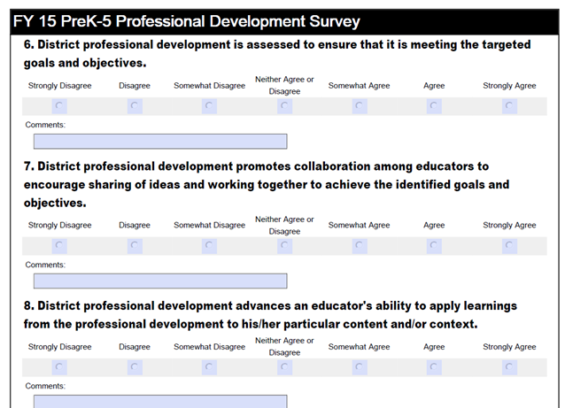
Future Directions: Using the HPQD Standards
The Melrose Public Schools teacher survey is administered by the PD Committee to gather data on educator perceptions of district-sponsored PD. It asks teachers to rate PD on the extent to which it meets each HQPD standard.

Slide 26
For More Information About This Project and to Read the Site Profiles:
Please see ESE’s Resources for PD Leaders and Educators page for relevant PD resources, including the full case studies.
Email: Profdev@doe.mass.edu

