Slide 1
Calibrating Feedback
A Model for Establishing Consistent Expectations of Educator Practice
Adapted from the MA Candidate Assessment of Performance

Slide 2
Warming Up

Slide 3
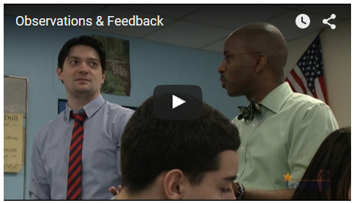
Hear from MA Teachers and Administrators about Observations and Feedback
Click here

Slide 4
Warm Up
Turn to a partner:
  What resonated with you?
  How do you currently conduct classroom observations (e.g., mostly short, unannounced; mostly longer, announced; using video; with a rubric)?
  How do you determine what feedback to provide following an observation?

Slide 5
Learning
The CAP Observation Protocol

Slide 6
Candidate Assessment of Performance
This model for conducting observations and calibrating feedback has been adapted from the MA Candidate Assessment of Performance (CAP).
CAP is aligned to the MA Educator Evaluation Framework and occurs throughout the pre-service practicum experience.
Learn more at the CAP website: http://www.doe.mass.edu/edprep/cap/.

Slide 7
Components of a CAP Observation
Active evidence collection occurs during the observation
  DO document what is happening (e.g., educator and student actions/behaviors).
  DO NOT make judgments about performance during the observation.
Analysis and synthesis of evidence occurs after the observation.
  Evidence is sorted and connected to elements of the rubric.
  Focus elements are identified for each observation.
Self-reflection by the educator occurs before educator receives feedback.
Evaluators provide targeted feedback to the educator in the form of areas of reinforcement and areas of refinement.

Slide 8
ESE’s Model CAP Observation Protocol
Before the Observation (for announced observations)
  Preparing for the pre-conference
  Conducting the pre-conference
During the Observation
  Actively collecting evidence
After the Observation
  Analyzing the evidence
  Preparing for the post-conference
  Identifying reinforcement/refinement objectives
  Conducting the post-conference

Slide 9
Model Protocol: Before the Observation
Pre-Conference (1-2 days prior to announced observation – 20 min)
  Gather evidence such as lesson plans and materials in advance
  Prepare 2-3 questions for pre-conference to better understand lesson plans and collect additional evidence, such as:
    “What do you expect students to know and be able to do at the end of the lesson?”
    “How is the lesson structured for students who progress at different learning rates?”
  Let the educator do most of the talking, but do help him/her reflect prior feedback when possible.

Slide 10
Model Protocol: During the Observation
Actively collect evidence without making judgments
  Options: scripting, videotaping, audio-recording
Evidence collected during an observation is to aid the evaluator in identifying trends and selecting illustrative examples.

Slide 11
Model Protocol: After the Observation
Review evidence and sort using the evidence chart included on the CAP Observation Form.
  Not every piece of evidence collected needs to be sorted.
  Consult the rubric when sorting evidence.
  Evidence statements should say what happened in the observation that shows/does not show that a skill has been demonstrated.

Slide 12
Model Protocol: After the Observation
Prepare for the post-conference.
  If conducted jointly, the observers should calibrate feedback before the post-conference.
  Collect self-reflection from educator
  Identify 1-2 areas of reinforcement (“keep doing what you’re doing”)
    Should identify educator’s instructional strength in a way that encourages continuation of effective practices.
  Identify 1-2 areas of refinement (“instead, try this…”)
    Should identify areas in need of instructional improvement.

Slide 13
Model Protocol: After the Observation
Conduct the post-conference. (30 minutes)
Post-conferences should occur after the evaluator has had an opportunity to synthesize the evidence.
  Ask the educator self-reflection questions related to areas of refinement (good source of evidence for the reflective practice element).
  Provide concrete suggestions for improvement and share resources/supports.
  Share observation form.
  Answer questions and confirm next steps.

Slide 14
Practicing

Slide 15
Simulated Unannounced Observation
In a moment we will watch a video of a 7th grade math lesson.
“Observe” the lesson using ESE’s Model CAP Observation Protocol.
  Remember, engage in active evidence collection by recording educator and student actions and behaviors without judgment.
  The focus elements for this lesson are: well-structured lessons and safe learning environment.

Slide 16
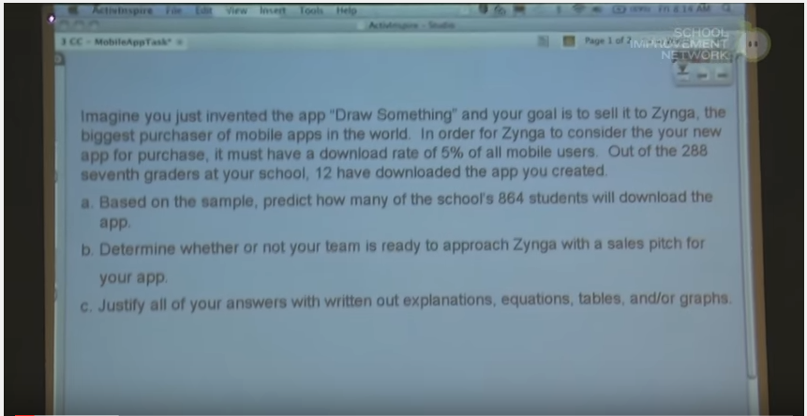

Simulated Unannounced Observation
Click here

Slide 17
Simulated Unannounced Observation
Analyzing the Evidence
Using the observation form and the rubric, sort evidence into the evidence chart.
  Not every piece of evidence collected needs to be sorted.
  Evidence statements should say what happened in the observation that shows/does not show that a skill has been demonstrated.

Slide 18
Simulated Unannounced Observation
Prepare for Post-Conference
Turn to a partner and calibrate judgments based on evidence.
  Work together to complete the Post-Conference Planning Form. Use the guiding questions in the Model CAP Observation Protocol to identify:
    1-2 areas of reinforcement (“keep doing what you’re doing”); and
    1-2 areas of refinement (“instead, try this…”).

Slide 19
Simulated Unannounced Observation
Whole-Group Discussion
Round robin sharing of 1-2 reinforcement and refinement areas.
Discuss:
  Were the indentified reinforcement/refinement areas consistent across all pairs?
  Are the identified resources and supports likely to help the educator improve practice in the refinement areas?
  What concrete feedback would you provide the educator during a post-conference?

Slide 20
Calibrating

Slide 21
Evaluator Calibration
Calibration is the result of ongoing, frequent collaboration of groups of educators to:
Come to a common, shared understanding of what practice looks like at different performance levels and
Establish and maintain consistency in aspects of the evaluation process including analyzing evidence, providing feedback, and using professional judgment to determine ratings

Slide 22
Evaluator Calibration Simulation
In a moment we will watch a second video of classroom instruction. This one features a 3rd grade classroom.
Again, “observe” the lesson using ESE’s Model CAP Observation Protocol.
  Remember, engage in active evidence collection by recording educator and student actions and behaviors without judgment.
  The focus element for this lesson is: adjustments to practice.
After the video we will simulate a calibration activity.

Slide 23
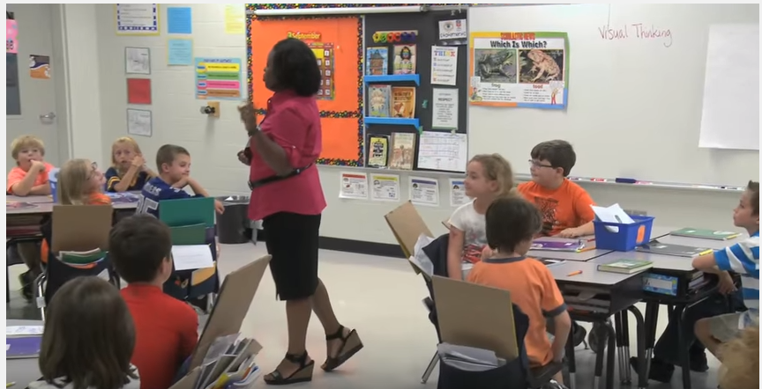
Assessor Calibration Simulation
Click here

Slide 24
Assessor Calibration Simulation
On your own:
  Using the observation form and the CAP Rubric, sort evidence into the evidence chart.
  Complete the Post-Conference Planning Form. Use the guiding questions in the Model Observation Protocol to identify:
    1-2 areas of reinforcement (“keep doing what you’re doing”); and
    1-2 areas of refinement (“instead, try this…”).

Slide 25
Evaluator Calibration Simulation
In teams of 3-4, conduct a peer review of a group member’s feedback to the educator:
  Choose 1 person to be the “subject.”
  The subject will read aloud his/her feedback to the educator from the Post-Conference Planning Form.
  The remaining team members discuss their assessments of the feedback and make suggestions to improve the feedback. The subject listens silently.
  The subject then responds to the team members’ assessment. The group listens silently.
  Together the team brainstorms specific ways to make the subject’s feedback stronger.
*Choose a new subject and repeat the process as time permits.

Slide 26
Evaluator Calibration Simulation
As a whole group:
  Each team shares the following with the full group:
    Exemplars of feedback to the educator and why they felt they were exemplars.
    One new common understanding or practice the team will adopt.

Slide 27
Recapping

Slide 28
Key Takeaways and Questions?

