Slide 1
Educator Evaluation Model Rubric Updates & Implementation Supports
June 2023

Slide 2
Agenda
Introduction
Model Rubric Updates
Pilots and Supports
Implementation Resources
Q&A

Slide 3
All students in Massachusetts, particularly students from historically underserved groups and communities, will have equitable opportunities to excel in all content areas across all grades. Culturally and linguistically sustaining classroom and school practices will support students to thrive by creating affirming environments where students have a sense of belonging, engage in deeper learning, and are held to high expectations with targeted support.

Slide 4
CREATING THE CONDITIONS that support the preparation, development, and retention of a diverse and effective educator workforce … so that all our students thrive.

Slide 5
Redefining Effective Practice
Preparation
Induction & Mentoring
Continuous Improvement
Guidelines for Administrator Preparation
Performance Assessment for Leaders (PAL)
Principal Induction & Mentoring Handbook
Revised Model Rubrics for Educator Evaluation
Guidelines for Program Approval
Candidate Assessment of Practice (CAP)
Implementation Resources
EDUCATIONAL VISION

Slide 6
Model Rubric Updates

Slide 7
Purpose
Updating model evaluation rubrics for classroom teachers and school-level administrators
Integrating culturally and linguistically sustaining practices throughout the Standards and Indicators of Effective Practice
Continuing to develop the rubrics as tools to support meaningful goal-setting, feedback, and professional learning

Slide 8
Timeline
Draft Rubrics Integrating Culturally & Linguistically Sustaining Practice
Teacher Rubric Pilot
Updated Admin Model Rubric Released
Informed by feedback from educators, students, and families
20-21
21-22
22-23
23-24
24-25
PAC/TAC Focus on Educator Evaluation and Racial Equity
Admin Rubric Pilot
Updated Model Teacher Rubric Released

Slide 9
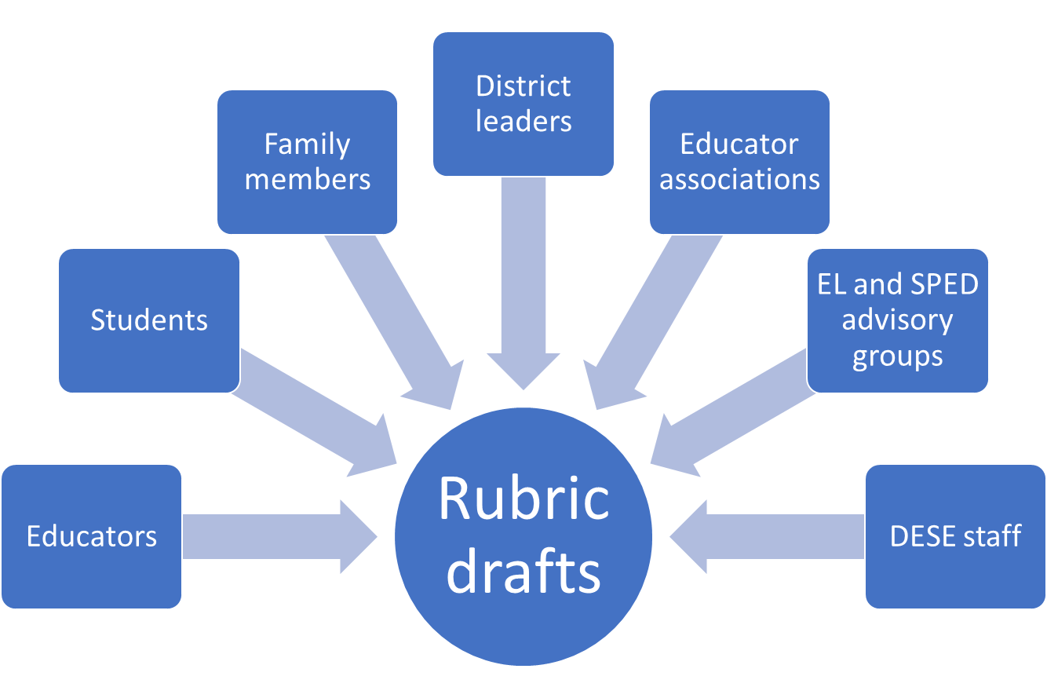
Stakeholder Feedback (2021-23)

Slide 10
1st Example of Changed Language
Student Engagement
Consistently uses instructional practices that are likely to motivate and engage most students in the content of the lesson.
Engaging Instruction
Engages all students as active participants in their own learning of meaningful, standards-aligned and grade-appropriate content by:
Providing opportunities for students to make choices, explore topics and apply learning in culturally sustaining ways, and through real-world, interactive contexts.
Building on students’ strengths, interests, cultural and linguistic backgrounds, and prior knowledge to motivate learning and support students’ information processing.
Facilitating cooperative learning with equitable student participation in discussion.
Integrating digital tools and educational technology that enhances learning experiences and promotes the development of digital literacy skills.

Slide 11
2nd Example of Changed Language
Well-Structured Units & Lessons
Adapts as needed and implements standards-based units comprised of well-structured lessons with challenging tasks and measurable outcomes; appropriate student engagement strategies, pacing, sequence, resources, and grouping; purposeful questioning; and strategic use of technology and digital media; such that students are able to learn the knowledge and skills defined in state standards/local curricula.
Curriculum Literacy
Skillfully implements curricular materials to:
Ensure a coherent instructional approach that builds student learning towards grade-level standards or individual learning goals over time through aligned lesson goals, scope, sequence, and tasks.
Plan lessons using evidence-based, inclusive, and culturally sustaining instructional methods and activities, including identifying opportunities to create meaningful, relevant connections rooted in the local context.
Provide all students access to grade-level instruction, including utilizing necessary supplemental resources and/or tiered supports.

Slide 12
3rd Example of Changed Language
High Expectations
Clearly communicates high standards for student work, effort, and behavior, and consistently reinforces the expectation that all students can meet these standards through effective effort, rather than innate ability.
High Expectations and Support
Supports all students to meet or exceed high expectations, produce high-quality work, and develop self-awareness and skills for independent learning by:
Using evidence-based pedagogical practices to provide equitable opportunities for grade-level learning.
Providing supports, scaffolds, and tools to meet students’ needs.
Providing clear criteria for success (e.g., models, rubrics, exemplars).
Reinforcing perseverance and effort with challenging content and tasks.

Slide 13
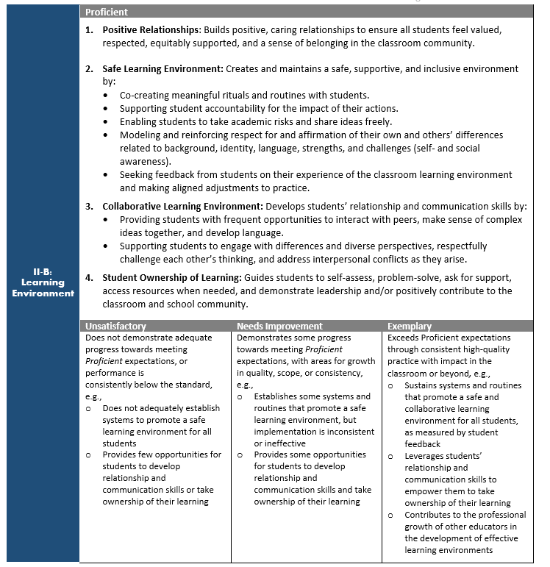
Indicator-level Performance Descriptors

Slide 14
Student Learning Indicator
Student Learning
Academic
(e.g. common assessments, SGP)
Non-Academic (e.g. engagement, sense of belonging)
Non-Academic Student Outcomes: Outcomes associated with students’ capacity to understand and value self (know their own strengths, interests, and areas of growth, be self-aware, be a self-advocate, and make responsible decisions), understand and value others (understand differences and multiple perspectives, empathize with others, and build connections with peers and adults), and engage with the world (understand and think critically about local, national, and world events and societal systems; and create positive change through civic action).

Slide 15
Pilots and Supports

Slide 16
2022-23 Administrator Rubric Pilot
4 pairs/teams of school leaders and supervisors are piloting the rubric with coaching support from CLEE
Selected for diversity of geography, district size, racial demographics of students, school leader experience level
Case studies on promising practices and supports needed

Slide 17
Reflections from Pilot Participants
“I see it as an important piece of bigger work. It continues to hold us accountable to appropriate equitable practices and ensuring equity for all in all lenses, not just in my goals, but how we work…” -Principal
“This forced me to be more thoughtful, intentional about programs, language use… For the demographics of [our district], it’s especially important for this work, because of the wide, diverse nature of students we have here.” -Principal
“For this to work, it authentically needs to be about reflection and growth as a professional… It comes down to how do we build relationships within our building? -Superintendent
“When there’s that cohesion between the district improvement plan, the school improvement plan, our goals, the teacher goals… that authenticity and relevance really gets strengthened....” -Superintendent
“We are still operating as though our district is 90% white… Over-identification of Hispanic students in special education and VOCAL data shows that students don’t feel welcome. The rubric helps us focus on this.” -District Administrator

Slide 18
Keys to Success
Relationships
Importance of trusting, collaborative relationship between district and school leaders
Time
Value of taking the time as an administrative leadership team to reflect and discuss
Coherence
Opportunity to prioritize key, equity-centered practices and align work around them

Slide 19
2023-24 Supports for Administrator Rubric
Community of Practice for the New Model Rubric for School-Level Administrators- Fall 2023
In the fall of 2023, DESE will host a state-wide community of practice for schools and districts implementing the new school-level administrator rubric for the 2023- 2024 school year. This community of practice will be a year-long series. Each session aims to promote a shared understanding of the rubric's language, expectations, and design and provide an opportunity to exchange ideas on implementation strategies and resources. If your school or district is interested, please complete the registration form.
Aspiring Principal Fellowship-Spring 2024 -
The Aspiring Principal fellowship program is scheduled to begin in the spring of 2024. It is a one-year program aimed at helping educators in Massachusetts who want to become school leaders. The program will focus on job-embedded, evidence-based practices that promote cultural responsiveness, equity, and anti-racism. The program aims to equip fellow leaders with the knowledge and tools to create a school environment that fosters excellence for all students.
See DESE’s 23-24 Catalog for additional opportunities

Slide 20
Why join the 2023-24 Teacher Rubric Pilot?
Reinforce equitable, evidence-based practices across the district
Strengthen skills in providing high-quality feedback to educators
Share feedback with DESE on the draft rubric and supports needed

Slide 21
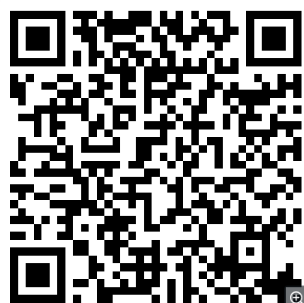
2023-24 Teacher Rubric Pilot
Open to all districts/schools in 2023-24
Training and support:
District team planning workshop on best practices for culturally responsive educator evaluation
OPTIC calibration training workshops for school leaders
Virtual community of practice open to all participating teachers and evaluators
Ongoing technical assistance as needed
https://tinyurl.com/rubricpilot

Slide 22
Technology Platforms (RFR 23MACISSC3)
Departmental Master Agreement (MA) to identify a list of vendors that can provide technology solutions to districts and schools using the updated rubrics.
Approved vendors:
Demonstrated experience partnering with schools and districts to provide technology solutions for educator evaluation
Capability to integrate updated rubrics into platforms in advance of upcoming school year
Product supports effective and efficient implementation of educator evaluation in alignment with MA framework
Training and technical assistance offered
Cost structure

Slide 23
Classroom Teacher Rubric Pilot: FAQs
1. Do all teachers in a district need to participate in the pilot?
No. Districts can pilot the draft rubric with a subgroup of educators. Districts must attest to securing agreement to participate from the teachers.
2. Can the draft rubric be used for evaluation during the pilot?
Yes. Though it’s in draft form, the updated rubric is of comparable rigor and meets regulatory requirements, so it can be used for evaluation. However, districts may also choose to enter into an MOU with local collective bargaining units to hold participating teachers harmless based on established criteria.
3. Is there a limit to the number of districts that can pilot?
No. Please register as soon as possible so that we can plan appropriately for training and supports.

Slide 24
Implementation Resources

Slide 25
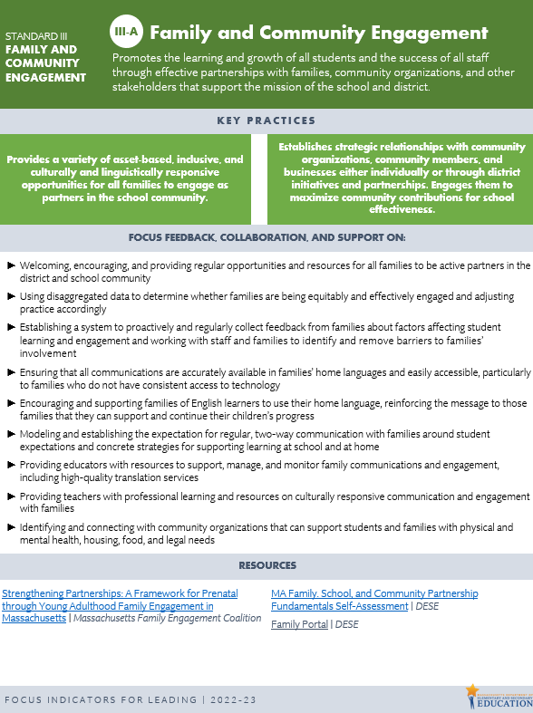
Focus Indicators
ADMINISTRATORS
TEACHERS
I-A
Curriculum & Planning
II-A
III-B
IV-A
IV-C
Family Collaboration
Reflection
Professional Collaboration
II-B
Learning Environment
Instruction
I-B
Instruction
I-D
Evaluation
II-A
Environment
II-B
III-C
IV-D
HR Management & Development
Sharing Responsibility
Continuous Learning
STANDARDS OF EFFECTIVE PRACTICE

Slide 26
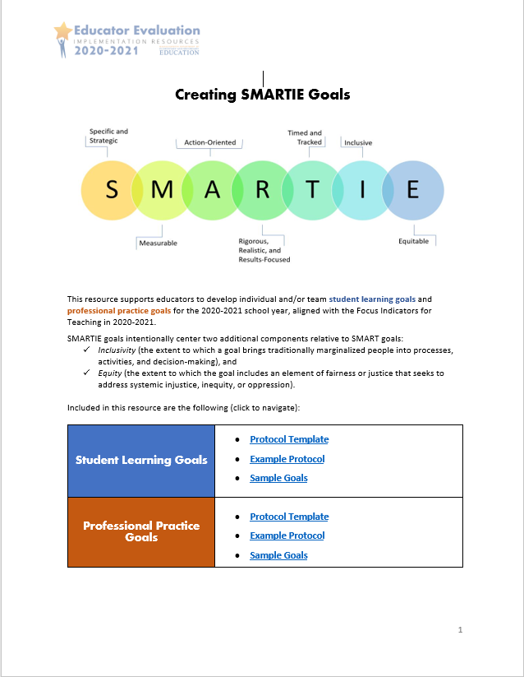
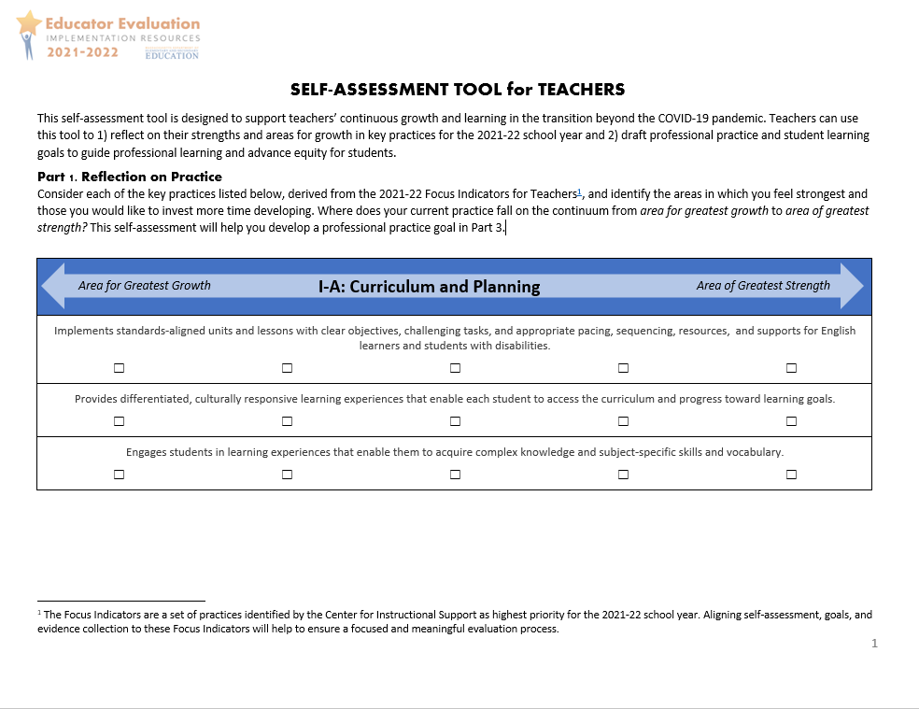
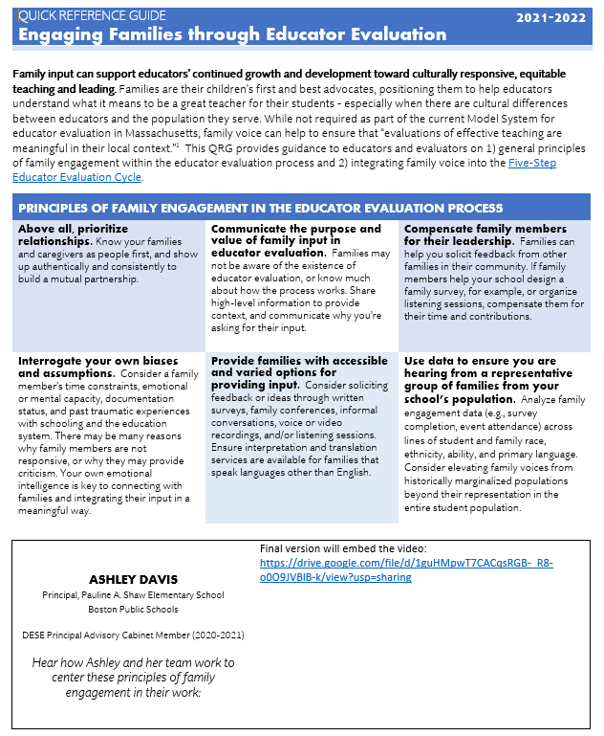
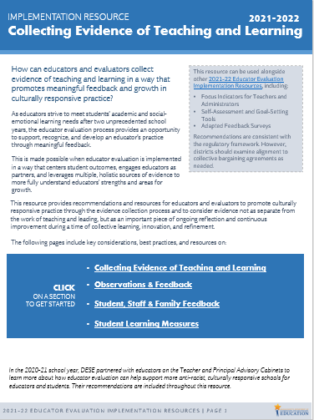
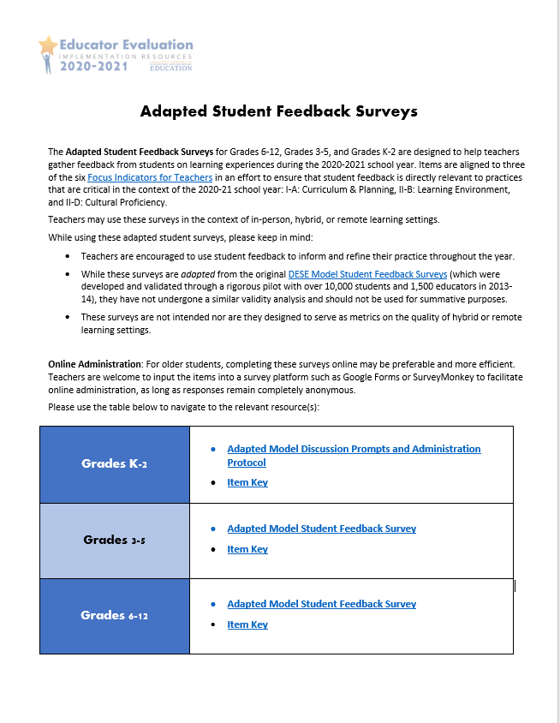
Aligned Tools & Resources
Self-Assessment Tool
SMARTIE Goal-Setting Protocol
QRG: Engaging Families in Educator Evaluation
Collecting Evidence of Teaching and Learning
Staff and Student Feedback Surveys

Slide 27
Links & Resources
Model Rubric Update Project
Ed Eval Implementation Resources
Supporting Culturally & Linguistically Sustaining Practices
DESE’s Educational Vision and Catalog of Aligned Resources

Slide 28
Q&A

Slide 29
Thank you!
Shannon Clancy | Claire Abbott
Educator Effectiveness Coordinator | Director, Educator Effectiveness
Shannon.Clancy@mass.gov | Claire.J.Abbott@mass.gov

