Slide 1




teacher workshop series:
The Ma educator evaluation system
Session 1: Rubric Review

Slide 2



Series Objectives
Teacher Workshop Series:
The MA Educator Evaluation System
Understand the key components of the evaluation framework
Collaborate with colleagues to engage in key activities from the 5-Step Evaluation Cycle

Slide 3



Series Overview
Session 1: Rubric Review
Session 2: Self-Assessment
Session 3: Setting S.M.A.R.T.I.E. Goals
Session 4: Gathering Evidence

Slide 4

Session 1:
Rubric review
01
Objective: Educators will review the classroom teacher rubric to learn about its purpose, structure, and how it defines effective practice.

Slide 5
Agenda
01
Background & Context
02
Rubric Crosswalk
03
Resource Review
04
Reflection & Discussion

Slide 6


Background & Context

Slide 7

the educator evaluation system
The purpose of the educator evaluation system is to ensure that each and every student has access to an effective educator through the following goals:
Step 1: Self-Assessment
Step 2: Goal-Setting & Plan Development
Step 3: Plan Implementation
Step 4: Formative Assessment/ Evaluation
Step 5: Summative Evaluation
Promoting educator growth and development,
Placing student learning at the center, using multiple measures of student learning, growth and achievement,
Recognizing excellence in teaching and leading,
Setting a high bar for professional teaching status, and
Creating clear processes and timelines for improvement.
5-Step Evaluation Cycle
Notes:
The goal of the educator evaluation system is to ensure that each and every student has access to an effective educator.
This is realized by:
Promoting educator growth and development through the evaluation process,
Placing student learning at the center, using multiple measures of student learning, growth and achievement,
Recognizing excellence in teaching and leading,
Setting a high bar for professional teaching status, and
Creating clear processes and timelines for improvement
The 5-step cycle includes self-assessment, goal-setting, plan implementation, and a formative and summative assessment. Throughout the cycle should be ongoing feedback and reflection.

Slide 8







Purpose of the model rubric in the evaluation process
Support professional growth and development
Inform judgments of practice
Define effective practice
The rubrics provide an organizing framework for evaluators to make informed professional judgments about Formative and Summative Performance Ratings on each Standard and overall.
The rubrics help educators and evaluators develop a consistent, shared understanding of what Proficient performance looks like in practice.
The rubrics provide a common terminology around which to focus goals, feedback, evidence collection, and professional learning throughout the evaluation cycle.
Notes:
The rubric plays a central role in the evaluation process by defining effective practice, supporting professional growth and development, and informing judgments of practice.

Slide 9
Rubric Structure
Standard I: Curriculum, Planning, & Assessment
I-A Curriculum & Planning
Standards
Indicators
Elements
I-A-1 Subject Matter Knowledge
I-A-2 Knowledge of Students
I-A-3 Curriculum Literacy
Notes:
The rubric is built on Standards, Indicators, and Elements. There are four Standards (I. Curriculum, Planning and Assessment, II. Teaching All Students, III. Family and Community Engagement, and IV. Professional Culture). Under each standard are three Indicators that provide more information about effective practice in that Standard. Each Indicator includes a set of elements. Elements are the most specific, granular level of the rubric.

Slide 10
Performance levels
Unsatisfactory
Needs Improvement
Proficient
Exemplary
The educator’s performance is consistently below the requirements and has not shown improvement.
The educator’s performance is not fully proficient. Growth and development is necessary and expected.
The educator’s performance fully meets the requirements. This is the expected, rigorous yet attainable level of performance for most educators.
The educator’s performance exceeds requirements and consistently demonstrates high-quality practice with impact in the classroom or beyond.
quality, scope, and consistency of performance
Notes:
There are four performance levels on the rubric. Teachers receive ratings on each Standard and overall.
Proficient means that an educator’s performance fully meets the requirements. This is the expected, rigorous yet attainable level of performance for most educators.
Distinctions by performance level are determined based on variations in quality (the ability to perform the skill, action, or behavior), scope (the scale of impact), and consistency (the frequency that skill, action, or behavior is demonstrated with quality).
The rubric includes examples of ways that educators may demonstrate Exemplary, Needs Improvement, or Unsatisfactory performance of each Indicator (indicated after “e.g.”). This is meant to illustrate, not prescribe, evidence that an educator “exceeds Proficient expectations,” “demonstrates some progress towards meeting Proficient expectations,” or “demonstrates performance consistently below the standard.”

Slide 11


What does this look like?
All students are known and valued
Learning experiences are relevant, real-world, and interactive
Individualized supports enable students to excel at grade-level or beyond
Notes:
DESE’s Educational Vision (2023) is grounded in high-quality teaching and learning for ALL students in the Commonwealth.

Slide 12
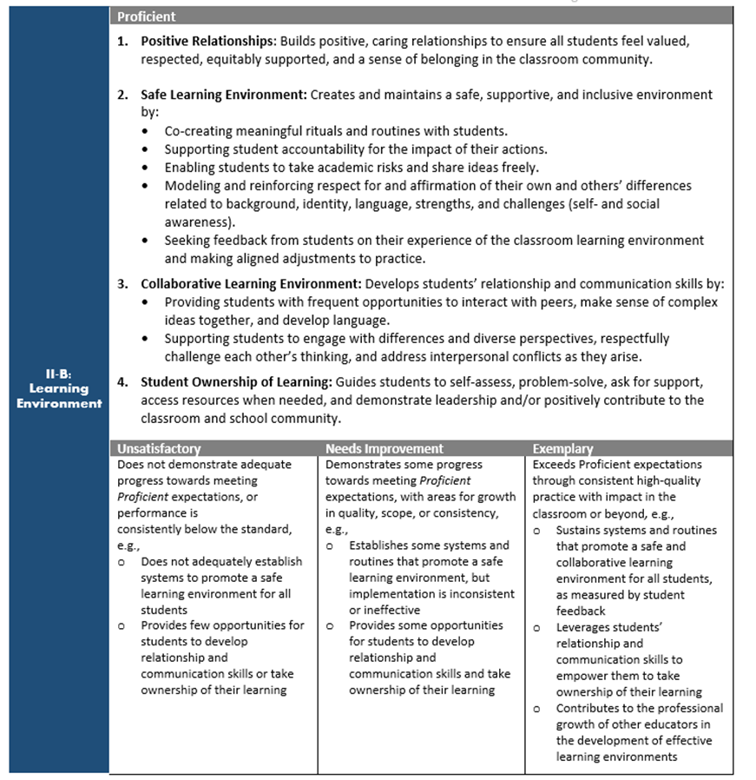
2024 model rubric updates
Updated model evaluation rubrics based on feedback from educators, students, and families
Integrated culturally and linguistically sustaining practices throughout the Standards and Indicators of Effective Practice
Notes:
The updated Model Rubric for School Level Administrators was released in June 2023 and the updated Model Rubric for Classroom Teachers was released in June 2024. These updates are grounded in DESE’s Educational Vision for effective teaching and leadership, and reflect input from educators, students, and families across Massachusetts on antiracist, inclusive, and equitable practices that support all students to attain academic knowledge and skills, understand and value themselves and others, and engage with the world.
DESE partnered with educators on the 2021-22 Principal and Teacher Advisory Cabinets as the key advisory group for this project. We also received input and feedback from students and families through a series of Student and Family Roundtables.

Slide 13
Rubric review

Slide 14
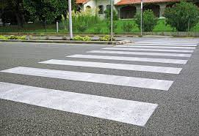
Option 1: rubric crosswalk
What shifts do you see between the 2018 and 2024 rubrics?
How is the Educational Vision reflected?
How does this align with your district/school’s goals and priorities?
Notes:
Divide into 2-4 groups. Each group will read the crosswalk between the 2018 rubric and the 2024 rubric for 1-2 Standards and prepare to share whole group:
What shifts do you see between the 2018 and 2024 rubrics?
How is the Educational Vision reflected? (see slide 11)
How does this align with your district/school’s goals and priorities?

Slide 15

Option 2: rubric review
How is the Educational Vision reflected in this Standard?
How does this align with your district/school’s goals and priorities?
Notes:
Choose a Standard. Read the Indicators, elements, and performance-level descriptors and discuss as a group:
How is the Educational Vision reflected in this Standard?
How does this align with your district/school’s goals and priorities?

Slide 16
Resource review

Slide 17
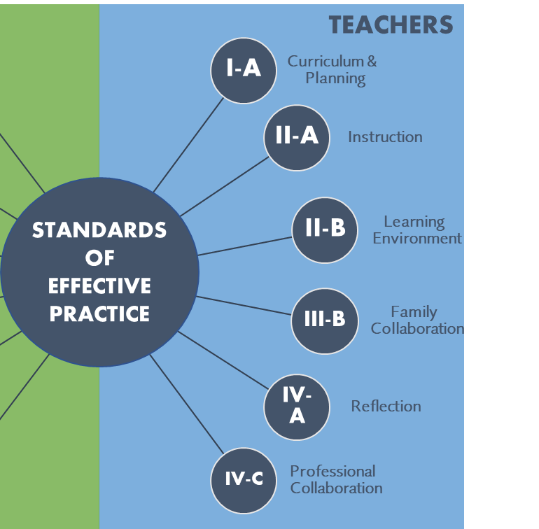
Focus Indicators
High-priority areas of the rubric
Key practices
Focus areas for feedback, collaboration, and support
Resources
Notes:
Independently review the Focus Indicators for Teaching, consider how this resource could be useful to you in your work.

Slide 18
Reflection & discussion

Slide 19

Which parts of the rubric and/or Focus Indicators resonate with you?
How might they support your professional growth this year?

Slide 20
Next steps

Slide 21
Next session…
Session 1: Rubric Review
Session 2: Self-Assessment
Session 3: Setting S.M.A.R.T.I.E. Goals
Session 4: Gathering Evidence

Slide 22





Contact us with questions or feedback
Office of Educator Effectiveness, Center for Instructional Support
educatordevelopment@mass.gov
https://www.doe.mass.edu/edeffectiveness/
135 Santilli Highway, Everett, MA 02149

