Slide 1
teacher workshop series:
The Ma educator evaluation system
Session 3:
Setting S.M.A.R.T.I.E. Goals

Slide 2
Series Objectives
Teacher Workshop Series:
The MA Educator Evaluation System
Understand the key components of the evaluation framework
Collaborate with colleagues to engage in key activities from the 5-Step Evaluation Cycle

Slide 3
Series Overview
Session 1: Rubric Review
Session 2: Self-Assessment
Session 3: Setting S.M.A.R.T.I.E. Goals
Session 4: Gathering Evidence

Slide 4
Session 3:
Setting s.m.a.r.t.i.e. goals
01
Objective: Educators will draft professional practice or student learning goals.

Slide 5
Agenda
01
Background & Context
02
Goal-Setting Protocol
03
Discussion

Slide 6
Background & Context

Slide 7
the educator evaluation system
The goal of the educator evaluation system is to ensure that each and every student has access to an effective educator.
Step 1: Self-Assessment
Step 2: Goal-Setting & Plan Development
Step 3: Plan Implementation
Step 4: Formative Assessment/ Evaluation
Step 5: Summative Evaluation
Promoting educator growth and development,
Placing student learning at the center, using multiple measures of student learning, growth and achievement,
Recognizing excellence in teaching and leading,
Setting a high bar for professional teaching status, and
Creating clear processes and timelines for improvement
5-Step Evaluation Cycle
Notes:
The goal of the educator evaluation system is to ensure that each and every student has access to an effective educator.
This is realized by:
Promoting educator growth and development through the evaluation process,
Placing student learning at the center, using multiple measures of student learning, growth and achievement,
Recognizing excellence in teaching and leading,
Setting a high bar for professional teaching status, and
Creating clear processes and timelines for improvement
The 5-step cycle includes self-assessment, goal-setting, plan implementation, and a formative and summative assessment. Throughout the cycle should be ongoing feedback and reflection.

Slide 8
Purpose of goal-setting in the evaluation process
Center educator and student needs in the evaluation process
Support reflective practice
Goal-setting establishes a basis from which educators can continually reflect on their progress throughout the year.
Meaningful goals provide a focus for professional learning, evidence collection, and feedback.
Notes:
Goal-setting is really core to the evaluation process. Good goal setting, informed by a thorough self-assessment of your strengths, areas for growth, and student needs, can become the basis for all of the activities that follow as part of the evaluation cycle – from professional learning, to evidence collection, feedback, and reflection. Setting a strong and meaningful goal is a key way to ensure that your voice as an educator is central to the evaluation process.

Slide 9
Types of goals
Student Learning Goals
Support the learning, growth, and achievement of students
Driven by the needs of the students for whom an educator or team has responsibility.
Professional Practice Goals
Support the development of the educator’s practice.
Driven by the needs of the educator in relation to the Standards of Effective Teaching or Administrative Leadership Practice.
Student Learning and Professional Practice Goals can and should be connected and complementary.
Notes:
Independently complete a self-assessment using the Focus Indicator Self-Assessment Tool or another tool provided by the district.

Slide 10
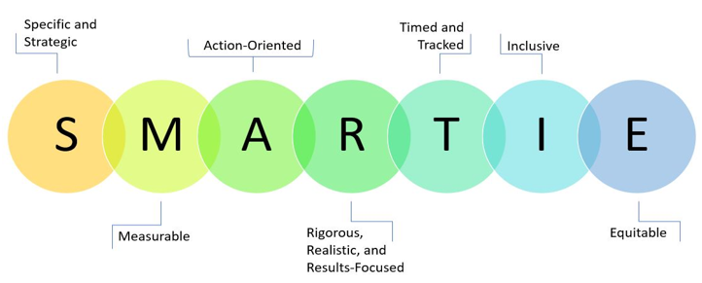
Breakdown of the SMARTIE Acronym
Notes:
S = Specific and Strategic Goals need to be straightforward and clearly written. A goal is strategic when it serves an important purpose of the school or district as a whole and addresses something that is likely to have a big impact on our overall vision.
M = Measurable How will we know if we’ve achieved the goal? And how will we measure progress along the way?
A = Action Oriented Goals should have action steps attached to them tell us “who” is doing “what.” Making clear the key actions required to achieve a goal also helps ensure that it is attainable.
R = Rigorous, Realistic, and Results-Focused (the 3 Rs) A goal needs to describe a realistic, yet ambitious result. It needs to stretch the educator, team, school, or district toward improvement but not be out of reach.
T = Timed A goal needs to have a clear timeline, so we know when actions will happen and when outcomes will be met.
I = Inclusivity: The extent to which a goal brings historically marginalized people into processes, activities, and decision-making
E = Equity: The extent to which the goal includes an element of fairness or justice that seeks to address systemic injustice, inequity, or oppression, such as anti-racism).

Slide 11
Key considerations
Consider team goals where appropriate.
Identify goals that are aligned to your school and district’s vision and priorities.
Use your self-assessment to target areas for growth.

Slide 12
Goal-setting protocol

Slide 13
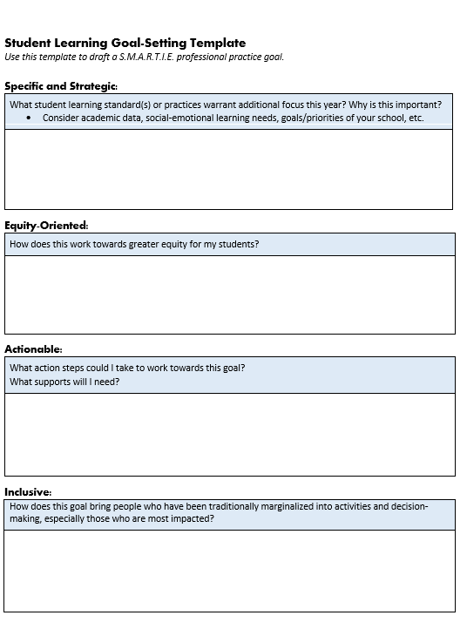
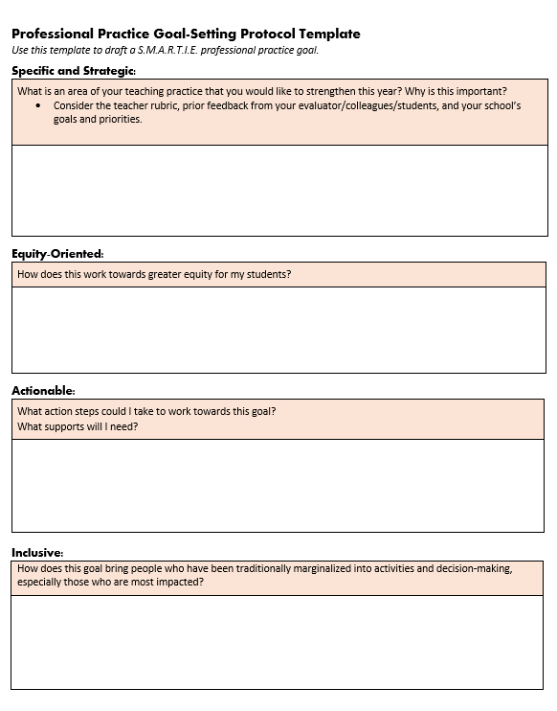
Practice Activity: Choosing a SMARTIE Goal
Choose to work on a student learning or professional practice goals
Review the sample goals
Follow the prompts to generate ideas for, and develop, a S.M.A.R.T.I.E. goal

Slide 14
discussion

Slide 15
Discussion Questions
What are you considering focusing on for your goal? Why?
How are you centering inclusivity and equity in your goal?
What school/district resources or professional learning opportunities are available to support you in meeting this goal?

Slide 16
Next steps

Slide 17
Next session…
Session 1: Rubric Review
Session 2: Self-Assessment
Session 3: Setting S.M.A.R.T.I.E. Goals
Session 4: Gathering Evidence

Slide 18
Contact us with questions or feedback
Office of Educator Effectiveness, Center for Instructional Support
educatordevelopment@mass.gov
https://www.doe.mass.edu/edeffectiveness/
135 Santilli Highway, Everett, MA 02149

