Slide 1
teacher workshop series:
The Ma educator evaluation system
Session 4: Gathering Evidence

Slide 2
Series Objectives
Teacher Workshop Series:
The MA Educator Evaluation System
Understand the key components of the evaluation framework
Collaborate with colleagues to engage in key activities from the 5-Step Evaluation Cycle

Slide 3
Series Overview
Session 1: Rubric Review
Session 2: Self-Assessment
Session 3: Setting S.M.A.R.T.I.E. Goals
Session 4: Gathering Evidence

Slide 4
Session 2:
Gathering evidence
01
Objective: Educators will identify strategic, authentic, and representative sources of evidence to share for feedback during the evaluation cycle.

Slide 5
Agenda
01
Background & Context
02
Resource Spotlight
03
Discussion
04
Activity: Identifying Evidence

Slide 6
Background & Context

Slide 7
the educator evaluation system
The goal of the educator evaluation system is to ensure that each and every student has access to an effective educator.
Step 1: Self-Assessment
Step 2: Goal-Setting & Plan Development
Step 3: Plan Implementation
Step 4: Formative Assessment/ Evaluation
Step 5: Summative Evaluation
Promoting educator growth and development,
Placing student learning at the center, using multiple measures of student learning, growth and achievement,
Recognizing excellence in teaching and leading,
Setting a high bar for professional teaching status, and
Creating clear processes and timelines for improvement
5-Step Evaluation Cycle
Notes:
The goal of the educator evaluation system is to ensure that each and every student has access to an effective educator.
This is realized by:
Promoting educator growth and development through the evaluation process,
Placing student learning at the center, using multiple measures of student learning, growth and achievement,
Recognizing excellence in teaching and leading,
Setting a high bar for professional teaching status, and
Creating clear processes and timelines for improvement
The 5-step cycle includes self-assessment, goal-setting, plan implementation, and a formative and summative assessment. Throughout the cycle should be ongoing feedback and reflection.

Slide 8
Purpose of the evidence collection in the evaluation process
Monitor progress towards goals
Create a comprehensive picture of educator practice
Strengthen feedback
When done well, the collection and analysis of evidence is a valuable process that supports educators to reflect on and monitor their own performance and progress.
A robust body of evidence of an educator’s strengths and areas for growth makes feedback more targeted and actionable.
.
Conducting evaluations based on a fuller understanding of an educator’s practice makes the process more fair and accurate.

Slide 9
Categories of evidence
Measures of Student Learning
Assessment data
Products of Practice
Observations
Artifacts
Other student outcome data
Student work samples
Additional Evidence
Student feedback
Evidence of fulfillment of professional responsibilities
Evidence of family engagement
Notes:
There are three required categories of evidence.

Slide 10
Key considerations
Plan for evidence collection at the beginning of the evaluation cycle
Prioritize evidence from across the four Standards that is aligned to your goals and your district’s priorities
Consider a representative sample of authentic evidence that tells a story of your practice.

Slide 11
Resource spotlight

Slide 12
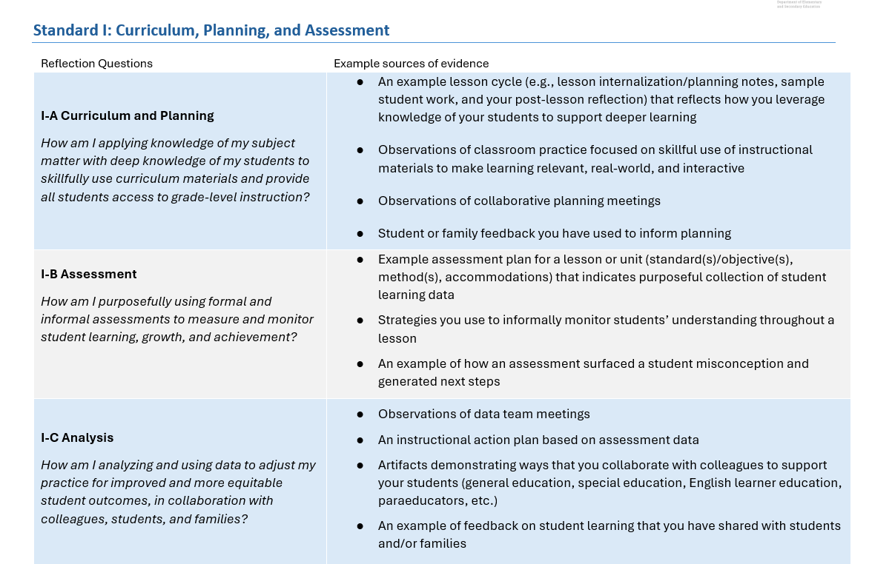
Reflection and evidence guide
Choose 1-2 Indicators from each Standard that are aligned with your goals and your district’s priorities.
Read through the reflection questions and example sources of evidence.
Which sources of evidence are most relevant to your goals and context?
How else could you demonstrate your practice in these areas?
Notes:
The Classroom Teacher Evaluation: Reflection and Evidence Guide is a resource to support educators in reflecting on the myriad of ways that they demonstrate effective practices aligned with the Model Rubric for Classroom Teachers. Educators and evaluators can use this document to collaboratively identify sources of evidence to guide the educator evaluation process.

Slide 13
identifying evidence

Slide 14
Bridge to Practice
Identify the artifacts, measures of student learning, and other sources of evidence that you expect to produce this year based on your goal(s).
What sources of evidence will demonstrate targeted, rich evidence of practice relative to your goals and overall professional practice?
Notes:
Using your goals and Educator Plan if available, identify the artifacts and measures of student learning that you expect to produce as a result of your planned action steps.
Consider the three required categories of evidence – measures of student learning, products of practice, and additional evidence relative to the performance standards, and consider evidence that is strategic, representative, and authentic to your work.

Slide 15
Next steps

Slide 16
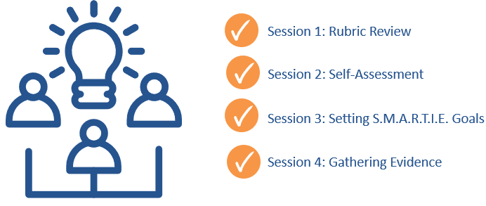
Share your Feedback on the teacher workshop series for Ma educator evaluation system
Please share your feedback on this workshop series:
educatordevelopment@mass.gov

Slide 17
Contact us with questions or feedback
Office of Educator Effectiveness, Center for Instructional Support
educatordevelopment@mass.gov
https://www.doe.mass.edu/edeffectiveness/
135 Santilli Highway, Everett, MA 02149

