Slide 1
Candidate Assessment of Performance
Conducting Observations and
Providing Meaningful Feedback
Workshop for Program Supervisors and
Supervising Practitioners

Slide 2
Warming Up

Slide 3
Learn from MA Teachers and Administrators about Observations and Feedback
Click here

Slide 4
Warm Up
Turn to a partner:
What resonated with you?
How do you currently conduct classroom observations (e.g., mostly short, unannounced; mostly longer, announced; using video; with a rubric)?
How do you determine what feedback to provide following an observation?

Slide 5
Learning
Observations in CAP

Slide 6
Goals of CAP
Provide candidates with opportunities to demonstrate the knowledge and skills they have gained in preparation.
Support candidates’ growth and development through consistent, high quality feedback and evaluation.
Ensure candidates are ready to make impact with students on DAY 1.

Slide 7
The CAP Process
CAP takes place throughout the practicum.
Program supervisors, supervising practitioners, and candidates collect evidence of practice, which informs CAP ratings.
Evidence includes:
At least 2 announced and 2 unannounced observations
At least one measure of student learning
Student feedback
Artifacts of the candidate’s practice

Slide 8
The Role of Observations
Observations are a critical source of evidence collected by CAP assessors.
Observations help assessors with two important tasks:
Collecting and documenting evidence of performance for the 6 essential elements measured by CAP.
Providing focused, actionable feedback to candidates about their performance.

Slide 9
The Four CAP Observations
Each source of evidence in CAP is designed to target a subset of the 6 essential elements – “focus elements.”
 | Well-Structured Lessons | Adjustments to Practice | Meeting Diverse Needs | Safe Learning Environment | High Expectations | Reflective Practice
Announced Observation 1 | X |  |  |  | X
Unannounced Observation 1 | X |  |  | X
Announced Observation 2 |  | X | X
Unannounced Observation 2 |  | X

Slide 10
Components of a CAP Observation
Active evidence collection
DO document what is happening (e.g., teacher and student actions/behaviors).
DO NOT make judgments about performance during the observation.
Analysis and synthesis of evidence following the observation.
Connect evidence to the 6 essential elements (required for at least the focus elements for the observation).
Self-reflection by the candidate
Targeted feedback to the candidate

Slide 11
ESE’s Model Observation Protocol
Before the Observation (for announced observations)
Preparing for the pre-conference
Conducting the pre-conference
During the Observation
Actively collecting evidence
After the Observation
Analyzing the evidence
Preparing for the post-conference
Identifying reinforcement/refinement objectives
Conducting the post-conference

Slide 12
Model Protocol: Before the Observation
Pre-Conference (1-2 days prior to observation – 20 min)
Do not influence the candidate’s plan
Gather evidence such as lesson plans and materials in advance
Prepare 2-3 questions for pre-conference to better understand lesson plans and collect additional evidence, such as:
“What do you expect students to know and be able to do at the end of the lesson?”
“How is the lesson structured for students who progress at different learning rates?”
Let the candidate do most of the talking, but do help him/her reflect prior feedback when possible.

Slide 13
Model Protocol: During the Observation
Actively collect evidence without making judgments
Options: scripting, videotaping, audio-recording
Evidence collected during an observation is to aid assessor in identifying trends and selecting illustrative examples.
ESE does not collect evidence from observations.

Slide 14
Model Protocol: After the Observation
Review evidence and sort using the evidence chart included on the CAP Observation Form.
Not every piece of evidence collected needs to be sorted.
Consult the CAP Rubric when sorting evidence.
Evidence statements should say what happened in the observation that shows/does not show that a skill has been demonstrated.

Slide 15
Model Protocol: After the Observation
Prepare for the post-conference.
If conducted jointly, the program supervisor and supervising practitioner should calibrate feedback before the post-conference.
Collect self-reflection from candidate
Identify 1-2 areas of reinforcement (“keep doing what you’re doing”)
Should identify candidate’s instructional strength in a way that encourages continuation of effective practices.
Identify 1-2 areas of refinement (“instead, try this…”)
Should identify areas in need of instructional improvement.

Slide 16
Model Protocol: After the Observation
Conduct the post-conference. (30 minutes)
Post-conferences should occur after the assessor has had an opportunity to synthesize the evidence.
Ask the candidate self-reflection questions related to areas of refinement (good source of evidence for the reflective practice element).
Provide concrete suggestions for improvement and share resources/supports.
Share observation form.
Answer questions and confirm next steps.

Slide 17
CAP Observation Forms
Forms available for each of the four required observations.
Indicate the focus elements for the observation, but accommodate evidence related to all 6 essential elements.
Are not designed for use during an observation, but rather as tools for synthesizing evidence and sorting by element.

Slide 18
Practicing

Slide 19
Simulated Unannounced Observation
In a moment we will watch a video of a 7th grade math lesson.
“Observe” the lesson using ESE’s Model Observation Protocol.
Remember, engage in active evidence collection by recording teacher and student actions and behaviors without judgment.
The focus elements for this lesson are: well-structured lessons and safe learning environment.

Slide 20
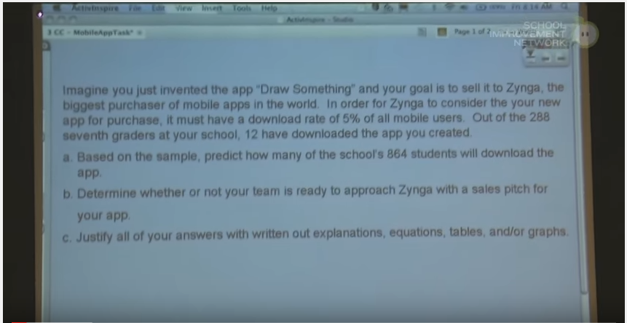
Simulated Unannounced Observation
Click here

Slide 21
Simulated Unannounced Observation
Analyzing the Evidence
Using the observation form and the CAP rubric, sort evidence into the evidence chart.
Not every piece of evidence collected needs to be sorted.
Evidence may demonstrate that one or more of the dimensions of an element (quality, scope, consistency) are being met OR that performance is not yet at the expected threshold.
Evidence statements should say what happened in the observation that shows/does not show that a skill has been demonstrated.

Slide 22
Simulated Unannounced Observation
Prepare for Post-Conference
Turn to a partner and calibrate judgments based on evidence.
Work together to complete the Post-Conference Planning Form. Use the guiding questions in the Model Observation Protocol to identify:
1-2 areas of reinforcement (“keep doing what you’re doing”); and
1-2 areas of refinement (“instead, try this…”).

Slide 23
Simulated Unannounced Observation
Whole-Group Discussion
Round robin sharing of 1-2 reinforcement and refinement areas.
Discuss:
Were the indentified reinforcement/refinement areas consistent across all pairs?
Are the identified resources and supports likely to help the teacher improve practice in the refinement areas?
What concrete feedback would you provide the teacher during a post-conference?

Slide 24
Calibrating

Slide 25
Assessor Calibration
Calibration is the result of ongoing, frequent collaboration of groups of educators to:
Come to a common, shared understanding of what practice looks like at different performance levels and
Establish and maintain consistency in aspects of the evaluation process including analyzing evidence, providing feedback, and using professional judgment to determine ratings

Slide 26
Assessor Calibration
Calibration between program supervisors and supervising practitioners, which we just simulated in pairs, is essential in CAP to provide candidates with consistent feedback.
Calibration across all program supervisors at a prep program is also important to establishing a common set of expectations for teacher candidates. Let’s practice that now as a group.

Slide 27
Assessor Calibration Simulation
In a moment we will watch a second video of classroom instruction. This one features a 3rd grade classroom.
Again, “observe” the lesson using ESE’s Model Observation Protocol.
Remember, engage in active evidence collection by recording teacher and student actions and behaviors without judgment.
The focus element for this lesson is: adjustments to practice.
After the video we will simulate a calibration activity that programs can use to build common expectations.

Slide 28
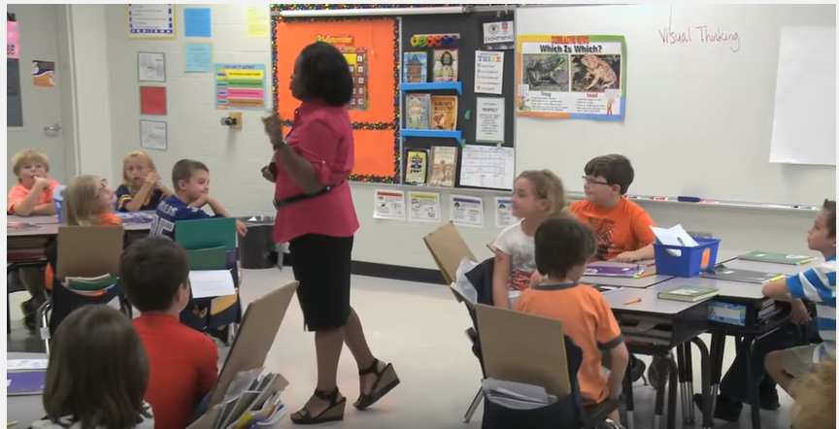
Assessor Calibration Simulation
Click here

Slide 29
Assessor Calibration Simulation
On your own:
Using the observation form and the CAP Rubric, sort evidence into the evidence chart.
Complete the Post-Conference Planning Form. Use the guiding questions in the Model Observation Protocol to identify:
1-2 areas of reinforcement (“keep doing what you’re doing”); and
1-2 areas of refinement (“instead, try this…”).

Slide 30
Assessor Calibration Simulation
In teams of 3-4, conduct a peer review of a group member’s feedback to the teacher:
Choose 1 person to be the “subject.”
The subject will read aloud his/her feedback to the teacher from the Post-Conference Planning Form.
The remaining team members discuss their assessments of the feedback and make suggestions to improve the feedback. The subject listens silently.
The subject then responds to the team members’ assessment. The group listens silently.
Together the team brainstorms specific ways to make the subject’s feedback stronger.
*Choose a new subject and repeat the process as time permits.

Slide 31
Assessor Calibration Simulation
As a whole group:
Each team shares the following with the full group:
Exemplars of feedback to the teacher and why they felt they were exemplars.
One new common understanding or practice the team will adopt.

Slide 32
Recapping

Slide 33
Recap
Observations are a critical source of evidence in CAP.
The goal of observations in CAP is two-fold:
Collecting and documenting evidence of performance for the 6 essential elements measured by CAP.
Providing focused, actionable feedback to candidates about their performance.
ESE’s model observation protocol describes key steps that should be taken before (for announced observations), during, and after each observation.

Slide 34
Recap
Evidence collected during observations should document teacher and student actions and behaviors without judgment.
After the observation, assessors should analyze the evidence to identify trends and select illustrative examples of the educator’s practice to ground feedback.
Feedback must be focused and actionable and be accompanied by specific strategies or supports available to the educator.
Calibration between program supervisors and supervising practitioners and across all program assessors is essential to delivering a consistent CAP experience for candidates.

Slide 35
Questions?

