Slide 1
CAP Online Platform
CAP Manager Training
2025-26
Notes:
​The hope is that you will take this information back to your organizations where you will train Program Supervisors and Supervising Practitioners to make the practicum experience as meaningful and logistically simple for candidates as possible.

Slide 2
Agenda
Overview
Detailed walkthrough
Troubleshooting tips
Resources
Questions
Notes:
During the session, I will provide a high-level overview of the CAP Online Platform and then jump into a much more detailed walk through of how to use the platform for each stage in the CAP Cycle.
After the walkthrough, I will share some troubleshooting tips for common issues that users run into with the platform as well as resources you can access for additional instructions and support.

Slide 3
Overview of the CAP Online Platform
Notes:
As you know, this year all sponsoring organizations are required to implement all CAP cycles according to the expectations in the 2024 Guidelines for the Candidate Assessment of Performance. While many of you are deeply familiar with these expectations, I will begin with a brief refresher with a focus on changes that directly impact what you will see within the CAP Online Platform.

Slide 4
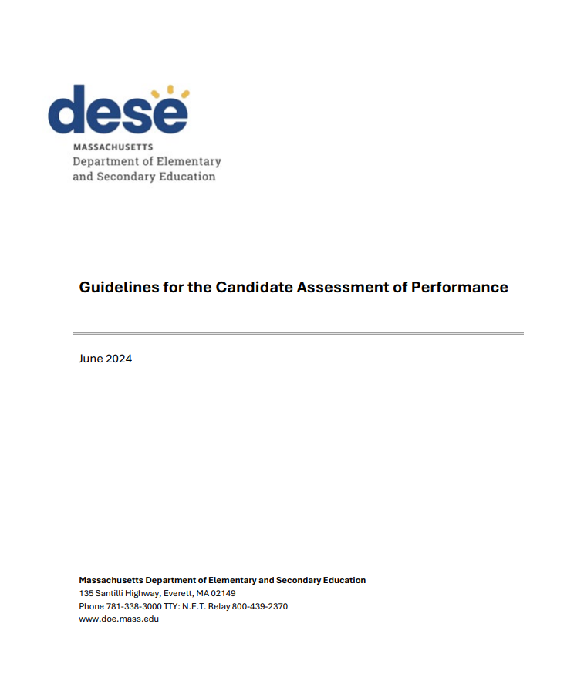
What is CAP?
The Candidate Assessment of Performance (CAP) is bridge from preparation to practice​.
​Measure teacher candidates’ practice on key elements as outlined in the Guidelines for the Professional Standards for Teachers (PSTs) and Guidelines for the Candidate Assessment of Performance​
Support teacher candidates to improve their practice through targeted feedback and performance evaluations
Ensure teacher candidates are ready to make a positive impact with students on day one.
​
​
Notes:
CAP creates an intentional bridge from preparation to practice by aligning preparation expectations with the Massachusetts Educator Evaluation Framework for in-service educators. This allows sponsoring organizations to ensure that teacher candidates have the skills necessary to be effective teachers in Massachusetts.
CAP is designed to support teacher candidates’ growth as well as assess readiness for their licensure role at the conclusion of their preparation experience.
CAP is one mechanism by which we ensure that new teachers enter classrooms prepared to make a positive impact for all students on day one.​

Slide 5
2024 CAP Guidelines – Key Changes
Updated Essential Elements
Aligned with the updated Standards for Effective Teaching Practice
Revised expectations for evidence collection
Each category of evidence must be used at least once
Each Essential Element must be demonstrated by at least two categories
Observations must be one of two categories for I-A-1, II-A-1, and II-B-2
Confirmation of supervising practitioner qualifications
SOs must verify whether SPs meet DESE’s expectations
If not, SOs must attest that attempts were made to find a qualified SP and that additional supports with be provided to the candidate
The CAP Guidelines and CAP Implementation Handbook should be consulted for details about each step of the CAP cycle.
Notes:
In 2024, the CAP Guidelines were updated. Three major changes were made. [Click]
First, all Essential Elements were revised to align with the updated Standards for Effective Teaching Practice, which center culturally and linguistically sustaining practices. [Click]
Second, new evidence collection were revised to require that:
Each category of evidence must be used at least once (this includes observations, the professional practice goal, the measure of student learning, student feedback, and candidate artifacts)
Each Essential Element must be demonstrated by at least two categories of evidence
Observations must be one of the two categories of evidence for I-A-1 Subject Matter Knowledge, II-A-1 High Expectations and Support, and II-B-2 Safe Learning Environment [Click]
Finally, sponsoring organizations are now required to verify whether each SP meets DESE’s expectations for the role
If not, organizations must attest that attempts were made to find a qualified SP and that additional supports will be provided to the candidate
[Click] This training will focus on the technical aspects of the platform
The CAP Guidelines and Implementation Handbook should be consulted to ensure sponsoring organizations implement each cycle step of the cycle according to DESE’s expectations
A lot of the information in this training is the same as in prior years. This is because many aspects of the platform have not changed. I will make it clear when something is new based on our recent updates to align the platform with the Guidelines.

Slide 6

What is the CAP Online Platform?
Virtual system for implementing CAP as outlined in the CAP Guidelines and Implementation Handbook​.
Allows sponsoring organizations (SOs), program supervisors (PSs), supervising practitioners (PSs), and teacher candidates (TCs) to complete all forms online.​
Notes:
The CAP Online Platform is a virtual system for implementing this performance assessment in alignment with the expectations outlined in the CAP Guidelines and Implementation Handbook​.
It allows sponsoring organizations to manage cycles from start to end, and allows program supervisors, supervising practitioners, and teacher candidates to complete all required forms online.​
Use of the CAP Online Platform is entirely optional. If the structure of the platform is not right for your organization – you can instead use the paper-based versions of the forms and upload key data at the end of the academic year.

Slide 7
Why use the CAP Online Platform?
​
Alignment to paper-based forms
Streamlined CAP process and triad communication
Ability to track candidate progress through each step of the cycle ​
Accounts linked to Security Portal/ELAR​
Quick, complete, and accurate CAP data reporting into EDWIN​
Notes:
There are several benefits to using the CAP Online Platform, including:
Ensuring implementation is aligned to DESE’s required forms
Streamlining the CAP process and consolidating triad communication
Tracking candidate progress through each step of the CAP cycle
Linking accounts to the Security Portal and ELAR
Ensuring quick and accurate CAP data reporting into EDWIN

Slide 8
Future of the CAP Online Platform
​
SY2025-26 - Full CAP cycle functionality and DESE support
SY2026-27 and beyond - CAP data reporting functionality and support only
Notes:
During DESE’s annual Back-to-School Welcome Meeting in the middle of August, we shared some news about the future of the CAP Online Platform. While some of you may have been there, I want to share it again now as it is very relevant for this group.
Like many of your organizations, DESE is navigating the ongoing uncertainty about policies, oversight, and federal funding from USDOE. With a statewide hiring freeze in place, we are currently unable to fill two recently vacated positions. We are also trying to anticipate and mitigate possible future cuts in federal funding. This has meant we have had to make difficult choices about where to invest our limited resources.
Unfortunately, school year 2025-26 will be the last year sponsoring organizations will be able to use the CAP Online Platform to conduct CAP cycles.
We devoted a lot of time over the past year to updated the CAP Online Platform. Like you, we have been eagerly awaiting its release. The updates were made assuming this would be the platform organizations used for years to come.
In the spring, we lost the dedicated IT support for the Platform. We were able to advocate for the resources to finish the planned updates and have organizations use it through the end of this school year.
Despite trying, we have been unable to find a sustainable alternative. And, without IT expertise and resources, we cannot maintain the platform’s functionality beyond this school year.
This decision was made recently so we do not have answers to the many questions it raises yet. We know this will impact many of your organizations so wanted to share transparently as soon as we could. We will share additional information and resources about this change over the coming months.
We do want to assure you that while your organization will not be able to start new CAP cycles, all information from previous CAP cycles will remain accessible. DESE will also continue to have access to these records when reviewing candidate artifacts during formal and interim reviews.
If you have further questions about this decision and its impact, please reach out to us at EducatorPreparation@Mass.gov.
The rest of this presentation and the Q&A will focus on the full functionality of the platform that can be used this year.

Slide 9
Roles and Responsibilities
Notes:
The CAP manager, PS, SO, and TC all have unique roles, responsibilities, and capabilities in the CAP Online Platform.

Slide 10
CAP Manager Role
CAP Manager
Train and support
PSs, SPs, and TCs
View progress of all cycles in the organization
View ratings reports and upload data for any cycles not using the platform
Sponsoring organizations may have up to three CAP managers
SOs with a Directory Administrator may add this permission independently, others can send a request to EducatorPreparation@mass.gov
There should only be multiple CMs in cases where candidate numbers or program structures make it difficult for one person to manage all cycles
Each CM should own a subset of cycles from start to finish rather than portions of the same cycles to ensure work is not overwritten
Notes:
The CAP Manager holds primary responsibility for training and supporting PSs, SPs, and TCs with both the components of the CAP cycle and technical use of the CAP Online Platform.
CAP managers can view candidate progress for all open cycles in the organization.
They can also view reports for all closed cycles and upload data for any cycles conducted outside of the CAP Online Platform [Click]
Sponsoring organizations have long requested the ability to assign CAP manager permissions to more than one person.
I am happy to share that SOs may now have up to three CAP managers!
SOs with a Directory Administrator may do this independently, others can send a request to EducatorPreparation@mass.gov
There should only be multiple CAP managers in cases where candidate numbers or program structures make it difficult for one person to manage all cycles.
In these cases, each should own a subset of cycles from start to finish rather than portions of the same cycles to ensure work is not overwritten in error.

Slide 11
CAP Cycle Responsibilities
CAP Cycle Capabilities​ | CM​ | PS​ | SP​ | TC​
Start CAP cycles​ | X​ | X​ | ​ | ​
View progress of CAP cycles​ | X​ | X​ | X​ | ​X
Complete forms​ | ​
CAP Form​ | X​ | X​ | X​ | X​
Rubric Summary​ | ​ | ​ | ​ | X​
Self Assessment​ | ​ | ​ | ​ | X​
Finalized Goal/Implementation Plan​ | ​ | X​ | X​ | X​
Observation Forms​ | ​ | X​ | X​ | ​
Formative/Summative Assessments​ | ​ | X​ | X​ | ​
Open closed forms​ | X​ | X​ | ​ | ​
Upload and tag evidence​ | X​ | X​ | X​ | X​
Add or change PS accounts​ | X​ | X​ | ​ | ​
Add or change SP accounts | X | X
End CAP cycles​ | X​ | X​ | ​ | ​
Notes:
This slide outlines the unique capabilities for the CAP Manager, as well as the PS, SP, and TC.
The CAP manager can start and complete cycles, view progress for all CAP cycles within the organization, open closed forms for further editing, upload evidence, and add or change PS and SP assignments.
The PS can do all of this for the subset of candidates assigned to them as well as enter information into their CAP Forms.
The SP has a more limited role. They can view progress, complete CAP forms, and upload evidence for the specific candidates assigned to them.
The TC has the most restricted role. They can view their own progress, complete a narrower subset of the forms, upload evidence, and view observation and assessment forms once they are submitted by their PS and SP.

Slide 12
Creating Accounts
Notes:
Each of these roles will need an account to access the platform.

Slide 13
Account Creation by Role
CAP managers (CMs) can be assigned by their sponsoring organizations Directory Administrator or by contacting EducatorPreparation@mass.gov if they do not have one. ​
Program supervisors (PSs) can either have permissions added to an existing account or have a new account created by their organization’s Directory Administrator or by contacting EducatorPreparation@mass.gov. ​
Supervising practitioners (SPs) will need a NEW CAP-specific account
Separate from their personal ELAR.
Automatically created when an SP is assigned to a candidate’s CAP cycle
Username will be sent to the email address provided when the CAP cycle is created.
It is crucial that you double check the SP’s email address.
If the wrong address is entered, the SP will not receive their log in information.
If the wrong address is entered, the CM will not be able to fix it and will need to email DESE for support.
Teacher candidates (TCs) will gain access to CAP through enrollment in Early ID and CAP cycle creation.
Notes:
[Click] CAP managers (CMs) permissions can be assigned by sponsoring organization’s Directory Administrator. If you need this permission and your organizations does not have a DA, you may email EducatorPreparation@mass.gov for assistance.​ [Click]
[Click] Program supervisors (PSs) can either have permissions added to an existing account or have a new account created by the organization’s Directory Administrator or by contacting EducatorPreparation@mass.gov. ​
[Click] Supervising practitioners (SPs) will need a NEW CAP-specific account
This account is separate from their personal ELAR.
The new account will be automatically created when an SP is assigned to a candidate’s CAP cycle
The username will be sent to the email address provided when the CAP cycle is created. Because of this, it is crucial that you double check the SP’s email address.
If the wrong address is entered, the SP will not receive their log in information.
Because of a technical limitation of the platform, the CM is also not be able to fix the error and will need to email DESE for support.
[Click] Finally, Teacher candidates (TCs) gain access to CAP through enrollment in Early ID and CAP cycle creation. Once added to a cycle, the CAP application will show up on their ELAR home page.

Slide 14
Logging In
Notes:
The next step is logging in.

Slide 15
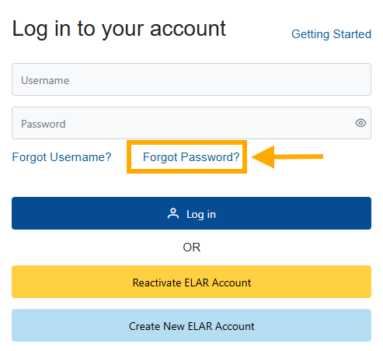
Logging In
https://gateway.edu.state.ma.us/
CMs, PSs, and SPs log in through the Security Portal
TCs log in through ELAR
When PSs or SPs log in for the first time they must
Select "Forgot Password“
Enter their email address and CAP-specific username
Follow emailed directions to reset the password
Log in using the new username and password
Notes:
All users can log in with the link shared on this screen. CMs, PSs, and SPs will be brought to the Security Portal. TCs be brought to ELAR [Click]
When PSs or SPs log in for the first time they must
Select "Forgot Password“
Enter the email address associated with the security portal and CAP-specific username
Follow the emailed directions to reset their password
Log in using the CAP-specific username and password
If a PS or SP reports issues logging in, they can try again in an incognito/private browser window to ensure saved personal ELAR account credentials are not automatically being entered.

Slide 16
If the SP Does Not Receive Username
If you assign an SP to a CAP cycle within the platform but they do not receive the email with their username, it is generally for one of the following reasons:
Some district firewalls block the autogenerated emails from reaching the SP.
The SP’s email address may have been entered incorrectly during cycle creation.
The text of the auto-generated email can also be viewed within the platform’s correspondence history.
The CM or PS can log in, open “Correspondence History” from the navigation bar, find the message, and send this info directly with the SP.
The platform will not allow the CM or PS to update the SPs email address.
If you suspect this is the issue, email EducatorPreparation@mass.gov.
Notes:
If you assign an SP to a CAP cycle but they do not receive the email with their username, it is generally for one of the following reasons [Click]
[Click] Some district firewalls block the autogenerated emails from reaching the SP. If you suspect this is the case, you can find the text from the auto-generated email within the platform. To find this information, the CM or PS can log in, click on “Correspondence History” from the left-hand navigation menu , find the message sent to the SP, and share the information with the SP from their own email account. [Click]
[Click] The other cause is that the SP’s email address may have been entered incorrectly during cycle creation. As I already mentioned, the platform will not allow the CM or PS to update the SPs email address. This must be addressed by DESE. If you think this is the issue, email EducatorPreparation@mass.gov for assistance.

Slide 17
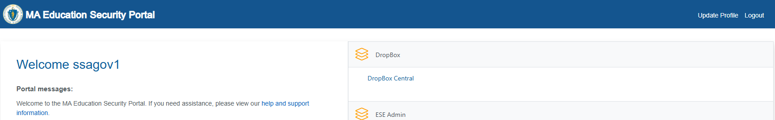
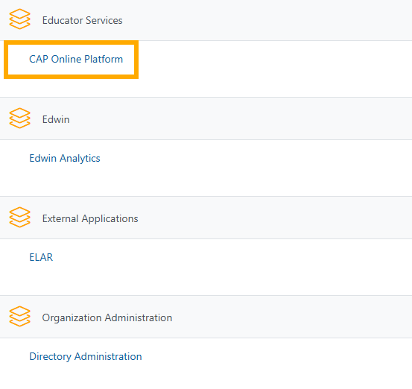
Entering the CAP Online Platform
Notes:
Once logged in, each user should see the “CAP Online Platform” in their list of available applications.
Please note, the available links will differ for each person based on their access to other applications, So, you shouldn’t expect the home page to look like the image on this slide for everyone.

Slide 18
Navigating the Platform
Notes:
There are a few overarching tips for navigating the platform.

Slide 19
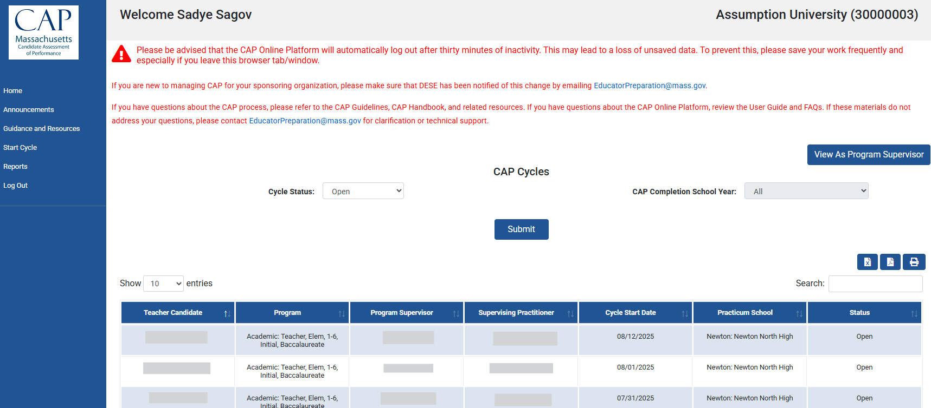
CAP Manager Home Page
Return to this page
Change view
Filter by cycle status or year
Search in table
Sort columns alphabetically
Enter a cycle for one TC
Notes:
After logging in, all users will be brought to the home page. The content of this page varies by user.
Candidates will see only their cycle, SPs and PSs will see only the cycles assigned to them.
As the CAP Manager, you have the option to view the platform as a CM (this is the default when you log in) or as a program supervisor. If desired, simply select “View as Program Supervisor” at the top right. [Click]
Regardless of account type there are a variety of functions embedded into the home page.
To filter by cycle status or CAP completion year, select your parameters from the dropdown menu(s) then click “Submit”. [Click]
To sort any column alphabetically, click on the up/down arrows at the top right of each column header. [Click]
To search for a specific candidate, SP, PS, program, etc. type or paste text into the search box [Click]
To open an individual candidate’s cycle, click on the row with their name [Click]
To exit an individual candidate’s cycle, click “Home” in the navigation bar.

Slide 20
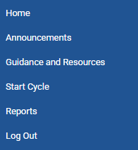
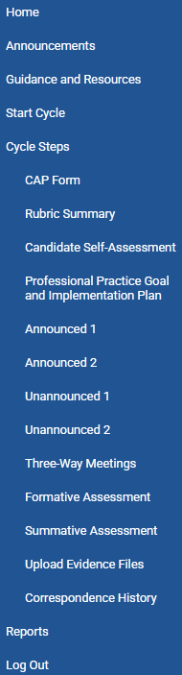
Cycle Pages
Once you open an individual candidate’s cycle, the left-hand navigation bar will expand to show all cycle steps.
Notes:
Once you enter an individual candidate’s cycle, the left-hand navigation bar will expand to show all cycle steps. [click]
This is how you and the supervisors will access all required forms, the evidence uploads page, and the correspondence history between members of the triad.

Slide 21
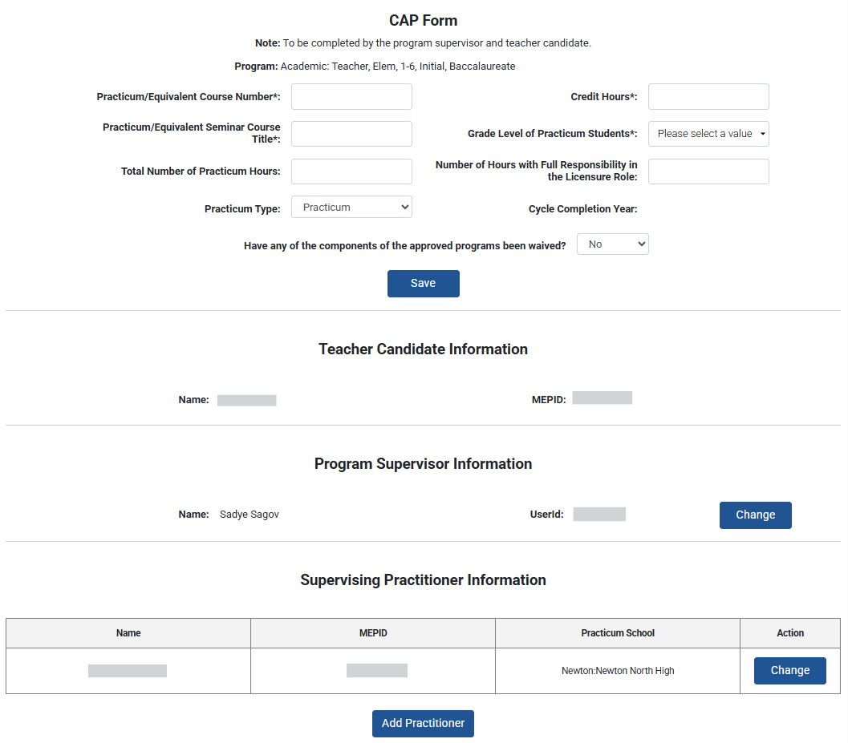
Things to Know
Throughout, required sections/fields are denoted with bold text and an asterisk*
The platform does NOT autosave like a Google document
Content will be lost if windows time out or are closed
It is important to use the “Save” buttons frequently
Supervisors may choose to paste information in from another document
Save
Notes:
Before moving into some guidance for each step within the cycle, there are two overarching things to know about how the platform functions. These are especially important for the PS and SP to know.
First, throughout the platform pages, required fields are denoted with bold text and an asterisk*, you can see an example of this for the grade level of practicum students on this page [Click]
It is also very important for supervisors to know that the platform does NOT autosave like a Google document
Content will be lost if windows are left open and time out or are closed
“Save” buttons should be used frequently when adding new information to forms
When entering a lot of text, such as when adding synthesized observation evidence or assessment feedback, we advise supervisors to draft content in another document and then paste it into the platform when finalized

Slide 22
Starting a Cycle
Notes:
With all of that as the foundation, let’s jump into a detailed walkthrough of how to use the platform for each step in the CAP cycle, beginning with how to create a new cycle.

Slide 23
Start Cycle
Notes:
To open a NEW CAP cycle, select “Start Cycle” from the left-hand navigation bar

Slide 24
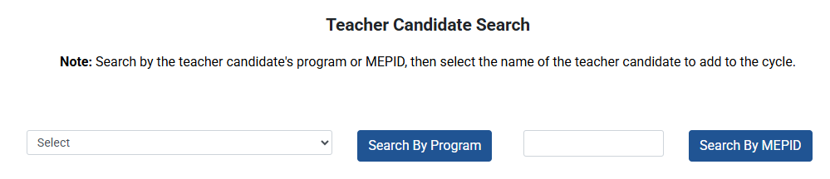
Teacher Candidate Search
Candidates must be enrolled in Early ID to show up in the CAP Online Platform.
If a candidate does not show up as expected, make sure they are enrolled.
Notes:
Next, select a candidate. You may do this in two ways:
The first option is to search by program. This will provide a list of all candidates in the program you select. You may then click on the specific candidate’s name from the results.
The second option is to enter the specific candidate’s MEPID. This will provide just one result.
[Click] Please note, candidates must be enrolled in Early ID will show up in these searches.

Slide 25
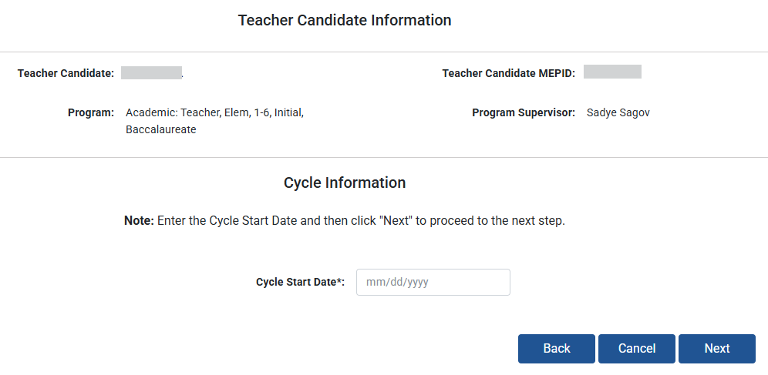
Cycle Start Date
Notes:
Once the candidate is selected, enter the current date as the Cycle Start Date and click next.

Slide 26
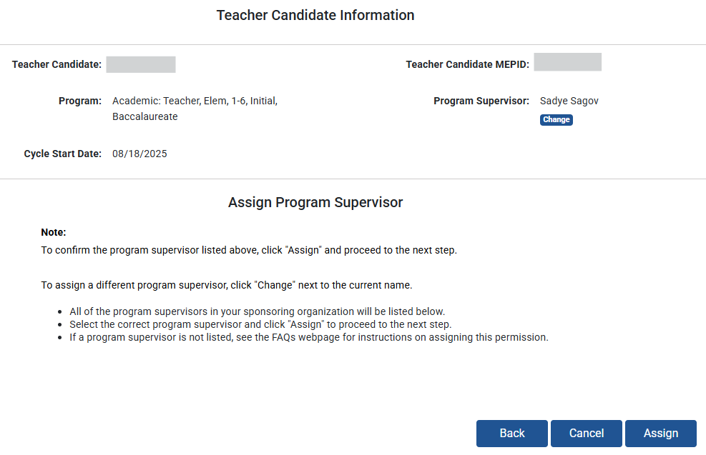
Assign a Program Supervisor
The person creating the CAP Cycle will automatically be assigned as the program supervisor.
To pick a different PS, click “Change” – you will then see a list of all available supervisors
To keep the default PS, click “Assign”
If a program supervisor does not show up in the list, they are not registered in the system.
Contact your sponsoring organization’s Directory Administrator or DESE for assistance.
Notes:
The person creating the CAP Cycle will automatically be assigned as the candidate’s program supervisor. [Click]
If you will be the program supervisor for the cycle, click “Assign” to keep this default and move on to the next step [Click]
If the candidate will have a different program supervisor, instead click “Change” [Click]
If this option is selected, the system will provide a list of all program supervisors within your sponsoring organization.
Click on the desired supervisor, then select “Assign” [Click]
If a program supervisor does not show up in the list, they are not registered them in the system. Contact your sponsoring organization’s Directory Administrator or DESE for assistance.

Slide 27
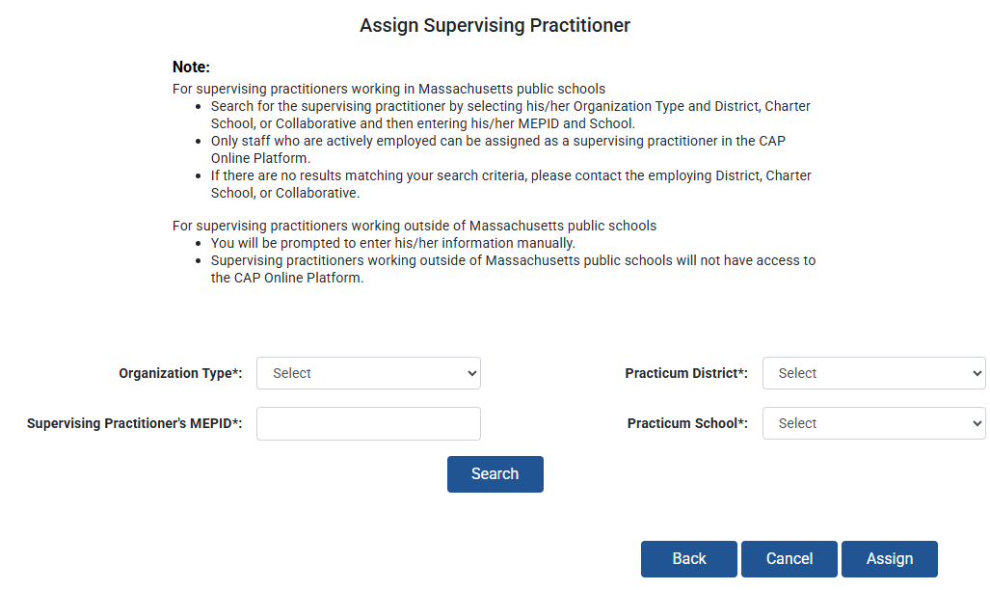
Assign a Supervising Practitioner
Supervising practitioners must be added in the CAP Online Platform.
If done in Directory Administrator, it will break the cycle. This cannot be fixed, and all cycle data will be lost.
  If an SP does not show up in the search, it is likely they were coded as “On Leave,” “Exited,” or reported by a different district in EPIMS. Check in with the district to confirm, then contact DESE for assistance if needed.
Choose the SP’s information from each dropdown menu, then click “Search”
  Double check the SP’s email to ensure it is correct!
Once the SP is selected and their email is entered, click “Assign”
Notes:
After assigning the PS, you will be asked to select the Supervising practitioner.
Supervising practitioners must be added in the CAP Online Platform.
If done in Directory Administrator, it will break the cycle. This cannot be fixed, and all cycle data will be lost.
To do so, select the SP’s Organization Type from the first dropdown menu. [Click]
If you select Charter District, Collaborative, or Public School District, you will then be able to select the SP’s district from Practicum District drop down menu and the SP’s school from the Practicum School drop down menu, Last, you will manually enter the SP’s MEPID.
Once you enter all this information, you will be able to “Search” for the SP.
[Click] After hitting “Seach” the SPs name will appear along with a box for their email address.
This email will be used to generate a new CAP-specific account, separate from their personal ELAR account.
The email will also be used to provide instructions to the SP for how to sign into the new account.
Please double or even triple check that the email address entered is correct. If it is wrong, it creates additional work for both you and DESE, and it halts the cycle until it is resolved!
[Click] Once you confirm the email is correct, click “Assign”
[Click] If you cannot find an SP, it is likely that educator has been coded as “On Leave,” “Exited,” or reported by a different district in EPIMS. If this appears to be the case, check with the district to confirm if have reported the educator in their EPIMs data. If they haven’t, follow the directions on the next slide until the SP is reported. If the district says the SP is in EPIMs, contact EducatorPreparation@mass.gov for further assistance.

Slide 28
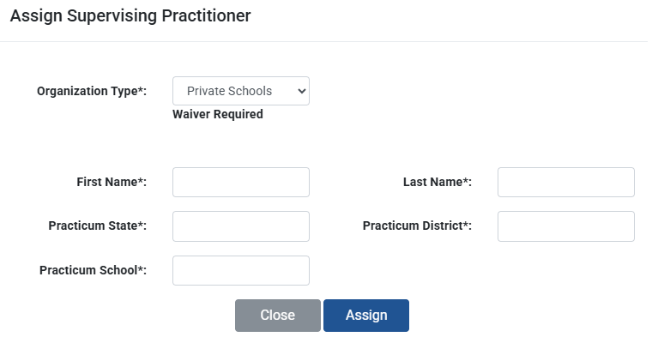
Private or Out-of-State Supervising Practitioners
Supervising practitioners from private or out-of-state schools cannot access the CAP Online Platform.
The CAP manager or program supervisor must enter information on their behalf for all forms.
Notes:
If the SP is from a Private or Out-of-State School, select the appropriate option from the Organization Type dropdown. This also includes special education schools.
In either case, you will need to manually enter the SP’s first name and last name as well as the practicum state, district, and school.
[Click] Private school and out-of-state SPs will NOT be able to fill out the forms on their own due to access and security concerns.
In these cases, the CM or PS will need to enter information within each relevant forms on their behalf.

Slide 29
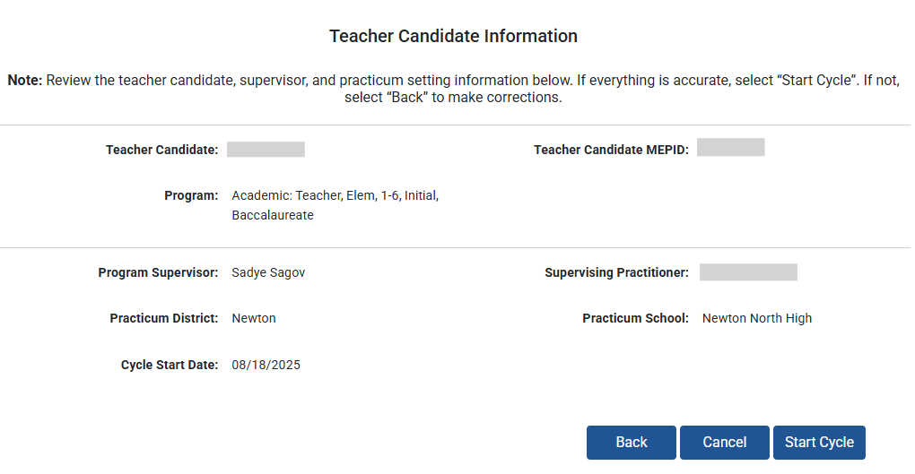
Verify Cycle Information
If all information is accurate, select “Start Cycle”
If any information is inaccurate, select “Back” to correct it
Notes:
Review the teacher candidate, supervisor, and practicum setting information below.
If everything is accurate, select “Start Cycle”. [Click]
If not, select “Back” to make corrections. [Click]

Slide 30
CAP Form
Notes:
Once you click “Start Cycle” you will automatically move on to the CAP Form.
The majority of the information on the CAP Form will be entered by the PS. However, there are several sections you should be aware of as the CAP manager.

Slide 31
Changing the Program Supervisor
Notes:
If needed at any point in the CAP cycle, you may change the candidate’s program supervisor from the CAP Form. [Click]
If relevant, scroll to the Program Supervisor Information section and click “Change”.

Slide 32
Change or Add a Supervising Practitioner
If the TC has a split practicum, select “Add Practitioner.”
This will keep the original SP
and add a second SP.
If the TC’s SP changes during a cycle, select “Change”.
This will replace the existing SP with a new SP.
Adding an SP will not add forms. Split existing forms between SPs or upload forms as tagged evidence.
Notes:
You may also change or add supervising practitioners on the CAP Form,
[Click] If the TC’s SP changes during the cycle, assign the new SP using the “Change” button. This will replace the existing SP with the new SP.
[Click] If a TC has a split practicum, select “Add Practitioner” button to add a second SP. This will keep the original SP and add another.
[Click] It is important to note that adding an SP will not provide you with extra observation or assessment forms. You will need to split the existing forms between SPs or upload additional forms as tagged evidence.

Slide 33
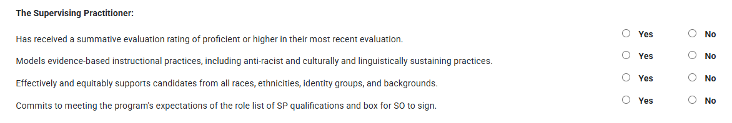
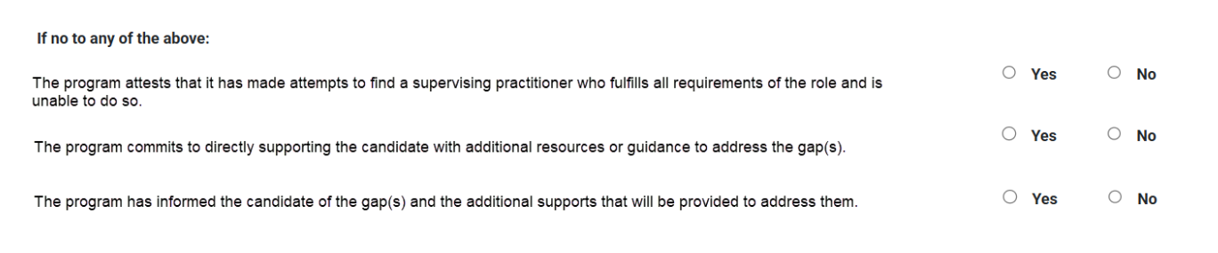
Supervising Practitioner Qualifications
Verify whether the SP meets each of DESE’s expectations for the role.
If “no” is selected for one or more expectation, a set of attestations will appear.
If no to any of the above:
The program attests it made attempts to find a supervising practitioner who fulfills all requirements of the role and was unable to do so.
The program commits to directly supporting the candidate with additional resources or guidance to address the gap(s)
The program has informed the candidate of the gap(s) and additional supports that will be provided to address them.
If a TC has two SPs, complete this section for BOTH. If either does not meet an expectation, select “No” and provide any necessary details in the open response box.
Notes:
As outlined in the 2024 CAP Guidelines, either the CAP Manager or PS must now verify whether the supervising practitioner meets each of DESE’s expectations for the role. This is a new requirement in the platform.
To take this step, scroll to the bottom of the CAP Form.
This section of the CAP Form will only be visible for the CM and PS.
Neither the questions nor selections will be visible for the SP or candidate.
You will use radio buttons to select “yes” or “no” for each expectation.
For example, in the first question you will verify whether the SP has received a summative rating of proficient or higher in their most recent evaluation.
You will notice that we do not ask about the other regulatory requirements of an aligned license and at least 3 years of experience. We can verify these aspects ourselves through ELAR so do not need SO attestation.
[Click] If you select “no” for one or more of the expectations, an additional set of required questions will appear.
These questions will ask you to attest that the organization:
Made attempts to find an SP who fulfilled all expectations and was unable to do so
Commits to directly supporting the candidate with additional resources or supports to address the gap
And has notified the candidate of the gap and the supports that will be provided
You will also see a required open response box where you will be asked to list the specific supports that will be provided for the candidate to fill these gaps.
[Click] If a TC has two SPs, complete this section for BOTH. If either does not meet an expectation, select “No” and provide any necessary details in the open response box.

Slide 34
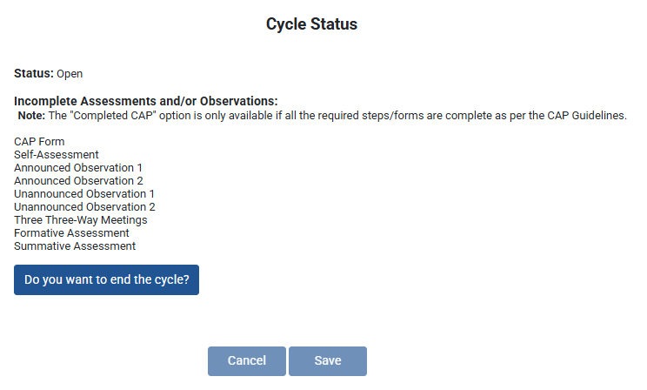
Check Cycle Status
Forms show up as incomplete for two reasons:
1) The form has not been started
2) One or more required fields are blank
Notes:
The CM and PS can also check the status of each candidate’s CAP cycle at the bottom of the CAP Form.
[Click] You can see whether the cycle is open or closed
[Click] as well as whether any forms are still incomplete
If a form shows up as incomplete, this may be because it has not yet been started
It could also be because the triad thinks a form is finished, but some required fields are still blank

Slide 35
End Cycle
“Exited the program” and “Cycle created in error” may be selected at any time.
“Completed CAP” will only appear once all required forms are complete.
If you expect to see the “Complete” button but it is not available, review all cycle components to confirm what aspect is missing.
Once a cycle is closed, you must contact DESE if it needs to be reopened.
Notes:
The CAP Form is also where you can end cycles
[Click] To do so, click on “Do you want to end the cycle?” at the very bottom of the page.
[Click] Then choose the reason for ending the cycle from the dropdown menu.
[Click] You will be able to select “Exited the program” and “Cycle created in error” at any point in the cycle
[Click] The option to select “Completed CAP” will only appear once all forms are complete
[Click] If you expect to see the “Complete” option but it is not yet available, review all required components to see what might be entirely missing or incomplete. One common issue is that dates are missing from the three-way meetings page.
[Click] Please note that once you have ended a cycle, you will not be able to reopen it yourself. If needed, email DESE to have the cycle reopened.

Slide 36
Rubric Summary and Self-Assessment
Notes:
The Rubric Summary Form and Self-Assessment must both be completed by the TC.
The CM, PS, and SP can view the content, but cannot edit it. ​

Slide 37
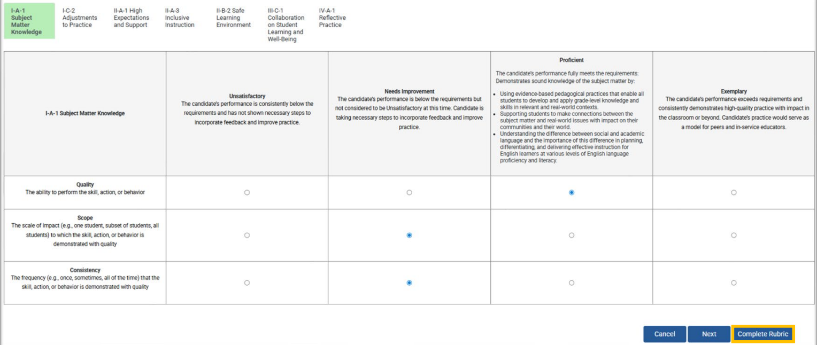
Rubric Summary
The TC fills out the Rubric Summary.
Click through these tabs to rate each element
The TC must click “Complete” on the last page of the Rubric Summary to access the Self-Assessment.
If the Self-Assessment cannot be edited, advise the TC to return to the rubric to take this step.
Notes:
On the Rubric Summary, the TC will click through the seven Essential Elements, read the proficiency descriptors, and select a quality, scope, and consistency rating for each one. [Click]
[Click] The TC must click “Complete” at the end of the Rubric Summary to access the Self-Assessment.
If the Self-Assessment cannot be edited, advise the TC to return to the final page of the rubric to take this step
This is a small technical step but is often the reason that cycles cannot progress or be closed.
We have added red banner text about this to the TC view of the platform. CMs and field supervisors should also alert candidates of the importance of this step.

Slide 38
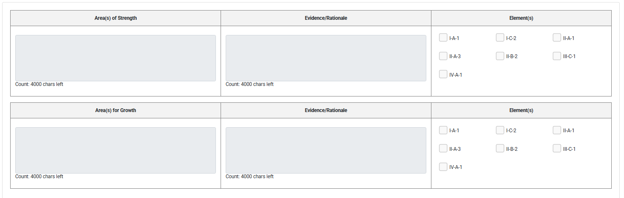
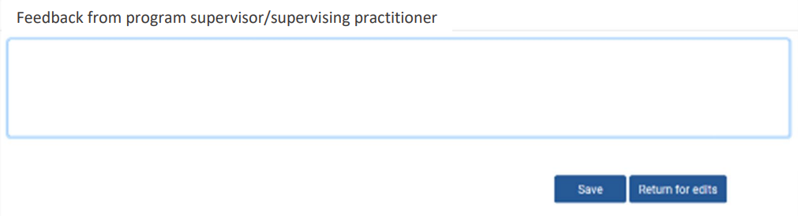
Self-Assessment
The TC fills out the Self-Assessment.
The PS and SP then provide feedback in the final section.
If the form is returned for edits, the TC will need check the “Complete” box at the end of the Rubric Summary again before being able to revise text on the Self-Assessment. ​
Notes:
The TC is also responsible for completing the Self-Assessment. On this page they will review a summary of their rubric ratings, reflect on their current strengths and areas for growth, and draft a preliminary professional practice goal.
[Click] When the TC is finished, the PS and PS can add feedback at the bottom of the form.
They may either save positive feedback [Click] or return the form for edits from the TC [Click]
[Click] If the form is returned for edits, the TC will need check the “Complete” box at the end of the Rubric Summary again before being able to revise text on the Self-Assessment. ​

Slide 39
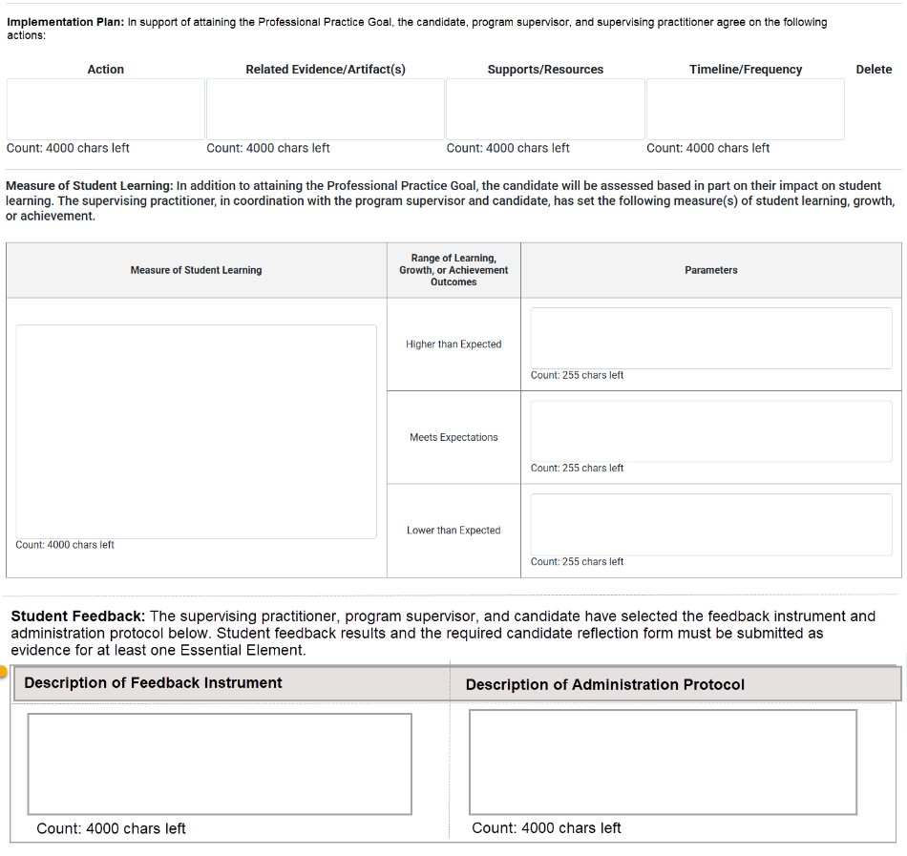
Professional Practice Goal and Implementation Plan
The triad completes this form together.
Finalized professional practice goal (TC)
Implementation plan (PS and SP)
Measure of student learning plan (SP)
Student feedback plan (SP)
This form is the plan for implementation. Artifacts related to progress on the goal as well as results and reflections on the measure of student learning and student feedback should be uploaded as tagged evidence later in the cycle.
The PS must mark the form as “Complete” once all triad members have finished their sections. This button will appear at the bottom of the form.
Notes:
After the PS and the SP approve the Self-Assessment Form, the full triad will collaborate to complete the Professional Practice Goal and Implementation Plan page. This form is unique, as it is the only one where all three users enter information.
[Click] First, the TC will finalize the Professional Practice Goal. The preliminary goal that was drafted in the Self-Assessment will automatically populate into this box. The TC will revise the text based on any input provided by the PS and SP.
[Click] The PS and the SP will then complete the Implementation Plan based on the goal.
[Click] Finally, the SP will complete the Measure of Student Learning and Student Feedback sections with input from the PS and TC.
This step has always been required, but it did not used to be embedded into the platform. It was added during the updates.
Click] This form is the plan for how this evidence will be collected and analyzed. Artifacts related to progress on the goal as well as results and reflections on the measure of student learning and student feedback should be uploaded as tagged evidence later in the cycle.
[Click] Once all members of the triad have finished their sections, the PS must select the “Complete” button that will appear at the bottom of the form. After clicking “Complete”, the form cannot be edited.

Slide 40
Three-Way Meetings
Notes:
Next we will move on to the three-way meetings page.

Slide 41
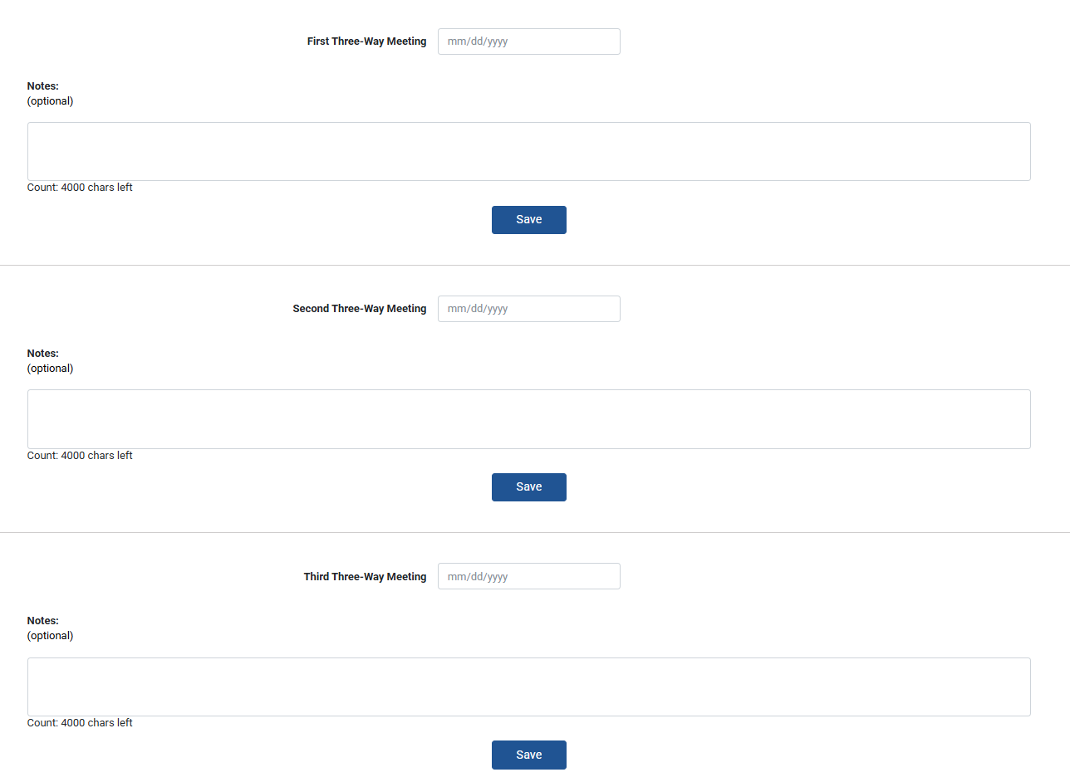
Three-Way Meeting Dates
Three-way meeting dates are required, and notes are optional.
Notes:
The TC, PS, and SP can all edit the Three-Way Meetings page.
To complete the CAP cycle, a date must be entered for each of the three meetings. [Click]
The dates are required, but the notes sections are optional. [Click]

Slide 42
Observation Forms
Notes:
The PS and SP share responsibility for conducting observations and completing the related forms.

Slide 43
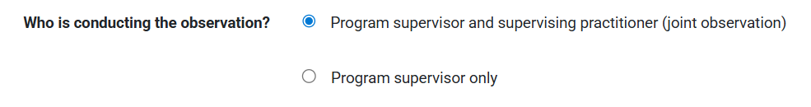
Individual vs. Joint Observations
Unannounced Observations
SP required
PS optional
Announced Observations
SP required
PS required
Observers are identified at the top of each observation form
“Supervising practitioner only” option is available in the SP view of the platform
All forms include a “PS Only” option for cases where a PS must enter information for an SP from a private school or out-of-state. In these cases, the SP must still be present for all observations.
Notes:
For Unannounced Observations, the SP must observe the candidate. The PS’ presence is optional.
For Announced Observations, both the SP and PS must observe the candidate, and feedback must be calibrated.
Click] At the top of each form, there is a question about observers.
If both the SP and PS conducted the observation, this is considered a joint observation
If only one supervisor conducted the observation this is considered an individual observation
The PS will have the option of “PS only” and the SP will see “SP only”
[Click] While SP is required to participate in all observations, all forms include a “PS Only” option. This option is present for cases where an out-of-state or private school SP does not have access to the online platform. In these cases, the SP still conducts the observation, but the PS must enter information in the forms.

Slide 44
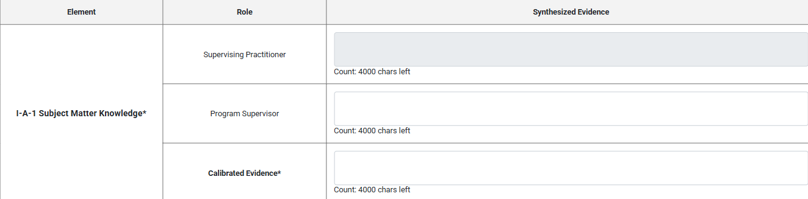
Individual vs. Joint Observations cont.
The Observation Form layout changes based on who is completing the form.
Individual observation layout
One box per question
Joint observation layout
Three boxes per question – SP, PS, and Calibrated
Only calibrated boxes are required and pre-populate into assessments
Notes:
The layout of each observation form changes based on who is conducting the observation
[Click] If completing the observation individually, supervisors will see one open-response box labeled with their own role for each question.
[Click] If completing the observation jointly, supervisors will see three separate boxes for each question: one for SP, one for PS, and one titled “calibrated”.
Only the calibrated boxes are required
Only the calibrated text will automatically pre-populate into the formative and summative assessments

Slide 45
Individual vs. Joint Observations cont.
Avoid toggling between the individual and joint version of the form
Switching back and forth between “PS/SP Only” and “Joint” modes is very likely to lead to data loss
To prevent this, supervisors should decide who will complete each observation in advance
For joint observations, only one supervisor should enter text in the “calibrated” boxes
These boxes reflect content from the last person who clicked “Save”
To avoid accidentally overwriting work, only one supervisor should enter text into the “calibrated” boxes
Supervisors should decide who will take this role ahead of time
Notes:
The observation forms can sometimes be a bit finicky. The tips of this slide can prevent the most common problems that can occur.
[Click] Avoid toggling between individual and joint forms
Switching back and forth between “PS/SP Only” and “Joint” modes is very likely to lead to data loss
To prevent this, supervisors should decide who will complete each observation in advance
[Click] For joint observations, only one supervisor should enter “calibrated” text
The “calibrated” boxes reflect content from the last person who clicked “Save”
To avoid accidentally overwriting work, only one supervisor should enter text into the “calibrated” boxes
Supervisors should decide who will take this role ahead of time

Slide 46
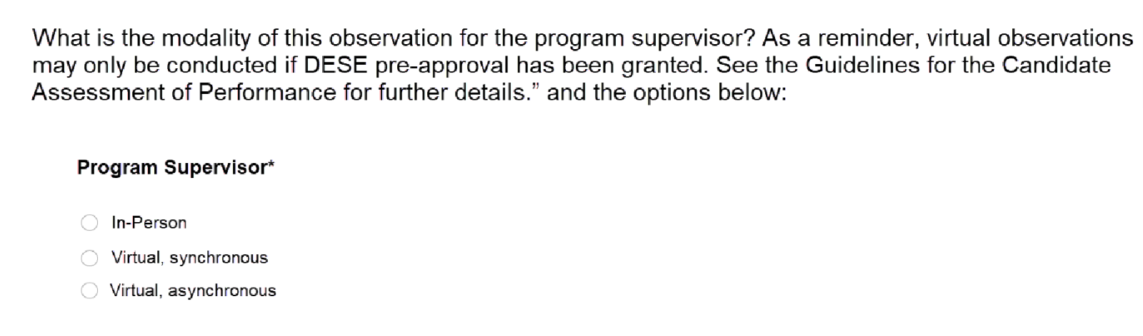
Program Supervisor Modality
On Announced Observation forms, the PS will indicate their modality
The PS may conduct the Announced observations virtually if DESE pre-approval has been granted
See the CAP Guidelines for further details on the approval process.
Notes:
There is a new question at the top of each Announced Observation form.
The program supervisor will be asked whether their modality is in-person, virtual synchronously, or virtual asynchronously.
This question will only appear on Announced Observation forms as both the supervising practitioner and program supervisor are both required to be in-person for Unannounced Observations.
As is detailed in the guidelines, the program supervisor may only conduct the Announced Observations virtually if DESE pre-approval has been granted.

Slide 47
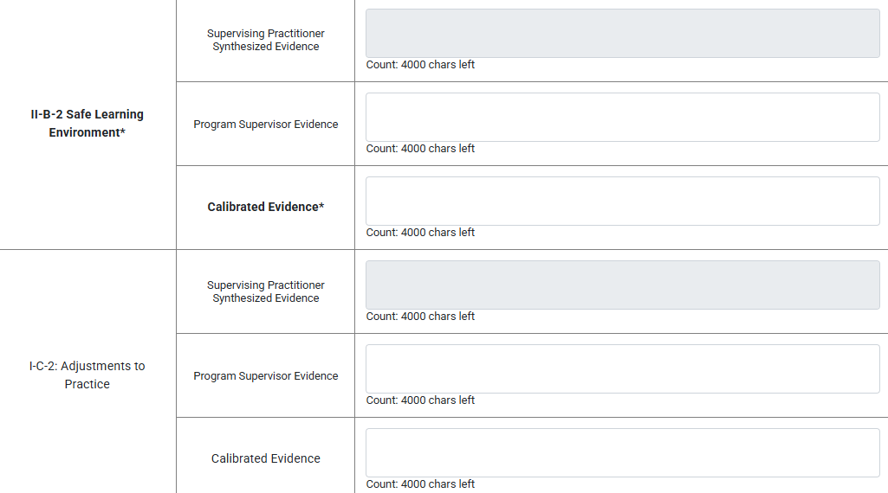
Required vs Optional Elements
Supervisors must include observation evidence to complete.
Same three across all observations
Listed at the top of each form
Bolded and with asterisk* in tables
Required Elements:
I-A-1 Subject Matter Knowledge
II-A-1 High Expectations and Support
II-B-2 Safe Learning Environment
Optional Elements:
I-C-2 Adjustments to Practice
II-A-3 Inclusive Instruction
III-C-1 Collab. on Student Learning
IV-A-1 Reflective Practice
Supervisors may include observation evidence, if collected.
Notes:
The required and optional elements have been updated in alignment with the revised guidelines.
In the past, there were different focus elements for each observation
Now, the focus elements are consistent across all four observations
[Click] Supervisors must include observation evidence for each of the three required elements.
These are listed at the top of each form and bolded with an asterisk* in the synthesized evidence tables
[Click] Supervisors may include observation evidence for the optional elements, if observed.
However, other categories of evidence such as student feedback or candidate artifacts may be used to demonstrate proficiency instead.

Slide 48
Active vs. Synthesized Evidence
Active Evidence Collection
Not included in the platform as there is no autosave and notes could be lost during the observation
Supervisors should take these low-inference notes in another document
Synthesized Evidence
Included in the platform
Supervisors paste or type key evidence for each element into these boxes
Notes:
While the paper observation forms include an optional space for active evidence collection, this box is not included in the CAP Online Platform.
We made this decision because the platform does not allow autosaving and we worried that raw notes could be lost during observations
Supervisors should take these low-inference notes in a separate document
[Click] Synthesized evidence is included in the platform. Supervisors should type or paste key evidence for each element into these boxes.
As a reminder, any section that is bold and includes as asterisk is required.
For the example on this slide, Safe Learning is a required element so it must be included in the observation. Adjustments to practice is optional.
Because this example is from a joint form, only the calibrated evidence is required. Notes from each supervisor are optional.

Slide 49
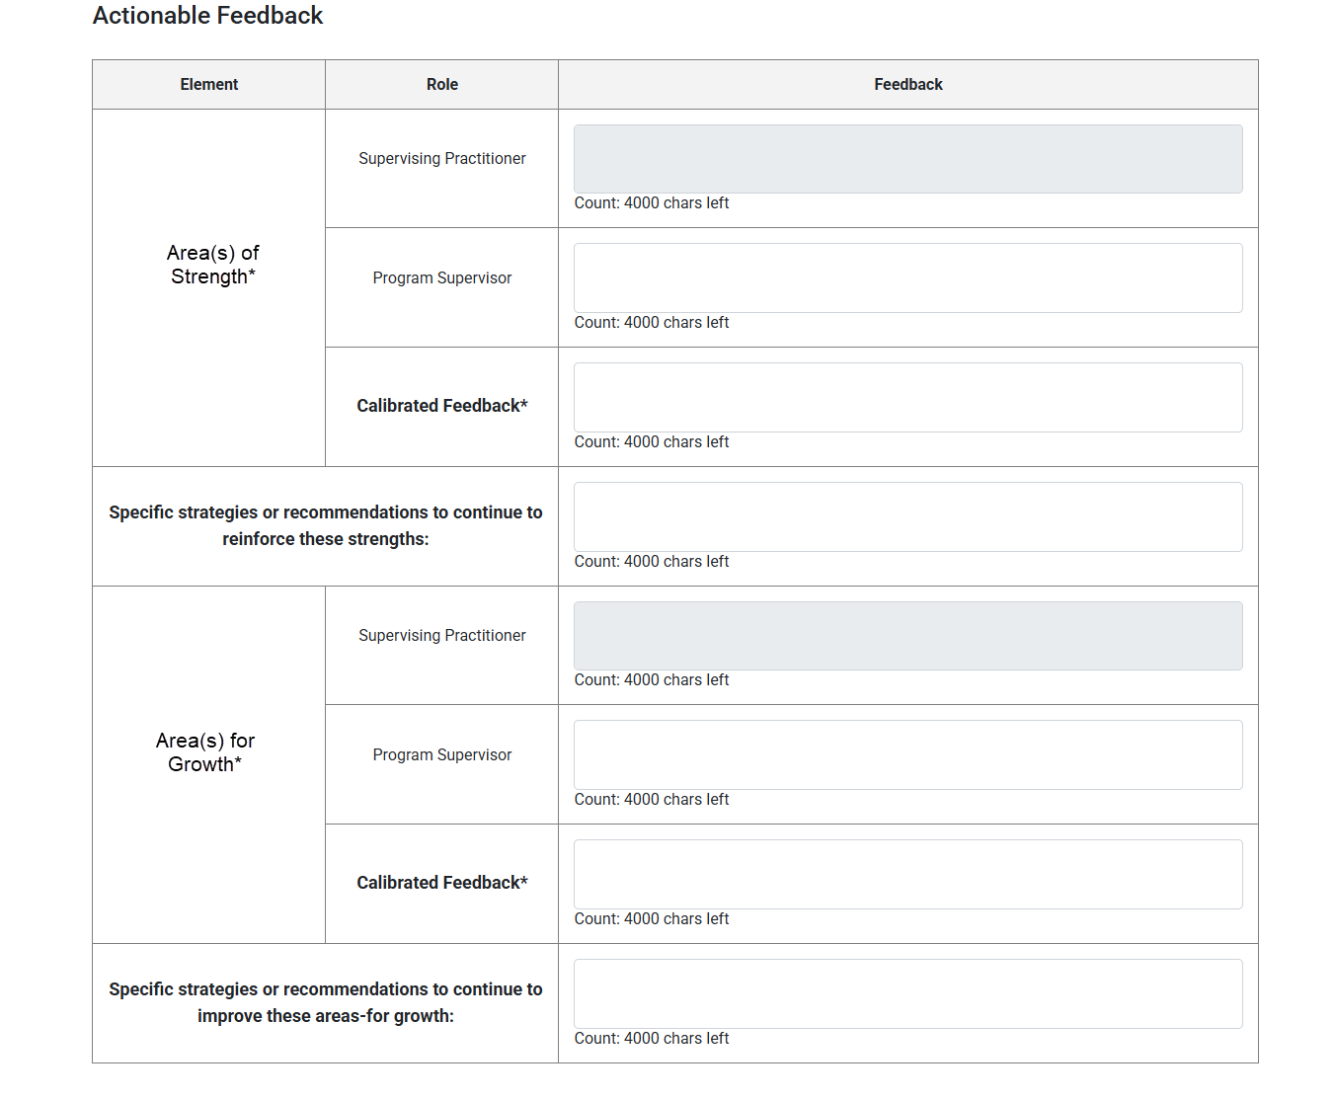
Actionable Feedback
Feedback provided at the end of each observation form includes:
Judgements about what is going well and what can be improved
Strategies, recommendations, or resources to reinforce or improve practice in these areas
The information in this section of the form may be tied to individual elements or multiple elements.
Regardless, all feedback should be clear, constructive, and actionable.
Notes:
[Click] The feedback section has always included space to document the candidate’s current area(s) of strengths and area(s) for growth. These should be targeted judgements about what is going well and what can be improved.
[Click] The form now also includes a space to add specific strategies, recommendations, or resources to reinforce or improve practice in these areas. This new section is also required.
[Click] The information in this section of the form may be tied to individual elements or span multiple elements. Regardless of scope, it should be timely, constructive, targeted, and actionable. You can see our High-Quality Feedback Quick Reference Guide for more information on DESE’s expectations for feedback.

Slide 50

Early Literacy Form
The Early Literacy Form is automatically embedded at the top of Announced Observation 2 for all Early Childhood, Elementary, and Moderate Disabilities PK-2/PK-8 candidates
Notes:
For candidates enrolled in Early Childhood, Elementary, and Moderate Disabilities PK-2 or PK-8 programs, the Early Literacy Look-Fors will be automatically embedded at the top of Announced Observation 2.
The form is embedded within Announced Observation 2 as it is recommended that the Early Literacy Observation occur near the end of the practicum while candidates are assuming full responsibility for instruction during a literacy block.
While DESE recommends that the Early Literacy Observation Form be completed as part of Announced Observation 2, there may be circumstances where a triad prefers to complete the observation during Announced Observation 1.
If this is the case, the triad should complete the Announced Observation 2 Form with the Early Literacy Observation Form first
The triad should then complete the Announced Observation Form 1 without the Early Literacy Form during the second observation
The CAP Online Platform does not prevent these forms being completed out of order

Slide 51
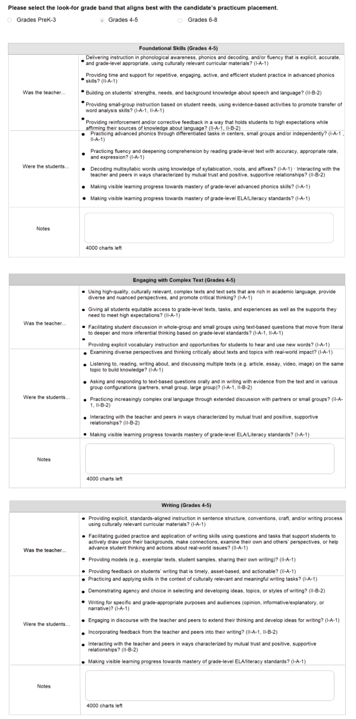
Early Literacy Look-Fors
During Announced Observation 2, supervisors for candidates in early literacy programs will:
Select the Look-For grade band that aligns with the candidate’s practicum placement grade
Record evidence of the Look Fors at the top of the form.​​
Incorporate these notes into the synthesized evidence for the three required focus elements and actionable feedback
The Look-Fors do not show up in the Formative and Summative Assessment Forms. Given this, it is crucial that early literacy is included in synthesized evidence.
Notes:
When completing the Announced Observation 2 form, supervisors for candidates in early literacy programs will take the following steps. [Click]
At the top of the form, the supervisor will be prompted to select the Look-For grade band that aligns with the candidate’s practicum placement grade.
For example, for an Elementary candidate placed in a 1st grade classroom the PK-3 band would be selected.
For an Elementary 1-6 candidate placed in a 4th grade classroom the 4-5 band would be selected. [Click]
The supervisor will then add evidence of the Early Literacy Look Fors in the notes section.​ [Click]
Finally, the supervisor will incorporate what they noticed into the synthesized evidence for the three required focus elements and actionable feedback, as relevant. [Click]
[Click] It is crucial that supervisors understand that the Look-Fors notes are a required field on the form but will not show up in the Formative and Summative Assessment Forms.
Given this, is very important that early-literacy specific feedback is woven into the Synthesized Evidence and Actionable Feedback sections.

Slide 52

Sharing Observations with the TC
The TC will only be able to view observation forms once supervisors select “Complete”
This button appears at the bottom of the form once all required components are filled in
If conducting a joint observation, both the SP and PS must select “Complete
Complete
The CM and PS can unlock completed forms if an error is made by clicking “Edit”
The “Edit” button will only appear once both supervisors have marked the form “Complete”
Notes:
The TC will only be able to view observation forms once supervisors select “Complete”
This button appears at the bottom of the form once all required components are filled in
If conducting a joint observation, both the SP and PS must select “Complete
The CM and PS can unlock completed forms if an error is made by clicking “Edit”
The “Edit” button will only appear once both supervisors have marked the form “Complete”

Slide 53
Evidence Uploads
Notes:
Observations are just one of the five categories of evidence. Files related to the other categories can be uploaded to the platform via the “Upload Evidence Files” page.

Slide 54





Adding Other Forms of Evidence
The CM, PS, SP, and TC can all upload evidence.
This can include, but is not limited to:
Candidate artifacts - lesson adaptations, student work, family collaboration or feedback, reflection logs
Measures of student learning - raw or summarized exit tickets, assignments, tests, and candidate reflections (may upload optional Measure of Student Learning Form)
Student feedback - raw or summarized student surveys or discussion notes
(should include the required Candidate Reflection on Student Feedback Form)
Additional observation forms - from split practicum SPs, fifth observations
Professional practice goal – materials will vary based on goal and benchmarks
Notes:
The CM, PS, SP, and TC can all upload files.
[Click] This includes, but is not limited to the following examples of each category of evidence
[Click through and read each line]

Slide 55

File Sizes and Formats
The maximum amount of data space for each cycle is 100 MB. Once reached, additional files cannot be added.
Formats allowed: .doc(x), .xls(x), .ppt(x) .pdf, .jpg, .png, .bmp, .gif, .mp3, .wav.
Notes:
There are some limitations on the amount of data space and formats of files.
The maximum amount of data space for each cycle is 100 MB. Once reached, additional files cannot be added.
Formats allowed include word documents, excel files, power points, PDFs, images, music, and videos

Slide 56
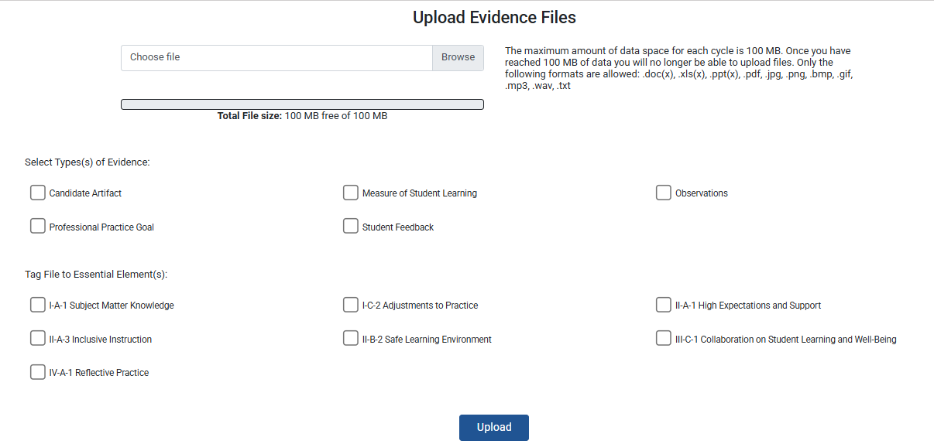
Tagging Evidence
Notes:
To appear in the Formative Assessment and Summative Assessment, each file must be tagged to:
[Click] One or more categories of evidence and
[Click] One or more Essential Elements
Once evidence has been uploaded, it will be viewable under the “Current Uploaded Evidence Files” at the bottom of page. Only tagged elements will appear in the Formative and Summative Assessments. More on that next!

Slide 57
Formative Assessment
Notes:
The first half of the CAP Cycle leads to the Formative Assessment. The expectations for this assessment are described in detail within the CAP Guidelines and Implementation Handbook. The next slides focus on how to enter this information within the platform.

Slide 58
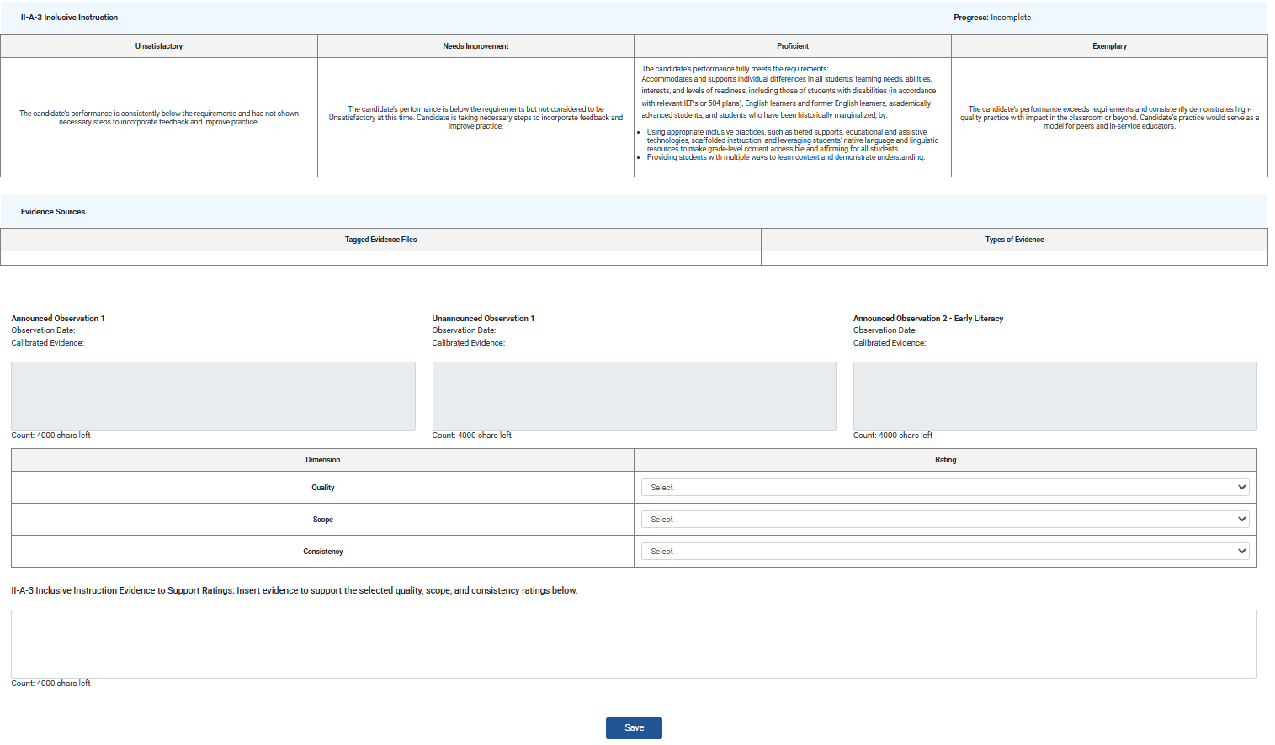
Layout for Each Element
Element-specific proficiency descriptors
For reference
Available evidence Automatically populated from observation forms and tagged evidence
Ratings and rationale Entered by PS/SP after calibration
Save button
Click after each element to save progress
Notes:
During the Formative Assessment, the PS and SP review all evidence collected up to this point in the practicum and come to calibrated ratings for quality, scope, and consistency for each Essential Element.
The screenshot on the slide is small so that it captures all required components for a single element. The same layout is repeated for each of the seven elements.
[Click] Each begins with the proficiency descriptors for unsatisfactory, needs improvement, proficient and exemplary. The language is specific to each element and should be consulted carefully.
[Click] The evidence sources section will automatically populate with :
Text entered in the synthesized evidence boxes from each observation conducted prior to the assessment
Links to uploaded evidence files tagged to the element
[Click] After reviewing the evidence, the PS and SP will choose ratings for quality, scope, and consistency from the dropdown menus
[Click] Finally, supervisors should click “Save” before moving on to the next element

Slide 59
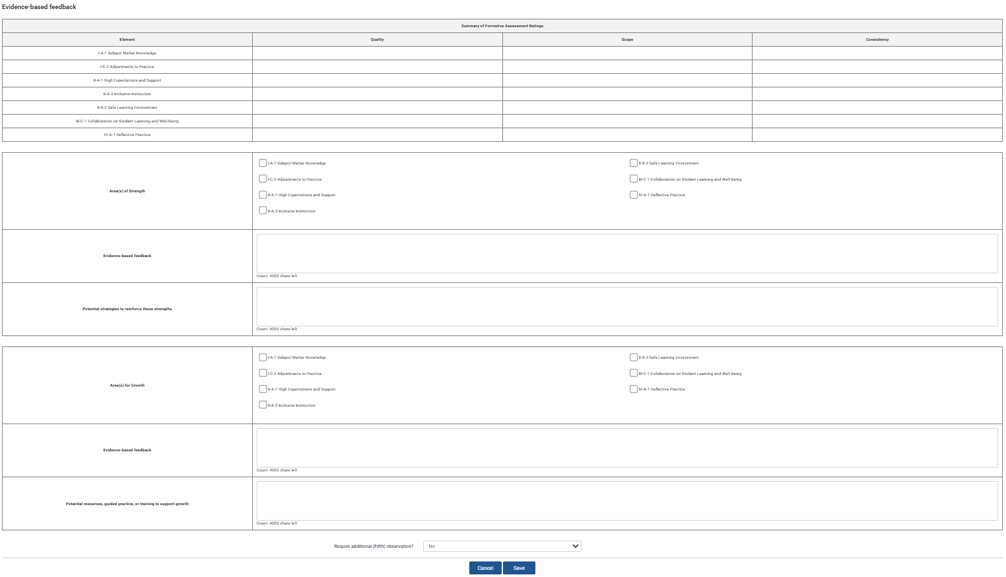
Layout for Overarching Feedback
Summary of Formative Assessment ratings
Automatically populated from selections above
Area(s) of strength
Entered by PS/SP after calibration
Area(s) for growth
Entered by PS/SP after calibration
Complete button
Will only appear once all required components entered
Notes:
Once ratings are completed for all seven elements, the PS and SP will move on to the overarching feedback.
[Click] This section begins with a pre-populated table summarizing all ratings selected above.
[Click] Supervisors will consider the candidate’s practice and share one or more areas of strength
[Click] and one or more areas for growth.
Each should include both evidence-based feedback and specific recommendations to support improvement.
[Click] Supervisors must click “Save” on this final section for the “Complete” button to appear

Slide 60
Closing the Formative Assessment
The TC will only be able to view assessment forms once supervisors select “Complete”
This button appears at the bottom of the form once all required components are filled in
If conducting a joint observation, both the SP and PS must select “Complete
Complete
The CM and PS can unlock completed assessment forms if an error is made by clicking “Edit”
The “Edit” button will only appear once both supervisors have marked the form “Complete”
Notes:
Like the observation forms, assessment forms will only be shared with the TC once both supervisors click “Complete”
The CM and PS can able to unlock completed assessments if an error is made

Slide 61
Summative Assessment
Notes:
The CAP cycle culminates with the Summative Assessment.

Slide 62
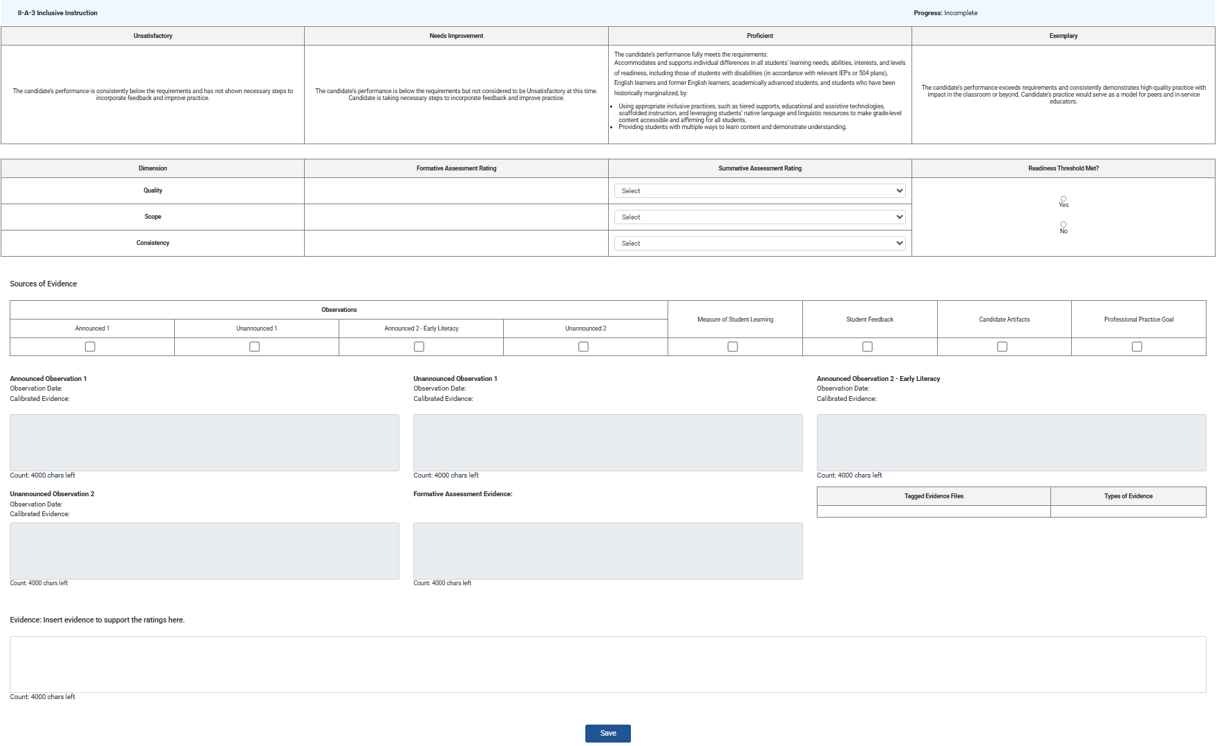
Layout for Each Element
Element-specific proficiency descriptors
For reference
Summative ratings and readiness threshold
Entered by PS/SP after calibration
Categories of evidence used to support selected ratings
Available evidence Automatically populated from observation forms and tagged evidence
Rationale
Entered by PS/SP
Save button
Click to save progress
Notes:
[Click] Like the Formative Assessment, each Summative Assessment element starts its proficiency descriptors
[Click] It also includes all available evidence, including sources included in the Formative Assessment and sources added since
[Click] The ratings section is expanded to include:
a summary of where quality, scope, and consistency landed during the Formative Assessment
followed by space to select updated ratings for the Summative Assessment
And yes/no radio bubbles to indicate whether readiness thresholds are met (at this stage, quality must be proficient, while scope and consistency may be needs improvement)
[Click] Supervisors will then check off the categories of evidence used to support the ratings. It is important that these boxes align with what is available in the pre-populated observations and tagged evidence files. If something is missing, it was likely not tagged to the correct element or evidence category when uploaded. If needed, the file can be re-uploaded and tagged.
[Click] Finally, supervisors will enter calibrated rationale for ratings based on the full body of evidence and click “Save”.

Slide 63

Evidence Categories
Supervisors must ensure these evidence expectations are met across elements:
Each category of evidence must be used to support the rating for at least one Essential Element
The rating for each Essential Element must be supported by two categories of evidence.
For Elements I-A-1, II-A-1, and II-B-2, observations must be used as one category of evidence
The platform does NOT automatically check for this, and cycles may be completed without all evidence requirements met. Sponsoring organizations must have systems in place to ensure these expectations are met for every candidate.
Notes:
As is outlined in detail with the updated Guidelines, supervisors are now required to ensure that the following evidence expectations are met across elements:
Each category of evidence must be used to support the rating for at least one Essential Element
The rating for each Essential Element must be supported by two categories of evidence.
For Elements I-A-1, II-A-1, and II-B-2, observations must be used as one category of evidence
[Click] It is important to note that the platform does NOT automatically check for this.
In other words, there is no mechanism to indicate that a cycle cannot be closed if these expectations are not met.
Given this, sponsoring organizations must have their own systems in place to ensure these expectations are met for every candidate.
As in the past, appropriate use of evidence is something that we will check for in the random sample of performance assessment files during Formal Reviews.

Slide 64
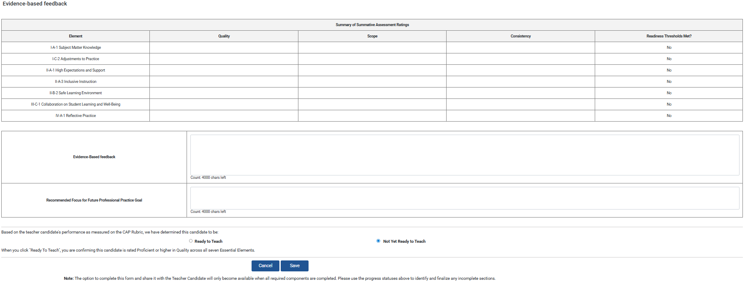
Layout for Overarching Feedback
Summary of ratings and thresholds met
Automatically populated from selections above
Evidence-based feedback and recommended goal
Entered by PS/SP after calibration
Ready to teach determination
Entered by PS/SP
after calibration
Make sure the SP selects “Complete” before they leave for the summer! There is currently no way to over-ride this necessary step to end the cycle.
Complete button
Will only appear once all required components entered
Notes:
[Click] At the bottom of the form, supervisors will see a pre-populated summary of ratings for each element.
[Click] They will then enter evidence-based feedback and a recommended future professional practice goal.
[Click] The final step is to determine whether the candidate is or is not “Ready to Teach”
To select “Ready to Teach,” all readiness thresholds must be met to select
[Click] As with all other forms, the complete button will only appear once all required components of the form are finished. Both supervisors must select this button to share it with the TC.
[Click] If this is taking place close to the end of the PK-12 school year, ensure the SP selects “Complete” before they leave for the summer! There is currently no way to over-ride this necessary step to end the cycle.

Slide 65
Reports
Notes:
The final page you may access is called reports.

Slide 66
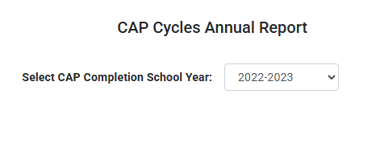
Reports – Annual Reports
Sponsoring organizations will have the option to download reports for all cycles completed:
In a one-year-period
Before August 31st, 2025 (pre 2024 CAP Guidelines implementation)
After September 1st, 2025 (post 2024 CAP Guidelines implementation for all programs and candidates)
All cycles prior to 2024 CAP Guidelines
All cycles using 2024 CAP Guidelines
2022-2023
2023-2024
2024-2025
Notes:
If you are using the CAP Online Platform, you do not need to submit CAP data reports at the end of the academic year. This is only required for SOs that use an alternative system to manage their CAP cycles.
However, you do have the option to download reports for closed cycles. You can download information for:
all cycles completed within any single year
all cycles completed prior to the 2024 CAP Guidelines
or all cycles completed using the 2024 CAP Guidelines once required for all programs and candidates
This will include any cycles created after Sept 1, 2025, but will not include candidates who piloted the revised CAP in 2024-25

Slide 67
Troubleshooting
Notes:
The next few slides include a consolidated list of ways to troubleshoot frequent problems that arise. All content was covered in previous slides so I will not delve into it now.

Slide 68
Common Challenges - Starting Cycle
Problems | Solutions
I can’t find the TC, SP, or PS I need | TC: Confirm the candidate is enrolled in Early ID. PS: Confirm individual is assigned PS role​ in DA SP: Confirm the MEPID is correct​
I still can’t find the SP with the correct MEPID | The platform pulls SP data from a point in time data capture via EPIMs reporting. Anyone who has been reported in the system as on leave, exited, or recently moved to another school may not appear immediately. In the meantime, start cycle with the SPs as “Out of State” ​
A candidate has a split practicum with two SPs | Do NOT create two CAP cycles. Instead, “Add” a second SP on the CAP Form. Communication needs to be clear about which SP will complete each part of the process.

Slide 69
Common Challenges - Logging In
Problems | Solutions
The TC doesn’t see the link to the CAP Online Platform on their ELAR home page. | This link only becomes accessible after the TC is added to a CAP cycle.​
The SP can get into their account but doesn’t see the CAP cycle information. ​ | The SP has likely logged in under his or her personal ELAR account. Tell them to try again with the CAP specific information received via an autogenerated email. If they did not receive this information, it is likely because their email was entered incorrectly or there is a district firewall. Check the built-in platform correspondence history and share the username with the SP. ​

Slide 70
Common Challenges - Completing Forms
Problems | Solutions
The TC cannot write in the Self-Assessment ​ | The Self-Assessment form does not become editable until the TC has entered all Rubric Summary ratings and clicked “Complete.” ​
Information was entered and then disappeared from an observation form | This could be for one of three reasons: The browser timed out while the SP/PS was typing (advise frequent saving) ​ The SP/PS accidentally saved over each other’s information (advise clear communication about who will enter information in each field) The SP/PS toggled back and forth between the individual and joint versions of the form (advise option is only changed once at the start)
The “Complete” button isn’t showing up on an observation or assessment form​ | One or more required component is not fulfilled. Review the form to ensure information is entered for all required fields (bold with an asterisk). For forms the SP and PS complete together (joint observations, assessments), both supervisors must mark the form as “Complete”.​

Slide 71
Common Challenges – Ending Cycle
Problems | Solutions
I can’t complete a cycle. ​ | If the option to complete a cycle does not appear after everything is complete, it could be that you missed one of the steps. Review the status section at the bottom of the CAP Form to see any incomplete forms. Then, click into any forms listed to ensure all required fields have text. In many cases, a Three-Way Meeting date is missing.

Slide 72
Available Resources
Notes:
With that, I will move on to the final slide - an overview of available resources to support implementation.

Slide 73
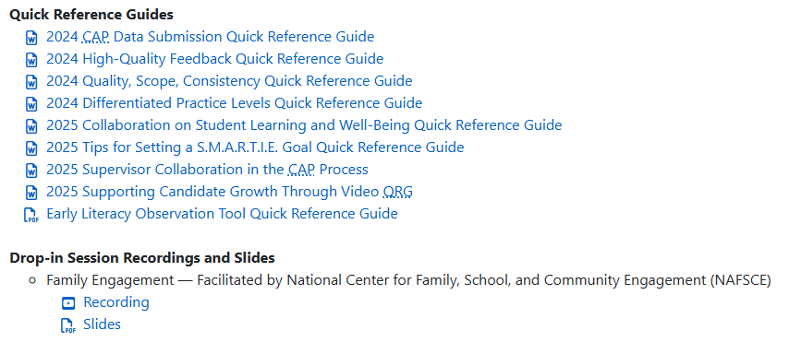
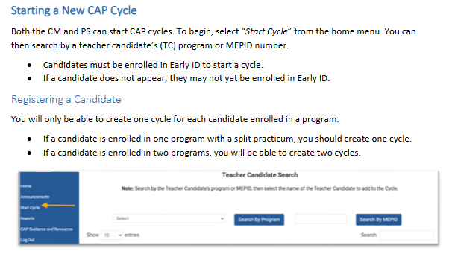
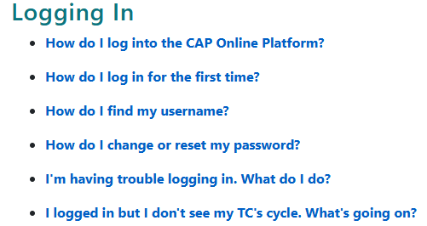
Resources
CAP Guidelines Webpage
Guidelines
Implementation handbook
Quick reference guides
Videos for users, and more!
Required and optional forms
CAP Online Platform Webpage
User guides for each role
Quick reference guides
FAQs
CAP Online Platform Office Hours
Please register at least 15 min prior
September 8th, 3-4pm
September 16th, 9-10am
September 23rd, 2:30-3:30pm
September 29th, 3-4pm
Notes:
The PST and CAP webpage includes a wide variety of resources including guidelines, an implementation handbook, all required and optional forms, quick reference guides on a range of topics, slides and recordings of prior webinars, and more.
It also includes a link to the CAP Resources Hub, where we continue to add resources shared by sponsoring organizations across the state. [Click]
There is also a webpage specific to the CAP Online Platform, which focuses on the technical aspects of the system.
It houses comprehensive user guides and quick reference guides for CAP managers, program supervisors, supervising practitioners, and teacher candidates as well as answers to frequently asked questions.
A video recording and slides from this session will be added soon.
This page is an important resource for both CAP managers and the members of each triad when moving through the steps of each cycle and troubleshooting technical issues. [Click]
Finally, we will hold CAP Online Platform Office Hours during the busiest periods within the CAP cycle.
The first sessions will be this fall. These sessions will have no planned content. CMs may join to ask technical questions about the platform as needed. Please use the links in the chat to sign up at least 15 minutes prior to each session. If no one signs up, we will not open the Zoom room.

Slide 74
Thank You
Notes:
Thank you for your attention during the presentation portion of this training. I know it was a LOT of information and hope it was useful.
I wish you all success as you open new cycles for the coming academic year. Our team is here to help you any time!

