Slide 1
CAP Online Platform
Supervising Practitioner Training

Slide 2
Thank you for supporting future teachers!
The Candidate Assessment of Performance (CAP) assesses a teacher candidate's readiness in relation to the Professional Standards for Teachers (PSTs). CAP parallels the Massachusetts Educator Evaluation system in order to better prepare teacher candidates and ensure that they are ready to be effective on day one. It measures teacher candidates' practice across a range of key indicators as outlined in the Guidelines for the Professional Standards for Teachers and supports them in improving their practice based on the results.
Successful completion of CAP is required to complete all teacher preparation programs. Sponsoring Organizations are required to send DESE all formative and summative ratings for all CAP participants by uploading their data to the CAP Online Platform.
Welcome!

Slide 3
Objectives
This module is focused on using the Candidate Assessment of Performance (CAP) Online Platform
This module will not review how to implement CAP itself.
Resources for the implementation of CAP should be provided by your Teacher Candidate's preparation program.
Additional DESE resources can be found here: Candidate Assessment of Performance (CAP) - Educator Preparation (mass.edu) In particular, please see the CAP Supervisor Modules: Candidate Assessment of Performance (CAP) Supervisor Course (mass.edu).

Slide 4
Sections
01
Overview of CAP Online Platform
02
Logging In
03
Functionality
04
Troubleshooting

Slide 5
Overview of CAP Online Platform
01

Slide 6
What is the CAP Online Platform?
The CAP Online Platform is a virtual system for implementing the Candidate Assessment of Performance (CAP) as outlined in the CAP Guidelines and Implementation Handbook
It allows CAP Managers (CM), Program Supervisors (PS), Supervising Practitioners (SP), and Teacher Candidates (TC), to complete forms, access information, and communicate in real-time.
If you are using the CAP Online Platform, the educator preparation organization your Teacher Candidate is from has elected to use it to facilitate the CAP process.

Slide 7
Role of the Supervising Practitioner
The SP has the ability to:
View candidate progress
View and complete Forms
Upload evidence
Communicate with the triad

Slide 8
Logging In
02

Slide 9
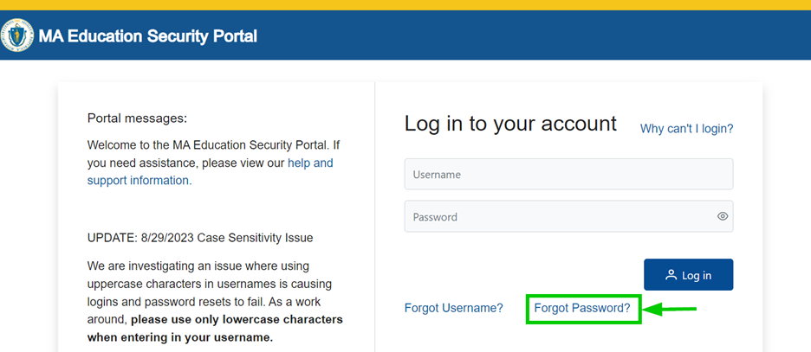
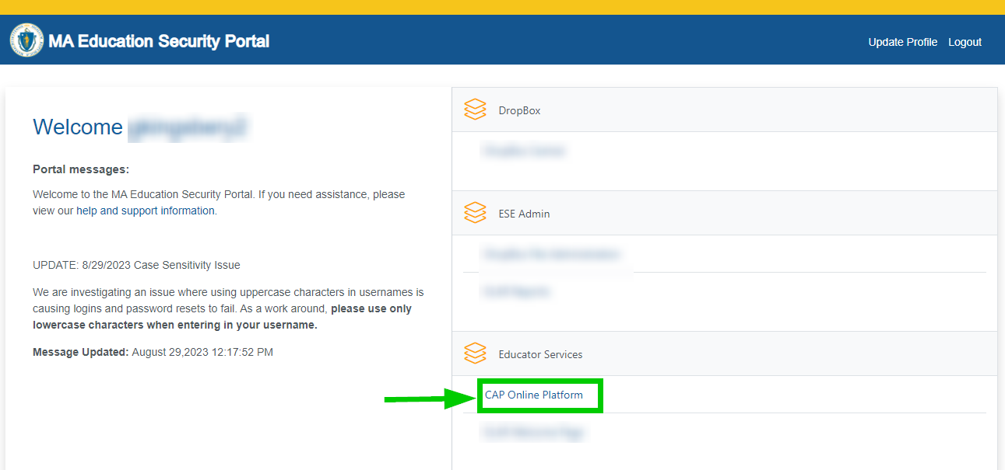
Account & Log-In Information
SP CAP specific accounts are created automatically as part of the CAP cycle creation process.
When you are assigned to a CAP cycle, the platform uses EPIMs data to generate you a NEW CAP specific username
Emails are sent to you with your NEW CAP specific usernames.
When logging in for the first time, you will need to use your given username, and click the “Forgot Password?” option.
You should NOT use your personal ELAR usernames to access the platform
Unfortunately, educators at schools that do not report in EPIMS (private, out-of-state, and approved special education schools) cannot use the CAP Online Platform and will need to work closely with the Program Supervisor to provide their feedback
MA Education Security Portal

Slide 10
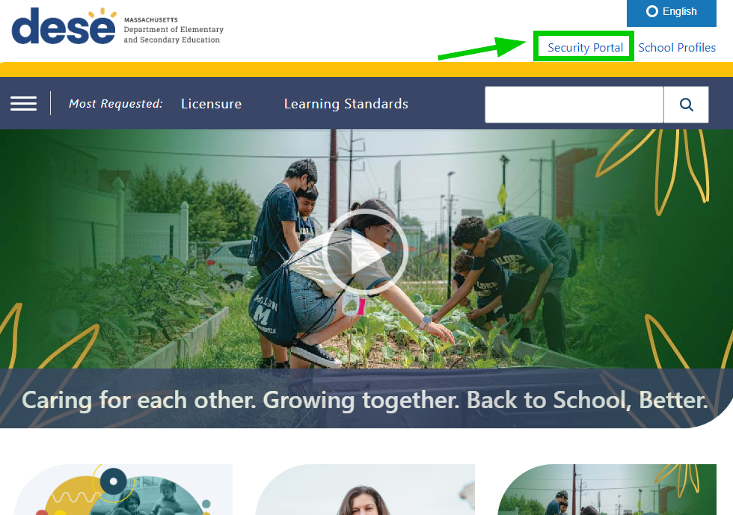
Logging in for the first time
First, log in through the MA Education Security Portal: https://gateway.edu.state.ma.us/stardust/login
Use the username provided to you via the system email that is autogenerated when you are added to a cycle. If you do not receive this email, reach out to your contact at your teacher candidate’s Sponsoring Organization.

Slide 11
Logging In – continued
You will be taken to a page to enter your username and password.
Use your given username, and select the “Forgot Password?” option to set a new password.

Slide 12
What to do if you do not receive your CAP specific account information
Some districts have firewalls that prevent the autogenerated emails with the usernames from reaching SPs. If you have not received your username/temporary password, please contact the CAP Manager (CM) at the educator preparation organization your Teacher Candidate is from.
If your CM is unable to help you, please email educatrpreparation@mass.gov.

Slide 13
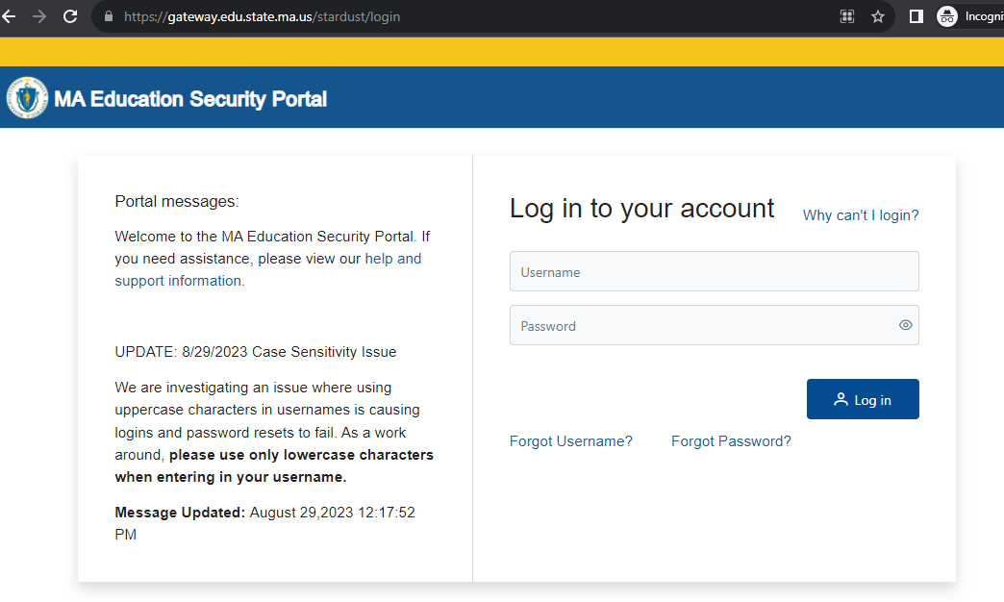
Where to start
DESE Security Portal
https://gateway.edu.state.ma.us/stardust/login

Slide 14
Accessing the CAP Online Platform
When you log in, you will see the CAP Online Platform listed as one (or the only) of the applications within the Security Portal

Slide 15
Functionality
03

Slide 16
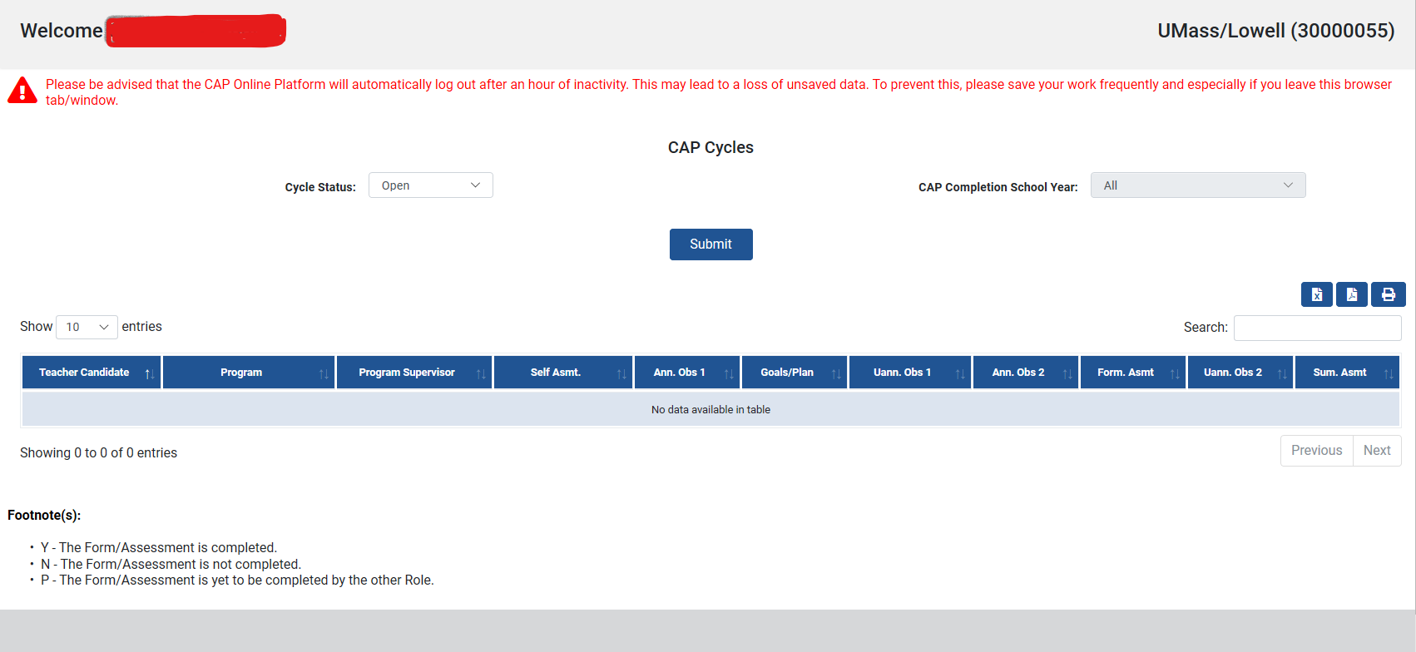
Homepage and Navigating the System as an SP
You will know if you have logged in correctly to the Security Portal with your CAP specific username because you will see the name of the educator preparation organization that your Teacher Candidate is from in the upper right-hand corner. If you do not see the organization name, and do not see the TC’s cycle, you have logged in with your personal ELAR username.

Slide 17
Navigating the CAP Cycle
The forms available in the CAP Online Platform align to the CAP forms available on the DESE website
Cycle Steps
CAP Form
Rubric Summary
Self-Assessment
Announced 1
Announced 2
Unannounced 1
Unannounced 2
Three-Way Meetings
Formative Assessment
Summative Assessment
Finalized Goal and Implementation Plan
Upload Evidence File
Correspondence History

Slide 18
CAP Form
Teacher Candidate A
1234567
Program Supervisor A
PS1
Supervising Practitioner A
123555

Slide 19
Self-Assessment
Once the candidate has completed their self-assessment summary rubric and self-assessment forms, they will save, and the forms will become viewable for you and the PS.
You and the PS can review and return the form for edits.
In the form you will be able to see the Self-Assessment Rubric Summary; the Areas of Strength and Growth, Evidence/Rationale and Elements; and Preliminary Goal-Setting
Once you return the form for edits, you will no longer have access to edit your feedback until the TC makes changes and sends it back to you for a second review.

Slide 20
Saving or Returning the Self-Assessment for TC Edits

Slide 21
Finalized Goal and Implementation Plan
After you and the PS approve the Self-Assessment Form, work as a triad to complete the Finalized Goal and Implementation Plan Form.
Three users share responsibility for this form.
You and the PS will complete the Measure of Student Learning section.
You and the PS complete the Implementation Plan section.
The TC completes the Professional Practice Goal section, based on the Self-Assessment and Goal-Setting Form.
The preliminary goal that was drafted during the Self-Assessment will be automatically entered into this box. The TC will have the opportunity to revise this goal based on any input provided by the you and the PS. Please make sure to use the “Save” buttons to save your work.

Slide 22
Finalized Goal and Implementation Plan continued
Supervising Practitioner A
Teacher Candidate A

Slide 23
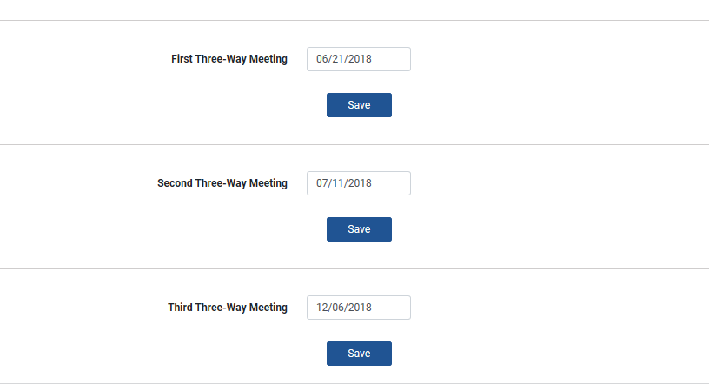
Three Way Meetings
The TC, PS, or SP can complete the Three-Way Meeting form

Slide 24
Observation Forms
You and the PS can conduct all observations together jointly, or:
The PS can conduct the two announced observations individually and you can conduct the two unannounced observations individually.
Different versions of the form are provided to you and the PS dependent on who is conducting the observation.
PS/SP complete the form together
PS or SP only

Slide 25
Observation Form Warnings
You and the PS MUST communicate ahead about who is filling out these forms. Particularly for the joint version of the form, determine ahead of time who will fill in the Calibrated Feedback boxes.
Toggling back and forth between the joint version of the form and the SP or PS-only version of the form may lead to loss of information.
The CAP Online Platform does time out.

Slide 26
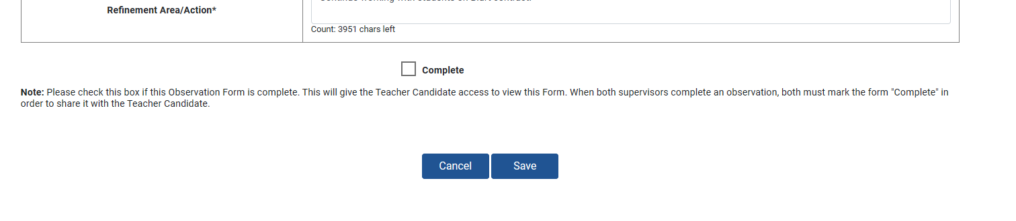
Completing the SP Only Version of the Form
All of the required areas of the form are bolded.
Once all of the required bolded areas of the form are complete, a Complete checkbox will appear. Once you check the Complete button, the form will appear to the TC.
Your CM is able to unlock a Completed form if an error is made. You will not be able to make edits to the form until you have Completed it and the CM unlocks it.

Slide 27
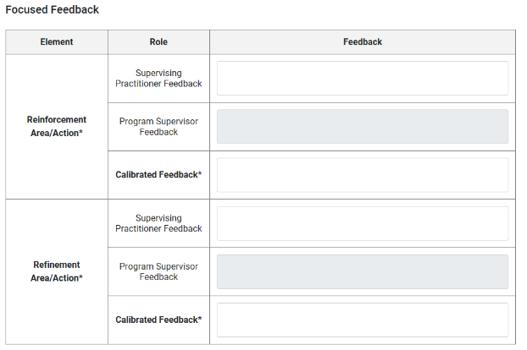
Completing the Joint Version of the Form
In the joint versions of the form, the PS Feedback is grayed out for Supervising Practitioners. You will be able to input information into the SP Feedback box and the Calibrated Feedback box. Please check with the PS before entering into the Calibrated Feedback box to ensure that you don’t save over each other’s information.
Please note that ONLY the Calibrated Feedback will be provided to candidates in the joint version of the form.

Slide 28
Completing the Joint Version of the Form continued
If you are completing a joint form with the PS, once you have both completed your individual feedback, and one of you has completed the Calibrated Feedback boxes, you can check off the “Complete” form option. Once the form is completed it becomes visible to the TC. Again, please note that ONLY the calibrated feedback is visible to candidates.
Your CM is able to unlock a Completed form if an error is made. You will not be able to make edits to the joint version of the form until you and the PS have completed it and the CM unlocks it.

Slide 29
Formative and Summative Assessments
Please complete these forms per the CAP Guidelines.
The option to click complete on either the Formative and Summative Assessment Forms will only become available when all required components of the form are completed.
If the “Complete” check box is not available, look back for an incomplete section. Please use the “Save” buttons to save as you work. You and the PS need to check “Complete” on the form before it becomes available to the candidate.
These forms are able to be edited until both you and the PS have selected “Complete.” Once “Complete” is selected, the forms are final and become visible to the TC.

Slide 30
Formative and Summative Assessments continued

Slide 31
Upload Evidence
Supervising Practitioner A

Slide 32
Troubleshooting
04

Slide 33
Supervising Practitioner Troubleshooting Tips
Common Questions/Challenges | Solutions
A form isn’t showing up as “complete.” | Confirm that you have checked the Complete box. Confirm that all required components of the form are completed (usually- required components are in bold). For forms that both the you and the PS complete together (e.g. observation forms, formative/summative) BOTH supervisors must mark the form complete.
You can log into an account but don’t see the CAP cycle information. | You likely logged in under your personal ELAR account information. You should have received CAP specific information via email. If you did not, it is likely because there is a firewall for your district. If they have not received an email with your account information, please contact the CM of the educator preparation organization your Teacher Candidate is from.
Observation Forms aren't showing what I expect | You should be very clear on who is filling out which form. Toggling back and forth between the PS/SP version of the form and the PS only or SP only views will cause a loss of information this is not recoverable. Please make sure you communicate carefully before working to complete the forms.

Slide 34
Supervising Practitioner Troubleshooting Tips continued
Common Questions/Challenges | Solutions
Information disappeared from the SP/PS observation form | This could be for one of three reasons. You and the PS may have accidentally saved over each other’s information. Please ensure that you communicate who is filling out the calibrated section of the observation form in advance. The system timed out. You should receive a warning if this is about to happen. Please note that if you have multiple tabs open, you may miss this warning. You or the PS may have toggled back and forth between the PS/SP version of the form and SP only or PS only versions.
Other issues | Check out our FAQs! http://www.doe.mass.edu/edprep/cap/onlineplatform-faq.html

Slide 35
User Guide and FAQs
For additional support, please check out our CAP Online Platform User Guide, Quick Reference Guides and FAQS: http://www.doe.mass.edu/edprep/cap/onlineplatform.html

Slide 36
Thank you!

