Slide 1
CAP Online Platform
Supervising Practitioner Training
2025-26
Notes:
Welcome to the CAP Online Platform Supervising Practitioner training. Thank you for serving in this important role!
My name is Sadye Sagov. I am a member of the Department of Elementary and Secondary Educations’ Educator Effectiveness Team and will be presenting this training module.

Slide 2
Agenda
Overview
Detailed walkthrough
Troubleshooting tips
Resources
Questions
Notes:
During the session, I will provide a high-level overview of the CAP Online Platform, outline resources you can turn to for additional information and support, and walkthrough how to use the platform for each stage in the CAP Cycle.
After the walkthrough, I will share some troubleshooting tips for common issues that users run into with the platform.

Slide 3
CAP Overview
Notes:
We will start with an introduction to CAP, which is short for the Candidate Assessment of Performance.

Slide 4
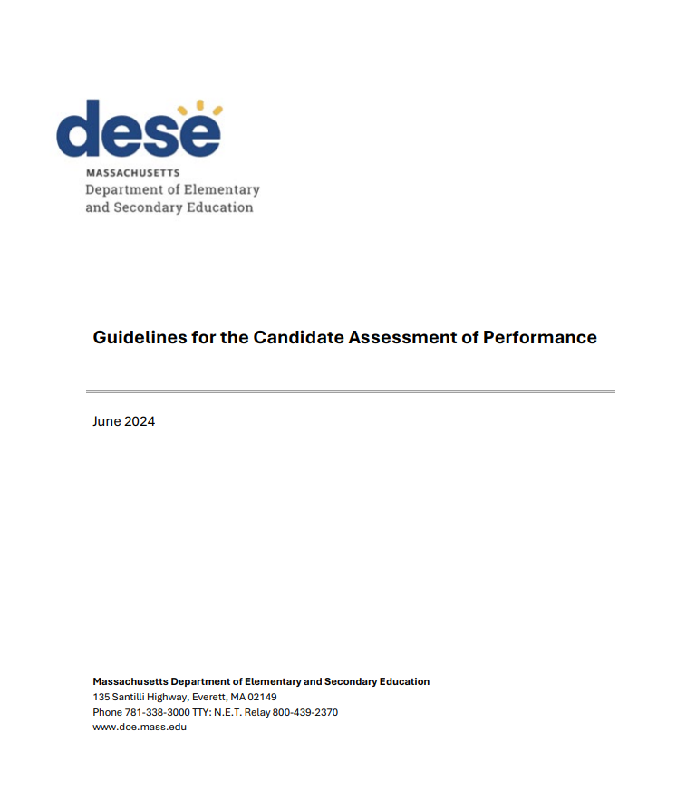
What is CAP?
The Candidate Assessment of Performance (CAP) is bridge from preparation to practice​.
Measures teacher candidates' practice across a range of key Professional Standards for Teachers (PSTs) and supports their growth based on the results.​
Successful completion is required to be considered “Ready to Teach” and complete an Initial Teacher licensure program.
Parallels the Massachusetts Educator Evaluation system to ensure new teachers are ready to have a positive impact on all students.
​
​
Notes:
CAP creates an intentional bridge from preparation to practice by aligning preparation expectations with the Massachusetts Educator Evaluation Framework for in-service educators.
CAP is designed to support teacher candidates’ growth as well as assess readiness for their licensure role at the conclusion of their preparation experience.
Successful completion of CAP is required to be considered “Ready to Teach” and complete an Initial Teacher licensure program.
This is one of several mechanisms by which we ensure that new teachers enter classrooms prepared to make a positive impact for all students on day one.​
For more information about CAP, please see the CAP Introduction Video for Supervising Practitioners on the DESE website.

Slide 5

What is the CAP Online Platform?
Virtual system for implementing CAP as outlined in the CAP Guidelines and Implementation Handbook​.
Allows program supervisors (PSs), supervising practitioners (PSs), and teacher candidates (TCs) to complete all forms online.​
If you are using the platform, the educator preparation program your TC is enrolled in has elected to use it to facilitate the CAP process.
Notes:
The CAP Online Platform is a virtual system for implementing this performance assessment in alignment with the expectations outlined in the CAP Guidelines and Implementation Handbook​.
It allows educator preparation programs to manage cycles from start to end, and allows program supervisors, supervising practitioners, and teacher candidates to complete all required forms online.​
Use of the CAP Online Platform is optional. If you are using the platform, the educator preparation program your TC is enrolled in has elected to use it to facilitate the CAP process.

Slide 6
CAP Resources and Support
Notes:
DESE has created a variety of resources to support successful implementation of the CAP process.

Slide 7
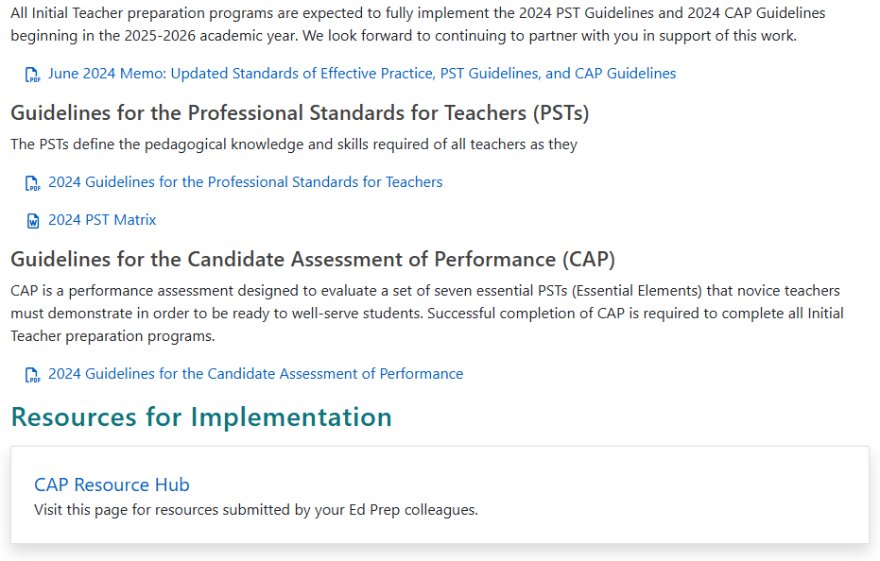
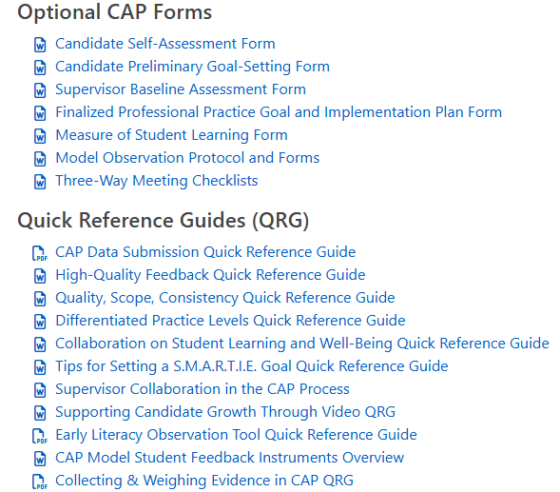
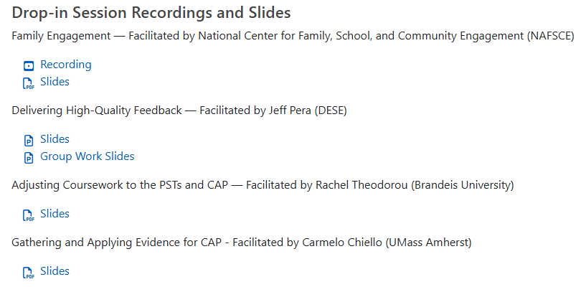
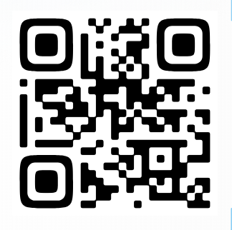
Resources for the CAP Process
The PST and CAP webpage includes information and resources about the full CAP cycle.
Guidelines outlining DESE’s expectations
Downloadable copies of all required and optional forms
Implementation handbook with instructions for each step in the cycle
Quick reference guides on topics such as high-quality feedback
Video deep drives, and more!
Scan the QR code above or visit https://www.doe.mass.edu/edprep/resources/guidelines-advisories/teachers-guide/
Notes:
The PST and CAP webpage includes a wide variety of resources including guidelines, an implementation handbook, all required and optional forms, quick reference guides on a range of topics, slides and recordings of prior webinars, and more.
It also includes a link to the CAP Resources Hub, where we continue to add resources shared by preparation programs across the state.
You can use the QR code or URL on this slide to access the webpage.

Slide 8
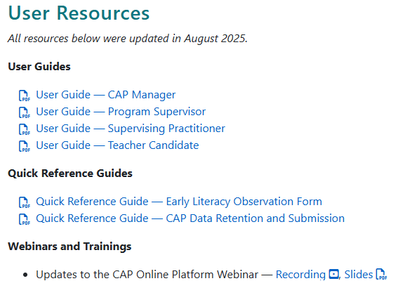
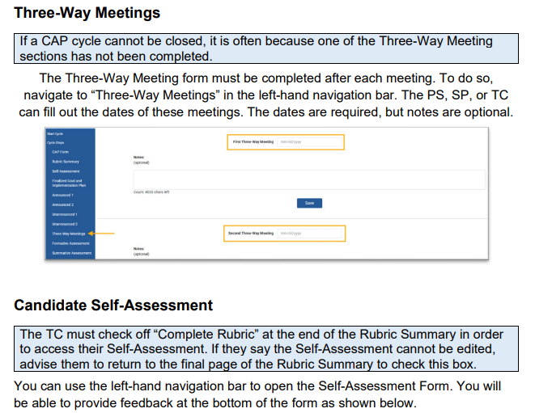
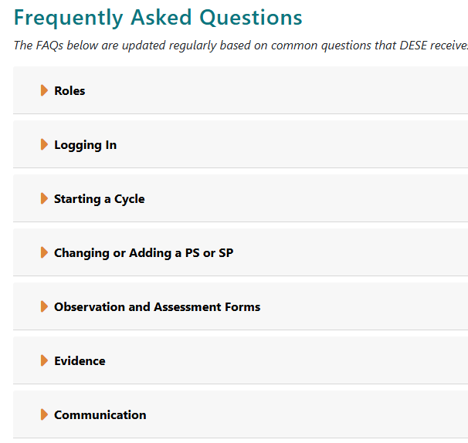
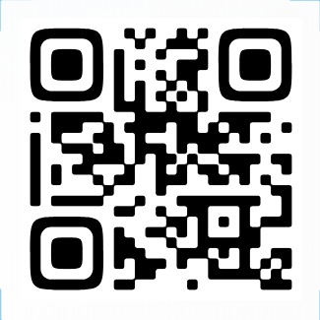
Resources for the CAP Online Platform
The CAP Online Platform webpage includes resources to support technical use of the digital platform.
Detailed user guides for supervising practitioners, program supervisors, and teacher candidates
Answers to common questions
Scan the QR code above or visit https://www.doe.mass.edu/edprep/cap/onlineplatform.html
Notes:
There is also a webpage specific to the CAP Online Platform, which focuses on the technical aspects of the system.
It houses comprehensive user guides and quick reference guides for supervising practitioners, program supervisors, and teacher candidates as well as answers to frequently asked questions.
This page is a useful resource when completing new actions on the platform or troubleshooting technical issues.
You may find it helpful to bookmark this page so you can return to it easily throughout the CAP cycle.

Slide 9

Additional Support
If you need assistance navigating the online platform, please reach out to your educator preparation program’s
CAP manager.
Notes:
If you need additional assistance navigating the CAP Online Platform, please reach out to your educator preparation program’s CAP manager.

Slide 10
CAP Online Platform
Roles and Responsibilities
Notes:
The CAP manager, program supervisor, supervising practitioner, and teacher candidate all have unique roles, responsibilities, and capabilities within the CAP Online Platform.

Slide 11
CAP Cycle Capabilities
Actions | CM​ | PS​ | SP​ | TC​
Start CAP cycles​ | X​ | X​ | ​ | ​
View progress of CAP cycles​ | X​ | X​ | X​ | ​X
Complete forms​ | ​
CAP Form​ | X​ | X​ | X​ | X​
Rubric Summary​ | ​ | ​ | ​ | X​
Self Assessment​ | ​ | ​ | ​ | X​
Finalized Goal/Implementation Plan​ | ​ | X​ | X​ | X​
Observation Forms​ | ​ | X​ | X​ | ​
Formative/Summative Assessments​ | ​ | X​ | X​ | ​
Open closed forms​ | X​ | X​ | ​ | ​
Upload and tag evidence​ | X​ | X​ | X​ | X​
Add or change PS accounts​ | X​ | X​ | ​ | ​
Add or change SP accounts | X | X
End CAP cycles​ | X​ | X​ | ​ | ​
Notes:
This slide outlines the unique capabilities for each role.
The CAP manager holds primary responsibility for training and supporting PSs, SPs, and TCs with both the components of the CAP cycle and technical use of the CAP Online Platform. They can start and end CAP cycles, view progress for all cycles within the organization, open closed forms for further editing, upload evidence, and add or change PS and SP assignments.
The PS can do all of this for the subset of candidates assigned to them as well as enter information into CAP Forms.
As an SP you can view progress, complete forms, and upload evidence for the candidates assigned to you.
Your candidates can view their own progress, complete a subset of the forms, upload evidence, and view observation and assessment forms once they are submitted by you and the PS.

Slide 12
Logging In
Notes:
I will now provide instructions for logging in.

Slide 13
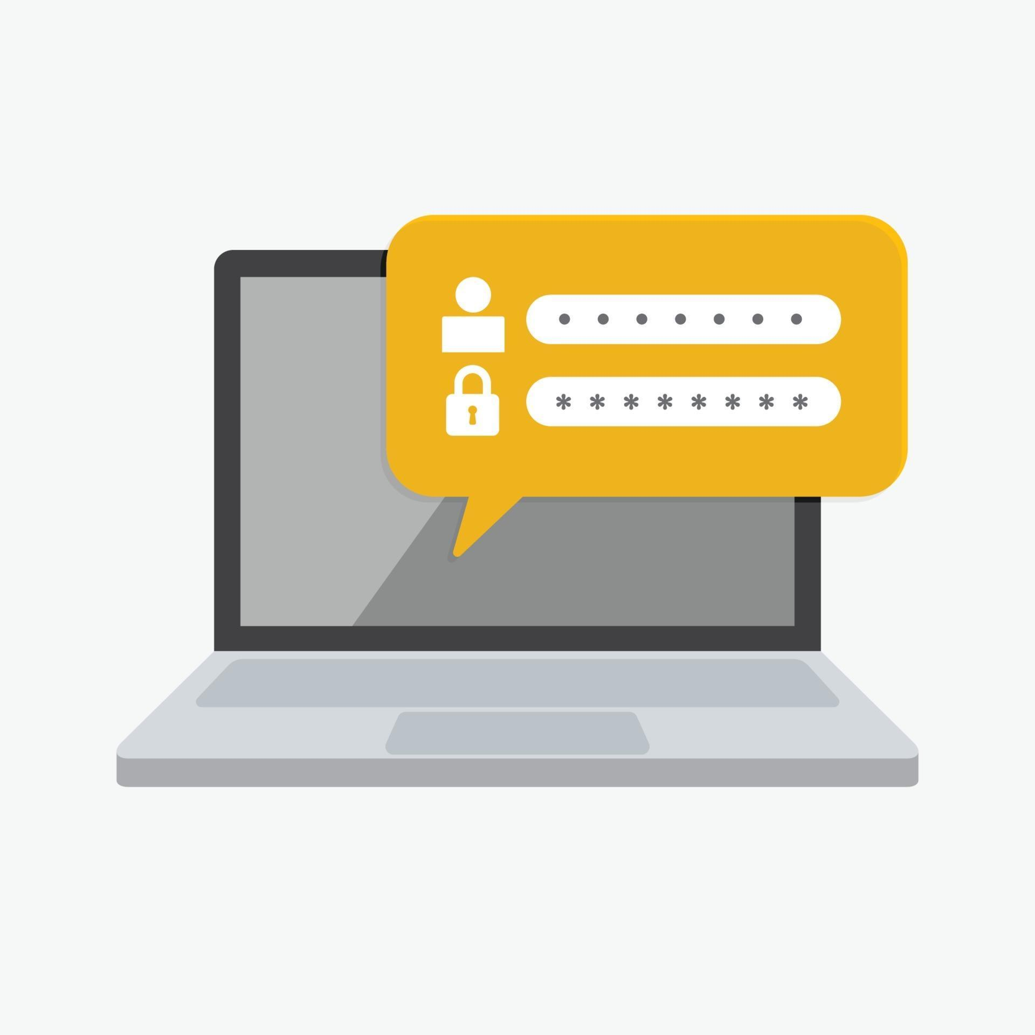
CAP Online Platform Username
You will receive a NEW username to access the platform.
The platform is embedded within the Education Security Portal, but you will NOT be able to access it with your personal ELAR username and password.
Once you are assigned to a candidate cycle within the platform, you will receive an automatic email with your CAP-specific username and instructions for how to log in.
Notes:
The CAP Online Platform is embedded within the Education Security Portal, but you will NOT be able to access it with your personal ELAR username and password.
Once you are assigned to a candidate cycle within the platform, you will receive an automatic email with your CAP-specific username and instructions for how to log in.
You must use this NEW username to access the platform.

Slide 14
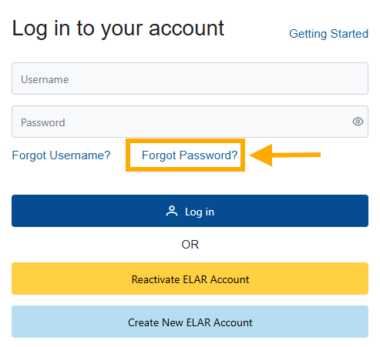
CAP Online Platform Password
Follow this link to log into the platform: https://gateway.edu.state.ma.us/
When logging in for the first time…
Select "Forgot Password“
Enter your email address and CAP-specific username
Follow the emailed directions to reset your password
Log in using the username and new password
Notes:
When you are ready to log in, follow the link on this slide.
[Click] The first time you log in, you will need to take a few extra steps to create a password for your CAP account.
Select "Forgot Password“
Enter your email address and NEW CAP-specific username
Check your emails and follow the directions to reset your password
Finally, log in using the NEW username and password

Slide 15
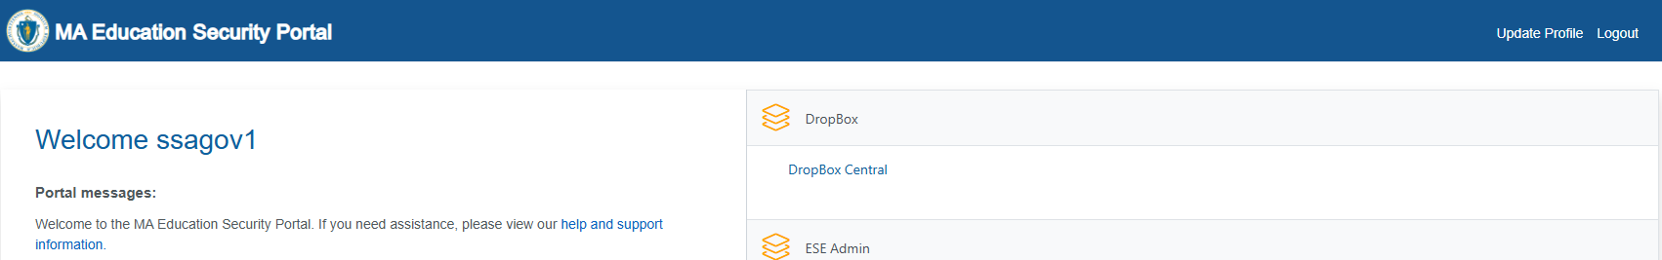
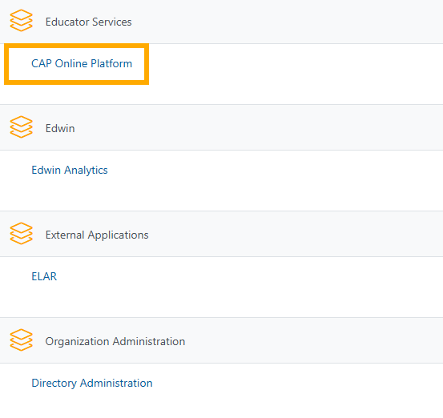
CAP Online Platform Application
Notes:
Once logged in, you see the “CAP Online Platform” application.

Slide 16
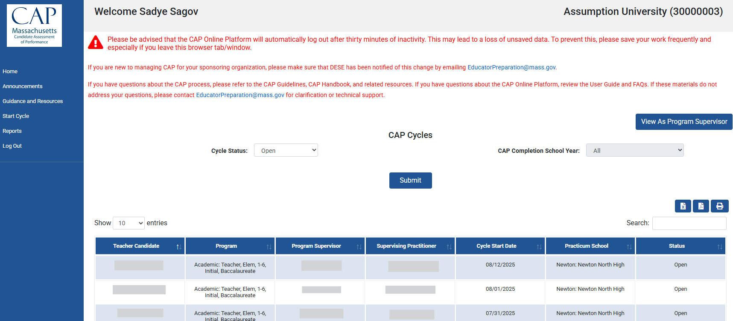
CAP Online Platform Home Page
If you have logged in with the correct credentials, you will see the name of the educator preparation program that your teacher candidate is enrolled in on the upper right-hand corner.
If you do not see the educator preparation program name, and do not see your teach candidate’s cycle, you have logged in with your personal ELAR credentials.
Notes:
If you have logged in with the correct credentials, you will see the name of the educator preparation program that your teacher candidate is enrolled in on the upper right-hand corner. [Click]
[Click] If you do not see the educator preparation program name, and do not see your teach candidate’s cycle, you have logged in with your personal ELAR credentials.

Slide 17
Navigating the Platform
Notes:
There are a few overarching tips for navigating the platform.

Slide 18
Home Page
Return to this page
Filter by cycle status or year
Search in table
Sort columns alphabetically
Enter a cycle for one TC
Notes:
After logging in, all users will be brought to the home page. The content of this page varies by user.
Candidates will see only their cycle, SPs and PSs will see all cycles assigned to them.
There are a variety of functions embedded in the home page.
These features are most helpful to CMs and PSs who work with many candidates at once.
However, they may be useful if you have been an SP for several years and have worked with multiple candidates.
To filter by cycle status or CAP completion year, select your parameters from the dropdown menu(s) then click “Submit”. [Click]
To sort any column alphabetically, click on the up/down arrows at the top right of each column header. [Click]
To search for a specific candidate, PS, or program, type or paste text into the search box [Click]
To open an individual candidate’s cycle, click on the row with their name [Click]
To exit an individual candidate’s cycle, click “Home” in the navigation bar.

Slide 19
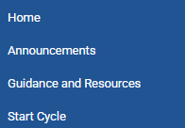
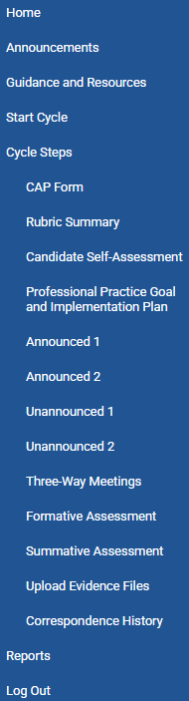
Cycle Pages
Once you open an individual candidate’s cycle, the left-hand navigation bar will expand to show all cycle steps.
Notes:
Once you enter an individual candidate’s cycle, the left-hand navigation bar will expand to show all cycle steps. [click]
This is how you will access all required forms, the evidence uploads page, and the correspondence history between members of the triad.

Slide 20
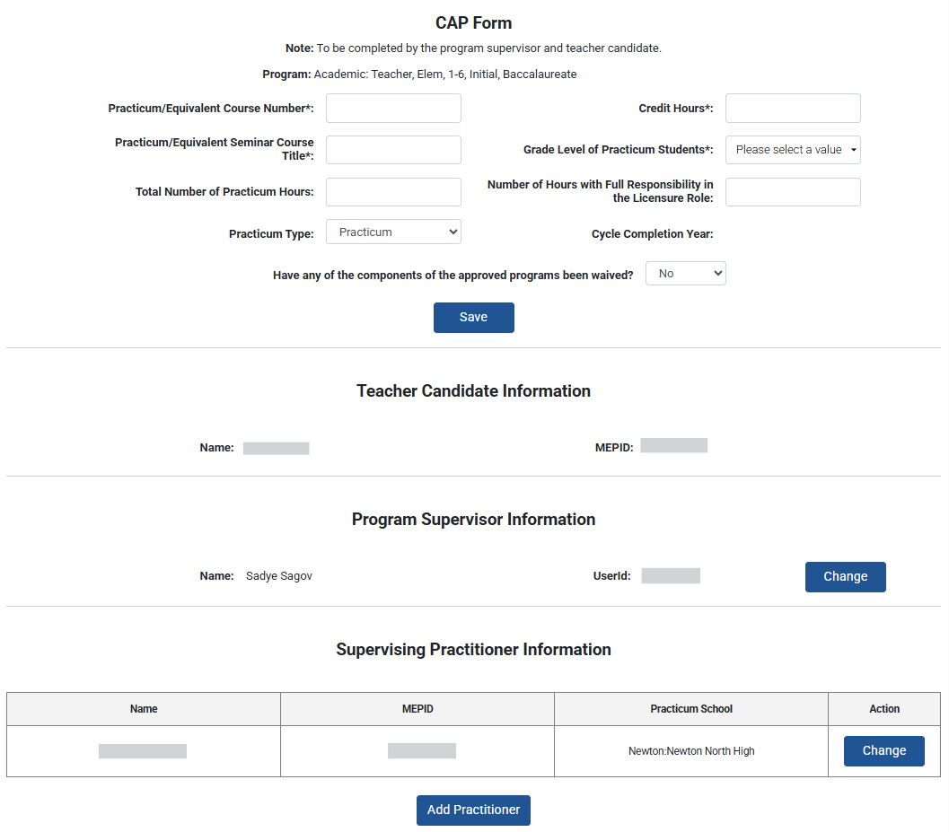
Things to Know
Throughout, required sections/fields are denoted with bold text and an asterisk*
The platform does NOT autosave like a Google document
Content will be lost if windows time out or are closed
It is important to use the “Save” buttons frequently
Supervisors may choose to paste information in from another document
Save
Notes:
Before moving into a walkthrough of steps within the cycle, there are two overarching things to know about how the platform functions
First, throughout the platform pages, required fields are denoted with bold text and an asterisk*, you can see an example of this for the grade level of practicum students on this page [Click].
In order to mark forms as complete, you must enter information for every required field.
It is also very important to know that the platform does NOT autosave like a Google document
Content will be lost if windows are left open and time out or are closed
“Save” buttons should be used frequently when adding new information to forms
When entering a lot of text, such as when adding synthesized observation evidence or assessment feedback, we advise supervisors to draft content in another document and then paste it into the platform when finalized
Now, let’s jump into some more detailed guidance.

Slide 21
CAP Form
Notes:
The CAP Form is completed by the PS and TC. As the SP, you will have view only access.

Slide 22
Cycle Information
Teacher candidate course, hours, and waiver information
Program supervisor information
Supervising practitioner information
Notes:
The top of the form lists information about the candidate’s practicum grade level, hours [Click], followed by information about the assigned PS [Click], and assigned SP [Click]

Slide 23
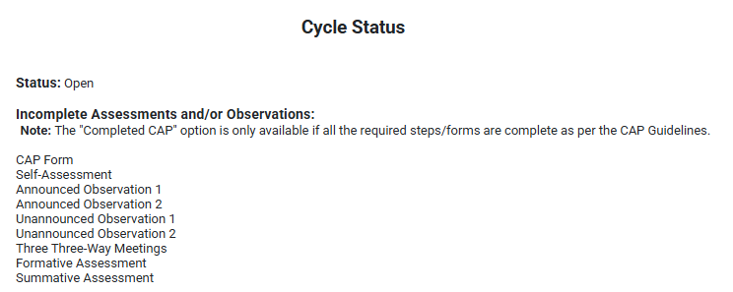
Cycle Status
Forms show up as incomplete for two reasons:
1) The form has not been started
2) One or more required fields are blank
Notes:
The bottom of the form provides the cycle status,
[Click] You can see whether the cycle is open or closed.
[Click] as well as whether any forms are still incomplete
If a form shows up as incomplete, this may be because it has not yet been started
It could also be because the triad thinks a form is finished, but some required fields are still blank
This section of the form is especially helpful as you near the end of practicum and work to ensure all aspects of the CAP cycle are complete.

Slide 24
Rubric Summary and Self-Assessment
Notes:
The Rubric Summary Form and Self-Assessment are both be completed by the TC.
The CM, PS, and SP can view the content, but cannot edit it. ​

Slide 25
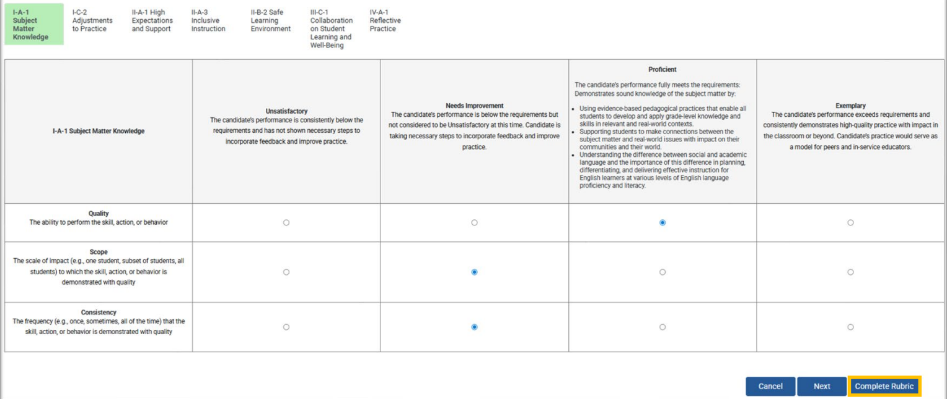
Rubric Summary
The TC fills out the Rubric Summary.
Essential Elements, each on a separate tab
Proficiency descriptors, specific to each element
Rating options for Quality, Scope, and Consistency
Complete button
The TC must click “Complete” on the last page of the Rubric Summary to access the Self-Assessment.
If the Self-Assessment cannot be edited, advise the TC to return to the rubric to take this step.
Notes:
On the Rubric Summary, the TC will click through the seven Essential Elements in the tabs at the very top of the page [Click], read the proficiency descriptors below [Click], and then select a quality, scope, and consistency rating for each element [Click]
[Click] The TC must click “Complete” at the end of the Rubric Summary to access the Self-Assessment.
If the Self-Assessment cannot be edited, advise the TC to return to the final page of the rubric to take this step
This is a small technical step but is often the reason that cycles cannot progress or be closed.
We have added red banner text about this to the TC view of the platform, but field supervisors should also alert candidates of the importance of this step.

Slide 26
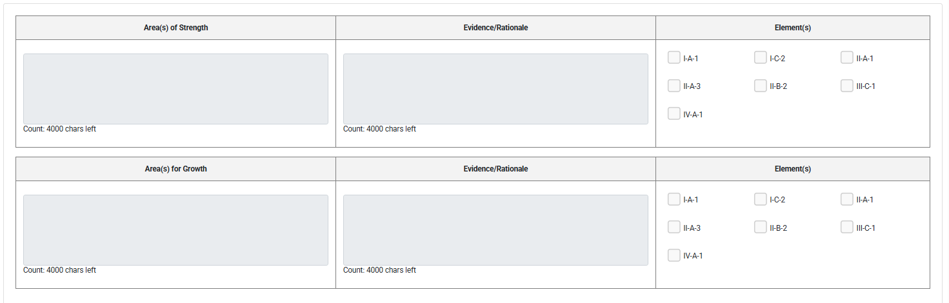
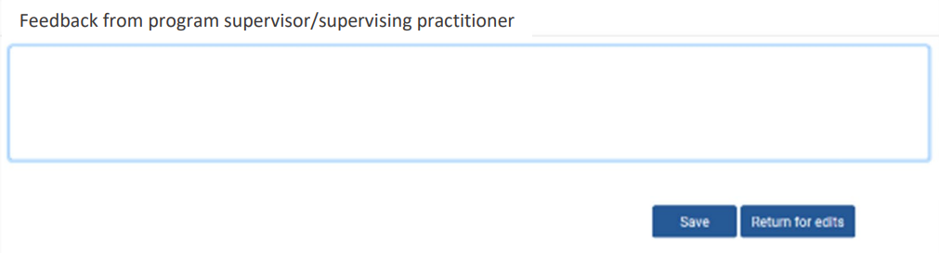
Self-Assessment
The TC fills out the Self-Assessment.
The PS and SP then provide feedback in the final section.
If the form is returned for edits, the TC will need check the “Complete” box at the end of the Rubric Summary again before being able to revise text on the Self-Assessment. ​
Notes:
The TC is also responsible for completing the Self-Assessment. On this page they will review a summary of their rubric ratings, reflect on their current strengths and areas for growth, and draft a preliminary professional practice goal.
[Click] When the TC is finished, the you and the PS can add feedback at the bottom of the form.
You will have the option to save feedback [Click] or return the form for edits from the TC [Click]
[Click] If the form is returned for edits, the TC will need check the “Complete” box at the end of the Rubric Summary again before being able to revise text on the Self-Assessment. ​

Slide 27
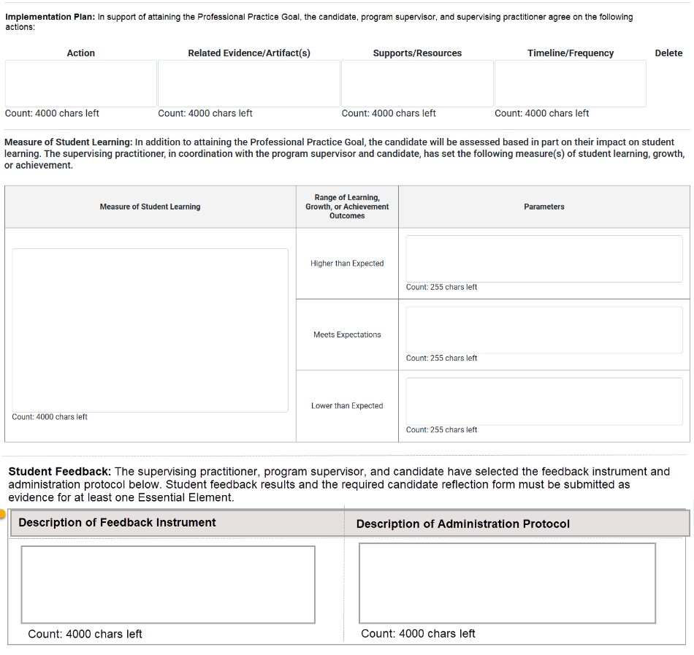
Professional Practice Goal and Implementation Plan
The triad completes this form together.
Finalized professional practice goal (TC)
Implementation plan (PS and SP)
Measure of student learning plan (SP)
Student feedback plan (SP)
This form is the plan for implementation. Artifacts related to progress on the goal as well as results and reflections on the measure of student learning and student feedback should be uploaded as tagged evidence later in the cycle.
The PS must mark the form as “Complete” once all triad members have finished their sections. This button will appear at the bottom of the form.
Notes:
Next, the full triad will collaborate to complete the Professional Practice Goal and Implementation Plan page. This form is unique, as it is the only one where all three users enter information.
[Click] First, the TC will finalize the Professional Practice Goal. The preliminary goal that was drafted in the Self-Assessment will automatically populate into this box. The TC will revise the text based on any input provided by the PS and SP.
[Click] Then, you and the PS will complete the Implementation Plan based on the goal.
[Click] Finally, you will complete the Measure of Student Learning and Student Feedback sections with input from the PS and TC.
This step has always been required, but it did not used to be embedded into the platform. It was added during the updates.
Click] It is important to note that this form is the plan for how this evidence will be collected and analyzed. Artifacts related to progress on the goal as well as results and reflections on the measure of student learning and student feedback should be uploaded as tagged evidence later in the cycle.
[Click] Once all members of the triad have finished their sections, the PS must select the “Complete” button that will appear at the bottom of the form. After clicking “Complete”, the form cannot be edited.

Slide 28
Three-Way Meetings
Notes:
Next we will move on to the three-way meetings page.

Slide 29
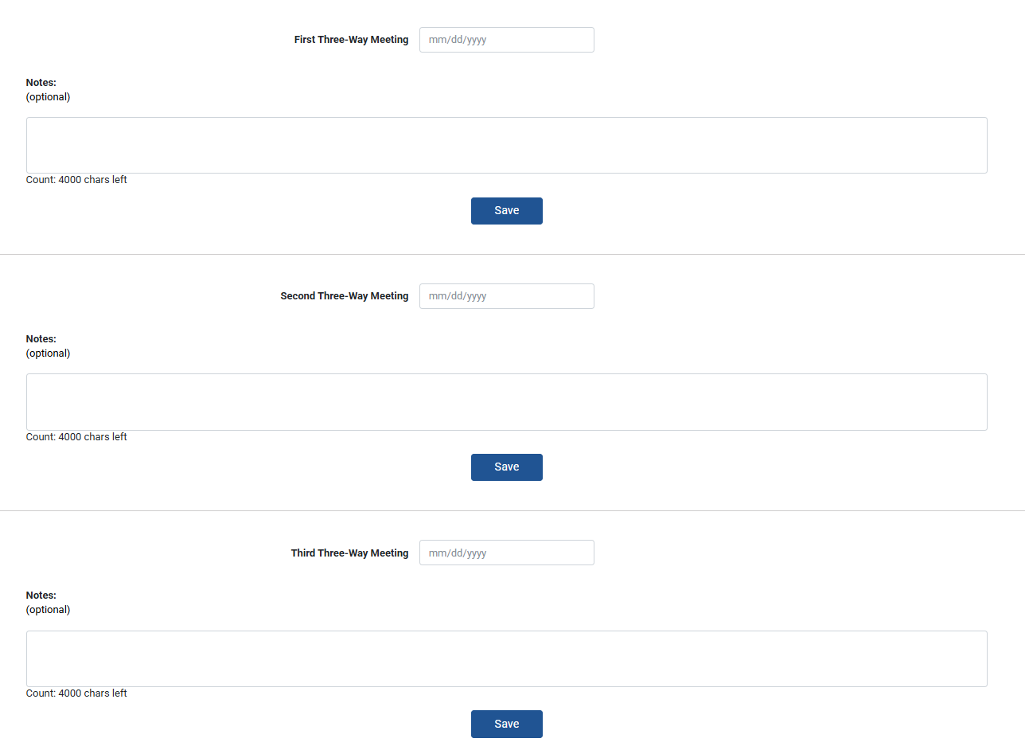
Three-Way Meeting Dates
Three-way meeting dates are required, notes are optional.
Notes:
The TC, PS, and SP can all edit the Three-Way Meetings page.
To complete the CAP cycle, a date must be entered for each of the three meetings. While the date fields are required, the notes sections are entirely optional.

Slide 30
Observation Forms
Notes:
The PS and SP share responsibility for conducting observations and completing the related forms.

Slide 31
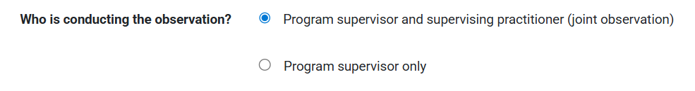
Individual vs. Joint Observations
Unannounced Observations
SP required
PS optional
Announced Observations
SP required
PS required
Observers are identified at the top of each observation form
Program supervisor and supervising practitioner (joint observation)
Supervising practitioner only
Notes:
For Unannounced Observations, the SP must observe the candidate. The PS’ presence is optional.
For Announced Observations, both the SP and PS must observe the candidate, and feedback must be calibrated.
Click] At the top of each form, there is a question about observers.
If both the SP and PS conducted the observation, this is considered a joint observation
If only one supervisor conducted the observation this is considered an individual observation
The PS will have the option of “PS only” and the SP will see “SP only”

Slide 32
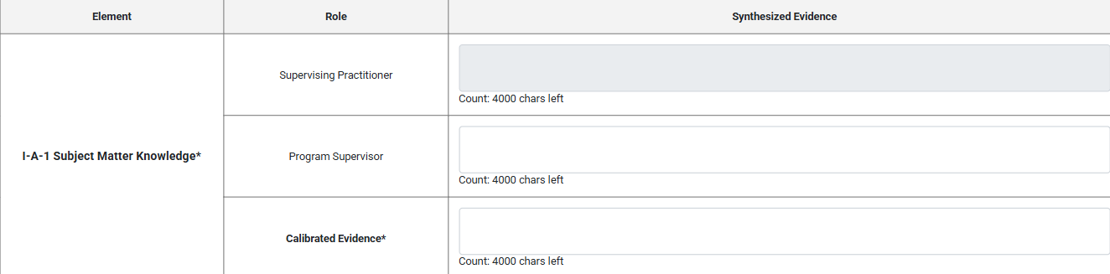
Individual vs. Joint Observations cont.
The Observation Form layout changes based on who is conducting the observation
Individual observation layout
One box per question
Joint observation layout
Three boxes per question – SP, PS, and Calibrated
Only calibrated boxes are required and pre-populate into assessments
Notes:
The layout of each observation form changes based on who is conducting it.
[Click] If completing the observation individually, you will see one open-response box for each question.
[Click] If completing the observation jointly, you will see three separate boxes for each question: one for SP, one for PS, and one titled “calibrated”.
You will be able to input information into the SP and the Calibrated boxes.
Only the calibrated boxes are required, and will automatically pre-populate into the formative and summative assessments

Slide 33
Individual vs. Joint Observations cont.
Avoid toggling between the individual and joint version of the form
Switching back and forth between “PS/SP Only” and “Joint” modes is very likely to lead to data loss
To prevent this, supervisors should decide who will complete each observation in advance
For joint observations, only one supervisor should enter text in the “calibrated” boxes
These boxes reflect content from the last person who clicked “Save”
To avoid accidentally overwriting work, only one supervisor should enter text into the “calibrated” boxes
Supervisors should decide who will take this role ahead of time
Notes:
The observation forms can sometimes be a bit finicky. The tips of this slide can prevent the most common problems that can occur.
[Click] Avoid toggling between individual and joint forms
Switching back and forth between “PS/SP Only” and “Joint” modes is very likely to lead to data loss
To prevent this, connect with the PST to decide who will complete each observation in advance
[Click] For joint observations, only one supervisor should enter “calibrated” text
The “calibrated” boxes reflect content from the last person who clicked “Save”
To avoid accidentally overwriting work, only one supervisor should enter text into the “calibrated” boxes
Talk with the PS to decide who will take this role ahead of time

Slide 34
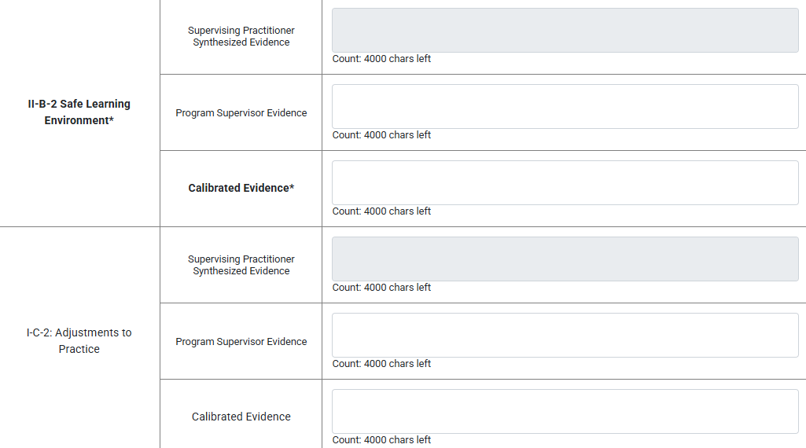
Required vs Optional Elements
Supervisors must include observation evidence to complete.
Same three across all observations
Listed at the top of each form
Bolded and with asterisk* in tables
Required Elements:
I-A-1 Subject Matter Knowledge
II-A-1 High Expectations and Support
II-B-2 Safe Learning Environment
Optional Elements:
I-C-2 Adjustments to Practice
II-A-3 Inclusive Instruction
III-C-1 Collab. on Student Learning
IV-A-1 Reflective Practice
Supervisors may include observation evidence, if collected.
Notes:
[Click] Supervisors must include observation evidence for each of the three required elements.
These are listed at the top of each form and bolded with an asterisk* in the synthesized evidence tables
[Click] Supervisors may include observation evidence for the optional elements, if observed.
However, other categories of evidence such as student feedback or candidate artifacts may be used to demonstrate proficiency instead.

Slide 35
Active vs. Synthesized Evidence
Active Evidence Collection
Not included in the platform as there is no autosave and notes could be lost during the observation
Supervisors should take these low-inference notes in another document
Synthesized Evidence
Included in the platform
Supervisors paste or type key evidence for each element into these boxes
Notes:
While the paper observation forms include an optional space for active evidence collection, this box is not included in the CAP Online Platform.
We made this decision because the platform does not allow autosaving and we worried that raw notes could be lost during observations
Supervisors should take these low-inference notes in a separate document
[Click] Synthesized evidence is included in the platform. Supervisors should type or paste key evidence for each element into these boxes.
As a reminder, any section that is bold and includes as asterisk is required.
For the example on this slide, Safe Learning is a required element so it must be included in the observation. Adjustments to practice is optional.
Because this example is from a joint form, only the calibrated evidence is required. Notes from each supervisor are optional.

Slide 36
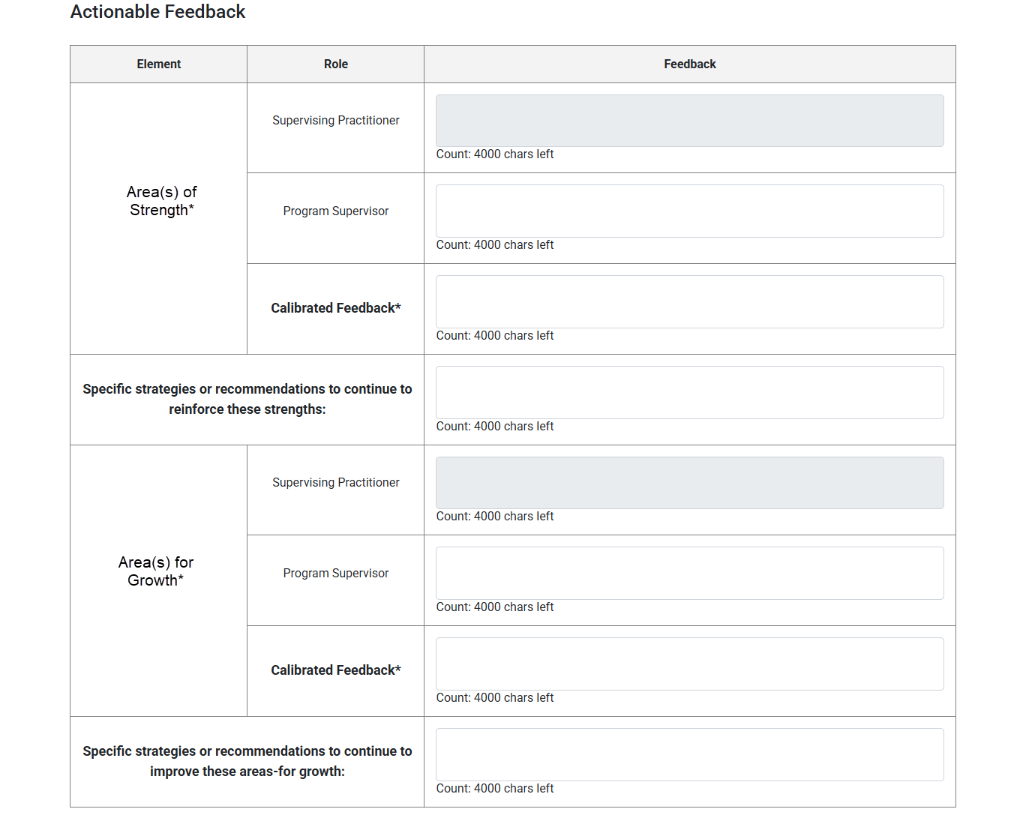
Actionable Feedback
Feedback provided at the end of each observation form includes:
Judgements about what is going well and what can be improved
Strategies, recommendations, or resources to reinforce or improve practice in these areas
The information in this section of the form may be tied to individual elements or multiple elements.
Regardless, all feedback should be clear, constructive, and actionable.
Notes:
[Click] The feedback section begins with space to document the candidate’s current area(s) of strengths and area(s) for growth. These should be targeted judgements about what is going well and what can be improved.
[Click] It also include space to add specific strategies, recommendations, or resources to reinforce or improve practice in these areas. This section is also required.
[Click] The information in this section of the form may be tied to individual elements or span multiple elements. Regardless of scope, it should be timely, constructive, targeted, and actionable. You can see our High-Quality Feedback Quick Reference Guide for more information on DESE’s expectations for feedback.

Slide 37

Early Literacy Form
If you supervise Early Childhood, Elementary, or Moderate Disabilities PK-2/PK-8 candidates Early Literacy Look-Forms will automatically show up at the top of Announced Observation 2
Notes:
For candidates enrolled in Early Childhood, Elementary, and Moderate Disabilities PK-2 or PK-8 programs, the Early Literacy Look-Fors will automatically be embedded at the top of Announced Observation 2.
The form is embedded within Announced Observation 2 as it is recommended that the Early Literacy Observation occur near the end of the practicum while candidates are assuming full responsibility for instruction during a literacy block.
While DESE recommends that the Early Literacy Observation Form be completed as part of Announced Observation 2, there may be circumstances where a triad prefers to complete the observation during Announced Observation 1.
If this is the case, complete the Announced Observation 2 Form with the Early Literacy Observation Form first
then complete the Announced Observation Form 1 without the Early Literacy Form during the second observation
The CAP Online Platform does not prevent these forms being completed out of order

Slide 38
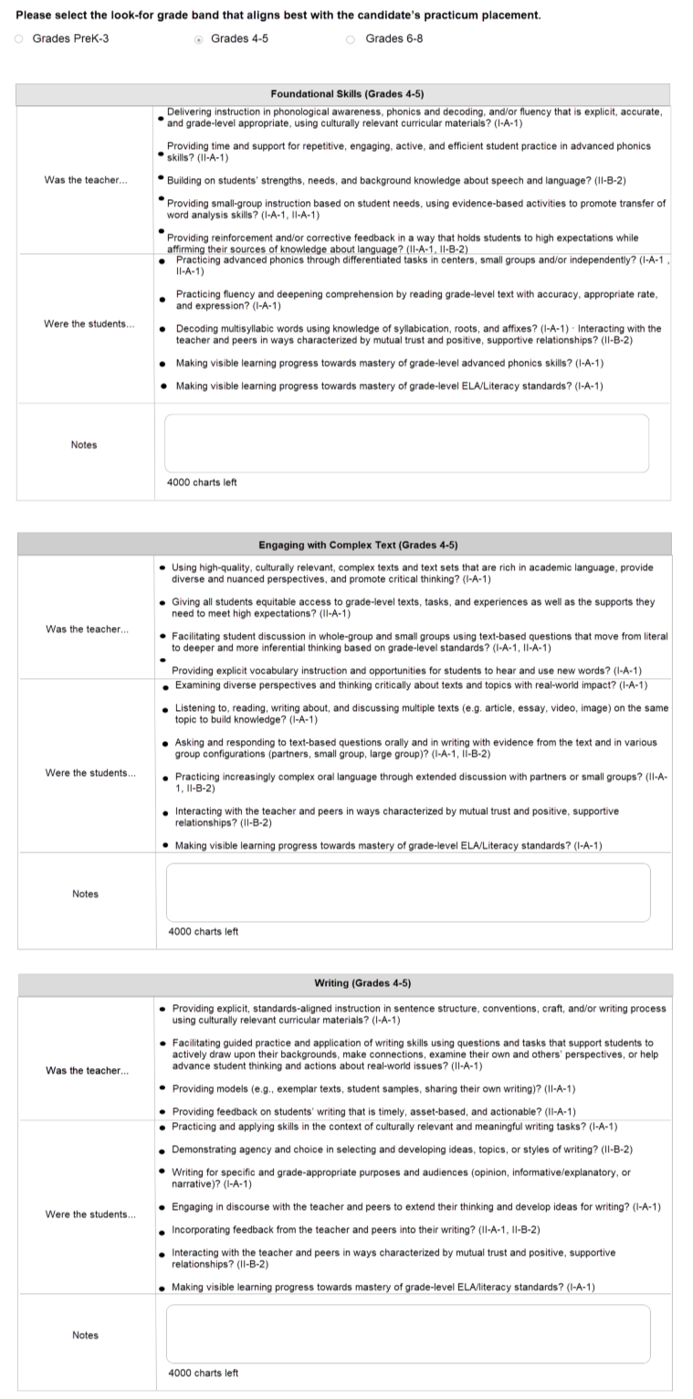
Early Literacy Look-Fors
During Announced Observation 2, supervisors for candidates in early literacy programs will:
Select the Look-For grade band that aligns with the candidate’s practicum placement grade
Record evidence of the Look Fors at the top of the form.​​
Incorporate these notes into the synthesized evidence for the three required focus elements and actionable feedback
The Look-Fors do not show up in the Formative and Summative Assessment Forms. Given this, it is crucial that early literacy is included in synthesized evidence.
Notes:
When completing the Announced Observation 2 form, supervisors for candidates in early literacy programs will take the following steps. [Click]
At the top of the form, you will be prompted to select the Look-For grade band that aligns with the candidate’s practicum placement grade.
For example, for an Elementary candidate placed in a 1st grade classroom the PK-3 band would be selected.
For an Elementary 1-6 candidate placed in a 4th grade classroom the 4-5 band would be selected. [Click]
You will then add evidence of the Early Literacy Look Fors in the notes section.​ [Click]
Like the calibrated feedback boxes, only one supervisor should enter text into the look-for notes boxes to avoid data loss.
Finally, you will incorporate what you noticed into the synthesized evidence for the three required focus elements and actionable feedback, as relevant. [Click]
[Click] It is crucial to know that the Look-Fors notes are a required field on the form but will not show up in the Formative and Summative Assessment Forms.
Given this, is very important that early-literacy specific feedback is woven into the Synthesized Evidence and Actionable Feedback sections.

Slide 39

Sharing Observations with the TC
The TC will only be able to view observation forms once supervisors select “Complete”
This button appears at the bottom of the form once all required components are filled in
If conducting a joint observation, both the SP and PS must select “Complete
Complete
The CM and PS can unlock completed forms if an error is made by clicking “Edit”
The “Edit” button will only appear once both supervisors have marked the form “Complete”
Notes:
The TC will only be able to view observation forms once supervisors select “Complete”
This button appears at the bottom of the form once all required components are filled in
If conducting a joint observation, both the SP and PS must select “Complete
The CM and PS can unlock completed forms if an error is made by clicking “Edit”
The “Edit” button will only appear once both supervisors have marked the form “Complete”

Slide 40
Evidence Uploads
Notes:
Observations are just one of the five categories of evidence. Files related to the other categories can be uploaded to the platform via the “Upload Evidence Files” page.

Slide 41





Adding Other Forms of Evidence
The CM, PS, SP, and TC can all upload evidence.
This can include, but is not limited to:
Candidate artifacts - lesson adaptations, student work, family collaboration or feedback, reflection logs
Measures of student learning - raw or summarized exit tickets, assignments, tests, and candidate reflections (may upload optional Measure of Student Learning Form)
Student feedback - raw or summarized student surveys or discussion notes, and candidate reflections
Additional observation forms - from split practicum SPs, fifth observations
Professional practice goal – will vary based on goal and benchmarks (may upload optional Finalized Professional Practice Goal Form)
Notes:
The CM, PS, SP, and TC can all upload files.
[Click] This includes, but is not limited to the following examples of each category of evidence
[Click through and read each line]

Slide 42

File Sizes and Formats
The maximum amount of data space for each cycle is 100 MB. Once reached, additional files cannot be added.
Formats allowed: .doc(x), .xls(x), .ppt(x) .pdf, .jpg, .png, .bmp, .gif, .mp3, .wav.
Notes:
There are some limitations on the amount of data space and formats of files.
The maximum amount of data space for each cycle is 100 MB. Once reached, additional files cannot be added.
Formats allowed include word documents, excel files, power points, PDFs, images, music, and videos

Slide 43
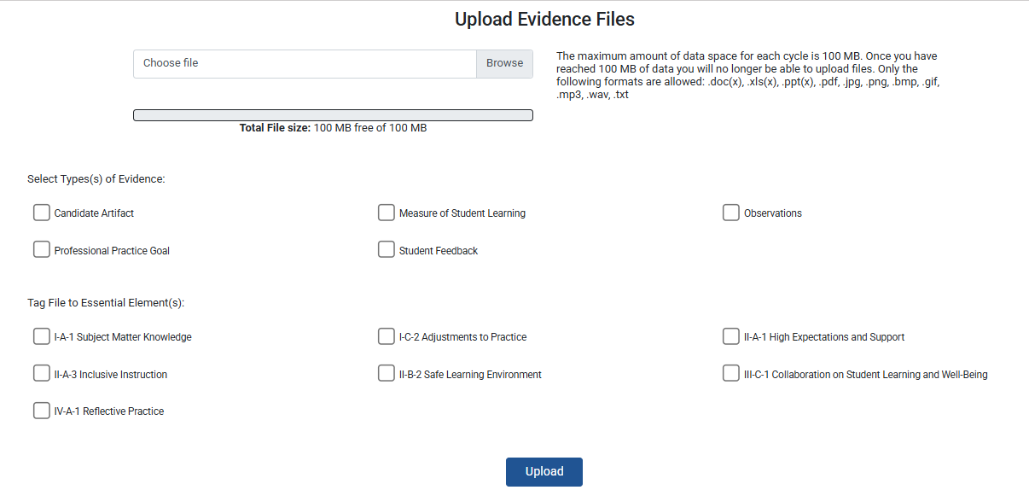
Tagging Evidence
Evidence categories,
one or more
Essential Elements,
one or more
Notes:
To appear in the Formative Assessment and Summative Assessment, each file must be tagged to:
[Click] One or more categories of evidence and
[Click] One or more Essential Elements
Once evidence has been uploaded, it will be viewable under the “Current Uploaded Evidence Files” at the bottom of page. Only tagged elements will appear in the Formative and Summative Assessments. More on that next!

Slide 44
Formative Assessment
Notes:
The first half of the CAP Cycle leads to the Formative Assessment. The expectations for this assessment are described in detail within the CAP Guidelines and Implementation Handbook. The next slides focus on how to enter this information within the platform.

Slide 45
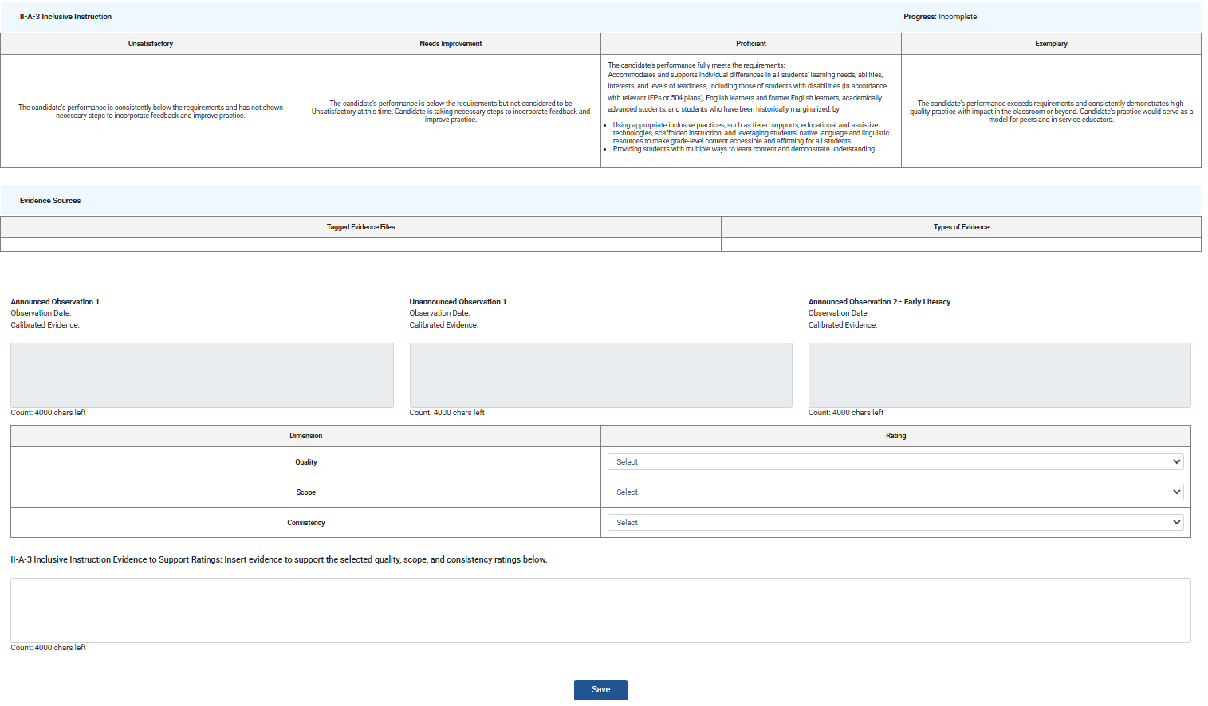
Layout for Each Element
Element-specific proficiency descriptors
For reference
Available evidence Automatically populated from observation forms and tagged evidence
Ratings and rationale Entered by PS/SP after calibration
Save button
Click after each element to save progress
Notes:
During the Formative Assessment, the SP and PS review all evidence collected up to this point in the practicum and come to calibrated ratings for quality, scope, and consistency for each Essential Element.
The screenshot on the slide is small so that it captures all required components for a single element. The same layout is repeated for each of the seven elements.
[Click] Each begins with the proficiency descriptors for unsatisfactory, needs improvement, proficient and exemplary. The language is specific to each element and should be consulted carefully.
[Click] The evidence sources section will automatically populate with :
Text entered in the synthesized evidence boxes from each observation conducted prior to the assessment
Links to uploaded evidence files tagged to the element
[Click] After reviewing the evidence, the PS and SP will choose ratings for quality, scope, and consistency from the dropdown menus
[Click] Finally, supervisors should click “Save” before moving on to the next element

Slide 46
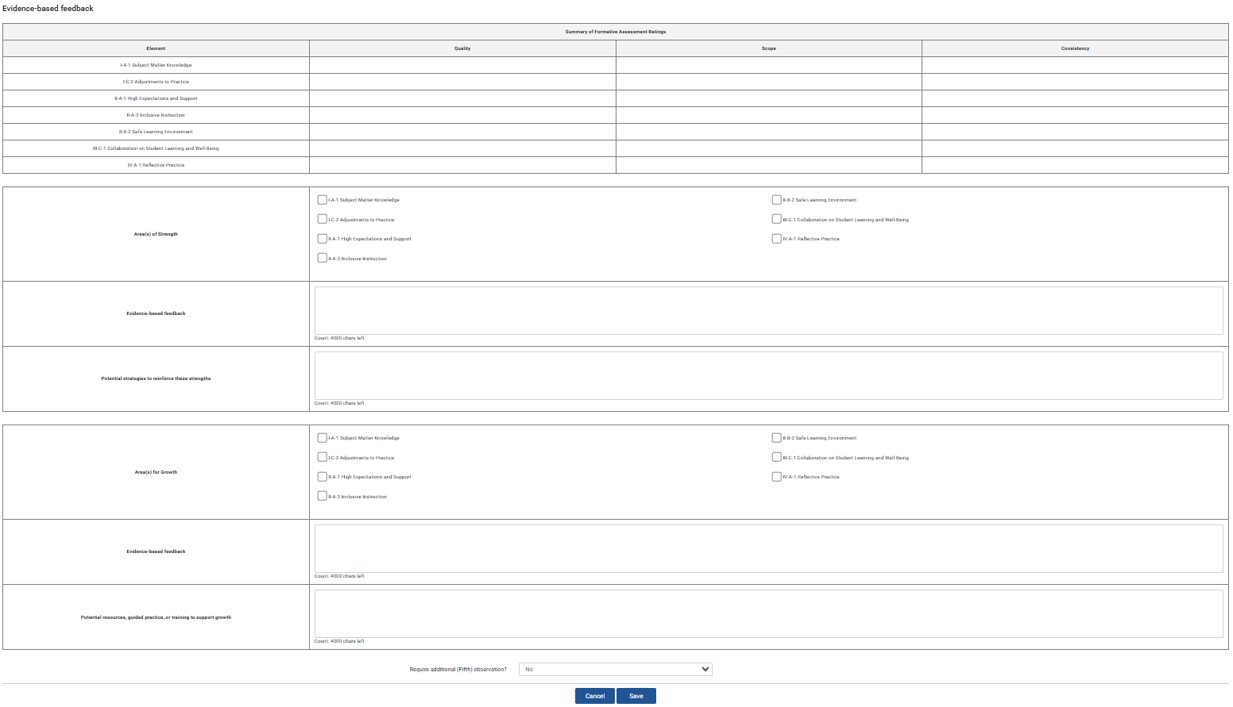
Layout for Overarching Feedback
Summary of Formative Assessment ratings
Automatically populated from selections above
Area(s) of strength
Entered by PS/SP after calibration
Area(s) for growth
Entered by PS/SP after calibration
Complete button
Will only appear once all required components entered
Notes:
Once ratings are completed for all seven elements, the SP and PS will move on to the overarching feedback.
[Click] This section begins with a pre-populated table summarizing all ratings selected above.
[Click] Supervisors will consider the candidate’s practice and share one or more areas of strength
[Click] and one or more areas for growth.
Each should include both evidence-based feedback and specific recommendations to support improvement.
[Click] Supervisors must click “Save” on this final section for the “Complete” button to appear

Slide 47
Closing the Formative Assessment
The TC will only be able to view assessment forms once supervisors select “Complete”
This button appears at the bottom of the form once all required components are filled in
If conducting a joint observation, both the SP and PS must select “Complete
Complete
The CM and PS can unlock completed assessment forms if an error is made by clicking “Edit”
The “Edit” button will only appear once both supervisors have marked the form “Complete”
Notes:
Like the observation forms, assessment forms will only be shared with the TC once both supervisors click “Complete”
The CM and PS can able to unlock completed assessments if an error is made

Slide 48
Summative Assessment
Notes:
The CAP cycle culminates with the Summative Assessment.

Slide 49
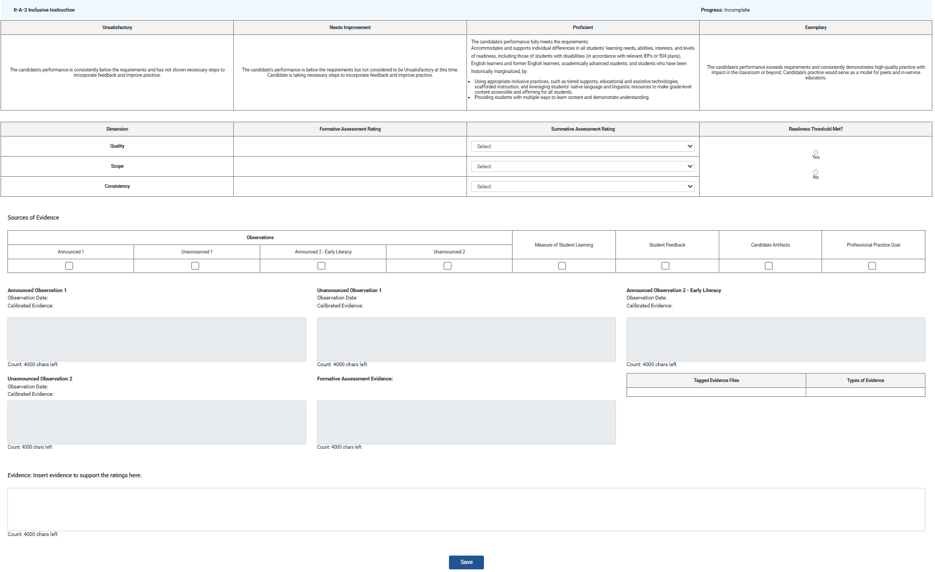
Layout for Each Element
Element-specific proficiency descriptors
For reference
Summative ratings and readiness threshold
Entered by PS/SP after calibration
Categories of evidence used to support selected ratings
Available evidence Automatically populated from observation forms and tagged evidence
Rationale
Entered by PS/SP
Save button
Click to save progress
Notes:
[Click] Like the Formative Assessment, each Summative Assessment element starts its proficiency descriptors
[Click] It also includes all available evidence, including sources included in the Formative Assessment and sources added since
[Click] The ratings section is expanded to include:
a summary of where quality, scope, and consistency landed during the Formative Assessment
followed by space to select updated ratings for the Summative Assessment
And yes/no radio bubbles to indicate whether readiness thresholds are met (at this stage, quality must be proficient, while scope and consistency may be needs improvement)
[Click] Supervisors will then check off the categories of evidence used to support the ratings. It is important that these boxes align with what is available in the pre-populated observations and tagged evidence files. If something is missing, it was likely not tagged to the correct element or evidence category when uploaded. If needed, the file can be re-uploaded and tagged.
[Click] Finally, supervisors will enter calibrated rationale for ratings based on the full body of evidence and click “Save”.

Slide 50

Evidence Categories
Supervisors must ensure these evidence expectations are met across elements:
Each category of evidence must be used to support the rating for at least one Essential Element
The rating for each Essential Element must be supported by two categories of evidence.
For Elements I-A-1, II-A-1, and II-B-2, observations must be used as one category of evidence
The platform does NOT automatically check for this, and cycles may be completed without all evidence requirements met. Sponsoring organizations must have systems in place to ensure these expectations are met for every candidate.
Notes:
As is outlined in detail with the CAP Guidelines, supervisors are now required to ensure that the following evidence expectations are met across elements:
Each category of evidence must be used to support the rating for at least one Essential Element
The rating for each Essential Element must be supported by two categories of evidence.
For Elements I-A-1, II-A-1, and II-B-2, observations must be used as one category of evidence
[Click] It is important to note that the platform does NOT automatically check for this.
In other words, there is no mechanism to indicate that a cycle cannot be closed if these expectations are not met.
Supervisors must have their own systems in place to ensure these expectations are met

Slide 51
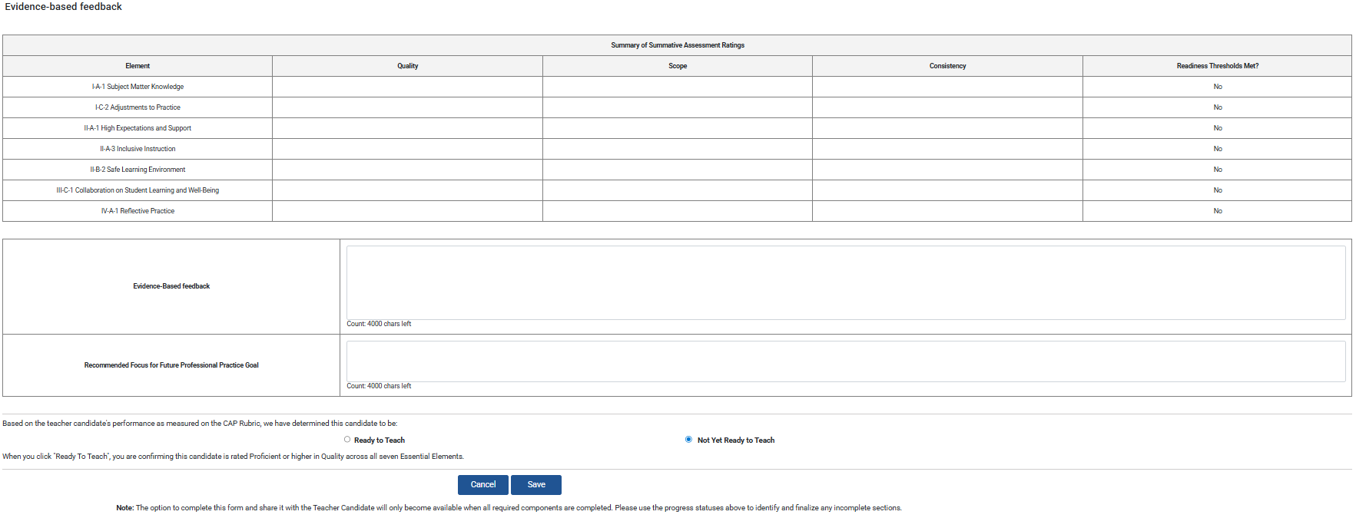
Layout for Overarching Feedback
Summary of ratings and thresholds met
Automatically populated from selections above
Evidence-based feedback and recommended goal
Entered by PS/SP after calibration
Ready to teach determination
Entered by PS/SP
after calibration
Make sure to select “Complete” before leaving for the summer! There is no way for the CM or PS to over-ride this step to end the cycle.
Complete button
Will only appear once all required components entered
Notes:
[Click] At the bottom of the form, you will see a pre-populated summary of ratings for each element.
[Click] Supervisors will then enter evidence-based feedback a recommended future professional practice goal.
[Click] The final step is to determine whether the candidate is or is not “Ready to Teach”
To select “Ready to Teach,” all readiness thresholds must be met to select
[Click] As with all other forms, the complete button will only appear once all required components of the form are finished. Both supervisors must select this button to share it with the TC.
[Click] Make sure to select “Complete” before leaving for the summer! There is no way for the CM or PS to over-ride this step to end the cycle.

Slide 52
Troubleshooting
Notes:
The next few slides include a consolidated list of ways to troubleshoot frequent problems that arise.

Slide 53
Common Challenges - Logging In
Problems | Solutions
I didn’t receive the email with my new username. | Some district firewalls block the autogenerated emails. If you do not see the email in your inbox or spam folder, reach out to the CM and ask for your CAP Online Platform username.
I logged in, but I do not see the candidate’s information | If you log in to the CAP Online Platform, but you cannot see the candidate cycle assigned to you, you have likely logged in through your personal ELAR account and not the account affiliated with your sponsoring organization. Reach out to the CM and ask for your CAP Online Platform username.
I used my CAP-specific credentials but am still having issues​ | If you log in with the correct username and are still having issues, log out and try clearing your web browser’s cache, opening an incognito browser, or using another browser. Then, log in again.
Notes:
If you did not receive the email with your new username.
Your district may have a firewall that blocked the autogenerated email. If you do not see the email in your inbox or spam folder, reach out to the CM and ask for your CAP Online Platform username.
[Click[ If you logged in, but do not see the candidate’s information
You have likely logged in through your personal ELAR account and not the account affiliated with CAP. Again, reach out to the CM and ask for your CAP Online Platform username.
[Click] If you used the CAP-specific credentials but are still having issues​
Log out and try clearing your web browser’s cache, opening an incognito browser, or using another browser. This will prevent your ELAR information from automatically populating when you try to log in again.

Slide 54
Common Challenges – Adding to Forms
Problems | Solutions
The TC cannot write in the Self-Assessment ​ | The Self-Assessment form does not become editable until the has entered all Rubric Summary rating and clicked “Complete.” ​
Observation Forms aren't showing as I expect​ | The PS may have changed it to a joint observation. You should be very clear on who is filling out which form. Toggling back and forth between the PS/SP version of the form and the PS only or SP only views will cause a loss of information this is not recoverable. Please make sure you communicate carefully before working to complete the forms. ​
Information was entered and then disappeared from an observation form | This could be for one of three reasons: The browser timed out while the SP/PS was typing (advise frequent saving) ​ The SP/PS accidentally saved over each other’s information (advise clear communication about who will enter information in each field) The SP/PS toggled back and forth between the individual and joint versions of the form (advise option is only changed once at the start)
Notes:
If the TC cannot write in the Self-Assessment ​
They likely did not click the “Complete” button at the bottom of the Rubric Summary. Instruct them to go to the very last element and click this button.​
[Click] If the observation forms aren't showing up with the layout you expect​
The PS may have changed it to a joint observation. Make sure to communicate before you make any further changes as toggling back and forth between versions of the form may cause a loss of information this is not recoverable.
​
[Click] If information was entered and then disappeared from an observation form this could be for one of three reasons:
The browser may have timed out while you were typing. Make sure to use the save buttons frequently.
The PS may have accidentally saved over each your information in a calibrated box.
One of the supervisors may have toggled back and forth between the individual and joint versions of the form resulting in data loss

Slide 55
Common Challenges – Completing Forms
Problems | Solutions
The “Complete” button is missing for a form | Confirm that all required components (indicated with bold text and an asterisk) have information entered.
The CAP Form’s status section says a form we finished is incomplete | If all required components are complete, confirm that you have checked the “Complete” box. ​ For forms that both the you and the PS complete together (e.g. Announced Observation Forms and Assessment Forms) BOTH supervisors must mark the form complete.​
Notes:
If “Complete” button is missing at the end of a form
Confirm that all required components (indicated with bold text and an asterisk) have information entered.
[Click] If the CAP Form’s status section says a form you finished is incomplete
First, confirm that all required components are complete,
If so, confirm that you have checked the “Complete” box. ​As a reminder, forms that both the you and the PS complete together (e.g. Announced Observation Forms and Assessment Forms) require that BOTH supervisors mark the form complete.​

Slide 56
Thank You
Notes:
That marks the end of this training. I hope the information was helpful and wish you success as you open new cycles for the coming academic year.

