Slide 1
Edwin Analytics Reports for Educator Preparation Programs
Webinar – Dec. 2014
Campbell McLean
MA Department of Elementary and Secondary Education – Center for Educator Effectiveness

Slide 2
Objectives:
To make sponsoring organizations
able to access Edwin Analytics and run
reports.
To answer questions sponsoring organizations have about Edwin.
To inform sponsoring organizations about where to get more information about using Edwin.

Slide 3
What is Edwin Analytics?
The umbrella under which all analytical tools are housed.
It includes ALL reports formerly included in the Education Data Warehouse
Reports geared to the Superintendent down to the classroom teacher and back to the educator preparation programs
Additional reports include the Early Warning Indicator System and Postsecondary Enrollment/Outcomes

Slide 4
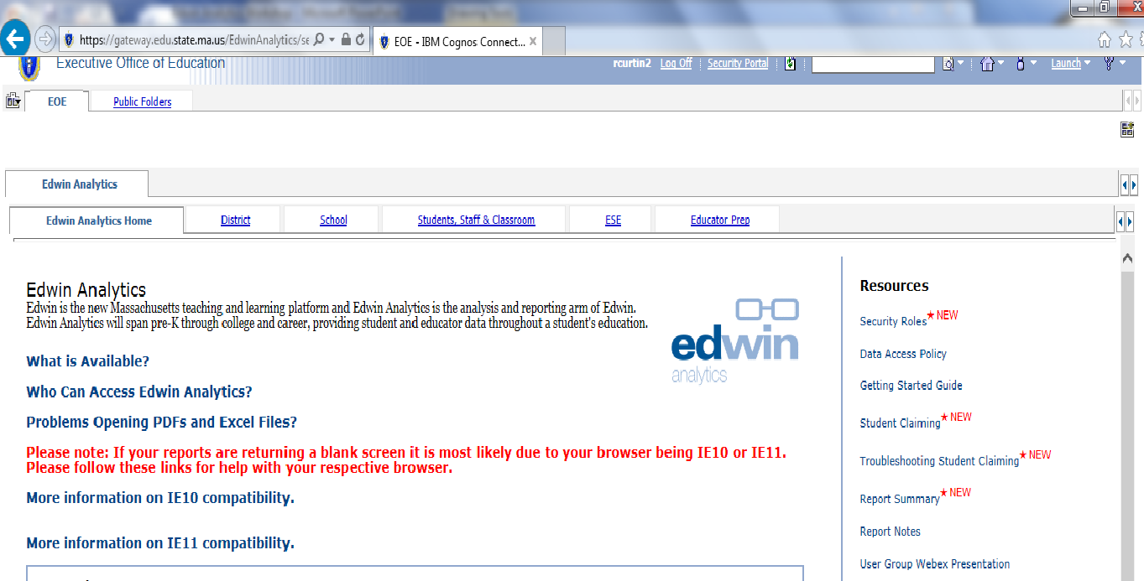
Homepage - Access Depends on Role

Slide 5
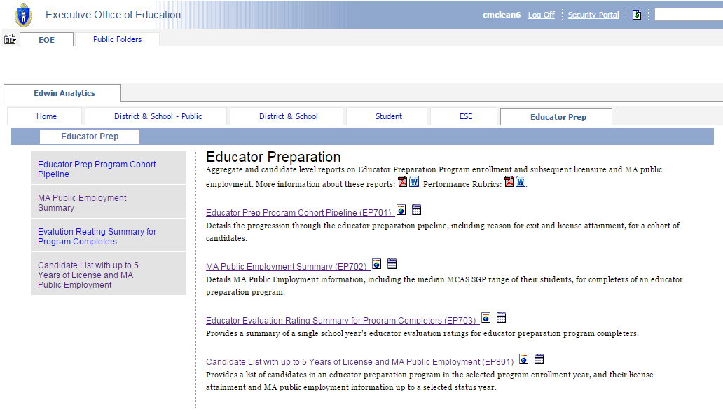
Educator Preparation Program Page

Slide 6
Educator Preparation Programs in Edwin Analytics
Four reports currently available about educator preparation programs
Developed with both internal and external stakeholders
Not available to the public; tools for programs to use for continuous improvement

Slide 7
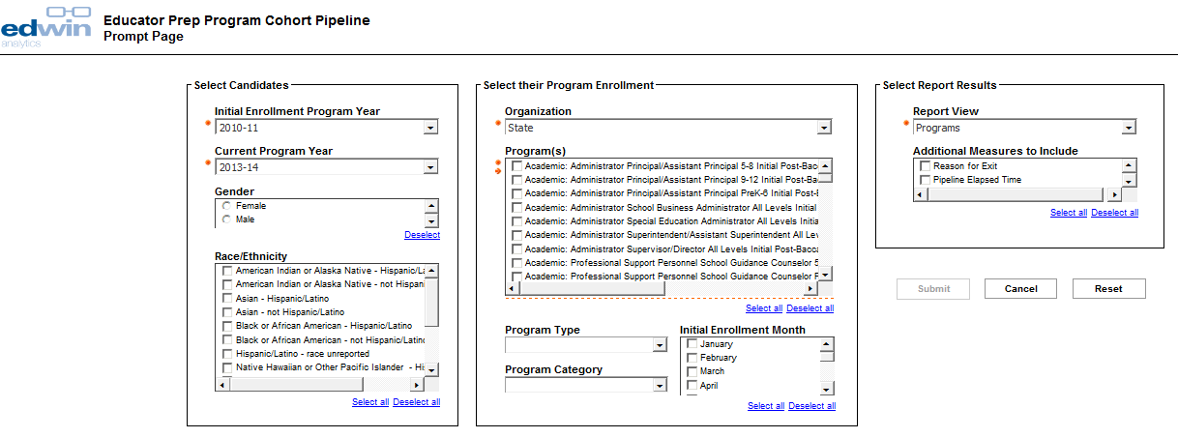
Example Prompt Page

Slide 8
EP701 – Educator Prep Program Cohort Pipeline
Report that provides aggregate details on the progression through the educator preparation pipeline, including reason for exit and license attainment for a cohort of candidate
Organization must have submitted complete 3-point data to have a full report
Could answer some of these questions:
What are the enrollment, persistence, and completion trends for a cohort from an individual preparation program, as well as statewide?
Do candidates tend to enroll in preparation programs at the baccalaureate or post-baccalaureate level?
What is the average elapsed time between program enrollment and completion?

Slide 9
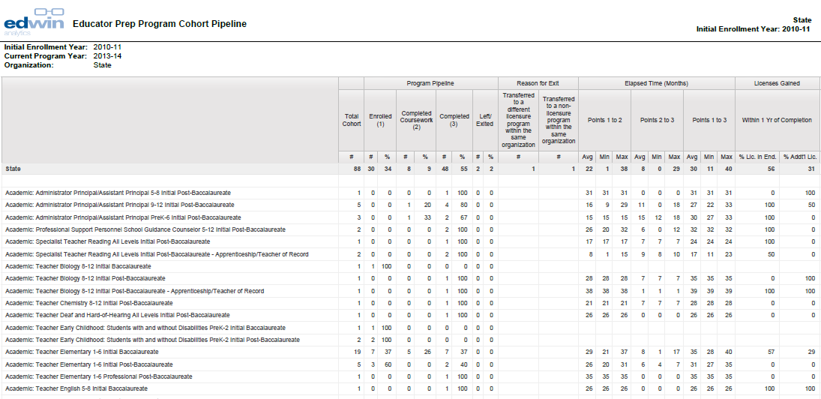
EP701 – Educator Prep Program Cohort Pipeline – by Program

Slide 10
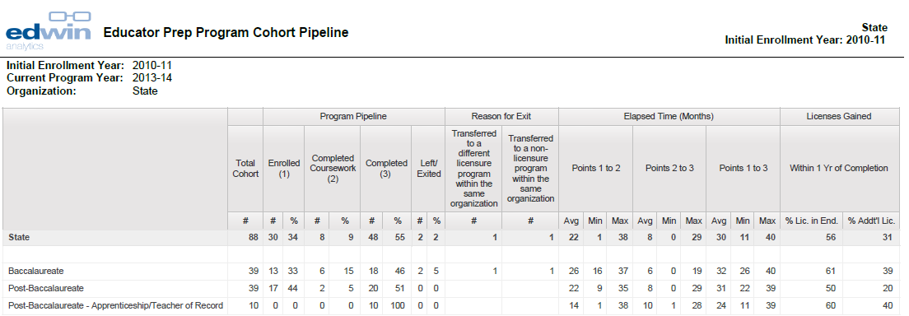
EP701 – Educator Prep Program Cohort Pipeline – by Program Type

Slide 11
EP702 – Massachusetts Public Employment Summary
Report that provides MA Public Employment information, including MCAS SGP range of their students, for completers of an educator preparation program
Could answer some of these questions:
What percent of program completers gain employment in MA public districts in a selected school year?
What types of positions do program completers hold (teachers, paraprofessionals, etc.) in MA public districts after completing a program?
Which MA public districts are completers finding employment?
Do completers retain employment in MA public districts?
What is the average elapsed time between program completion and MA public employment?

Slide 12
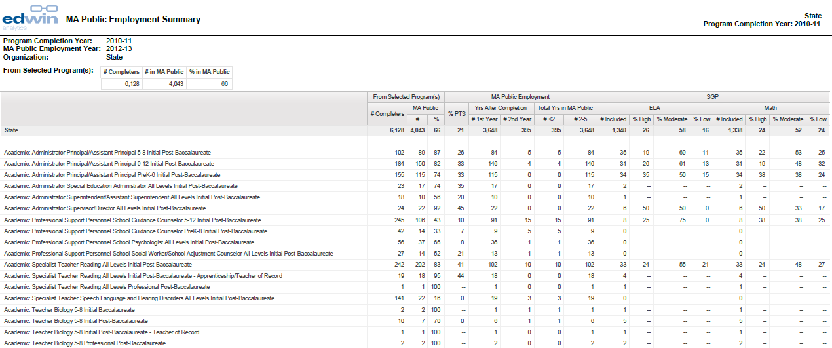
EP702 – Massachusetts Public Employment Summary – by Program

Slide 13
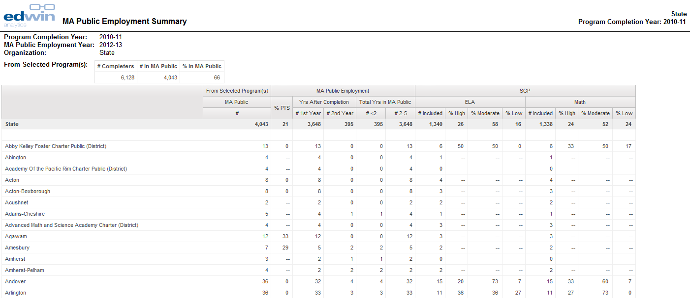
EP702 - Massachusetts Public Employment Summary – by District

Slide 14
EP703 – Educator Evaluation Rating Summary – by Program
Report that provides MA Public Educator Evaluation Rating information for completers of an educator preparation program
Could answer some of these questions:
What are the educator evaluation ratings of completers who were evaluated as Teachers? As Administrators?
Is there any variance in educator evaluation ratings between programs?
How did a set of completers perform on a particular standard?
What percent of completers received overall ratings of Exemplary, Proficient, Needs Improvement, or Unsatisfactory?
How do evaluation ratings change over time for a given program?

Slide 15
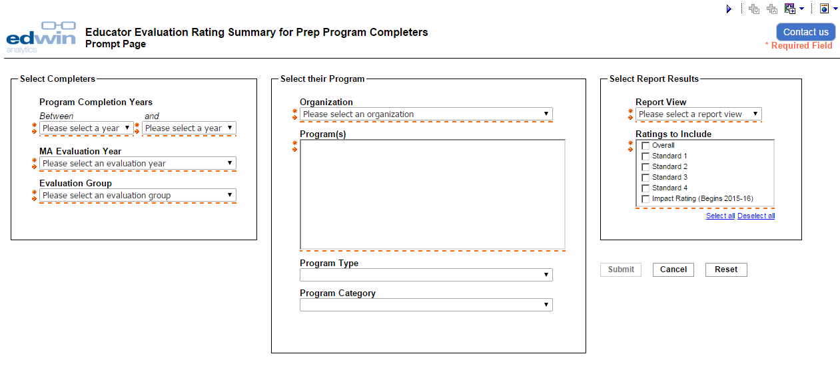
EP703 – Educator Evaluation Rating Summary – by Program

Slide 16
EP703 – Educator Evaluation Rating Summary – by Program

Slide 17
EP703 – Educator Evaluation Rating Summary – by Program

Slide 18
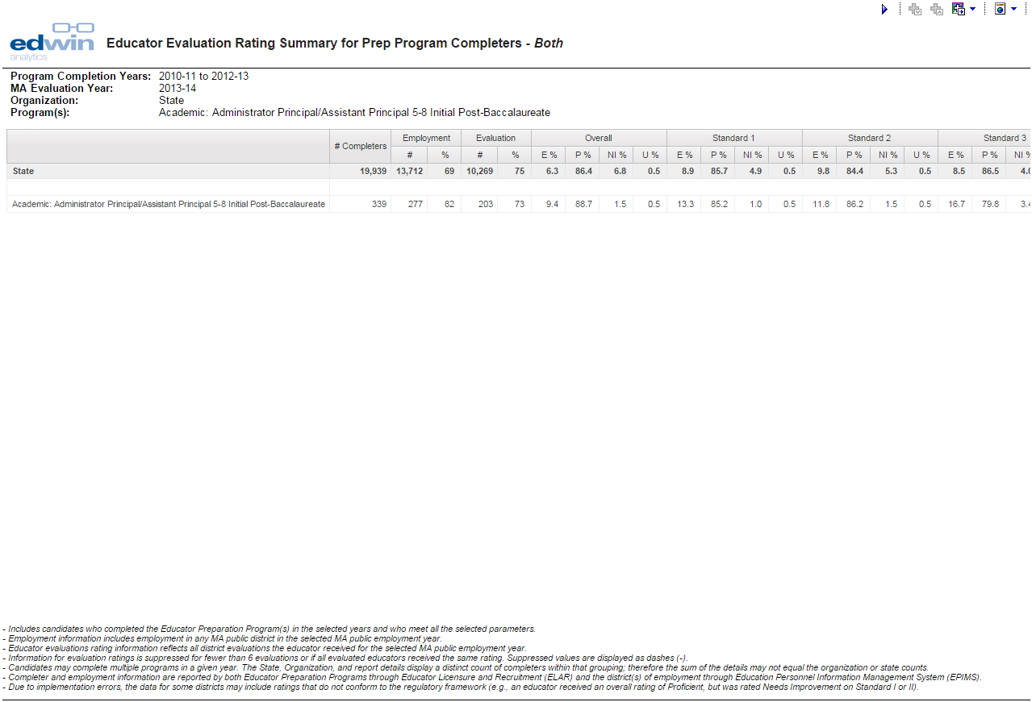
Footnotes (bottom of each completed report)

Slide 19
Footnotes (bottom of each completed report)
- Includes candidates who completed the Educator Preparation Program(s) in the selected years and who meet all the selected parameters.
- Employment information includes employment in any MA public district in the selected MA public employment year.
- Educator evaluations rating information reflects all district evaluations the educator received for the selected MA public employment year.
- Information for evaluation ratings is suppressed for fewer than 6 evaluations or if all evaluated educators received the same rating. Suppressed values are displayed as dashes (-).
- Candidates may complete multiple programs in a given year. The State, Organization, and report details display a distinct count of completers within that grouping; therefore the sum of the details may not equal the organization or state counts.
- Completer and employment information are reported by both Educator Preparation Programs through Educator Licensure and Recruitment (ELAR) and the district(s) of employment through Education Personnel Information Management System (EPIMS).
- Due to implementation errors, the data for some districts may include ratings that do not conform to the regulatory framework (e.g., an educator received an overall rating of Proficient, but was rated Needs Improvement on Standard I or II).

Slide 20
EP801 – Candidate List
Report that provides a list of candidates in an educator preparation program in selected program enrollment year, and their license attainment and MA public employment information since completion up to a selected status year
Could answer some of these questions:
Which candidates are enrolled in a particular program in a given year, and what are their licensure and employment information?
Did candidates gain a license in the fields they were endorsed in? What other licenses did they gain after completing the program?
Do candidates find employment teaching subjects they were endorsed in?

Slide 21
EP801 – Candidate List

Slide 22
How Do I Get A User Name Or Password For Edwin?
Your Ed Prep contact person should contact ESE via the Ed Prep Inbox (edprep@doe.mass.edu) to request access
Access requests should include:
Name of Sponsoring Organization
First and last name
Email address
Phone number
Where possible, please group requests in a list

Slide 23
Additional Edwin Information
Upcoming Info Resources (Ed Prep website):
1-pager, User Guide, FAQ, video – January 2015
Edwin’s homepage: www.doe.mass.edu/edwin
Technical questions about Edwin: edprep@doe.mass.edu
Edwin’s Twitter Account: @Edwin_DESE

Slide 24
Questions and Discussion

