Slide 1
April 2025
Early Literacy Interim Review Overview

Slide 2
Meet The Early Literacy Specialists
Siobhan Allen
Jessica Bazinet

Slide 3
Two Early Literacy Review Processes: Formal and Interim Reviews
Formal Reviews
The Early Literacy Program Approval Criteria will be integrated into the formal review process for sponsoring organizations already scheduled to undergo formal review between SY2024-25 and SY2028-29, as outlined in the 2023 Guidelines for Educator Preparation Program Approval.
Interim Reviews
Sponsoring organizations with formal reviews scheduled in SY2028-29 and beyond will undergo literacy-specific interim reviews on an accelerated timeline. DESE will conduct these stand-alone Early Literacy Interim Reviews of the four relevant licensure programs over the next four years using a review process that is similar to the formal review process and aligned to the Early Literacy Program Approval Criteria.

Slide 4
Goals for Early Literacy Interim Review
Effective
Efficient
Consistent
Equity-Driven

Slide 5
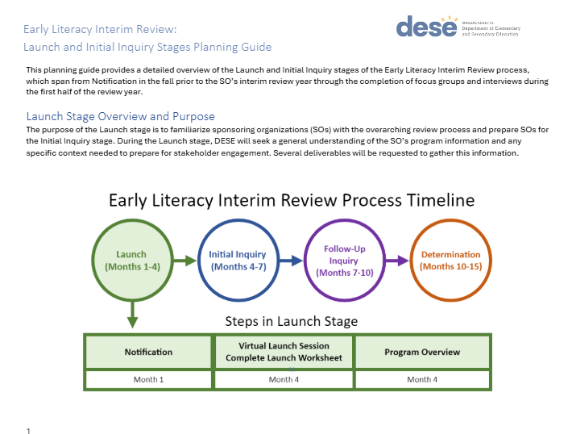
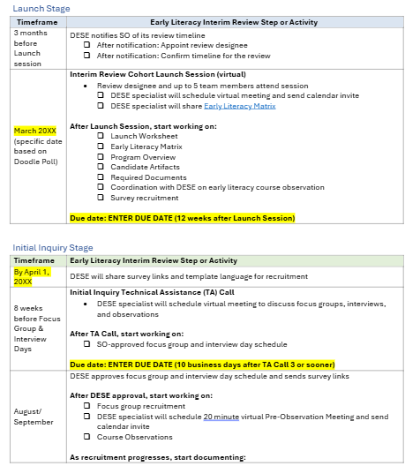
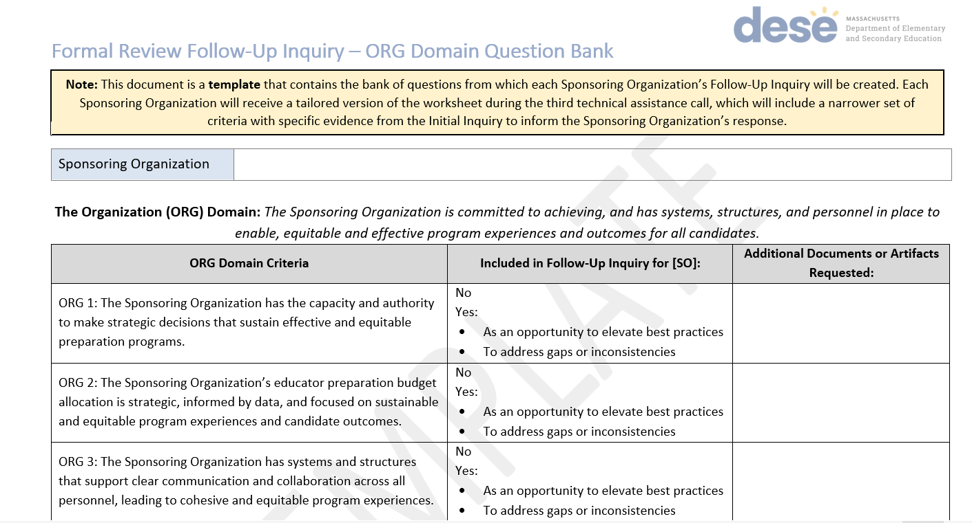
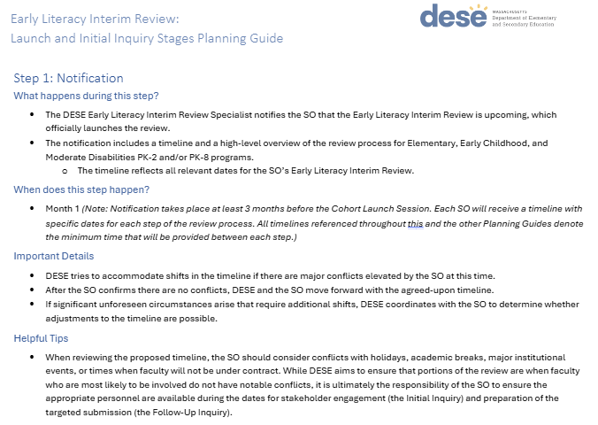
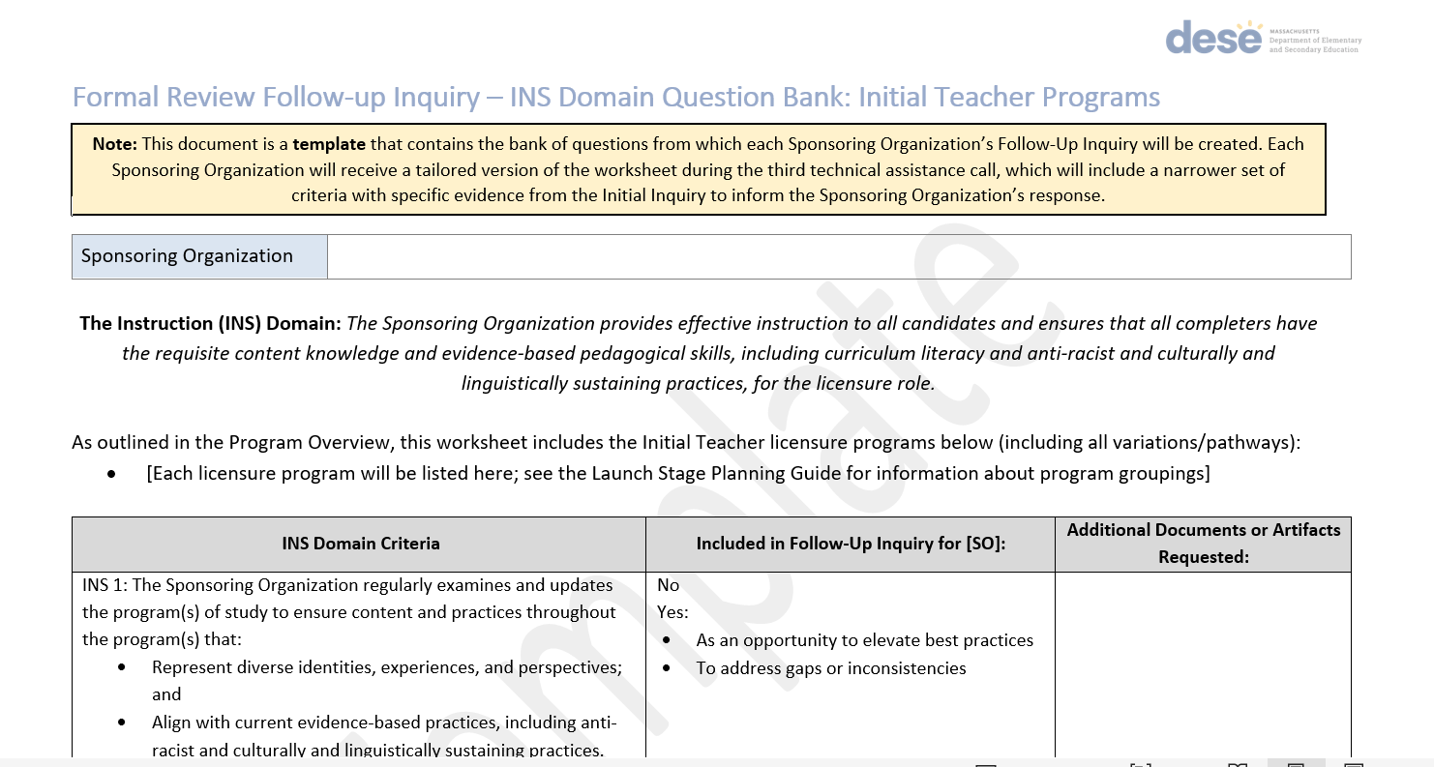
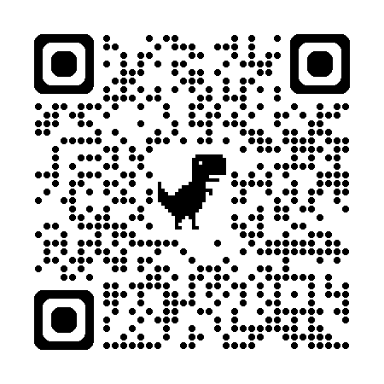
Early Literacy Interim Review Toolkit:
Planning Guides for each Stage
What is required for this step in the process?
What are helpful tips or considerations for this step?
Specific details about required documents, candidate artifacts, recruitment and outreach, etc.
Early Literacy Interim Review Template Timeline
Follow-Up Inquiry Question Banks
https://www.doe.mass.edu/edprep/review/toolkit/early-literacy-interim/

Slide 6
Important to Note
The interim review process will align with the updated* "flipped" formal review process (with a narrower lens and shorter timeline)
The interim review is not a full review of all programs offered by your organization; DESE will only collect evidence for the Early Literacy Program Approval Criteria
*See the 2023 Guidelines for Educator Preparation Program Approval

Slide 7
Early Literacy Interim Review Timeline

Slide 8
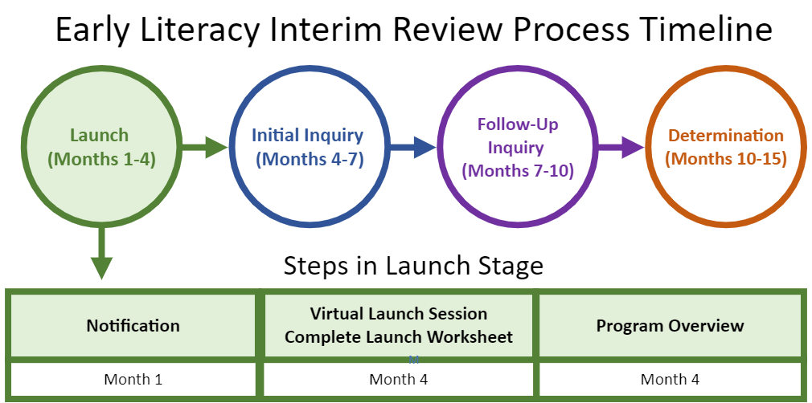
Early Literacy Interim Review Process Timeline: Launch

Slide 9
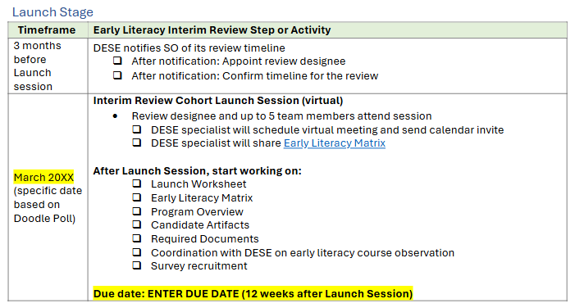
Early Literacy Interim Review Timeline: Launch
https://www.doe.mass.edu/edprep/review/toolkit/early-literacy-interim/

Slide 10
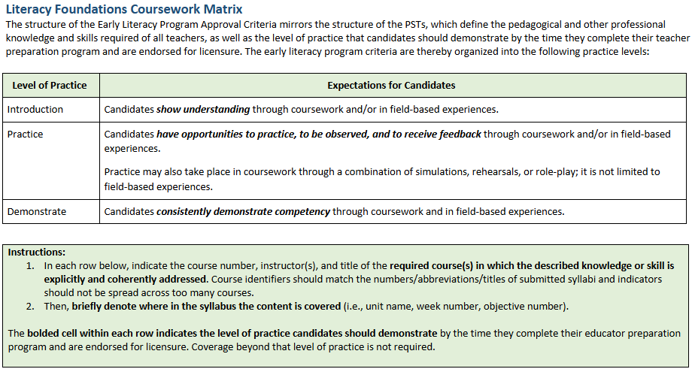
Early Literacy Matrix

Slide 11
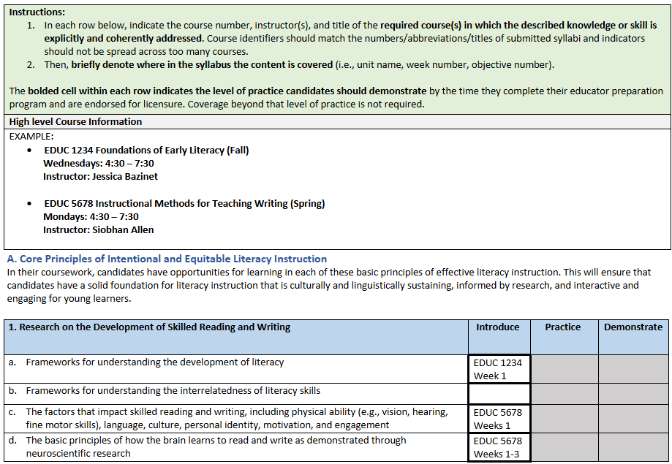
Early Literacy Matrix - Example
High Level Course Information
Semester
Course Number and Session Information

Slide 12
Early Literacy Matrix Example
Early Literacy Matrix
When you are completing the DEMONSTRATE column, be sure to also include where the criteria was introduced and practiced as well.

Slide 13
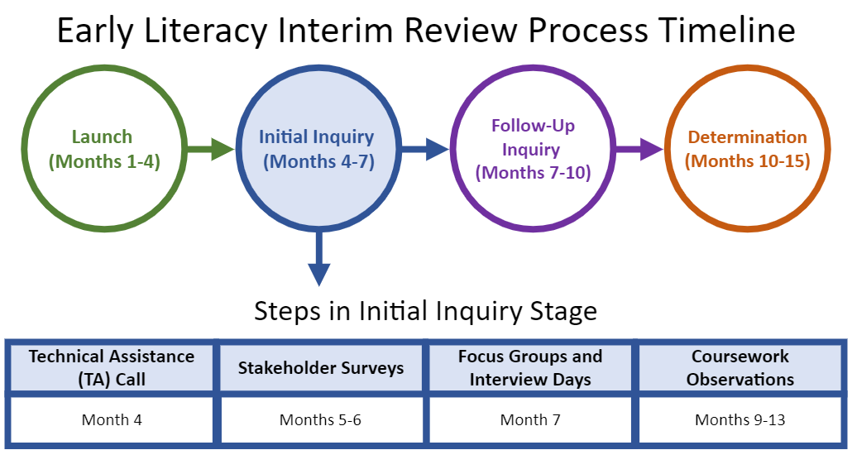
Early Literacy Interim Review Process Timeline: Initial Inquiry
Month 6
Months 4-5

Slide 14
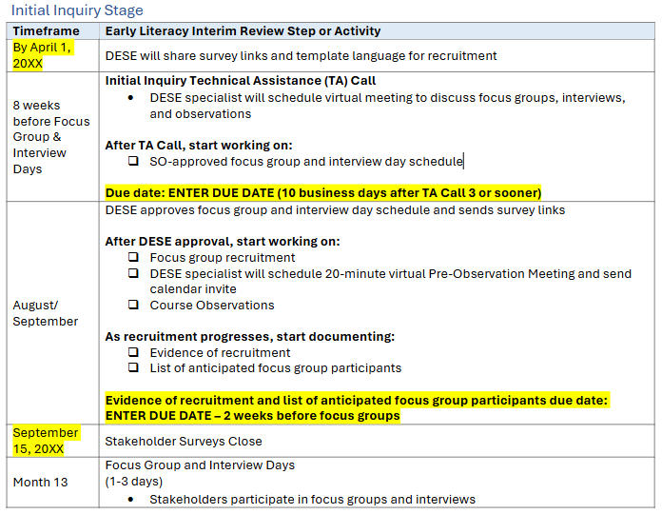
Early Literacy Interim Review Timeline: Initial Inquiry
https://www.doe.mass.edu/edprep/review/toolkit/early-literacy-interim/

Slide 15
Survey Distribution
DESE will create three surveys for your organization and send links to your review designee:
Ed Prep Personnel Survey
PK-12 Partner & Supervising Practitioner Survey
Candidate & Completer Survey
DESE asks your organization to collect survey data from your stakeholders about their experiences relative to the Early Literacy Program Approval Criteria by:
Sharing the survey with all relevant stakeholders from the last 3 years.
Emphasizing the importance of these surveys with your stakeholders
DESE has also included an editable social media post to help with recruitment, located in Appendix C of the Launch and Initial Inquiry Planning Guide

Slide 16
Focus Groups and Interviews
The DESE team hears directly from the organization’s stakeholders about the organization’s approach to meeting the Early Literacy Program Approval Criteria through virtual focus groups and interviews.
Stakeholder groups may include:
Candidates and completers
Faculty of early literacy coursework
Program Supervisors
Partners
Supervising Practitioners
Field Based Experience Personnel
Leadership at the organization

Slide 17
Course Observations
Pre-Observation Meetings
Course Observations
Syllabi Review

Slide 18
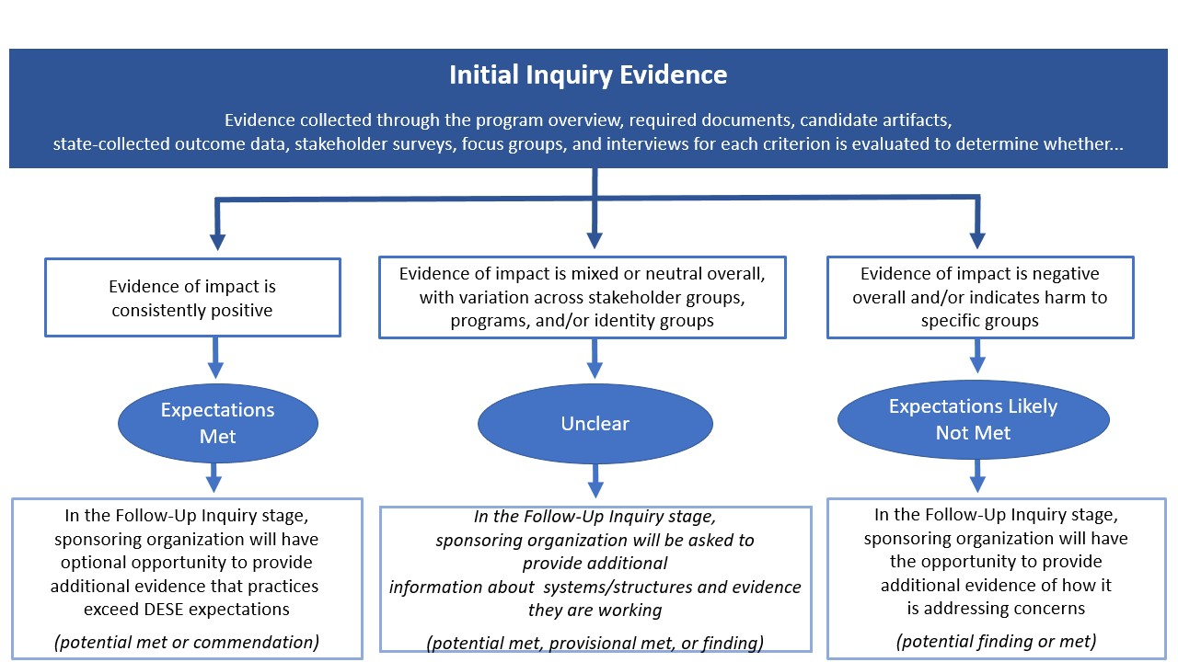
Initial Inquiry Evidence

Slide 19
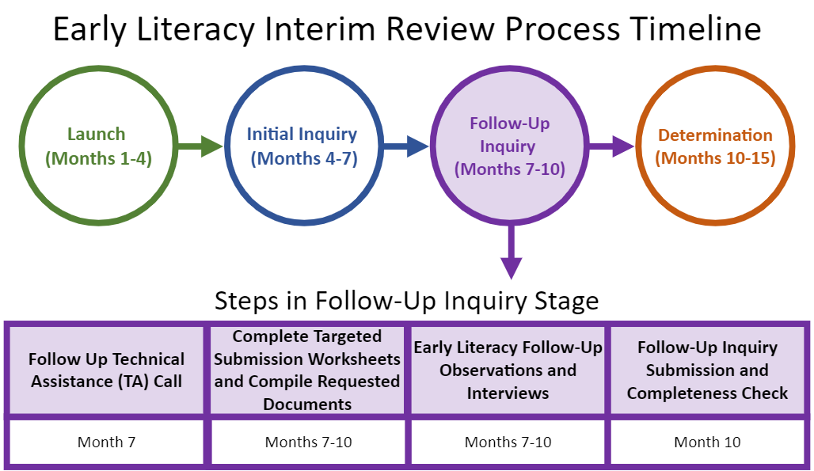
Early Literacy Interim Review Process Timeline: Follow Up Inquiry

Slide 20
Early Literacy Interim Review Timeline: Follow Up Inquiry
https://www.doe.mass.edu/edprep/review/toolkit/early-literacy-interim/

Slide 21
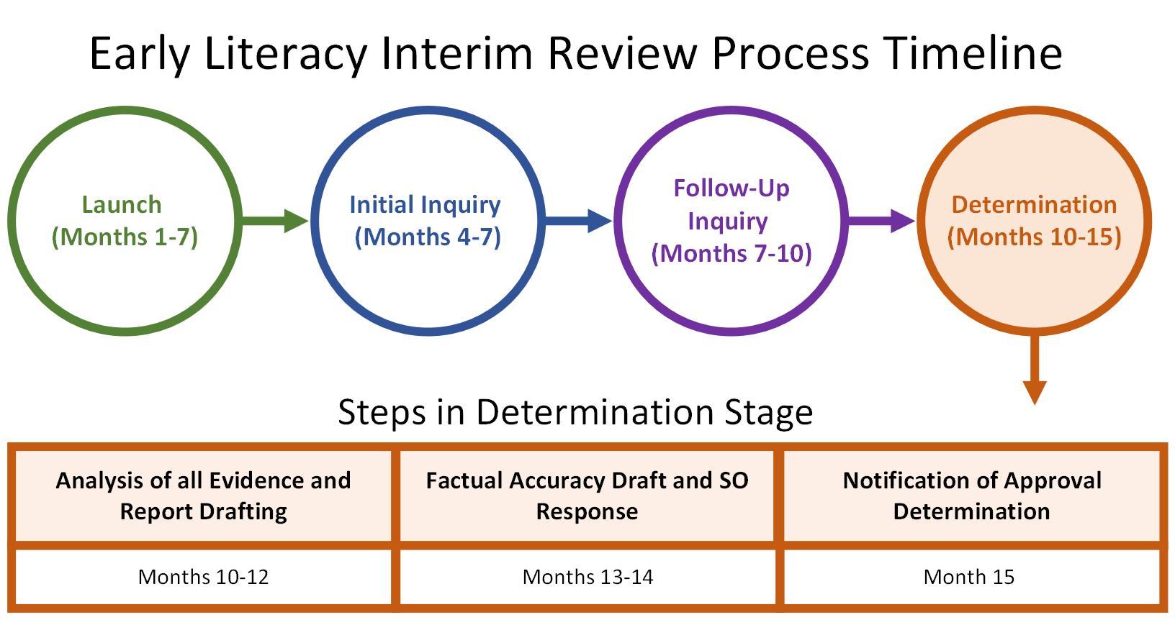
Early Literacy Interim Review Process Timeline:Determination

Slide 22
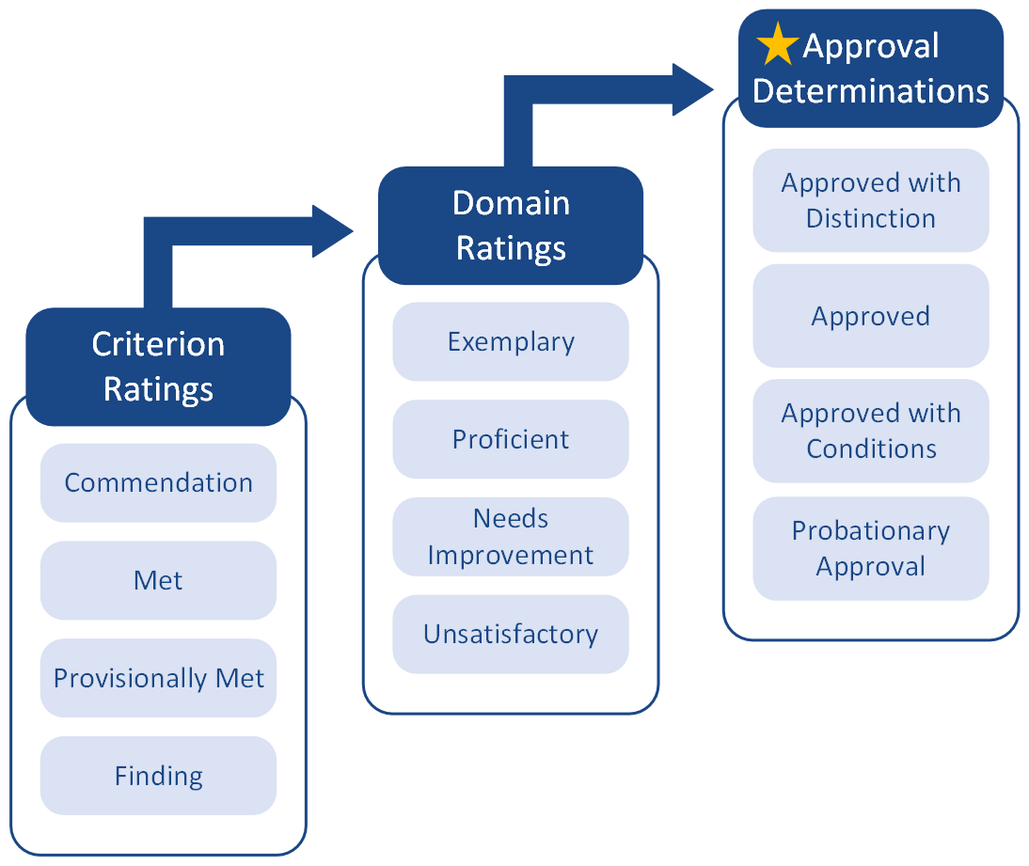
Decision-Making in Interim Reviews
DESE considers the totality of evidence to make judgments at the criterion level for the Early Literacy Program Approval Criteria only. The criterion-level ratings inform domain ratings which, in turn, inform the approval recommendation made to the Commissioner.
Each Early Childhood, Elementary, Moderate Disabilities PK-2, and Moderate Disabilities PK-8 Initial program will receive an approval determination
Programs granted Approved with Conditions or Probationary Approval will complete an improvement plan
Formal Reviews for each organization will take place approximately 3 years after the Interim Review and will include both Program Approval Criteria and Early Literacy Program Approval Criteria

Slide 23
Early Literacy Interim Review Timeline: Determination
https://www.doe.mass.edu/edprep/review/toolkit/early-literacy-interim/

Slide 24
educatorpreparation@mass.gov
https://www.doe.mass.edu/edprep/review/toolkit/early-literacy-interim/

