Slide 1
Supporting Sponsoring Organizations with Training for Program Supervisors and Supervising Practitioners
Virtual Drop-In Session April 1, 2025
11:00 AM

Slide 2
Welcome
As you enter, please share something that has recently brought you joy in the chat.
Please rename yourself with your name and organization
Example: Jessica.DESE

Slide 3
Agenda
Agenda
DESE Vision
Helpful Tips from a Former SP
Discussion/Breakout Rooms
Share Out

Slide 4
To ensure that all students have an equitable education, we must ensure that all educators are prepared to be effective, meaning they use evidence-based practices, including anti-racist and culturally and linguistically sustaining practices, that support all students to thrive.

Slide 5
Framing Our Work
This session is an opportunity for us to learn, exchange ideas, and discuss both successes and challenges with partners and colleagues who understand our work and can help support and enhance our practices.
FBE 3: The Sponsoring Organization supports and monitors all Supervising Practitioners and Program Supervisors to ensure that all candidates receive robust and equitable supervision in their licensure field, including high-quality feedback and evaluation that prepare them to be effective educators.
FBE 5: Performance assessments are implemented consistently within and across programs to improve practice and ensure only candidates who are ready for full responsibility in the licensure role are endorsed.

Slide 6
Helpful Tips From a Former SP
From a former SP

Slide 7
Clearly state (and document) expectations for each role
Clear communication chain with contact information
From a former SP

Slide 8
Create a visual timeline/checklist with embedded milestones and completion dates
From a former SP

Slide 9
Share coursework syllabi so PSs and SPs can have context of content that is being taught so they can make connections with current placement experiences
Newsletter/Email Updates
From a former SP

Slide 10
Share - CAP Handbook - Informational videos and/or trainings
about CAP from your organization or DESE - Information about culturally and
linguistically sustaining practices
From a former SP

Slide 11
Share the specific criteria from the Program Approval Criteria (FBE,PAR)
*Early Literacy Program Approval Criteria if applicable
From a former SP

Slide 12
Share examples of high-quality feedback
From a former SP
Non-Example | Example
Great classroom management today! Keep working on consistency. | You introduced the new attention signal effectively today. Practicing the signal with the students before the lesson started communicated clear expectations. They remembered the signal and followed your directions precisely. At the end of the lesson, students didn’t freeze when you used the signal, so you repeated the signal rather than trying to talk over the students. This reinforces the importance of respecting the speaker. Reinforce this routine for yourself and your students by asking students to briefly practice the attention signal before your lesson each day this week.
Targeted
Actionable
High-Quality Feedback QRG

Slide 13
Consider platforms/sites to have all supporting information in one place (Google Classroom, Google Site, Link within Organization, etc.)
From a former SP

Slide 14
PDPs
Professional Development
Tuition Incentives
From a former SP

Slide 15
Helpful Tips From a Former SP Checklist
Clearly state (and document) expectations for each role/Communication Chain with Contact Information
Create a visual timeline/checklist with embedded milestones and completion dates
Share coursework syllabi so PSs and SPs can have context of content that is being taught so they can make connections with current placement experiences Newsletter/Email Updates
Share - CAP Handbook - Informational videos and/or trainings about CAP from your organization or DESE - Information about culturally and linguistically sustaining practices
Share the specific criteria from the Program Approval Criteria to (and the Early Literacy Program Approval Criteria if applicable)
Share examples of high-quality feedback
Consider platforms/sites to have all supporting information in one place (Google Classroom, Google Site, Link within Organization, etc.)
PDPs, Professional Development, Tuition Incentives
From a former SP

Slide 16
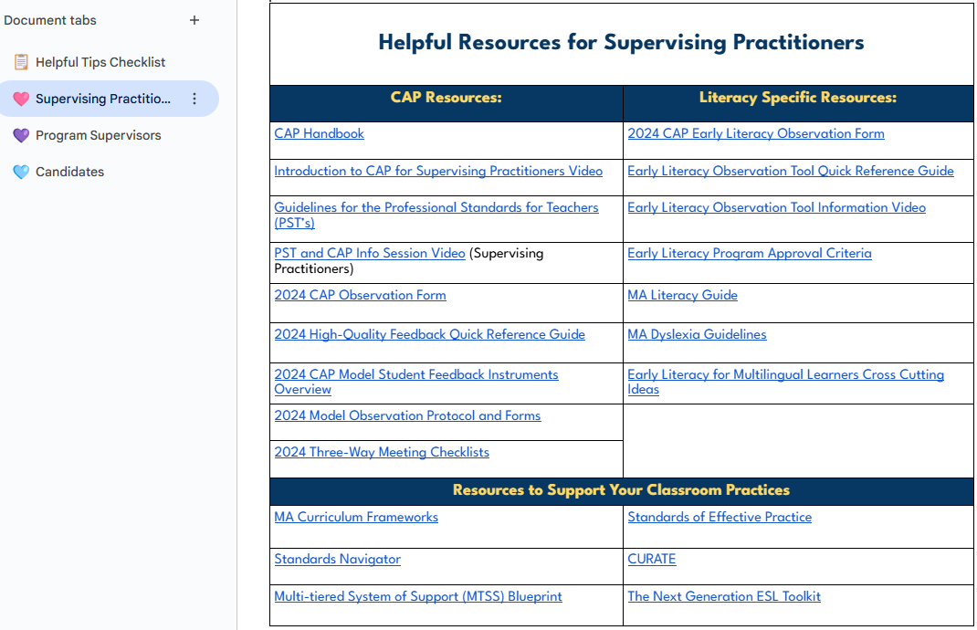
Helpful Resources for Supervising Practitioners – Image Showing a Preview of A Linked Resource

Slide 17
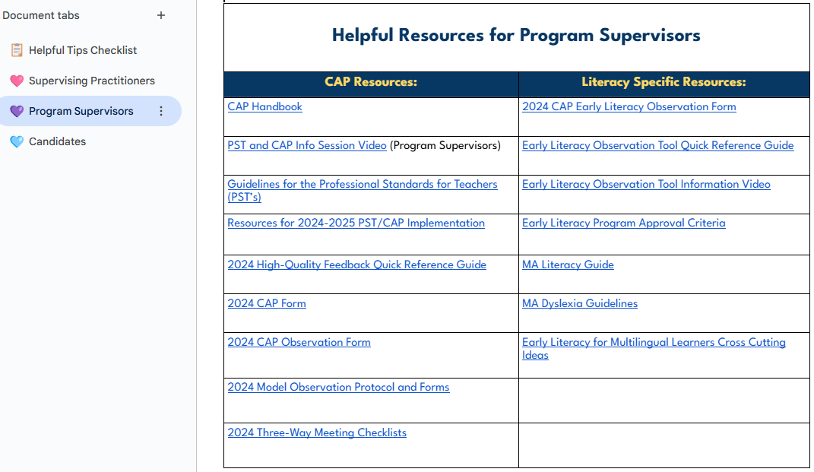
Helpful Resources for Program Supervisors – Image Showing a Preview of A Linked Resource

Slide 18
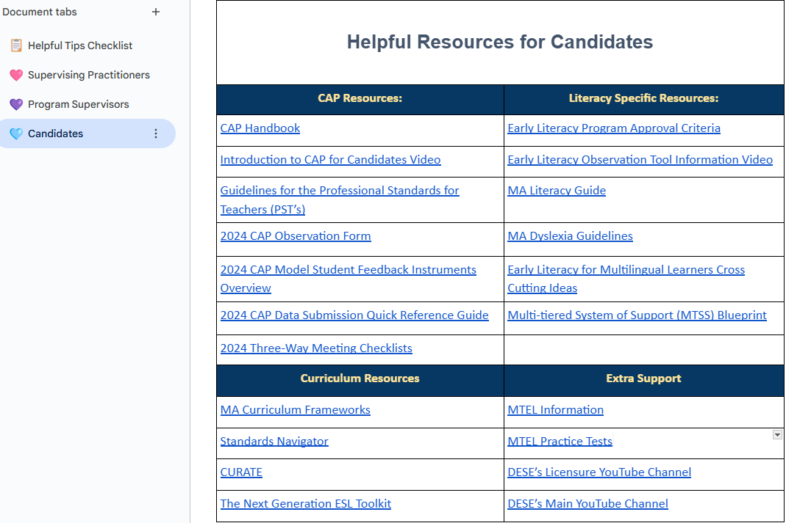
Helpful Resources for Candidates – Image Showing a Preview of A Linked Resource

Slide 19
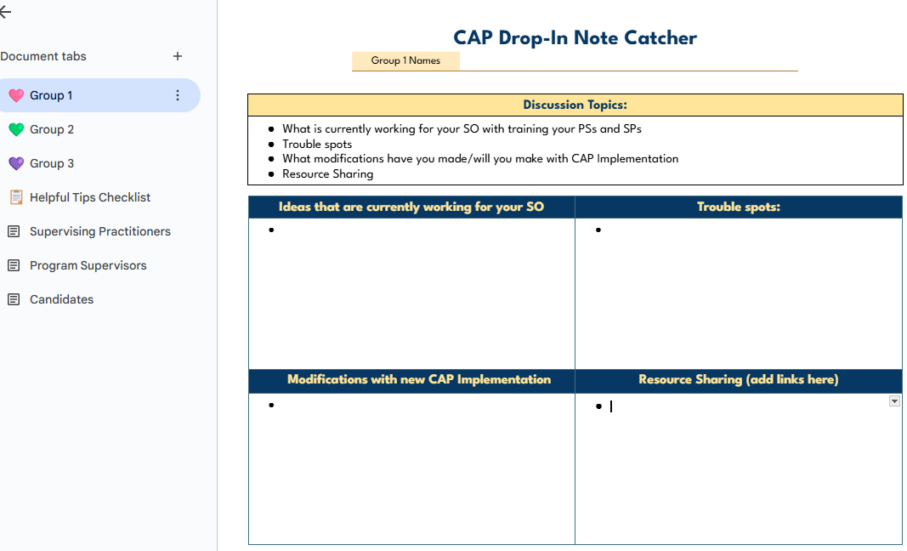
Let’s Share

Slide 20
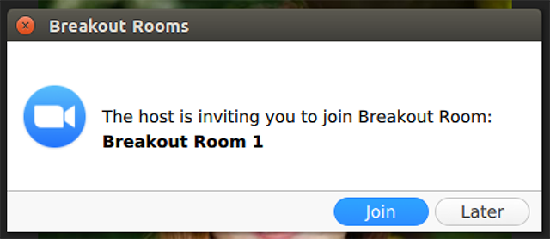
Breakout Rooms
You should see this appear on your screen
If you do not see the invitation pop up on your screen, you can find your virtual room by clicking on the breakout rooms icon

Slide 21
Share Out
Summary of Note Catchers and Supporting Resources

Slide 22
Thank you

