Slide 1
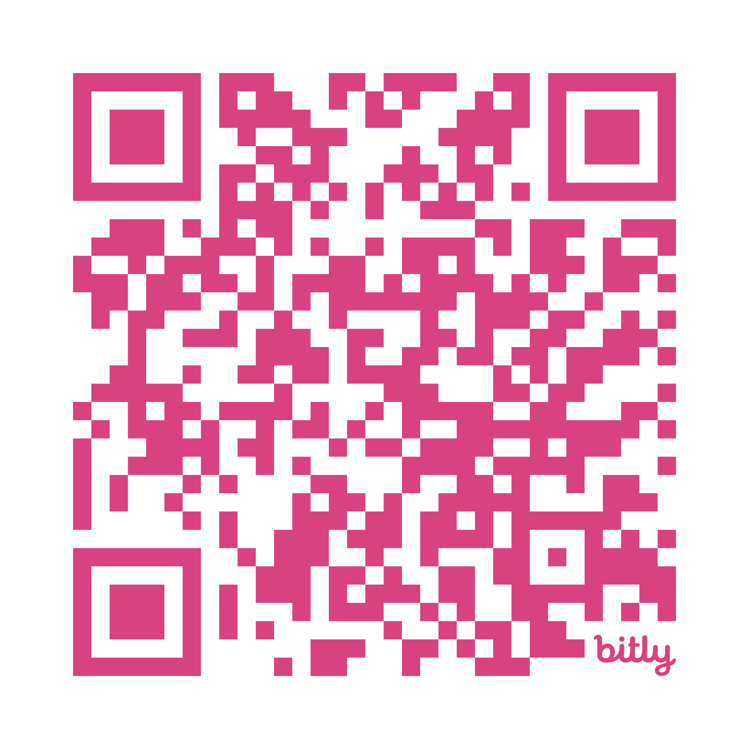
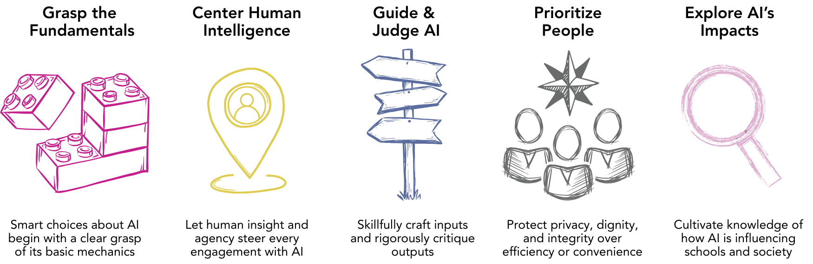

The Principles of AI Literacy
https://bit.ly/MA-ai-literacy
Facilitation & Discussion Guide Slides for Facilitators
(Slides correspond to sample 2.5-hour agenda)

Slide 2
Note
These optional slides correspond to the sample agendas provided in the AI Literacy for Massachusetts Educators, Facilitation & Discussion Guide, which is aligned with DESE’s AI Literacy for Educators online module.
These slides are optional and provided for reference; facilitators are encouraged to modify them to suit local goals and contexts.

Slide 3

Agenda
Sharing our own thoughts about AI
Review and discussion of Principles 1-5
Principles in Action — Example Scenarios
Group Debrief
Closing

Slide 4
Opening Question: Turn & Talk
1 minute per person
When you were going through school, what was new classroom technology of the time, and how was it used?
How do you think your teachers felt when it was introduced?

Slide 5
Review The Five Principles

Slide 6
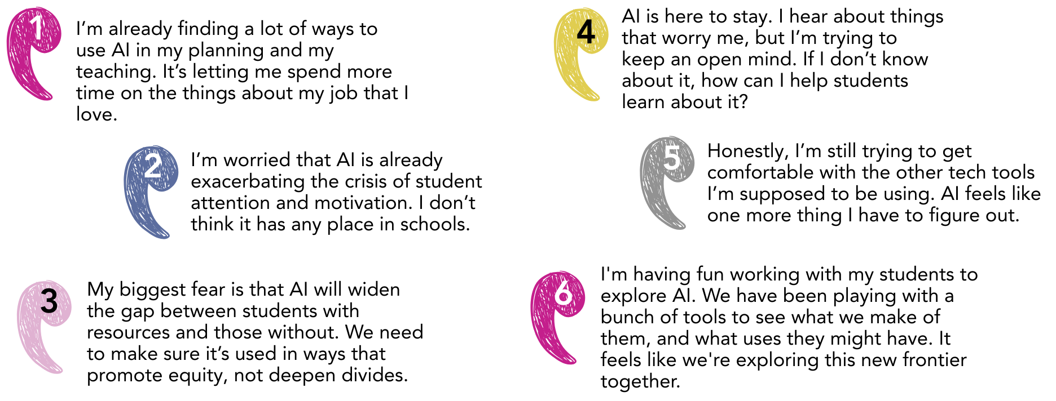
Perspectives

Slide 7



Groups: Principle 1 or Principle 2
Part I: 10 minutes
Read (front and back)
Answer Questions
Share
Part II: 10 minutes (5 min each)
Find a partner from the other Principle.
Share the most important things to know and understand about the Principle their group explored.
Share answers to reflection questions.
PRINCIPLE 1
Grasp the Fundamentals
Smart choices about AI begin with a clear grasp of its basic mechanics
PRINCIPLE 2
Center Human Intelligence
Let human insight and agency steer
every engagement with AI

Slide 8

Principle 3
PRINCIPLE 3:
Guide & Judge AI
Skillfully craft inputs and rigorously critique outputs

Slide 9

Quick Poll
How confident do you feel about your ability to craft a prompt for an AI tool that will yield the results you are looking for?

Slide 10
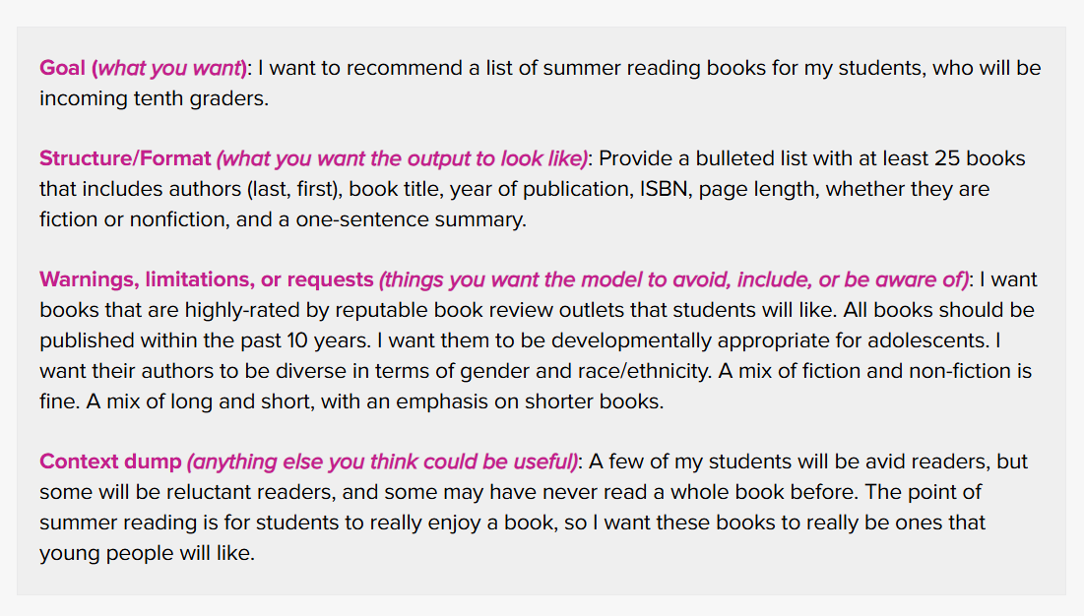
Crafting a Prompt - Sample

Slide 11

Principle 4
PRINCIPLE 4:
Prioritize People
Protect privacy, dignity, and integrity over efficiency or convenience

Slide 12
Small Groups (4-5 people)
Explore this scenario from the online resource:
  “I used an AI tool to help create an engaging slide presentation for an upcoming lesson. Do I disclose this use of AI to my students? To others?”
How would you respond?

Slide 13

Now, discuss…
One insight
One tension
One question
This activity raised for you.

Slide 14
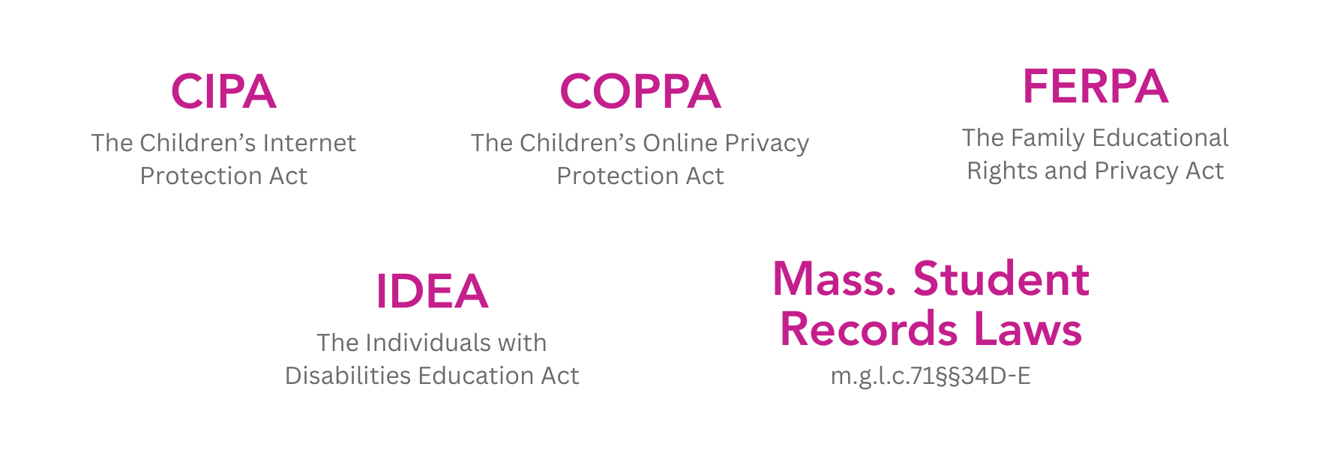


Review Handout &
Answer Reflection Questions
Could I be risking student data or privacy?
Am I using AI in ways that respect others and build trust?

Slide 15

Principle 5
PRINCIPLE 5:
Explore Broader Impacts
Cultivate knowledge of how AI is influencing schools and society

Slide 16
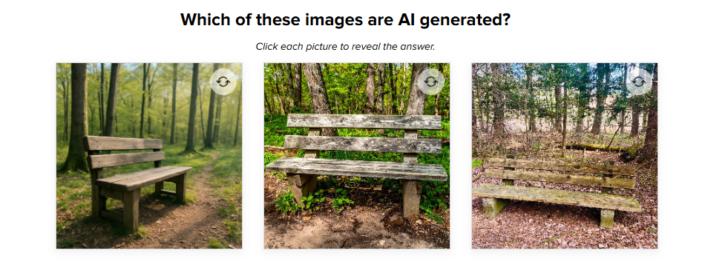
Question…
How do you currently handle verifying information or misinformation in your life? (Facebook, Instagram, news outlets, X, etc.)

Slide 17
Read these three on your handout. Pick one:
How do we model and reinforce academic integrity in a world with AI?
How do we help students navigate AI-generated misinformation?
What other AI impacts should I be aware of?

Slide 18
Report Out – 2 minutes per group
How do we model and reinforce academic integrity in a world with AI?
In the context of student use of AI, how should academic integrity be defined? Should that definition differ for educators?
How do we help students navigate AI-generated misinformation?
Are there ways that you can help students deepen their understanding of media literacy? If so, how?
What other AI impacts should I be aware of?
What broader impacts of AI are most important to you? Why? Are there ways you can help students learn about them?

Slide 19

Principles in Action
Scenarios to help educators explore the AI Literacy Principles

Slide 20
3 Groups - Part I
Group 1 = Scenario 1- A building administrator uses AI to help plan faculty meetings
Group 2 = Scenario 2- A 5th grade teacher uses AI to create grade-appropriate text
Group 3 = Scenario 3- A high school English teacher navigates AI detection and academic integrity

Slide 21
Principles in Action – Part I
Read your scenario & the Principles in Action handout.
Then:
What do you approve of about this educator’s approach?
What do you aspire to emulate about this educator’s approach?
What choices about AI use would you argue with if you were talking to this educator?

Slide 22
3 Groups - Part II
Group 1 = Scenario 3- A high school English teacher navigates AI detection and academic integrity
Group 2 = Scenario 1- A building administrator uses AI to help plan faculty meetings
Group 3 = Scenario 2- A 5th grade teacher uses AI to create grade-appropriate text

Slide 23
Principles in Action – Part II
Read your scenario & the Principles in Action handout.
Then:
What do you approve of about this educator’s approach?
What do you aspire to emulate about this educator’s approach?
What choices about AI use would you argue with if you were talking to this educator?

Slide 24
AI: 1-2-3 Reflection
Summarize your (1) biggest takeaway from this PD.
Identify (2) two topic areas from this series you want to work on moving forward and (2) colleagues you can partner with to do so.
Identify (3) immediate next steps you can take in your role to implement what you’ve learned.

Slide 25
Reflection & Themes
What key themes emerged?

