Slide 1
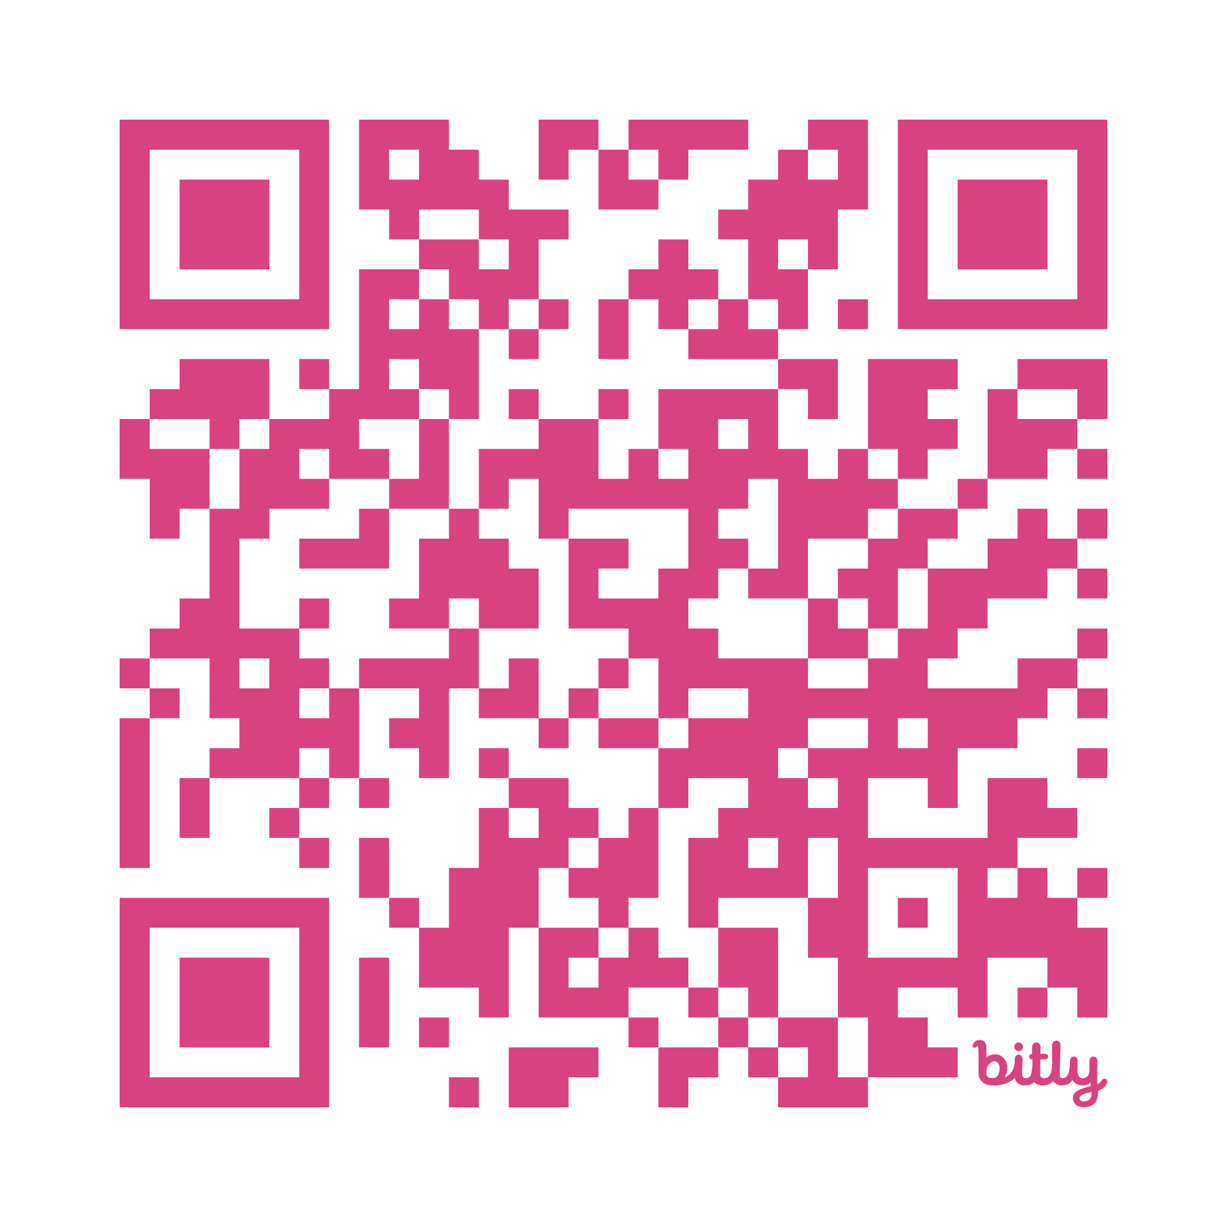
AI Literacy for Massachusetts Educators
https://bit.ly/MA-ai-literacy
Facilitation & Discussion Guide Slides for Facilitators
(Slides correspond to sample 45-minute agendas)

Slide 2
Note
These optional slides correspond to the sample agendas provided in the AI Literacy for Massachusetts Educators, Facilitation & Discussion Guide, which is aligned with DESE’s AI Literacy for Educators online module.
These slides are optional and provided for reference; facilitators are encouraged to modify them to suit local goals and contexts.

Slide 3
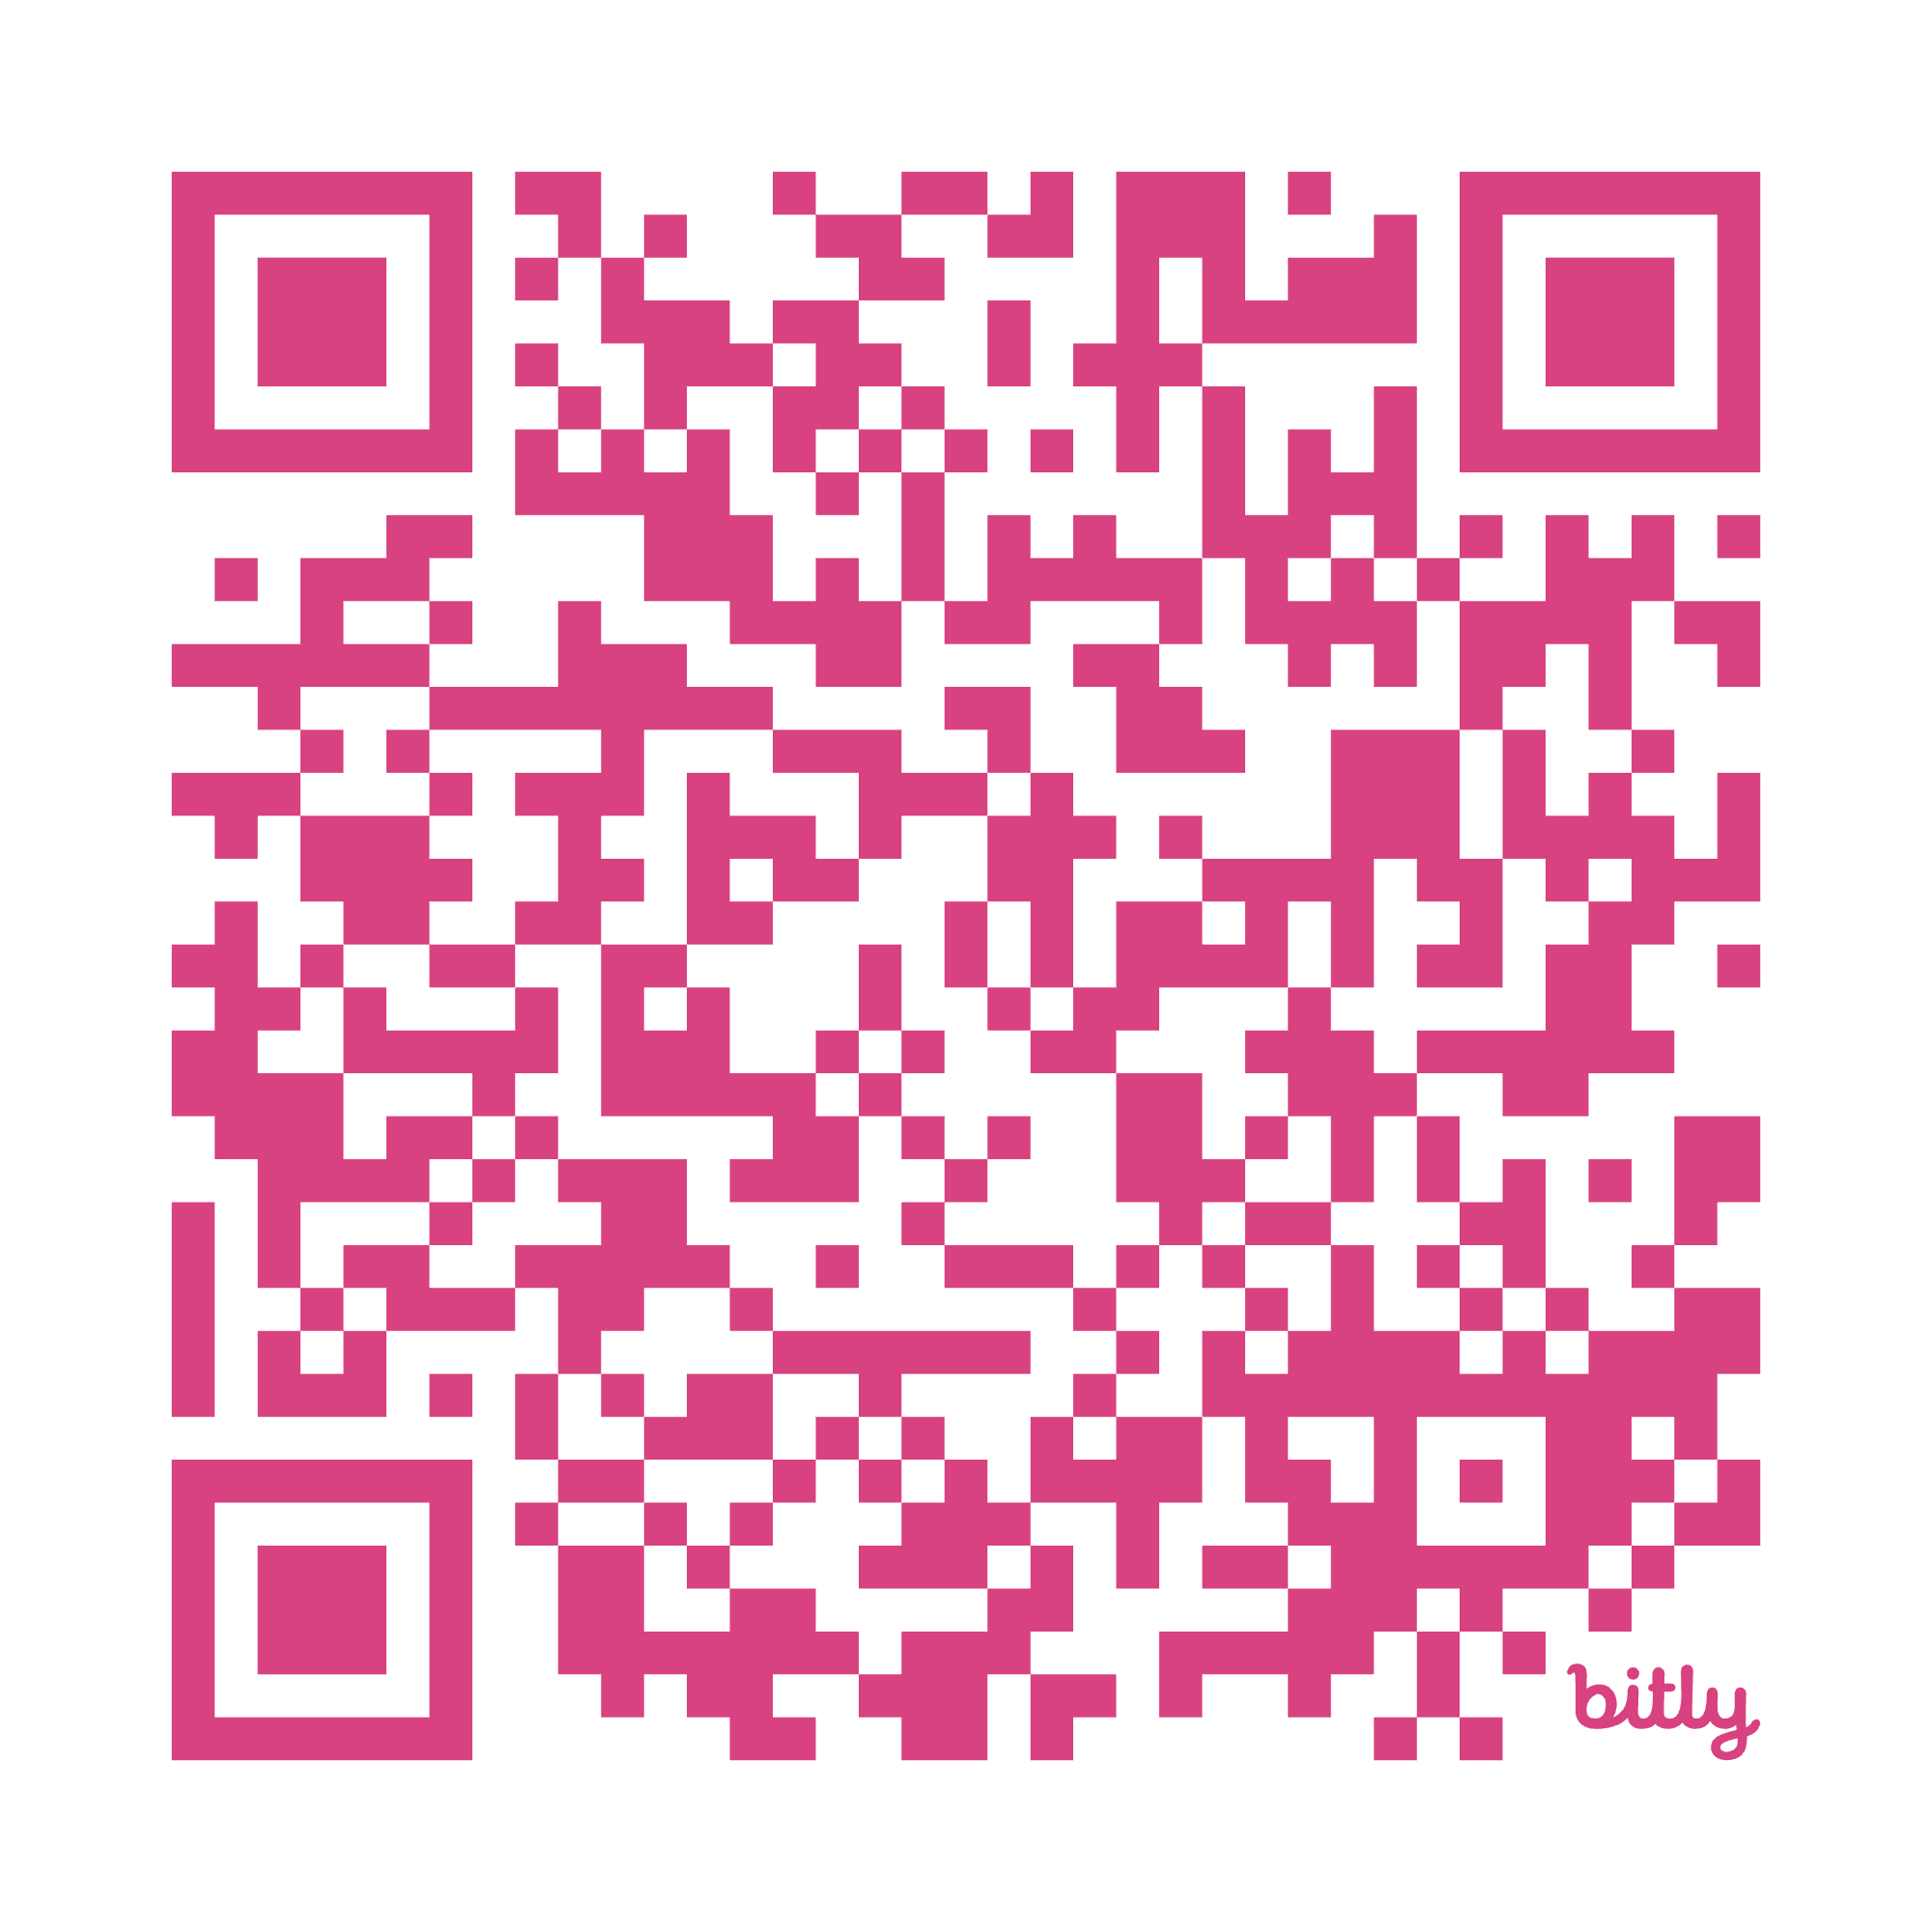
INTRODUCTION & OVERVIEW
https://bit.ly/MA-ai-literacy-guiding

Slide 4
Intro & Overview - Opening Question
When you were going through school, what was new classroom technology of the time, and how was it used?
How do you think your teachers felt when it was introduced?

Slide 5
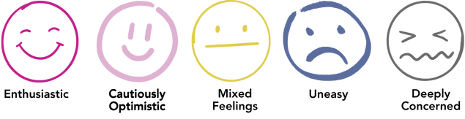
Intro & Overview - Turn & Talk:
How are you feeling about AI in education?

Slide 6
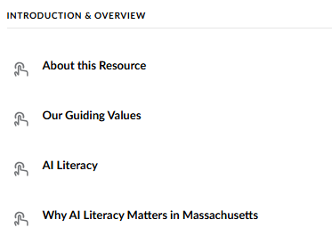
Intro & Overview - Review
https://bit.ly/MA-ai-literacy-guiding

Slide 7

Intro & Overview - Key Points
Educators have a wide range of perspectives about AI.
DESE has 5 guiding values about AI in education.
AI literacy connects with MA Educational Vision.

Slide 8
Intro & Overview - Question 1
Silent reflection:
How would you describe your current perspective on AI in schools?

Slide 9
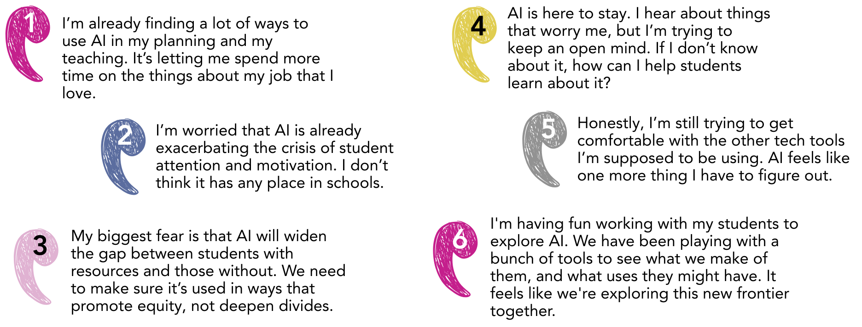
Perspectives

Slide 10
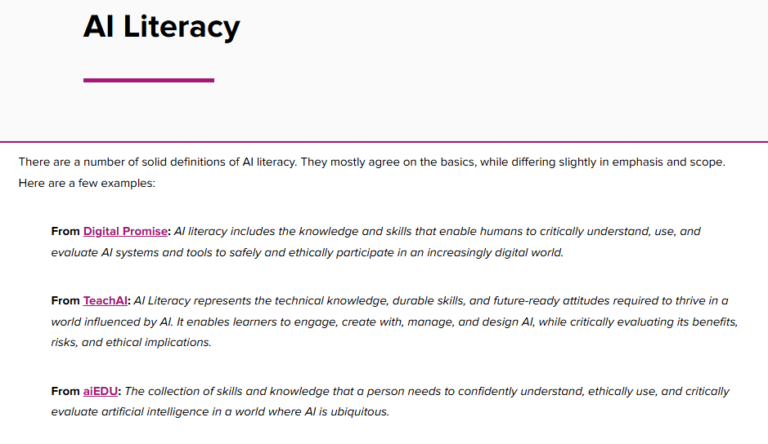
Making Connections
2. What connections do you see between AI literacy and your professional practice? Why might it be important for you learn about AI?
3. What values will guide the way you approach AI in your practice? How will those values meaningfully shape your actions?

Slide 11

Intro & Overview - Closing
Grab a Post-It
I'm wondering about....
I want to learn more about...
I find this interesting because...
One really important point raised today that resonated with me is...
Next up
Principle 1: Grasp the Fundamentals

Slide 12
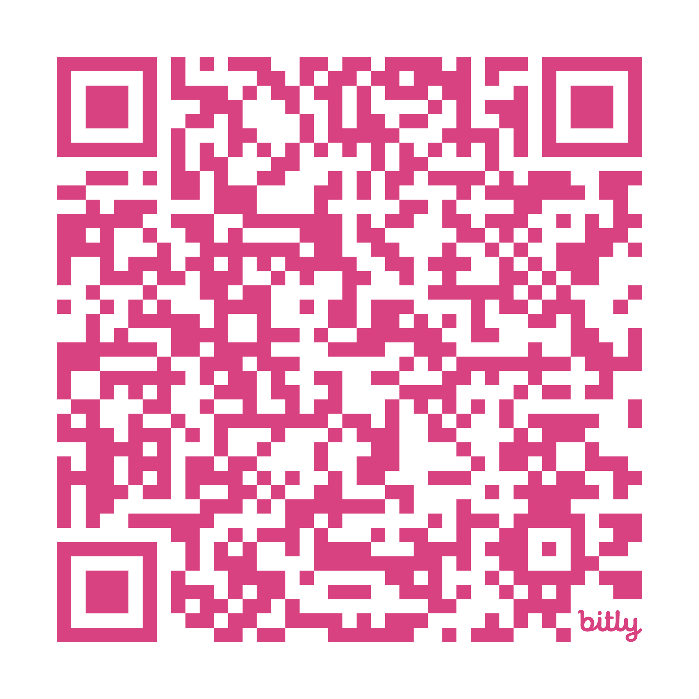
PRINCIPLE 1
Grasp the Fundamentals
Smart choices about AI begin with a clear grasp of its basic mechanics
https://bit.ly/MA-ai-literacy-principle1

Slide 13
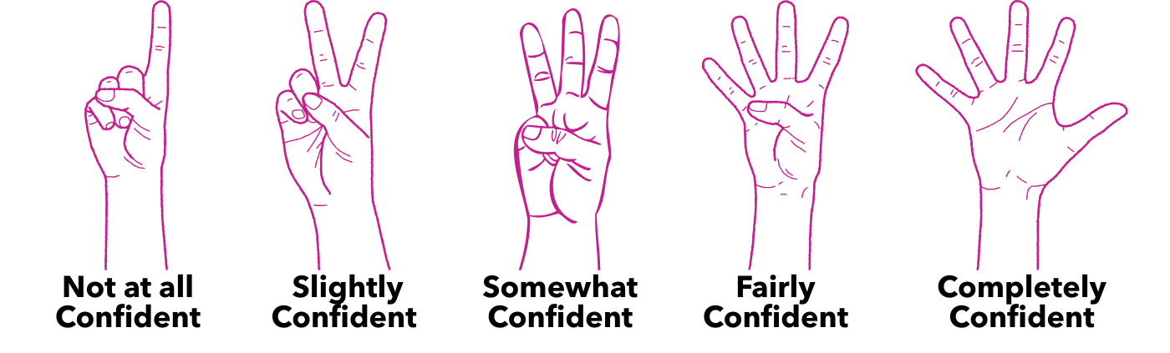
Principle 1 - Opening Question
How confident do you feel about your understanding of how AI works?

Slide 14
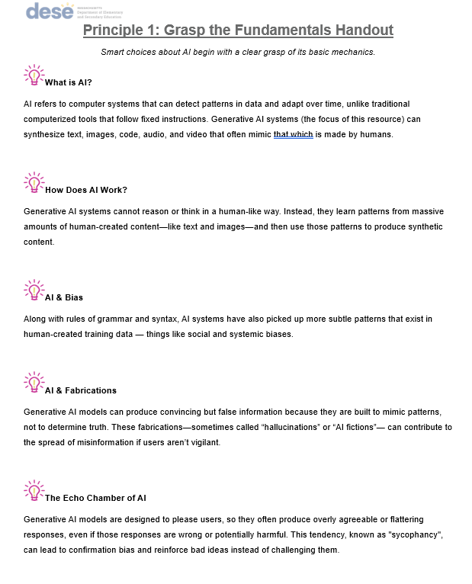
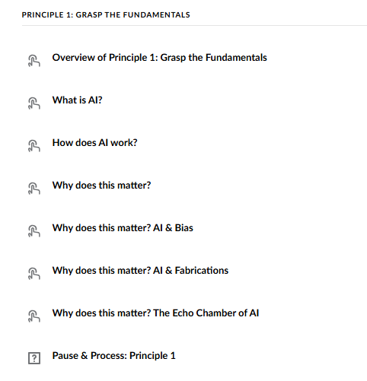
Principle 1 - Review Key Takeaways

Slide 15
Principle 1 - Discuss Key Takeaways
Part I: Turn and Talk
Pick one and explain it to the person next to you in your own words.
Part II: TQE
Share a thought
Share a question
Share an epiphany

Slide 16

Principle 1 - Going Deeper
https://bit.ly/MA-ai-literacy-principle1

Slide 17
Principle 1 - Individual Reflection
What’s one thing you learned or clarified about how AI works from this resource?
How does understanding AI basics help you think about its role in your practice, or in education in general?
If AI systems can reinforce dominant worldviews, how can we use them in ways that support equity and inclusion instead?

Slide 18

In pairs or small groups:
Discuss:
  One insight
  One tension
  One question
Add to the posters around the room
Gallery walk to read other responses

Slide 19

How confident do you feel about your understanding of how AI works? How has your answer changed or stayed the same? Why?
Next up
Principle 2: Center Human Intelligence

Slide 20
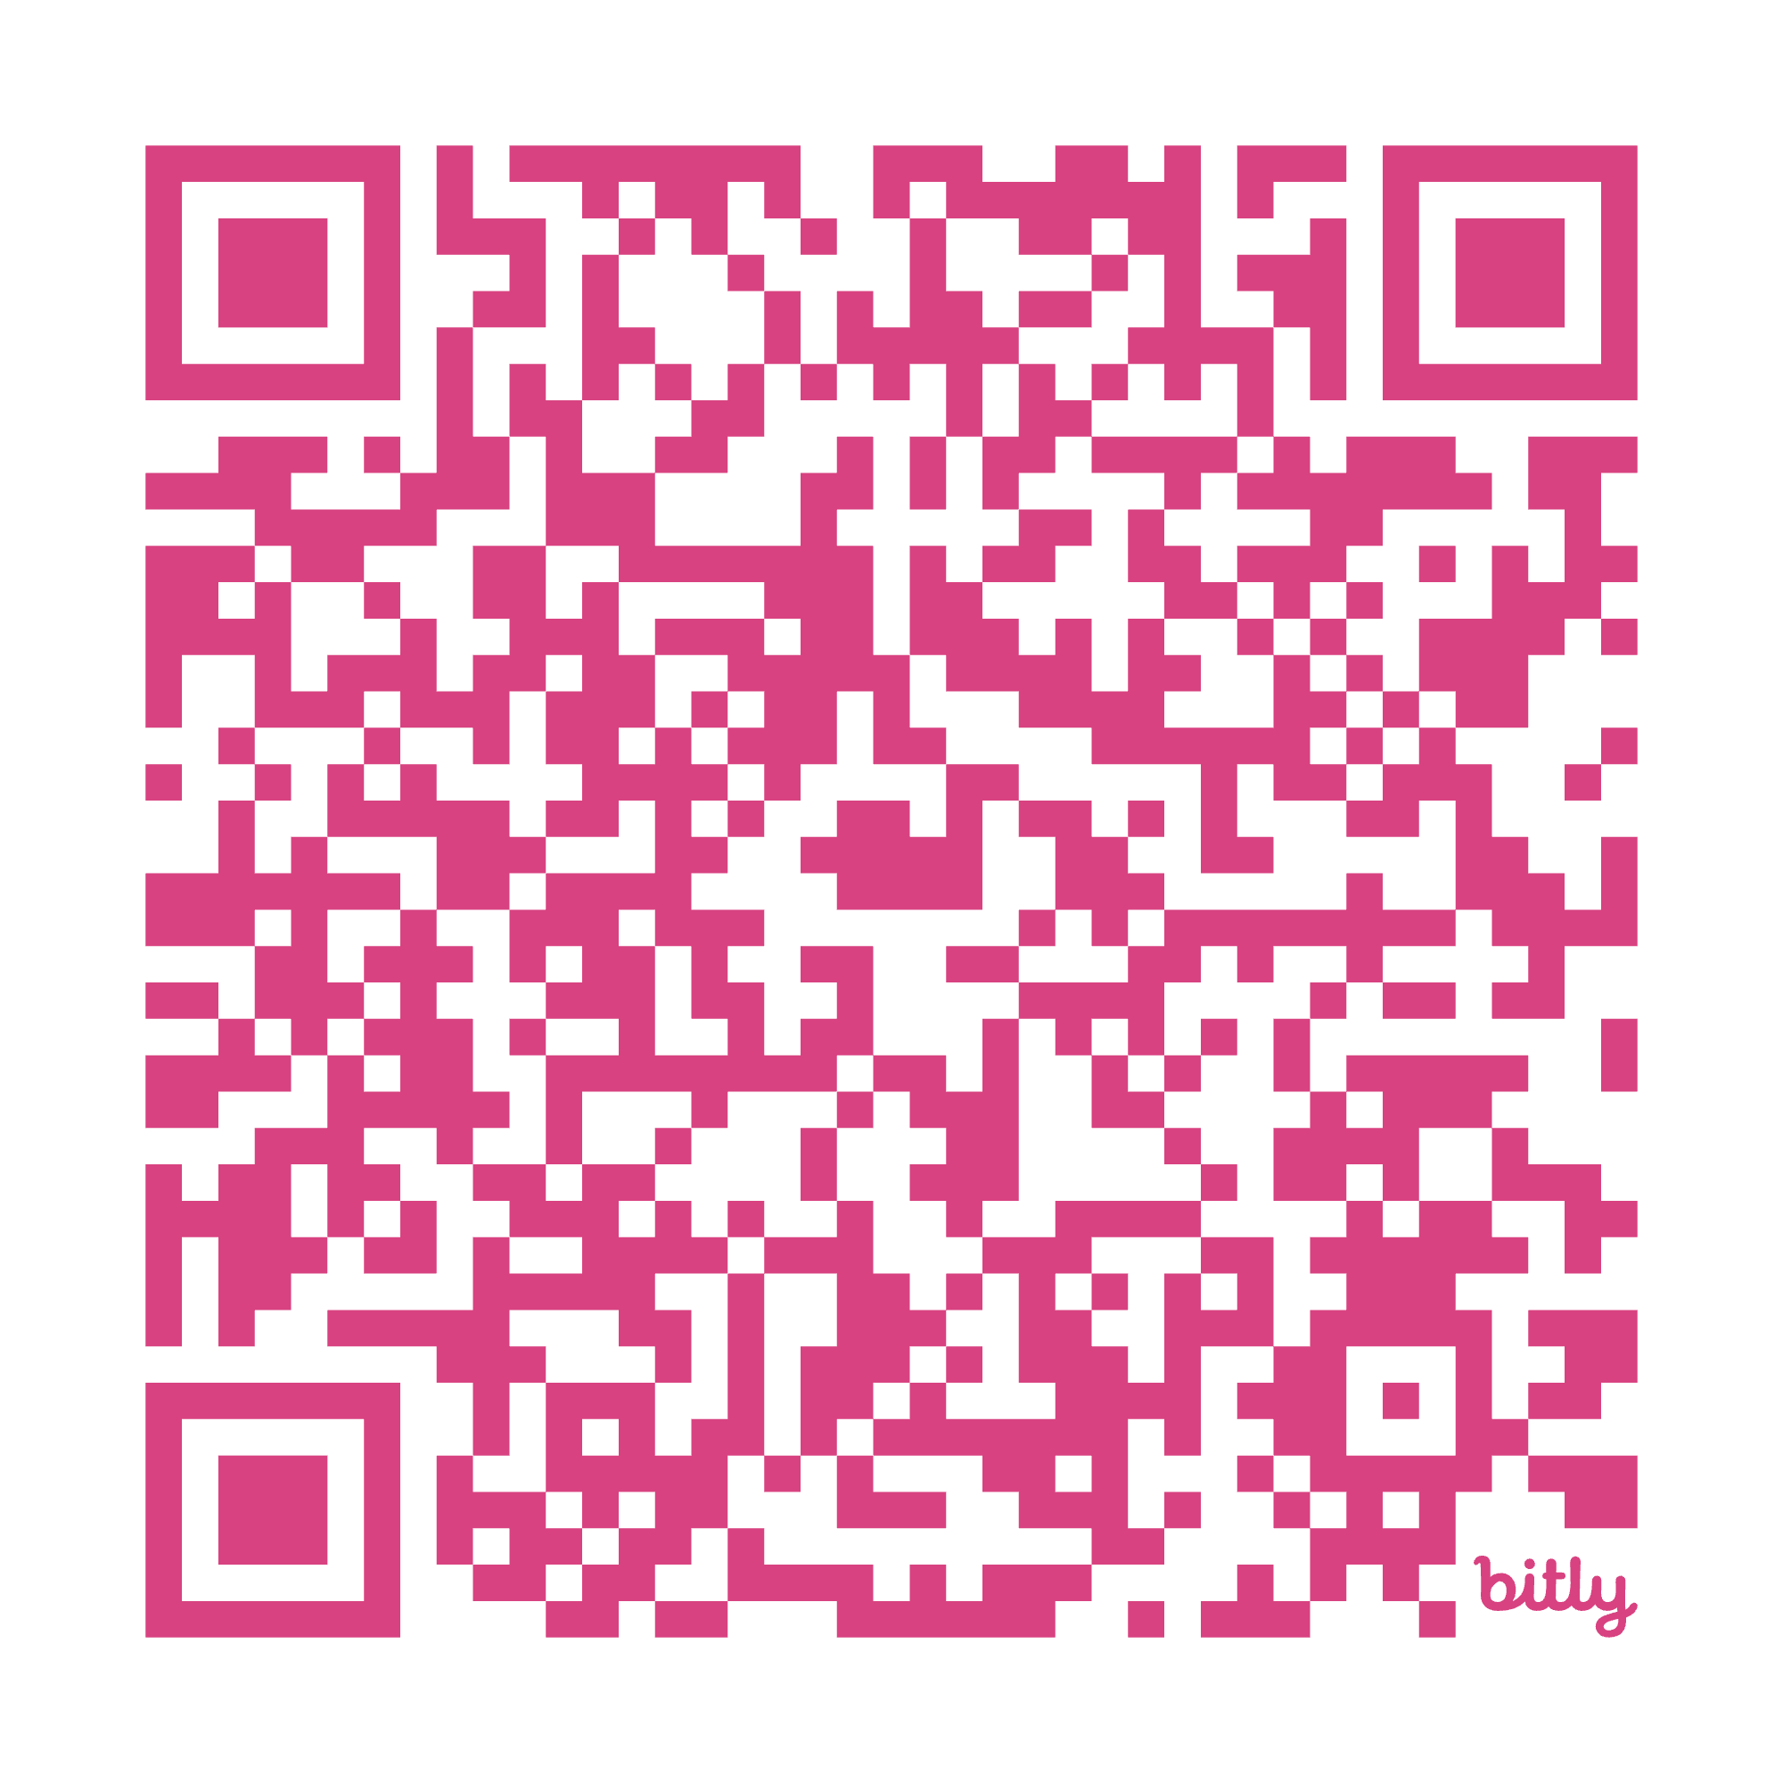
PRINCIPLE 2
Center Human Intelligence
Let human insight and agency steer every engagement with AI
https://bit.ly/MA-ai-literacy-principle2

Slide 21
PRINCIPLE 2 - Opening Question
What’s one thing you bring to a task that AI never could?

Slide 22
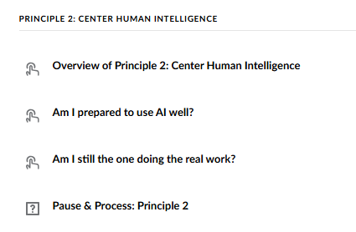
PRINCIPLE 2 - Review
https://bit.ly/MA-ai-literacy-principle2

Slide 23


PRINCIPLE 2 - Review Key Takeaways
Am I prepared to use AI well?
Am I still the one doing the real work?

Slide 24
PRINCIPLE 2 - Reflection
What do you think it means to “center human intelligence” when using AI?
Describe circumstances where you will be well-positioned to use AI, and circumstances where you should refrain from using AI.
How do technological tools shape the way we think, and how might AI shape our thinking differently than tools before it?

Slide 25
Share
Shift in perspective
New realization
Lingering question

Slide 26

PRINCIPLE 2 - Closing
What’s one way you can be intentional about keeping human insight at the center if or when you use AI?
Next up
Principle 3: Guide & Judge AI

Slide 27
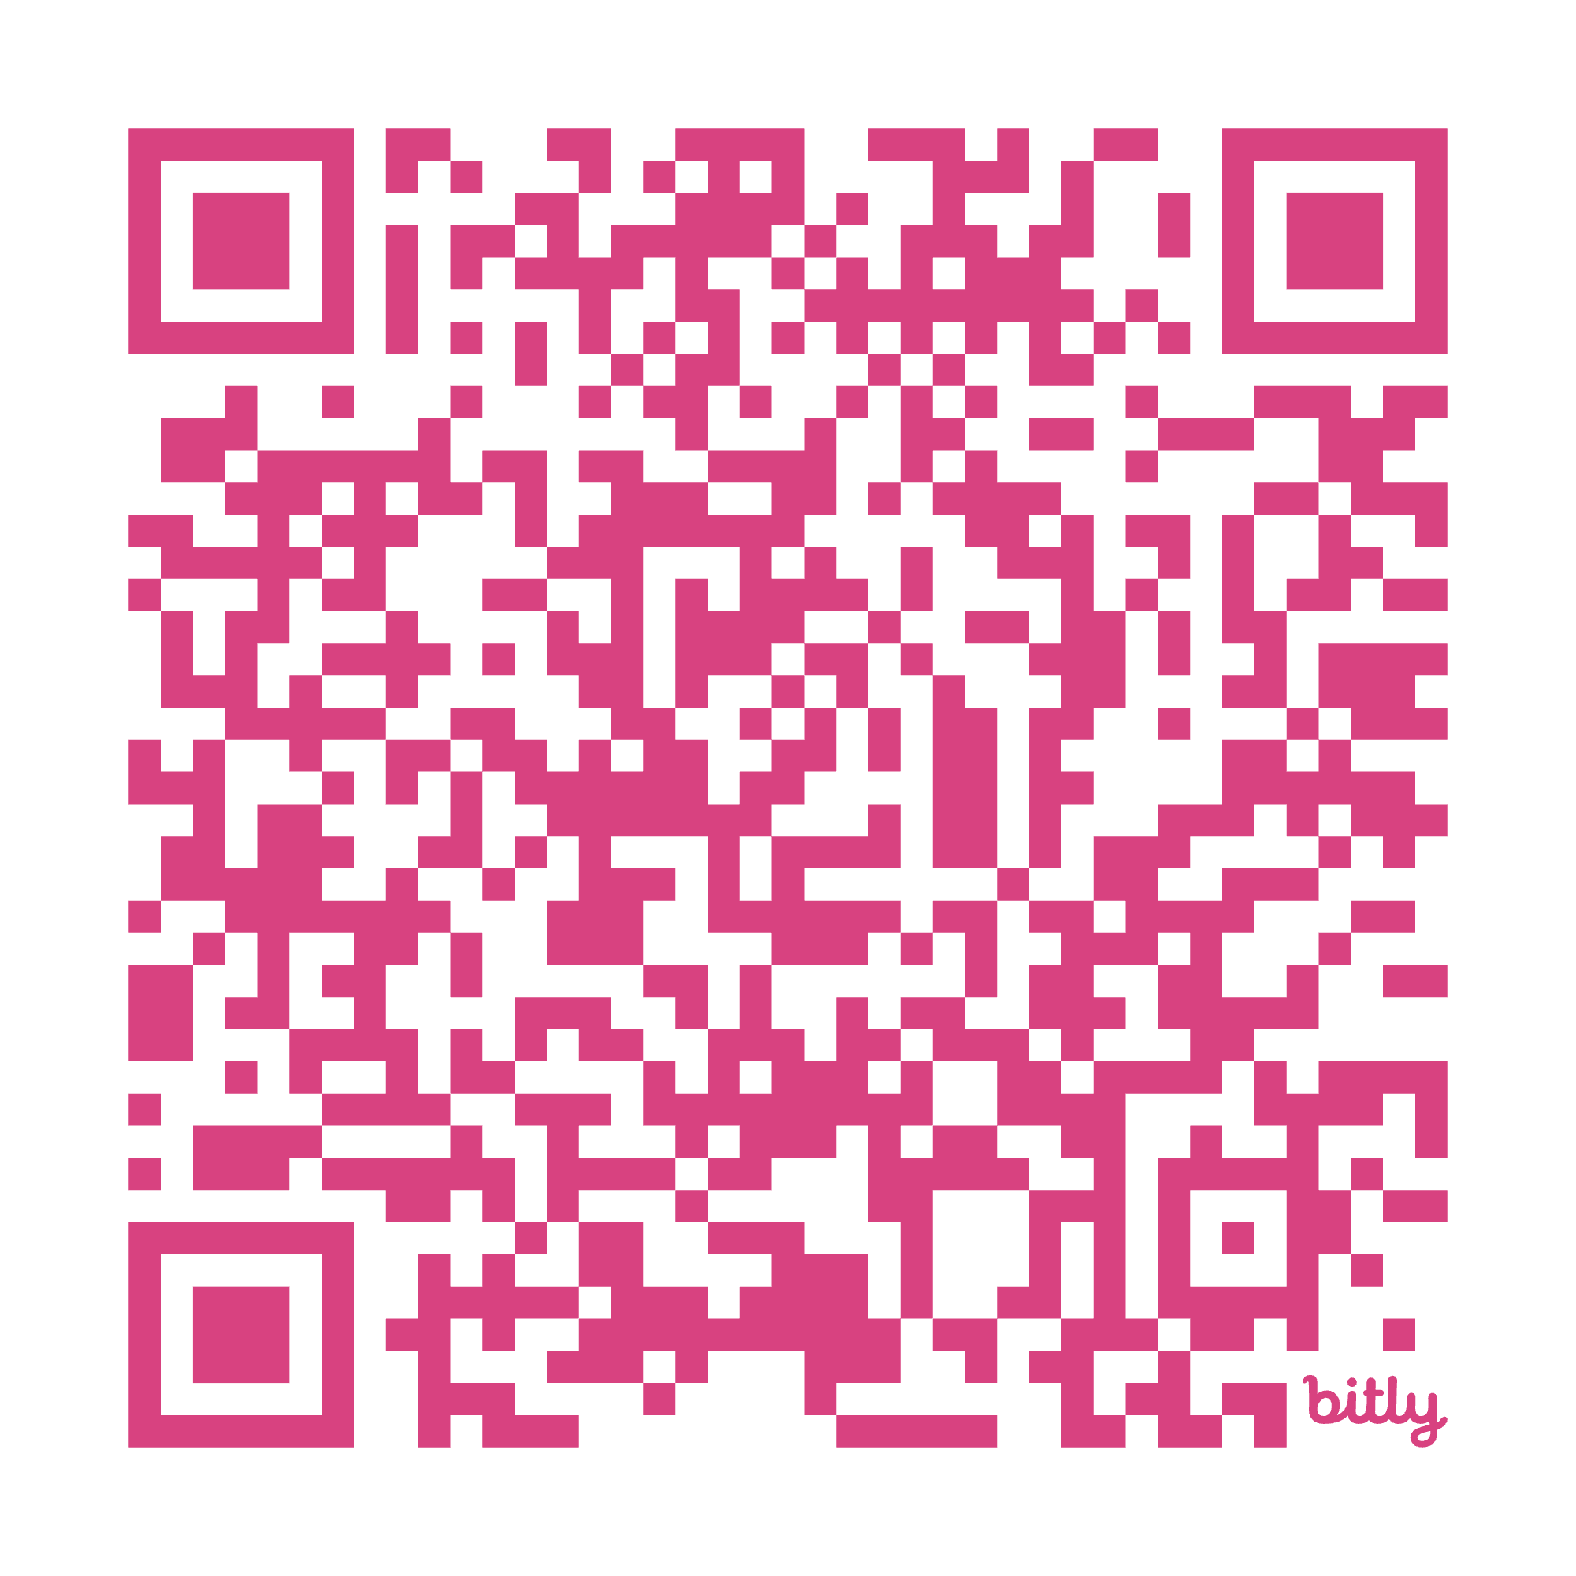
PRINCIPLE 3
Guide & Judge AI
Skillfully craft inputs and rigorously critique outputs
https://bit.ly/MA-ai-literacy-principle3

Slide 28
PRINCIPLE 3 - Opening Question
What’s one lesson, insight, or ‘aha’ you’ve had about using technology wisely that stuck with you?
(This can be about any technology, not just AI.)

Slide 29
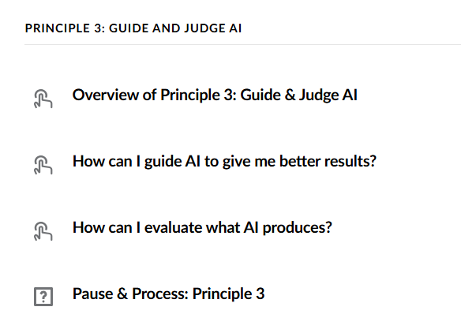
PRINCIPLE 3 - Review
https://bit.ly/MA-ai-literacy-principle3

Slide 30


PRINCIPLE 3 - Review Key Takeaways
How can I guide AI to give me better results?
How can I evaluate what AI produces?

Slide 31
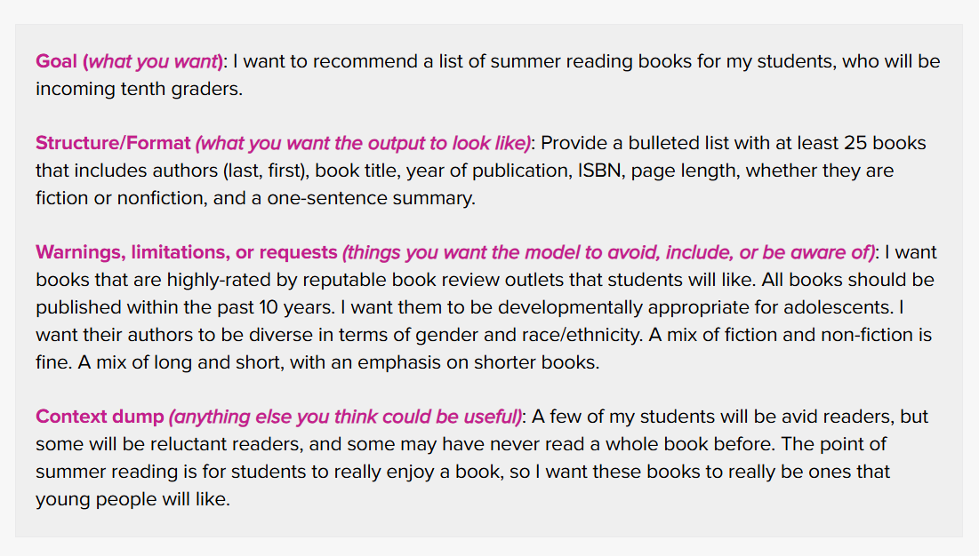
Crafting a Prompt - Sample

Slide 32
PRINCIPLE 3 - Reflection
Have you tried any AI prompting strategies? If so, which ones have worked well for you? If not, where might you start?
How might your own viewpoint affect what you notice, trust, or question in an AI model’s output?
What opportunities or challenges might emerge if you and your colleagues collectively get stronger at both prompting AI and critically assessing what it produces?

Slide 33

PRINCIPLE 3 - Closing
What’s one idea or strategy from today that you plan to apply in your work right away?
Next up
Principle 4: Prioritize People

Slide 34
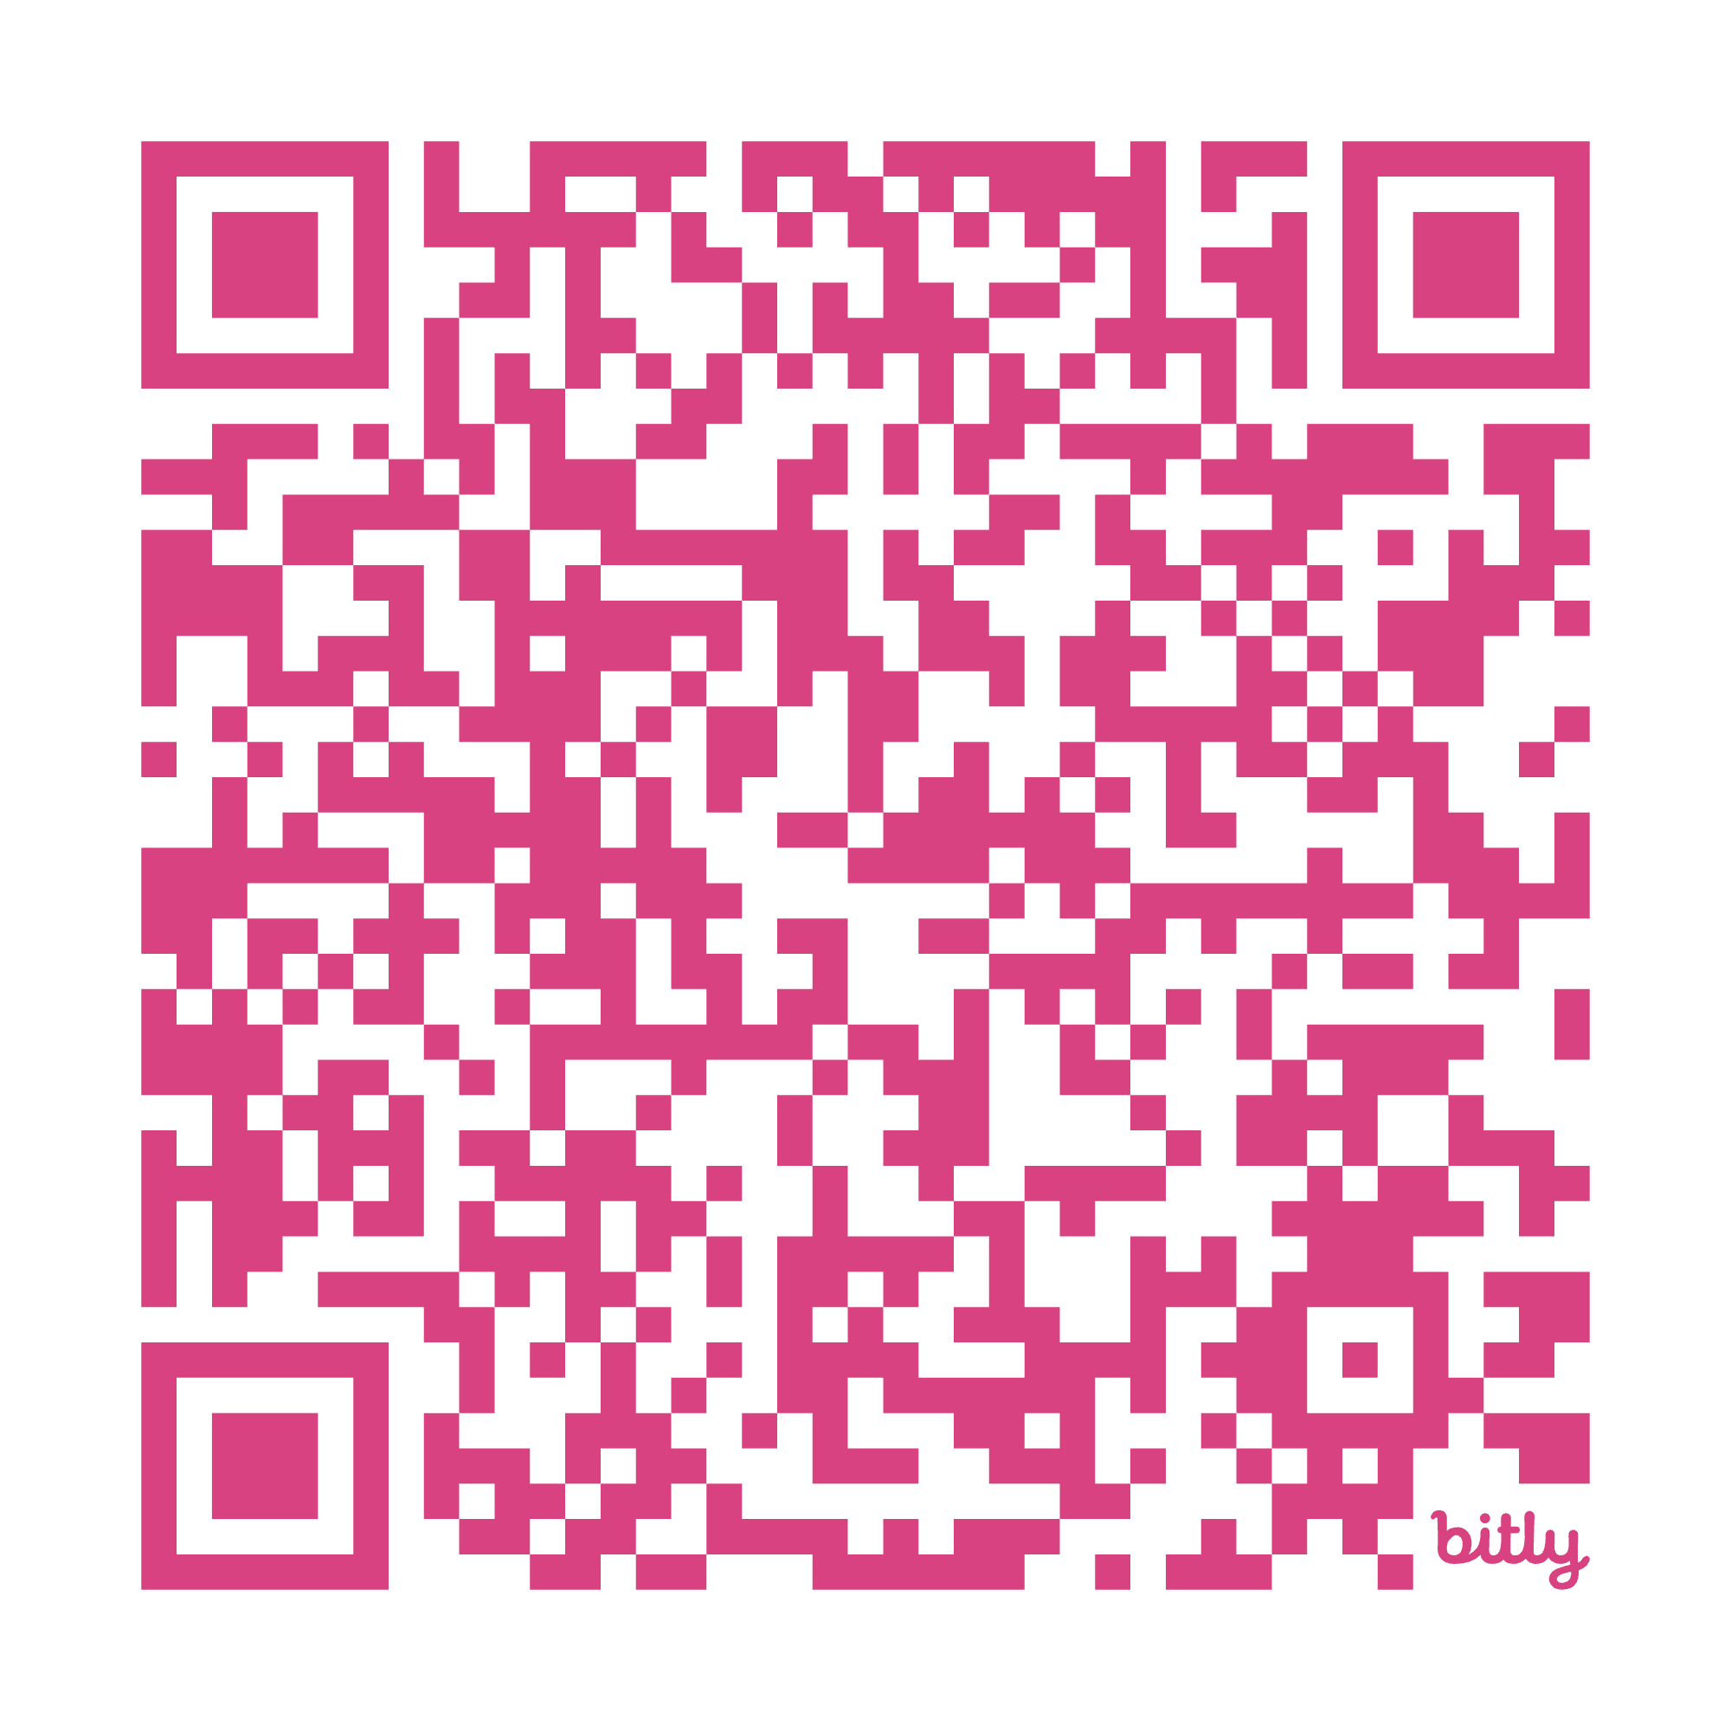
PRINCIPLE 4
Prioritize People
Protect privacy, dignity, and integrity over efficiency or convenience
https://bit.ly/MA-ai-literacy-principle4

Slide 35
PRINCIPLE 4 - Opening Question
In your own life, how does technology build connections between you and others?
How does it erode or interrupt connections?

Slide 36
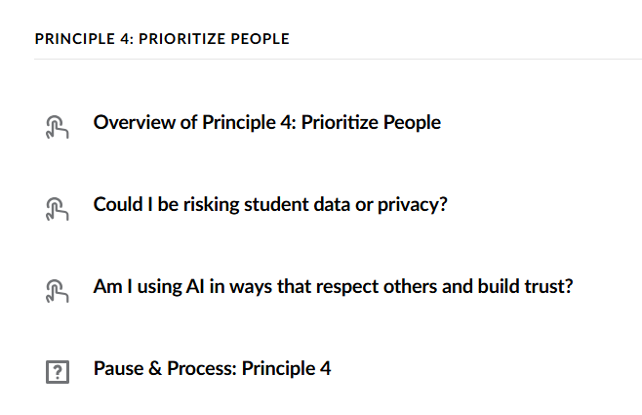
PRINCIPLE 4 - Review
https://bit.ly/MA-ai-literacy-principle4

Slide 37
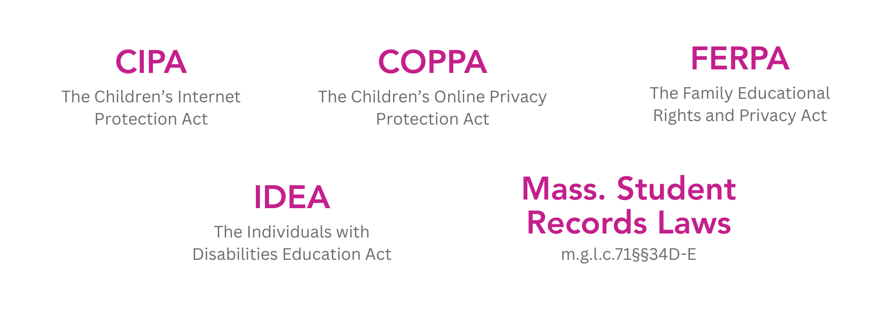

PRINCIPLE 4 - Review Key Takeaways
Could I be risking student data or privacy?
Am I using AI in ways that respect others and build trust?

Slide 38
PRINCIPLE 4 - Turn & Talk
Turn to a partner to explore this scenario from the online resource:
  “I used an AI tool to help create an engaging slide presentation for an upcoming lesson. Do I disclose this use of AI to my students? To others?”
How would you respond?

Slide 39
PRINCIPLE 4 - Reflection
How do the laws noted in this section apply to you? Are you already familiar with these laws? Which ones are you less familiar with?
How do your own values and experiences shape the way you approach both getting consent and being open about AI use? How might others’ values and experiences impact their approach to consent and being open about AI use?
In your opinion, what are the most important ways to “prioritize people” when it comes to use (or non-use) of AI?

Slide 40

PRINCIPLE 4 - Closing
I used to think ________, but now I think ____.
Next up
Principle 5: Explore Broader Impacts
Next meeting include pre-work completed by _____.

Slide 41
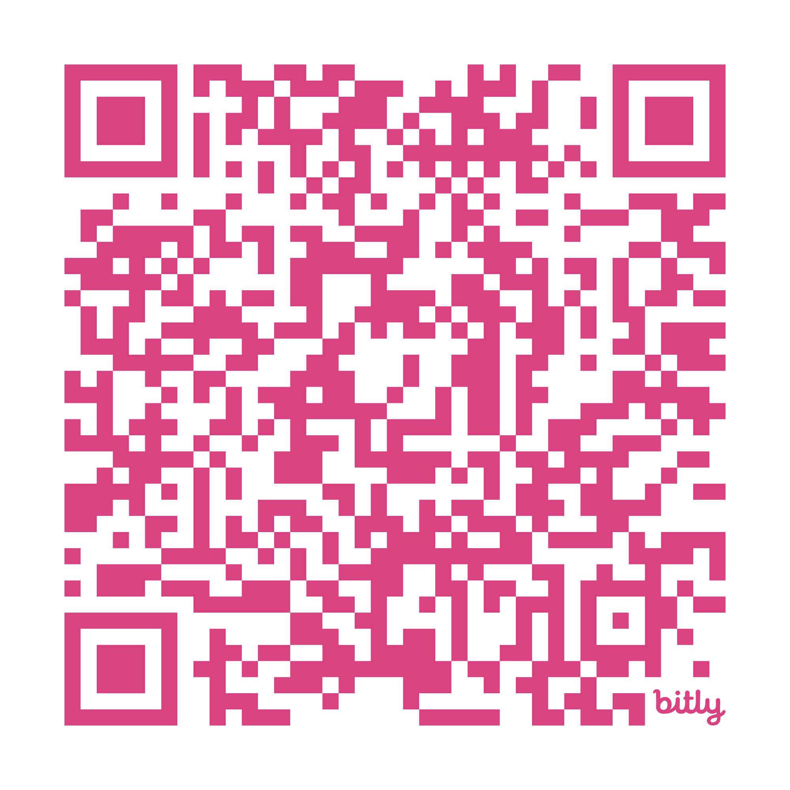
PRINCIPLE 5
Explore Broader Impacts
Cultivate knowledge of how AI is influencing schools and society
https://bit.ly/MA-ai-literacy-principle5

Slide 42
PRINCIPLE 5 - Opening Question
What’s one technology, past or present, that’s changed how you work or live?

Slide 43
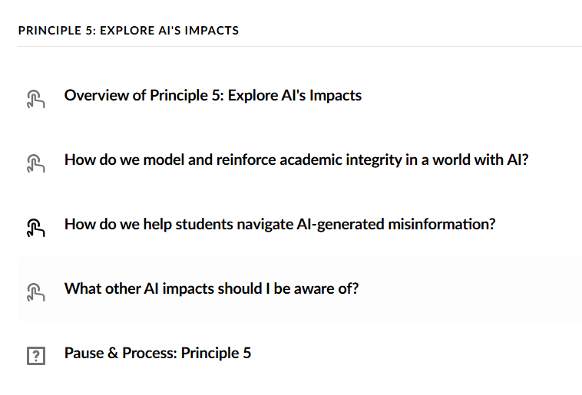
Pre-Work Included a Review of Principle 5
https://bit.ly/MA-ai-literacy-principle5

Slide 44
PRINCIPLE 5 - Review
How do we model and reinforce academic integrity in a world with AI?
How do we help students navigate AI-generated misinformation?
What other AI impacts should I be aware of?

Slide 45
PRINCIPLE 5 - Turn & Talk
How do you currently handle verifying information or misinformation in your life? (Facebook, Instagram, news outlets, X, etc.)

Slide 46
PRINCIPLE 5 - Reflection
In the context of student use of AI, how should academic integrity be defined? Should that definition differ for educators?
Are there ways that you can help students deepen their understanding of media literacy? If so, how?
What broader impacts of AI are most important to you? Why? Are there ways you can help students learn about them?

Slide 47

PRINCIPLE 5 - Closing
What’s one thing you want to learn about AI?
What’s one thing you want to try?
Next up
PRINCIPLES IN ACTION

Slide 48
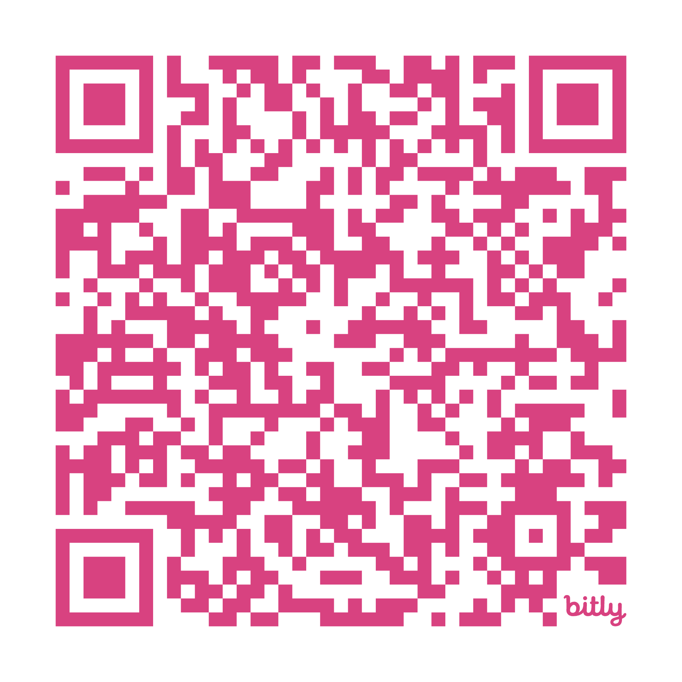
PRINCIPLES IN ACTION
Scenarios to help educators explore the AI Literacy Principles
https://bit.ly/MA-ai-literacy-principles

Slide 49
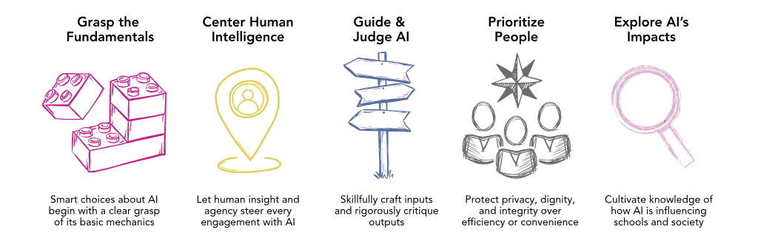
PRINCIPLES IN ACTION - Turn & Talk
Of the 5 AI literacy principles, which do you feel the most and least clear about?

Slide 50
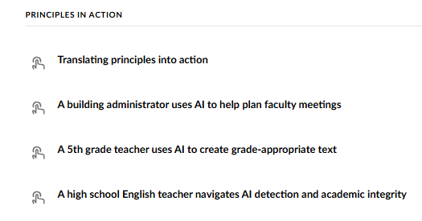
PRINCIPLES IN ACTION - Digging Deeper
https://bit.ly/MA-ai-literacy-principles
Read your scenario.
Review the Principles in Action handout.
Then:
What do you approve of about this educator’s approach?
What do you aspire to emulate about this educator’s approach?
What choices about AI use would you argue with if you were talking to this educator?

Slide 51
AI: 1-2-3 Reflection
Summarize your (1) biggest takeaway from this PD series.
Identify (2) two topic areas from this series you want to work on moving forward and (2) colleagues you can partner with to do so.
Identify (3) immediate next steps you can take in your role to implement what you’ve learned.

