Slide 1
How did our students do after graduating? The Three Basic Reports:
Postsecondary Outcomes of Public HS Graduates:
All Institutions (CR301)
Postsecondary Outcomes of Public HS Graduates:
MA Public Institutions Only (CR302)
Postsecondary Outcomes of Public HS Graduates:
Academic Preparation (CR303)
Notes:
Academic Preparation =
MassCore Completion
AP Course Completion
MCAS 10th Grade ELA
MCAS 10th Grade Math
MCAS High School Science

Slide 2
Comparing Three Reports
Use when setting school and district goals!
Potential Questions | CR301 | CR302 | CR303
How many graduates go on to postsecondary? | X | X | X
What type of institutions (4-year/2-year, private/public) do graduates attend? | X | X | X
Which specific institutions did students attended? How many went to each? | X | X
What are the enrollment rates of students who complete MassCore or AP coursework compared to those who don’t? | X | X | X
What are the persistence and degree obtainment rates of students who complete MassCore or AP coursework? |  |  | X
What is the postsecondary experience of students from a specific subgroup? (CVTE, ELL, SWD, high needs, etc) | X | X | X
What percentages of students enroll in and complete remedial courses? |  | X | X
In what remedial subjects to do students enroll? |  | X
What are the MCAS scores of students who take remedial coursework in math and reading? |  | X | X
How many credits, on average, do public high school graduates earn in their first year of college? |  | X | X

Slide 3
National Student Clearinghouse: 97% of currently enrolled postsecondary students nationwide (98.9% of all public and private institutions) SIMS/SCS- our K-12 data collection system HEIRS- a centralized database of student unit-record data from 28 of the 29 public higher education institutions in Massachusetts (15 community colleges, nine state universities, and the four undergraduate campuses of the University of Massachusetts). College Board -For SAT data
Where do these data come from?

Slide 4
When are these data “refreshed”

Slide 5
Additional Post-Secondary Reports
Several additional new Edwin Analytics reports may assist schools and districts in analyzing post-secondary data for program improvement.
CR304 Postsecondary Outcomes of Public HS Graduates View by MA Public Postsecondary Institution: Details postsecondary enrollment, achievement, and outcomes of MA public graduating students from a fall enrollment class in a specific MA public postsecondary institution. It also contains details by “feeder” MA public high schools. (Postsecondary data source: MA Department of Higher Education)
CR321 CVTE Graduate Pathway Summary: MA Public Postsecondary: Details postsecondary enrollment, outcomes, and continuation of vocational field of study for MA public school graduates who were CVTE concentrators and who enrolled in a MA public postsecondary institution. (Postsecondary data source: MA Department of Higher Education)

Slide 6
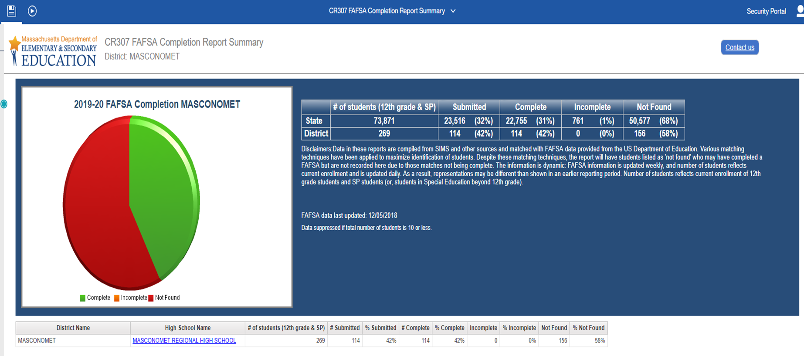
FAFSA Report
DESE and DHE in partnership with the Massachusetts Executive Office of Education have developed reports that allow schools and districts to monitor the status of student submission and completion of FAFSA.
School counselors and other educators can use this alongside other college and career readiness resources to support students in the college application process.

Slide 7
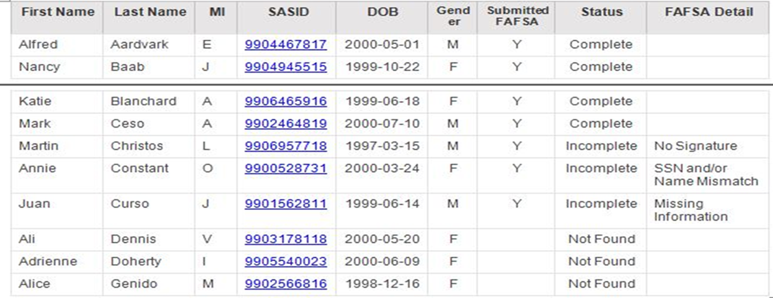
FAFSA CR607 (student level report)

