Slide 1
What do we know about students’ early childhood experiences and their connection to elementary outcomes? The Two Reports:
SR313: Impact of Early Childhood Dosage on Elementary Performance – SIF Districts Only
SR 513: Early Education of Current Students – SIF Districts Only
Notes:
Academic Preparation =
MassCore Completion
AP Course Completion
MCAS 10th Grade ELA
MCAS 10th Grade Math
MCAS High School Science

Slide 2
Comparing two reports
Comparing Two Reports
Potential Questions | SR313 | SR513
How many children (K-3) had a formal early childhood experience¹ prior to kindergarten? | X | X
Which groups of children (K-3) had a formal early childhood experience prior to kindergarten? | X | X
Which specific early childhood programs did children attend as infants, toddlers, preschool-age children? |  | X
How many children attended multiple programs in the course of one year? |  | X
What are the attendance patterns in formal early childhood programs for children who were enrolled? | X
What percentage of children who have a formal early childhood experience have an IEP or 504 plan? | X
What percentage of children who have a formal early childhood experience are retained? | X
What percentage of children who have a formal early childhood experience are suspended? | X
What percentage of children who have a formal early childhood experience meet/exceed expectations on Grade 3 MCAS tests? | X

Slide 3
Where do these data come from? Department of Elementary and Secondary Education Student Information Management System: - public preschool enrollment data - K-3 data, including enrollment, special education supports, attendance, retention, suspension and MCAS data Department of Early Education and Care (EEC) Child Care Financial Assistance (CCFA): -enrollment data for children receiving income-eligible subsidies - group type and placement -attendance data
Where do these data come from?

Slide 4
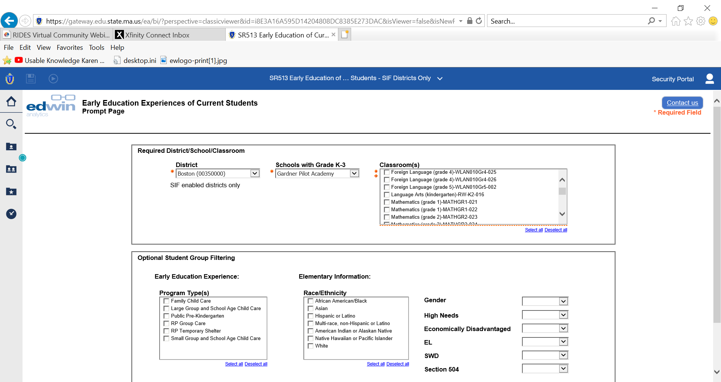
SR 513 – Initial Screen

Slide 5
SR 513 – Data Report (Excel)
Last Name | First Name | SASID | Program Name | Program Type | City/ Town | Full Time / Part Time | Age Group | Start Date | End Date
D | LAYLANNIE |  | Little Sprouts - Lowell | Large Group and School Age Child Care | Lowell | Full Time | Infant | Dec 2013 | Dec 2013
D | LAYLANNIE |  | Little Sprouts - Lowell | Large Group and School Age Child Care | Lowell | Full Time | Infant | Dec 2013 | Nov 2014
D | LAYLANNIE |  | Little Sprouts - Lowell | Large Group and School Age Child Care | Lowell | Part Time | Infant | Dec 2012 | Feb 2013
D | LAYLANNIE |  | Little Sprouts - Lowell | Large Group and School Age Child Care | Lowell | Part Time | Infant | Mar 2013 | Apr 2013
D | LAYLANNIE |  | Under 2 Family Day Care System (Master) |  | Shirley | Full Time | Infant | Apr 2013 | Jun 2013
D | LAYLANNIE |  | Under 2 Independent Family Day Care (Master) |  | Lowell | Part Time | Pre-School | Aug 2017 | Apr 2018
N | JOHN |  | Informal In Home (Master) |  | Lowell | Part Time | Toddler | Jul 2015 | May 2016
N | JOHN |  | Informal In Home Relative (Master) |  | Lowell | Part Time | Pre-School | Nov 2016 | Nov 2016
N | JOHN |  | PS - NB _P-Full Day Preschool (CPC) |  | Lowell | Part Time | Pre-School | Jun 2016 | Nov 2016
N | JOHN |  | PS - NB _P-Full Day Preschool (CPC) |  | Lowell | Part Time | Pre-School | Jan 2017 | Jan 2017
O | AYVIAN |  | Toddler (15 Mo - 2 Yr 8 Mo) (Master) |  | Dracut | Part Time | Toddler | Jul 2015 | Jan 2017
P | NOELLE |  | B & A Kindergarten or Full time (Master) |  | Lowell | Part Time | Toddler | Sep 2015 | May 2016
P | NOELLE |  | Under 2 Independent Family Day Care (Master) |  | Lowell | Part Time | Toddler | Jul 2015 | Jul 2015
R | ISAACK |  | Informal In Home Relative (Master) |  | Lowell | Part Time | Pre-School | Sep 2017 | Aug 2018
R | ISAACK |  | Toddler (15 Mo - 2 Yr 8 Mo) (Master) |  | Lowell | Part Time | Toddler | Jul 2015 | May 2017

Slide 6
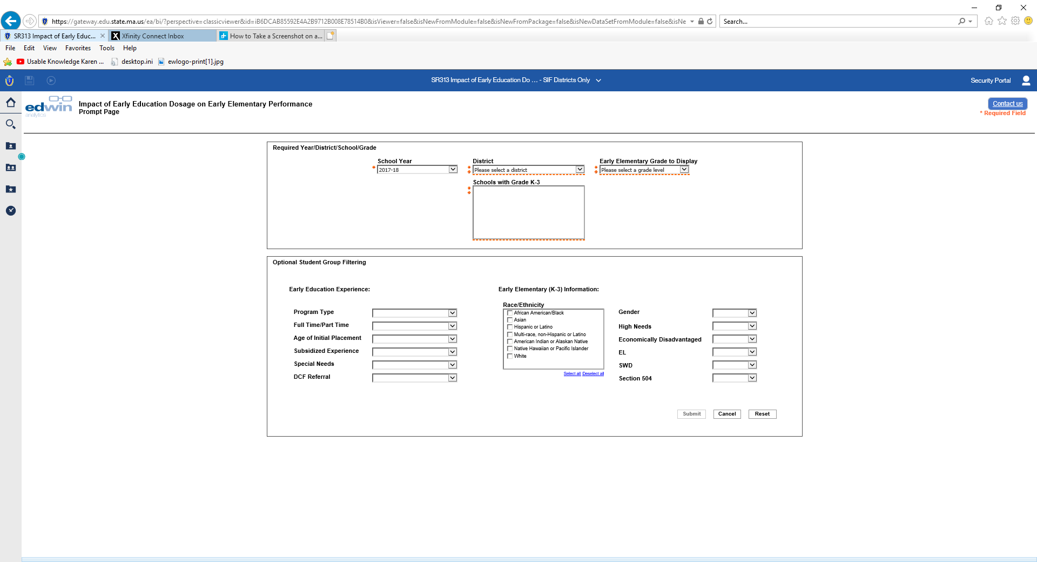
SR 313 – Initial Screen
Notes:
I think there are opportunities presented by these reports to:
Better understand feeder patterns of children coming into kindergarten
By better understanding the feeder patterns, schools and districts can:
Use the information on where children are prior to kindergarten to build partnerships with local community-based providers;
Better understand what children know and are able to do by sharing date across programs with family permission;
Create opportunities for alignment between the birth to five system and the K-12 system to ensure consistently high quality learning opportunities for young children prior to kindergarten and beyond; and
Design joint professional development between public schools and community-based programs to address curriculum, instruction, assessment
When combined with information from SIMS data element DOE050, schools and districts can have a fuller picture of what experiences children bring with them to kindergarten. For children who come without a formal early childhood experience, these data could also assist the schools, districts and communities to reflect on family engagement opportunities in the early years to ensure that families are supported in guiding their child’s development and learning.
In terms of structures and goals for the data use, I think that a minimum a team from the district/schools that include an early childhood coordinator, elementary principal, PK-2 teacher(s), community-based preschool provider, community and/or school-based after-school and out-of-school time provider, family member could be convened to meet at regular intervals (determined by the members) to do some planning/goal setting around its community’s Birth to Age 8 (also known as B-8) system. The idea being that if we are looking to improve outcomes for children by grade 3, how can community-providers, schools, districts and families collaborate and use data to ensure that young children have high quality learning opportunities in their first 8 years.

Slide 7
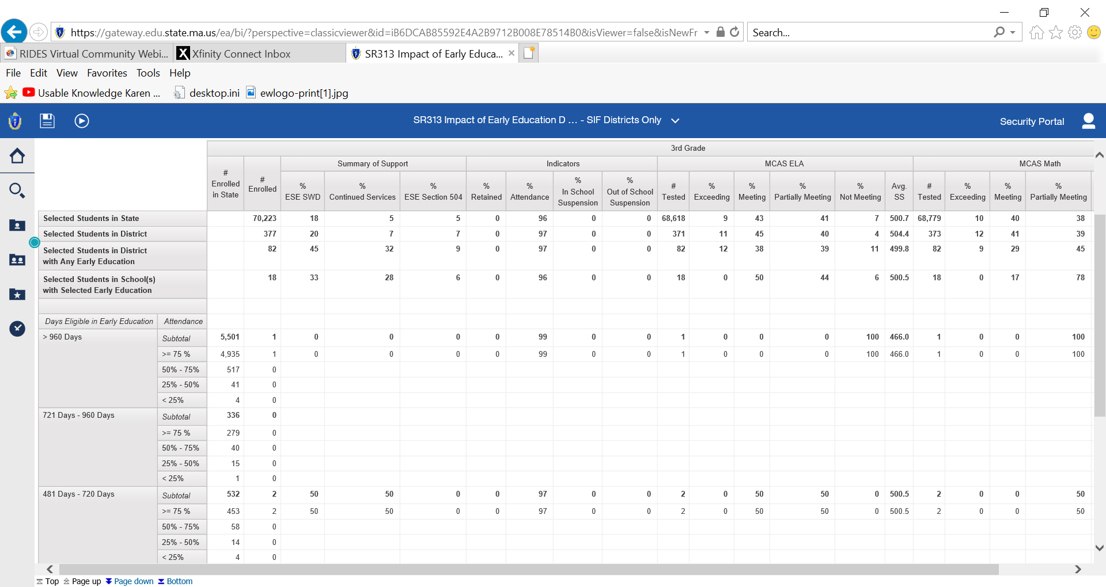
SR 313 – Data Report

Slide 8

Data use
Data Use

