Slide 1
Title: Edwin webinar – CVTE Pathways report
Edwin Webinar:
CVTE Pathways Report
Spring 2019

Slide 2
We’ll cover –
The CVTE Graduate Pathways Report
Where to find it, how to use it, what it means

Slide 3
CVTE Pathways Report is designed to show the postsecondary educational pathways for CVTE students who have graduated HS
Use it to answer questions such as –
How many CVTE concentrators are participating in postsecondary education?
What degrees are they earning?
How many have continued in programs related to their CVTE program?
This report is limited to CVTE concentrators who have graduated HS and then enrolled in MA public higher ed institutions.
Notes:
Top ½: CVTE concentrators: CVTE programs – either reported as participating in Perkins programs (seq of 2+ courses) or Ch74 programs.
These are disaggregated by ‘flavors’ of CVTE programming.
Useful for Program improvements – ex. PAC – or considering college advising
spring/summer or end of year is great time to reflect back and consider what to keep doing or to do differently … and

Slide 4
From the Edwin home page –

Slide 5
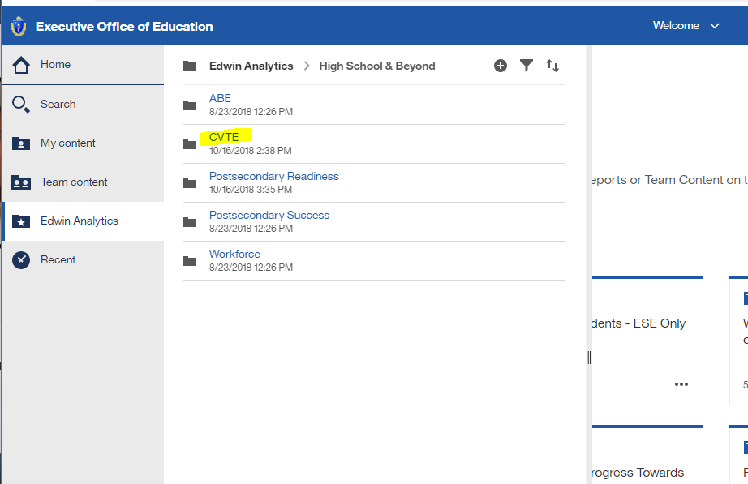
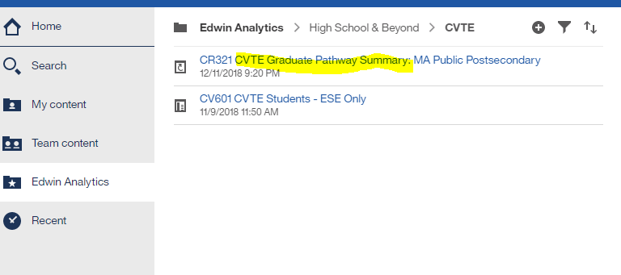
Select “High School & Beyond” – CVTE – Graduate Pathways

Slide 6
On prompt page, red * are required; others are optional.

Slide 7
The report includes a state summary, and HS details by program
ABC HIGH SCHOOL
STATE
SCHOOL

Slide 8
How many CVTE grads are participating in MA public postsecondary education?
1.
Of the CVTE HS grads in 2015 –
4,737 are in MA public postsecondary education
90% began immediately after HS graduation
10% began within 16 months.
ABC HIGH SCHOOL
1

Slide 9
How many CVTE grads are participating in MA public postsecondary education?
ABC HIGH SCHOOL
2.
Of the CVTE HS grads in 2015 who participated in MA public postsecondary education –
78% are still enrolled
19% dropped or stopped out
3% attained a degree
after two years.
2
Notes:
Note: could select these other bits to see, after 4 or 6 years

Slide 10
What degrees are they earning?
ABC HIGH SCHOOL
3
3. Of the CVTE HS grads in 2015 who participated in MA public postsecondary education –
11% earned a certificate
56% received an associates
1% received a bachelors
33% are not available
These are the highest undergrad degrees earned within 6 years.

Slide 11
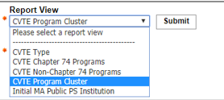
How many have continued in programs related to their CVTE program?
ABC HIGH SCHOOL
4
4. Of the CVTE HS grads in 2015 who participated in MA public postsecondary education –
32% were enrolled in a cluster related to their HS program
4% attained a degree in their cluster
Notes:
That was for the state. Below are all the same info, for HS programs offered.
Can also select results by other views – Type (Ch74 & non-Ch74, also called Perkins-only)

Slide 12
See also results by Program Cluster
Cluster continuation indicates the student enrolled and/or attained a degree in a postsecondary program within the same cluster as the student's high school vocational program.
ABC HIGH SCHOOL
STATE
SCHOOL
Notes:
For this school, there are a few program clusters with > 20 grads who continued to MA publics. A sizable % are still enrolled, and many are enrolled in related clusters. A few have even finished a degree in that cluster.

Slide 13
Footnotes may address some questions –
MA public institutions include University of Massachusetts campuses, MA state universities, and MA community colleges.
Student characteristics and MA public high school graduation are based on information reported by the districts in the Student Information Management System (SIMS).
MA public postsecondary enrollment is based on information reported by the institutions to Department of Education through the Higher Education Information Resource System (HEIRS).
What are the clusters?

Slide 14
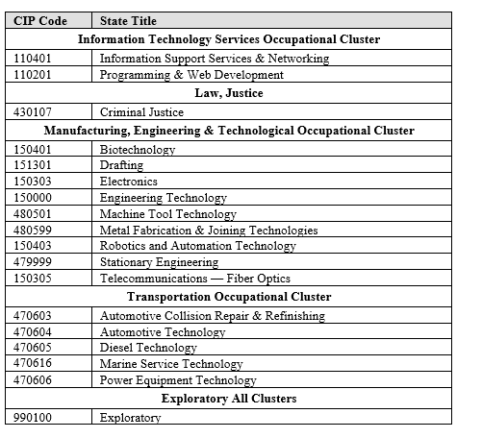
CVTE Occupational Clusters are found in Appendix of the SIMS handbook on the DESE website.
Postsecondary programs are mapped to these same clusters.
http://www.doe.mass.edu/infoservices/data/sims/SIMS-DataHandbook.docx

Slide 15
Questions? Comments? Ideas?
Contact CCTE or liaisons to learn about CVTE data resources
Jennifer.Appleyard@doe.mass.edu

Slide 16
Thank you
Thank you!
Jen Appleyard
EWIS@doe.mass.edu
jennifer.appleyard@doe.mass.edu
www.doe.mass.edu
75 Pleasant Street, Malden, MA 02148

