Slide 1
Edwin Analytics School Finance Reports
July 10, 2019

Slide 2
Edwin School Finance Reports
Quick overview of reports [Source: http://www.doe.mass.edu/edwin/gateway/more-info-finance-2.docx]
Examples: comparing expenditures across districts
Other school finance data resources
Questions

Slide 3
overview
Overview
01

Slide 4
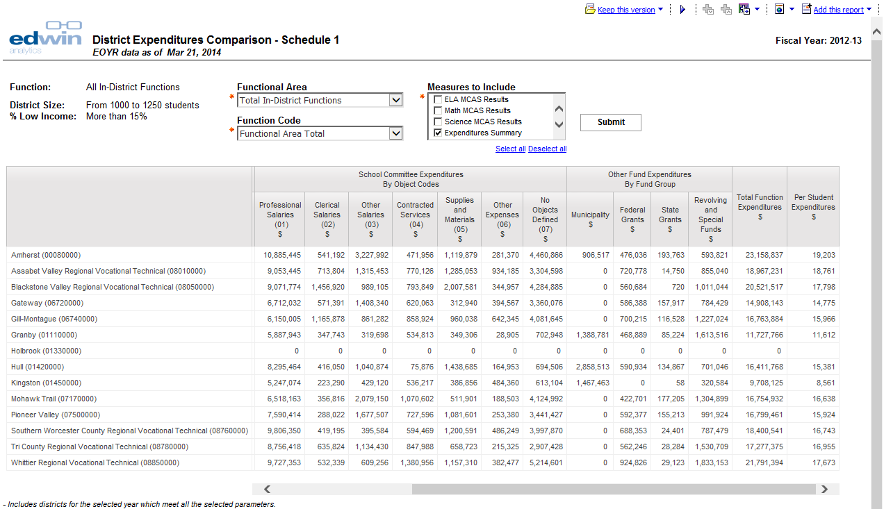
FN214 District Expenditures Comparison
Information on instructional expenditures is available at the school level in report FN314

Slide 5
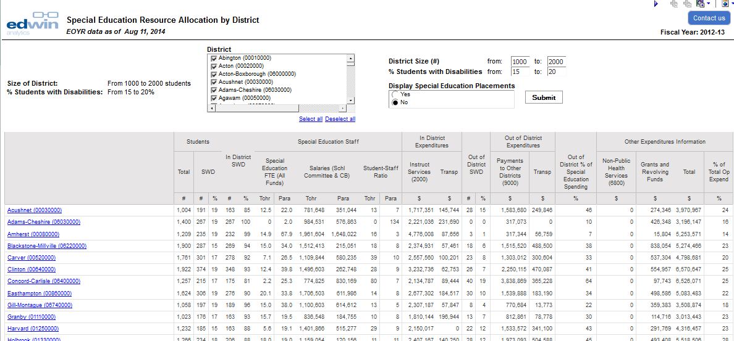
FN215 District Special Education Resource Allocation
Report FN315 provides more detailed information.

Slide 6
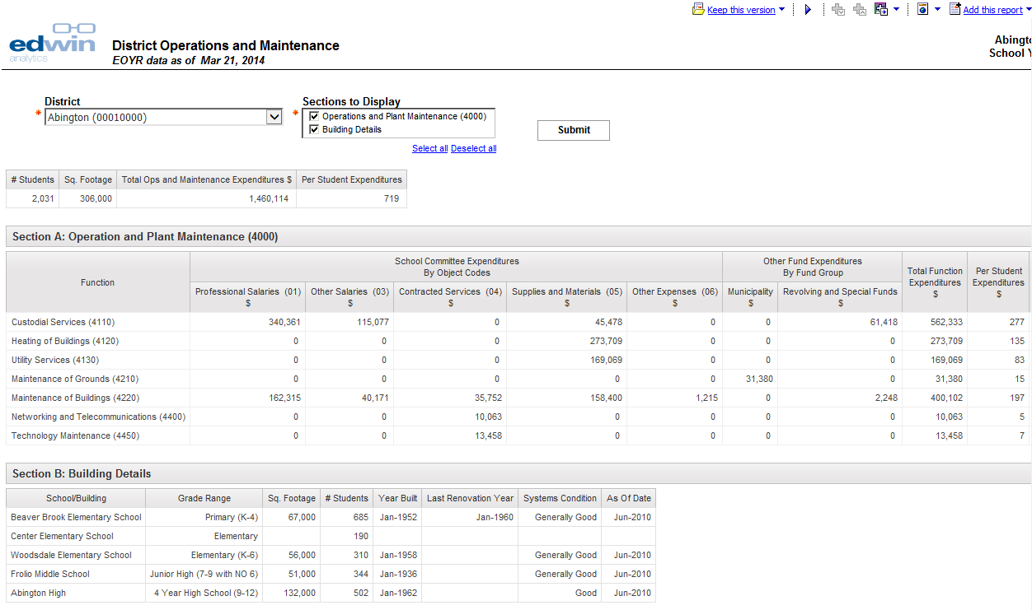
FN316 District Operations and Maintenance

Slide 7
District comparison reports
District Comparison Reports
02

Slide 8
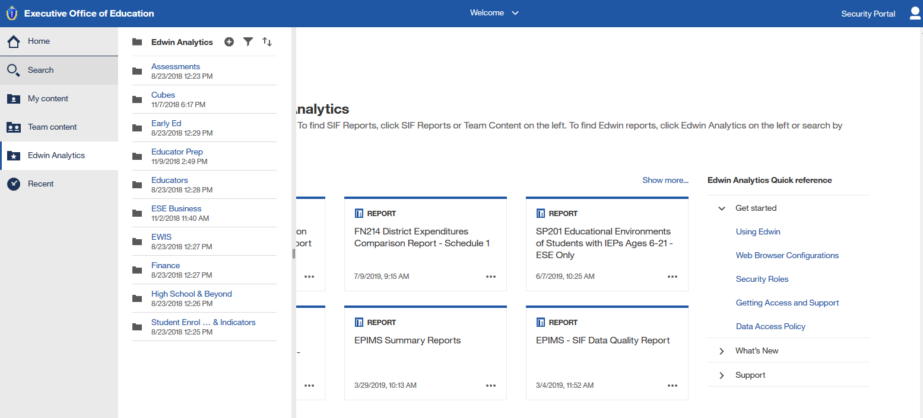
FN214 Example

Slide 9
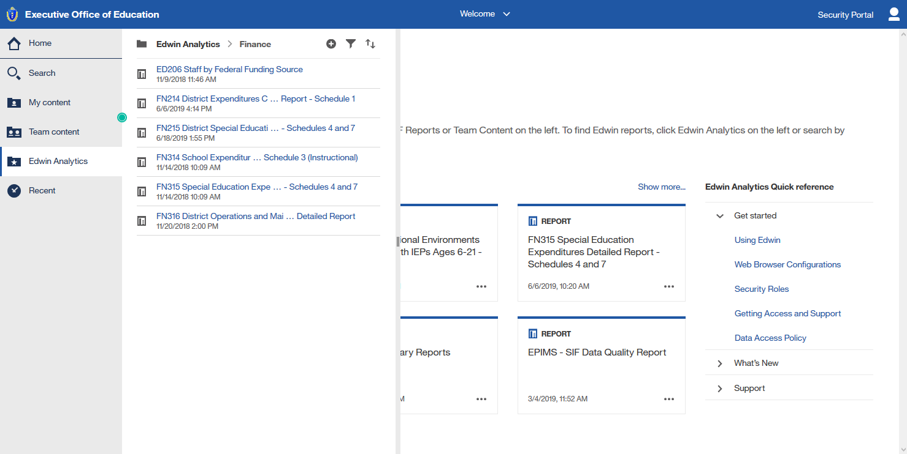
FN214 Example

Slide 10
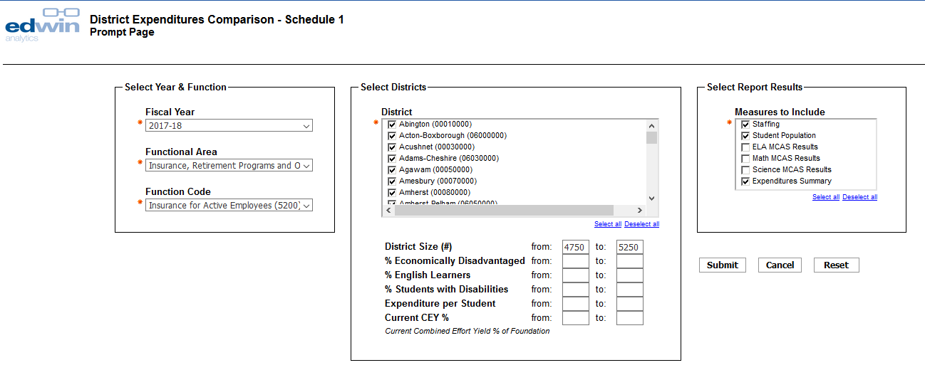
FN214 Example

Slide 11
FN214 Example

Slide 12
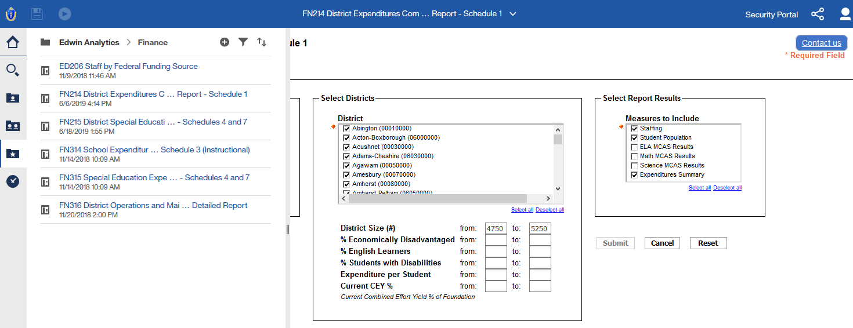
FN215 Example

Slide 13
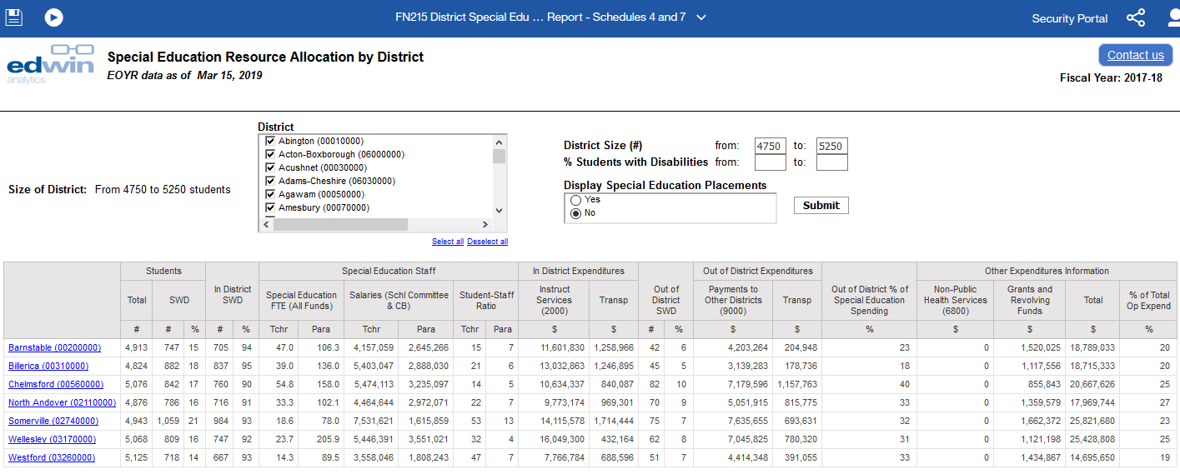
FN215 Example
% of all SWD
% of all SWD

Slide 14
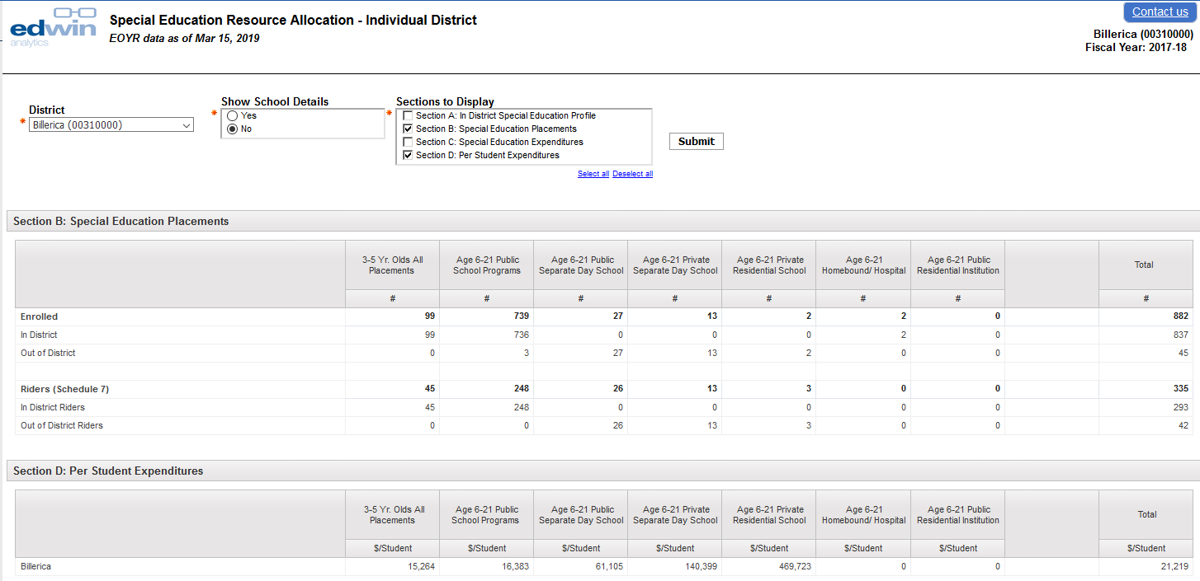
FN315 Individual District Example

Slide 15
Other resources
Other resources
03

Slide 16
Other school finance resources
Resource Allocation and District Action Reports (RADAR): http://www.doe.mass.edu/research/radar/
Per pupil expenditures report: http://www.doe.mass.edu/finance/statistics/ppx14-18.html
Teacher salary report: http://www.doe.mass.edu/finance/statistics/
School-level expenditure data: http://reportcards.doe.mass.edu/

Slide 17
Thank you
Thank You
Rob Hanna, Senior Fiscal Analyst Office of District and School Finance
robert.hanna@doe.mass.edu
www.doe.mass.edu/finance
75 Pleasant Street, Malden, MA 02148

