Slide 1
Edwin Webinar: MCAS Reports October 3 & 7, 2019

Slide 2
We’ll cover –
An overview of state results and the interim graduation standard.
The MCAS Assessments Reports
Achievement Analysis: scaled scores; achievement levels; SGP; student groups
Achievement Analysis—Student Level
Curriculum Analysis
Growth Analysis
Item Analysis
Where to find reports; how to run them; scenarios for use

Slide 3
English Language Arts Achievement Results
2019 ELA by Grade
2017–2019 Change
Grade | Average Scaled Scores |  |  | Scaled Score Change, 2017 to 2019
 | 2017 | 2018 | 2019
Grade 3 | 498.8 | 502.2 | 504.1 | +5.3
Grade 4 | 499.2 | 501.8 | 501.8 | +2.6
Grade 5 | 498.9 | 501.9 | 501.2 | +2.3
Grade 6 | 499.4 | 501.0 | 501.3 | +1.9
Grade 7 | 499.1 | 497.0 | 499.0 | -0.1
Grade 8 | 498.8 | 499.1 | 499.8 | +1.0
Grades 3-8 | 499.0 | 500.5 | 501.2 | +2.2
Grade 10 |  |  | 506.2

Slide 4
Mathematics Achievement Results
2019 Mathematics by Grade
2017–2019 Change
Grade | Average Scaled Scores |  |  | Scaled Score Change, 2017 to 2019
 | 2017 | 2018 | 2019
Grade 3 | 498.8 | 499.9 | 499.4 | +0.6
Grade 4 | 498.0 | 497.9 | 499.2 | +1.2
Grade 5 | 498.6 | 497.5 | 498.5 | -0.1
Grade 6 | 499.2 | 498.6 | 500.8 | +1.6
Grade 7 | 498.6 | 497.5 | 498.2 | -0.4
Grade 8 | 499.6 | 498.8 | 499.0 | -0.6
Grades 3-8 | 498.8 | 498.4 | 499.2 | +0.4
Grade 10 |  |  | 505.1

Slide 5
Science and Technology/Engineering
2019 Next-Generation Gr. 5 & 8
Legacy Grade 10
 | Grade 5 |  | Grade 8
Exceeding Expectations | 8 | 48% | 8 | 46%
Meeting Expectations | 40 |  | 38
Partially Meeting | 39 |  | 41
Not Meeting Expectations | 12 |  | 13
Avg. Scaled Score | 498.9 |  | 498.2

Slide 6
Statistical Linking Model (ELA)
13% Exceeding Expectations
48% Meeting Expectations
% of students
31% Partially Meeting Expectations
8% Not Meeting Expectations

Slide 7
Zooming in on the Pass/Fail Line (ELA)
472
Partially Meeting Expectations
240
470
EPP
required
% of students
5% Passing & Not Meeting
Expectations
455
220
3% Not Passing & Not Meeting
Expectations
200
440

Slide 8
MCAS Reports Show Results for Enrolled as of Most Recent SIMS Collection, and Currently Claimed Students
MCAS reports provide Results at the following levels:
Student; School; District; State
Use them to answer questions such as –
At the student level: How did my transfer students perform on prior MCAS tests? Which students should be placed in an AP course of study? Which high school students need to complete an EPP?
At the school level: How did my school perform overall, and on individual items, in comparison to other schools in the district? In comparison to students across the state?
At the district level: Which domain/cluster/standards should we prioritize for professional development or curriculum alignment?

Slide 9
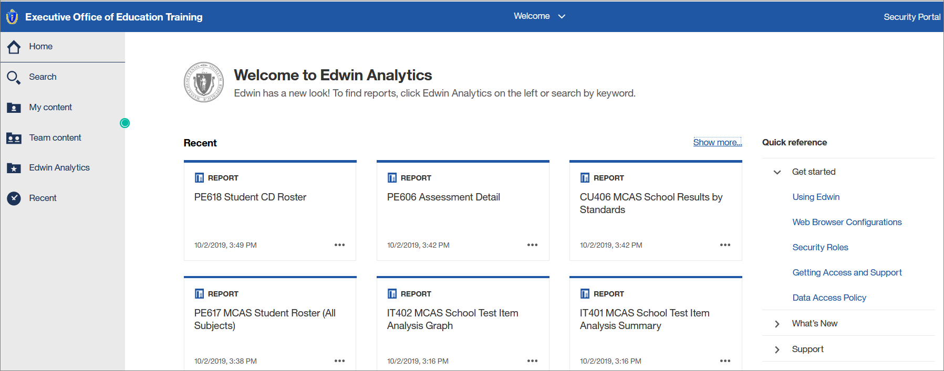
From the Edwin home page –

Slide 10
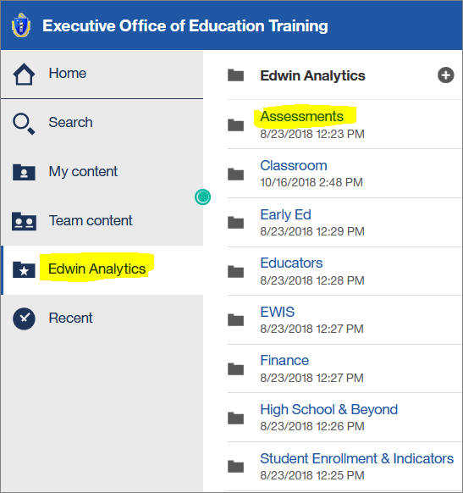
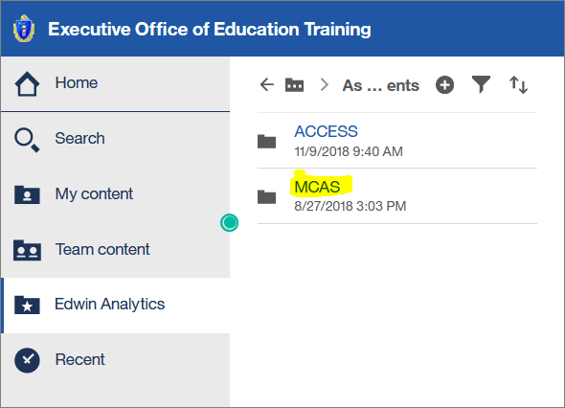
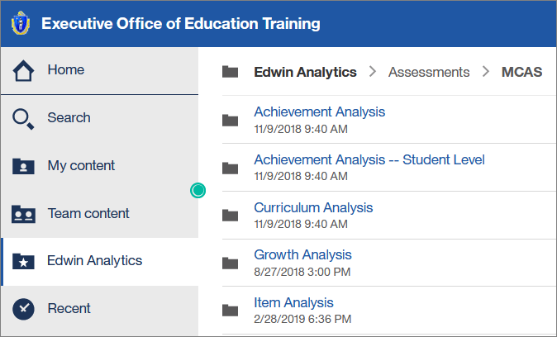
Select Edwin Analytics → Assessments → MCAS

Slide 11
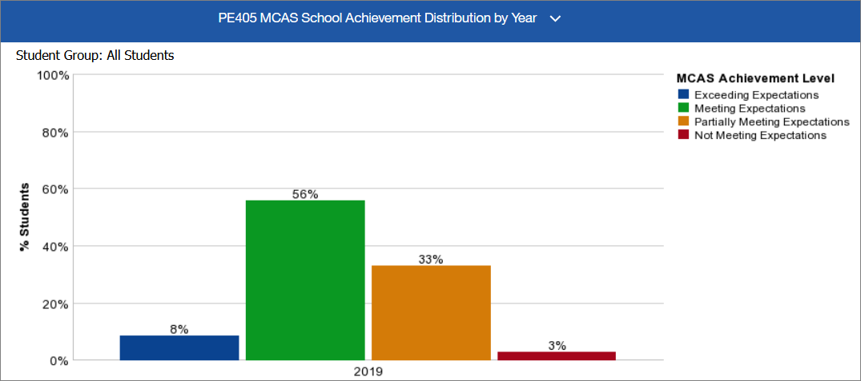
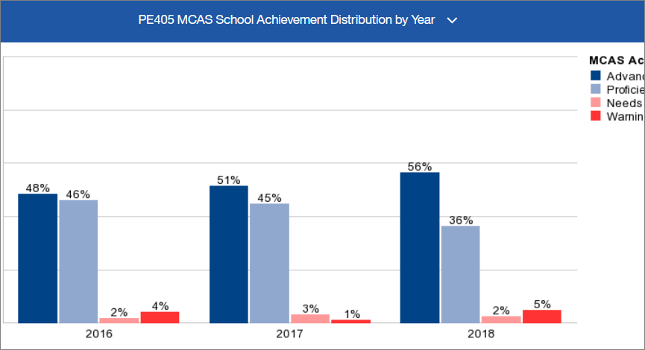
Achievement Analysis: PE405 Achievement Distribution by Year
Legacy and next-generation MCAS tests are reported using
different scales and achievement levels (high school example)

Slide 12
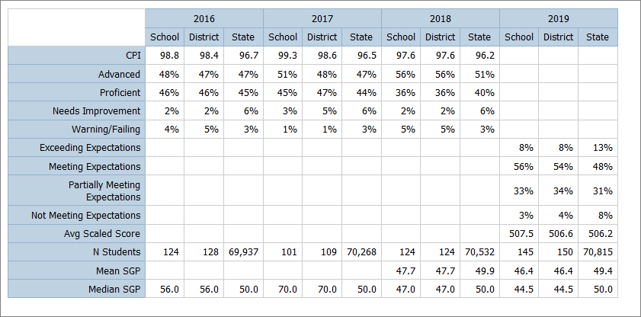
Achievement Analysis: PE405 Achievement Distribution by Year
The table for a sample high school (below the bar graphs) shows legacy and next-generation test history; mean/median SGP can be used as a reliable measure across assessments.

Slide 13
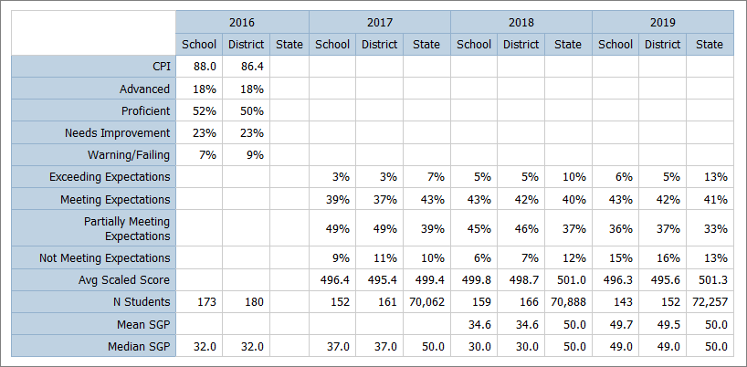
Achievement Analysis: PE405 Achievement Distribution by Year
The table for a sample middle school (below the bar graphs) shows legacy and next-generation test history; mean/median SGP can be used as a reliable measure across assessments.

Slide 14
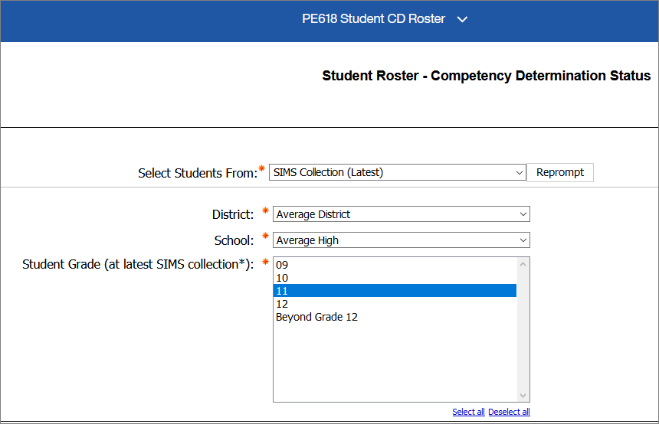
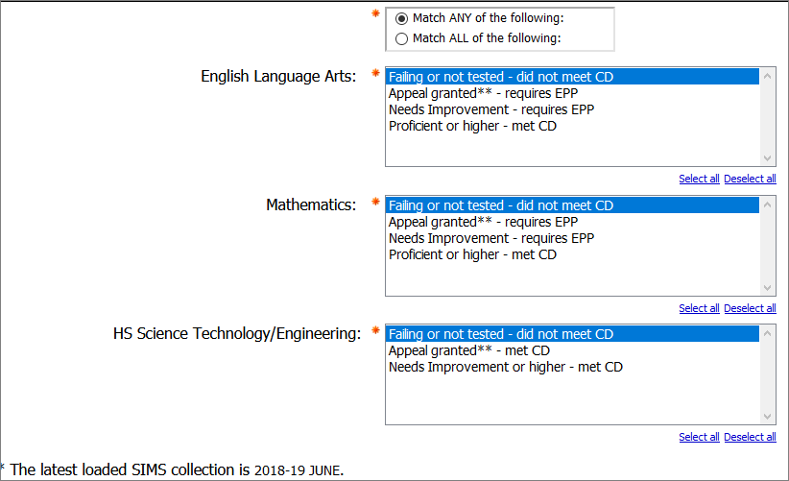
Achievement Analysis—Student Level: PE618 Student CD Roster
Which students have not earned the Competency Determination?

Slide 15
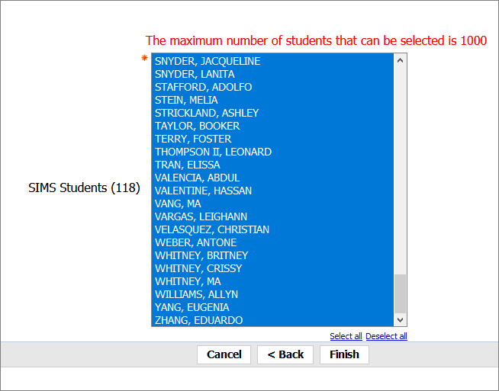
Which students have not earned the Competency Determination?
For this sample dataset, as of June 2019 SIMS, 118 grade 10 students have not met the MCAS testing requirement in one or more subjects.

Slide 16
Which students have not earned the Competency Determination?
Legacy-to-next-generation scaled score conversion table, available at http://www.doe.mass.edu/mcas/results.html
Spring 2019 MCAS
Grade 10 ELA NextGen Scaled Score Range | Grade 10 Math NextGen Scaled Score Range | Legacy-equivalent Scaled Score Range | Legacy-equivalent Achievement Level | CPI | CD status code | CD status
440 - 446 | 440 - 453 | 200 - 208 | F | 0 | 0 | Did not pass
447 - 454 | 454 - 468 | 210 - 218 | F | 25 | 0 | Did not pass
455 - 462 | 469 - 476 | 220 - 228 | NI | 50 | 1 | Passed, requires EPP
463 - 471 | 477 - 485 | 230 - 238 | NI | 75 | 1 | Passed, requires EPP
472 - 500 | 486 - 503 | 240 - 258 | P | 100 | 2 | Passed
501 - 560 | 504 - 560 | 260 - 280 | A | 100 | 2 | Passed

Slide 17
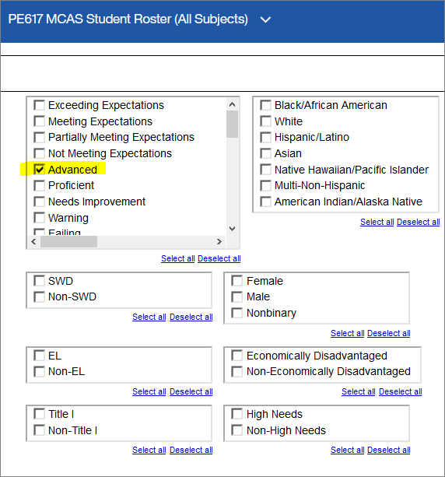
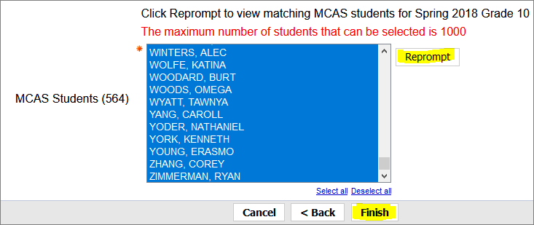
Achievement Analysis—Student Level: PE617 MCAS Student Roster
Which students may be eligible for the Adams Scholarship?
Filter the list of students who scored Advanced in at least one subject.
Click “Reprompt” to apply the filter, then click “Finish.”

Slide 18
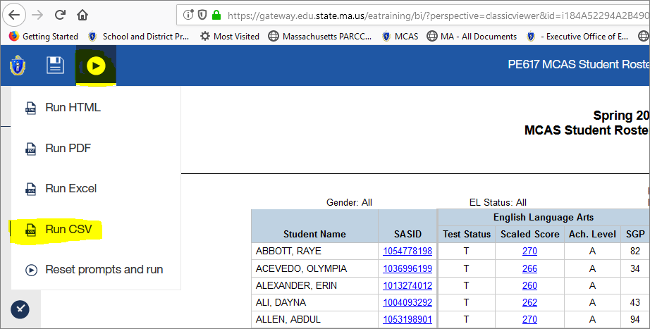
Which students may be eligible for the Adams Scholarship?
Select “CSV” from the RUN menu to open a file
Enter formula to calculate the total score across all tests

Slide 19
Which students may be eligible for the Adams Scholarship?
Create “Total Score” column: enter formula =sum(D2,H2,L2) in row 2.
Divide total # students by 4; note the number.
Sort Total Score in descending order
Scroll to the number (step 2) to see the top 25% cutoff score.

Slide 20
Growth Analysis—Student Growth Scatter Plot
Select “Enrolled on or after Oct 1st to view all students;
Select “Enrolled on Oct 1st to view students reported on profiles and for accountability;
Select desired student groups (defaults to ALL).

Slide 21
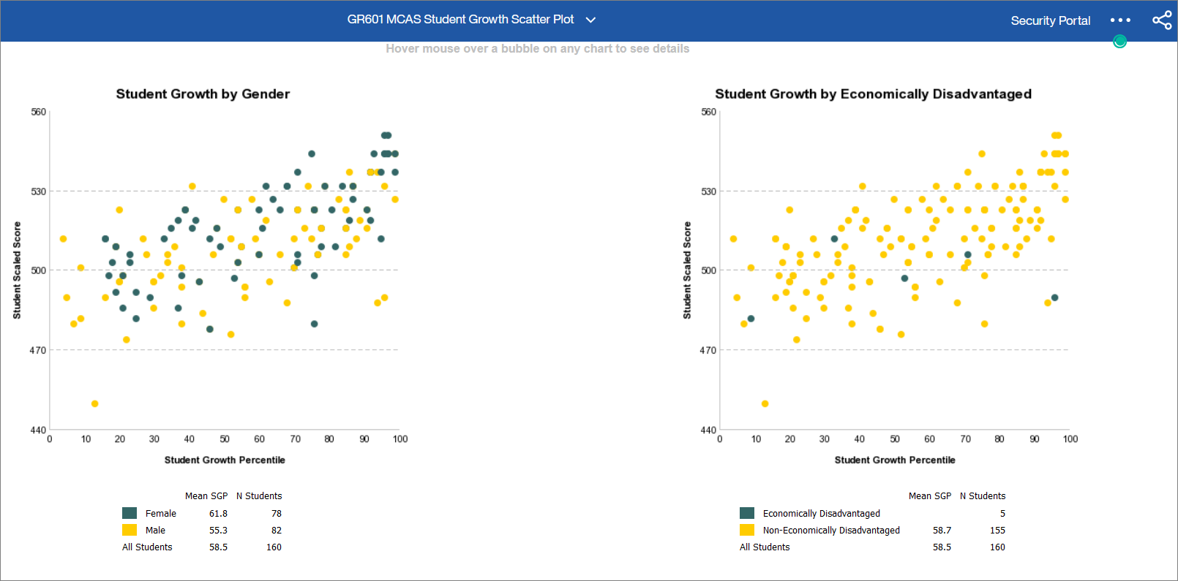
Growth Analysis—GR601 Student Growth Scatter Plot

Slide 22
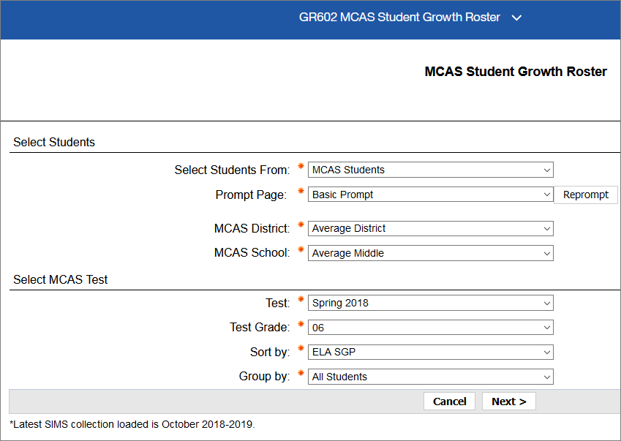
Growth Analysis—GR602 MCAS Student Growth Roster
Spring 2019 SGP data loaded as of June 2019 SIMS;
Set “Select Students From” prompt to “Claimed Students” for transfer students who have been claimed.

Slide 23
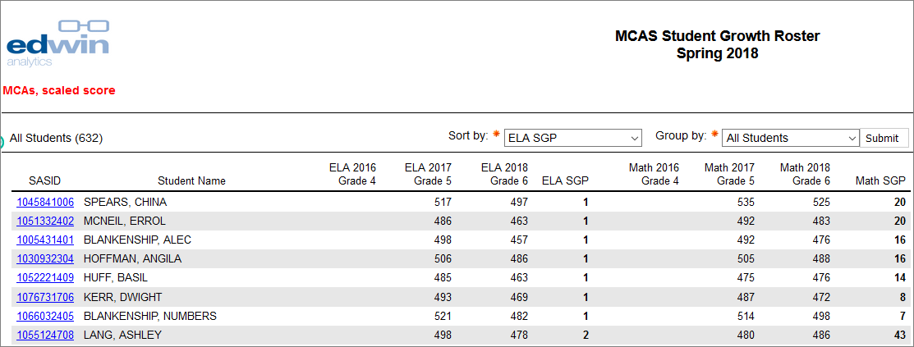
Growth Analysis—GR602 MCAS Student Growth Roster
Which low growth students are at risk of falling behind?

Slide 24
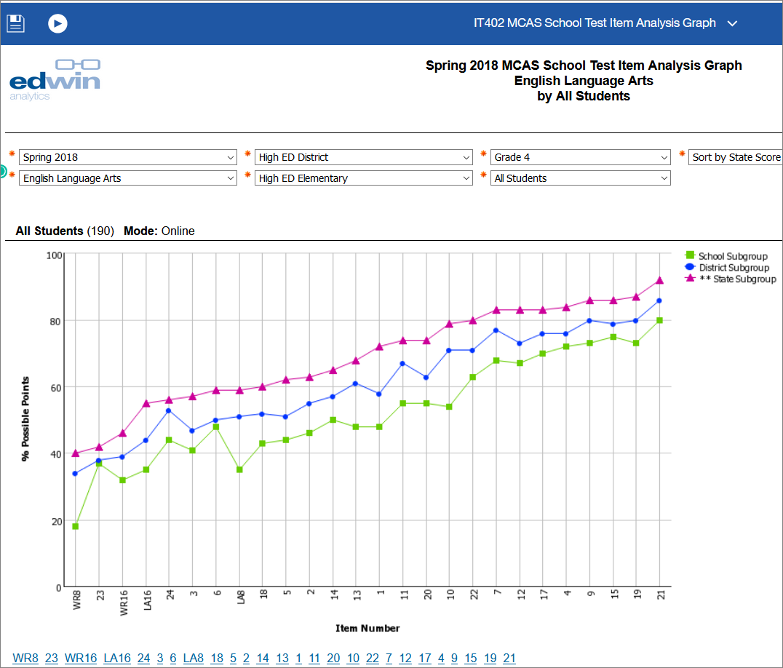
Item Analysis—IT402 MCAS School Test Item Analysis Graph
Graph of how students performed on easy and more difficult items, compared to other schools in my district and the state.
Sort by “State Score”
Click through to standard and digital item library

Slide 25
Item Analysis—IT401 MCAS School Test Item Analysis Summary
Table of how students performed on easy and more difficult items, compared to other schools in my district and the state.
Includes item description
Click through to standard and digital item library

Slide 26
Available Resources
Resource | Resource description | Where to find it
Student Work Samples | Samples of student work for each score point for ELA, math and STE; ELA essays include annotations for each score point. | MCAS Sample Student Work & Scoring www.doe.mass.edu/mcas/student/2019/
Student Essay Responses | One essay at each grade in grades 4–8; one constructed response item in grade 3; both essays released at grade 10 | PearsonAccess Next mcas.pearsonaccessnext.com
Released Items | Approximately 50% of items released at grades 3–8; 100% released at grade 10 ELA and math | MCAS Resource Center mcas.pearsonsupport.com/released-items/
Edwin Analytics | Official embargoed MCAS interactive reports available on Sept. 19; student Competency Determination status available in PE618 Student CD Roster | DESE Security Portal gateway.edu.state.ma.us
District Analysis and Report Tools (DART) Success after high school report | Analysis of school and district postsecondary outcomes. See what proportion of the students from your school attended college, required remediation and graduated. | DESE Data Tools http://www.doe.mass.edu/dart/dart-success-after-high-school.xlsx

Slide 27
Questions? Comments? Ideas?
Contact Student Assessment
mcas@doe.mass.edu
781-338-3625

