Slide 1
Edwin Webinar: Classroom Reports December 10, 2019

Slide 2
MCAS Classroom Reports Show Results for Most Recent SIMS Collection and Currently Claimed Students
MCAS classroom reports provide results at the following levels: student; school; district; state
Use them to answer questions such as –
What’s the mean SGP of higher-achieving 5th grade math students across my district (Meeting & Exceeding Expectations), by class?
How did students in my 8th grade writing class perform on their 7th grade ELA essay questions last year?
What items were most difficult for at-risk students in my science class last year, and which standards should I prioritize for this group this year?

Slide 3
We’ll cover –
The MCAS Classroom Reports: Where to find them; how to run them
Achievement & Growth by Classroom—GR501
Achievement & Growth by Teacher—PE520
Classroom MACS Results—CU522
Classroom Standards Summary—PE506
Classroom Item Analysis Roster—IT516
Student MCAS Item Analysis—IT523
Course Three Year Performance Trend by Teacher—PE521

Slide 4
Data Collection Rules
For nearly all districts, SIF classroom data are available for the current school year. SIF data are also used for previous school years until the EOY (June) collections are loaded (typically late in the calendar year).
What’s the difference between SIF vs Oct/EOY collection? SIF is not certified so there may be some teacher/classroom omissions or mistakes. If you find a potential issue with SIF data, talk to your local data collection team.
The latest loaded EPIMS and SCS collection is 2018-19 JUNE (when was this loaded?)

Slide 5
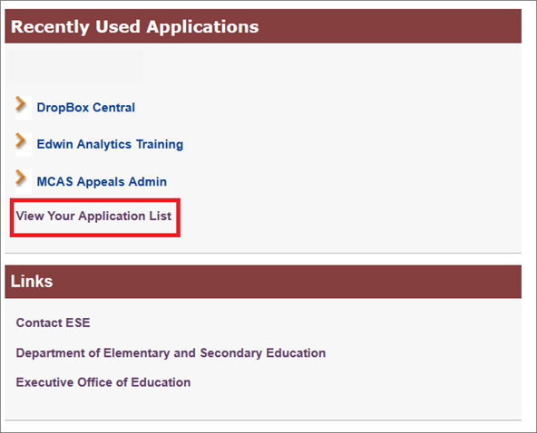
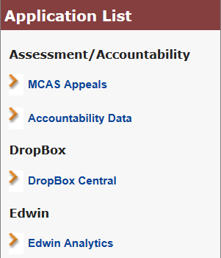
From the Security Portal home page –
Select Edwin Analytics. If the link does not appear, click “View Your Application List.”
If Edwin Analytics does not appear in your Application List,
contact your Directory Administrator for access at:
http://www.doe.mass.edu/infoservices/data/diradmin/list.aspx.

Slide 6
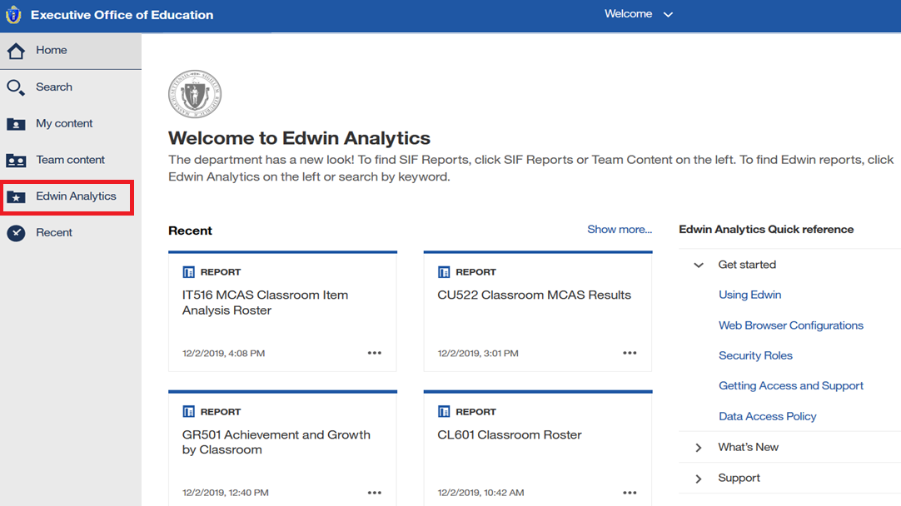
From the Edwin home page → Select Edwin Analytics

Slide 7
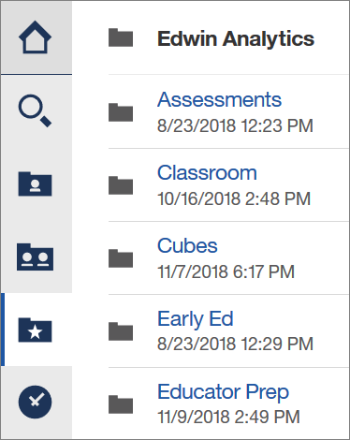
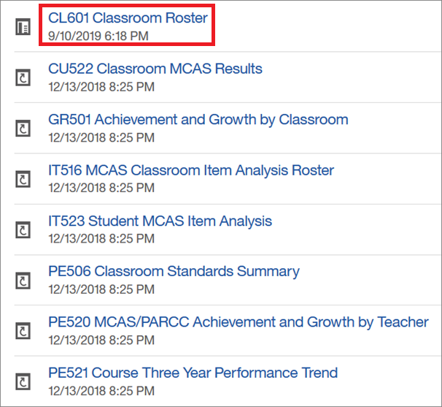
Select → Classroom for Available Reports
No MCAS data in CL601

Slide 8
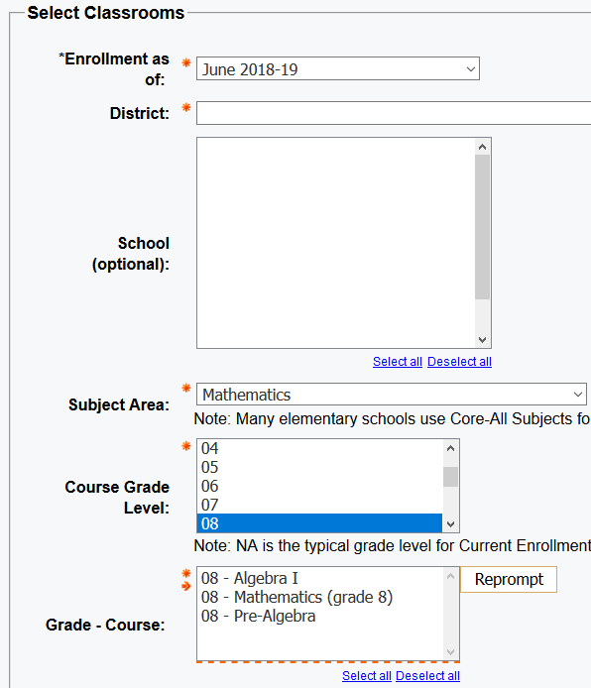
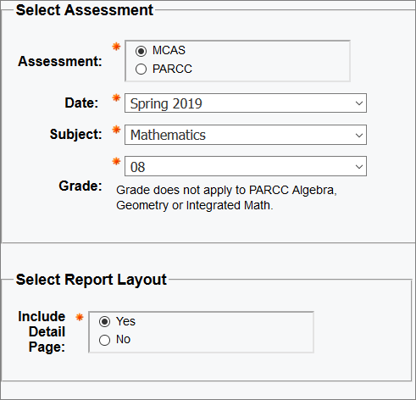
Achievement and Growth by Classroom: GR501 Prompt Page
Select district for all courses; school selection is optional.
Select Subject Area and Grade.
Click Reprompt to see Courses for that grade and subject.
Select test year and subject.
Select Detail Page for table output.

Slide 9
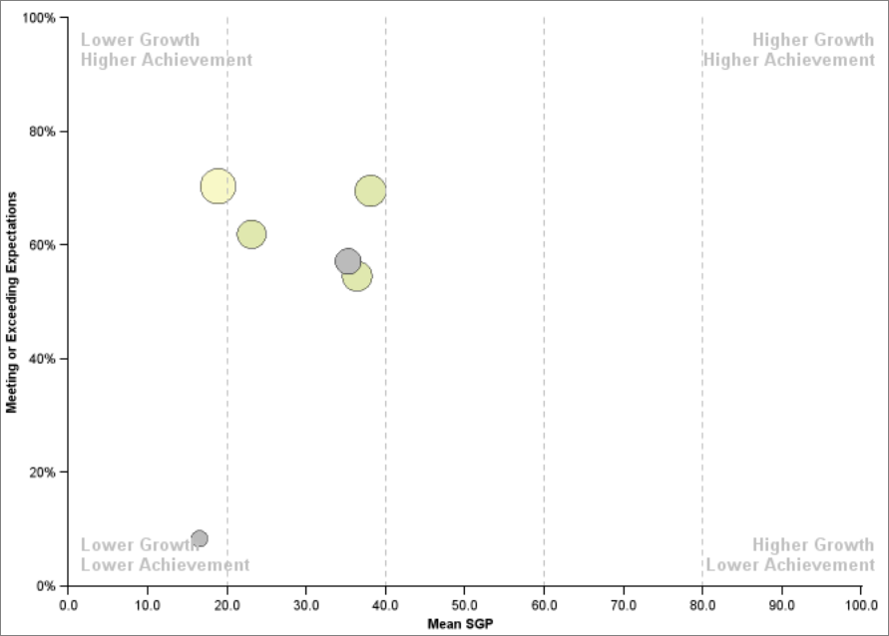
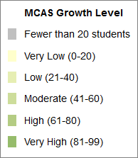
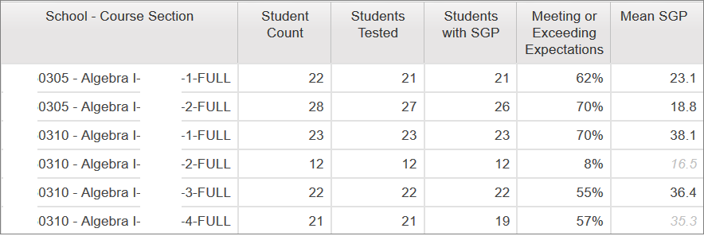
Achievement and Growth by Classroom: GR501 Report
Percent Meeting or Exceeding Expectations
Each bubble represents a classroom
Results suppressed for <6 students
SGP in gray for <20 students
Hover cursor for details
Detail Page shows number of students,
Achievement, and mean SGP classrooms
Mean SGP

Slide 10
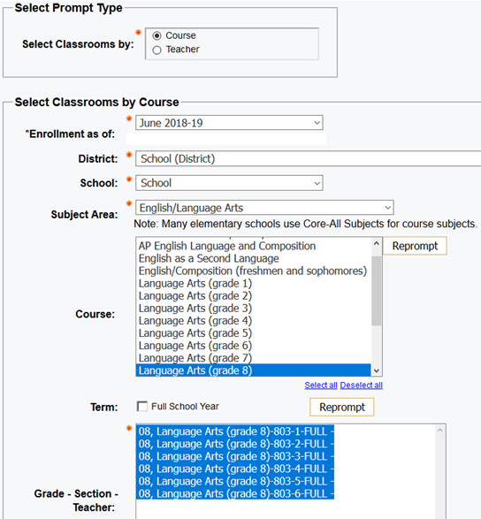
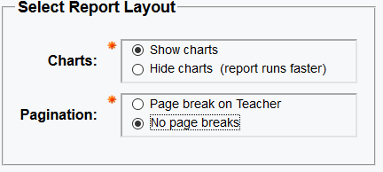
Achievement and Growth by Teacher: PE520 Course Prompt Page
Provides a 1-year summary of student MCAS achievement distribution, average SGP, and growth distribution.
Select the Course prompt to see all courses in the selected subject.
Select June for 2018-2019 classes and MCAS results.
Select Current to view 2019-2020 classes and prior MCAS results.
Click Reprompt to see all courses in the selected subject area
and select teacher courses by teacher name

Slide 11
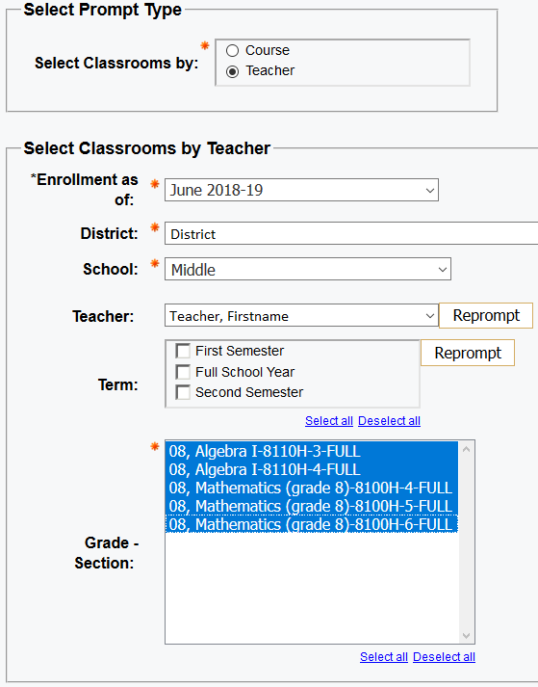
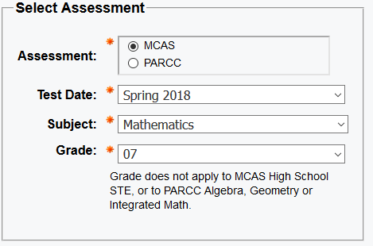
Achievement and Growth by Teacher: PE520 Teacher Prompt Page
Provides a 1-year summary of student MCAS achievement distribution, average SGP, and growth distribution.
Select Teacher prompt, to see all courses taught by selected teacher.
Select June for 2018-2019 classes and MCAS results.
Select Current to view 2019-2020 classes and prior MCAS results.
Click Reprompt to see and select teacher’s classes

Slide 12
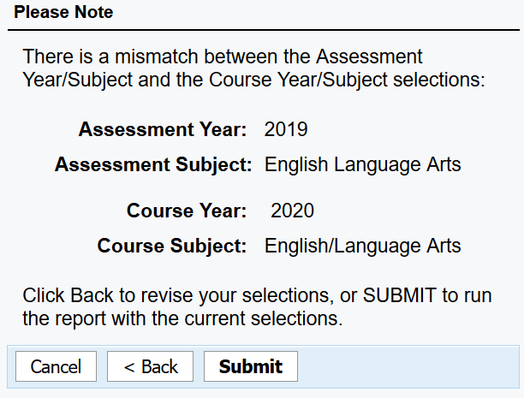
Achievement and Growth by Teacher: PE520 “Mismatch” Note
Selecting June enrollment for current year’s class and prior MCAS results produces this warning.
Click Submit to continue.

Slide 13
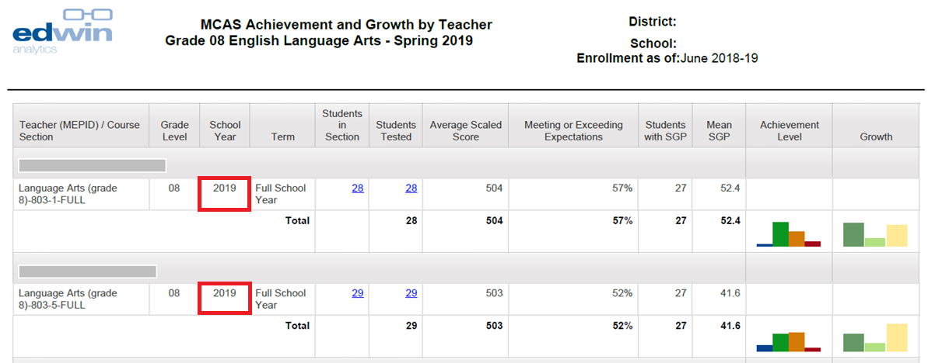
Achievement and Growth by Teacher: PE520 Report
When Current Enrollment prompt is selected, 2020 classroom assignments are shown.
Click-through: Students in Section to CL601 Classroom Roster (course grades)
Click-through: Students Tested to IT516 Classroom Item Analysis Roster

Slide 14
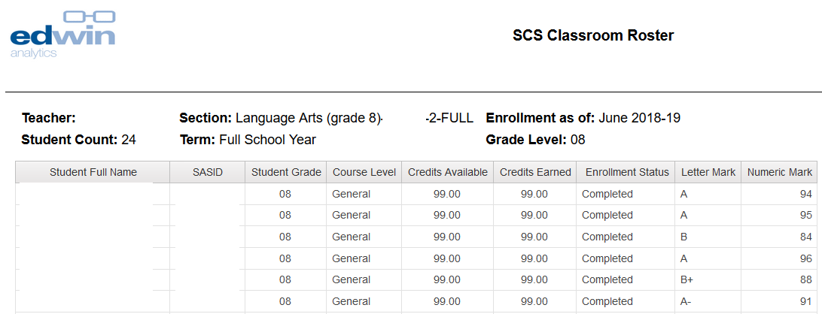
SCS Classroom Roster: CL601 Report
Provides a list, by classroom, of students' grades, course levels, credits, enrollment statuses, and marks.

Slide 15
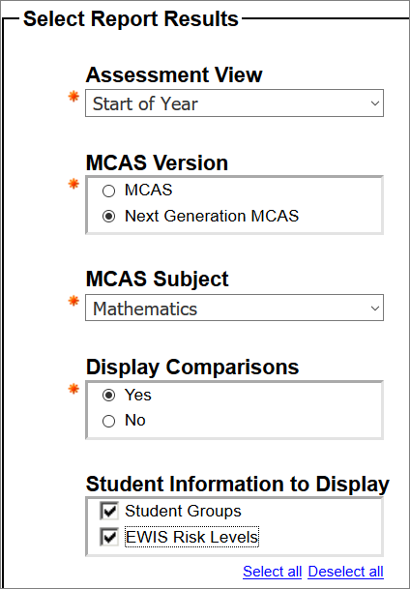
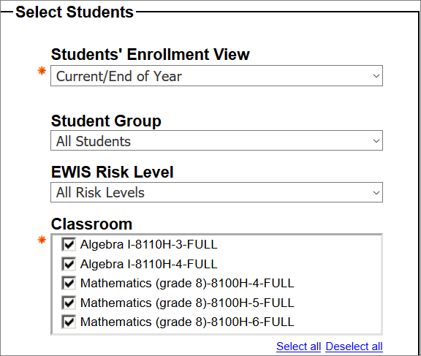
Classroom MCAS Results: CU522 Prompt Page
Select teacher to see all classrooms
Start of Year: prior MCAS
End of Year: current MCAS
Compare to school, district,
state
High Needs,
Econ. Disadvantaged
EL, Former EL
SWD

Slide 16
Classroom MCAS Results: CU522 Report
Report filters dynamically
update all results
This report is wide and best viewed as HTML or Excel

Slide 17
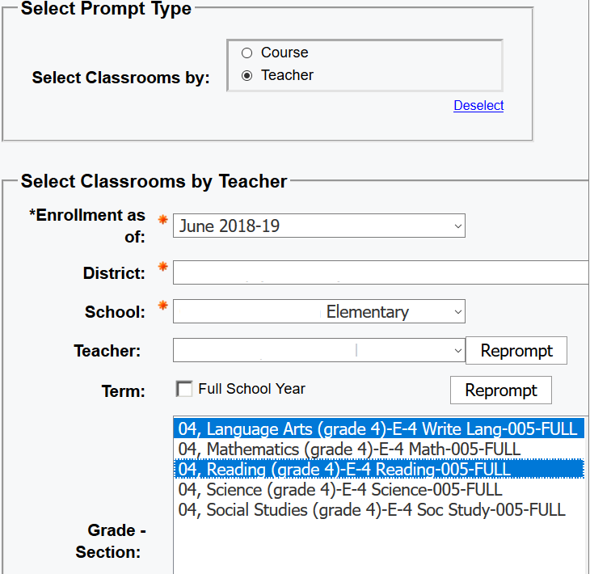
Classroom Standards Summary: PE506 Prompt by Teacher Page
Displays MCAS % correct by standards and question type for classroom, school, district and state, including the classroom/state difference.
Select Teacher prompt to select classes taught by that teacher.
Select Course prompt to see all classes and teachers in that subject
Select June for 2018-2019 classes and MCAS results.
Select Current to view 2019-2020 classes and prior MCAS results.

Slide 18
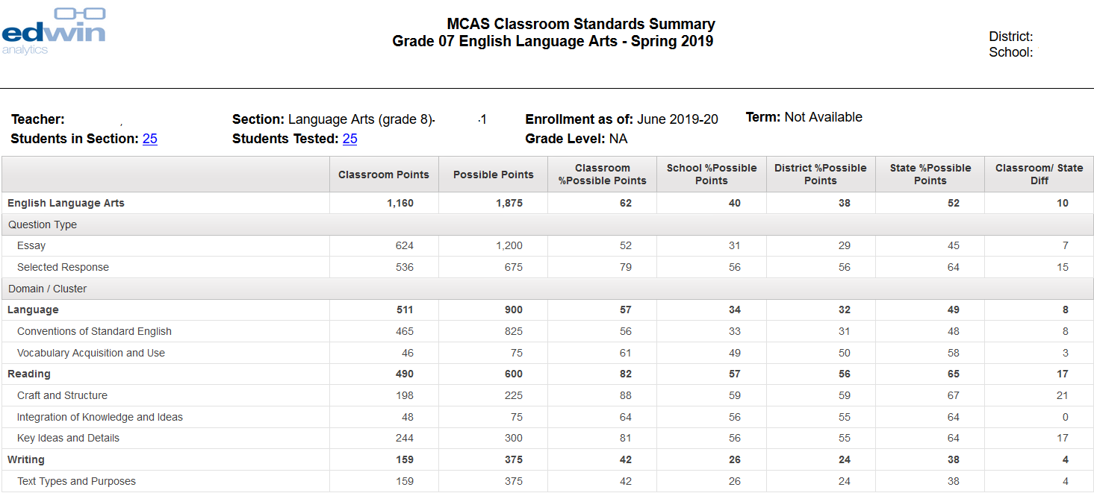
Classroom Standards Summary: PE506 Report
Click Students in Section for CL601 Classroom Roster
Click Students Tested for IT516 Classroom Item Analysis Roster

Slide 19
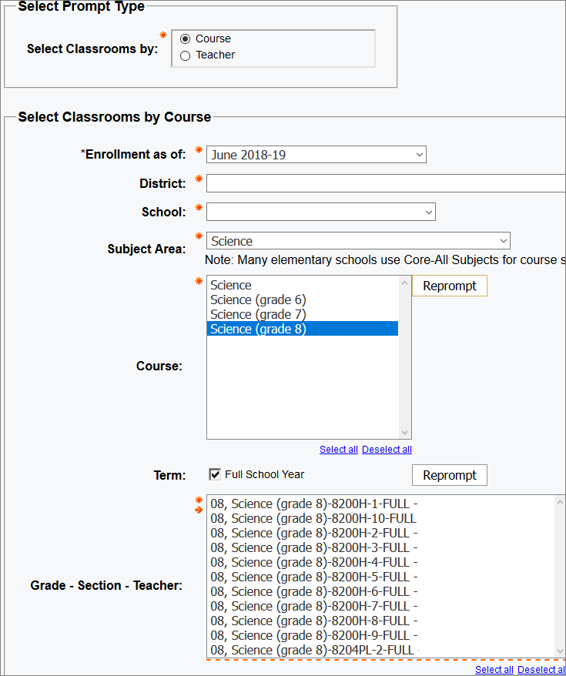
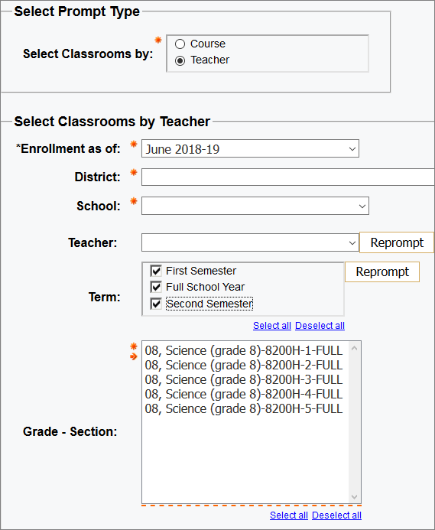
Item Analysis Roster: IT516 Teacher and Course Prompt Pages
Provides MCAS item analysis roster for classrooms; select by teacher or course.

Slide 20
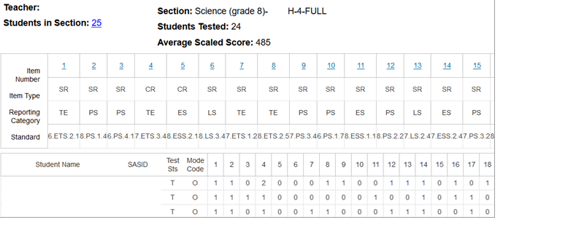
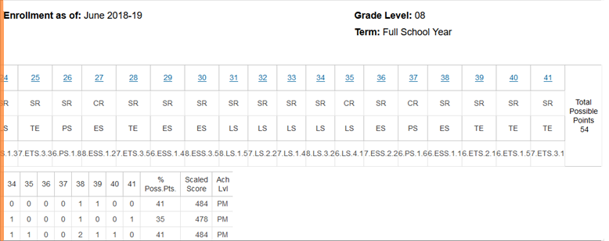
MCAS Item Analysis Roster: IT516 Report
Clicking released items takes you to the Digital Item Library at mcas.digitalitemlibrary.com/home.
Clicking unreleased items takes you to Released Item Documents at www.doe.mass.edu/mcas/release.html, where reporting categories, standards and descriptions for all operational items can be found. This will soon be updated to display the unreleased item info as on profiles.doe.mass.edu.

Slide 21
Student MCAS Item Analysis: IT523 Prompt Page
Provides start- or end-of-school-year MCAS item analysis roster for classrooms. Displays results by domain, cluster, learning standard, and item.
Student Enrollment View:
Current/End of Year – assigned to the classroom as of the most recent assignment;
Full School Year - assigned at the start of the year;
Ever in School Year - ever assigned to the classroom during the year.
Assessment View:
Start of Year - MCAS results from the previous MCAS test year
End of Year - MCAS results for the year.
**Current/June contains SIF data. For past school years, Current/June contains the June collection.

Slide 22
Student MCAS Item Analysis: IT523 Report-Start of Year View
Start of Year view: MCAS tested grade is above the table; classroom grade is in the table
Click student SASID for PR600 Student Profile Report

Slide 23
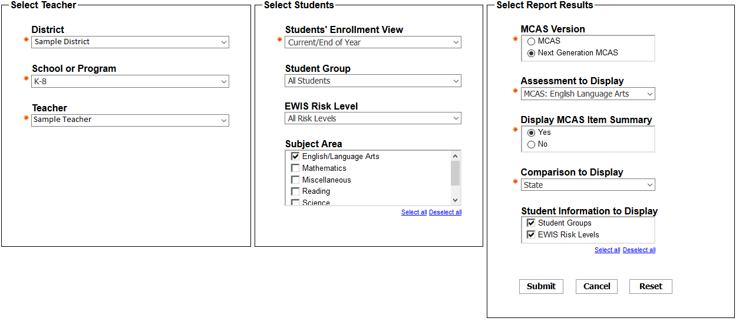
Three Year Performance Trend by Teacher: PE521 Prompt Page
This report runs for 3 years ending with the latest EOY SCS and EPIMS data available. The latest loaded EPIMS and SCS collection is 2018-19 JUNE.

Slide 24
Available Resources
Resource | Resource description | Where to find it
Student Work Samples | Samples of student work for each score point for ELA, math and STE; ELA essays include annotations for each score point. | MCAS Sample Student Work & Scoring www.doe.mass.edu/mcas/student/2019/
Student Essay Responses | One essay at each grade in grades 4–8; one constructed response item in grade 3; both essays released at grade 10 | PearsonAccess Next mcas.pearsonaccessnext.com
Released Items | Approximately 50% of items released at grades 3–8; 100% released at grade 10 ELA and math | MCAS Resource Center mcas.pearsonsupport.com/released-items/
Edwin Analytics |  | DESE Security Portal gateway.edu.state.ma.us
District Analysis and Report Tools (DART) Success after high school report | Analysis of school and district postsecondary outcomes. See what proportion of the students from your school attended college, required remediation and graduated. | DESE Data Tools www.doe.mass.edu/dart/dart-success-after-high-school.xlsx
Data in Action YouTube Channel | Suite of 43 videos that include MCAS alongside other ESE data sources | www.youtube.com/playlist?list=PLTuqmiQ9ssqsCEVNSi2Zm2FPHqZoHLAuu

Slide 25
Questions? Comments? Ideas?
Contact Student Assessment
mcas@doe.mass.edu
781-338-3625

