Slide 1
EDWIN OFFICE HOURS:
SLE REPORTS
DECEMBER 1, 2021

Slide 2
OBJECTIVES
SLE Reports: Overview & Context
SLE Reports: Walk-through
Questions?

Slide 3
Student Learning Experience (SLE) Reports:
Overview and Context

Slide 4
REPORT:
Teacher Equity Gaps in Massachusetts (October 2017) https://www.doe.mass.edu/research/reports/2017/10teacher-equity.docx
Notes:
https://www.doe.mass.edu/research/reports/2017/10teacher-equity.docx

Slide 5
RESEARCH
HIGHLY RATED
EXPERIENCED
IN-FIELD
Students assigned a teacher earning an exemplary evaluation accrue about
18 to 24 additional weeks of learning relative to those assigned a teacher earning an unsatisfactory evaluation.
Typical third-year teacher produces
4 additional weeks
of learning per year as compared to the typical novice teacher.
Research shows that a teacher’s subject matter knowledge is related to student achievement.

Slide 6
IN MA
Economically disadvantaged, students of color, and English learners are
Hispanic/Latinx students are
73-79%
30-40%
2.2x
more likely to be assigned
to a teacher rated
Needs Improvement or Unsatisfactory.
more likely to be assigned
to teachers with less than
3 years of experience.
as likely to be assigned to teachers rated Needs Improvement or Unsatisfactory.

Slide 7
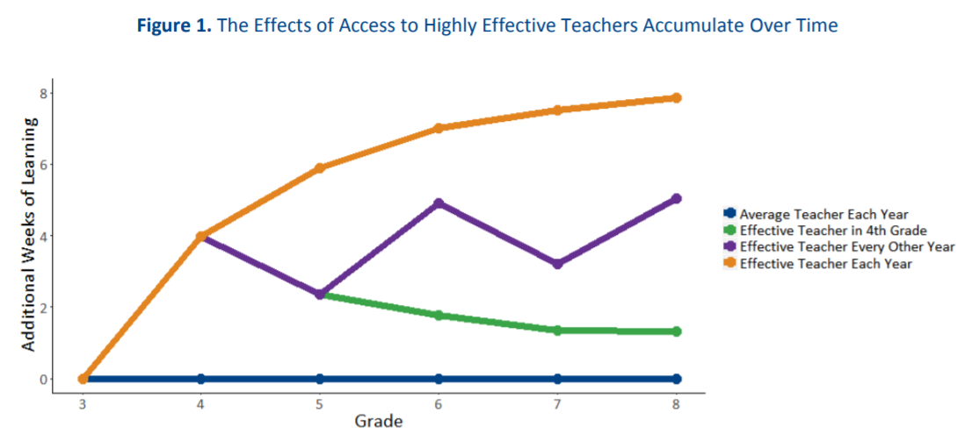
DID YOU KNOW?

Slide 8
Student Learning Experience (SLE) Reports:
Walk Through

Slide 9
STUDENT LEARNING EXPERIENCE (SLE) REPORTS
SE321
District/School
SE622
Student List
PR600
Individual Student
SE821
Educator List

Slide 10
VARIABLES
STUDENTS
TEACHERS
Economically disadvantaged
Students of color
English learners
Students with disabilities
Experienced
Qualified
Effective

Slide 11
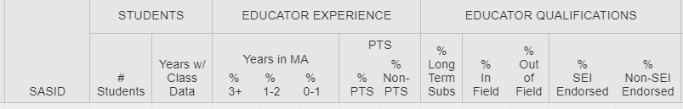
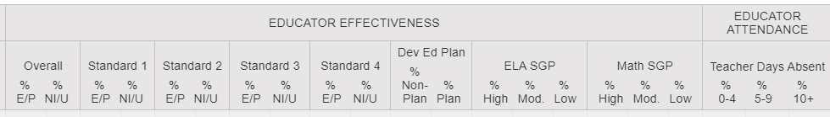
SE622 – Student Learning Experience Detailed Report

Slide 12
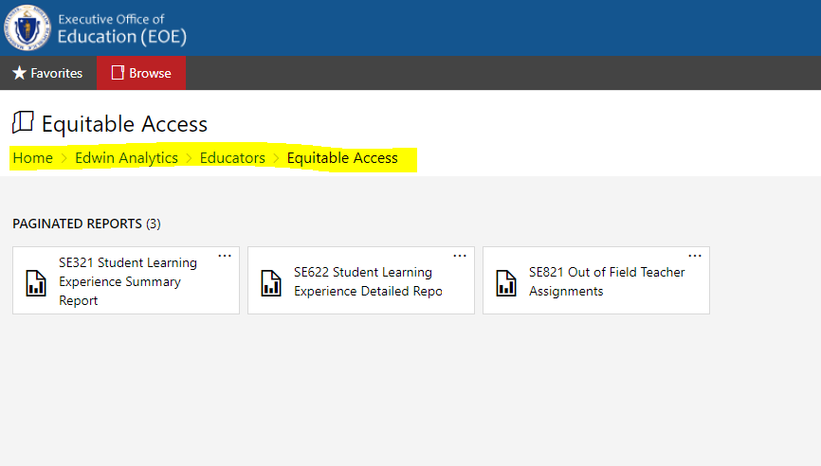
EDWIN OVERVIEW

Slide 13
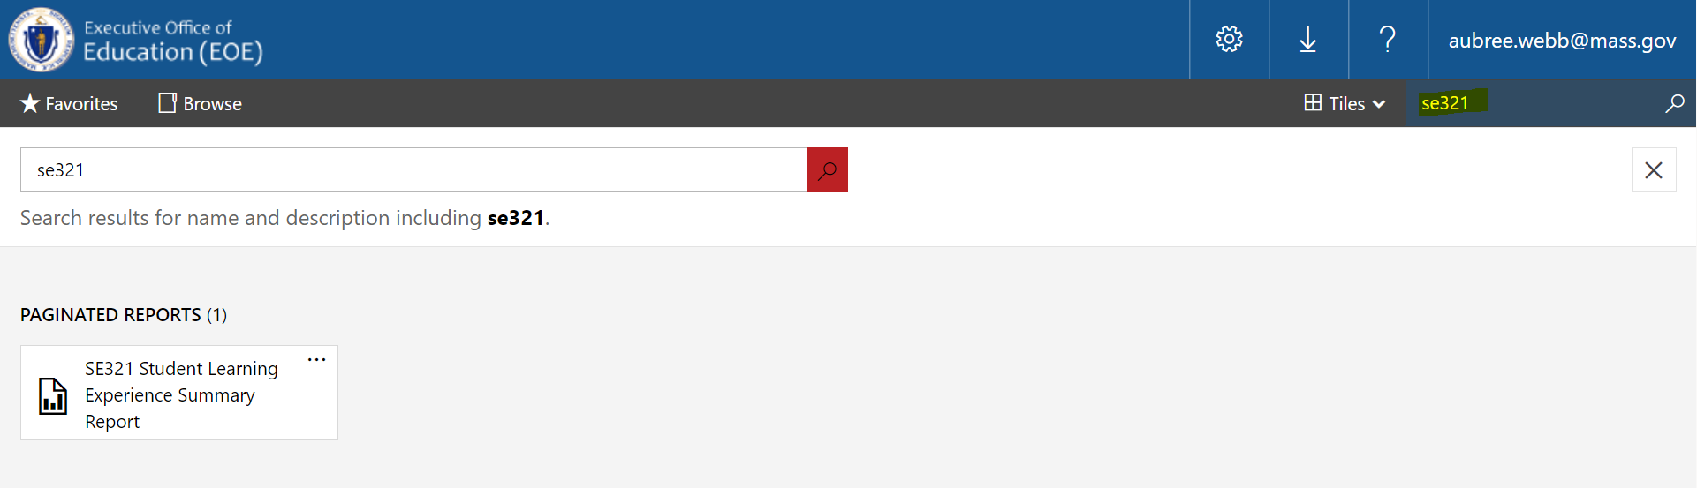
EDWIN OVERVIEW - SEARCH

Slide 14
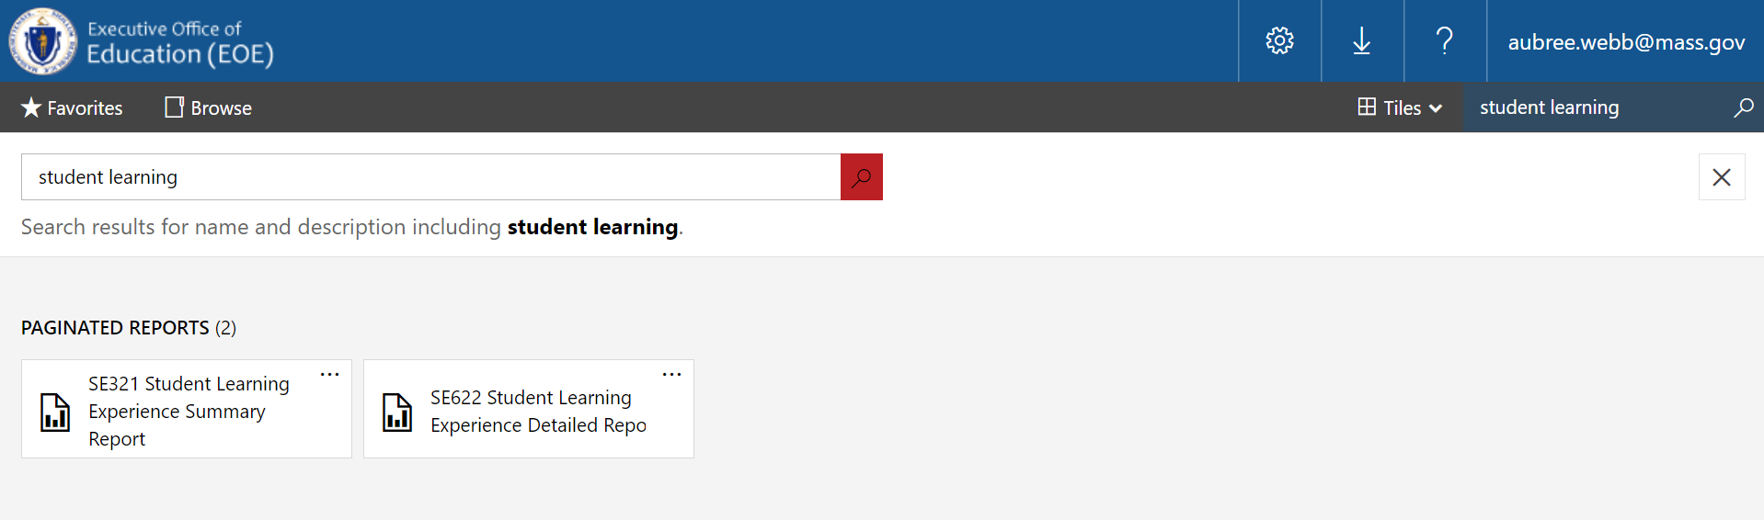
EDWIN OVERVIEW – SEARCH 2
Notes:
Aubree’s class code:
ckpfoiqsi00093a9gx3rifnnh
URL
https://spa.maeoe.net/portal/apps/app/ckmds2hhj009l01l6bo6t5p49/datacollector?action=signIn&classCode=ckpfoiqsi00093a9gx3rifnnh

Slide 15
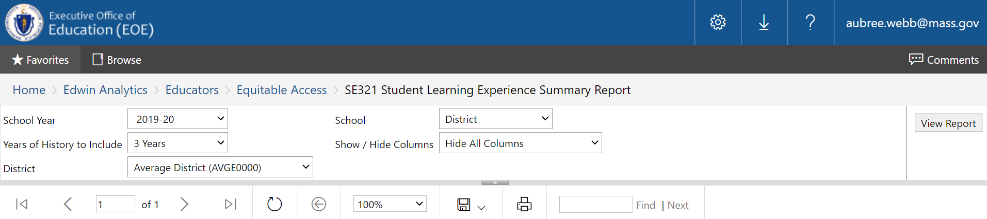
SE321 – Student Learning Experience Summary Report
Years of History:
The number of years of student learning experience history included in the report. For example, when three years are selected, the report determines the group of students based on the "Selected School Year" and includes the most recent three years of learning experiences for those students.

Slide 16
STUDENT LEARNING EXPERIENCE (SLE) REPORTS – SE321
SE321
District/School
SE622
Student List
PR600
Individual Student
SE821
Educator List

Slide 17
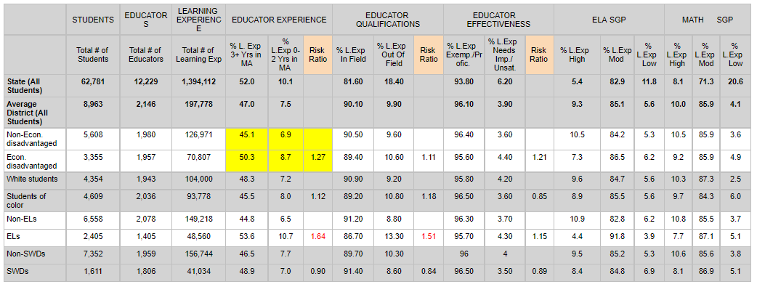
SLE321 Report Sample: District Level

Slide 18
SLE321 Report Sample: District Level with Highlights
If we add up each time a student in the district was assigned to a teacher over the past three years, 90.10% of those times the teacher was teaching in-field.
In the past three years, English learners were 1.64 times more likely to be assigned to an educator with 0-2 years of experience in MA than their peers.

Slide 19
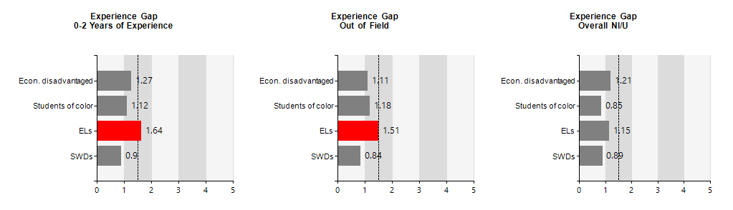
SLE321 Report Sample

Slide 20
SLE321 Report Sample with Highlights
ELs in this school were 1.64 times as likely
to be assigned to a teacher with 0-2 years of experience than their peers.

Slide 21
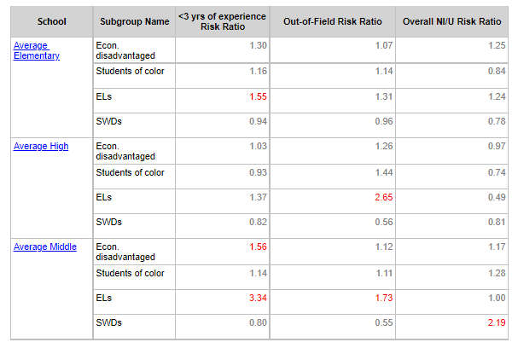
SLE321 Report Sample: School Level

Slide 22
SLE321 Report Sample: School Level with Highlights
ELs are much more likely to have a teacher with less than three years of experience in Average Middle.
Notes:
Let’s look at Average Middle, focusing on ELs.

Slide 23
STUDENT LEARNING EXPERIENCE (SLE) REPORTS – SE622
SE321
District/School
SE622
Student List
PR600
Individual Student
SE821
Educator List

Slide 24
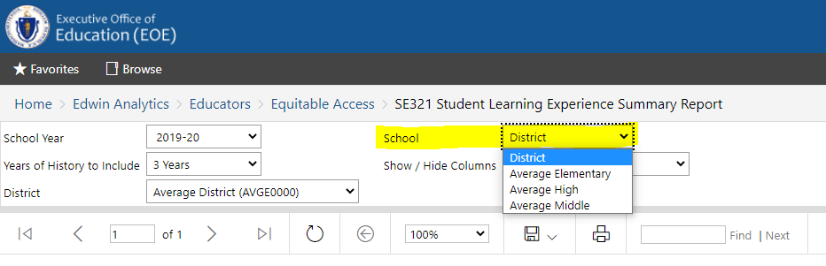
SE622 – Student Learning Experience Detailed Report – choose school
Notes:
Let’s look at Average Middle, focusing on ELs.

Slide 25
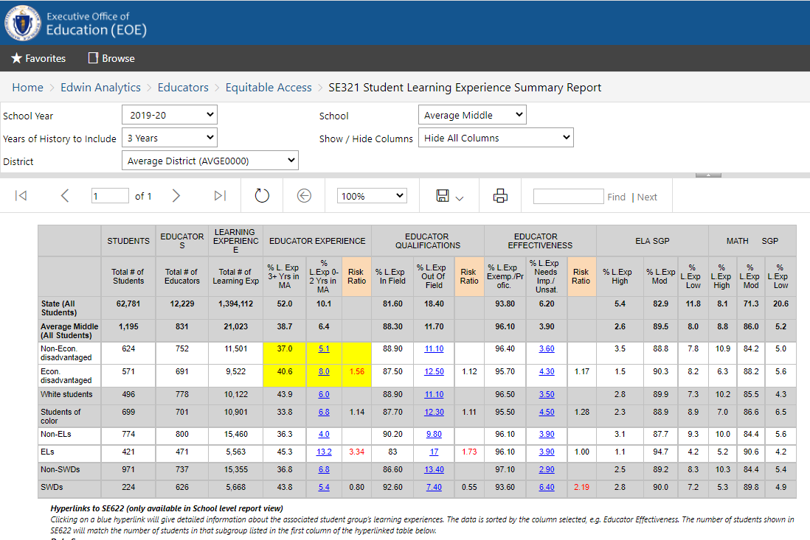
SE622 – Student Learning Experience Detailed Report with Hyperlink
Let’s look at Average Middle, focusing on ELs.

Slide 26
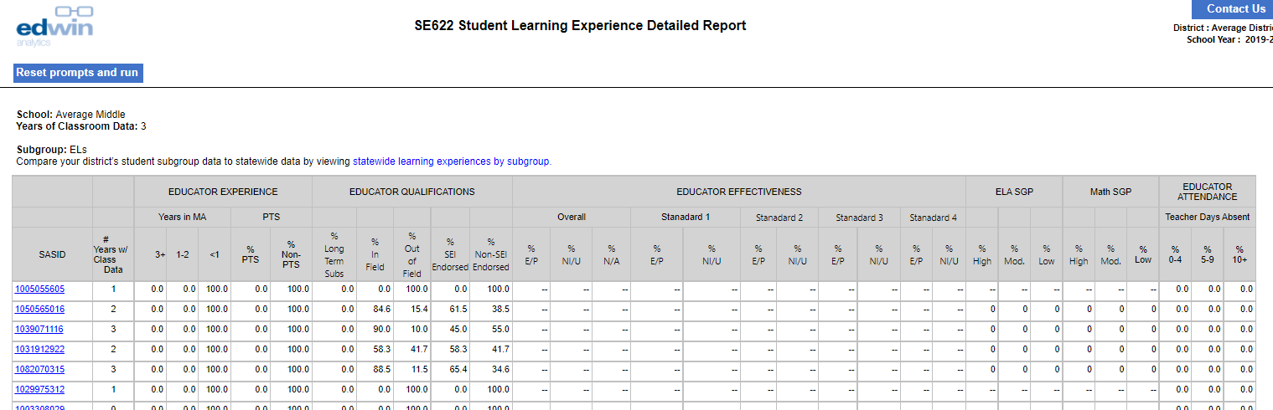
SE622 – Student Learning Experience Detailed Report from Hyperlink

Slide 27
SE622 – Student Learning Experience Detailed Report with Highlight
Let’s look at this student who had 100% of their learning experiences with teachers who have <1 years of experience.

Slide 28
STUDENT LEARNING EXPERIENCE (SLE) REPORTS – PR600
SE321
District/School
SE622
Student List
PR600
Individual Student
SE821
Educator List

Slide 29
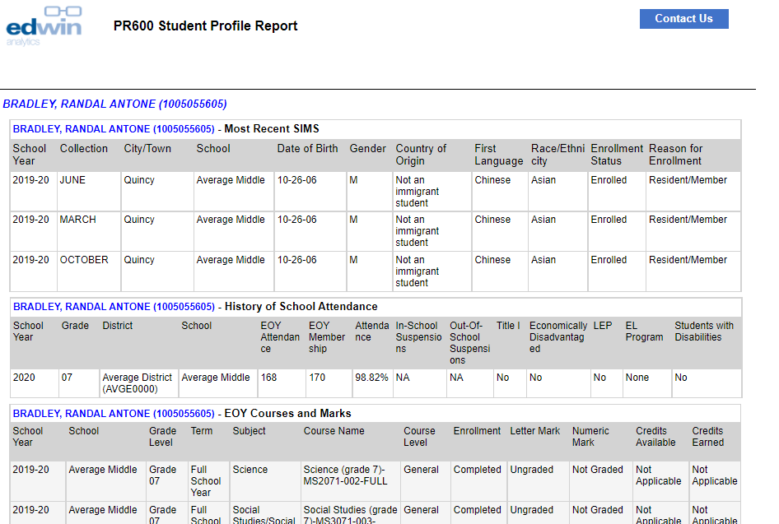
PR600 – Student Profile Report

Slide 30
STUDENT LEARNING EXPERIENCE (SLE) REPORTS – SE622, enter SASIDs
SE321
District/School
SE622
Student List
PR600
Individual Student
SE821
Educator List

Slide 31
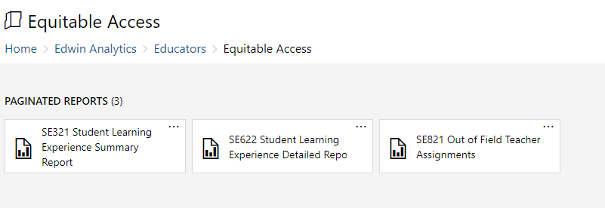
SE622 – Student Learning Experience Detailed Report in Edwin
  Enter Individual SASIDs

Slide 32
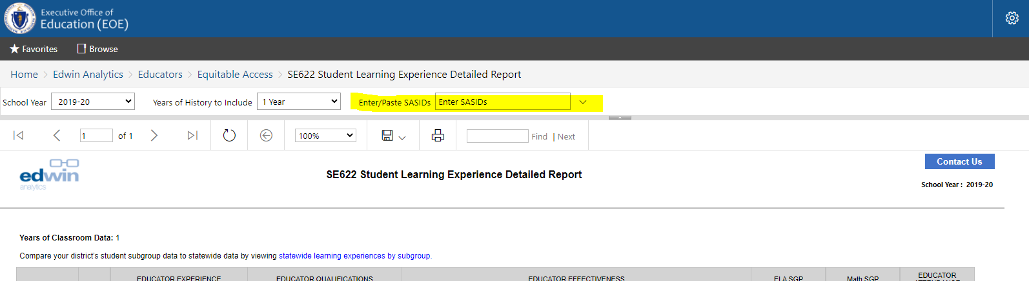
SE622 – Student Learning Experience Detailed Report with SASIDs

Slide 33
STUDENT LEARNING EXPERIENCE (SLE) REPORTS – SE821
SE321
District/School
SE622
Student List
PR600
Individual Student
SE821
Educator List

Slide 34
SE821 – Out of Field Teacher Assignments in Edwin

Slide 35
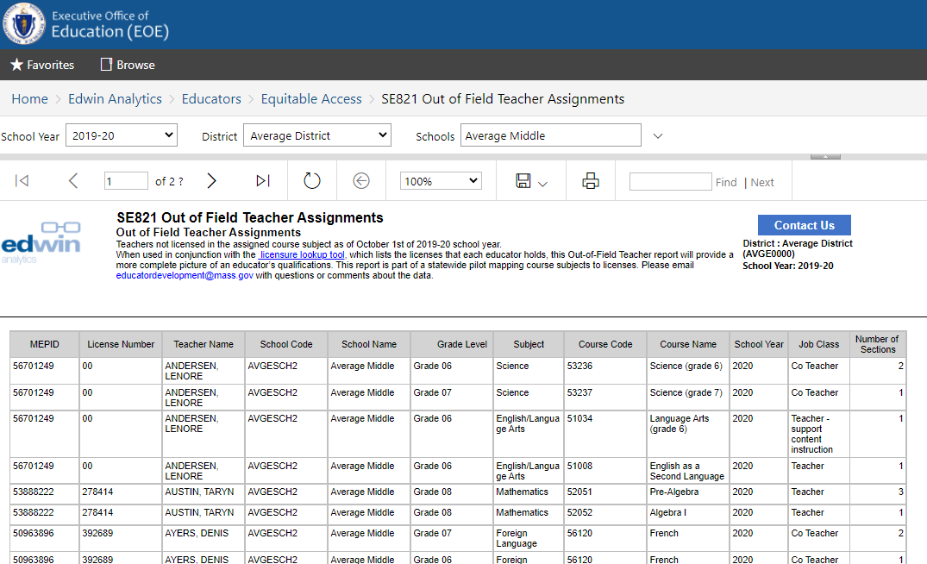
SE821 – Out of Field Teacher Assignments

Slide 36
Questions the SLE Report can answer
SCHOOL LEVEL
At which schools have students had less access to experienced teachers over the past 3 years?
SCHOOL & STUDENT GROUP LEVEL
Did the ELs at Middle School A have different learning experiences than the ELs at Middle School B last year?
Which students in 11th grade had the least experience with highly rated math teachers?
GRADE LEVEL
What were the last 5 years of learning experiences for a student who transferred into your district?
STUDENT LEVEL

Slide 37
SLE Report Webpage https://www.doe.mass.edu/edwin/gateway/SLEreport-supp.html
In-Field Mapping Tool https://www.doe.mass.edu/edeffectiveness/equitableaccess/resources/mapping.html
SLE Summary [download] http://bit.ly/SLEoverview

Slide 38
QUESTIONS?

Slide 39



Thank You
Lien Hoang,
Research and Evaluation
Aubree Webb,
Policy Analyst
lhoang@doe.mass.edu
aubree.webb@doe.mass.edu
75 Pleasant Street, Malden, MA 02148
www.doe.mass.edu

