Slide 1
Exploring Edwin
Kate Sandel
Summer/Fall 2021
These webinars were held several times over summer/September 2021.
A recording available at:
https://us02web.zoom.us/rec/play/COiUddSWOHFuGCdLgxVF0VSv4bRdyCLPn73PMl9ukSjzrGIXIEzqNpMr9XYpSbrY3RvUlaOCYo9qwLHH.7D8S3mdg6iBXNpgA

Slide 2
Moving to Power BI
Over last year, we have migrated reports in Edwin to new platform.
New version became available on June 1; most reports available with remaining reports being added throughout June.
Edwin Analytics (Legacy) available until July 1 .

Slide 3
What is different
New user interface
Prompts at the top of report pages
Some reports have been modified or merged some reports
    School and district reports merged
    Added visuals, format changes
    What are the reports in Edwin: check out the Edwin Report tool or Edwin Report List
Better performance

Slide 4
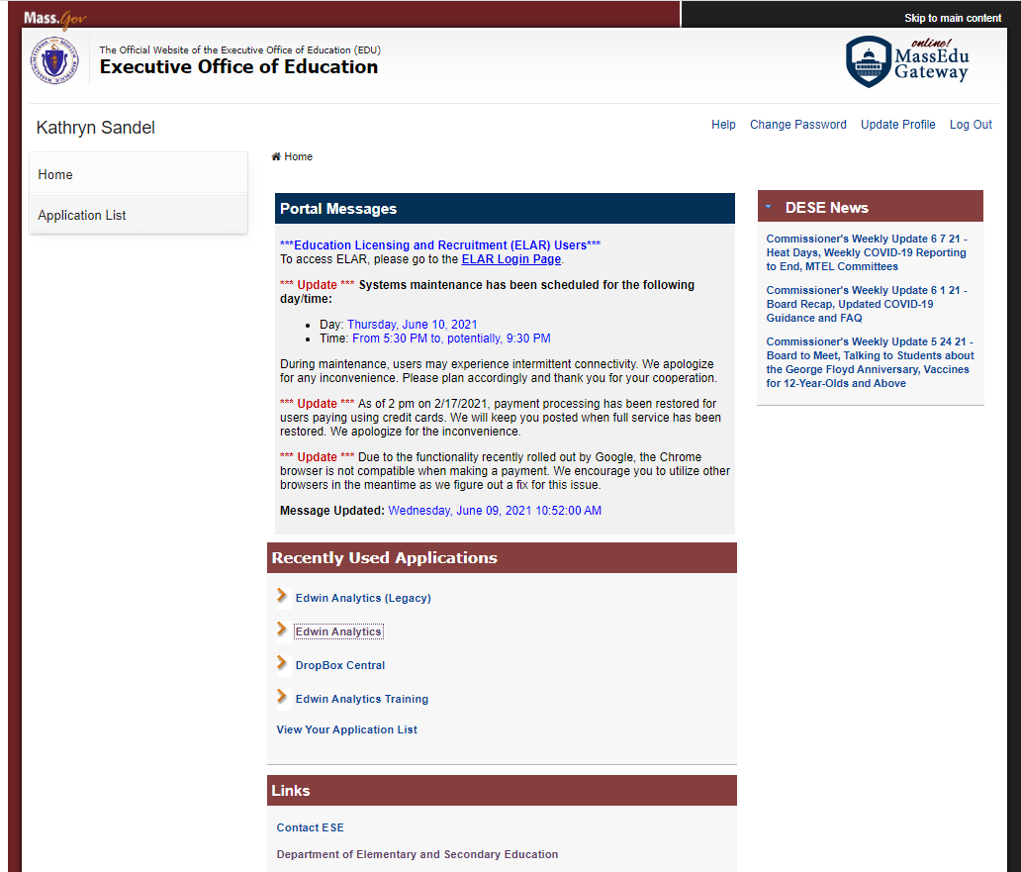
Logging on
Notes:
Security portal login screen- you can click Edwin analytics to get to new version. Legacy version will be available until July 1.
During June, the remaining reports will become available. This includes some of the finance and postsecondary success reports, some of the student and enrollment indicator reports (suspension,. Attendance, special education students)

Slide 5
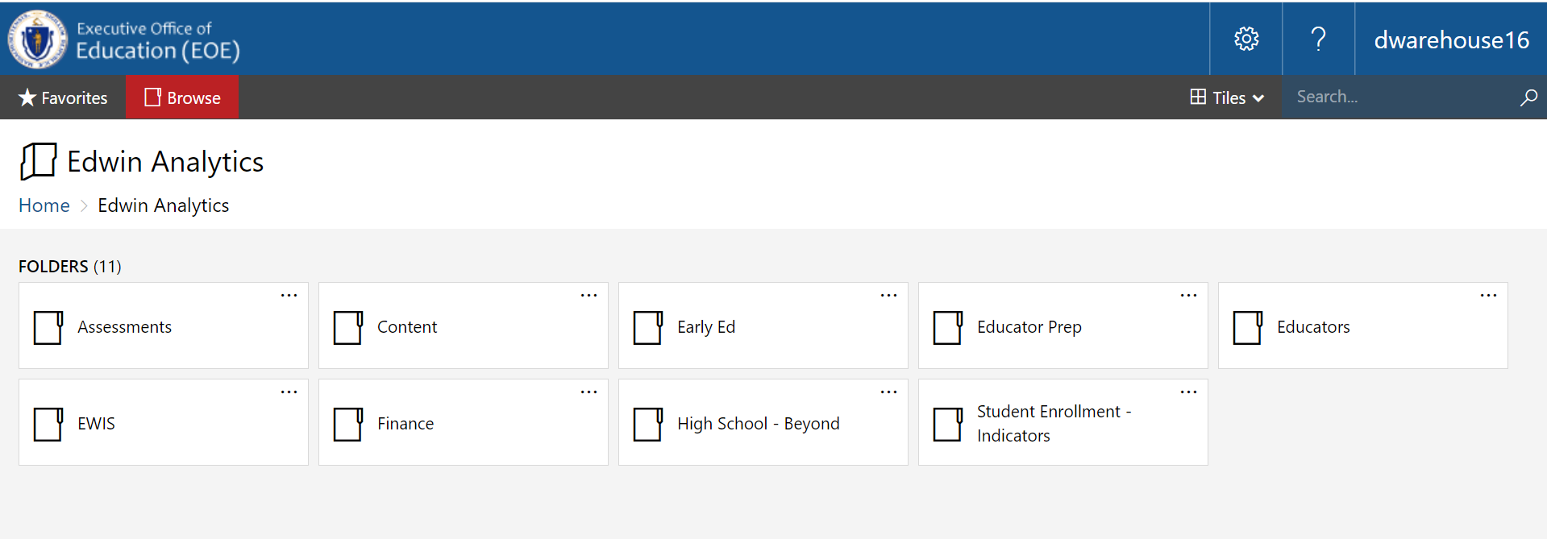
The home page
Notes:
HOME – for other applications. Also hit Browse to return to the Home (click on Edwin Analytics to get back to Edwin home page)
Tiles: default view is tiles. If you prefer, you can click tiles in the top right and change it to list view. This can help
We do not have recently run reports anymore, but can add your favorite reports to populate in your favorites section. Will show you how to add those a little bit.
Reports are grouped by folder (and sub folder) . The folders mirror the folder system from before. You can also use the search bar in top right corner. At the moment it can only search by words in the report name (we are adding the “tags” that we have in legacy Edwin) .
You can time out – so if your session has been dormant for a while, may get an error message. If you do get an error message- my tip is click on the browser address bar. That will take you back to the security portal login page for you to reenter your credentials if you need to.
And if you have to return to the security portal to get a different application, go to your username in the top right corner. Select logout.

Slide 6
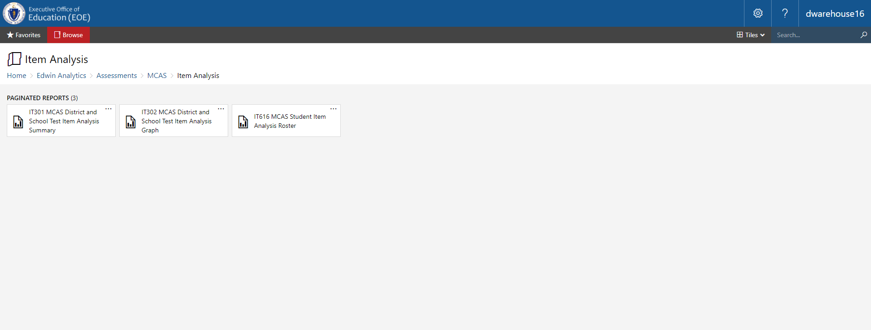
Reports are grouped in folders and subfolders
Notes:
This is an example of clicking thru folders and subfolders to (Item analysis)
You see a number of reports are “District and School” So- for example this IT301 report you essentially merged theold IT301 (district level) and old IT401 (school level) report. Can run it for either school (s) or district level.

Slide 7
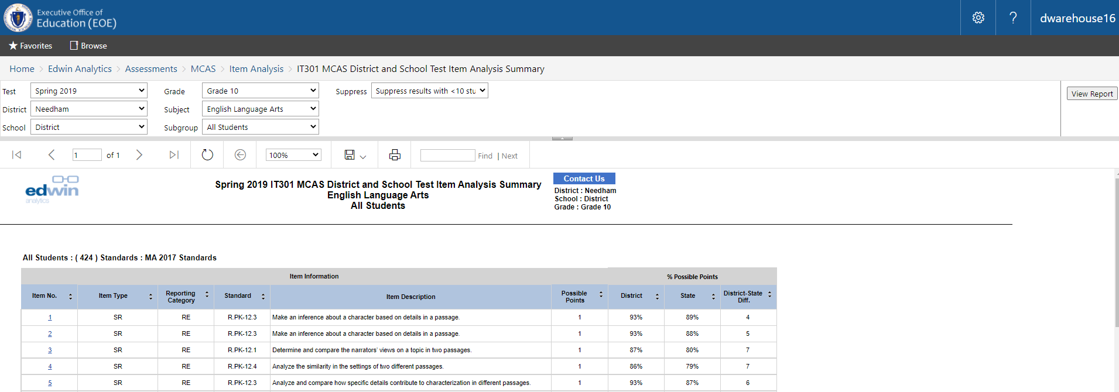
Lets look at a report
Notes:
When you open a report, you now will be taken to the report with prompts at the top of the page (this was the case for many Assess. In most cases, this means when you click on report, it will open populated with data. You can then adjust the filters to rerun the report based on your needs.
Some student level reports do not automatically open with data populating the report section (will show you move later) .
To run an aggregate report at the district level, select all schools in district. This is typically the default. You can select one school to run the report at the school level.
Filters are single or multi-select. Multi-select filters have carrot outside of the box. Single select have carrot inside the box. By default, all multi-select filters are set to “select all”. This report only has single select options.
When you change any filter selections, hit “view report” button to the right of the prompts to rerun the report. (demo selecting one school– hit run report. Oops- let me check my prompts– change the grade. Suppression option depends on how you plan to share the data. If unsupressed, you can only share with folks who have access to student level data)
This report has sorting function turned on. Some reports have additional information available if your scroll over an i. (example Additionally, some reports have notes at the beginning and end to help interpret the report.
Hide parameters tab (click that if it is taking up too much screen) .
You may need to use the scroll bars to view all prompt options or filter menus
You may need to scroll across or down to view the whole report.
Choose gender- walk thru ribbon

Slide 8
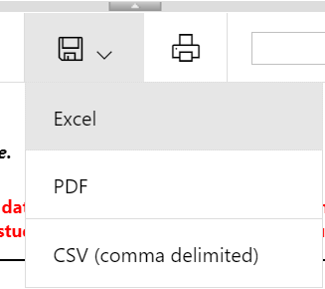
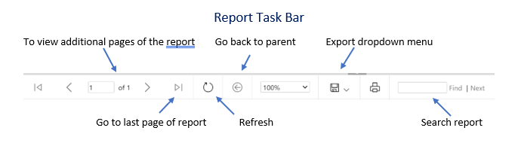
Report Task Bar
Notes:
Some reports have multiple pages. Use the control in the report task bar (see below) to navigate across pages.
Some reports have hyperlinks that allow you to click through to a different report (e.g. a student level report). To go back, click on the button in the task bar to return to the parent report.
Export dropdown menu: export to excel, PDF, csv. Some reports must be in excel (needs to download with multiple tabs). Where the download pops up depends on the browser and settings. For formatting reasons, there may be a blank row at the top or left of excel and csv downloads. Those are easy to delete. We have tried to avoid merged rows within the excel spreadsheets which some of the old version had since they can make filtering or merging data more difficult.
To find a student, SASID, or word or phrase, enter it in the search box. The search works across all pages of the report.
(note: To navigate back to the prior screen, you can use the back button or click on the folder path displayed. s. You also can select the browse button to return to the home screen. You can also use search (and of course go to favorites))

Slide 9
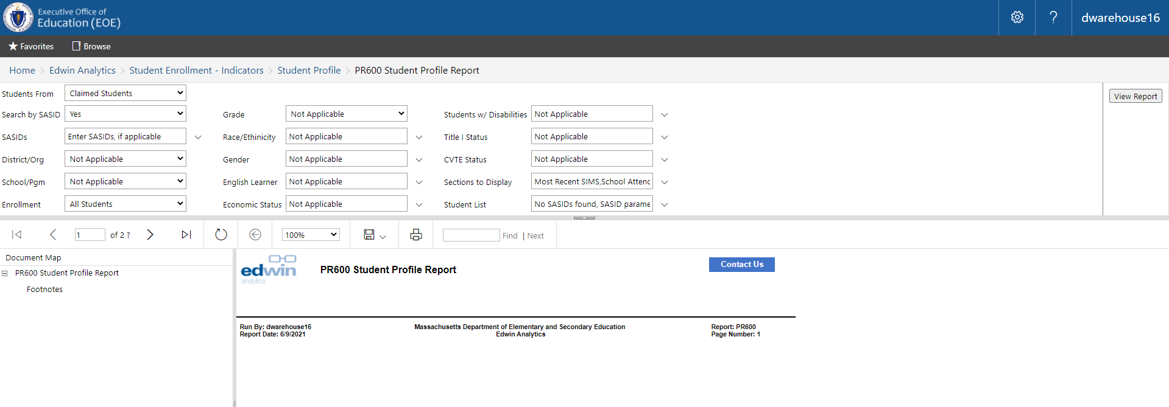
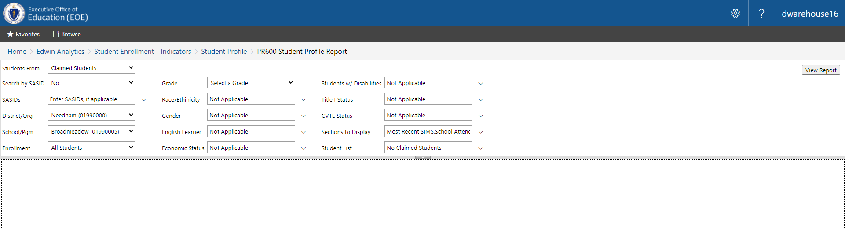
PR600 Student Profile Report
Notes:
As you run reports, they will open in the same browser. If you want to have multiple reports open at once, open reports in new tab or window.
Some student level reports do not automatically open with data populating the report section. You can enter SASIDs in the SASID box or change “Search by SASID” to no and change any relevant filters to run these reports.
If using the “Search by SASID” option on applicable reports, be sure to copy SASIDs separated by commas. Make sure all previous text and blank lines at the end are removed.
Students from and student list.
Carrot inside: Single select. Outside: Multi-select. multi-select by default are “select all” (but typically they are all listed out.
Some reports have a “Document map” sidebar which lets you navigate to other pages of the report. PR600 Student profile report will list the names of all the students you have run it for to easily click to students of interest.

Slide 10

What else?
If you have any problems- hit the contact us button to let us know the problem.
Providing feedback will help us improve the reports and functionality
  Share any issues with running the reports/data anomalies
  Share ideas for changes
  Share new ideas for reports
Please be patient as we work out any little hiccups!

Slide 11
Resources: https://www.doe.mass.edu/edwin/
Using Edwin
(http://www.doe.mass.edu/edwin/UsingEdwin.docx)
Edwin Report tool
(https://www.doe.mass.edu/edwin/reporttool.html)
Edwin Report List
(http://surveygizmolibrary.s3.amazonaws.com/library/72307/Edwinreports.xlsx)
FAQ (will be updated based on questions)
https://www.doe.mass.edu/edwin/faq.html
https://www.doe.mass.edu/edwin/gettingstarted.html: Information on security roles, getting access, Edwin data overview (what data is in Edwin and when it gets updated)

Slide 12
Thank you
Kathryn.sandel@mass.gov

