Slide 1
Views of Climate and Learning (VOCAL): Edwin Webinar
February 8, 2022
VOCAL Main Webpage
VOCAL 2021 Webpage
VOCAL 2019 Webpage
VOCAL 2018 Webpage

Slide 2
CONTENTS
01
Review of Views of Climate and Learning (VOCAL) survey design & new developments
02
What is a meaningful difference in students’ perceptions?
03
Edwin/VOCAL Interface Demo
04
VOCAL Dashboard Preview

Slide 3
Review of Views of Climate and Learning (VOCAL) survey design and new developments
01

Slide 4
In 2021, student participation rates are lower across all four grades
 | Grade 4 | Grade 5 | Grade 8 | Grade 10
2019 Number of students | 55,796 (82%) | 59,456 (84%) | 59,180 (85%) | 53,274 (76%)
2021 Number of students | 45,851 (64%) | 47,582 (66%) | 48,365 (63%) | 39,241 (51%)
Number of items | 40 | 40 | 40 | 40

Slide 5
What is measured?
Three dimensions of school
  Engagement (culture competence (CLC), relationships (REL), participation (PAR))
    Students like to have friends who are different from themselves (for example, boys and girls, rich and poor, or classmates of different color). G4, G5
    Students respect one another. G4, G5, G8, G10
    My teachers use my ideas to help my classmates learn. G4, G5, G8, G10
  Safety (emotional safety (EMO), physical safety (PSF), bullying/cyber-bullying (BUL))
    Teachers support (help) students who come to class upset. G4, G5, G8, G10
    I have seen students with weapons at our school. G8
    In my school, groups of students tease or pick on one student. G4, G5, G8, G10
  Environment (instructional environment (ENV), mental health env. (MEN), discipline environment (DIS))
  Students help each other learn without having to be asked by the teacher. G5, G8, G10
  At our school, students learn to care about other students' feelings. G4, G5
  Teachers give students a chance to explain their behavior when they do something wrong. G5, G8, G10
Students respond: Always true, mostly true, mostly untrue, or never true

Slide 6
New Item Development: Items designed to improve reliability of Engagement and Environment dimensions
Field tested in 2021 (17 of 18 items tested are retained for 2022 survey)
  Engagement: Participation (9 items), Culture Competence (1 item), Relationships (1item)
    In at least two of my academic classes, students are asked to teach a lesson or part of a lesson. G8, G10
    In my academic classes, students wrestle with problems that don't have an obvious answer. G8
    In my classes, students teach each other how they solved a problem. G5
  Instructional Environment (6 items)
  In my classes, it is OK for me to suggest other ways to do my work. G5
  Students are given multiple opportunities to show that they have mastered their classwork. G8
  In my classes, mistakes or even failure on an assignment are viewed as an important part of our learning. G10

Slide 7
What is currently reported to districts and schools, and what is new for 2022?
District Report
  2021: Overall and 3 Dimension scores (Engagement, Safety, and Environment), and Bullying topic score (N ≥ 50) and item response data
    School
    Grade
    Student group (gender, race/ethnicity, low income (or ecodis), EL, and SWD): overall score only
  New in 2022
    Student group data broken out by dimension (N ≥ 20)
School Report
  2021: Overall and 3 Dimension scores (Engagement, Safety, and Environment ), and Bullying topic score (**New**; N ≥ 50), and item response data
    Grade
    Student group (gender, race/ethnicity, low income (or ecodis), EL, and SWD
  New in 2022
    Student group data broken out by dimension (N ≥ 20)

Slide 8
New data report: Favorability categories and profile narratives
Profile narratives are based on item distribution at 3 cut points
In 2021, new report available in PowerBi dashboard only

Slide 9
New Developments: Excerpt from G8 profile narrative
Grade 8 2021 VOCAL Benchmark Profiles: Student Average Score = 49; Standard Deviation = 17.4
Student Point of View | Student Point of View | Student Point of View
Benchmark: 30 points Least favorable to Somewhat favorable | Benchmark: 50 points Somewhat favorable to Favorable | Benchmark: 70 points Favorable to Most favorable
Teachers set moderately high expectations for student work and are available when students need help. Teachers encourage students to work hard and, for the most part, instill a belief that all students can do well. Teachers tend not to use student ideas and interests to plan or guide their instruction and students have little latitude to choose how to show their learning. The classroom environment is collaborative. Teachers are supportive of students’ work even when it is not their best effort. Not all students behave appropriately in class. Most students do not view their schoolwork as suitably challenging, and it tends to lack cultural relevance. Many students believe what they are learning in school is unimportant. | Teachers set moderately high expectations for student work and are available when students need help. Teachers encourage students to work hard and instill a belief that all students can do well. Teachers use student ideas and interests to plan and guide their instruction and students have latitude to choose how they want to show their learning. The classroom environment is collaborative. Teachers are supportive of students’ work even when it is not their best effort. Most students behave appropriately in class. Most students view their schoolwork as suitably challenging and culturally relevant and believe what they are learning in school is important. | Teachers set high expectations for student work and are readily available when students need help. Teachers actively encourage students to work hard and instill a belief that all students can do well. Teachers use student ideas, and interests to plan and guide their instruction and students have latitude to choose how they want to show their learning. The classroom environment is very collaborative. Teachers are very supportive of students’ work even when it is not their best effort. Most students behave appropriately in class. Most students view their schoolwork as suitably challenging and culturally relevant and believe what they are learning in school is important.
A student with a scaled score of 30 points responds, “always true” to 0 items, “mostly true” to 24 items, “mostly untrue” to 15 items, and “never true” to 1 item. | A student with a scaled score of 50 points responds, “always true” to 7 items, “mostly true” to 31 items, “mostly untrue” to 2 items, and “never true” to 0 items. | A student with a scaled score of 70 points responds, “always true” to 24 items, “mostly true” to 16 items, “mostly untrue” to 0 items, and “never true” to 0 items.

Slide 10
New Reporting Process
Preliminary report early summer
  Edwin Paginated Report with Excel/PDF/csv download capability
  Students assigned to schools using March SIMS
  Final report in the summer/early fall
  PowerBi Dashboard Report
  Students assigned to schools using official MCAS file

Slide 11
What is a meaningful difference in students’ perceptions?
02

Slide 12
Measurement scale: Index scaled scores are an objective metric for measuring differences in student perceptions of school climate
Student-level (all grades):
Baseline average (2018)
30
50
70
1
99
SD = 20
A higher average score is indicative of a more positive climate for all dimensions and for the bullying topic score
2019 and (2021) student responses are anchored on the 2018 baseline scale
      Accurately measures trend over time
      All students (G4 → G10) and all items (G4 → G10) are on the same scale metric
      Accurately measures school, grade, and student group differences

Slide 13
Like previous years, 2021 students in upper grades have less favorable views of school climate when compared to students in lower grades
2018
2019
2021
Year | ∆ G10 vs. G5 Percentile
2018 | -26
2019 | -26
2021 | -29
2021 data pattern replicates 2019 results
Context in 2021 is very different from prior years: recommend not to use 2021 data in trend analyses
NA

Slide 14
Interpreting school/group scaled score differences: Very small to very large effects
Size of effect (Negative or positive) | ∆ or Difference in:
 | Standard deviation units | Percentiles | Scaled score points (pts)*
Not meaningful | Less than .05 | Less than 2 | <1pt
Very small | .05 to less than .10 | 2 to less than 4 | 1pt to <2pts
Small | .10 to less than .20 | 4 to less than 8 | 2pts to <4pts
Moderate | .20 to less than .30 | 8 to less than 12 | 4pts to <6pts
Large | .30 to less than .50 | 12 to less than 19 | 6pts to <10pts
Very large | .50 and above | 19 and above | 10pts and above
*Rough guide to associated scaled score point differences

Slide 15
Edwin/VOCAL Interface Demo
03

Slide 16

Edwin Analytics Portal is within the Security Portal and is accessed on DESE’s webpage
https://www.doe.mass.edu/
Security Portal
Enter User-Name and Password
Click on Edwin Analytics

Slide 17
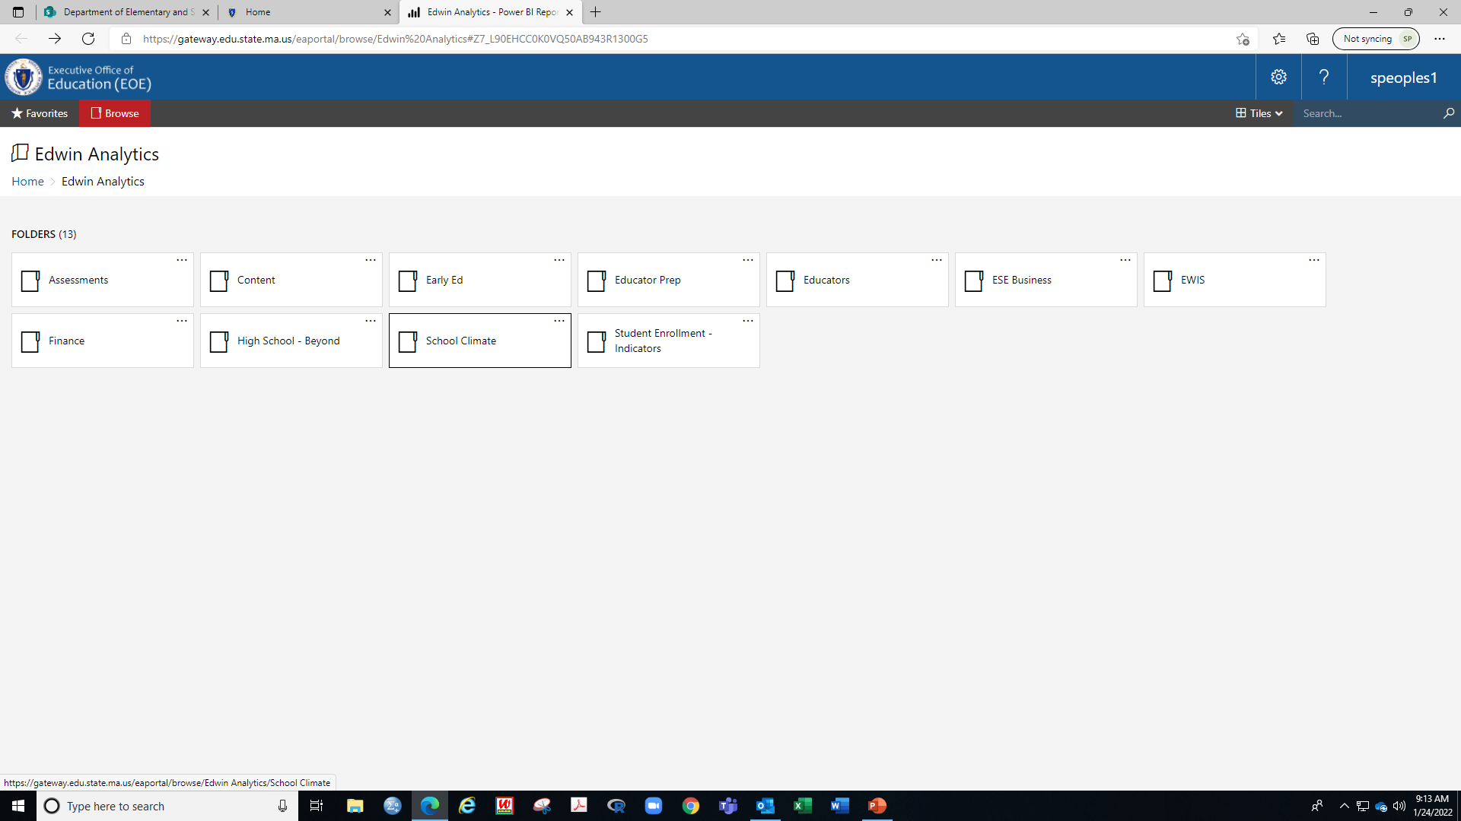
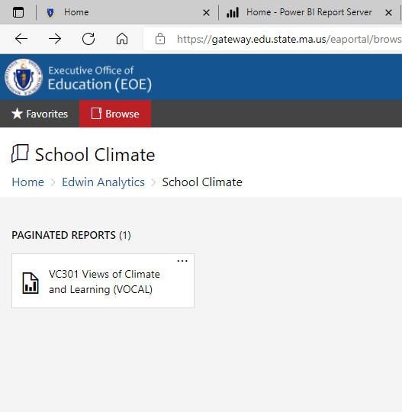
Edwin Analytics Portal
VOCAL data is found in the School Climate folder
VOCAL report is VC301

Slide 18
School Climate Dropdown Menu Interface
Prior Years’ Data
2017-2018 baseline year
Select Report:
Index scaled score data, or
Item Response data
Student Group:
Select “All” students or one of up to five different student groups
View Report:
Refresh button if a different report is selected
District/school Filters
Access restricted by role
Grade:
Select “All” grades, single grade or combination of grades
Save or
print report
Page advancer:
Report data may be on more than one page

Slide 19
School Climate Index report: All scaled scores are on the same scale metric (1 to 99); districts/schools can compare scores across schools, grades, and student groups
District-level report
Report viewed
District-level report
All student average
Scores broken out by four grades
Student count & overall score
Dimension scores
Bullying topic score
Grade 10 district average scores
State comparison data
Grade 10 state score comparison

Slide 20
Females in younger grades within School 3 report more favorable school climate views than males; their views are comparable by grade 8
Report viewed
School-level Index report
All student average
Scores broken out by gender and grade
District
District 2
School
In 2021, no dimension scores provided for student groups
Females score, on average, 8-points & 3-points higher in grades 4 & 5, respectively.
Females and males in grade 8 have comparable views of school climate.
Grade 4 male students score, on average, 6 points lower than their peers in the state
Insufficient number of non-binary students in school to report score

Slide 21
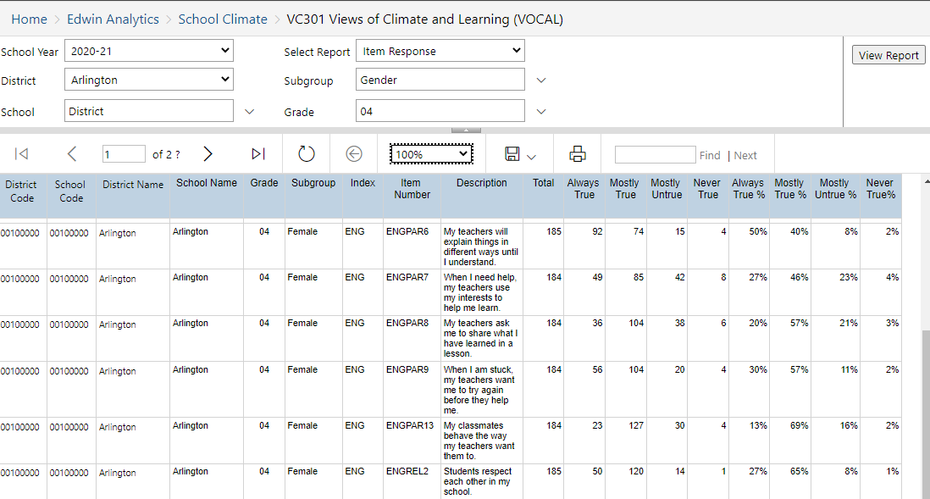
What views (items) explain the difference between females and males in grade 4?
Report viewed
District-level Item Response report
Scores broken out by gender
Grade 4 only
District 2
School 3
Student count
Percent response
Item number coding:
Engagement (ENG)
CLC (Cultural Competence)
REL (Relationships)
PAR (Participation)
Safety (SAF)
EMO (Emotional safety)
PSF (Physical safety)
BUL (Bullying/Cyber-bullying)
Environment (ENV)
INS (Instructional Environ.)
MEN (Mental health Environ.)
DIS (Discipline Environ.)
District 2
School 3
District 2
School 3
District 2
School 3
District 2
School 3
District 2
School 3
District 2
School 3
Save report to Excel, PDF, or csv file
4 response options

Slide 22
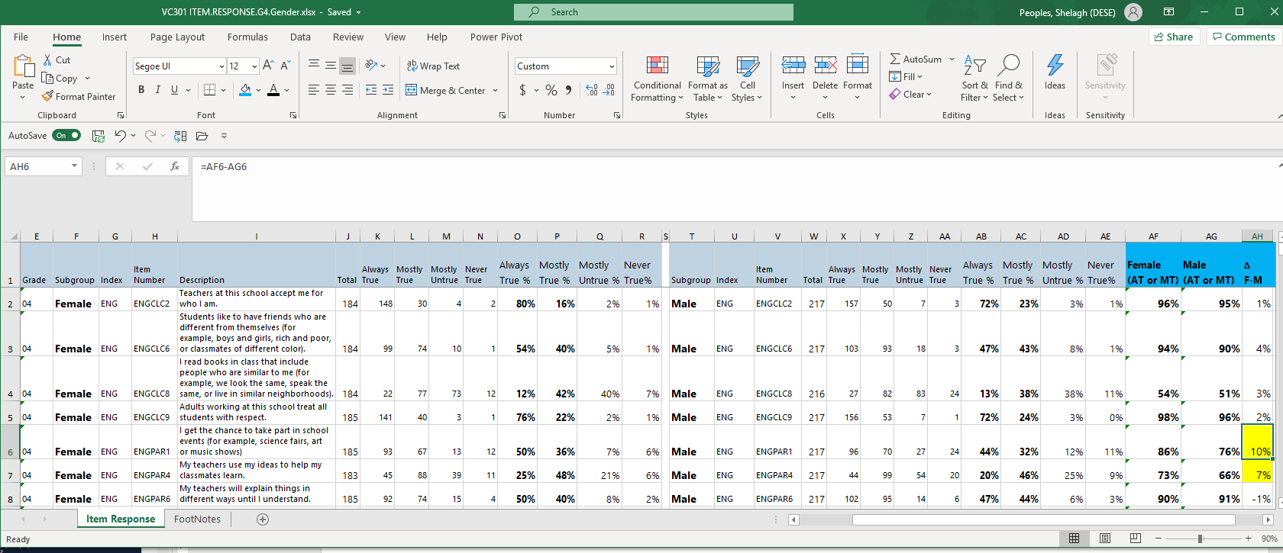
In Excel, copy and paste comparison group (males) so it is in contiguous rows to reference group (females); sum “mostly true” and “always true” then calculate difference between groups
Sum of Always true (AT) or mostly true (MT)
Female data
Male data
Student count
Percent response
Student count
Percent response
Difference between females’ and males’ percent sums (AT+MT)
ENGPAR6: Engagement Dimension, Participation Topic, Item number 6

Slide 23
What views (items) explain the difference between females and males in grade 4?
Topic/ Grade | Percent always true and mostly true (always true). Think of the last 30 days in school: | Female | Male | ∆ %
ENGPAR1 | I get the chance to take part in school events (for example, science fairs, art or music shows). | 73 (50) | 66 (44) | -7
ENGPAR4 | My teachers use my ideas to help my classmates learn. | 73 (25) | 66 (20) | -7
ENGPAR9 | When I am stuck, my teachers want me to try again before they help me. | 87 (30) | 80 (25) | -7
ENVDIS3 | Students help decide school rules. | 56 (12) | 36 (8) | -20
ENVINS4 | In class, students help each other learn. | 94 (33) | 81 (28) | -13
ENVINS14 | When I am home, I like to learn more about the things we are learning in school. | 58 (18) | 42 (17) | -16
ENVMEN7 | At our school, students learn to care about other students' feelings. | 95 (57) | 86 (43) | -9
SAFEMO12 | Students will help other students if they are upset. | 94 (44) | 87 (29) | -7
SAFBUL4 | Students at school try to stop bullying when they see it happening. | 92 (45) | 76 (33) | -16
SAFBUL7 | I have been hit by other students more than once in school. | 14 (4) | 36 (18) | +22
SAFBUL13 | In my school, groups of students tease or pick on one student. | 10 (2) | 17 (5) | +7

Slide 24
VOCAL Dashboard Preview
04

Slide 25


Thank you!
Shelagh Peoples, Psychometric Coordinator
781-338-3119
Shelagh.Peoples@mass.gov
vocalsurvey@doe.mass.edu

