Slide 1
Edwin Office Hours
April 2022

Slide 2
Highlights
Edwin
CVTE context
Edwin Report: CV601

Slide 3
CVTE, CTE, VTE …
"Chapter 74" refers to a Massachusetts law. These programs are in MA only.
"Perkins" refers to a federal (US) law. Perkins programs are across the country.
Chapter 74-approved vocational technical education programs and non-Chapter 74 career and technical education programs
Chapter 74 or state-approved
programs that meet the definition of vocational technical education contained in Massachusetts General Law Chapter 74 and are approved by DESE pursuant to Chapter 74 and the Vocational Technical Education Regulations
Regular, Coop, After Dark
they also meet the federal Perkins Act definition of career and technical education
Perkins-Only (also called Non-Chapter 74 or local)
programs that meet the federal Perkins Act definition of career and technical education although not Chapter 74-approved vocational technical education programs
See CVTE pages – Info for Families – for more https://www.doe.mass.edu/ccte/cvte/default.html

Slide 4
Edwin CV601 - Prompts

Slide 5
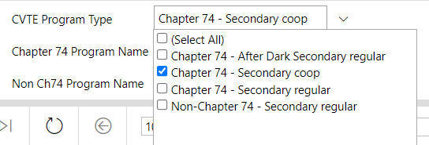
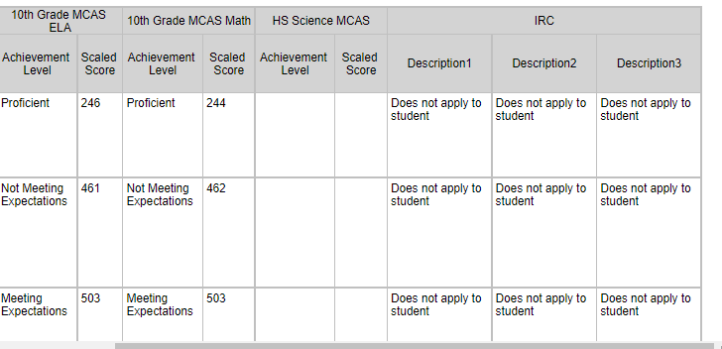
Edwin CV601
Follow the data guidelines established by your district.

Slide 6
Examples –

Slide 7
Questions?

Slide 8
Notes
This report has “Student Group” info.
Race & Ethnicity
Gender
English Learner status
Students with Disabilities details
Economically Disadvantaged/Low Income
Follow district policies about data access & confidentiality.
Access to Edwin is managed by district Directory Administrators
Questions or Feedback?

Slide 9
Pause

Slide 10
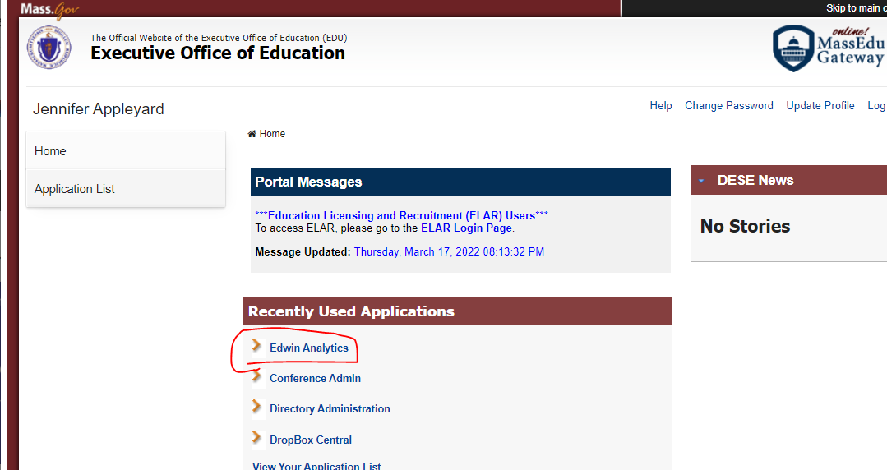
Log into Security Portal. Then select Edwin, High School & Beyond, CVTE

Slide 11
Quote:

Slide 12
Thank you
THANK YOU

