Slide 1
EL Longitudinal Outcomes Report Edwin Office Hours Webinar
April 5, 2022

Slide 2
EL424 EL Longitudinal Outcomes
This report lets you look at the outcomes for students who exited EL status in a prior school
Sample questions this report can help answer:
How did students who exited EL status as 1st graders two years ago do on the grade 3 MCAS? How do the attendance and suspension rates of exited EL students compare to students who were never ELs?
What are advanced coursework rates or CVTE course taking rates in high school for students who exited EL status in 8th grade? How do these compare to students who were never EL?

Slide 3
Need to make some decisions when running this report
Choose Exit year and Exit grade
Can only run for one grade and year at a time
Choose Longitudinal year (outcome year)
Default is most recent year of MCAS data available (Currently 2020-2021 SY)
Choose MCAS subject: ELA, Math, Science
Default is ELA
Can only run for one subject at a time
Additional Measures include:
Attendance and Suspension
High School Enrollment Indicators (only available if students in gr 9-12 in longitudinal year)
4 yr Grad and Dropout (for grade 12 in longitudinal year)

Slide 4
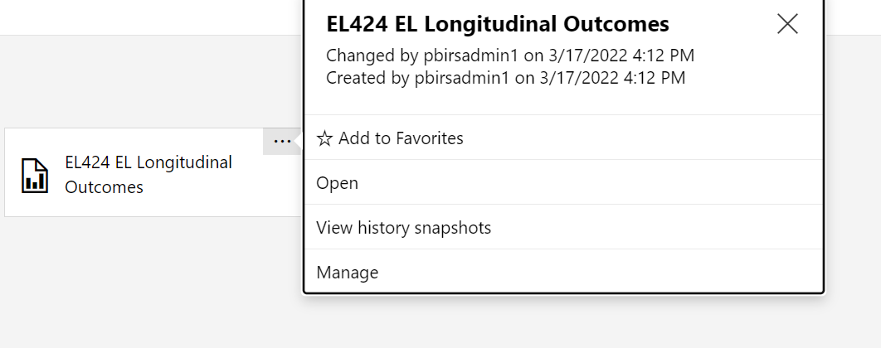
How to find it?
Report is in Student Enrollment-Indicators > English Learners folder
Or use search feature- typing Longitudinal or EL424 or Outcome
Can add to favorites

Slide 5
Prompt Section
Want to select Exit Year and Exit Grade
Longitudinal Year (if different than most recent year of data available)
Can use additional filters or run with default setting
Recommend first run with defaults before adding additional filters

Slide 6
Row Headers
Ever EL
Exited EL: Students identified as EL in the October SIMS of Exit Year who were not classified as EL in the following March, June, or October SIMS collection.
EL: Students Identified as EL in October SIMS
Previously Exited EL: Student exited EL status prior to selected “Exit Year”
Never EL: students not identified as EL in SIMS during or prior to Exit year
Selected Students = Total Ever EL + Never EL

Slide 7
Reading the Report
Students #: number of students in Exit grade level during Exit Year. Counts based on October SIMS
ACCESS information from Exit year
Enrolled section shows information for Longitudinal Year
Note: report not suppressed, so will show data even if number of students. Data that falls below suppression rules are in italics.

Slide 8
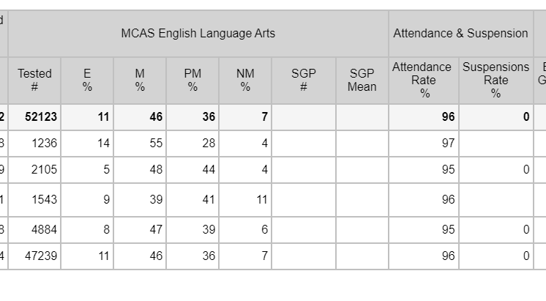
MCAS section and Attendance & Suspension section
MCAS:
Shows # tested and % who scored at each level
SGP not available is grade 3 is longitudinal year grade
Shows Attendance Rate and Suspension Rate
2021 SY had VERY LOW suspension rates

Slide 9
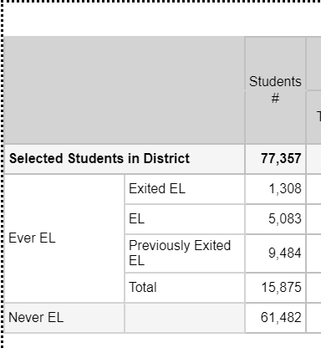
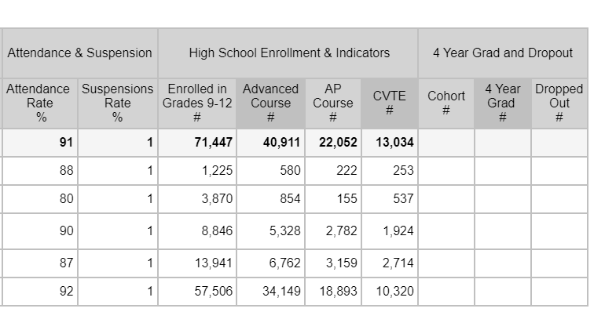
If run for anticipated grade 9-12 longitudinal year students
Example: state, exit gr 9 2018-9, Longitudinal year 2020-21
HS enrollment shows #s; can calculate percent
Cohort grad and drop data being loaded- not currently available. This is the cohort dropout rate – not annual

Slide 10
Download to Excel
Click on Export Drop Down menu (disk or save icon) to download to excel (not compatible in PDF or csv due to width of report and formatting)

Slide 11
Thank you!
Kathryn.sandel@mass.gov

