Slide 1
Edwin 101 Fall 2023

Slide 2
Today’s Agenda
What Reports are in Edwin?
Logging in & New Edwin Highlights
Demo
How to run reports & download data
Report tips
Q&A

Slide 3
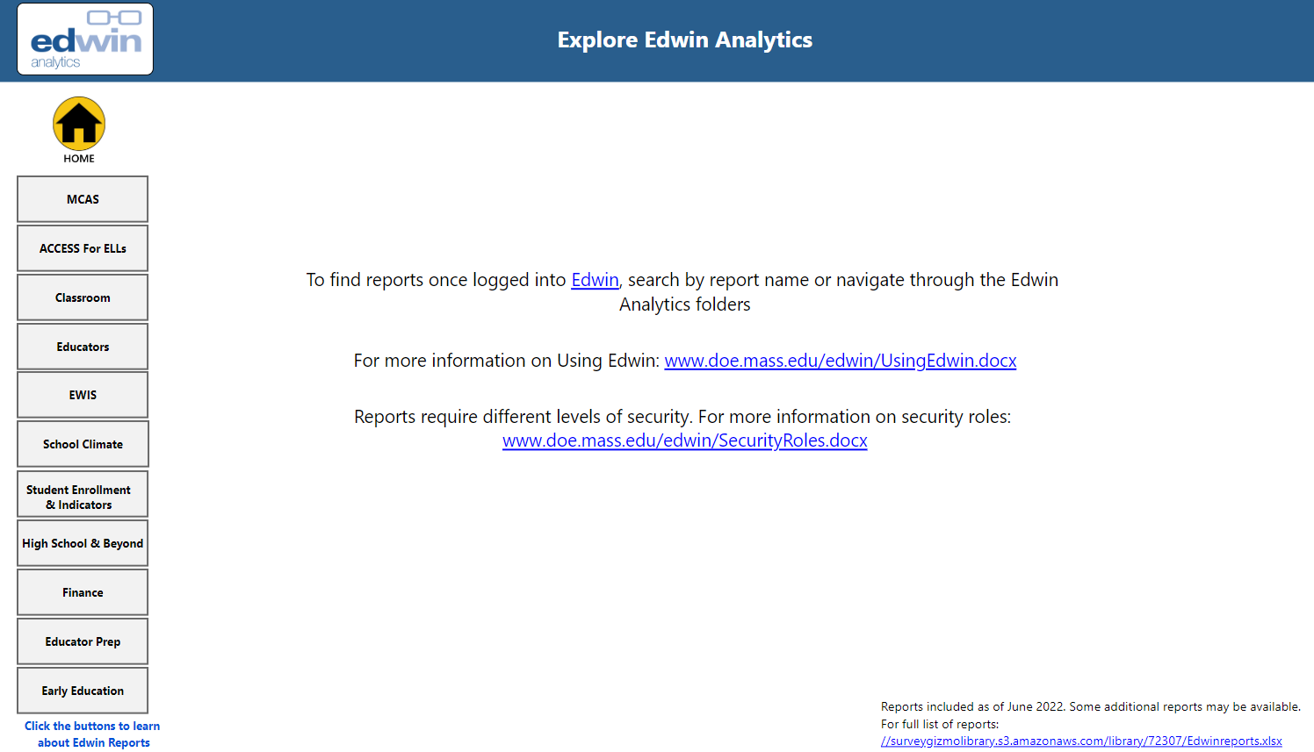
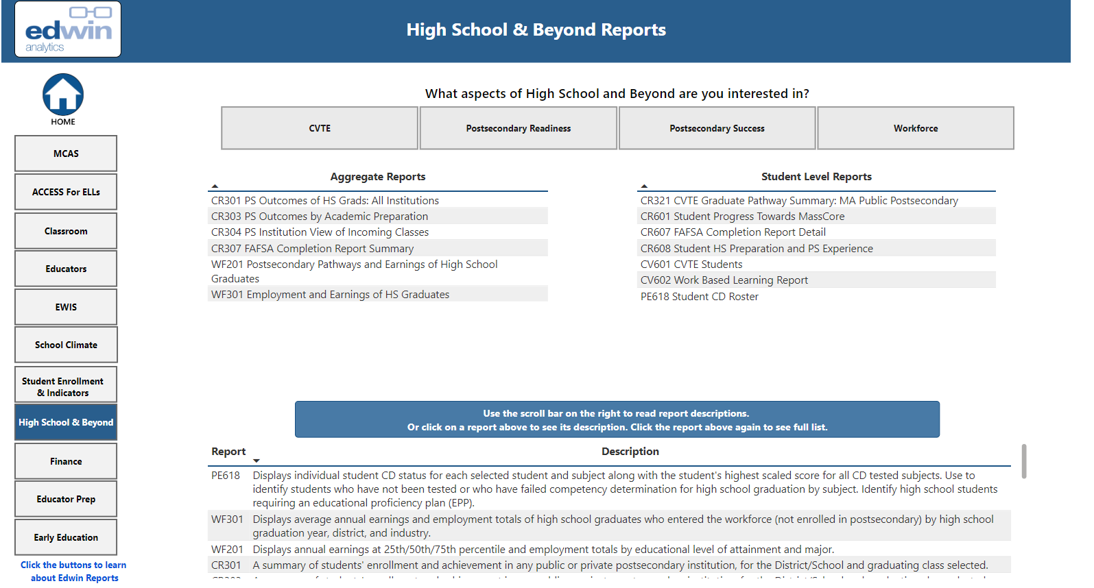
What reports are in Edwin?
Check out the Edwin Report tool
or Edwin Report List Excel spreadsheet of reports by topic/subtopic with description
https://www.doe.mass.edu/edwin/edwin-reports.xlsx
Notes:
or Edwin Report List Excel spreadsheet of reports by topic/subtopic with description
https://www.doe.mass.edu/edwin/edwin-reports.xlsx

Slide 4
Edwin in the Cloud
DESE Security Portal moved to the Cloud end at the end of August
Users should have preregistered in Spring/Summer. They can now reset their password and log in
If having trouble:
First, try resetting Password
Otherwise contact your local Directory Administrator or the ESP help desk at 781-338-MESP(6377).
Note: Logging in to security portal has Multi-factor Authentication

Slide 5
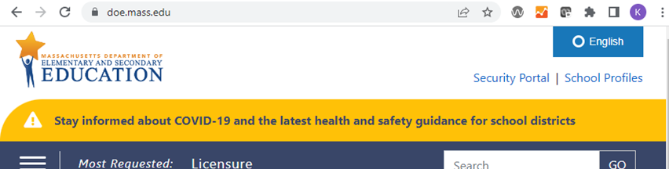
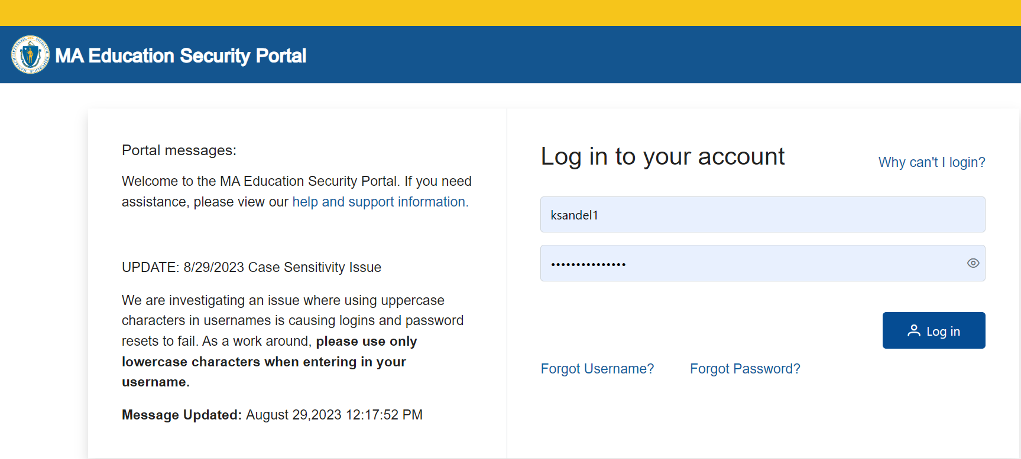
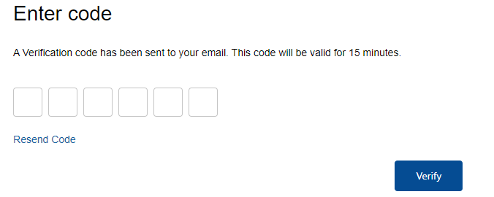
Logging into Edwin
Edwin operates a little differently! For tips see
https://www.doe.mass.edu/edwin/UsingEdwin.docx

Slide 6
Edwin homepage
Use search box to look for report by name or keyword
Reports grouped by topic/subtopic
Notes:
One thing not there- is favorite folder. Not currently available in the cloud version of this application. We hope it becomes possible, or we figure out some workaround to create that!

Slide 7
Prompts reordered: Read prompts horizontally
Read prompts in rows, from left to right, from top to bottom
Sometimes prompts reset based on another selection
If you get no data after running a report, make sure prompts match
does the school selected have the grade selected?
Notes:
First prompts are typically

Slide 8
Hit the green button!!!
After you change ANY prompts- you must hit the VIEW REPORT button to see new data
If the “View Report” is Green, hit the button to view new data.
Even if the report screen goes momentarily blank or you see a “fetching data” box appear on the screen, new data will not be displayed until you use the button.
Once you have made all the changes to the prompts that you want, hit the green “view report” button to see new info.
You are not seeing the data reflected by the prompts you picked if the view report button is green!

Slide 9
PR600 Student Profile Report
Full history of school enrollment noted in SIMS, SCS (course data) and SSDR (suspension), as well as MCAS and ACCESS assessment history and CD status.
In Student Enrollment - Indicators > Student Profile
Run by SASID (can input list of SASIDs you have claimed, from multiple schools/grades)
Use prompts (but limited to single grade/school selection- only can run for one grade or school at a time)
Export to PDF (easier to navigate among students) or Excel.

Slide 10
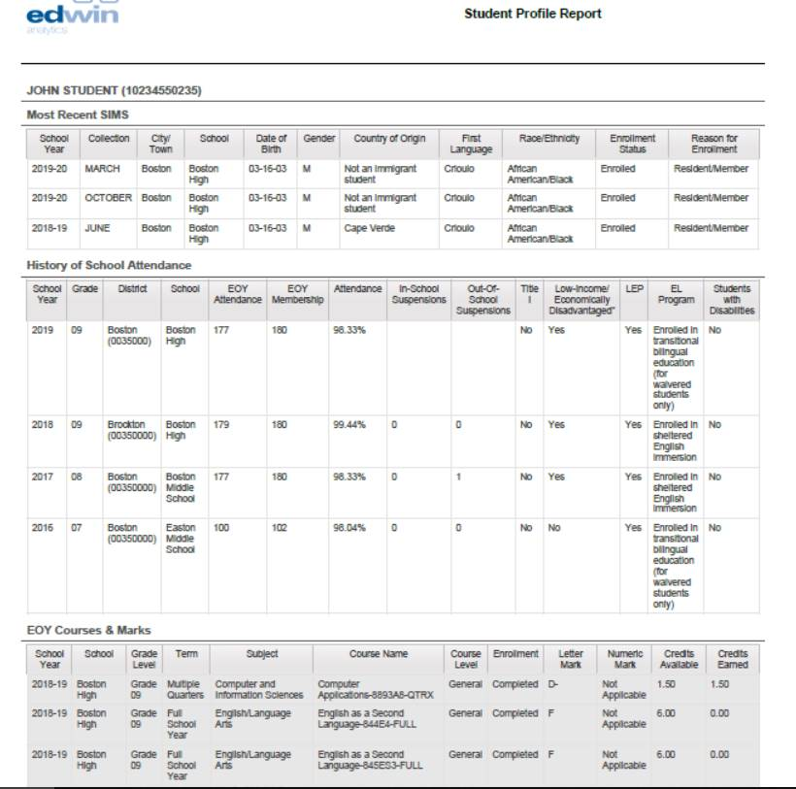
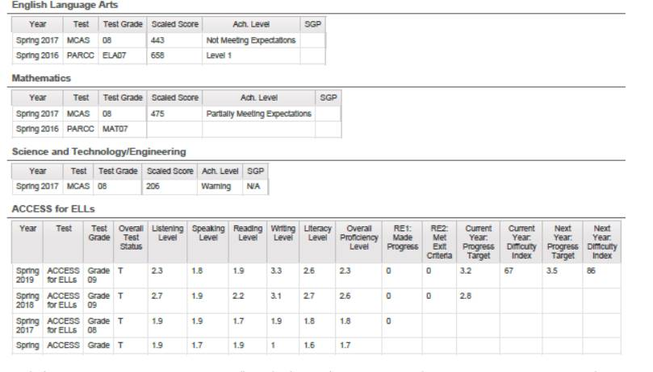
Student Profile (PR600)
Notes:
Ther are two other reports I want to make you aware of. You may have noticed hyperlinks peeking out of boxes hiding the SASID columns. These hyperlinks will take you to the Student Profile Report, which is history of school attendance and information for the student. This is really helpful for understanding new students. You can also run this report for a single student or group of students on its own.

Slide 11
Search by SASID
Some reports can be run for a group of SASIDs rather than using district/school/grade prompts
For PR600, the report opens with SASID search defaulted to yes.
It can be run by entering SASIDs in the SASIDs box or change “SASID Search” to “No” and other prompts will be made available for running the report on an organization.
You can type in SASID(s) or copy/paste a list of SASIDs from a spreadsheet or other document.
SASIDs should appear on separate lines or with a comma separating them.
It is okay to leave the “Enter SASIDs, if applicable” in the box as long there is a space between it and any SASIDs.
After making any additional changes to the prompts, hit the “view report” button to see your report.

Slide 12
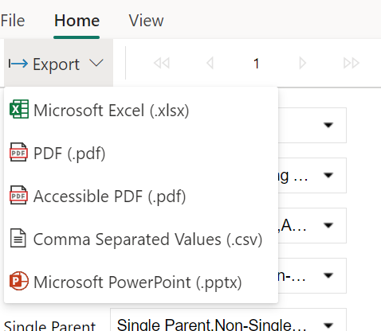
Report Task Bar
Navigate between pages for multi-page reports
Reminder: Sometimes notes appear on last page or bottom of the report page
Show/hide the prompt area
Notes:
At the top of the report is task bar including the export menu, page navigation buttons, and show/hide parameter options.
The export button is on the right of the report task bar at the top of the reports. This allows you to export to excel, csv, pdf or other formats. Note: Not all reports are optimized for all export options. The PDF format displays and prints the report exactly as it appears on your screen. Downloading to excel may be helpful to do additional filtering and merging with other data. Some reports must be in excel (needs to download with multiple tabs). Where the download pops up depends on the browser and settings. For formatting reasons, there may be a blank row at the top or left of excel and csv downloads. Those are easy to delete. We have tried to avoid merged rows within the excel spreadsheets which some of the old version had since they can make filtering or merging data more difficult.
Some reports have multiple pages. Use the control in the report task bar to navigate across pages.
You can minimize the prompt section by selecting Parameters button in the task bar at the top of the page. You can show the prompt section by hitting the parameters button again.

Slide 13
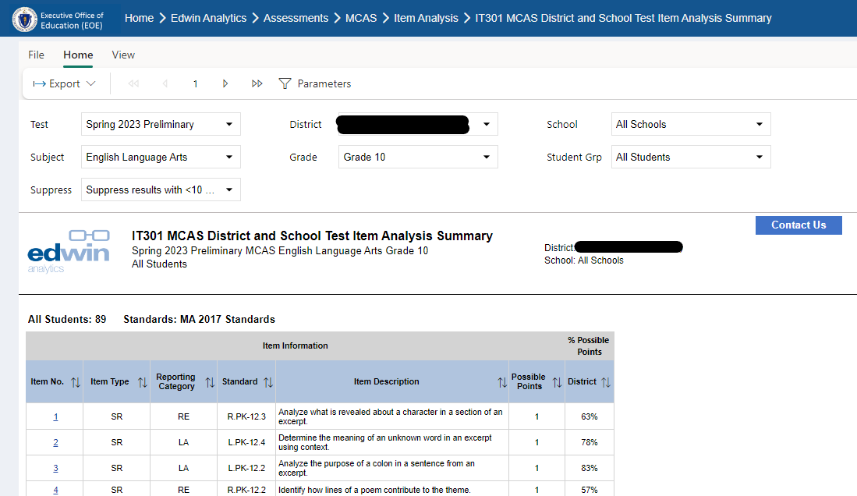
Let's look at another report: IT301 MCAS district and School Test Item Analysis

Slide 14
Other Report Tips
You can scroll through dropdown menus, or remove text and type to get autofill of available options
Aggregate reports can be run for the district level or school level in the same report
Hyperlinks will take you to another report (e.g. a student level report)
Reports may have helpful information at the beginning or end of reports (bottom of screen or on last page)
Hover over for additional information embedded in the report
Can sort the data in the table

Slide 15
Running into problems?
If you have any problems- hit the contact us button to let us know the problem.
https://massgov.service-now.com/eoe
Providing feedback will help us improve the reports and functionality
Share any issues with running the reports/data anomalies
Share ideas for changes
Share new ideas for reports

Slide 16
Reminder: Important Tips for running reports in Edwin
Read prompts horizontally - in rows, from left to right, from top to bottom
After you change ANY prompts- you must hit the VIEW REPORT button
If the “View Report” is Green, hit the button to view new data.
Even if the report screen goes momentarily blank or you see a “fetching data” box appear on the screen, new data will not be displayed until you use the button.
Once you have made all the changes to the prompts that you want, hit the green “view report” button to see new info.
You are not seeing the data reflected by the prompts you picked if the view report button is green!

Slide 17
Contact Information
https://massgov.service-now.com/eoe
Kate Sandel
Kathryn.sandel@mass.gov

