Slide 1

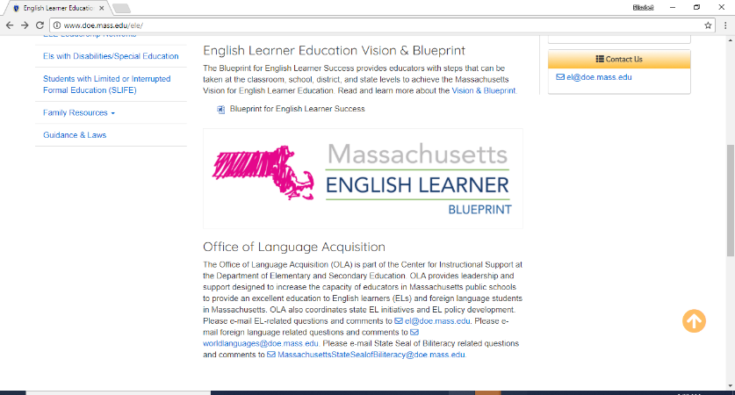

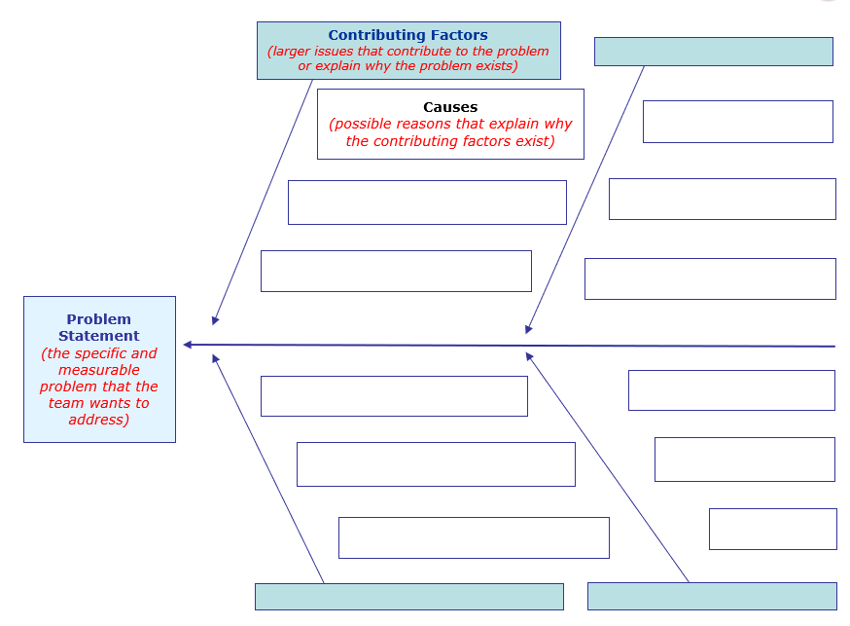
Blueprint Initial Implementation Tools and Resources: Fishbone Diagram Template
A fishbone diagram helps teams collaboratively explore why a problem occurs, not just the symptoms of a problem. Teams can use this diagram to dig deeper into a priority improvement area identified during self-assessment in the Blueprint Module 2.
This slide presents components of the diagram, and the next slide provides an editable blank template educators can use. For an example of a completed fishbone diagram, visit the Blueprint Planning and Professional Development page.

Slide 2
Blueprint Initial Implementation Tools and Resources: Fishbone Diagram Template p2

