Slide 1
ELE Tiered Focused Monitoring CIMP Orientation Webinar
January 2023

Slide 2
Webinar Objective To build a district leader’s understanding of the required corrective cycle following a
Tiered Focus Monitoring (TFM) Review

Slide 3
Compliance is the Floor, Not the Ceiling
IMPROVEMENT COMPLIANCE

Slide 4
What is next after the TFM review?
Once the TFM onsite review is complete:
Receive Draft Feedback Summary and have access to the draft of the TFM Report in WBMS.
Submit a response if you don't agree with DESE comments.
TFM Report will be created after OLA reviews the district's response.
Any finding in the TFM Report requires development of a Continuous Improvement & Monitoring Plan (CIMP).
The district has 20 business days to submit the CIMP after the TFM report is issued.

Slide 5
CLARIFICATION: DRAFT FEEDBACK SUMMARY
Preview of final report
Opportunity to agree or respond to documented finding(s)
Response not required
Upload any additional artifact with your response
Draft Feedback Response Acknowledgment notification from Department

Slide 6
CIMP PROCESS (1)
Log into the WBMS PQAWebmonitoring system in the DESE Security Portal.
Select OLA Tier Review.
Go to the Go to the Feedback/CIMP menu option.
Select the CIMP Summary to review the findings and enter your CIMP.

Slide 7
CIMP PROGRESS (2)
The CIMP has 6 fields you will need to complete:
Title/Role of Responsible Person(s)
LEA Outcome: a brief narrative (description/overview) of the anticipated outcome(s) from the CIMP activities.
Refer to your finding)
Action Plan: a detailed narrative of the steps they will take to bring the district/school into compliance.
The district/school will identify its proposed activities for all areas connected to the finding.
Depending on the finding, the district/charter school may have multiple entries.
Success Metrics: The district/charter school will indicate what measures will demonstrate the successful implementation of the action plan.
These measures can include revised policies, training materials, record review results, and other documents as evidence.
Measurement Mechanism: Description of the district’s process or steps to ensure the ongoing success of its action plan. Examples include a periodic file review or a review of student data as sources of verification.
Progress Update Dates: The dates by which the district/charter school anticipates completion of the action plan activities.

Slide 8
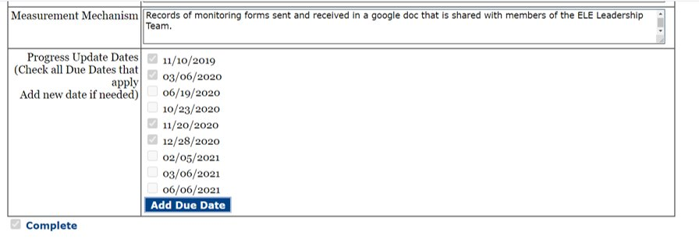
CIMP PROCESS (3)
Once done with all 6 sections, be sure to mark your CIMP as complete
Please note that the system will not allow you to submit an incomplete CIMP (common error)

Slide 9
CIMP PROCESS (4)
Once all the areas of concern are complete, you will be able to submit your CIMP for review by choosing the Submit CIMP menu option.
Please be sure to provide updated name and contact information;
Check the box; and then
Click the blue SUBMIT Box.

Slide 10
Progress Update Cycle
TFM Review
CIMP
Progress Updates
District communicates updates periodically to the Department
Progress updates follow the approved CIMP and may include additional information and/or artifacts as requested by the Department to monitor progress and compliance.

Slide 11
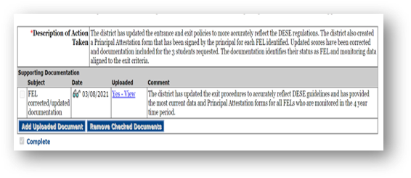
Progress Updates after CIMP: WRITING IT
You can submit progress updates on or before the due date.
Log in,
Select OLA Tier Review
Click on Progress Update Summary
Continue by choosing the appropriate date from the drop down and
Click the SELECT button.
Provide update based on CIMP and OLA feedback
Upload your evidence/artifacts to support update
Mark update as Complete by checking the box

Slide 12
Progress Updates after CIMP: SUBMITTING IT
Check that your Progress Update Summary is complete.
Locate the “Submit Progress Update” option and click.
Find the date of the progress update in the dropdown menu and click.
Submit the progress update.
You should receive a confirmation…. And voila.
If you receive an error message, go back and ensure that summary is marked complete.

Slide 13
ELE 5: Alignment to the Castañeda Test and the MA Blueprint for EL Success
Project in progress to resolve common findings for ELE 5 using the Castañeda Test and the MA Blueprint for EL Success
Most common findings:
ESL curriculum and instruction
Benchmark requirements
Data showing no sufficient progress
Insufficiently staffed ELE program

Slide 14
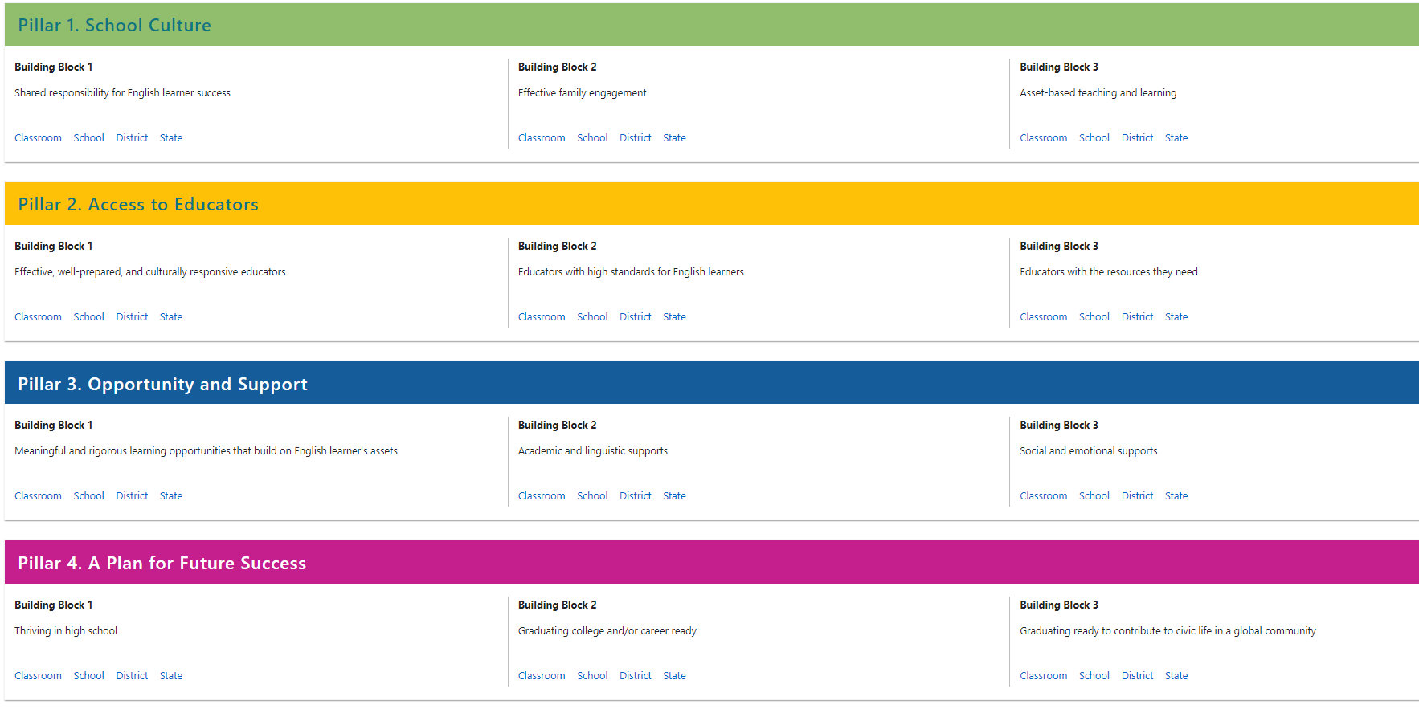
Non-compliance with benchmark requirements
Findings Language:
Documentation also indicated that the district has not adopted procedures to identify English learners who do not meet English proficiency benchmarks and has not established a process for the district/charter school to:
identify areas in which identified English learners need improvement and establish personalized goals for the identified English learners to attain English proficiency;
assess and track the progress of English learners in the identified areas of improvement;
review resources and services available to identified English learners that may assist said learners in the identified areas of improvement;
incorporate input from the parents or legal guardian of the identified English learner as required under M.G.L. c. 71A, § 11.
Castañeda Three Prong Test Connections:
Prong 2
Click to view specific prompts
Resources:
OLA Benchmarking webpage
HQIM for ESL rubric
Features of High Quality ESL Instruction
Collaboration Tool
Quick reference guides (QRGs)
Sample Action Plans:
Low incidence
Mid incidence
High incidence
Notes:
Improve – ELLevation vs home-made – create a bank of goals, etc (would be different project); Lynn (RC) has bank of comments/goals by domain and language that is embedded into district report card (drop down menu of comments)
Remove – references to ELLevation in sample action plans
Add –links to resources for HQIM for ESL (rubric, etc); OLA benchmarking webpage
Big focus q’s:
Is it better to have the image/link open the web page or download? Does it depend on the resource?
Is it helpful to have the visual with the areas related already identified (like blueprint)? Are there other resources we could do this with? (not action plans, Castaneda; maybe NGESL resources?)

Slide 15
Connections to Castañeda
PRONG 2: The program and practices used by the district are reasonably calculated to implement effectively the educational theory adopted by the district.
Please describe the ongoing monitoring of ELs’ linguistic, academic and socio-emotional progress and the types of formative and summative assessments used by the district to provide rigorous learning experiences to ELs that accelerate their progress toward mastery of content standards and English language proficiency. If the district or its schools have not met their ELP benchmarks, did the district establish a process to:
Identify the areas in which identified ELs need improvement and establish personalized goals for attaining English proficiency;
Assess and track the progress of ELs who did not meet benchmarks in the identified areas in need of improvement;
Review resources and services available to assist ELs in the identified areas in need of improvement;
Incorporate input from the parents or legal guardian of the identified EL.
Please explain how the district provides instructional supports and services tailored to the unique academic and linguistic needs of ELs including SLIFE, ELSWD and newcomers.

Slide 16
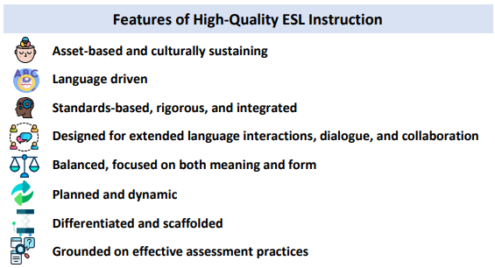
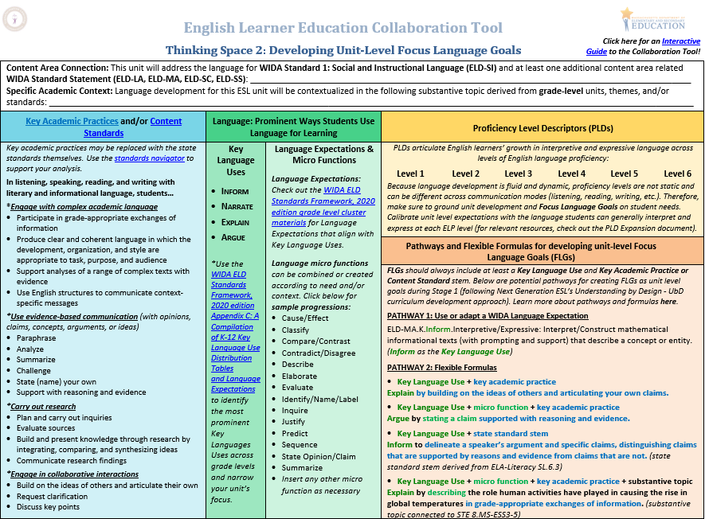
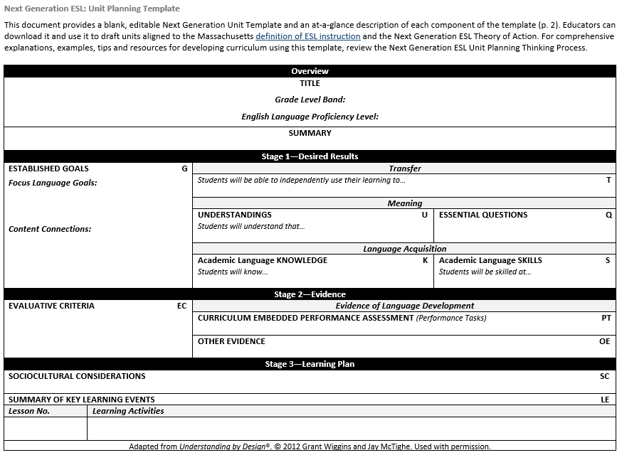
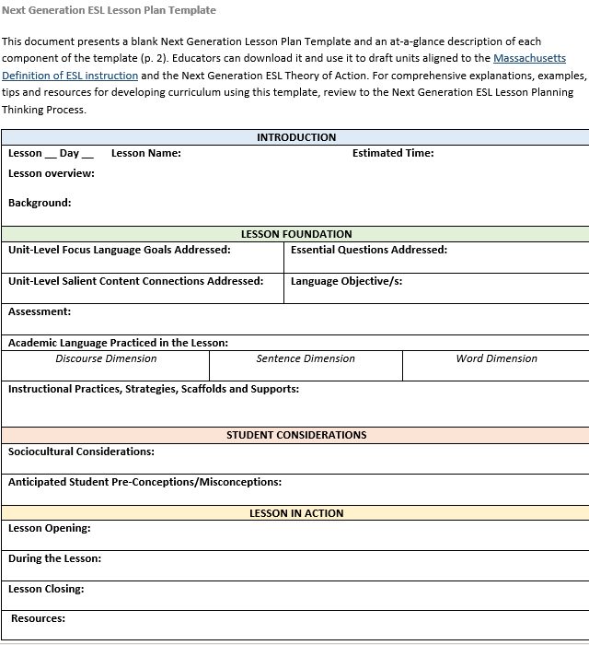
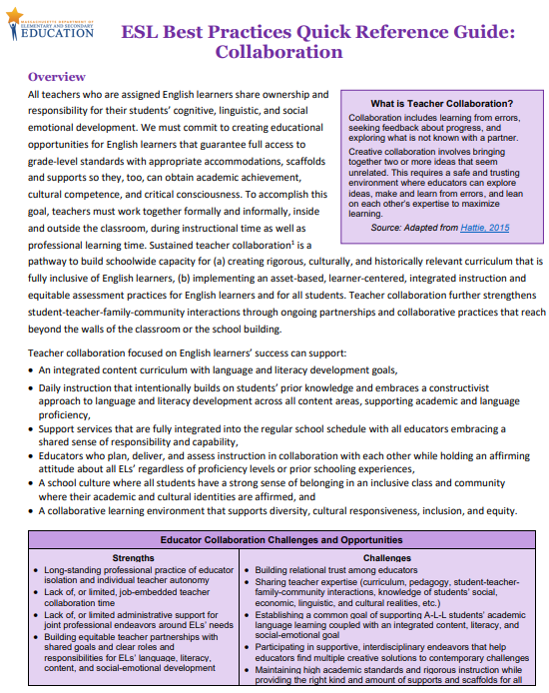
Resources

Slide 17
High incidence
High incidence
Title/Role(s) of Responsible Person(s) | EL Director, EL teachers, SEI teacher who teach Els who did not make progress on ACCESS
LEA Outcome | The district will have successfully created a procedure for identifying EL students who (i) have not met English proficiency benchmarks, establish personalized goals for the identified students; (ii)assess and track the progress of EL students in the identified area(s) of improvement; (iii)identify resources and services that are available to identified EL students that may assist them in identified areas of improvement; and (iv) incorporating input from parents and/or legal guardians.
Action Plan | By August 16, 2022, the district ELL Coordinator will create a procedure that will be used to identify EL Students who have not met proficiency benchmarks, establish personalized goals for each student; assess, monitor and track the progress of identified students; list and utilize the resources and services that are available to identified students, incorporating input from parents/legal guardians. By September 2022, the district ELL Coordinator will have provided training to the district EL teachers on the use and implementation of the updated procedure, its corresponding data tracking sheets, resources and services available to assist learners who have not met personalized goals, and guidance for gathering input from parents and guardians (via either in person meetings with interpretation, Zoom call with interpretation or phone calls/home visits as per the family preference), as well as update the data tracker used to collect assessment, progress monitoring or other tracking data that will ensure the student is progressing towards or meeting their personalized goal(s). End of September 2022: This training will be repeated for SEI staff with EL teachers presenting and meeting with the SEI staff they collaborate with, specifically the staff who also teach Els who have an established personalized goal in an identified area of need. These meetings will take place during district provided collaboration time (i.e. in lieu of staff meeting or other district meeting in the month of September) and will allow time for the EL teacher to discuss the goal, the supports and scaffolds that will be implemented and the SEI teacher will be able to ask questions and begin planning to implement the supports and scaffolds in daily instruction. By the end of September 2022, the beginning of the year benchmark (WIDA MODEL) will be utilized and data will be collected and analyzed in an EL team meeting. This data will be used to update students’ goals as well as adjust daily ESL instruction. EL teachers will be given collaboration time to meet with the team of teachers for each EL with a personalized goal to review the goal, supports, strategies and scaffolds that are to be used in daily instruction. EL teachers will coordinate with the family to ensure that there are options for input including: either in person meetings with interpretation, Zoom call with interpretation or phone calls/home visits as per the family preference; where the family will be presented with the new data, understand the adjustments made to the goal of their child, and provide insight into any changes they have seen at home in terms of the goal and any supports the family can provide at home. By October 2022, there will be documentation included in the students' cumulative files and district EL files identifying those students who may not have met their personalized goals, identifying supports and services that have been implemented to assist with progress and documenting input from parents and/or guardians as well as update the data tracker used to collect assessment, progress monitoring or other tracking data that will ensure the student is progressing towards or meeting their personalized goal(s). By the end of December 2022, middle of the year benchmark (WIDA MODEL) will be utilized and data will be collected and analyzed in an EL team meeting. This data will be used to update students’ goals as well as adjust daily ESL instruction. EL teachers will be given collaboration time to meet with the team of teachers for each EL with a personalized goal to review the goal, supports, strategies and scaffolds that are to be used in daily instruction. EL teachers will coordinate with the family to ensure that there are options for input including: either in person meetings with interpretation, Zoom call with interpretation or phone calls/home visits as per the family preference; where the family will be presented with the new data, understand the adjustments made to the goal of their child, and provide insight into any changes they have seen at home in terms of the goal and any supports the family can provide at home. By the end of February 2023, all Els will have completed ACCESS testing By the end of April 2023, end of the year benchmark (WIDA MODEL) will be utilized and data will be collected and analyzed in an EL team meeting. This data will be used to update students’ goals as well as adjust daily ESL instruction. EL teachers will be given collaboration time to meet with the team of teachers for each EL with a personalized goal to review the goal, supports, strategies and scaffolds that are to be used in daily instruction. EL teachers will coordinate with the family to ensure that there are options for input including: either in person meetings with interpretation, Zoom call with interpretation or phone calls/home visits as per the family preference; where the family will be presented with the new data, understand the adjustments made to the goal of their child, and provide insight into any changes they have seen at home in terms of the goal and any supports the family can provide at home. By the end of June 2023, ACCESS 2023 data will be analyzed in an EL team meeting. Any student not making progress will have a draft goal developed by the EL teacher. EL teachers will be given collaboration time to meet with the 2023-2024 team of teachers for each EL with a personalized goal to review the goal, supports, strategies and scaffolds that are to be used in daily instruction for the 2023-2024 school year. EL teachers will coordinate with the family to ensure that there are options for input including: either in person meetings with interpretation, Zoom call with interpretation or phone calls/home visits as per the family preference; where the family will be presented with the new data, understand the adjustments made to the goal of their child, and provide insight into any changes they have seen at home in terms of the goal and any supports the family can provide at home.
Success Metrics | Documentation and supporting data will be included in the files of any students who have not met English Proficiency goals, to document the personalized goals, tracking, monitoring and parent input. EL department and applicable SEI staff complete the training in the benchmarking procedures EL and SEI staff utilize the student goals in daily instruction as evidenced by lesson and unit plans, data collection and collaborative meetings
Measurement Mechanism | ELE Staff will conduct file reviews in August to identify those EL students who have not met English proficiency benchmarks and will establish personalized goals for each area, documenting efforts, assessment and tracking in student files. EL Director will provide training to EL department and SEI staff (as applicable) regarding the implementation of the benchmarking process and procedures as well as expectations for use in daily instruction in both ESL and SEI contexts El director will request exemplars of instructional planning from both EL and SEI staff throughout the year that have been adjusted to include the strategies, supports or scaffolds for Els with a personalized goal

Slide 18
REMINDER: CIMP or CAP for ELE 5
When In Need
of an Extension
Communication
Prior to due date
Documentation
Through TFM portal using original submission date
Timeline
Clearly stated

Slide 19
Compliance is the Floor, Not the Ceiling
IMPROVEMENT COMPLIANCE

Slide 20
Questions?
Sibel Hughes Samantha Kodak
Judith Magloire Andy McDonie David Parker David Valade

