Slide 1
ELPAC Leadership Convening
February 9 & 10, 2021

Slide 2






Welcome to the first English Learner Parent Advisory Council Leadership Convening

Slide 3
Day 1: Parents Rights and Opportunities
February 9, 2021

Slide 4
Introductions and Data
1
Welcome, Logistics, & Introductions
2
Keynote: FAMILIES IN MULTILINGUAL CONTEXTS:
Building Together a Bright and Joyful Future for Our Children
3
4
ELPAC Member Panel
Shrewsbury/Nantucket/Boston
5
Networking: Parents with Parents, Districts with Districts
6
Share-out, Next Steps, and Survey

Slide 5
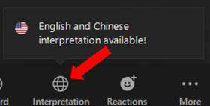
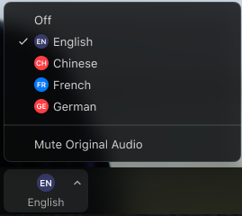
Welcome interpreters from JTG, inc.
In your meeting/webinar controls, click Interpretation.
Click the language that you would like to hear.
Available languages:
Spanish, Portuguese, Mandarin,
Arabic, French, Japanese, Korean

Slide 6
Desired Outcomes
Agenda
2:00-2:20
  Welcome, Logistics, & Data,
2:20-2:40
  Keynote: FAMILIES IN MULTILINGUAL CONTEXTS: Building Together a Bright and Joyful Future for Our Children,
2:40-3:00
  Prenatal through Grade 12 Family Engagement Framework: Diverse Family Communities
3:00-3:20
  Breakout Sessions
3:20-3:25
  Break
3:25-3:45
  District ELPACs Panel
3:45-4:00
  Networking
4:00-4:15
  Reflection & Survey
We will leave today:
Understanding ways to support our children, ourselves, and their education
Understanding how ELPACs can support collaboration with stakeholders.
Planning our next steps.

Slide 7
ELPAC Convening Presenters: Day 1
Dr. Maria Serpa, Professor Emerita of Education and Special Education at Lesley University
Tere Ramos, Advocacy Lawyer
Olga Lopez, Family Engagement Specialist-DESE
Andrea Parker, MA Statewide Family Engagement Center
Cambria Russell, MA Statewide Family Engagement Center at Federation for Children with Special Needs (FCSN)

Slide 8
Introductions & Data
Paul Aguiar, Director, Office of Language Acquisition

Slide 9
ELPAC Convening
February 9, 2021

Slide 10
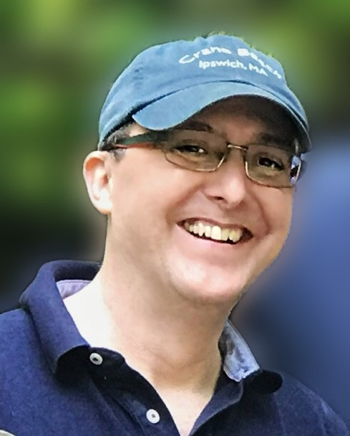
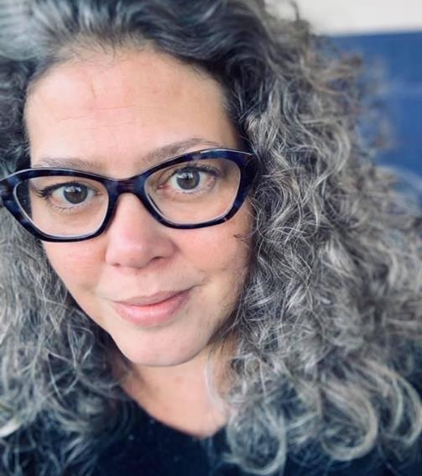
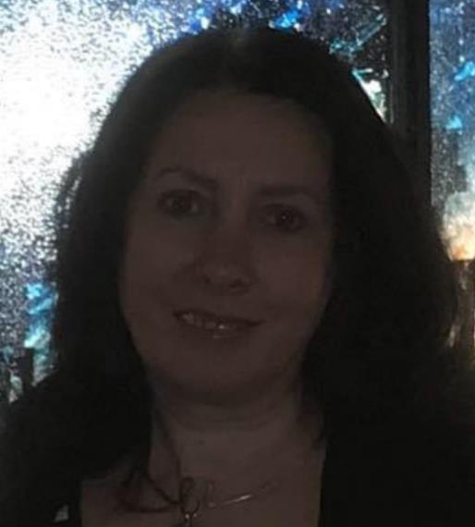
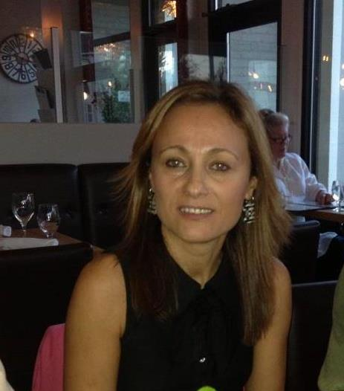
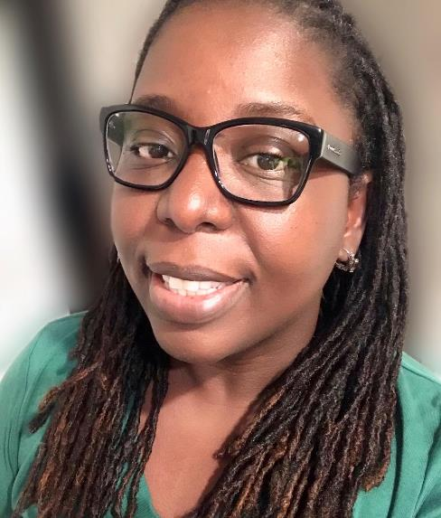
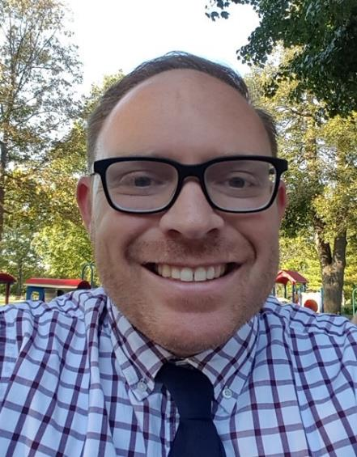

Meet the OLA Staff
Paul Aguiar,
Diana Gentile
Sibel Hughes
Zhaneta Liti
Judith Magloire
Andy McDonie
David Valade

Slide 11
English Learner and First Language Not English Enrollment Data at a Glance
English Learners

Slide 12
English Learner Education Program Enrollment at a Glance

Slide 13
EL Student Indicators: % of Students Making Progress on ACCESS
2019
2020
Percentage of Students Making Progress Percentage of Students Making Progress

Slide 14
Focus on HS: English Learner High School Enrollment Data

Slide 15
English Learner Dropout Rates
5,186 of the 291,096 students enrolled in 9-12 dropped out in SY19
1,427 of 19,974 EL students enrolled in 9-12 dropped out in SY19

Slide 16
Data Summary
The number of English Learners continues to grow, and opportunities for bilingual education are expanding but not keeping pace.
Middle and especially high schoolers are making progress in achieving English proficiency at less than half the rate of elementary students
English Learner high school enrollment continues to grow, but so do English Learner dropout rates
COVID-19 has both highlighted and worsened the achievement gaps faced by English Learners
Source: The Rennie Center “Condition of Education in the Commonwealth” 2021 Data Dashboard: https://www.renniecenter.org/sites/default/files/COE_2021_Data_Dashboard.pdf

Slide 17
If you have questions, please contact the following people
Paul Aguiar - Director, paul.j.aguiar@mass.gov
Diana Gentile - Program Manager, diana.gentile@mass.gov
Sibel Hughes – Assistant Director, sibel.hughes@mass.gov
Zhaneta Liti - ELE Content Lead, zhaneta.liti@mass.gov
Judith Magloire - ELE Content Specialist, judith.r.magloire@mass.gov
Andy McDonie - World Language Specialist, d.andrew.mcdonie@mass.gov
David Valade - ELE Content Lead, david.valade@mass.gov

Slide 18




THANK YOU
Paul Aguiar, Director, OLA
781.338.3538
Paul.J.Aguiar@mass.gov
www.doe.mass.edu
75 Pleasant Street, Malden, MA 02148

Slide 19
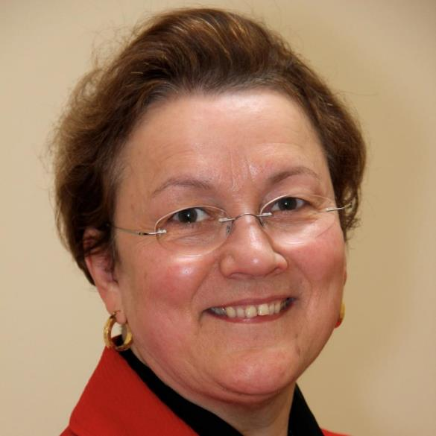

Keynote:
FAMILIES IN MULTILINGUAL CONTEXTS:
Building Together a Bright and Joyful Future for Our Children
Dr. Maria Serpa, Professor Emerita of Education and Special Education at Lesley University

Slide 20
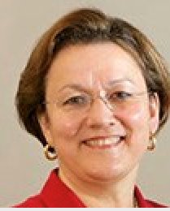
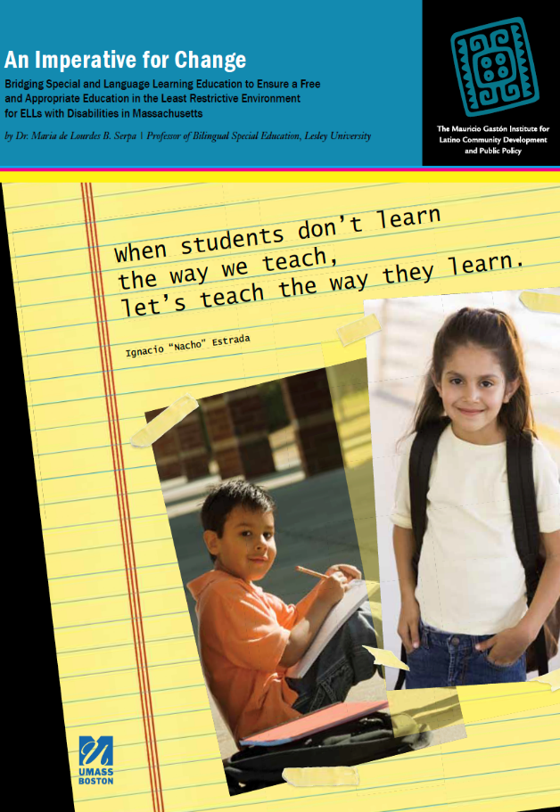
FAMILIES IN MULTILINGUAL CONTEXTS :
Building a Bright and Joyful Future for Our Dual Language Children in MA
Dr. Maria B Serpa
Professor Emerita Bilingual Special Education
School of Education Lesley University
mserpa@Lesley.edu
Keynote:
ELPAC
Mass Department of Elementary
and Secondary Education

Slide 21

Please add your language in the chat box if you do not see it here…

Slide 22

Guiding Questions
On the road to a joyful future:
  Where have we been?
  Where are we?
  Where we need to go?

Slide 23
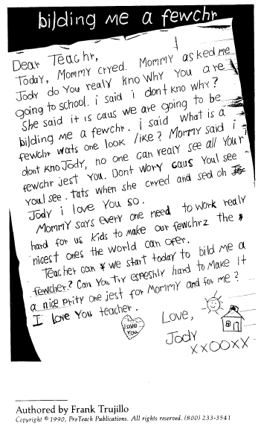
Building
a
Joyful Future
for
OUR B-EL Children
(PreK-12 with and without disabilities)

Slide 24



Commonalities & Differences in Diverse Families Who Have Children with Disabilities
Dual Language (English+ Spanish, Port. Haitian etc.)
Speaking Families
Non-English Speaking:
Spanish, Portuguese, Haitian…
What is additional and different?
English Speaking
13 Disabilities • 13 Disabilities • 13 Disabilities • 13 Disabilities • 13 Disabilities • 13 Disabilities

Slide 25
Where have we been?
Bilingual English Language Learners

Slide 26
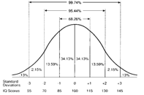
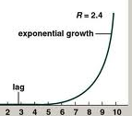
Current Historical Context: EDUCATIONAL MISSION EVOLUTION
Education for Some
No Compulsory Schooling
Education for All
Compulsory schooling Learning for EVERYONE
Compulsory schooling
Education for All
Learning for SOME
Learning for A FEW
where we are
© Serpa (2017)

Slide 27


Since Q2 emphasis has been on English Only for B-EL
Confusion about the effects of bilingualism as a positive outcome
Language and Culture of Home mainly invisible at school
Most public-school teachers are mainly monolingual English while 76 percent of the nation’s English-learners speak Spanish.
Limited awareness or acknowledgement of the negative consequences for B-EL children who became ashamed of their families because…

Slide 28
Where are we?
Bilingual English Language Learners

Slide 29
Current Historical Context: EDUCATIONAL MISSION EVOLUTION
where we are
Education for Some
No Compulsory Schooling
Education for All
Compulsory schooling Learning for EVERYONE
ESSA, (2017)
IDEA,(2004)
Compulsory schooling
Education for All
Learning for SOME
Learning for A FEW
© Serpa (2017)

Slide 30
We need to know more and different things. -Darling-Hammond
when we want to teach the way
B-ELLs with and without disabilities learn at home or at school
- Adapted from Nacho

Slide 31
What is different/ADDITIONAL in assessment and teaching when the needs of B-EL and B-ELSWDs are to addressed?
Cultural
Language
Legal
Research - influences these factors
© Serpa, M (2011) Graphics by Rinaldi

Slide 32

Public education "is a right which must be made available to all on equal terms."
U.S. Supreme Court, Brown v. Board of Education
(Retrieved from www.CAST.org June 1,2010)

Slide 33
There is no equity of treatment merely by providing students with the same facilities, textbooks, teachers and curriculum; students who do not understand English are effectively foreclosed from any meaningful education.
-US Supreme Court • Lau vs. Nichols (1974)

Slide 34
Legal Foundations For B-English Learners with a Disability (B-ELSWDs)
Additional laws
Language Learning Laws protect rights of B-ELLs
Civil Rights Laws protect rights of all students
Three
Interacting
Kinds
Of
Laws
Guarantee
FAPE2 in LRE2
where we are
B-ELSWDs
Special Education Laws protect rights of SWDs
Source: Serpa (2011)
34

Slide 35

Language Learning Education Programs MA 2021
Which program can eliminate the B-EL achievement gap?
RANK | Type | Grade level Achievement | Proficiency in 2 languages
1st | Two Way Bilingual Programs | YES | YES
2nd | Transitional Bilingual Education | YES | No
3rd | Sheltered English Immersion Program | NO (Failure rate (70-80% MCAS after 5 yrs. See Halting the Race to the Bottom…) | No
4th | Opt Out | NA | NA

Slide 36
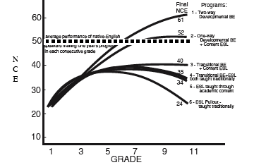
PATTERNS OF K-12 ENGLISH LEARNERS’ LONG-TERM ACHIEVEMENT IN NCEs ON STANDARDIZED TESTS IN ENGLISH READING COMPARED ACROSS SIX PROGRAM MODELS
Results aggregated from a series of 4-8 year longitudinal studies from well-implemented, mature programs in five school districts) © Thomas & Collier (1997)
Research - factors

Slide 37
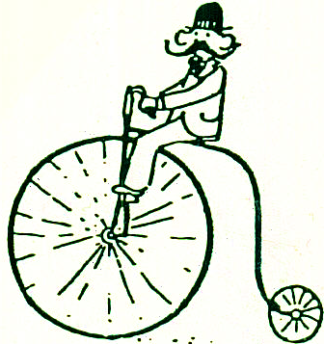
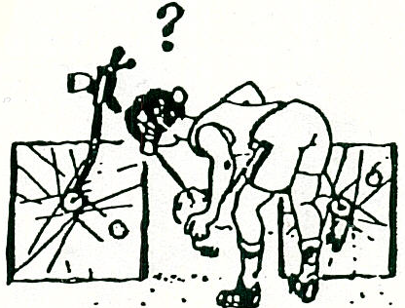
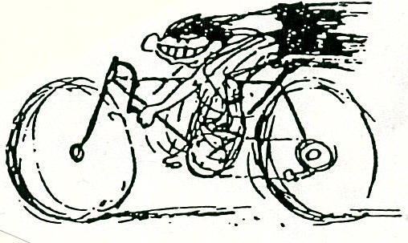
Research - factors
What does the research indicate about bilingualism in children (with or without disabilities)
Proficient Bilingualism (2L)
Positive cognitive effects
Partial Bilingualism
Neither positive or negative effects
Limited Bilingualism
Negative cognitive effects
EXAMPLE: Students with native language loss, English fluent but not grade level proficient
Source: Adapted from J. Cummins

Slide 38
Learning to read only happens once in life
Cummins 1971
Research - factors
When a child has achieved reading skills in his her native language (Stage 3 Chall,1983 )s /he transfers to English as soon as the student speaks English equivalent to what is on the written page
(See Serpa, (1981).
Refer to the National Literacy Panel (2006)

Slide 39
What is “effective instruction” for the average 3rd grader may be totally inappropriate for the average B-ELL who, nonetheless is in 3rd grade.
Ortiz (2008)

Slide 40
Josefina Language Barriers
Can access learning
in English
WIDA 3
WIDA2
WIDA 4
WIDA 1
circle
WIDA 5
People
LEVEL OF ENGLISH PROFICIENCY

Slide 41
Language Learning Education Programs MA 2021
Which program can eliminate the B-EL achievement gap?
RANK | Type | Grade level Achievement | Proficiency in 2 languages
1st | Two Way Bilingual Programs | YES | YES
2nd | Transitional Bilingual Education | YES | No
3rd | Sheltered English Immersion Program | NO (Failure Rate (70-80% students MCAS after 5 yrs. See Halting the Race to the Bottom… research report | No
4th | OptOut | NA | NA

Slide 42
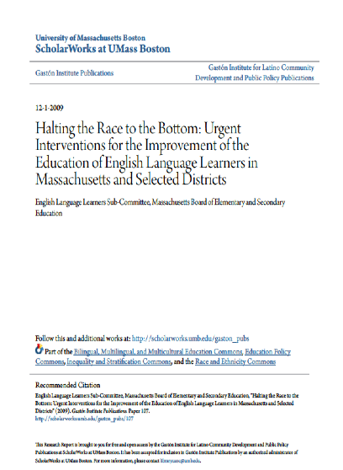
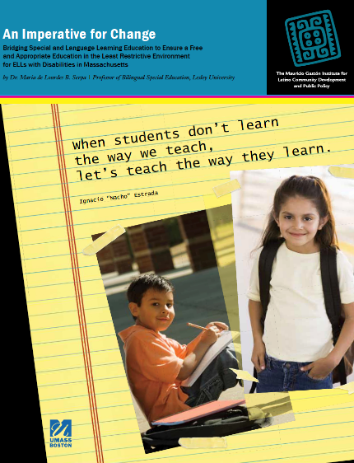
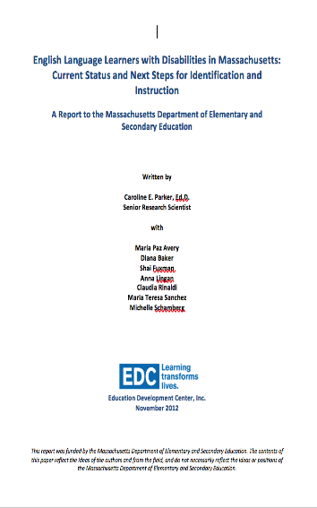

FYI:Documentos de investigações recentes em MA
Research - factors
Imperative for Change…
ELLSWD in MA (2011)
Halting the Race to
The Bottom… 2010
English Language Learners
with Disabilities (2014)
Number 1 for Some
(2018)
http://scholarworks.umb.edu/gaston_pubs/107/
http://scholarworks.umb.edu/gaston_pubs/152/
https://number1forsome.org

Slide 43

mserpa@lesley.edu
CULTURAL: What is in a Name?
What is your full name?
Maria de Lourdes
2. Are you named after anyone?
my mother
3. What does your name mean?
Religious name honoring Blessed Mary (Christian)

Slide 44
Where do we need to go?
Bilingual English Language Learners
What do we need to do now?

Slide 45

Tod@s l@s estudiantes pueden aprender
Tod@s @s estudantes podem aprender
Understand
Not the same day or the same way!
Variability

Slide 46
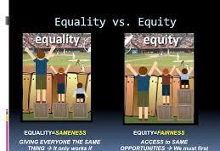
Need to address equity to ensure:
•grade level achievement in academics for all students
How? Two
•learn English(L2) Proficiency
•Social emotional well being and happiness
• Dual language proficiency

Slide 47

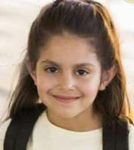
“There is no excellence without equity”
# 1 for some

Slide 48


”communication is key to student success and access”
(language barriers are real) EdWeek Spotlight (2020)
To understand
“communication is a human right” –Dr. Johnston (2019)
Therefore,
Access to instruction via home language while learning English is urgent. Why? Because language communication mediates access to 2-understanding content and grade level achievement (along with appropriate instruction).

Slide 49
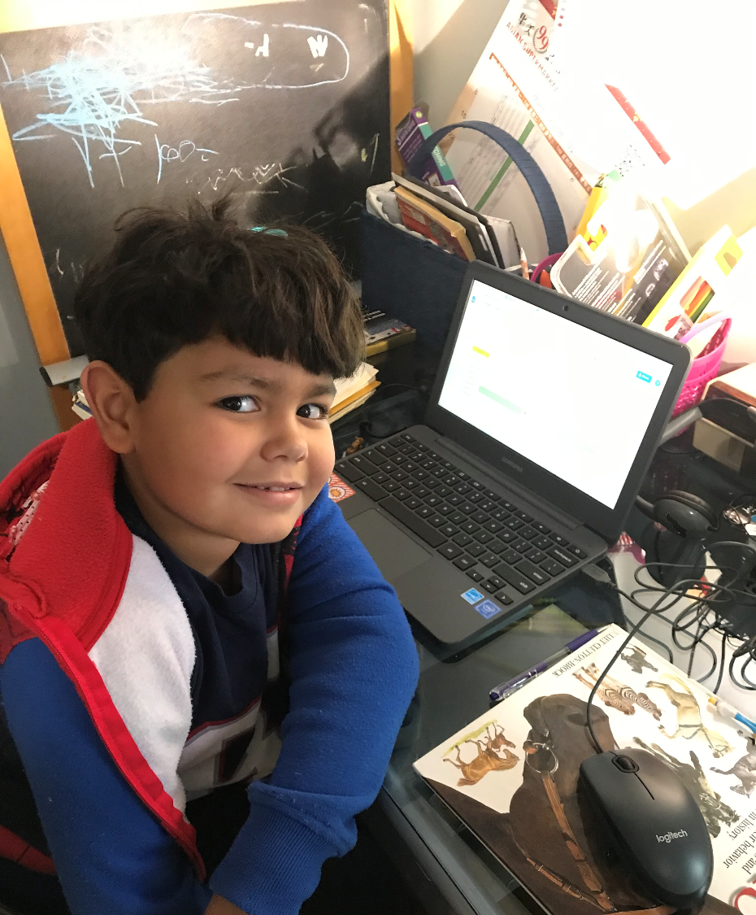
Victor informed his mother two days ago that he does not want to speak Portuguese (the home language) even though the mother and father do not yet speak English. He said:
  “Eu não falo o seu voice mãe.”
  “Eu falo o voice to meu teacher”
Can you imagine the suffering that young and not so young students go through when they feel pressured to speak “English only” and are not encouraged required to speak the home language along with English.
Victor 6 anos Portuguese speaking family

Slide 50

Em que língua deve falar em casa?
Que idioma debe usted hablar con su hijo o hija en su casa?
What language to use to communicate at home?
THE LANGUAGE OF THE ❤️

Slide 51
6 Recommendations for Families in Multilingual Contexts
to Build Joyful Futures for their children
Advocate for Dual Language Programs not only for your child but for all students in your school district whose families which their children to become bilingual.
Advocate for Ethnic/Cultural Studies of community membership for all students (See Dr. Cardona Secretary of Education).All students need to be better informed about our collective history in the USA
Realize that there are cognitive advantages to knowing more than one language, and to preserve and expand home language learning
Realize that there are cognitive advantages also to becoming bi-culturally competent at home, at school and in the workplace
Speak + the home/heritage language at home. Examples include:
  Lots of Story Telling – it is equivalent to reading books
  Sing Songs
  Have children watch selected TV Programs in the home language
  Play traditional cultural games including board games that are collaborative
  Cultural Toys
  Video projects
  Other
6. Advocate for knowing more about the contributions of immigrants in the USA and other Americans from their own background to support their sense of self worth

Slide 52
6 Recommendations to Educators About B-ELs
Understand the benefits of bilingual brains for kids and adults
Study the home culture of each child to better connect and communicate. (See www.ldldproject.net for info about the following cultures: Portuguese, Brazilian, Puerto Rican and Khmer)
Consider adding/ another language
Value and honor the home/heritage language at school and at home.
  Educators must learn pronunciation of each student’s names (DO NOT TRANSLATE student’s NAME)
  Educators need to learn basic words in the student’s home language to better connect with families who do not yet know how to speak in English
  Welcome sign in multiple languages.
  Give assignments related to home culture
  Encourage non-English-speaking parents to speak their home language (Language of the heart ❤️).
  NEVER TELL PARENTS TO SPEAK ENGLISH AT HOME-WHEN THEY DON’T KNOW HOW
Rethink and promote culturally responsive teaching strategies for All students:
  Ask parents to be involved in story telling in home language. (Reading books is not an option for some of them)
  Ask Parents to Play Games they know and acknowledge that toys in many families are not fisher price or the use of blocks
6. Promote PBL based on Biographies about recent Immigrant or Americans from Diverse Cultural Backgrounds (Refer to Serpa (1993) Portuguese American Authors with biographies written both in English and/or in Portuguese.

Slide 53
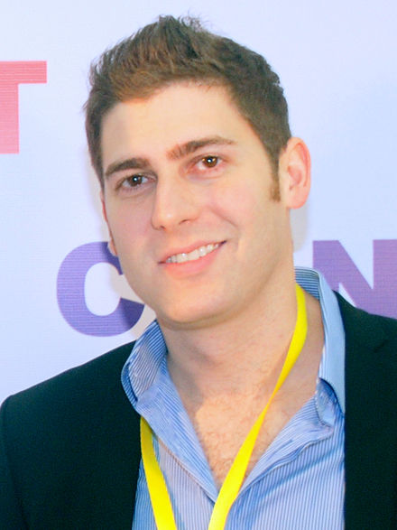
Famous Immigrant Americans from Brazil
Giselle Caroline Bündchen
Highest Paid Model
Eduardo Saverin
Investor &Cofounder Facebook

Slide 54
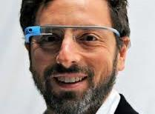

Famous Immigrant Americans from Russia & South Africa
Sergie Brin
Founder of Google
Elon Musk
SpaceX & Tesla

Slide 55


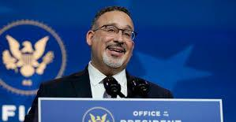
Famous Americans from a Spanish Speaking Background
Dr. Quinones
Neurosurgeon & Scientist
Jennifer Lopez
Actress, singer, dancer, fashion designer, producer & businesswoman
Dr Alfredo Quinones
Dr. Miguel Cardona
US Secretary Education

Slide 56

If we want a flower to grow
We don’t achieve it by stretching the stem
but
by
providing
the appropriate nutrients
To ensure a bright and Joyful Future for all our Bilingual English Learners,
we must do what it takes to support their bilingual academic grade level achievement, & their emotional wellness…
56

Slide 57
Concluindo
Choose one
Write Response in the Chat
1 A new concept
1 A question
1 An action step

Slide 58
Dialogo

Slide 59


Thank you
LEER
mserpa@lesley.edu
Recommended Citation:
Serpa, M. L. (2021). Keynote FAMILIES IN MULTILINGUAL CONTEXTS: Building a Bright and Joyful Future for Our Dual Language Children in MA: ELPAC Meeting MA DESE, February 9 online

Slide 60
Prenatal through Grade 12 Family Engagement Framework: Diverse Family Communities
Olga Lopez, Family Engagement Specialist-DESE

Slide 61

Strengthening Partnerships
A Framework for Prenatal through
Young Adulthood
Family Engagement in
Massachusetts

Slide 62
Purpose
To create a roadmap to family engagement, which:
builds on existing family engagement frameworks,
integrates principles of equity and cultural responsiveness, and
provides an aligned approach to engaging with families.

Slide 63
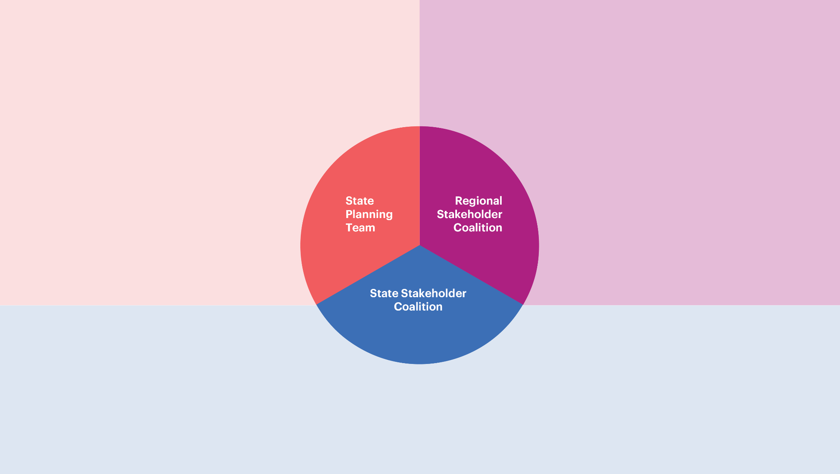
Background: MA Family Engagement Coalition
Early Intervention
Families and Parent Leadership
Networks
WIC
Regional DCG Offices
Department
of Early Education
and Care
Gail DeRiggi
Public schools
FCC
Home visiting
Regional DCF offices
CFCEs
Museums and Libraries
Department of
Public Health – Bureau of Maternal and Child Health
Suzanne Gottlieb
Roxanne Hoke-Chandler
Department of Elementary and Secondary Education
Kathy Rodriguez
Donna Traynham
Emily Taylor
Family Engagement and cultural Organizations
Head Start and EEC programs
Family Advocates and parent child home programs
Department of Public Health
Department of Children and Families
Department of Transitional Assistance
Department of Mental Health
Office of Refugees and Immigrants
Massachusetts Developmental Disabilities Council
Department of Early Education and Care
Department of Elementary and Secondary Education
Department of Higher Education
Children's Trust
University of Massachusetts
MA Board of Library Commissioners

Slide 64
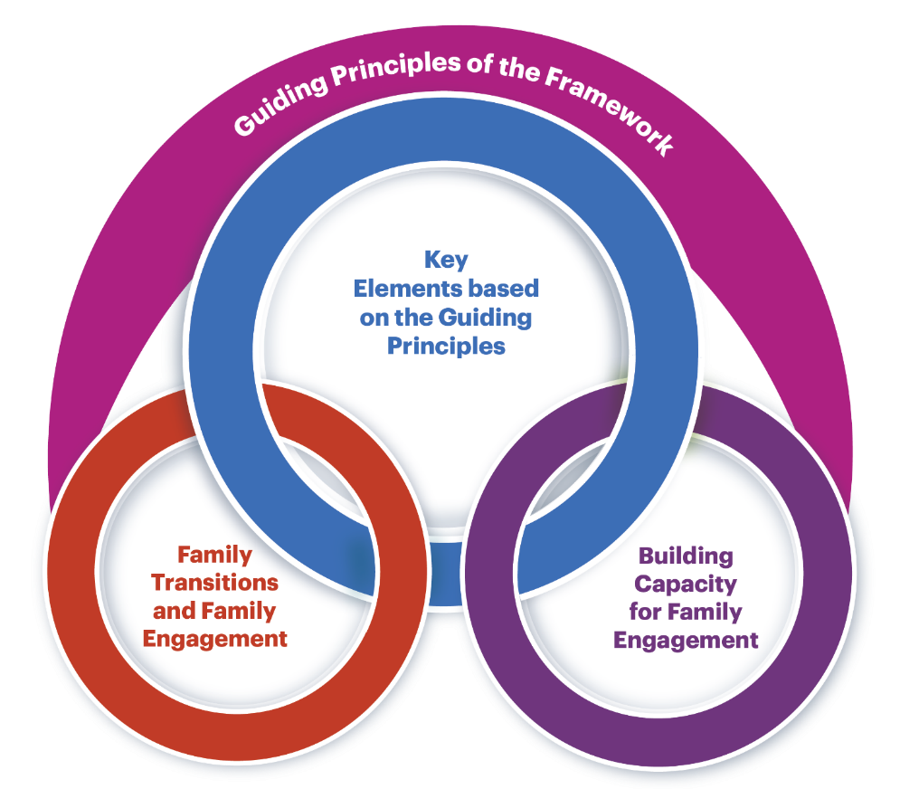
Framework Design

Slide 65
Framework Guiding Principles
Each family is unique and all families represent diverse structures. Family engagement includes genuine efforts to understand each family’s beliefs, values, priorities, goals and aspirations. Families and practitioners make joint decisions and share responsibility in a successful partnership.
Diversity is expressed and experienced at multiple levels such as (but not limited to) race, religion, ethnicity, culture, language, family structures, ability, sexual orientation, socio-economic status, and educational level. Acknowledging and accepting the need to engage all families is essential for successful engagement of diverse families and includes recognizing the strengths that come from their diverse backgrounds.
Building a respectful, trusting, and reciprocal relationship is a shared responsibility of families, practitioners, organizations, and systems. This positive relationship has the individual family’s strengths and assets at its center.
Families are their child’s first and best advocate. This premier role puts families in a unique position to nurture their children’s growth and development and to help practitioners become knowledgeable about their child.
Equity is the eradication of privilege, oppression, disparities, and disadvantage. Family engagement must be equitable. Equitable family engagement comprises intentional and meaningful engagement activities and systems for all families or groups of families irrespective of families’ level of or approach to engagement. Providing equity-based opportunities for family engagement can help family members become effective advocates for their children.

Slide 66

Framework Elements

Slide 67
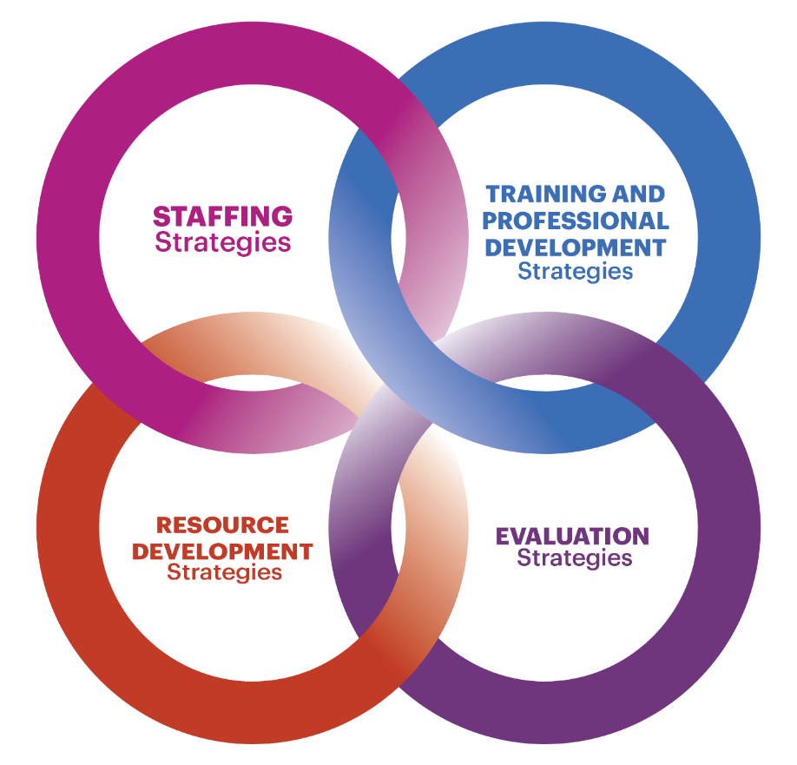
Strengthening Capacity

Slide 68

Break

Slide 69

ELPAC Member Panel
Shrewsbury/Nantucket/Boston

Slide 70

Shrewsbury Public Schools ELPAC
Kathleen Lange-Madden, ELE Director preK-12
Jean Coelho, ELPAC co-leader & parent of 6th grade son
Kaori Sasaki, ELPAC co-leader & parent of 6th grade daughter &
9th grade son

Slide 71
When did the Shrewsbury ELPAC start & how often does it meet?
The SPS ELPAC started in the fall of the 2019-20 school year, with six dedicated parents.
Surprisingly, these six parents had a child, or had children, attending each of the five elementary schools, two middle schools, and the one high school.
We met on a monthly basis, from 5:00-6:00pm at one of the middle schools. We sometimes met for more than one hour.
The COVID pandemic did derail our efforts and we didn’t meet for the remainder of the school year (March-June)

Slide 72
When did the Shrewsbury ELPAC start & how often does it meet? continued
Four of the six ELPAC parents returned to home country or moved to another district.
The remaining two parents continued collaborating with the ELE Director to strengthen the SPS ELPAC and are participating in this February 9-10, 2021 ELPAC Convening.
Together, we have streamlined our ELPAC’s goal, as well as taken equal responsibility to increase parent participation and take steps to work toward our goal.

Slide 73
How does Shrewsbury support and empower ELPAC members? and What are our recommendations for starting an ELPAC?
Persevere – keep reaching out until you find the one or two parents who understand and share your vision of what an ELPAC can become
Plan & Communicate – monthly ELPAC meetings require behind the scenes planning, meeting, and continuous communication
Divide & Conquer – capitalize on each other’s strengths and delegate tasks

Slide 74
Shrewsbury ELPAC Norms established by the 2019-20 group and continues for 2020-21 group
Be present (don’t let your worries & cell phones interrupt your participation in the meeting )
Look at the people in our group and don’t look at computers, cell phones (unless we need them for our meeting)
Everyone who comes to the meeting is important
Share your ideas because we need them
If you don’t understand, make your voice heard and say, “Wait! What?”
Know we are a team and we share a goal

Slide 75
2019-2020 ELPAC goal vs. 2020-21 ELPAC goal
“We are a volunteer organization made up of parents, caregivers, and educators. We have formed this ELPAC to have an official setting to increase communication and strengthen the home to school partnership. We want to be able to support students who are working with English language teachers and to support students who have worked with English language teachers.”
TO
“We are a volunteer organization made up of parents, caregivers, and educators. We have formed this ELPAC to have an official setting to increase communication and strengthen the home to school partnership. Our goal is to increase communication with and between our diverse families.”

Slide 76

NANTUCKET PUBLIC SCHOOLS
Student Population ~1600
ELS~ 18 %
Multilingual- 40%
80% of Els speak Spanish
Most Els are from El Salvador
Panelists:
Doris Avelar- President
Maria Gutierrez- Member
Maria Rubina-Bilingual Support Specialist
Kelly Cooney- EL Director

Slide 77
NPS ENGLISH LEARNER PARENT ADVISORY COUNCIL
2014-2017 | EL Parent Group was established
2017 | Immigration info sessions for parents were held
2018-2019 | NPS ELPAC conducted social and informational meetings with ELPAC members and participants with entertainment, food, childcare and school committee introductions. Met every 5 weeks
2019-20 | Progress on by-laws, introduction of dual language programs, morning ESL classes for adults and after school program at elementary school. With Covid meetings focused on Remote learning/ Covid updates etc. Met every 6 weeks.

Slide 78

NPS ELPAC for SY 2020-21 and beyond
Approve by-laws;
Get back on track with non- Covid related meetings;
Explore Dual Language programming;
Message parent concerns about Hybrid;
Survey parents on other priorities;
Present at school committee

Slide 79
How does NPS support and empower elpac members?
How does NPS support and empower ELPAC members?
Provide funding for food & supplies for meetings Assist with recruitment and meeting organization Supports EL PAC school committee presentation planning Responded to request for adult ESOL and after elementary help Support EL PAC by arranging town health director & superintendent participation in meetings re: Covid Work as team to build the EL PAC as a strong advocacy group

Slide 80
Boston Public Schools
Office of English Learners and
District English Learner Advisory Committee
Presentation to MA Department of Elementary & Secondary Education ELPAC Leadership Conference
February 9, 2021
Ahmed Noor, Director of EL Community Outreach
Vera Johnson, Director of Newcomer Assessment & Counseling Center
Marie Stinfil, DELAC Member

Slide 81
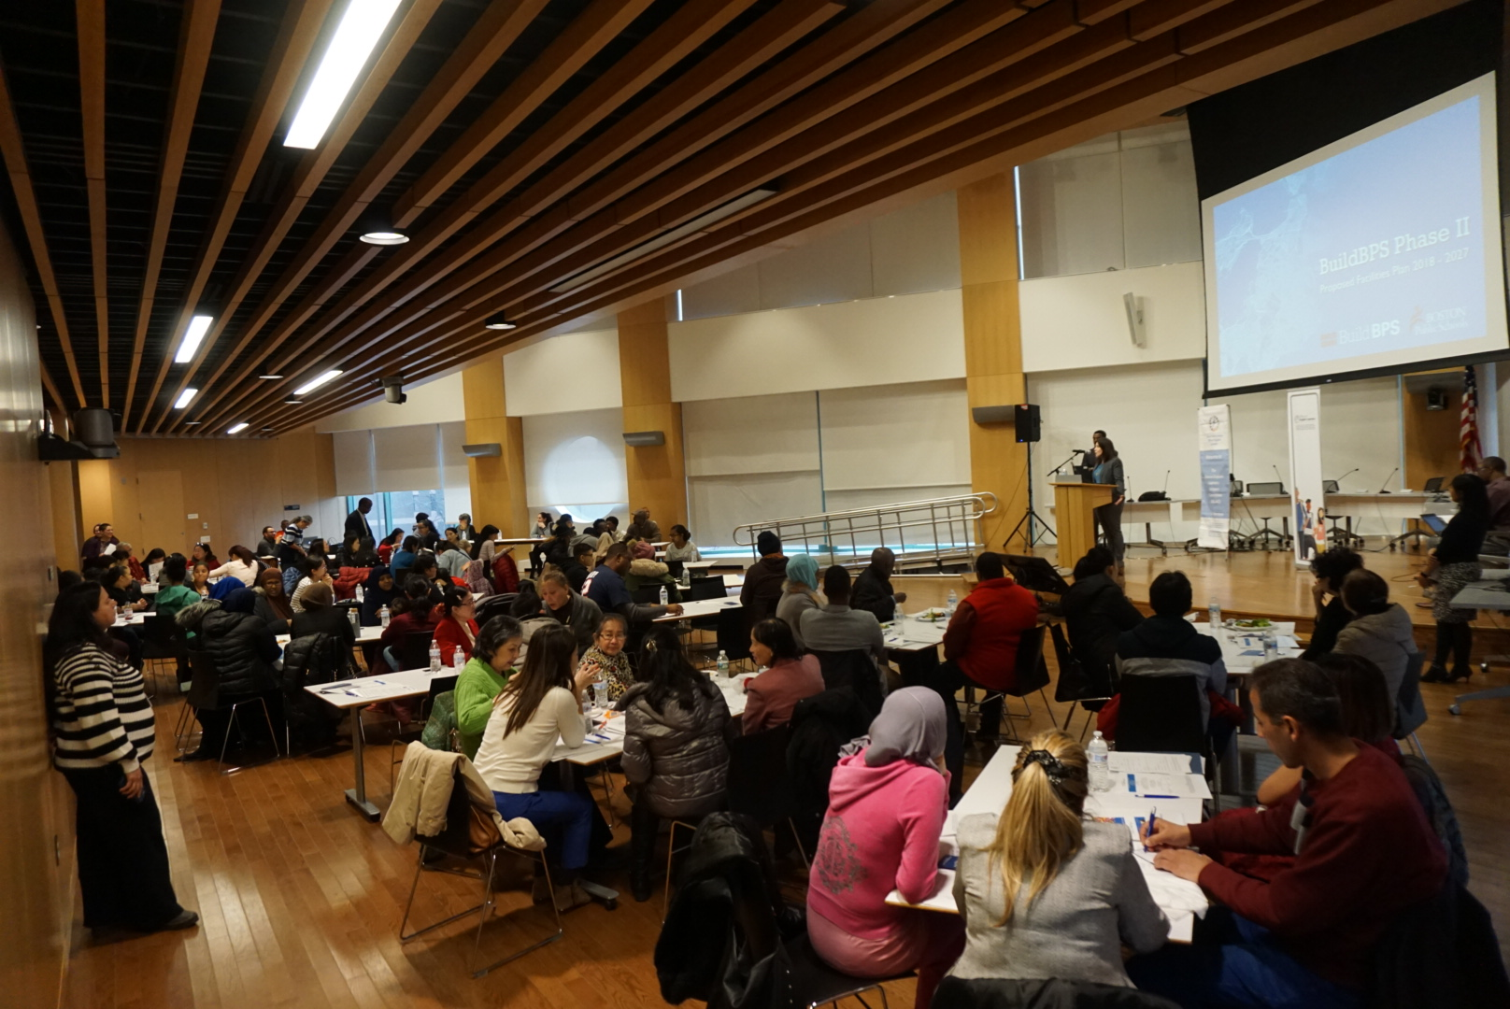
How does Boston Public Schools support and empower ELPAC members?
Engaging &
Building
Supporting &
Empowering
Enhancing &
Expanding
Engaged stakeholders
-Hosted 3 annual EL parent conferences per year
-Hosted parent-centered trainings in native language
Developed organizational structure with bylaws
Established executive team to manage DELAC
Host and facilitate monthly meetings in native language through district level language-based ELACs
Provide technology support
-District platforms
-Chromebooks
Engaging CBOs to provide native language courses for parents
Coordinate heritage month activities that celebrate culture and language
Hiring EL parents to support other parents.
Enhance district’s visibility at DELAC meetings
- Inviting central office departments to present
-Integrate feedback into policies and initiatives with accountability measures
Expand DELAC’s visibility and influence
-Formal attendance within other district parent groups
-Increase visibility within district feedback cycle for major initiatives/decisions

Slide 82
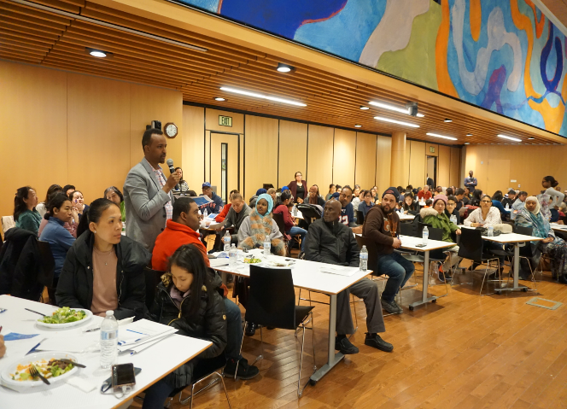
Boston Public Schools
How does Boston Public Schools support and empower ELPAC members?
Newcomer Assessment & Counseling Center (NACC):
Fill Out EL Parent Intake Form for referrals and share information with families about ELACs & DELAC
  How to join the group
  Upcoming events
  Meeting dates
Disseminate information to families during district Parent Engagement Meetings and presentations
Office of English Learners LOOK Act Parent Team:
Connect families to the following resources
  Access to school and community-based services
  Food/P-EBT Cards
  Housing
  ESOL
  Job /Technology Trainings
  Connects parents with supports available within the district for student concerns
Additional Support

Slide 83
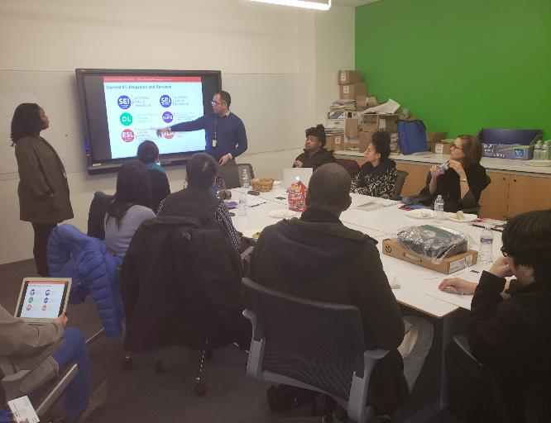
Boston Public Schools
How does being a DELAC member support my child’s education?
As DELAC members, parents:
Provide feedback to OEL/BPS on major policies that impact services or programs for English Learners
Learn how the BPS system works and become better advocates for their children and community
Share interests, concerns, or ideas to improve educational services for their children
Make additional requests:
  Data
  Parent Workshops
  Resources
Benefits for
Parents

Slide 84
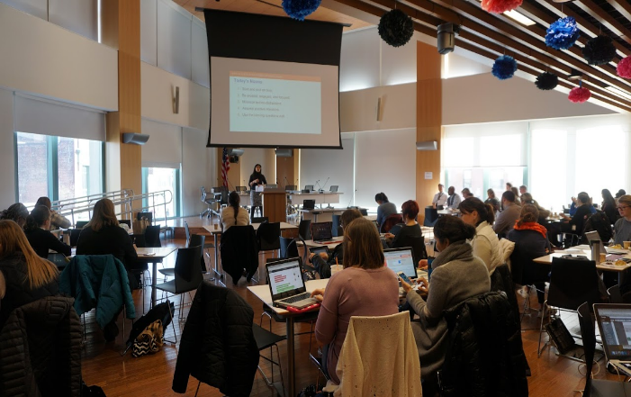
Boston Public Schools
How does being a DELAC member support my child’s education?
As DELAC members, parents can also:
Network with other parents
  DELAC/ELACs
  Represent DELAC/ELAC at other district level meetings
    City Wide Parent Council
    BPS SpedPAC
    BPS Community Engagement Advisory Council
Advocate with central office for direct supports for school related issues
Are encouraged to share what we hear/learn with other parents
Benefits for
Parents

Slide 85
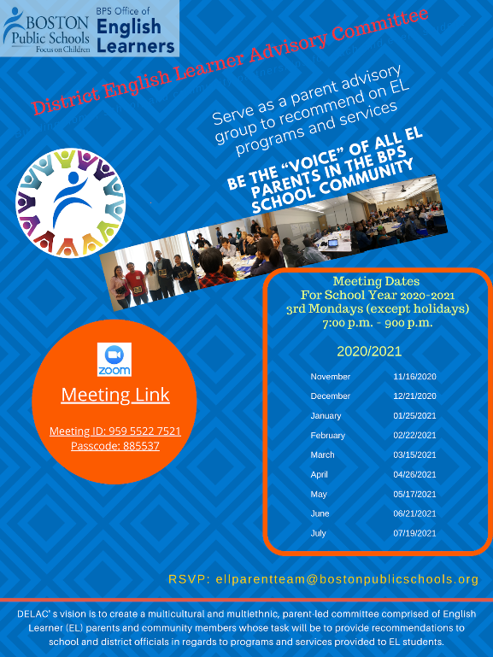
Boston Public Schools
DELAC
ELACs
Meetings
DELAC meets monthly.
OEL and DELAC Executive team co-plan the agenda
OEL staff facilitates the meeting
Interpretation is provided
Parent requests are responded
OEL/central office provides policy and initiative updates
Each language-based ELAC meets monthly.
7 Different language-based ELACs
EL Family Resource Specialist who speaks the language facilitates the meeting
Meetings are conducted in the native language
Community Based Organizations are invited to share direct service opportunities with parents.
Parents network with other parents of the same language group

Slide 86
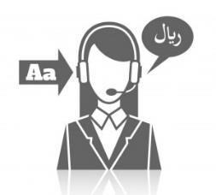
Networking
Parents with Parents/District with Districts

Slide 87
Families with Family Networking
If you feel comfortable sharing your contact information, please enter it on the form in the chat
Creating a community and monthly check-ins
Leading, recruiting and creating a trusting, safe environment
Adult Learning - facilitation moves, tips and strategies
Challenges and opportunities
Questions? aparker@fcsn.org

Slide 88
Districts with Districts Networking
How has the ELPAC helped make changes in your district or school?
How does your district support and empower ELPAC members?
What have you heard today that you’d like to follow up with your district ELPAC and/or families?

Slide 89
Share out, Next Steps, Survey

Slide 90
THANK YOU
The Office of Language Acquisition (OLA)
www.doe.mass.edu/ele/
EL@doe.mass.edu
www.doe.mass.edu
75 Pleasant Street, Malden, MA 02148

