Slide 1

ELPAC Convening Day 2
Break out Sessions

Slide 2

BREAK OUT SESSIONS
=
Strengthening Family Engagement Initiative: Train the trainers building capacity , Donna Traynham, Early Learning Team Lead, Olga Lopez, Family Engagement Specialist
Supporting Preschool Students, Michelle Godfrey, Cambridge Coordinated Family and Community Engagement Grantee
Preparing for College and Career, David Baird, CCTE LEE Fellow & Jennifer Gwatkin, Early College Pathways Coordinator
Promoting Literacy at Home, Lena Marecki, ESOL Family Literacy Instructor, Jaqueline Portillo, Parent Learner, Barbara Krol-Sinclair, Director

Slide 3

Train the Trainers Building Capacity
The English Learner Parent Advisory Council (ELPAC) Leadership Convening
Wednesday, February 10
Presentation by:
Olga Lopez, Family Engagement Specialist
MA Department of Elementary and Secondary Education – Office of Student and Family Support
&
Donna Traynham, Early Learning Team Lead
MA Department of Elementary and Secondary Education – Office of Student and Family Support

Slide 4

Train the Trainers Building Capacity
  Why the Train the Trainers Matters ?
  Increase the capacity of practitioner
  Increase the skills and capacity of families.
  Implement engagement activities
  Position practitioners, organizations, and communities, in partnership with families, to move from the planning and designing phase to the actual implementation of authentic family engagement strategies that meet the individual needs of the families

Slide 5

Introduction to the Framework Module 1
Provide a scaffold for the development of programs
Develop policies and practices that align from prenatal to young adulthood
Support meaningful family engagement across health, human services and education.

Slide 6

A Deeper Dive Module 2
  The Guiding Principals
  The four sequential elements
  The Framework includes goals and practices for each element.
  Transitions are vital opportunities to engage families.

Slide 7

Culturally Responsive Family Engagement Module 3
Building relational trust
Acknowledging your own biases and not making assumptions
Learning about students and their families
Valuing families’ funds of knowledge and working with a strengths-based approach
Meeting families where they are and reaching beyond the families that “show up”

Slide 8
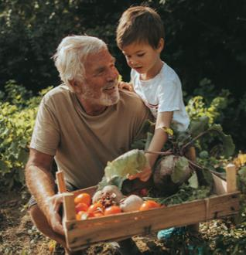
Where Do We Go From Here?
Strengthening Capacity : Module 4
Types of Transitions:
Developmental
Everyday
Systems Transitions
Unanticipated Transitions
Strengthening Capacity in:
Staffing
Training and Professional Development
Resource Development and
Evaluation

Slide 9



Let’s talk
Michelle Godfrey
Cambridge Coordinated Family and Community Engagement Grantee

Slide 10
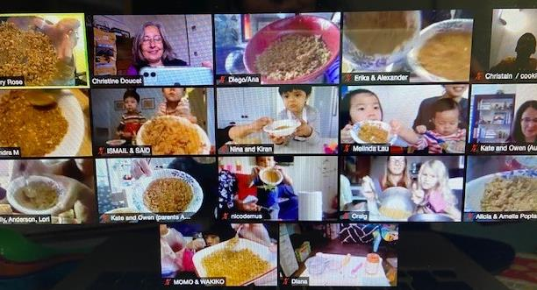
Coordinated Family and Community Engagement Programs offer:
parent/child playgroups and activities
parent education workshops
programs just for Dads
community building events
access to information, resources and referrals
opportunities to better understand your child’s development using
the Ages and Stages Questions
CFCE programs are located in every community across the state.
  https://eecweb.eec.state.ma.us/childcaresearch/CFCE.aspx

Slide 11

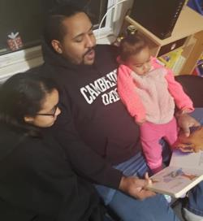
How can we as parents support our young children's literacy development during these challenging times?

Slide 12
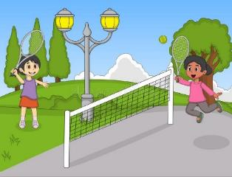
The Brain
How do our children’s brains grow and develop?
  Serve and Return
  It is amazing how many words our children learn during these years!
Notes:
12

Slide 13
Talking Matters!
Talk with your child as much as possible...
    while doing everyday activities in the language you speak the best
    Play Talk “versus” Business Talk
      Talking, reading, playing, singing and telling stories are all ways to do play talk
    OWL (Observe, Wait, Listen)
Notes:
13

Slide 14

Reading
Read with your child every day. Talk as much as you read.
Interactive Reading
  Using books in your own language
  Wordless books
Notes:
14

Slide 15
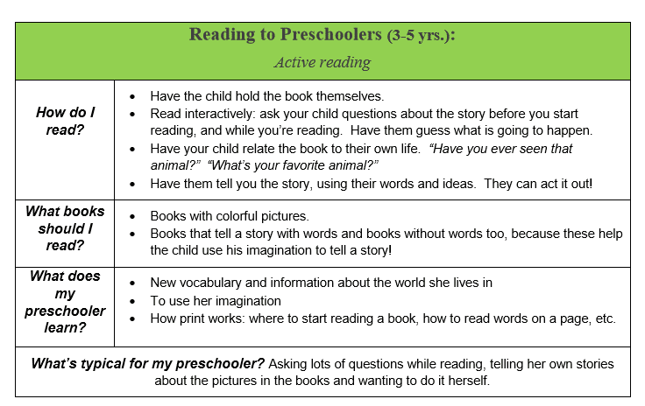
Reading
Notes:
15

Slide 16
Things to Remember
You are your child’s first teacher.
Talking in the language you speak best
Talk with your child as much as possible doing
everyday activities.
Read with your child every day. Talk as much as
you read.

Slide 17
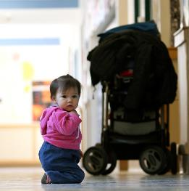
Tips and Tools
  https://letstalkcambridge.org/

Slide 18
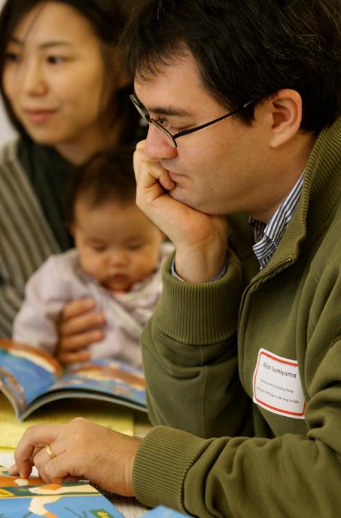
Questions?

Slide 19
College and Career Ready
David Baird and Jennifer Gwatkin,
Office for College, Career, & Technical Education

Slide 20
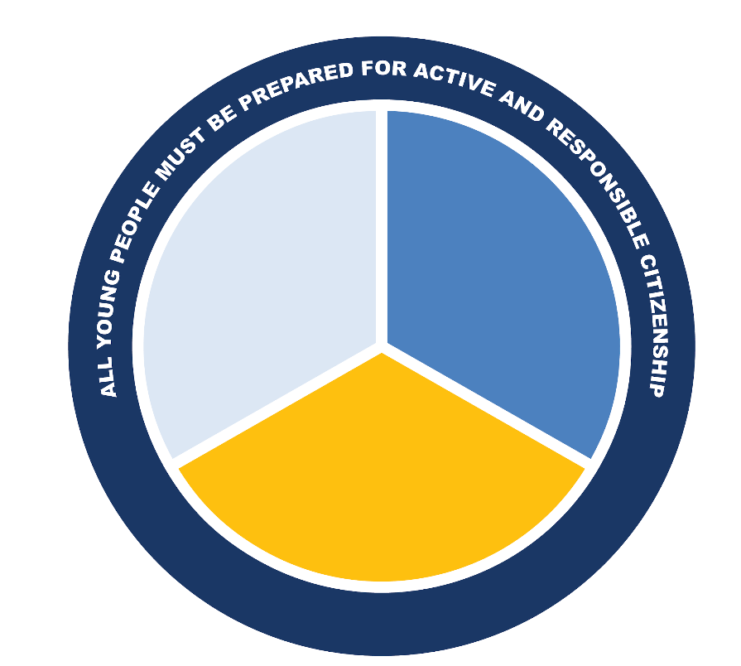
College, Career, and Civic Ready
BESE and BHE approved in 2016:
Readiness means an individual has the requisite knowledge, skills and experience in the academic, workplace readiness and personal-social domains to successfully navigate to completion an economically viable career pathway in a 21st century economy and engage in active civic life.
Workplace
Readiness
Academic
Learning
Knowledge, Skills, and Experiences for College and Career Readiness, & Civic Preparation
Personal/Social Development

Slide 21
Career Development Education
In an exemplary CDE model, students participate in a well-designed sequence of CDE activities that become progressively deeper and more intensive as the students gain skills and maturity. This sequence of CDE activities help students move from the cognitive to the experiential..
CAREER AWARENESS
CAREER EXPLORATION
CAREER IMMERSION
Students learn about the world of work, including its broad range of industries and occupations:
Students learn through activities and work experiences that help them explore career options.
Students engage in immersive work experiences that prepare them for choices about post secondary education and careers:
Job Shadowing
Job Rotation
Informational Interviews
Job Skills Portfolio
Community Service
Leadership in Career Clubs
Contextual Learning
Labor Market Information
Career Speakers
Career Days/Fairs
Career Interest Inventories
Company Tours
Internships
Capstone Projects
Entrepreneurial Enterprise
Clinical Experiences
Part-Time Employment
CVTE Cooperative
Education
Apprenticeship
CDE is led by Education in partnership with Business/Industry

Slide 22



MY CAREER AND ACADEMIC PLAN (MyCAP)
DISCOVER:
Skills
Interests
Talents
Strengths
PLAN:
Course-taking
Career Development
Post-secondary options
ACT:
AP, Early College, IP, Contextual Learning experiences
Applications and decision-making

Slide 23
Enroll in a High-Quality Pathway Program
Participation in a designated pathway contextualizes student learning, engages students in their high school experience, and can lead students to opportunities for meaningful careers in the relevant industry sector upon their completion of needed postsecondary education and training.
Programs in Massachusetts:
Career Vocational and Technical Education (CVTE) Pathways
Innovation Pathways (IP)
Early College Pathways (EC)

Slide 24
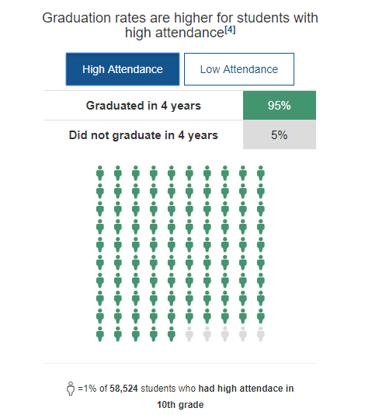
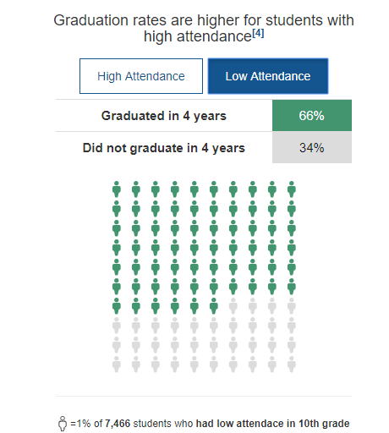
Attendance Matters
High Attendance
Low Attendance

Slide 25
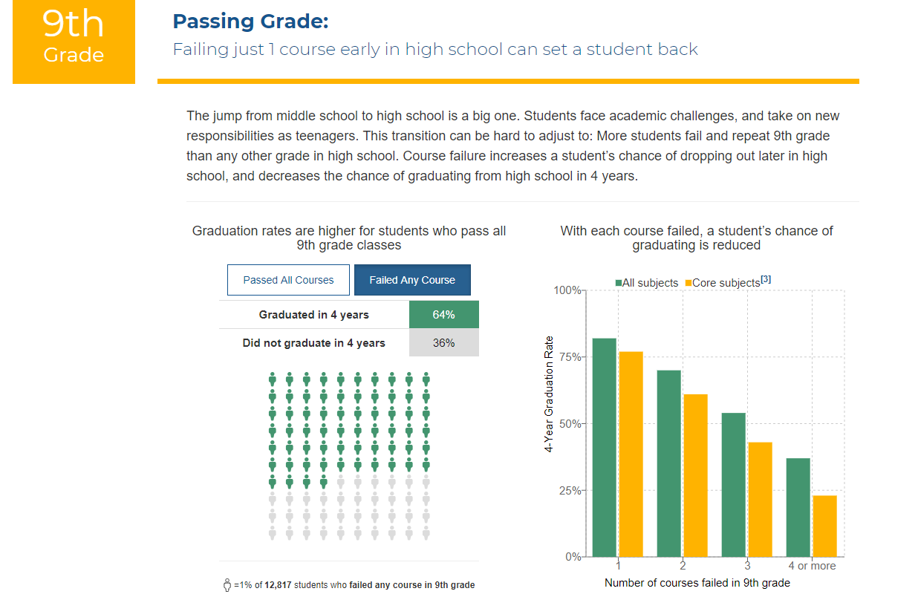
9th grade

Slide 26

Your Questions
This Photo by Unknown Author is licensed under CC BY

Slide 27
Contact Information
David Baird
LEE Fellow
Office for College, Career, and Technical Education
g.david.baird@mass.gov
Jennifer Gwatkin
Innovation Pathways Lead
Office for College, Career, and Technical Education
jennifer.a.gwatkin@mass.gov

Slide 28

Promoting Literacy at Home
Presentation by:
Lena Marecki, ESOL Family Literacy Instructor
Jaqueline Portillo, Parent Learner
Barbara Krol-Sinclair, Director

Slide 29
Today we will explore how we can increase bilingual literacy at home.
We will consider:
Digital resources
2. Activities that take place away from screens

Slide 30
First, let’s look at online resources.
How can we support our children’s literacy at home, outside of their school day?

Slide 31



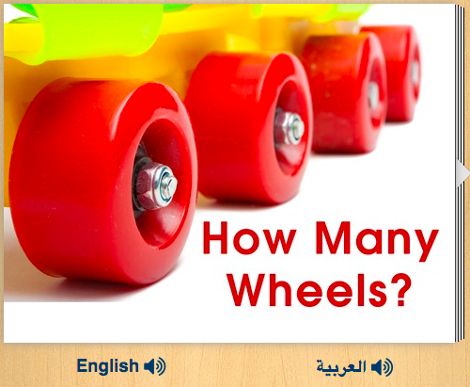
Unite for Literacy
  Free access to all books
  All texts available in English and Spanish
  Narration available in 52 languages!

Slide 32
Here are other great resources that
explore a range of subjects:

Slide 33
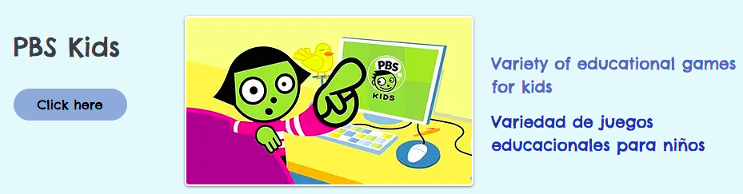

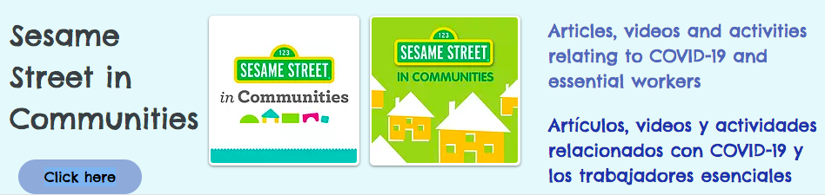
Online resources

Slide 34
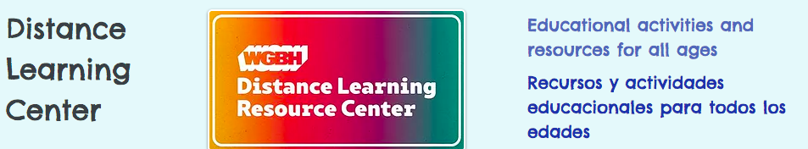
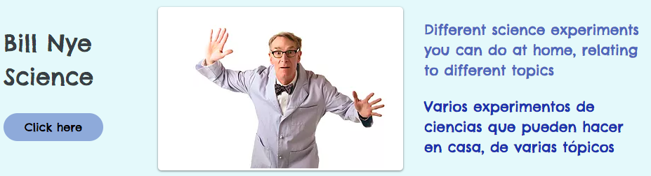
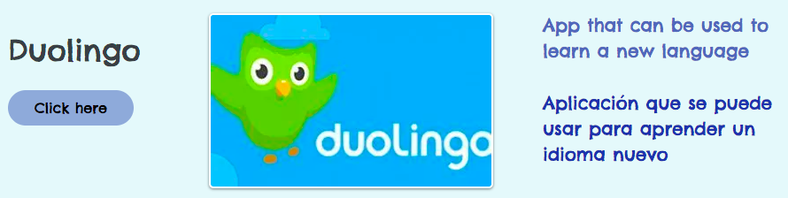
More online resources

Slide 35
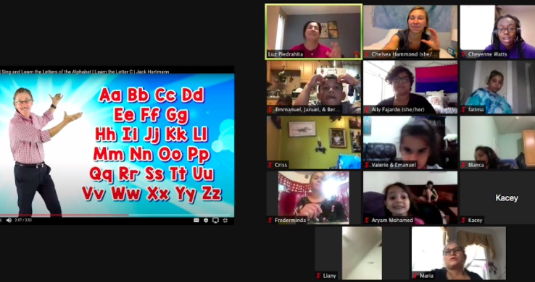
Zoom class

Slide 36
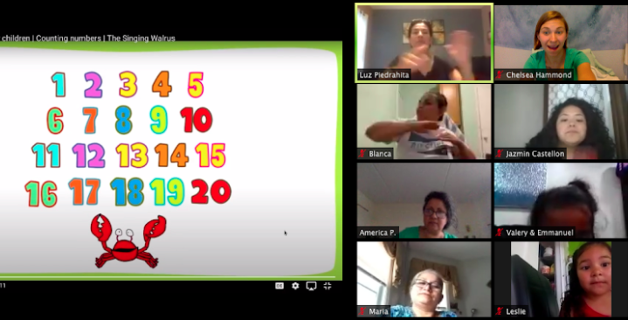
Zoom class2

Slide 37
And ideas for when we need a break from screens.

Slide 38


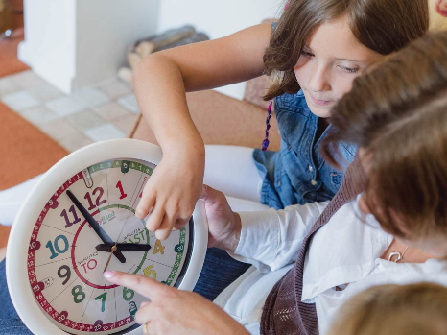

activities
Reading physical books
  Many libraries in MA offer pick-up services right now.
Writing poems, stories, rhymes, and letters
Arts and crafts
  Look on Pinterest or YouTube for inspiration
Reading and following recipes
Board games
Telling time
Working with magnets

Slide 39
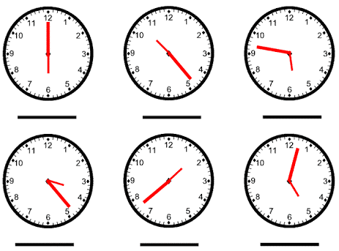
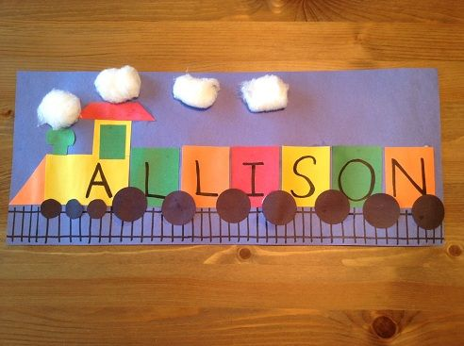
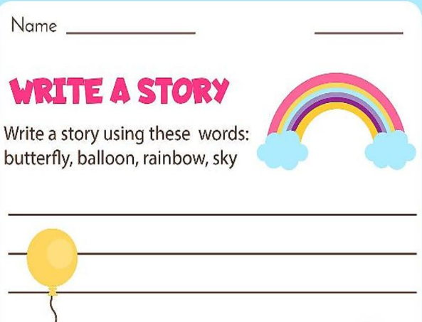


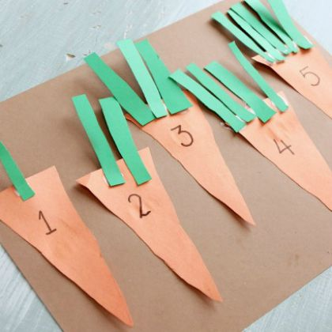
More activities

Slide 40

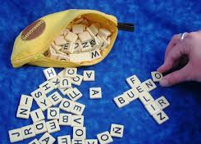
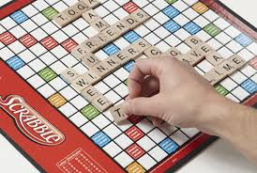

Some more activities

Slide 41
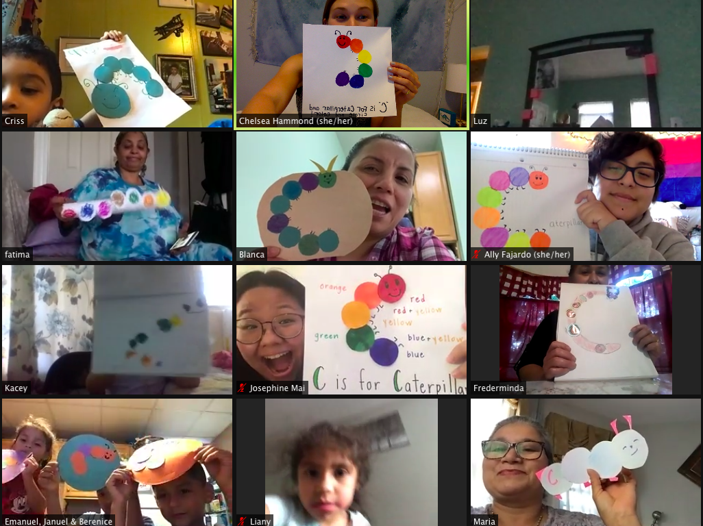
Zoom class 3

Slide 42
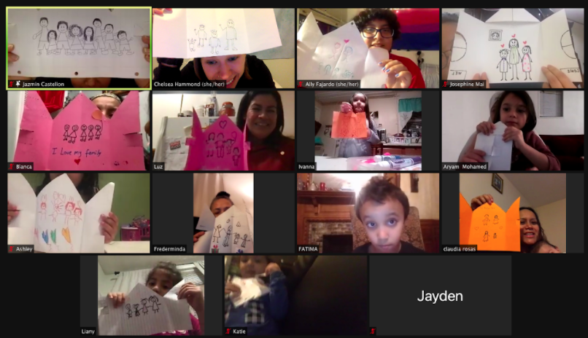
Zoom class 4

Slide 43
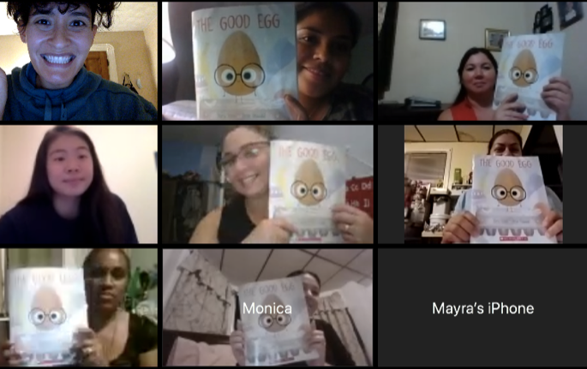
Zoom class 5

Slide 44
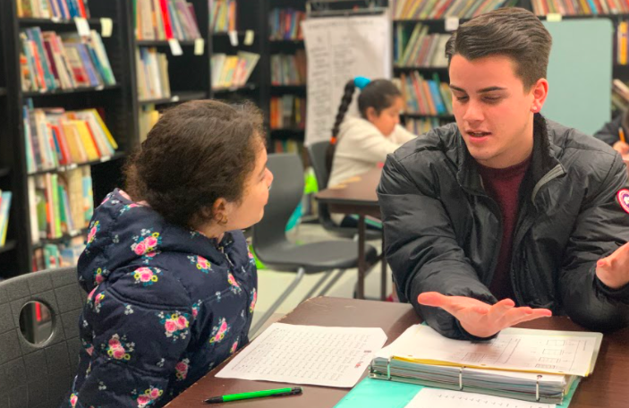
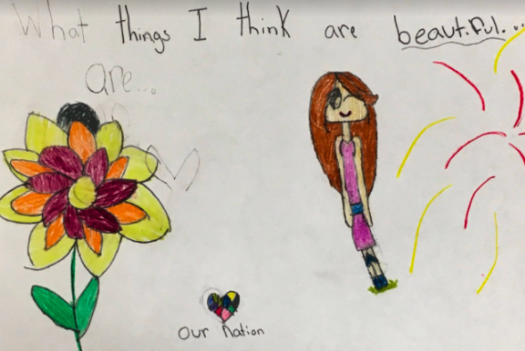
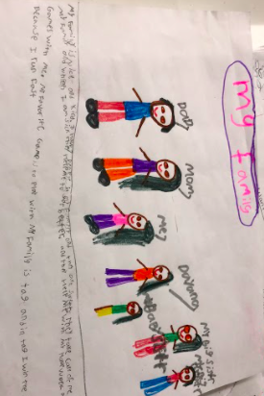
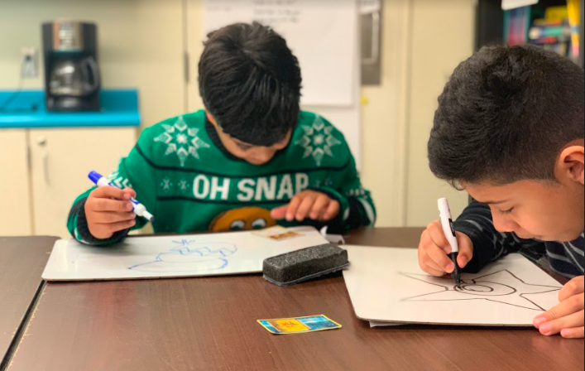
Art activities

Slide 45
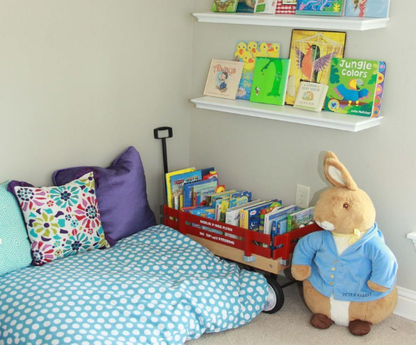

Create a space
If possible, create a space where children are excited to read, write, and learn.
Items to consider:
  Book baskets
  Whiteboards, chalkboards
  Art supplies

Slide 46
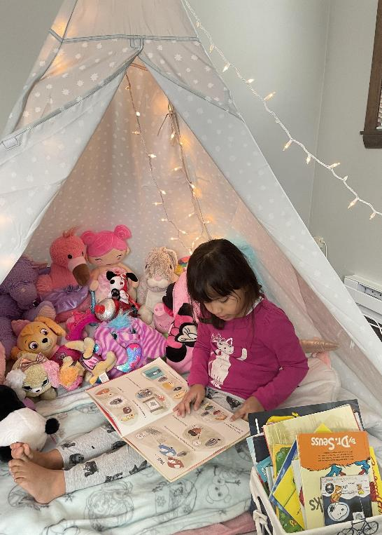
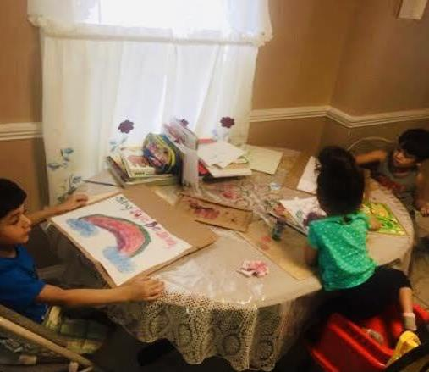
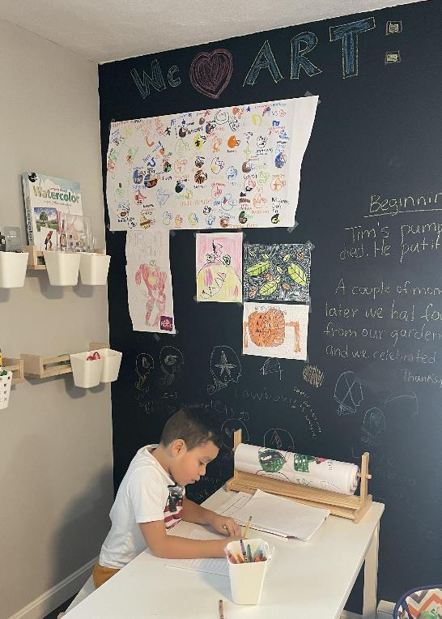
Reading spaces

Slide 47
A word from a parent learner,
Jaqueline Portillo

Slide 48
Questions?

