Slide 1
Day 2: Supporting your Child’s Education
February 10, 2021

Slide 2
Keynote: Family, School and Community Engagement Partnership Fundamentals
1
Welcome, Logistics, & Introductions
2
Networking
Parents with Parents/District with Districts
3
4
Next Steps and Survey

Slide 3
Welcome to the first English Learner Parent Advisory Council Leadership Convening

Slide 4
Welcome, Logistics, & Introductions
Judith Magloire, Office of Language Acquisition

Slide 5
WEBINAR REMINDERS
Camera: great to see your faces and connect but understand that you may need to turn off at times.
Microphone: please keep on mute unless sharing with the group.
Chats: Comments and questions will be addressed during the reflection session.
Engagement: Can Do Attitude Welcomed ☺

Slide 6
Desired Outcomes
Agenda
2:00-2:10
Welcome, Logistics, & Introductions
2:10-2:40
Keynote: Family, School and Community Engagement Partnership Fundamentals
2:40-2:50
Break
2:50-3:10
Breakout Sessions
3:10-3:40
Networking
3:40-3:50
Group Share
3:50-4:00
Next Steps & Survey
We will leave today:
Understanding ways how stakeholders can collaborate.
Planning our next steps

Slide 7
ELPAC Convening Presenters: Day 2
Donna Traynham, Early Learning Team Lead
Michelle Godfrey, Cambridge Coordinated Family and Community Engagement Grantee
David Baird, CCTE LEE Fellow
Jennifer Gwatkin, Early College Pathways Coordinator
Lena Marecki, Intergenerational Literacy Program, Chelsea Public Schools

Slide 8
WEBINAR REMINDERS
Camera: great to see your faces and connect but understand that you may need to turn off at times.
Microphone: please keep on mute unless sharing with the group.
Chats: Comments and questions will be addressed during the reflection session.
Engagement: Can Do Attitude Welcomed ☺

Slide 9
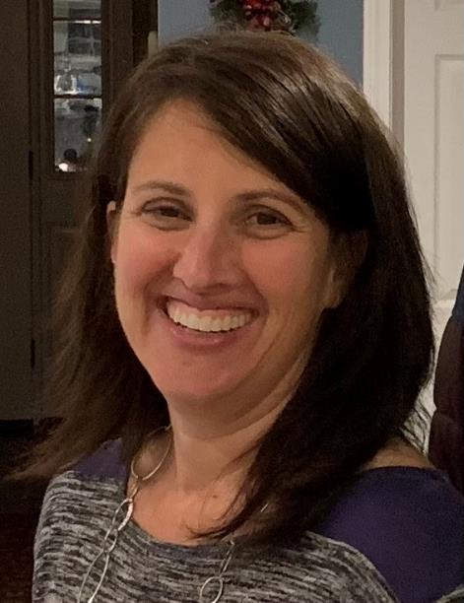
Keynote: Family, School and Community Engagement Partnership Fundamentals
Donna Traynham, Early Learning Team Lead

Slide 10
The English Learner Parent Advisory Council (ELPAC) Leadership Convening
Wednesday, February 10, 2021
Presentation by:
Donna Traynham, Early Learning Team Lead
MA Department of Elementary and Secondary Education – Office of Student and Family Support
&
Olga Lopez, Family Engagement Specialist
MA Department of Elementary and Secondary Education – Office of Student and Family Support

Slide 11
Strengthening Partnerships
A Framework for Prenatal through Young Adulthood Family Engagement in
Massachusetts

Slide 12
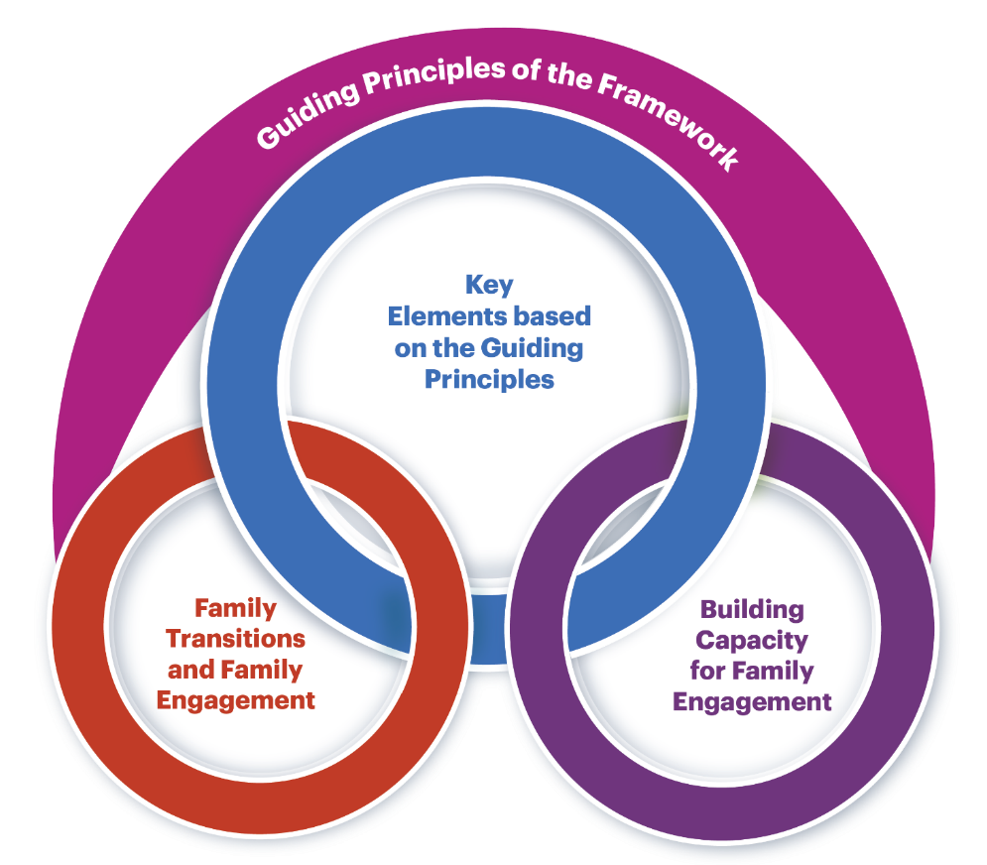
Framework Design

Slide 13
Framework Guiding Principles
Each family is unique and all families represent diverse structures. Family engagement includes genuine efforts to understand each family’s beliefs, values, priorities, goals and aspirations. Families and practitioners make joint decisions and share responsibility in a successful partnership.
Diversity is expressed and experienced at multiple levels such as (but not limited to) race, religion, ethnicity, culture, language, family structures, ability, sexual orientation, socio-economic status, and educational level. Acknowledging and accepting the need to engage all families is essential for successful engagement of diverse families and includes recognizing the strengths that come from their diverse backgrounds.
Building a respectful, trusting, and reciprocal relationship is a shared responsibility of families, practitioners, organizations, and systems. This positive relationship has the individual family’s strengths and assets at its center.
Families are their child’s first and best advocate. This premier role puts families in a unique position to nurture their children’s growth and development and to help practitioners become knowledgeable about their child.
Equity is the eradication of privilege, oppression, disparities, and disadvantage. Family engagement must be equitable. Equitable family engagement comprises intentional and meaningful engagement activities and systems for all families or groups of families irrespective of families’ level of or approach to engagement. Providing equity-based opportunities for family engagement can help family members become effective advocates for their children.

Slide 14
Framework Elements

Slide 15
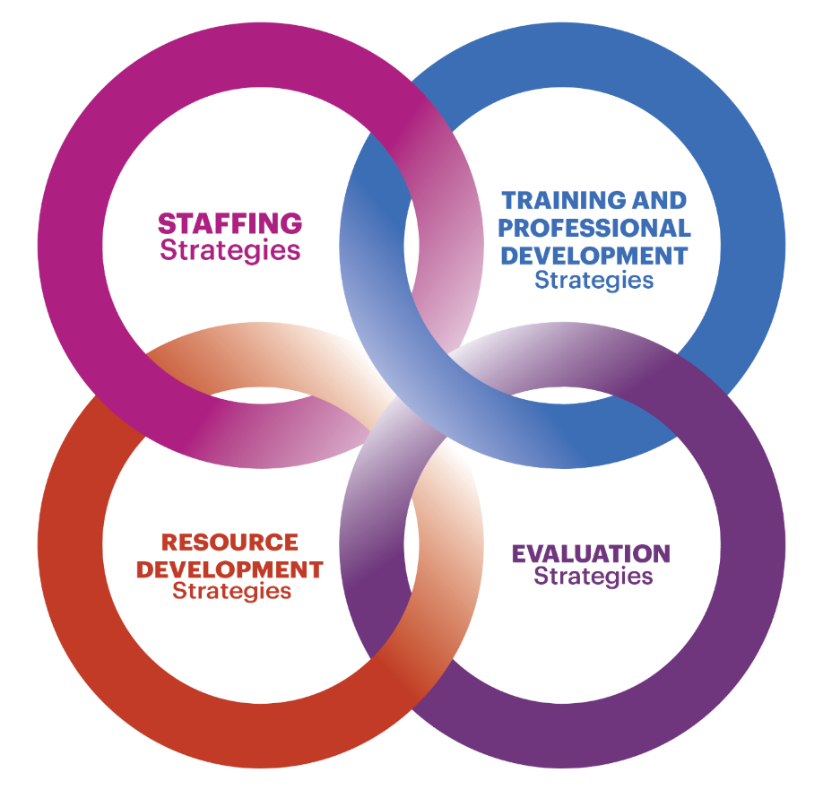
Strengthening Capacity

Slide 16
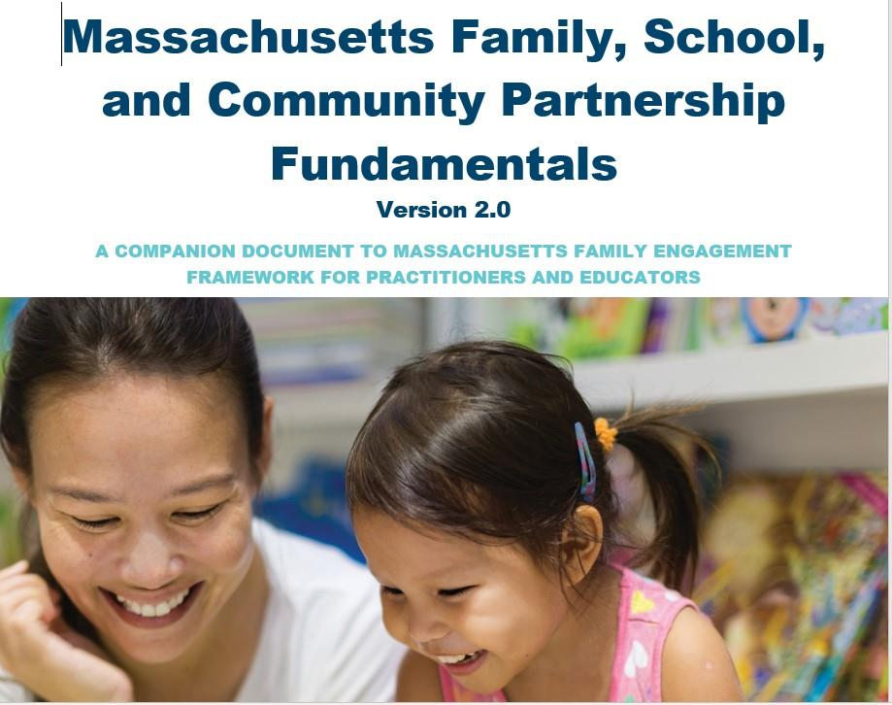
A Family Engagement Self-Assessment Tool

Slide 17
MA Family, School and Community Partnerships Fundamentals – What Is It?
A self-assessment tool for districts and schools to utilize as they reflect on their current family engagement practices;
Originally modeled after the National Parent Teacher Association (PTA) standards
Originally developed by the Board of Elementary and Secondary Education’s Parent and Community Engagement and Involvement Advisory Council (PCEIAC);
Defines guidelines and research-based practices for the engagement of families, schools, and communities in supporting equitable learning opportunities for students;
Revised in 2020 to align with our state’s new family engagement framework

Slide 18
Components of the Fundamentals Document
5 sections to the self-assessment
Building Positive Relationships
Supporting Family Well-Being
Promoting Pathways for Partnerships with Families
Supporting Child and Youth Development, Learning, Health and Well-Being
Building Capacity of the Staff
Continuum of Development and Implementation
Initiating
Progressing
Mastering
1-3 Indicators of Practice at Each Level of Development

Slide 19
Format and Key Features

Slide 20
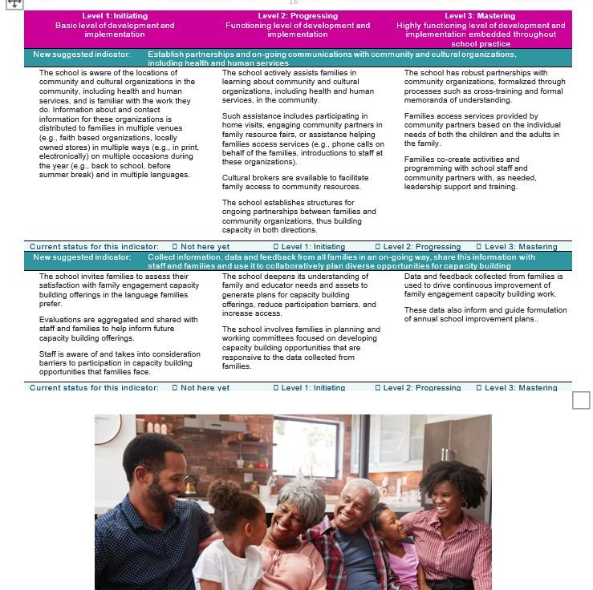
Building Capacity of Staff and Alignment with the Dual Capacity Framework

Slide 21
Implementation Examples and Strategies for Consideration
Community-Wide
Professional development
Building the capacity of administrators, educators and families
Strategies:
Importance of multiple perspectives when reflecting on family engagement
Importance of leadership commitment
Starting small

Slide 22
What ideas do you have for using the Fundamentals?

Slide 23
Networking
Parents with Parents/District with Districts

Slide 24
Parents with Parents
If you feel comfortable sharing your contact information, please enter it on the form in the chat
Creating a community and monthly check-ins
Leading, recruiting and creating a trusting, safe environment
Adult Learning - facilitation moves, tips and strategies
Challenges and opportunities
Questions? aparker@fcsn.org

Slide 25
Educators with Educators
How has the ELPAC helped make changes in the district or school?
How does your district support and empower ELPAC members?
What have you heard today that you’d like to follow up with your district ELPAC and/or families?

Slide 26
Next Steps & Survey

Slide 27
THANK YOU
The Office of Language Acquisition (OLA)
www.doe.mass.edu/ele/
EL@doe.mass.edu
www.doe.mass.edu
75 Pleasant Street, Malden, MA 02148

