Slide 1
OLA's FY26 Competitive Grants: FC181: English Learner Education Support FC189: Proficiency Outcomes in World Languages
May 21, 2025

Slide 2
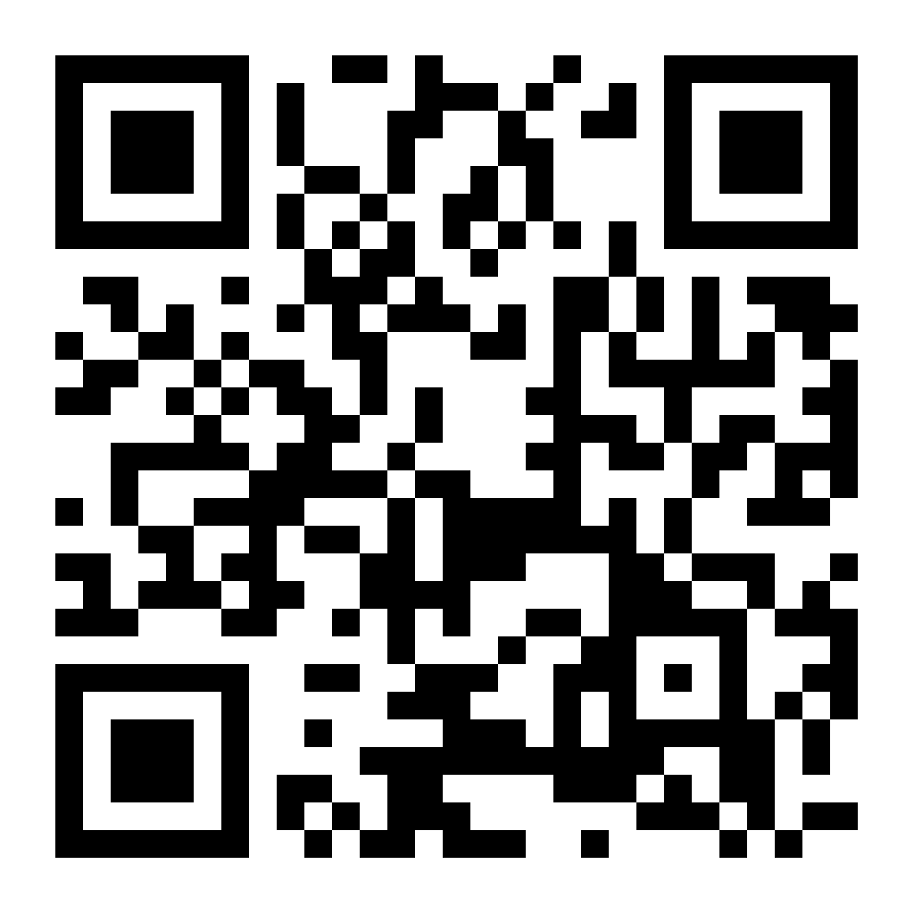
Agenda
Put questions on the Padlet as we go – we will take Q&A from the Padlet and post to the ELE Home Page .
If you have additional questions after the webinar, email them to Diana (diana.gentile@mass.gov).
Overview of FC181
What's new this year?
Overview of FC189
What's new this year?
Applying for the grant(s)
Timeline
GEM$ Reminders
Useful links

Slide 3
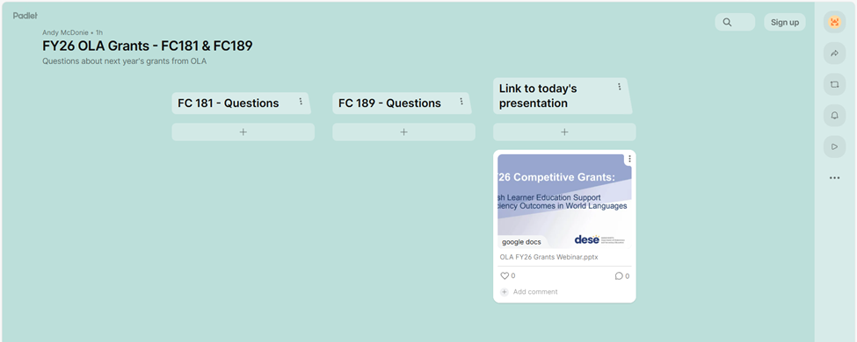
Padlet

Slide 4
Q&A
Because these are competitive grants, we will not have a Q&A session in this presentation.
Please add your questions to the Padlet linked in the next slide.
All questions submitted to the Padlet will be answered in a QA document that will be posted on the ELE home page along with this presentation.
If you have additional questions after this webinar, please email them to Diana.Gentile@mass.gov.

Slide 5
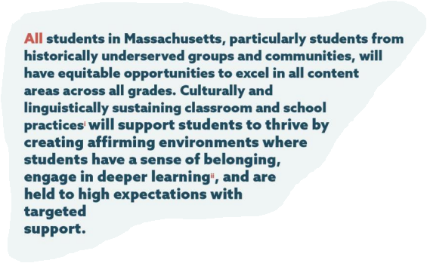
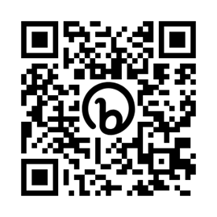
DESE’s Educational Vision
From DESE’s Educational Vision
Notes:
AB

Slide 6
What guides our work?
Continuously increase the number of students who graduate from high school with the state Seal of Biliteracy by ensuring all students have access to high-quality multilingual programs, including bilingual, heritage language, and world language.
Improve outcomes for multilingual learners by increasing access to grade-appropriate, culturally and linguistically sustaining instruction, and leverage compliance monitoring as a tool to support this work.
Build our collective capacity to meet the needs of specific student groups, with a focus on newcomers, SLIFE, and ELs with disabilities.
Notes:
AB

Slide 7
Sharing our Impact
Network sharing of successes and challenges
Let’s collaborate instead of working in silos!
Help OLA understand how we can design grants and resources that are most helpful to you.
Sharing district developed ESL & Dual Language curriculum
Sharing World Languages and Heritage Languages data to support new tools and guidelines for the field

Slide 8
FC181
English Learner Education Support

Slide 9
Overview
As a consequence of Question 2, the only allowable EL instruction in Massachusetts from 2002 to 2017 was Sheltered English Immersion (SEI).
By the time of LOOK Act (2017), there was a desert of bilingual programs and resources in the state
OLA has a goal to create the conditions to promote multilingualism for all students through bilingual education
The English Learner Education Support grant (181) is designed to seed and nurture bilingual programs

Slide 10
Goals
English Learner Education Support Goals
Develop and/or implement a bilingual program or other alternative ELE program
Create and cultivate a bilingual education hub
Create and cultivate an ESL Teacher hub
Develop, enrich or adopt high quality ESL or bilingual curriculum

Slide 11
FC181: What's new this year?
While the RFP is much like previous years, there are some important changes this year:
Districts may apply for up to two goals, IF one of the goals is Goal 2 or Goal 3. This means that districts may apply for either Goal 1 or Goal 4, but not both.
Goal 4 awardees are required to submit artifacts created with this funding to DESE by September 1, 2026 and to record classroom video of the artifacts in use upon request, with the understanding that these artifacts and videos may be shared with other districts or organizations at DESE’s discretion.

Slide 12
FC181: What's new this year? 2
While the RFP is much like previous years, there are some important changes this year:
Application Deadline and Grant Start Date are earlier than in previous years
Items that may NOT be funded with this grant:
Out of state travel
Food or any other costs associated with district/school events for staff, students, or family/other stakeholders
For Goals 2 and 3: Professional Development that does not contribute directly to licensure or DL Endorsement

Slide 13
Eligibility
Districts that commit to the multiyear process of implementing a well-developed plan
Goal 1: Districts that have not been awarded Goal 1 funding more than three times
Priority for districts/consortia with large EL populations

Slide 14
Required Submission Materials
Affidavit of Participation (for Goals 2 and 3)
GEM$ Required Narratives

Slide 15
Evaluation Criteria
Required:
Goal 1: Partnership with IHE Goals 2 and 3: Partnership with IHE, Affidavits of Participation from partner districts
ALL Goals: Superintendent approval in GEM$
Prioritized:
Strategic Transformation Region
Other priorities may differ by Goal, and are outlined in GEM$
High number of ELs

Slide 16
FC189
Proficiency Outcomes in World Languages

Slide 17
What Is FC189: Proficiency Outcomes in World Languages?
A competitive DESE grant for districts, charter schools, collaboratives, and partnerships
Centers on WL programming with an equity lens
Supports data-driven, standards-aligned, multilingual programming

Slide 18
What’s New in FY26?
Stronger emphasis on diversity, equity, and inclusion
Broader Local WL Advisory Team role
Structured, sustainable support for local data analysis

Slide 19
Core Activities for Districts Receiving FC189 Funds
Administer WL assessments
Convene Local WL Advisory Team
Share Insights with DESE WLAT

Slide 20
Core Commitments
Implement assessments
Convene local WLAT
Analyze data
Engage in state WLAT
Align to 2021 Framework
Attend Proficiency Academy
Present at OLA Network
Allow observations

Slide 21
Administering and Using Assessments
Select Seal-approved tests
Milestone limitations:
4 (elementary/middle/high)
3 (middle/high)
2 (high only)
Analyze and share results

Slide 22
Convening Local WL Advisory Teams
Diverse team composition
Analyze data
Identify equity gaps
Recommend changes

Slide 23
Engaging in the Statewide WLAT
1–2 reps
Collaborate and share data
Inform state guidance
Held from 9:30-11:30 on:
10/3/2025
12/5/2025
1/30/2026
3/27/2026
5/29/2026

Slide 24
Funding Overview: FC 189 funds may be used for:
Assessments
Time (stipends/subs)

Slide 25
Funding – Assessments
$25 per test
Milestones:
4 (elem/middle/high)
3 (middle/high)
2 (high only)

Slide 26
Funding – Time (Stipends/Subs)
Max Support:
$10k (single-component program)
$15k (multi-component program)
Additional Stipulations:
$2k WLAT rep
$1.5k Local advisory team staff
$1k Academy rep
Exceptions allowed with justification

Slide 27
Required Submission Materials 2
Assurance form
GEM$ Required Narrative
Three spreadsheets:
SY2024-25 WL Enrollment & Access reflection
SY2024-25 Assessment reflection
SY2025-26 Assessment plan

Slide 28
Evaluation Criteria 2
Required:
Public school district or public charter school (or partnership) with a WL program
Superintendent approval in GEM$
Prioritized:
Strategic Transformation Region
Chronically underperforming status
High number of ELs
Past participation in WLAT (SY2024–25)
Breadth and equity of WL program offerings and assessment practices
Degree of alignment to the 2021 WL Framework
Quality of advisory team engagement and reflection

Slide 29
Applying for the Grant(s)

Slide 30
Timeline – NEW!
Deadline for Applications in GEM$ – Friday, June 27th at 5:00 pm
DESE team will review applications and make award recommendations to the Commissioner's office in July
Upon Commissioner's Office Approval, the awards recommendations will be submitted to the Governor's office.
Applicants will be notified of award decisions upon GOV approval
Start date of Grant – while we can never guarantee approval dates, our goal is a start date of 9/1/2025

Slide 31
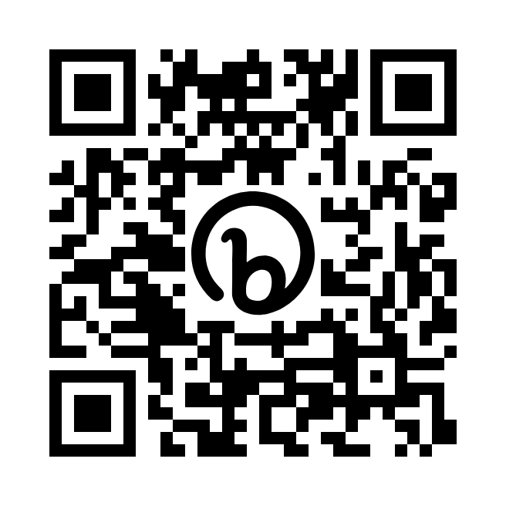
Reminders about GEM$
Applications to both the FC181 and FC189 must be submitted via GEM$.
For an overview of using GEM$, go to the main page (no login needed) and look for “Slide Decks from LEA Training Sessions on March 1 and May 1 (5/1/2023).” This is an excellent overview with both slide decks and video.

Slide 32
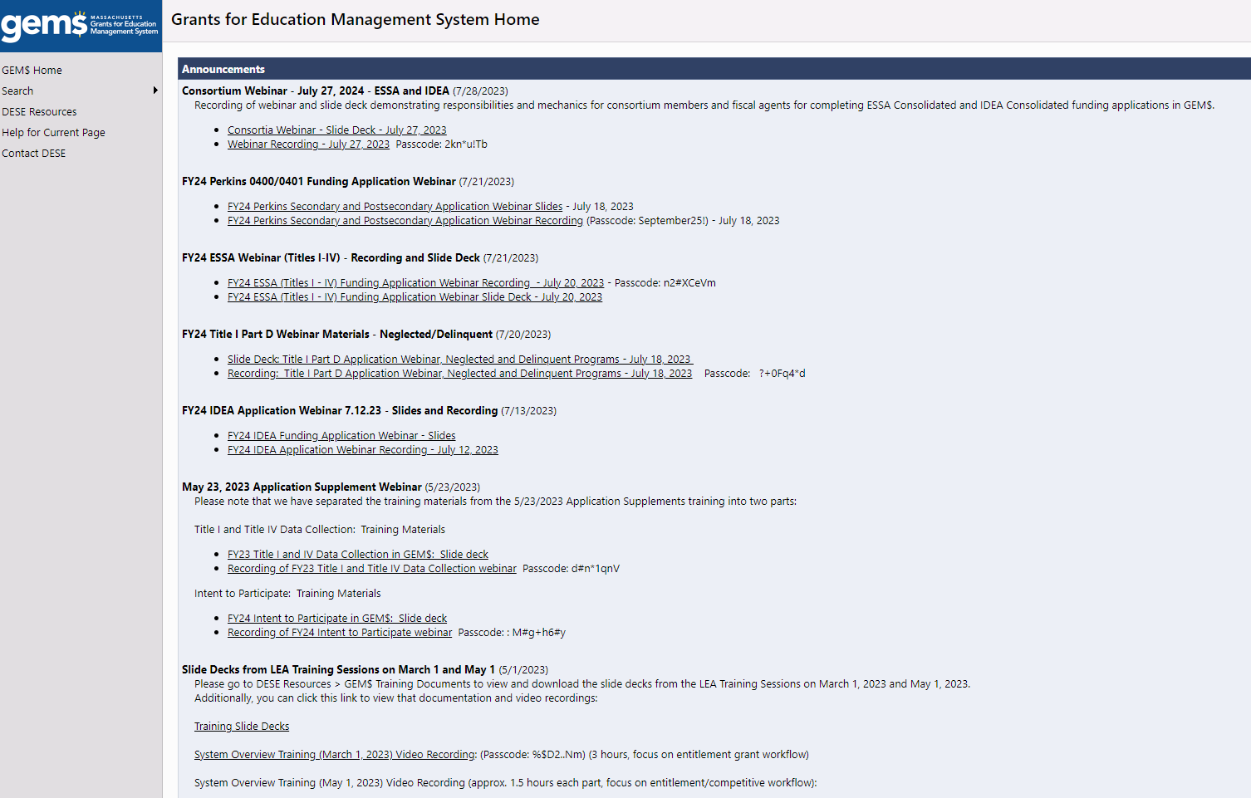
GEMS home page

Slide 33
Funding Application Roles in GEM$
Every organization must have at least one user with the following roles in order to submit a funding application in GEM$. To be assigned a Funding Application Role in GEM$ follow the directions on the next slide.
LEA Grantwriter
Users with this role may be an organization’s Program Director, Manager, or Lead Agency Representative.
LEA Fiscal Representative
Users with this role may be an organization’s CFO, Fiscal Agent, Business Manager, or Bookkeeper.
LEA Superintendent – Chief Executive
Users with this role may be an organization’s Executive Director, President, Director (signing authority for agency), CEO, Managing Director.
User Access Administrator
User Access Administration

Slide 34
Requesting a login/funding role from your User Access Administrator
To see who in your organization is a User Access Administrator (logging in is not needed)
In GEM$, go to “Search > Organization’ and enter the name of your district.
Click on the name of your district.
Use the left navigation menu to access the “Address Book.”
Click on the name of the User Access Administrator to retrieve their email address and phone number.
Request a role and login from your User Access Administrator

Slide 35
Superintendent Approval
Competitive grant applications are considered submitted when the Superintendent / Chief Executive approves the grant application in GEM$. In order to be considered for competitive funding, the Superintendent/Chief Executive MUST approve the application in GEM$ by the due date listed in the RFP.
The Superintendent / Chief Executive Approved Step allows for the organization lead to review and approve the grant application. Removing the requirement for the Part I Standard Contract Form, this step signifies Superintendent /Chief Executive sign off. Any grant budget changes requiring signature, will re-execute this step when amended signifying the organization lead is approving these changes.

Slide 36
Useful Links
FC181
Vision for English Learner Education and Blueprint for EL Success
Dual Language Education Programs
Transitional Bilingual Education Programs
Program Development and Evaluation
Next Generation ESL Toolkit
Evaluating High Quality NGESL Instructional Materials (HQIM-NGESL) Rubric
ESL Curriculum Design Modules
FC189
Seal of Biliteracy webpage
World Languages Curriculum Framework
World Languages Framework Implementation
General
OLA Grants Webinar Q&A Padlet
GEM$

Slide 37
THANK YOU!
Please email Diana.Gentile@mass.gov with any further questions.

