Slide 1
ORI & AGO
Know Your Rights 4.0
Q&A on Immigration
This presentation is for informational purposes only. For legal advice, please contact an attorney.

Slide 2
Webinar Topics
This presentation is for informational purposes only. For legal advice, please contact an attorney.
  Refresher: Know Your Rights/School-Specific Actions
  Application: Scenarios + Considerations
  Additional Resources

Slide 3
Refresher: Know Your Rights
Overview of ICE Authority
School-Specific Considerations

Slide 4
Overview of ICE Authority
ICE is subject to different, but similar, rules as other Law Enforcement
ICE is a federal law enforcement agency
ICE’s authority is generally limited to immigration related enforcement, unless acting in concert with federal or state law enforcement, or investigating crimes through ICE criminal investigative units
When carrying out its enforcement activities, ICE officers must follow different, but similar rules as other law enforcement agencies.
ICE officers must adhere to constitutional restrictions, as well as restrictions set by statutes, regulations and policies.
Individuals engaging with ICE have rights including (i) the right to remain silent; and (ii) the right to an attorney – though ICE is not required to provide one.
This presentation is for informational purposes only. For legal advice, please contact an attorney.

Slide 5
Basic Rules Surrounding ICE Authority
ICE can demand identification:
Immigrants often must carry identification on them, including copies of a green card and/or proof of registration.
Depending on the facts and circumstances, ICE officers, when they have probable cause to believe a person is here unlawfully, can ask for identification.
ICE can interrogate:
ICE officers may interrogate a noncitizen or person believed to be a noncitizen as to their “right to be, or to remain in the United States” without a warrant. (NOTE: individuals have a right to remain silent and to a lawyer even if undocumented).
ICE cannot approach any individual based on race or nationality alone. However, ICE can approach a person based on factors unknown to the interrogated person.
This presentation is for informational purposes only. For legal advice, please contact an attorney.

Slide 6
What is Harboring?
Harboring -- Subsection 1324(a)(1)(A)(iii) makes it an offense for any person who -- knowing or in reckless disregard of the fact that an alien has come to, entered, or remains in the United States in violation of law, conceals harbors, or shields from detection, or attempts to conceal, harbor, or shield from detection, such alien in any place, including any building or any means of transportation.
This presentation is for informational purposes only. For legal advice, please contact an attorney.

Slide 7
Likely not harboring/Harboring
Not Harboring
Could be considered harboring
Lawful assistance provided to a person who has documented or pending legal status.
Any help provided for basic human needs such as food, clothing, etc. that is NOT intended to hide the undocumented person from ICE.
Legal assistance designed to obtain lawful status.
Neighborhood watches that assist everyone and are not intended to assist individuals to remain in violation of the law.
Lying to ICE about the whereabouts of a person known to be undocumented or present in violation of the law, with the specific intent to hide that person.
Physical interference with ICE officers with the specific intent to hide a person who is undocumented or present in violation of the laws.
Warning specific individuals about ICE presence.
This presentation is for informational purposes only. For legal advice, please contact an attorney.

Slide 8
Rights of All Students to Education Regardless of
Immigration or Citizenship Status
Schools must provide equal access to education to all students regardless of immigration or citizenship status.
Schools must avoid policies that discourage or deny access to school on the basis of immigration status.
Schools must not discriminate on the basis of: race, color, sex, gender identity, religion, national origin, citizenship or immigration status, disability, or sexual orientation. Student Anti-Discrimination Act, M.G.L. 76 s. 5
For more information:
Attorney General’s Advisory Regarding Equal Access to Public Education for All Students Irrespective of Immigration Status (updated April 2022).
Upholding the Rights of Immigrant Students to Enroll in School: Guidance for School Committees and Districts (December 2024).
This presentation is for informational purposes only. For legal advice, please contact an attorney.

Slide 9
Detention of Parents/Guardians and Family Members of Students
This presentation is for informational purposes only. For legal advice, please contact an attorney.
Be prepared in advance:
  Update emergency contact information, alternative caregiver contacts, and authorized pick-up contacts for all students.
  Share 'plan ahead' resources with families.
  Establish clear protocols for school response in the event a student or their parent is detained by ICE.
  Provide counseling and social work support to students experiencing increased anxiety, especially those whose families are directly affected by changes to federal immigration policy.

Slide 10
Family at Risk? ‘Plan Ahead’ Resources
Massachusetts Planning for those with uncertain immigration status:
  Emergency Planning Guide for Parents with Uncertain Immigration Status (available in Spanish, Portuguese, Haitian Creole, Simplified Chinese)
  Emergency Planning Fact Sheet for Parents with Uncertain Immigration Status (available in Spanish, Portuguese, Haitian Creole, Simplified Chinese)
Boston Medical Center Family Plan:
  https://www.bmc.org/sites/default/files/Patient_Care/Specialty_Care/IRHP/family_preparedness_plan.pdf
This presentation is for informational purposes only. For legal advice, please contact an attorney.

Slide 11


Plan Ahead
This presentation is for informational purposes only. For legal advice, please contact an attorney.
Schools can try to plan ahead to avoid situations where no chain of custody in place:
Partner with Family Resource Clinics to host clinics for families to prepare caregiver affidavits (requires a notary)

Slide 12
Other Steps for Schools to Take
This presentation is for informational purposes only. For legal advice, please contact an attorney.
When planning school events:
  Consider holding events inside or in demarked private spaces open only to students, staff, and students’ families
  Post signage indicating the event is a “private event” for students and their families
  Consider a virtual streaming option for families who may wish to attend virtually
  Student Directory:
  Provide opportunities for parents to opt out of including directory information. Schools may also limit what information is included in the directory, and limit disclosure of information to their school community and not to third parties.
  Establish clear protocols re: ICE contact with school staff:
  Designate an on-call contact at central office for school staff to call in the event of ICE contact with school
  Superintendent or designee should consult with the district’s legal counsel before proceeding
  Immediately inform student’s parent/guardian
  With advice of counsel, review documents provided by ICE to determine if it’s an administrative warrant or a judicial warrant, order, or subpoena

Slide 13
Scenarios + Considerations

Slide 14
Scenario #1: On School Grounds
This presentation is for informational purposes only. For legal advice, please contact an attorney.
  On a day when school is in session, employees of a landscaping company subcontracted by the district are working outside on the campus of the district’s public high school building. ICE arrives on campus, armed, and arrests several of the landscapers.
  What might school staff consider when faced with this situation?

Slide 15
Scenario #1: On School Grounds
This presentation is for informational purposes only. For legal advice, please contact an attorney.
Safety Protocols: During Event
Provide counseling and social work support to students
May consider soft lockdown (if consistent with school policy regarding law enforcement presence on school grounds)
Safety Protocols: After Event
Maintain sensitivity and awareness regarding student absences, lack of engagement, and behavioral challenges in school
If ICE is seeking access to a person inside the school building, they must present a judicial warrant. Contact central office and district counsel.
It is illegal to obstruct, impede, or assault an ICE agent.

Slide 16
Scenario #1: On School Grounds
This presentation is for informational purposes only. For legal advice, please contact an attorney.
Factors to Consider
  Likelihood of students witnessing or interfering with the ICE encounter
  Whether the school has a lockdown policy that extends to all forms of armed law enforcement on school grounds (due to inherent risks of weapons, for e.g.)
  Location on campus (e.g., inside school, outside but on school property, off-school property)?

Slide 17
Rights and Responsibilities of School Staff as Bystanders
You may bear witness to a public arrest
Physically interfering or verbally berating ICE could have adverse consequences for both you and the immigrant
Rights of Bystanders
You have the right to witness and document
Massachusetts law allows for videotaping, disclose if using sound
You can ask the immigrant if they want you to call someone
You can remain silent if asked any questions by ICE
You can help by keeping calm and promoting calm
You can observe ICE officers from a safe distance
This presentation is for informational purposes only. For legal advice, please contact an attorney.

Slide 18
Scenario #2: Child At School
This presentation is for informational purposes only. For legal advice, please contact an attorney.
  During the school day, a member of school staff learns that the custodial parent of a student has just been detained by ICE. The student is currently at school and is unaware of the situation.
  What might school staff consider when faced with this situation?

Slide 19
Scenario #2: Child At School
This presentation is for informational purposes only. For legal advice, please contact an attorney.
Supporting Impacted Student
Provide counseling and social work support to students directly and indirectly impacted
Community-wide Considerations
Determine alternative caregiver:
Check student’s emergency contact information + authorized pick-up contacts
Is there a custodial chain on file? Check for alternative caregiver documents (e.g., caregiver authorization affidavit, temporary agent, guardian) → If no alternative caregiver plan in place: DCF
Notify student, being mindful of mental health implications of this news
If not already done:
Update emergency contact information, alternative caretaker contacts, and authorized pick-up contacts for all students
Share 'plan ahead' resources with families
Establish clear protocols for school response if a student or their family is detained by ICE
Be prepared for possible outreach by media contacts—consider student privacy concerns

Slide 20
Scenario #3: Parent Detained Outside of School Hours
This presentation is for informational purposes only. For legal advice, please contact an attorney.
  On Monday morning, a teacher learns via a media article that a parent of one of their students was detained by ICE over the weekend. The student is in school but visibly distraught.
  What might school staff consider when faced with this situation?

Slide 21
Scenario #3: Parent Detained Outside of School Hours
This presentation is for informational purposes only. For legal advice, please contact an attorney.
Supporting Impacted Student
Provide counseling and social work support to students indirectly impacted
Community-wide Considerations
Check in with student:
Offer school counseling support
Be prepared for possible outreach by media contacts—consider student privacy concerns
Is there a custodial chain on file? Check for alternative caregiver documents (e.g., caregiver authorization affidavit, temporary agent, guardian) → If no alternative caregiver plan in place: DCF
Alert school and district leadership
Refer to additional mental health services as appropriate
For ALL students: Maintain sensitivity and awareness regarding student absences, lack of engagement, and behavioral challenges in school

Slide 22
Scenario #4: Child Detained Outside of School Hours
This presentation is for informational purposes only. For legal advice, please contact an attorney.
  On Monday morning, a teacher learns from a fellow student that one of their students was detained by ICE over the weekend.
  What might school staff consider when faced with this situation?

Slide 23
Scenario #4: Child Detained Outside of School Hours
This presentation is for informational purposes only. For legal advice, please contact an attorney.
Supporting Closely Impacted Students
Provide counseling and social work support to students indirectly impacted
Community-wide Considerations
Check in with student’s sibling(s) & classmates:
Offer school counseling
Be prepared for possible outreach by media contacts—consider student privacy concerns
Contact the AGO or ORI if your district learns of a student who was detained
Provide immigration attorney referral resources
For those wishing to hold community events for assisting families left behind, email: Request a Community Meeting with ORI
School staff should alert school and district leadership
Refer to additional mental health services as appropriate
Check in with family/caregiver
For ALL students: Maintain sensitivity and awareness regarding student absences, lack of engagement, and behavioral challenges in school

Slide 24
Scenario #5: Student Absenteeism Due to ICE Concerns
This presentation is for informational purposes only. For legal advice, please contact an attorney.
  A principal is aware that one of their students has uncertain legal status. Following several publicized instances of ICE presence in the neighborhood surrounding the school, this student has been consistently absent from class.
  What might school staff consider when faced with this situation?

Slide 25
Scenario #5: Student Absenteeism Concerns
This presentation is for informational purposes only. For legal advice, please contact an attorney.
How can schools support students who are absent from school because of a
fear of ICE presence?
  Offering tutoring/educational services.
  Students who are not physically present at school but are receiving academic instruction from the district for at least half the school day should be counted as present.
  Maintain sensitivity and awareness regarding student absences, lack of engagement, and behavioral challenges in school.
  Conduct supportive outreach to families rather than filing CRAs for truancy.
  Carefully consider the decision prior to filing a 51A.
  Parent pick-up/transportation considerations
  Students who are not physically present but are receiving educational services for at least half the school day should be counted as present.

Slide 26
Scenario #6: SRO Involvement
This presentation is for informational purposes only. For legal advice, please contact an attorney.
  Two students at a high school are involved in a verbal altercation. One of the students pushes and throws a towel at the other student. The high school has an SRO on site, who arrives to the scene after the fight has ended and the students have separated. Unbeknownst to the SRO, one of the students has uncertain immigration status.
  What might school staff consider when faced with this situation?

Slide 27
Scenario #6: SRO Involvement
This presentation is for informational purposes only. For legal advice, please contact an attorney.
First, a preliminary consideration:
Is SRO involvement appropriate here under state law?
Ensure that your district has an SRO MOU that is compliant with the statewide Model SRO MOU. Compliance is mandatory—the model is a minimum requirement.
SRO involvement only permitted as a last resort to ensure safety in response to imminent threat of substantial harm.
School staff shall not ask an SRO to serve as a school disciplinarian or enforcer of school regulations. It may be appropriate for school administrators, rather than SROs to handle low-level offenses.
Schools and SROs shall not disclose a student’s immigration status except as required by law.
Arrests at school and bringing students directly from school to the police station should be avoided wherever possible. A summons is the preferred method for bringing all juveniles to court.

Slide 28
Scenario #6: SRO Involvement
This presentation is for informational purposes only. For legal advice, please contact an attorney.
Further Considerations regarding SRO involvement/School-Based Arrests
If an SRO or other police officer becomes involved and a student is taken to the police station and fingerprinted, their information is automatically shared with federal authorities including ICE.
Strategies that can be effective in some circumstances to maintain safety:
  Administrative search
  Ensure safety and contact parents
  Involve community-based youth-serving organizations
There is no requirement to have SROs on site at schools. School districts decide what is best for their community.

Slide 29
Additional Resources

Slide 30
Community Resource Toolkit for Supporting Immigrant Families
Community-Based Organizations Resources
Family-Facing Resources
ORI Community Meeting Request Form
  ORI can join existing meetings to:
    Listen to community concerns
    Assess needs around essential services, housing, food access, health, and other supports
    Connect families and providers to legal services, behavioral health care, and other trusted resources
This presentation is for informational purposes only. For legal advice, please contact an attorney.

Slide 31
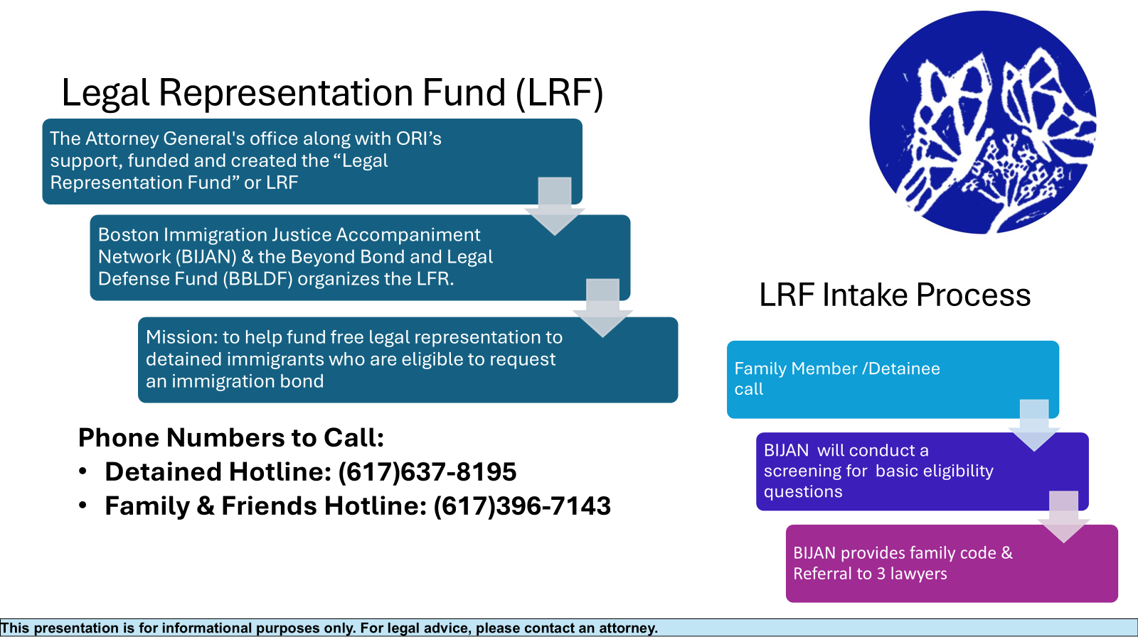
Legal Representation Fund

Slide 32
When to Reach Out to ORI or MA AGO CJU
MA AGO’s Children’s Justice Unit – liza.hirsch@mass.gov
Immigration enforcement in or around schools
ORI – susan.church@mass.gov
Immigration enforcement in or around EA shelters, schools, places of worship, or other sensitive locations
Detention of a parent/caregiver for a child with significant disabilities
Detention of a parent/caregiver for a child who is currently undergoing medical treatment for a serious medical condition (such as cancer)
Detention of a teenager, younger person, student
Detention of individual with no criminal record, United States Citizen children and significant long term US residence (more than 15 years approximately)
Other cases where a significant humanitarian concern is presented, including larger scale workplace raids or immigration enforcement events
Detention of young person under the age of 19
This presentation is for informational purposes only. For legal advice, please contact an attorney.

Slide 33
Immigration Attorney Referral Resources
Massachusetts Legal Resource Finder: https://masslrf.org/en/home
The American Immigration Lawyers Association’s online directory: https://www.ailalawyer.com/
The National Immigration Project of the National Lawyers Guild’s “Find an Attorney” website: https://nipnlg.org/work/find-attorney
Immigration Court list of legal services: https://www.justice.gov/eoir/list-pro-bono-legal-service-providers
City of Boston free immigration consultations: https://www.boston.gov/departments/immigrant-advancement/free-immigration-consultations
MIRA immigration Helpline: https://miracoalition.org/news/immigration-helpline/

Slide 34
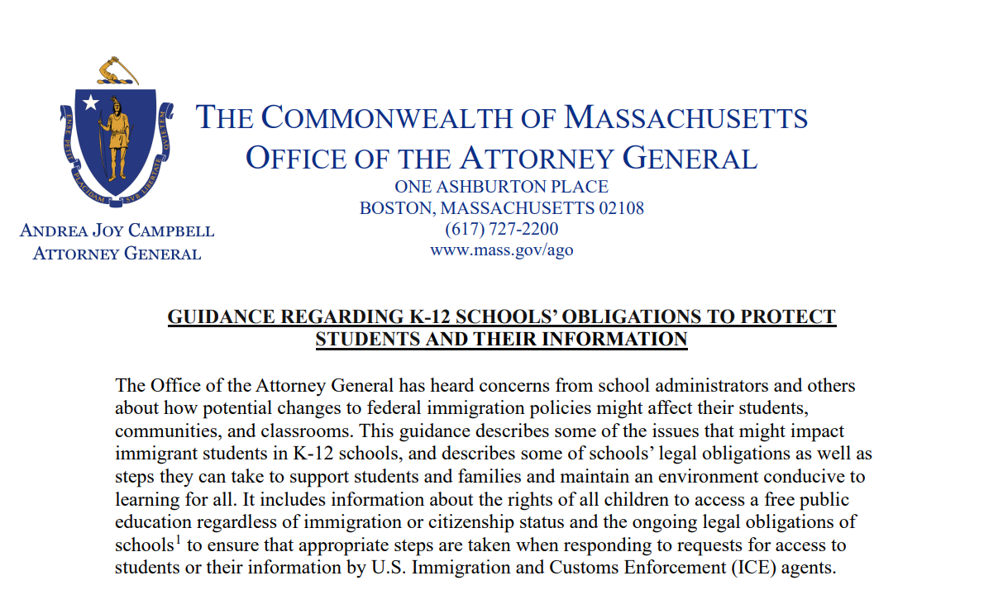
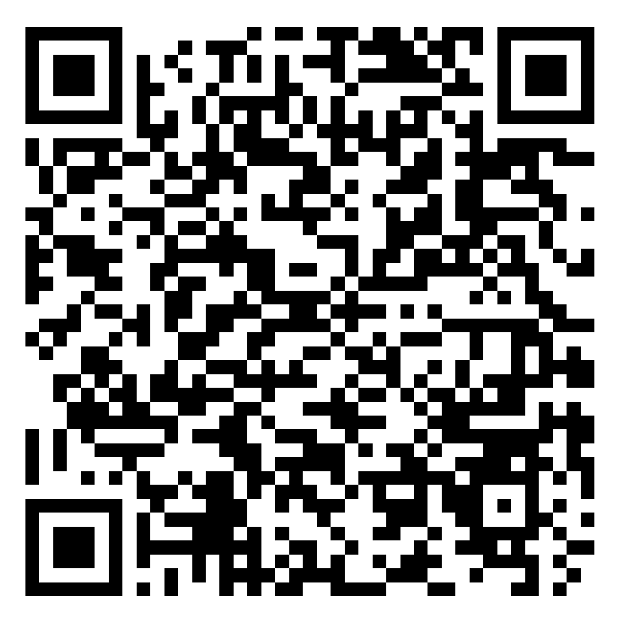
Guidance Regarding Public Schools’ Obligations to Protect Students and Their Information
This presentation is for informational purposes only. For legal advice, please contact an attorney.
QR Code
This presentation is for informational purposes only. For legal advice, please contact an attorney.

Slide 35
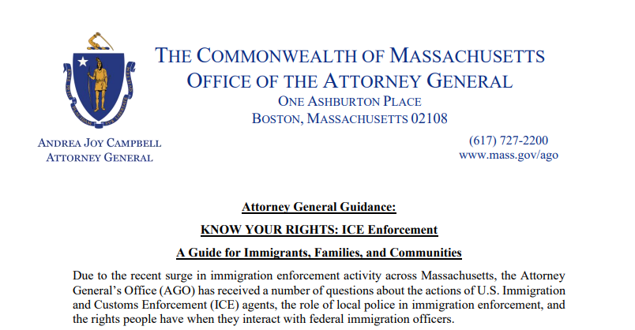
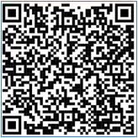
Know Your Rights Guidance Regarding ICE Enforcement for Immigrants, Families, and Communities
This presentation is for informational purposes only. For legal advice, please contact an attorney.
QR Code
This presentation is for informational purposes only. For legal advice, please contact an attorney.

Slide 36
Additional Resources
AGO Resources:
Flyer for K12 Schools on Protecting Students and Their Information
KNOW YOUR RIGHTS: ICE Enforcement A Guide for Immigrants, Families, and Communities
Additional resources for immigrants on the Attorney General’s website: https://www.mass.gov/info-details/resources-for-immigrants-in-massachusetts
To File a Civil Rights Complaint with the Attorney General’s Office, visit www.mass.gov/how-to/file-a-civil-rights-complaint, or for related civil rights questions, email civilrights@mass.gov, or call (617) 963-2917.
For those wishing to hold community events for assisting families left behind, email: Request a Community Meeting with ORI
The ICE detainee locator (https://locator.ice.gov/odls/homePage.do) can help people determine if their family member has been detained and where the family member is being held. Please note: The ICE detainee locator is intended only for locating individuals who are already detained. If someone has general questions about his or her immigration status, they should consult legal counsel.

