Slide 1
ARP Emergency Assistance for Non-Public Schools or EANS-II
Matt Deninger,
Chief Strategy and Research Officer, DESE
Megan Evans, Non-Public School Relief Program Coordinator
Aug 17 and 23, 2022

Slide 2
Welcome to the EANS-II webinar!
Housekeeping items before we begin:
The slides and approved vendor list will be emailed to all registrants after the webinar.
To preserve bandwidth and avoid distractions, your video and microphone are turned off.
Use the Q & A feature at the bottom of the screen to ask questions (not the Chat feature).

Slide 3
CONTENTS
01
EANS-II Program
02
EANS Vendors
03
ClassWallet Onboarding
04
Q&A

Slide 4
EANS-II Program
01

Slide 5
ARP Act: The Second Round of EANS Funding
The American Rescue Plan Act of 2021 (ARP Act) was signed into law on March 11, 2021.
ARP EANS authorized a second round of funding to provide services or assistance to non-public schools.
$24,826,386 million awarded to Governor Baker through the ARP Act
$200,000 for DESE program administration
$24,626,386 for non-public schools (assistance and services)

Slide 6
ARP EANS (EANS-II): Program Requirements
The requirements of ARP EANS are the same as those in section 312(d) of the CRRSA Act with two key exceptions:
a State educational agency (SEA) may only provide services or assistance under ARP EANS to non-public schools that enroll a significant percentage (25.9%) of students from low-income families and are most impacted by the novel Coronavirus Disease 2019 (COVID-19) emergency; and
an SEA may not use ARP EANS funds to provide reimbursements to any non-public school for costs the school incurred to address the impact of COVID-19 emergency.

Slide 7
Eligibility – low-income threshold
USED’s default low-income eligibility threshold was 40%, however, they allowed states to apply for an alternative threshold
DESE applied for an alternative threshold of 14% (the average poverty for EANS-I participants)
USED did not approve of that threshold, and instead approved an alternative significant low-income threshold of 25.9% for Massachusetts to use in determining a non-public school’s eligibility for EANS-II funding.

Slide 8
ARP EANS (EANS-II): Eligibility
Non-public schools were eligible if:
a non-public elementary or secondary school in Massachusetts;
approved to operate as a non-public school under Massachusetts General Laws;
a non-profit entity;
is currently operating and was in existence and operating prior to March 13, 2020; and
did not participate in the second federal Paycheck Protection Program (on or after December 27, 2020). Those who participated in PPP before December 27, 2020, are still eligible.

Slide 9
COVID impact was used to weight award amounts
The EANS-II program must prioritize services or assistance to non-public schools were/are most impacted by COVID:
DESE used #infections per capita in municipality where school is located

Slide 10
ARP EANS (EANS-II): Allowable Uses of Funds
Allowable uses of funds are the same under the ARP EANS program as they are under the CRRSA EANS program, with the following exception:
Under the ARP EANS program, an SEA may not use ARP EANS funds to provide reimbursements to any non-public school for costs the school incurred to address the impact of COVID-19 emergency.
DESE can provide goods, services, and assistance to non-public schools, with the following requirements:
DESE must be the purchaser.
Non-public schools are bound to select from EANS state-approved vendors.
Goods, services, and assistance must fit into the categories allowed by ARP.

Slide 11
Allowable Uses of Funds
The law spells out the following uses:
supplies to sanitize, disinfect, and clean school facilities;
personal protective equipment;
improving ventilation systems, including windows or portable air purification systems to ensure healthy air in the non-public school;
training and professional development for staff on sanitation, the use of personal protective equipment, and minimizing the spread of infectious diseases;
physical barriers to facilitate social distancing;

Slide 12
Allowable Uses of Funds, continued
other materials, supplies, or equipment to implement public health protocols, including guidelines and recommendations from the Centers for Disease Control and Prevention for the reopening and operation of school facilities to effectively maintain the health and safety of students, educators, and other staff during the qualifying emergency;
expanding capacity to administer coronavirus testing to effectively monitor and suppress coronavirus, to conduct surveillance and contact tracing activities, and to support other activities related to coronavirus testing for students, teachers, and staff at the non-public school;
educational technology (including hardware, software, connectivity, assistive technology, and adaptive equipment) to assist students, educators, and other staff with remote or hybrid learning;

Slide 13
Allowable Uses of Funds, continued
redeveloping instructional plans, including curriculum development, for remote learning, hybrid learning, or to address learning loss;
leasing of sites or spaces to ensure safe social distancing to implement public health protocols, including guidelines and recommendations from the Centers for Disease Control and Prevention;
reasonable transportation costs;
initiating and maintaining education and support services or assistance for remote learning, hybrid learning, or to address learning loss.

Slide 14
EANS Program Timelines
Schools that received funding through EANS-I and EANS-II should be mindful of the associated timelines and prioritize spending of remaining EANS-I funds, as applicable.
Program | Period of Funds Availability
CRRSA EANS (EANS-I) | Through September 30, 2023.
ARP EANS (EANS-II) | Through September 30, 2024.

Slide 15
EANS-II Allowable Use Timeline and Required Inventory
Equipment and supplies purchased with EANS-II funds for students and teachers in a non-public school may be used for the authorized purposes of the EANS-II program during the period of performance (through September 30, 2024) OR until the equipment and supplies are no longer needed for the purposes of the EANS-II program.
Non-public schools are required to inventory equipment and pilferable items purchased with EANS funds. Rules and guidance for maintaining an inventory are forthcoming.

Slide 16
EANS Vendors
02

Slide 17
EANS Vendors
Non-public schools must verify that a vendor is an approved EANS vendor with DESE prior to entering a partnership if EANS funds will be sought for payment in part or whole for vendor services.
Vendors often incorrectly communicate to non-public schools that they are an approved EANS vendor when they have not been approved by DESE for EANS services.

Slide 18
EANS Vendors
If a non-public school enters a partnership with a vendor and the vendor is not approved to provide services through the EANS program, EANS funds cannot be used to pay the vendor.
EANS funds can only be used to pay the vendor for services rendered on or after the date the organization becomes an approved EANS vendor.
As vendors are approved to provide services through the EANS programs, an updated list is emailed to all Awardees.

Slide 19
EANS-II Allowable Uses of Funds
Allowable Use | Reimbursement? | DESE Service?
A. Cleaning supplies | No | In Progress
B. PPE | No | In Progress
C. Ventilation upgrades | No | Potentially
C.* Ventilation in the form of portable air purifiers | No | Potentially
D. Training and PD on minimizing spread of disease | No | Potentially
E. Physical barriers | No | Potentially
F. Other materials to implement public health protocols | No | Potentially
G. Coronavirus testing | No | In Progress
H. Educational technology | No | In Progress
I. Curriculum development to address learning loss/lag | No | Yes
J. Leasing space to increase social distancing | No | Potentially
K. Reasonable transportation | No | Potentially
L. Initiating or maintaining education and support services | No | Yes

Slide 20
ClassWallet Onboarding
03

Slide 21
ClassWallet EANS School Users
There are two types of users for EANS schools:
Fiscal Agents - EANS awardees can have one designated fiscal agent. Fiscal agents are responsible for submitting documentation to DESE through ClassWallet to request vendor payments as well as managing the fiscal oversight of the program on behalf of the school.
View Only Agents - The school fiscal agent may want to designate a school administrator, director or other stakeholder to have the ability to access spend reporting via a view only agent account. A school can have many designated view only agents. View only agents have access to all orders and reporting submitted by the fiscal agent. Please note: the purse balance will read $0 for view only agents and they do not have the ability to submit orders on behalf of the school.

Slide 22
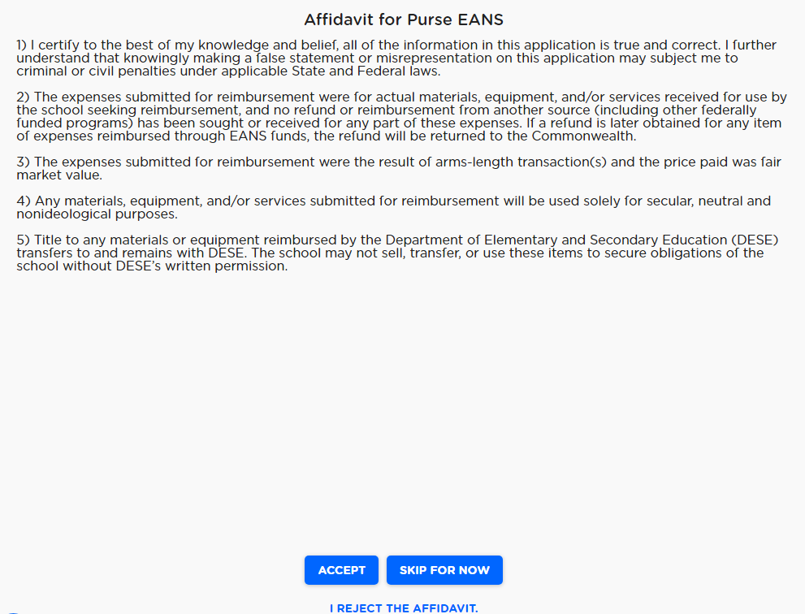
ClassWallet Affidavit
When a new fiscal agent logs in for the first time, there will be a required affidavit related to funds made available to the non-public school.
Before any funds can be spent, the fiscal agent must read and accept the affidavit as outlined by the U.S. Department of Education and the Massachusetts Department of Elementary and Secondary Education (DESE).

Slide 23
ClassWallet Home Page
Options available on the ClassWallet home page:
Updates – Important ClassWallet system notifications
Balance – View your balance
Pay Vendor – Issue a direct payment to approved registered service providers
Reports – View funds received and all order details
Support – Find training videos, FAQs or contact Support
Account Settings – Edit basic info, update your password or security question and answer

Slide 24
Processing Vendor Payments
All EANS-II transactions must be processed through the ‘Pay Vendor’ feature in ClassWallet, which can be easily accessed via the home page.

Slide 25
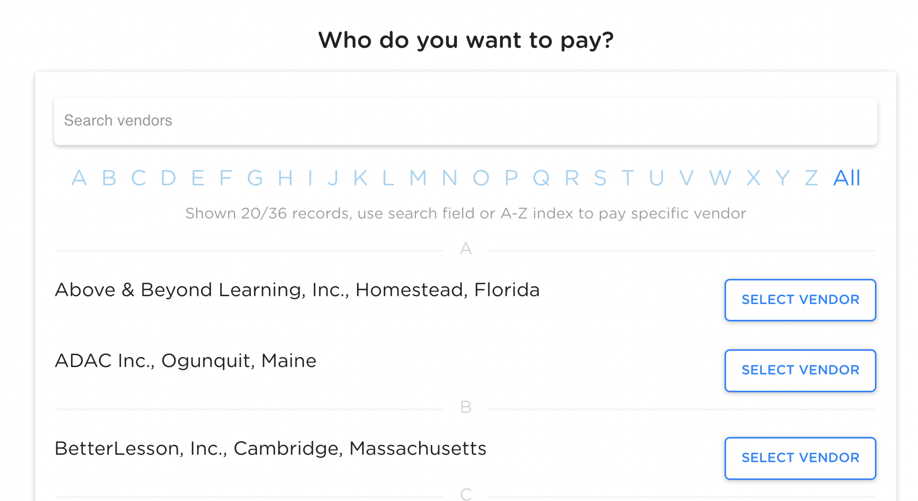
Processing Vendor Payments
Once in the ‘Pay Vendor’ feature, select the appropriate vendor from the list of approved EANS vendors and click ‘Next’.

Slide 26
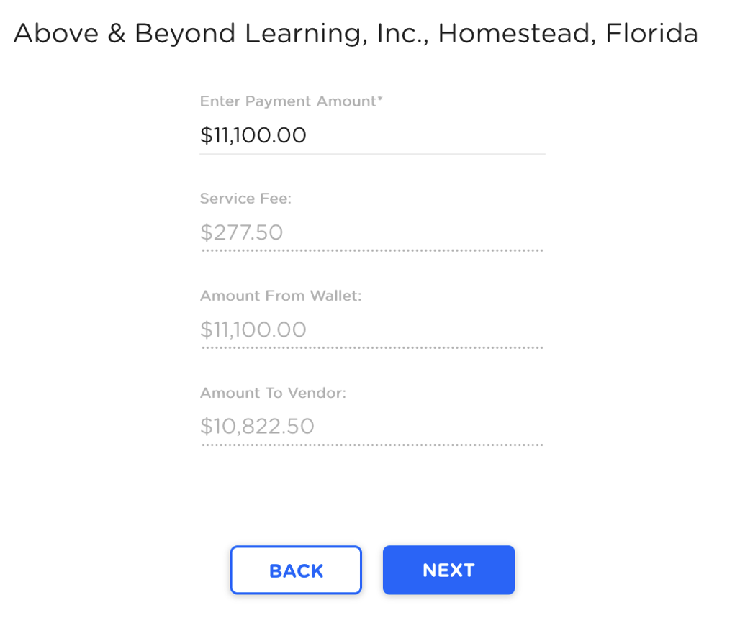
Processing Vendor Payments
Sample Vendor
Enter the amount indicated on the invoice in the ‘Enter Payment Amount’ field and click ‘Next’.
Please note: The ‘Amount to Vendor’ field will automatically adjust for the 2.5% transaction processing fee that is assumed by the vendor.
This fee may already be reflected on the provider’s invoice. Either way, do not adjust the payment amount, simply enter the amount invoiced by the vendor.

Slide 27
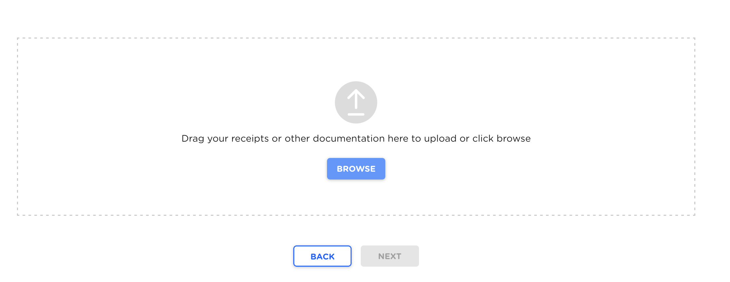
Processing Vendor Payments
Upload all associated invoices and documentation provided by the vendor and click ‘Next’. Acceptable file types are: .PDF, .JPEG, and .PNG.

Slide 28
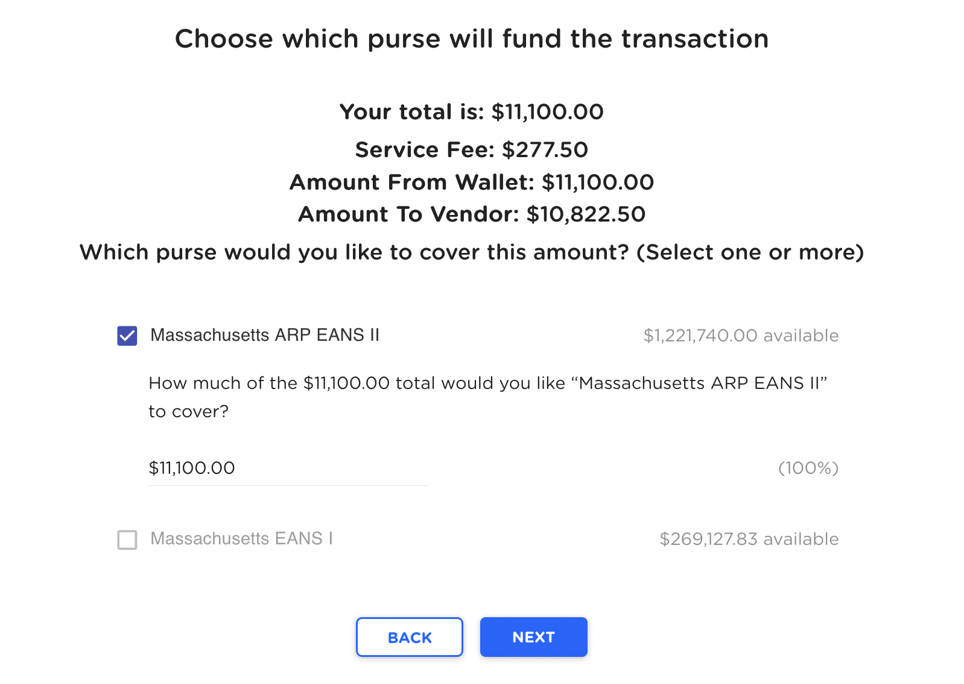
Processing Vendor Payments
Select which ‘purse’ will fund the transaction, as applicable, and click ‘Next’.

Slide 29
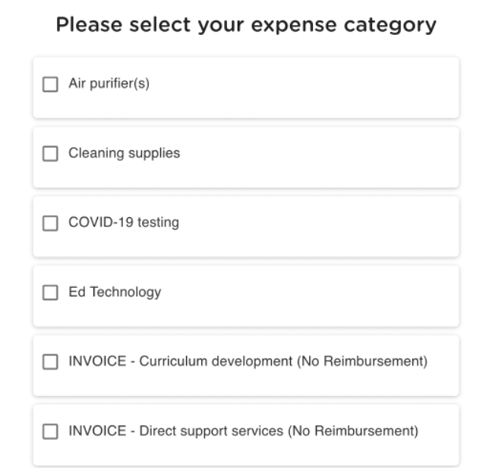
Processing Vendor Payments
Select the appropriate expense categories.

Slide 30
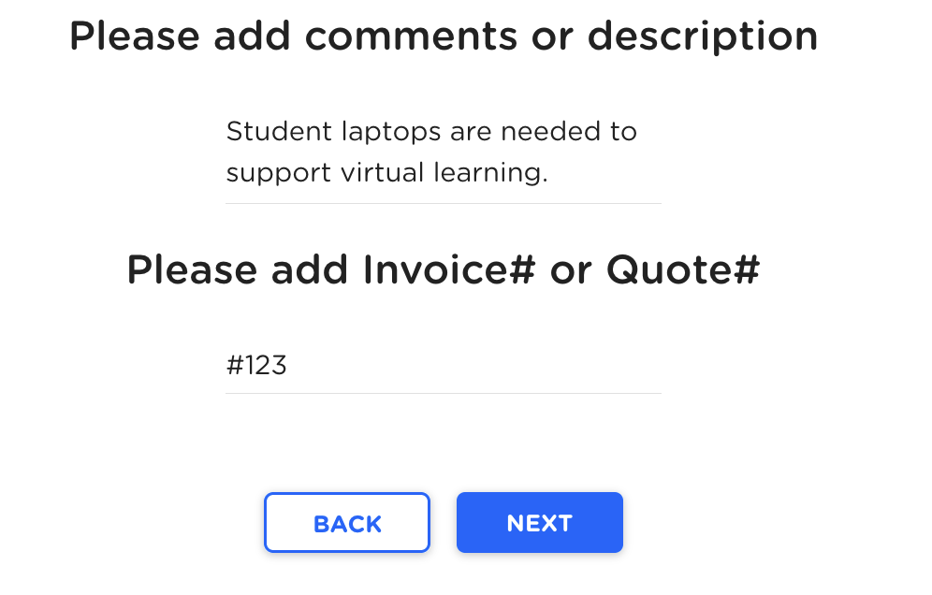
Processing Vendor Payments
In the ‘Comments or Description’ box at the bottom of the screen, enter a brief description of how the request is tied to an initiative to prevent, prepare for, and respond to the pandemic.
Please note: If the description is incomplete or insufficient, reviewers cannot determine if an expense is allowable, which may cause the request to be rejected and/or reimbursement to be delayed.
Then, enter the Invoice# or Quote # and click ‘Next’.

Slide 31
Processing Vendor Payments
Prior to final submission, the system will prompt the fiscal agent to review all details. Once the order has been verified for accuracy, click ‘Next’ to submit.
All payments, along with the associated uploads, will be sent to the program administrators for audit, review, and are subject to approval. To avoid delays or rejections of requests, be sure to submit the proper documentation.

Slide 32
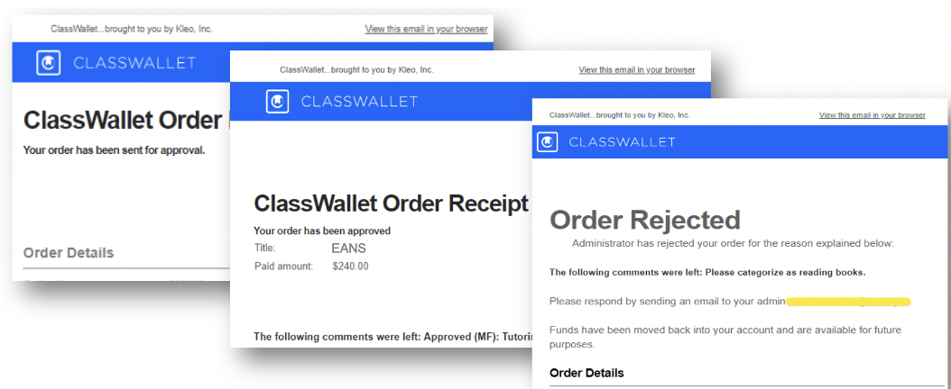
Transaction Confirmation Emails
You will receive the following emails after you submit reimbursement receipts or vendor payments:
Confirmation of payment / reimbursement submission for the designated administrator to review
Confirmation of the administrator’s approval or rejection, along with any applicable comments for successful resubmission, if applicable.

Slide 33
Q & A
04

Slide 34
QUESTIONS and ANSWERS

Slide 35
EANS-II Resources
DESE EANS-II Website (https://www.doe.mass.edu/federalgrants/esser/eans2.html)
U.S. Department of Education website (https://oese.ed.gov/offices/education-stabilization-fund/emergency-assistance-non-public-schools/)
Send questions to EANS@mass.gov

Slide 36
THANK YOU
781.338.3134
EANS@mass.gov
www.doe.mass.edu/federalgrants/esser/eans.html
75 Pleasant Street, Malden, MA 02148

