Slide 1
Community Partnerships that Make a Difference
Haverhill Public Schools - Vacation Academies
Extended Learning Time
Funded by Title I

Slide 2
2020-2021
Haverhill Public Schools offered families three learning options
Full in person
Hybrid of remote and in person
Full remote

Slide 3
February 2021
Vacation Academies were launched
Who: Students grades 1-8
When: February and April
Vacation weeks
Where: YWCA
YMCA
The Boys/Girls Club

Slide 4
The Goal?
Increase contact hours between students, peers and teachers
Academic Support
Social interactions with peers
Recreation
Offer working families an option of free high quality child care

Slide 5
How?
A
Academic Support
Hands on, theme based, interactve lessons in ELA, Math, Science & Social Studies
Social Interactions with Peers
Core competencies: Self-Management, Social Awareness, Relationship Skills, Self Awareness & Responsible Decision Making
Recreation
Physical activities ie: Basketball, Gymnastics, Swimming, Sports, STEM activities.
Quality Child Care
4 locations, offered at no cost to families 8:30 am - 5:30 pm

Slide 6
Planning:
A circle of continuous improvement
Fall/Winter 2022 planning ordering & assembling
Summer 2022 PLC/PD
PD and Site February Vacation Academy staff survey
PD and Site April Vacation Academy staff survey
March: revise based on feedback

Slide 7
Vacation Academy Teaching staff included:
Teachers
Educational support personnel
And two assistant principals who taught to the delight of the students!

Slide 8
Teacher feedback
Critical to the success of these partnerships
Vacation Academy evaluation surveys were used as a vehicle to improve practice

Slide 9
The result of teacher voice?
Vacation Academy Professional Learning Community included in FY 2022 budget

Slide 10
Under leadership of a Lead Curriculum Supervisor
9 teachers participated in 20 hours of lesson development in Summer, 2022 in preparation for the 2023 Vacation Academies
Using Understanding by Design Unit Templates, teachers worked in a professional learning community to create interdisciplinary units with well structured lessons for multi-grade students

Slide 11
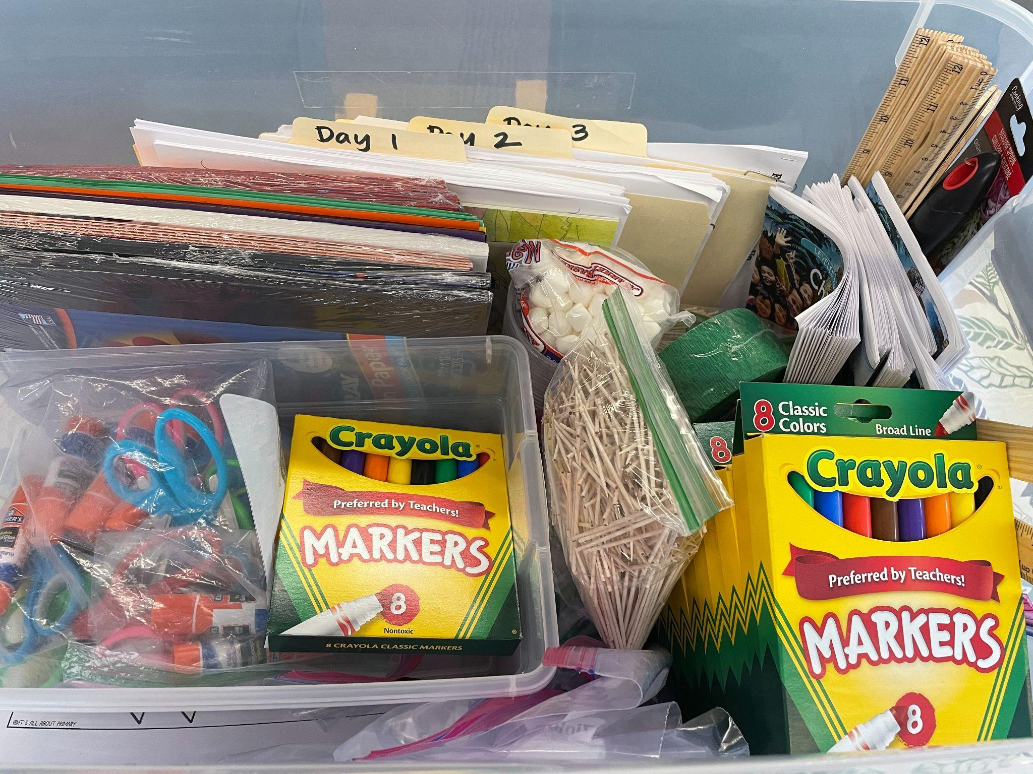
Example of unit supply bin provided to each teacher

Slide 12
Continuous Growth
Year | # Students | # Students | # Staff | # Staff
Vacation Academy | Feb | April | Feb | April
2021 | 185 | 199 | 17 | 23
2022 | 286 | 323 | 36 | 32
2023 (capacity for growth) | 564 | 564 | 47 | 47

Slide 13
Budget
Costs
2 hours of PD/Visit @ $40 per hour per teacher
18 hours @$40 per hour, per teacher, per week = $720
½ hour of prep time per day built in
Food Service:
breakfast = $2.52 lunch = $4.40$
Supplies: $3,000 - $5,000

Slide 14
Cost for HPS
(Approximate)
$45,000 per week for 323 students = $140 per student
Vacation Academy cost per family: $0
Comparable to:
Health Club =$300 (est.)
Daycare = $279 (avg)

Slide 15
Haverhill Public Schools is grateful for the tremendous support from our community partners to work collaboratively and creatively to provide learning opportunities for all our students and support our families.

Slide 16
A few words from our
Community Partner
Tracy Fuller
Executive Director of the Haverhill/Plaistow YMCA

Slide 17
Q and A
Does anyone have
questions?

