Slide 1
Culturally Responsive Practice in
Using Federal Grant Resources
Federal Grant Programs Conference
November 15, 2022

Slide 2
Welcome
WELCOME!
Notes:
ALBERT

Slide 3
What is your accessibility?
WHAT IS YOUR ACCESSIBILITY?

Slide 4
Goals
Federal grant program managers will:
understand key concepts related to culturally responsive practice; and
apply these concepts in planning, implementing, and evaluating federally-funded programs.

Slide 5
Defining Culturally Responsive Practice

Slide 6
Resources
Gorski, Paul. 2018. Reaching and Teaching Students in Poverty: Strategies for Erasing the Opportunity Gap. New York: Teachers College Press.
Jackson, Yvette. 2011. The Pedagogy of Confidence: Inspiring High Intellectual Performance in Urban Schools. New York: Teachers College Press.
Hammond, Zaretta. 2015. Culturally Responsive Teaching & the Brain: Promoting Authentic Engagement and Rigor Among Culturally and Linguistically Diverse Students. Thousand Oaks, CA: Corwin.
Krownapple, John. 2017. Guiding Teams to Excellence with Equity: Culturally Proficient Facilitation. Thousand Oaks, CA: Corwin.

Slide 7
Equitable access to opportunity for excellence

Slide 8
Cultural Awareness

Slide 9
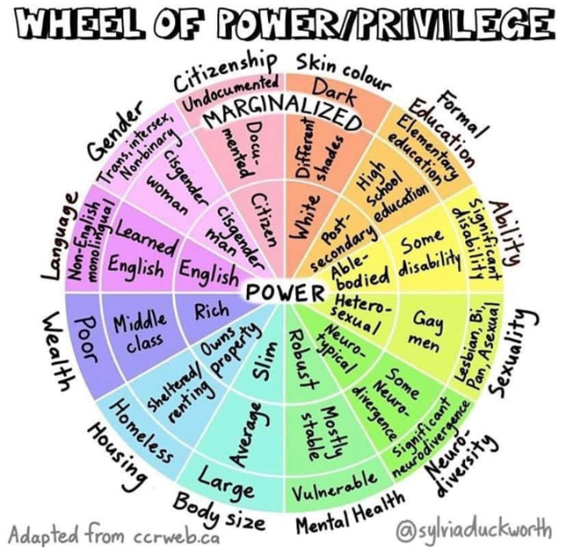
Wheel of Power/Privilege
Notes:
Some of our identities fit closer to the center and some are further out
This has a lot to do with how we’ve experienced socialization and oppression in schools and our life
Image from : https://vpfo.ubc.ca/2021/03/intersectionality-what-is-it-and-why-it-matters/
*Continuum
*Intersectionality
*Language for identities – “queer”
2 takeaways:
*The very many dimensions of being human around which we can experience oppression that we internalize and enact
*People whose identities sit closer to the center experience the world very differently than people whose identities move toward the margins

Slide 10
Implicit Bias

Slide 11
Cultural Proficiency
Cultural proficiency requires us to understand our own biases and how they are tied to privilege and even to societal inequalities, a commitment embedded in the principles of equity literacy.
, Paul. 2018. Reaching and Teaching Students in Poverty: Strategies for Erasing the Opportunity Gap, p. 18.
Gorski, Paul. 2018. Reaching and Teaching Students in Poverty: Strategies for Erasing the Opportunity Gap, p. 18.

Slide 12
What is Unconscious/Implicit Bias?
a preference for a group
operate outside our awareness
based on stereotypes and attitudes we hold
tend to develop early in life
tend to strengthen over time
are malleable
often contradict our explicit values
Attitudes
Evaluative feelings that are positive or negative
Stereotypes
Traits we associate with a category
Notes:
Implicit bias or social cognition, is the process by which the brain uses "mental associations that are so well-established as to operate without awareness, without intention, or without control."Source: Project Implicit, Harvard University
Everyone has schema/implicit bias
a preference for a group (positive or negative)
often operating outside our awareness
based on stereotypes and attitudes we hold
that tend to develop early in life and
tend to strengthen over time

Slide 13
Examples of Unconscious Bias in Schools
Not speaking directly to a student with a disability, but to the paraprofessional, parent/guardian or teacher instead
Asking a student with a disability to take on a specific role (e.g., notetaker) during group work, assuming that it is the only way the student will be able to contribute
Assuming that a student from a certain background (e.g., low income/poor or Person of Color) will be satisfied with lower achievement levels
Holding the unaware expectation that students who speak with certain accents will be/are poor writers

Slide 14
Microaggressions

Slide 15
Racial microaggressions
Racial microaggressions are the brief and everyday slights, insults, indignities, and denigrating messages sent to People of Color by well-intentioned [people] who are unaware of the hidden messages being communicated.
--Derald Wing Sue, Columbia University

Slide 16
Impacts of Microaggressions
“Racial microaggressions create a hostile and invalidating climate for People of Color, saps their spiritual and psychic energies, and their cumulative nature can result in depression, frustration, anger, rage, loss of self esteem, anxiety, etc.”
--Derald Wing Sue, Columbia University

Slide 17
Common themes
Common themes to which
microaggressions attach

Slide 18
Good news
Good news
Motivation matters.
Intervention works.
Bias is malleable.
18

Slide 19
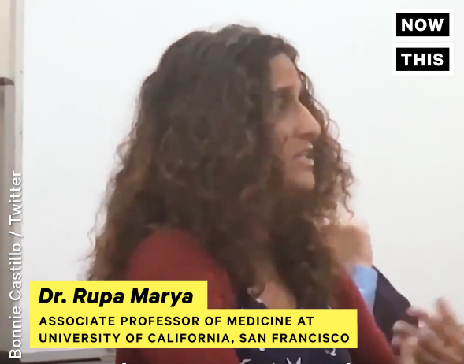
Cultivating awareness to interrupt bias
Notes:
https://www.facebook.com/NowThisPolitics/videos/1985138634850950/
Example of how to intervene on bias…. How to start working with bias more consciously...
New England Journal of Medicine: “Black women have the worst health outcomes related to heart attacks because they aren’t listened to.”
DEBRIEF QUESTION: What strategies to interrupt bias did you hear?

Slide 20
Questions to consider
What do I know?
What don’t I know? What am I assuming?
What am I missing?

Slide 21
How to interrupt bias?
Do not suppress. Rather, openly acknowledge and confront one’s biases.
Intention: Motivation to change
Attention: To when stereotypical responses or assumptions are activated
Time: To practice new strategies
Build alliances: Helps to see our bias
Perspective: Challenge deficit thinking

Slide 22
Culturally Responsive Reflection and Action
Culturally Responsive
Reflection and Action

Slide 23
Next steps
Start with Phase I (p. 1), Phase II (p. 5) or Phase III (p. 10).
Circle, underline or highlight prompts that:
pique your interest
name a strength in your current use of federal grant funds, and
invite a growth opportunity in your current process.

Slide 24
Contact
Albert E. Johnson-Mussad, Ph.D.
Leadership and Instruction
Continuous Improvement Specialist
Collaborative for Educational Services
Northampton, MA 01060
413-588-5945 (office)
908-623-0652 (cell)
ajohnsonmussad@collaborative.org

