Slide 1
Grant Management:
Rules of the Road
Andrew O’Leary
New Bedford Public Schools

Slide 2
Shared & Effective Strategic Planning
“Many Superintendents and school boards have shared we have a great strategic plan. It was a very inclusive process and clearly states our values and priorities”…(but not the plan forward).”
- Nate Levenson, Smarter Budgets, Smarter Schools

Slide 3
Shared & Effective Strategic Planning
“Strategy is problem-solving. It is how you overcome the obstacles that stand between where you are and what you want to achieve.”
- Richard Rumelt, The Crux: How Leaders Become Strategists (Public Affairs, May 2022).

Slide 4

Shared & Effective Strategic Planning

Slide 5
Shared Strategic Plan
School system budgets “are constructed incongruently over decades to fund enrollment, build schools, support programs, hire staff, etc. What exists today are funding arrangements so complex that it is difficult to use resources strategically or track their effects.”
– Smart School Budgeting, The Rennie Center

Slide 6
Shared & Effective Strategic Planning
“Many Superintendents and school boards have shared we have a great strategic plan. It was a very inclusive process an clearly states our values and priorities”…(but not the plan forward).”
“Strategy is problem-solving. It is how you overcome the obstacles that stand between where you are and what you want to achieve.”
School system budgets “are constructed incongruently over decades to fund enrollment, build schools, support programs, hire staff, etc. What exists today are funding arrangements so complex that it is difficult to use resources strategically or track their effects.”

Slide 7
District level Budget and fund authority
Budget and fund authority in the school operating and grant budgets belongs to the School Committee under M.G.L. Ch. 71:34
New Bedford School Committee Policy Per district policy (NBPS Policy DBE/DBF), CMR 603.10, and M.G.L. 71:34, the School Committee shall establish the total appropriation for the support of the public schools and determine expenditures within the total appropriation.

Slide 8


Nate Levenson – Smarter School Budgeting

Slide 9

Procurement is strategy and budget in action
The Power of Procurement: How Effective District Procurement Operations Can Make a Difference for Students, helps systems establish a clear and measurable vision for procurement. Specifically, the report guides systems through setting goals for how procurement impacts student learning; the staff’s experience in ordering and using goods and services; and the time it takes to receive deliveries. As part of the vision-setting process, the report also provides guidance on how sound procurement processes can help districts make smarter use of available funds; get needed supplies and supports to classrooms faster; expand capacity; and track and communicate performance. The second part of the resource includes steps districts can take to achieve their vision. There are recommendations for assessing current operations, launching initiatives, and implementing changes and evaluating their impact.

Slide 10
Grant Management: Rules of the Road
Grant Management: Rules of the Road
A grant is a contract agreement with a funder, headed by a grant manager who is responsible for all documentation, monitoring and reporting- from submission, through implementation, with grants auditable for several years beyond the close date
Submit all grant proposals, amendment requests and NBPS “Service Transfers Requests” to the Business Office for review (before taking them to the Superintendent’s Office and copying the Fiscal Office)
New Bedford Public Schools

Slide 11
Grant Management: Rules of the Road
All awarded grants must have a formal payment notice/approval letter that lists start date, end date, funding amount and payment or reimbursement structure. “Project Duration Periods” must be strictly adhered to. (Example: You cannot pre-pay for summer camp from a June ending grant.)
Supply orders or vendor services shall not commence until NBPS PO# is issued. Without an approved PO the contract is not legally valid under MGL and vendor runs the risk of nonpayment. (Do not sign contracts. Contracts that bind the district to legal obligations can only be signed by School Committee, Superintendent, Business Manager or Mayor).
New Bedford Public Schools

Slide 12
Grant Management: Rules of the Road
Fiscal will reject or hold requisitions and orders that do not meet 30B procurement rules. Payment to personnel will strictly follow NBPS personnel contracts and require full pre-approval and require full pre-approval and administrative sign off.
Grant manager maintains easily accessible files that track all fiscal and programmatic activities. Where assigned to a grant fund, a grant clerk should regularly monitor expenditures by overall fund, by line, by PO and by vendor, reporting to grant manager when spending milestones are reached or when concerns anise.
New Bedford Public Schools

Slide 13
Grant Management: Rules of the Road
Line item adjustments: For MADESE funds: You may expand/increase a line by 10% (NOT TO EXCEED $10,000) without a formal amendment to MADESE if you have available funding in other lines to offset the increase.
    If you need to expand a line by more than 10% you must do an amendment request to MADESE.
    Rules for other funders vary. Call the Fiscal or Business Office for specifics.
All grant paid staff should be aware of their position’s funding status and certify twice per year as grant paid employees, knowing the end date of their fund, at which point their position is eliminated entirely or eliminated contingent on re-approval of grant fund. Grant manager is responsible for notifying staff of status, semi-annual certification and funding end dates.
New Bedford Public Schools

Slide 14
Grant Management: Rules of the Road
June 30th is the end of the Fiscal Year date City Hall temporarily stops/closes all fiscal activity, regardless of your project duration period. Any outstanding requisitions are cancelled as of that date. Service Transfer Requests done after June 30th for activities that took place prior to June 30th will not be honored. After that date no invoices/bills for activities prior to that date can be processed.
Example: If a consultant provides a workshop or service late in June and invoices you in July, he or she cannot be paid. Requisition activity does not resume until mid-July.
New Bedford Public Schools

Slide 15
Grant Management: Rules of the Road
Deadlines:
  Service transfer Requests- April 2nd, for any expense known to you now & ASAP after that for anything that is unanticipated. However, any late Service Transfer Requests must be discussed with Federal Director first and will also need to be signed by the Superintendent.
  MADESE Amendments & Supplies Requisitions:
  April 30th for all June ending grants.
  MADESE Amendments & Supplies Requisitions:
  May 31st for all August ending grants.
New Bedford Public Schools

Slide 16
Grant Management: Rules of the Road
Andrew O’Leary
Assistant Superintendent of Operations & Finance x14200
Fiscal and Grants Audit Office
  Kelly Gomes, Senior Accountant x14201
  Rosemary Andrade, Grant Facilitator x14255
  Nancy Santos, Bookkeeper x14256
Supplemental Services Office
  Jennifer Ferland, Director x14206
  Susana Mattos, Facilitator x14277
New Bedford Public Schools

Slide 17

17

Slide 18
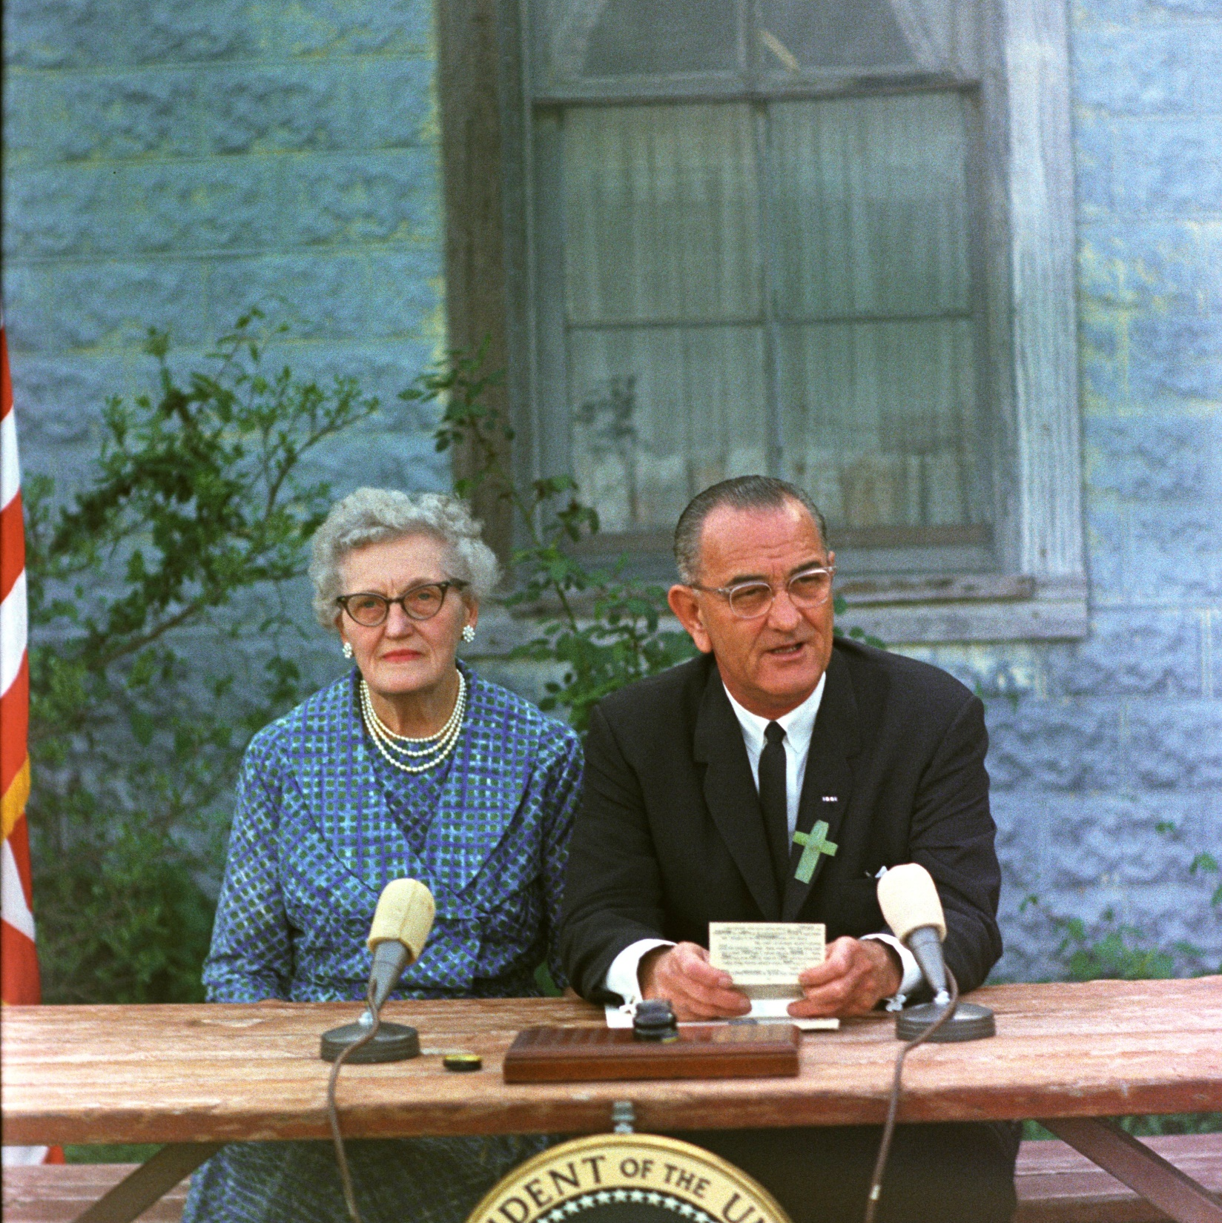
Education President
Title 1, 1965
Signed into law by President Lyndon B. Johnson on April 11, 1965
Lyndon B. Johnson at the ESEA signing ceremony, with his childhood schoolteacher Ms. Kate Deadrich Loney.
The Johnson Administration saw the passage of over 60 education bills, more education legislation than in any other presidential administration. In comparison, only six major education bills were passed from the time of Lincoln to Kennedy.

