Slide 1
High-Quality Mathematics Curriculum & Professional Learning
November 15th, 2022

Slide 2
All students should have learning experiences that are engaging, rigorous, culturally relevant, and affirm and support their identities.
Curriculum Frameworks
Equitable Instruction
Curricular Materials

Slide 3
Research is showing that curriculum matters.
The materials teachers put in front of students matter.
  Providing teachers with access to high-quality, standards-aligned, culturally relevant curricular materials and professional learning can significantly improve student outcomes.
Good materials make teaching and learning easier.
  Well-designed curricular materials can refocus teachers’ workloads, deepen their pedagogical content knowledge, and increase coherence within and across grades.
Well-aligned materials are not necessarily more expensive.
  Ensuring curricular materials’ quality and alignment to standards costs less, builds more human capacity, and scales more easily than many other “interventions” in education.
Notes:
Research continues to show that curriculum matters. [read slide bullets]

Slide 4
Strengthening Curriculum in MA: Theory of Action
If schools and districts have the information and supports they need to provide teachers with access to high-quality, standards-aligned, culturally relevant curricular materials…
and if sustainable and collaborative professional learning structures help teachers use those materials to orchestrate student learning experiences skillfully…
then teacher and student experiences, and ultimately student outcomes, will improve.
Notes:
Our theory of action

Slide 5






Curriculum Matters
Curriculum Matters Goals:
More widespread and systematic use of high-quality, standards-aligned, and culturally responsive curricular materials
More in-service professional learning (PL) focused on educators identifying high-quality, standards-aligned, and culturally responsive curricular materials and using them skillfully
More emphasis in educator preparation (prep) on candidates’ identifying high-quality, standards-aligned curricular materials and using them skillfully
Theory of Action
Mass Literacy Guide
Accelerating Math Instruction
Curriculum Matters
HQIM Implementation Grant
Open Access Professional Learning (OAPL)
Evaluating and Selecting Network
Investigating
History
Notes:
In 2018, CIS developed the Instructional Materials Professional Development (IMPD Focal Area). This Focal Area identified 3 goals (see slide).
CIS developed a multi-year strategic plan that aims to achieve these goals. To achieve these goals, we first needed to define quality and identify high-quality instructional materials. Curriculum Ratings by Teachers (CURATE) is the project that set out to do that. CURATE results in user-friendly published reports that determine the quality of curricular materials used across MA.
But we know that signaling quality is not enough. Therefore in Year 2, we launched the Evaluating and Selecting Network which builds off the work from CURATE in order to support districts to narrow down further through programs that are considered high-quality based on district local contexts.
In the last year, additional projects have been launched to address the rest of our IMPD goals. But today we will only focus on the Evaluating and Selecting Network.

Slide 6




Curriculum Matters
At DESE, we support the district process by providing guidance, assistance, resources, funding, and opportunities.
Notes:
https://www.doe.mass.edu/instruction/impd/implement-ma-process/story.html

Slide 7
Curriculum Matters: What are the costs?
Notes:
https://www.doe.mass.edu/instruction/impd/implement-ma-process/story.html

Slide 8
Curriculum Matters: What are the costs?
Staffing of leadership and coaching
Stipends for Curriculum Council
PD for Curriculum Council
Notes:
https://www.doe.mass.edu/instruction/impd/implement-ma-process/story.html

Slide 9
Curriculum Matters: What are the costs?
Field testing materials
Purchase costs (printing, manipulatives, digital accounts)
Stipends for Curriculum Council
Notes:
https://www.doe.mass.edu/instruction/impd/implement-ma-process/story.html

Slide 10
Curriculum Matters: What are the costs?
Launch Professional Development for teachers & administrators
Stipends for Implementation Council
Notes:
https://www.doe.mass.edu/instruction/impd/implement-ma-process/story.html

Slide 11
Curriculum Matters: What are the costs?
Staffing of leadership and coaching
Ongoing Professional Development
Stipends for Implementation Council
Infrastructure (online access, communication with families, etc)
Teacher collaboration time
Notes:
https://www.doe.mass.edu/instruction/impd/implement-ma-process/story.html

Slide 12
Curriculum Matters: What are the costs?
Staffing of leadership and coaching
Stipends for Curriculum Council
PD for Curriculum Council
Field testing materials
Purchase costs (printing, manipulatives, digital accounts)
Stipends for Curriculum Council
Notes:
https://www.doe.mass.edu/instruction/impd/implement-ma-process/story.html

Slide 13
Curriculum Matters: What are the costs?
Launch Professional Development for teachers & administrators
Stipends for Implementation Council
Notes:
https://www.doe.mass.edu/instruction/impd/implement-ma-process/story.html

Slide 14
Curriculum Matters: What are the costs?
Staffing of leadership and coaching
Ongoing Professional Development
Stipends for Implementation Council
Infrastructure (online access, communication with families, etc)
Teacher collaboration time
Notes:
https://www.doe.mass.edu/instruction/impd/implement-ma-process/story.html

Slide 15
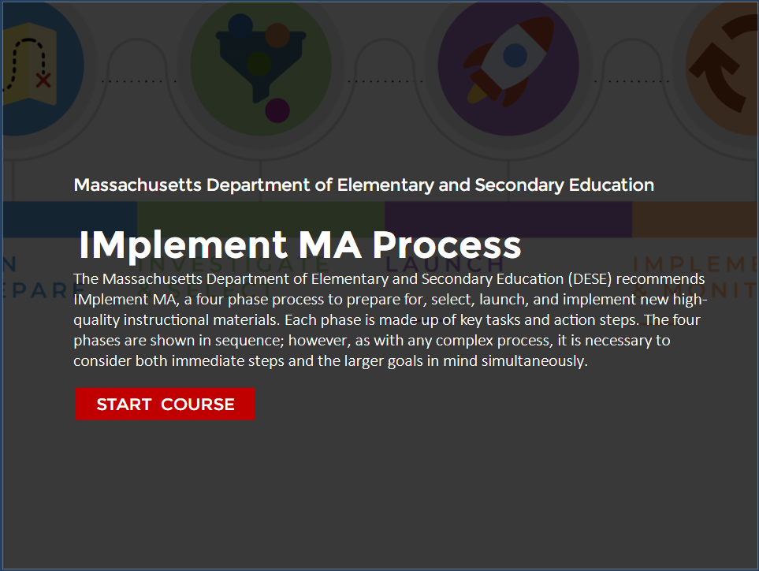
IMplement MA Guide
How can DESE support Massachusetts districts to make a selection for high quality core instructional materials that is a best fit for their local context? How do districts distinguish the strong horse from the imagined unicorn?
Introducing the IMplement MA Guide, the Department of Elementary and Secondary Education's (DESE) high-quality instructional materials adoption process. Grounded in equity for students, the IMplement MA Guide outlines an inclusive four-phase process to select and implement the high-quality instructional materials that best meet each district's local needs.
https://www.doe.mass.edu/instruction/impd/

Slide 16
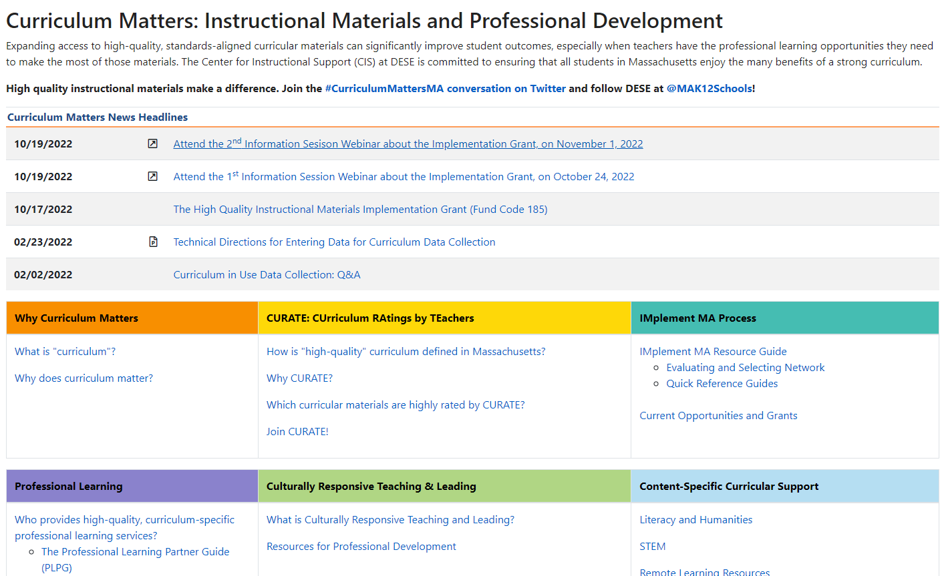
Curriculum Matters
Notes:
https://www.doe.mass.edu/instruction/impd/default.html

Slide 17
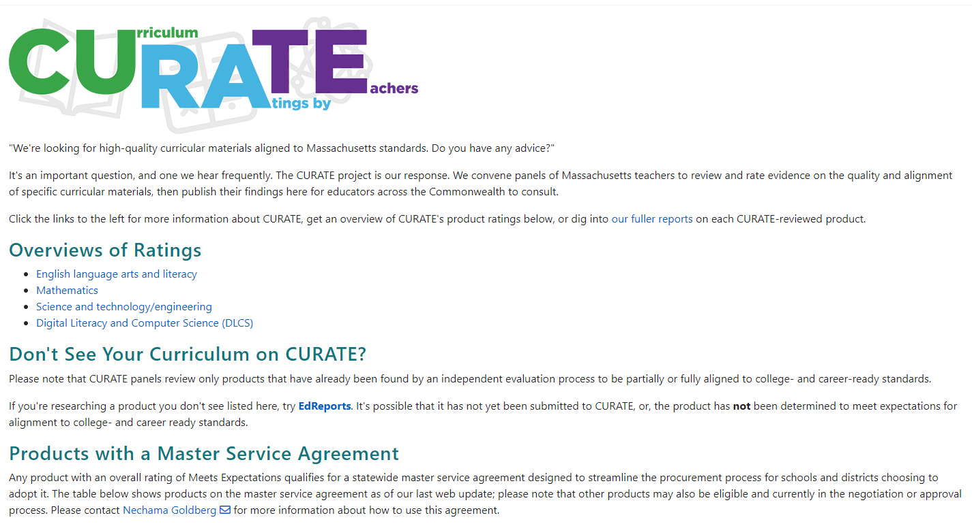
CURATE
Notes:
https://www.doe.mass.edu/instruction/curate/default.html

Slide 18
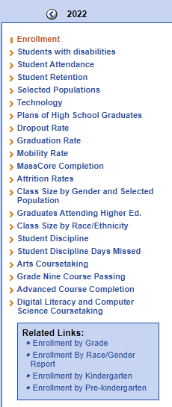
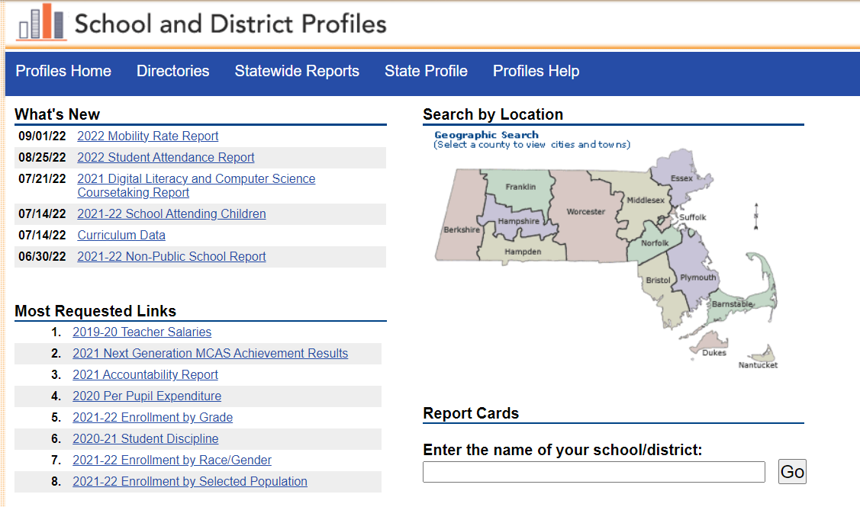


Curriculum Data
c
c
Notes:
Reminder we are collecting curriculum data
School and District Profiles: https://profiles.doe.mass.edu/
Curriculum Data: https://profiles.doe.mass.edu/statereport/Curriculumdata.aspx
DLCS Course Report: https://profiles.doe.mass.edu/statereport/computersciencecourse.aspx
Statewide Reports: assessment and accountability, educator preparation, educators, students, finance, and high school and beyond
Search School or District
School and District Report Cards (Parent facing): https://reportcards.doe.mass.edu/

Slide 19




THANK YOU
Ian Stith, PhD Acting Co-Director of STEM
413-237-8537
Ian.T.Stith@mass.gov
www.doe.mass.edu
75 Pleasant Street, Malden, MA 02148

