Slide 1
DESE Resources/Initiatives related to Behavioral and Mental Health & Social Emotional Wellness
Federal Grants Program Conference – November 15, 2022
Chris Pond & Kristen McKinnon
Assistant Director & Behavioral and Mental Health Specialist Student & Family Support (SFS)

Slide 2
Major Themes
DESE is supporting schools/collaboratives with funding, guidance, and professional development.
We’re seeing promising practices across the state.
Statewide advisory groups are informing the efforts.

Slide 3
DESE Grant Funding
Example includes:
Supporting Students’ SEL, Behavioral & Mental Health (MH), and Wellness through MTSS (SEL & MH Grant)
developing comprehensive, integrated multi-tiered systems for student, family, and educator social-emotional and/or mental health supports; and
building sustainable infrastructure to facilitate integrated coordination between school and community-based services and/or providers.
FY23 continuation SEL Mental Health Grant awardees- https://www.doe.mass.edu/grants/2022/awards/613-311-332.docx

Slide 4
Funding Sources through DESE-Formula
Examples include:
ESSA (e.g., Titles I, IVA…) for districts
ESSER funding (I, II, III)
II QRG: Allowable fund use includes: Social Emotional Supports, Parent and Student Engagement: to address student mental health and wellbeing and engagement in learning
III: To help schools and districts safely reopen and sustain the safe operation of schools and must respond to the academic, social, emotional, and mental health needs of all students, and particularly those disproportionately impacted by the COVID-19 pandemic.
In FC 119 RFP (4-yr total amounts posted): 20% min. of district ESSER III funds to address lost instructional time through the implementation of evidence-based interventions and ensure that those interventions respond to students' social, emotional, and academic needs and address the disproportionate impact of COVID-19 on underrepresented student subgroups…
Submitted early Oct. 2021, with updated plans due approx. every 6 months until 9/30/23

Slide 5
Guidance/Information/Professional Development
Examples include:
Holistic Support and Enrichment, SEL, Health and Safety Newsletter
Sign-up & See Past Issues
Mental & Behavioral Health and Wellness Supports
Multi-Tiered Systems of Support (MTSS) Academies
E.g., SEL/Mental Health, Systemic Student Support (S3), and Culturally Responsive Teaching

Slide 6
District Presentations
Agawam
Phoenix Charter Academy- Lawrence
Plymouth

Slide 7
AGAWAM Public School

Slide 8
The Challenge: Pandemic Angst!
Our number of psychiatric crisis referrals had increased.
Due to the lack of intensive mental health options and hospitalization services, most students are turned away or were waiting for days for assistance, even weeks in the ER for a placement.
Many of our students were not deemed in need for further intensive support.
Students would come back to school the next day with no information, no supports in place, leaving staff vulnerable in creating support plans that were not meetings student’s high level needs.

Slide 9
Building comprehensive mental health systems to support students, families, and school staff.
Used grant money last year to hire a consultant to work with SEL Director and created stipend positions for staff to support the work.
Outcome:
Purchased updated SOS curriculum which included training videos (It is free as of last year and this year)
Trained staff to use the BSAD
Trained staff to use the Columbia-Suicide Severity Rating Scale as a follow up for BSAD when students answer yes to having suicidal thoughts.
Collaborated with local Children’s Behavioral Health Initiative crisis director to develop better reporting standards in order for the evaluator to have pertinent information when making decision around care.
Incorporated a SAFE-T Protocol
Developed tools for data collection
Last year:
Focused on piloting mental health screening
We built off current practices: Used the SOS (Signs of Suicide) program Pre-Covid.
SOS is an evidence-based, universal prevention program for middle and high school students
SOS includes Brief Screen for Adolescent Depression screening (BSAD)
What we realized:
No one was really trained in the program for years
We had an outdated curriculum
No one was trained on how to use the BSAD
There were practices being used to handle the outcomes of the BSAD.
This year:
Increasing the use of SOS with students and strengthening the practice of using the protocols developed
Used grant money to continue work with consultants and stipend positions for staff to develop comprehensive and coordinated re-entry meetings when students return to school after a crisis
What we realized that informed our next steps:
We need to reach out to our most used therapeutic services providers and stakeholders to contribute to the protocol and build common language.
Work with families and school staff to develop re-entry plans that incorporate tiered interventions.

Slide 10
Phoenix Charter Academy

Slide 11
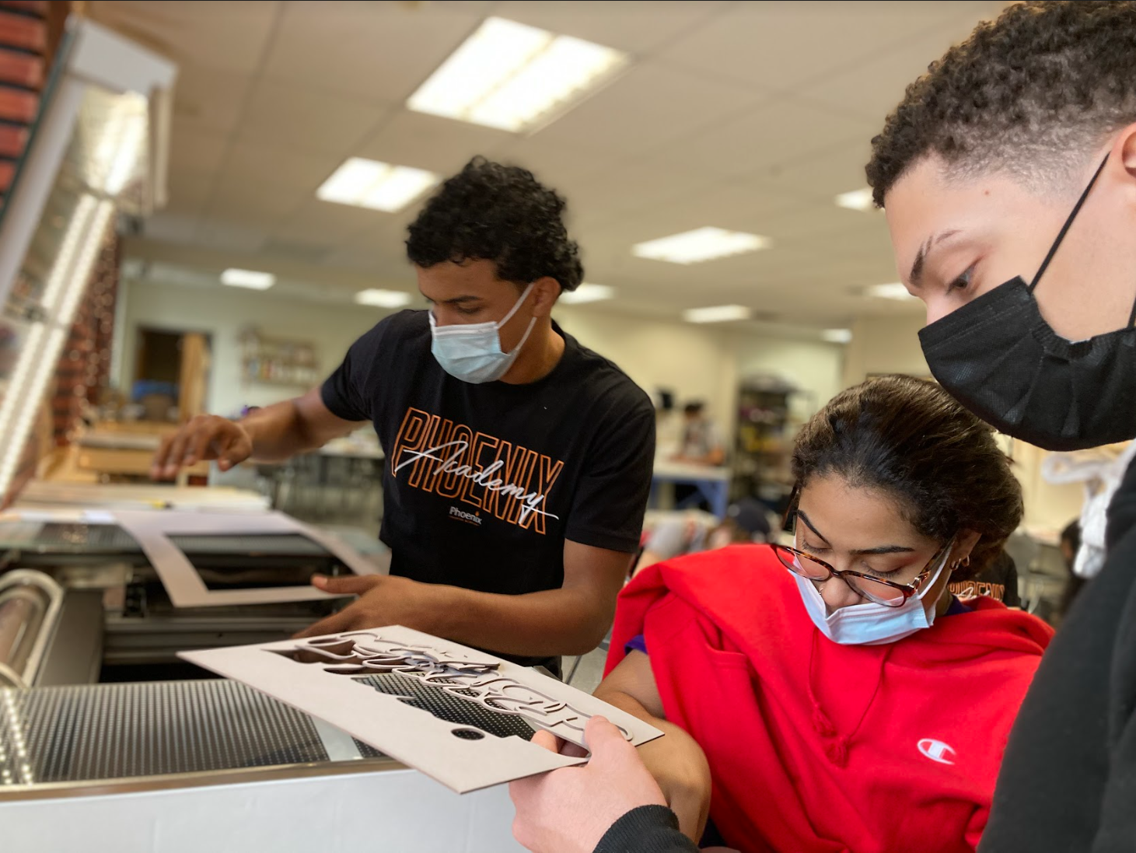
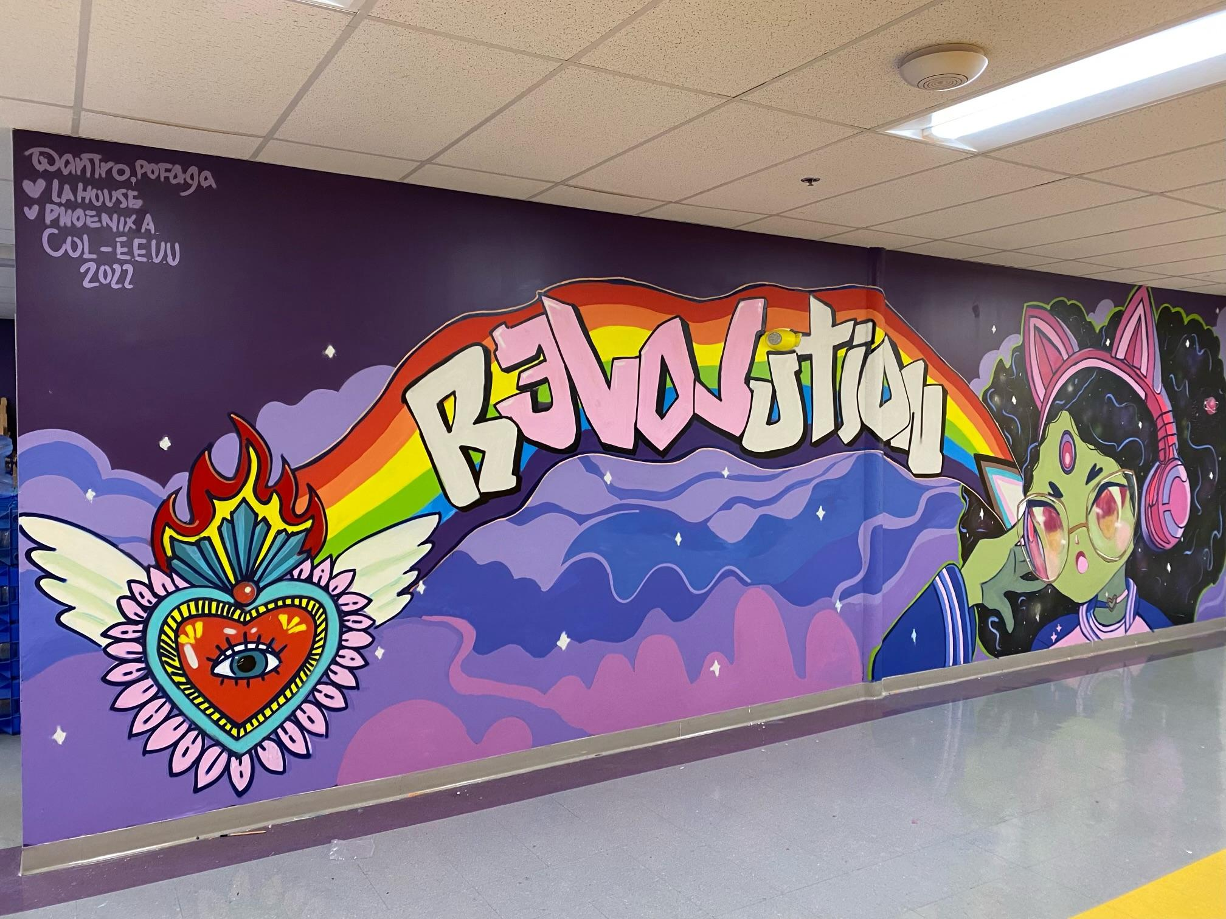
MTSS @ Phoenix
Charter Academy:
Using Federal Grant Funds to Support Social-Emotional Learning &
Student Mental Health
Federal Grants Programs Conference Breakout Room
Erin McNiff: School Social Worker & Program Coordinator
@ Phoenix Lawrence
Sol Pakes: Director of Development @ Phoenix Network

Slide 12
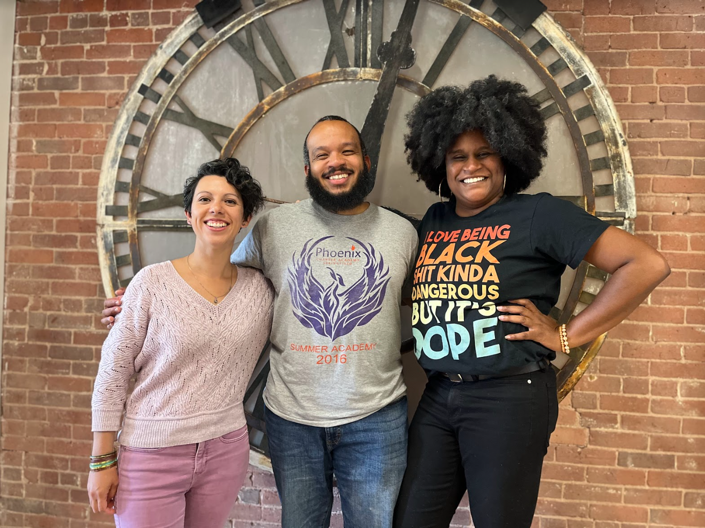
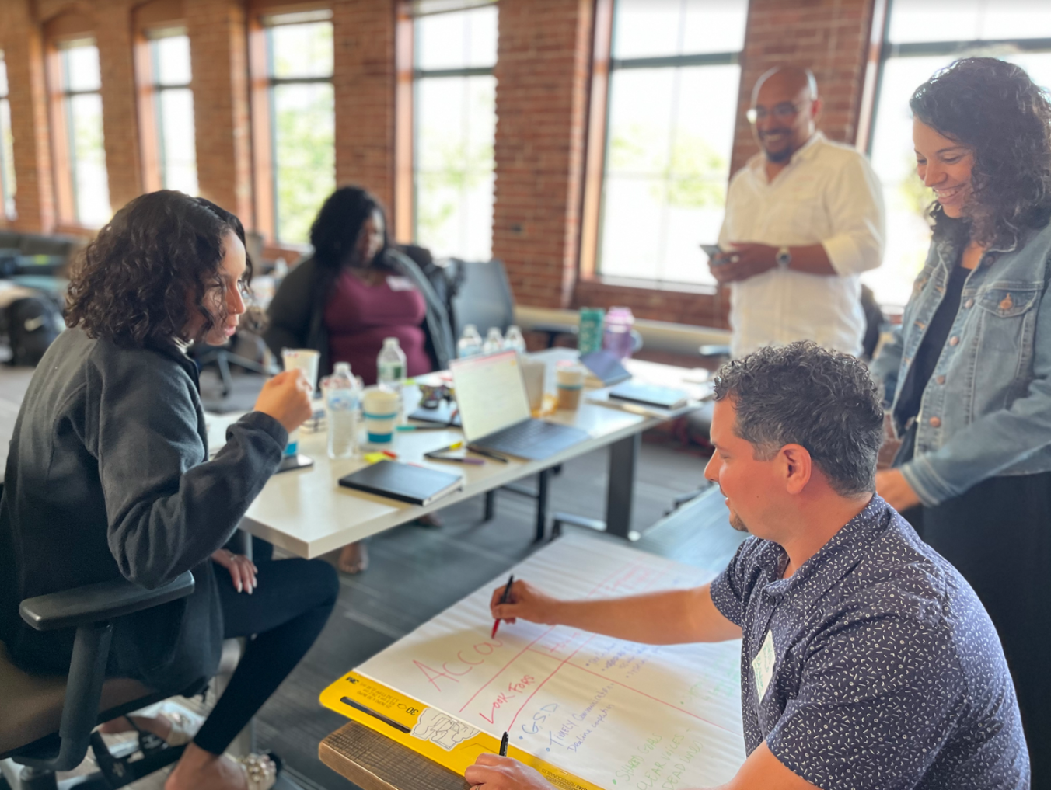
Organizational Challenges
Three distinct campuses, each with a unique vision, as well as and distinct strengths and needs;
Increased student need for SEL and mental health services; macro-disruptions on the societal level (e.g., COVID-19, social media)
Evolving / expanding funding landscape (e.g., ESSER funds)

Slide 13
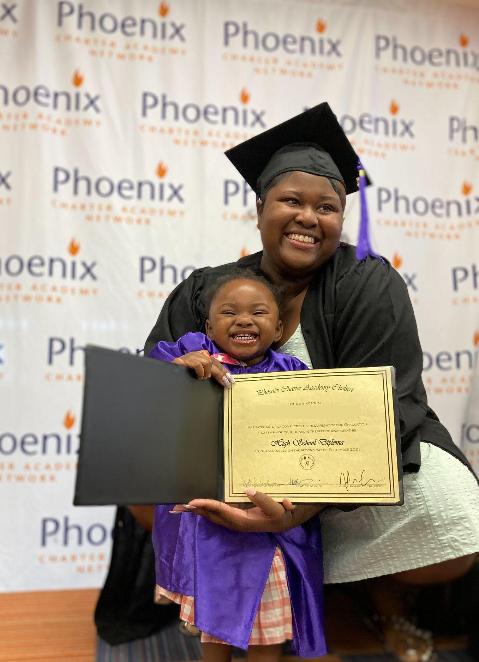
Promising Practices - Organizational
Unity of mission and clarity / transparency of funding priorities
Continuity of collaboration between district-level team and program / implementation teams
Partnerships with community-based organizations, which provide:
Additional expertise in mental health and SEL
Community context & cultural relevance
Increased capacity for program implementation
Case study on next slide!

Slide 14
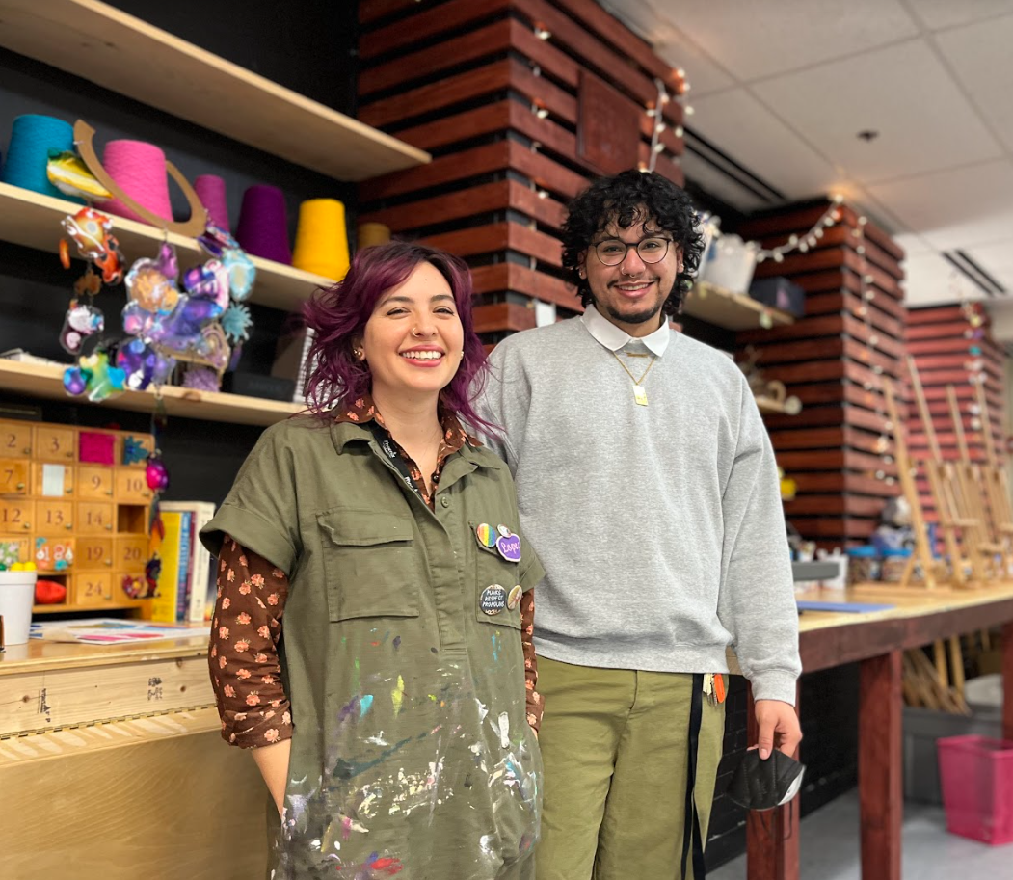
Promising Practices - Case Study
Partnering with Community-Based Organization:
The Makerspace
Phoenix Lawrence and La House have partnered to provide formalized art based therapeutic supports in several ways:
Weekly open studio classes with therapeutic milieu- serving all PAL students
Small focus group classes targeted to a particular medium and interest (branding, tufting, wordsmithing)- small group classes
Individual therapy sessions with licensed art therapist and sessions with art facilitator- individual level support

Slide 15
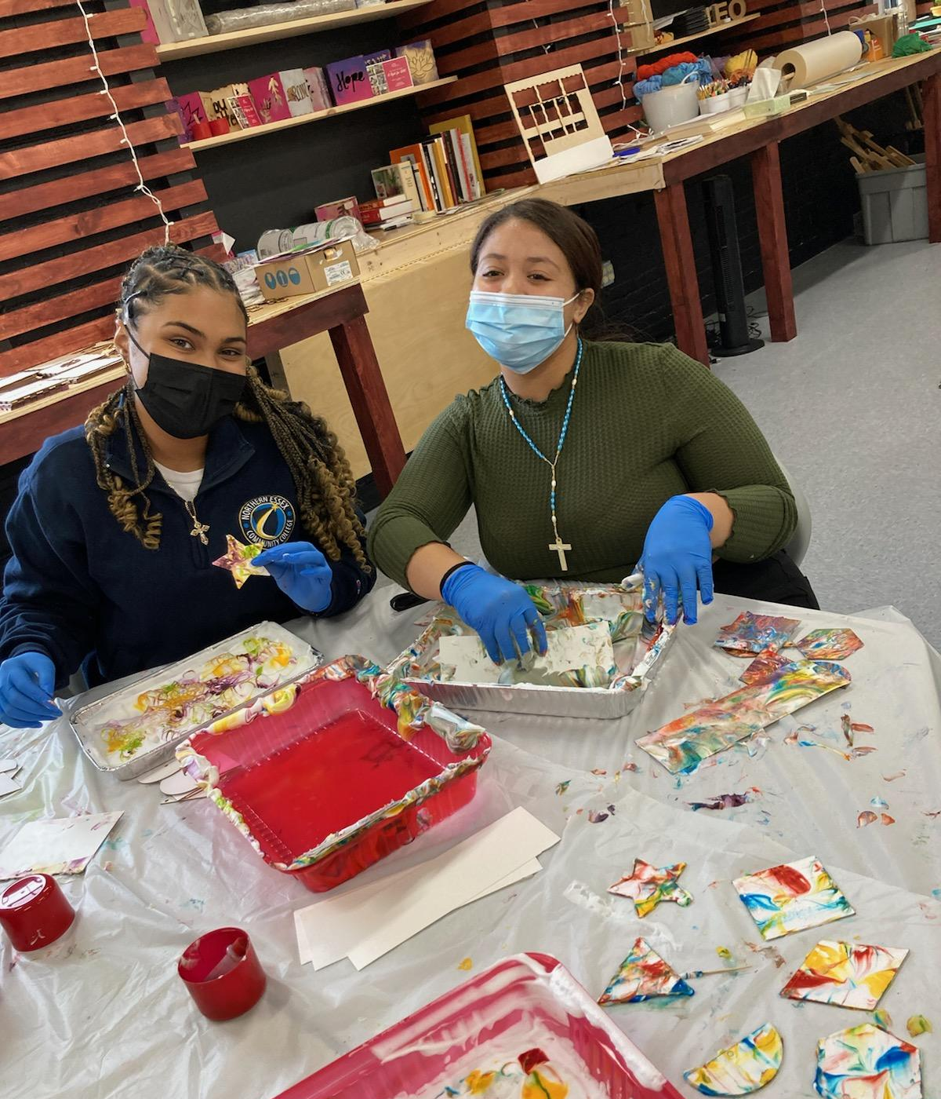
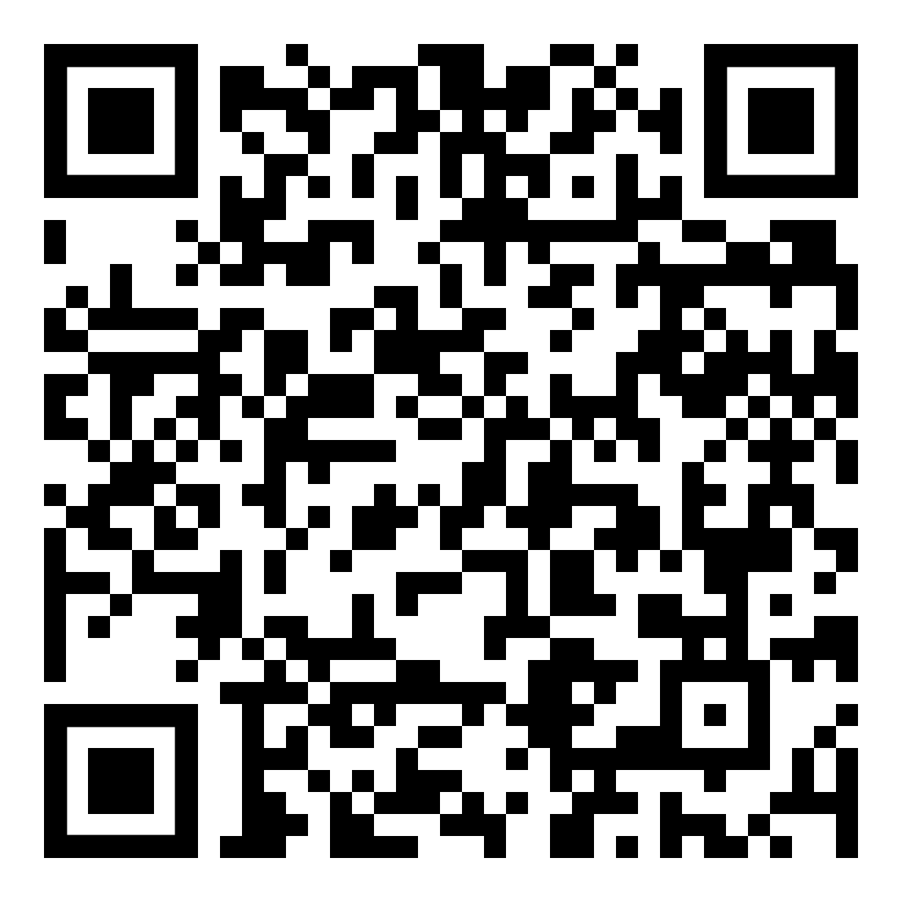
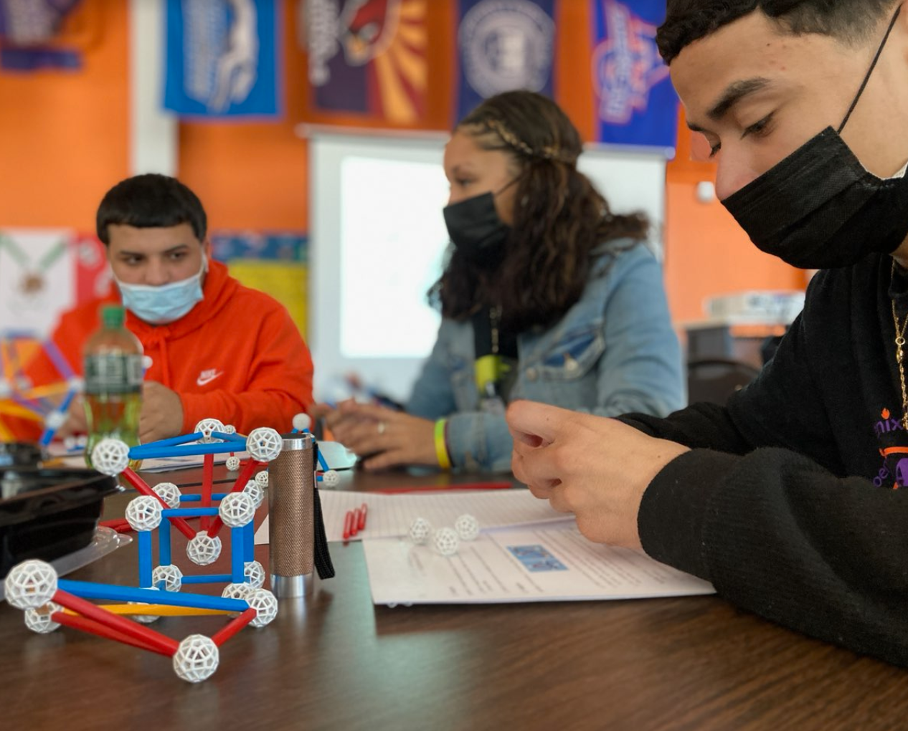
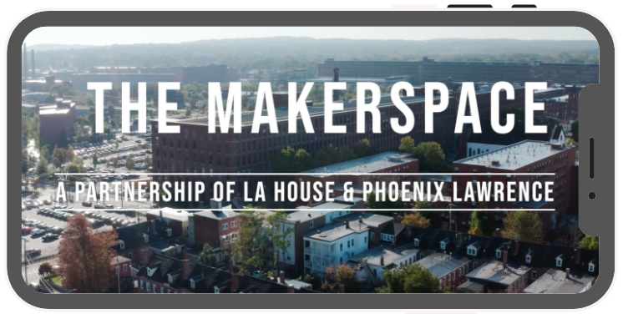
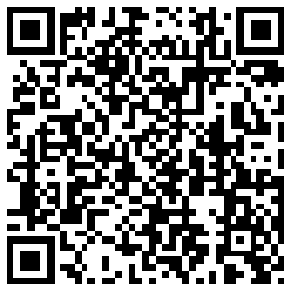
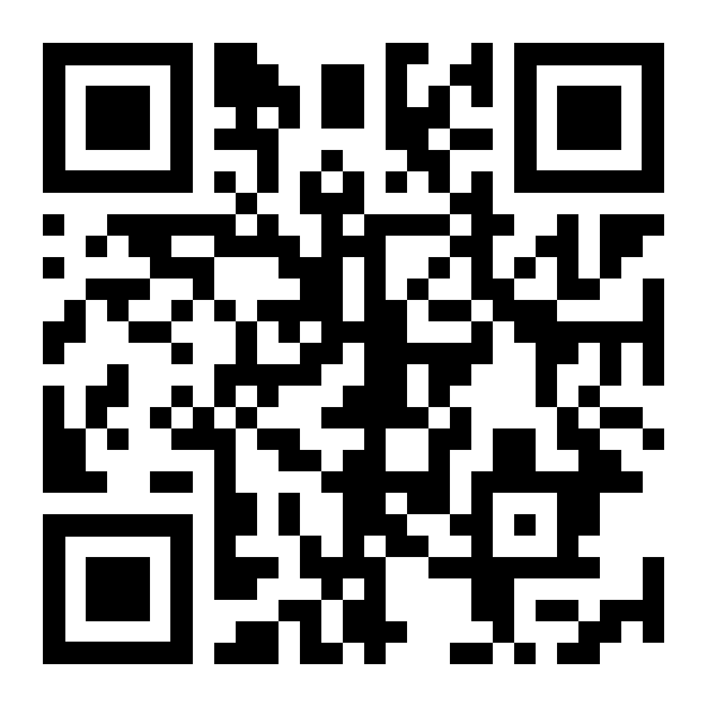
Find Out More & Stay Connected!
You can visit our websites at:
www.phoneixcharteracademy.org
www.lahouse.org
To learn more about the Makerspace, feel free to check out our brand new video @ https://tinyurl.com/2p99r89a

Slide 16
Plymouth Public School

Slide 17
Plymouth Public Schools
Using SEL data collection to support multi-tiered systems of support

Slide 18
District Wide SEL Data Collection
In an effort to use data driven practices to support MTSS interventions,, we have prioritized:
Creating and monitoring SEL interventions at the Tier 1, 2, and 3 level
Consistent use of student surveys regarding social emotional learning
To reach this goal, PPS uses Panorama, an all-in-one data platform that tracks student social emotional learning competencies through their educational career in the district.
Challenges: Due to the size of our district (over 7,000 students across 13 schools), maintaining consistency in utilization of the platform has been difficult

Slide 19
Promising Practices
Promising Practices: Through our partnership with Panorama, we have been able to:
Provide staff with a library of interventions. Using Playbook – Panorama’s professional learning library – school leaders and educators can move from understanding data to taking action and implementing specific strategies or interventions
Streamline the CST process
Roll out teacher and student surveys twice a year. These surveys address belonging, teacher-student relationships, student engagement, school safety, and other SEL related topics. Panorama’s Social-Emotional Learning measures are well-aligned CASEL framework.
This year we have created building based teams to support the utilization of the platform as a “boots on the ground” model

Slide 20
Thank You
achievement@doe.mass.edu
781.338.3010
www.doe.mass.edu/sfs
Office of Student & Family Support (SFS)

