Slide 1
Principal Induction and
Mentoring Handbook
November 15, 2022

Slide 2



Partnership

Slide 3
Thought to Ponder
Leading in a Culture of Change (2001), Michael Fullan identifies five characteristics of effective principal leadership: moral purpose; understanding the change process; strong relationships; knowledge sharing; and coherence or connecting new knowledge with existing knowledge.

Slide 4
Background & Context
1

Slide 5

Table Talk
What is the difference between between coaching and mentoring?
What are the characteristics of your current principal induction program?

Slide 6
Framing the Purpose
“An effective principal’s impact is stronger and broader than previously thought, making it “difficult to envision” a higher return on investment in K-12 education than the cultivation of high-quality school leadership. - The Wallace Foundation, How Principals Affect Students and Schools, June 2021
The Department of Elementary and Secondary Education (DESE) is seeking to strengthen school leadership in Massachusetts by focusing on the standards and expectations that govern the design and execution of:
Administrator preparation programs, and
Strengthening the alignment and partnership between pre-service preparation and in-service PK-12.
Performance Assessment for Leaders (PAL)
“The school leader is integral to school success and vital to student achievement... However, in Massachusetts, this goal is elusive.” - The Barr Foundation, Strengthening School Leadership in Massachusetts, June 2019

Slide 7
Theory of Action
In order to disrupt historical patterns of racial inequities, we need effective, anti racist leaders who are more prepared and better supported to remain in Massachusetts schools.
If principal preparation programs are cultivating ongoing critical self-reflection, anti racist leadership competencies, and collective advocacy in their principal candidates, and if licensure assessments support these competencies, then candidates become novice principals who are positioned to:
Continually create, identify, and uphold antiracist school policies and practices that disrupt systemic racism;
Continually support and develop educators that use culturally responsive and sustaining practices and high-quality curriculum and instructional materials that are rigorous and culturally relevant for all students; AND
Continually embed oneself and educators with knowledge and strategies specifically designed to recognize and eliminate racism in instructional practices and one’s own leadership practices,
which leads to:
improved outcomes and experiences for Black, Latinx, Indigenous, Asian, and Multiracial students; and
improved experiences for educators, which will increase the retention of effective, culturally responsive teachers in MA schools

Slide 8
Aligned Efforts in PK-12
PREPARATION
Revised Guidelines for the Preparation of Admin. Leaders
NOVICE PRINCIPALS
Model Principal Induction & Mentoring Handbook
THE FOUNDATION
Anti-Racist Leadership Definition and Competencies
Notes:
Lastly, we want to acknowledge that as you move forward with this work, we recognize it puts us slightly out in front of your PK12 colleagues, particularly with regard to how effective practice is currently defined within the written indicators and ed eval expectations for PK-12. Given the urgency and importance of anti-racist leadership, we are forging ahead while we continue to work with colleagues across the agency to build out additional resources, supports, and aligned expectations for PK-12.
There are two key projects that will help bridge this gap, and support a learning trajectory from preparation into a principal’s first years as a school leader. First, is our Principal Induction and Mentoring Handbook. This handbook is a resource districts can use to support their principal induction and mentoring program, and was designed in partnership with our PRAC members based around both the antiracist leadership competencies that served as the foundation for the Guidelines revisions. We hope that this work encourages districts to further support leaders to develop the anti racist leadership competencies.
(next slide is the second project – Ed Eval updates)

Slide 9
Vision for Mentoring and Induction
The Principal Induction and Mentoring supports all novice principals in completing a rigorous and cohesive induction and mentoring program that develops, supports, accelerates, and sustains effective, equitable leadership practices, skills, and dispositions to improve outcomes for all students and educators.
This is accomplished in collaboration with highly skilled mentors who provide meaningful and sustained strategic planning support and consistent, ongoing feedback to help novice principals build a repertoire of equitable and culturally responsive strategies, content knowledge, and skills to maximize teacher and student learning.

Slide 10
Purpose of the Principal Mentoring and Induction Handbook
Includes tools for mentors to use with novice principals to support Anti-racist leadership
Provides the support and guidance necessary to develop Anti-racist principals
Not self-directed tools for novice principals to complete independently

Slide 11
Structure of the Principal Mentoring and Induction Handbook
Introductory Module
Professional and Inclusive Culture Module
Instructional Leadership Module
Human Capital Development Module
Inclusive and Responsive Engagement Module

Slide 12
Introductory Module
2

Slide 13
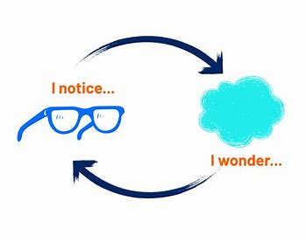
Module 1 : Exploration
Take 5 minutes to explore the module.
What do you notice?
What do you wonder?
Potential barriers?
Potential successes?

Slide 14





Introductory Module
Design
Purpose
Timeline
Planning

Slide 15
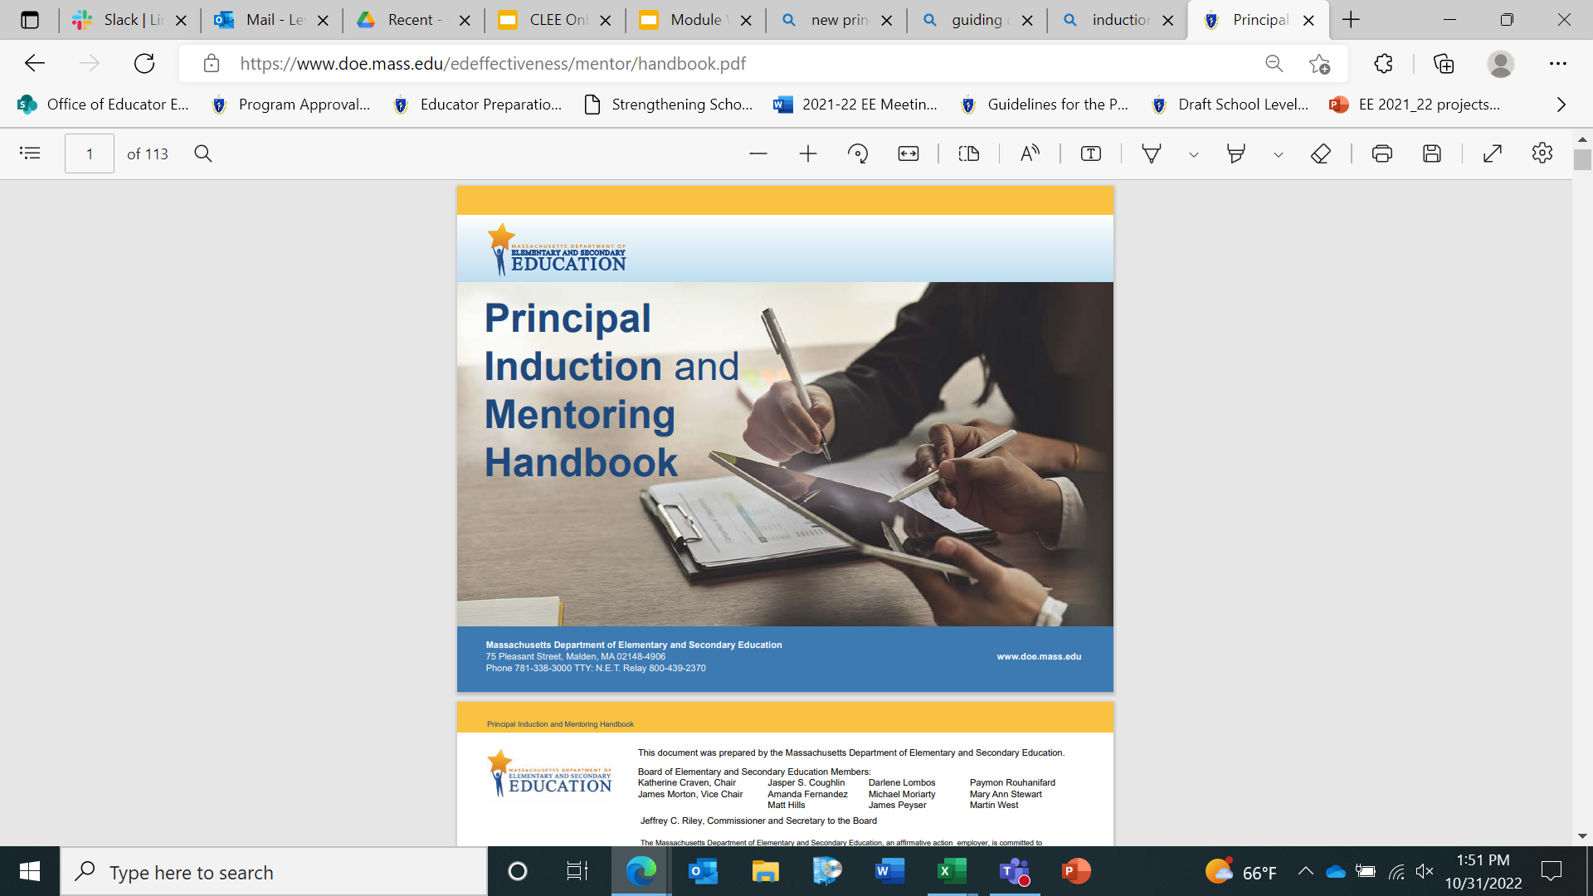
Introductory Module- Where to Start?
This module should be completed first. This module lays the foundation for new principals.
Ideal implementation would from July-September.

Slide 16
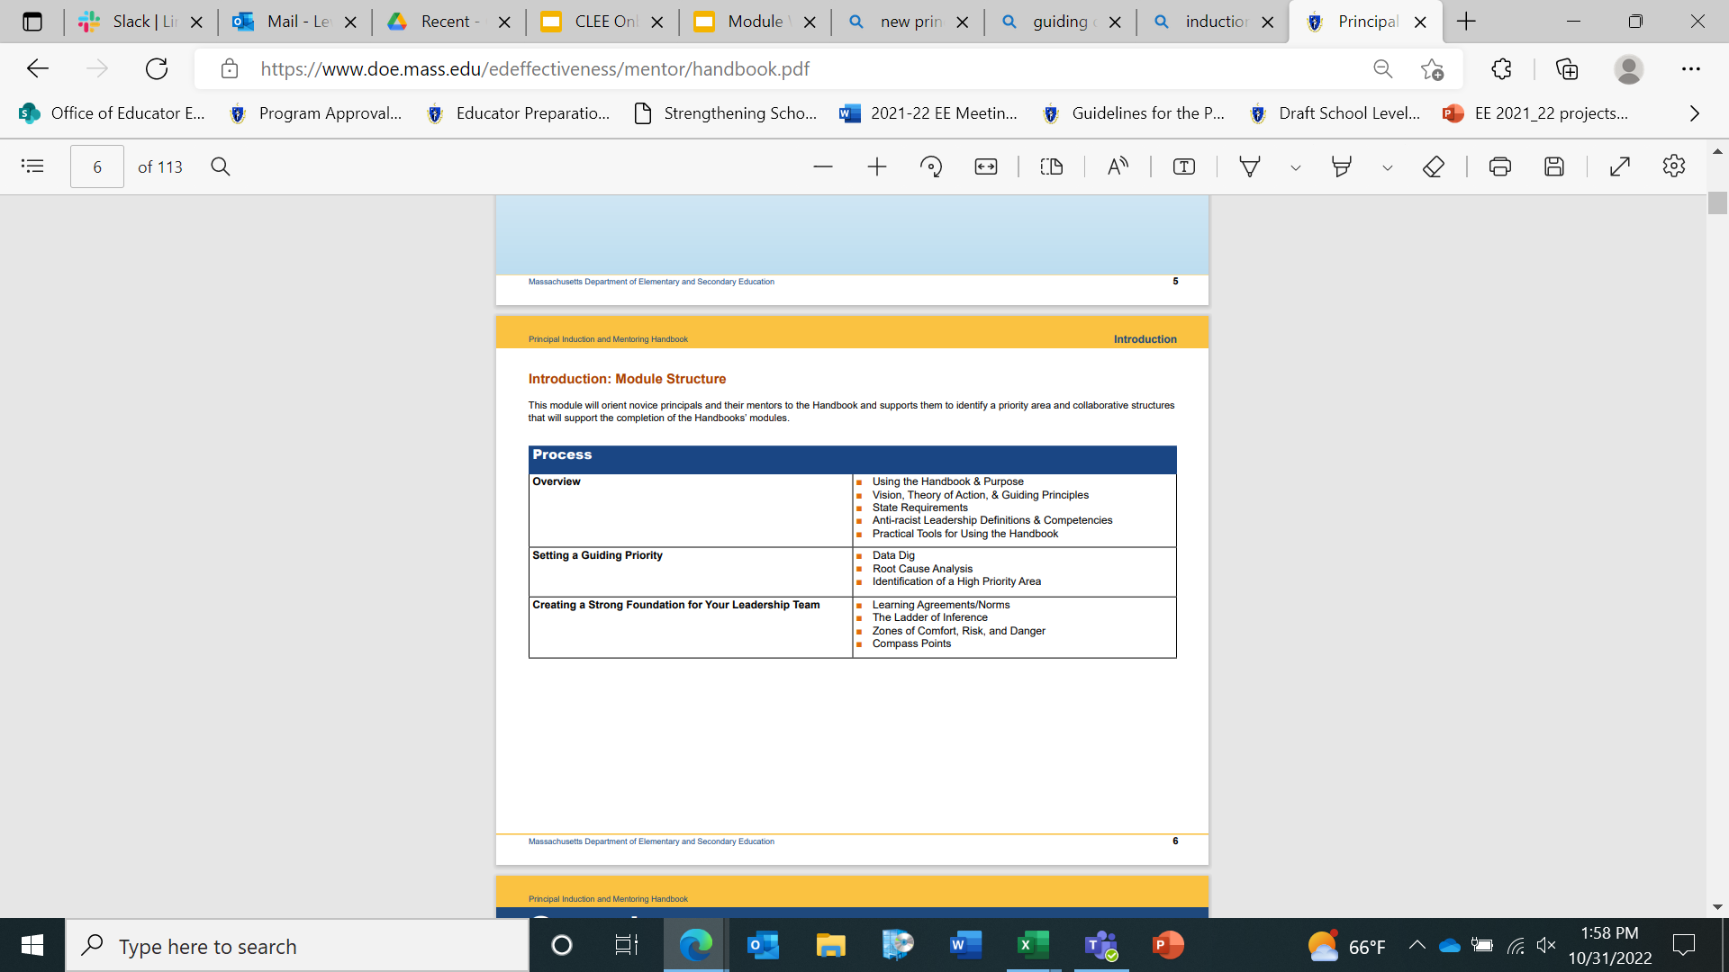
Introductory Module
This module:
Provides context by introducing the Anti-racist Leadership Competencies and Leadership Standards
Includes Data Dig and Root Cause Analysis
Incorporates Important Tips for Mentors

Slide 17
Introductory Module- Data Focus
This module requires each participant to engage in a data dig tasks that ultimately will leads new leaders to the identification of equity focal group and problem statement. Data to consider:
MCAS data
STAR data
Comparative data

Slide 18
Introductory Module- Data Focus
The data dig process
Root cause analysis is structured with a protocol
Leads to identification of a high priority area
Is revisited throughout the completion of the modules within the handbook
Determines order for completion of remaining modules

Slide 19

Introductory Module- Table Talk
Which of the anti-racist competencies were visible and effective in this module?
What support do you need to implement this module effectively within your organization?
What components of this module stand out to you?

Slide 20
Module Structure
3

Slide 21
Remaining Modules
Module 1: Professional and Inclusive Culture
Module 2: Instructional Leadership
Module 3: Human Capital Development
Module 4: Inclusive and Responsive Engagement

Slide 22




Module Stages*
Learn Individually and Collaboratively
Collect and Analyze Data
Set Learning Goals
Implement Continuous Learning Plan

Slide 23
Module Tools
Tools within each stages were developed to help novice principals lead through an Anti-racist lens
Tools are intended to replicate responsibilities novice principals should fulfill within their role

Slide 24
Completing the Modules
4

Slide 25
Recommended Timeline
To complete all modules within two years the following timeline is recommended:
Module | Dates for Completion
Year 1
Introduction | July - September
Module #____________ | October - January
Module #____________ | January - May
Year 2
Module #____________ | August - January
Module #____________ | January - May

Slide 26
Recommendations
Mentors should schedule bi-weekly meetings with mentees
Meetings should be structured to include support within the role and support to complete the modules
A meeting agenda template and example are provided in the Introductory Module

Slide 27
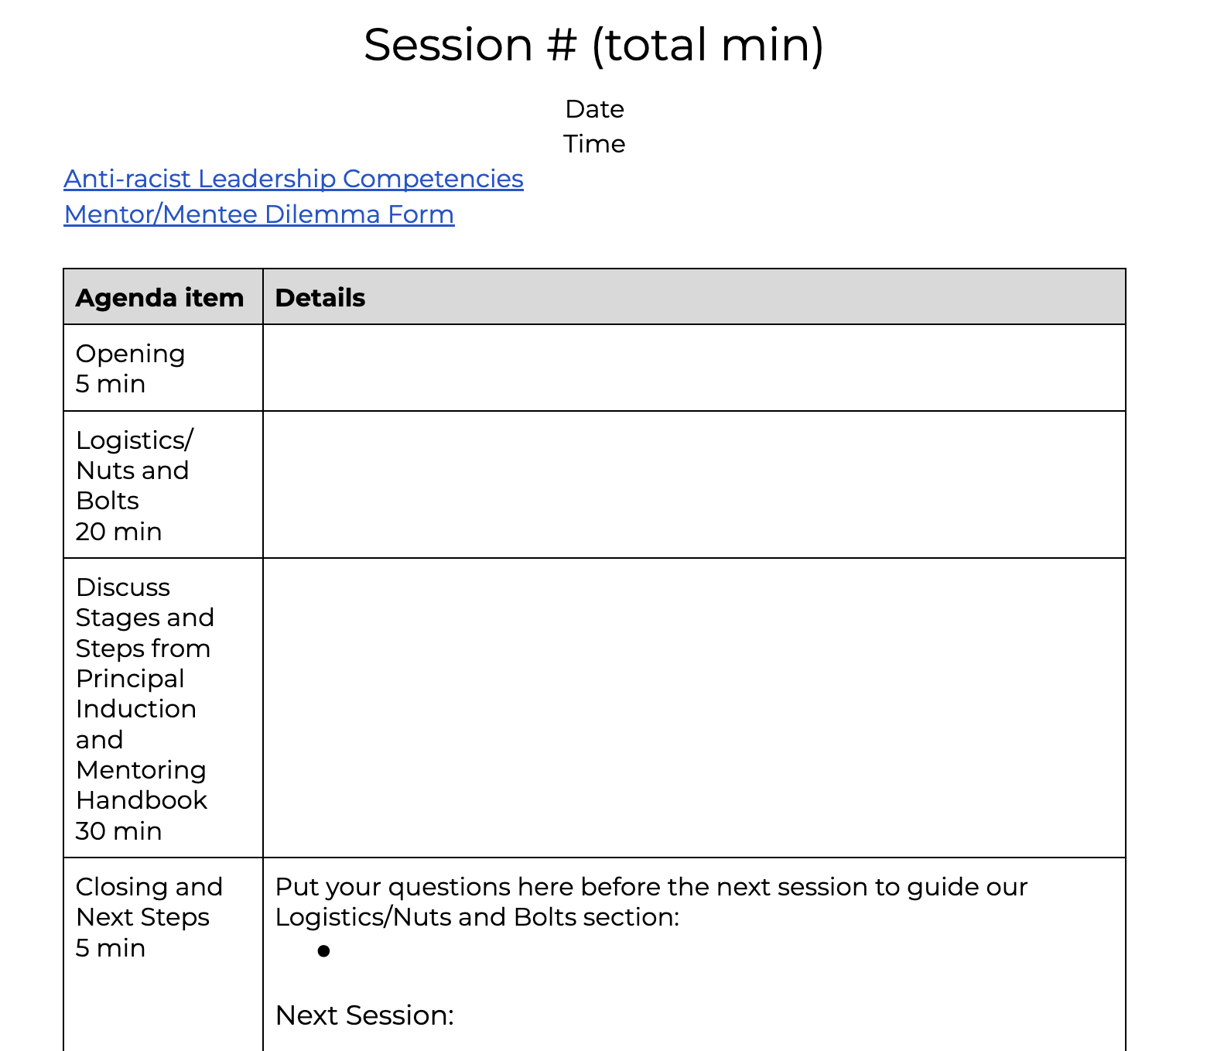
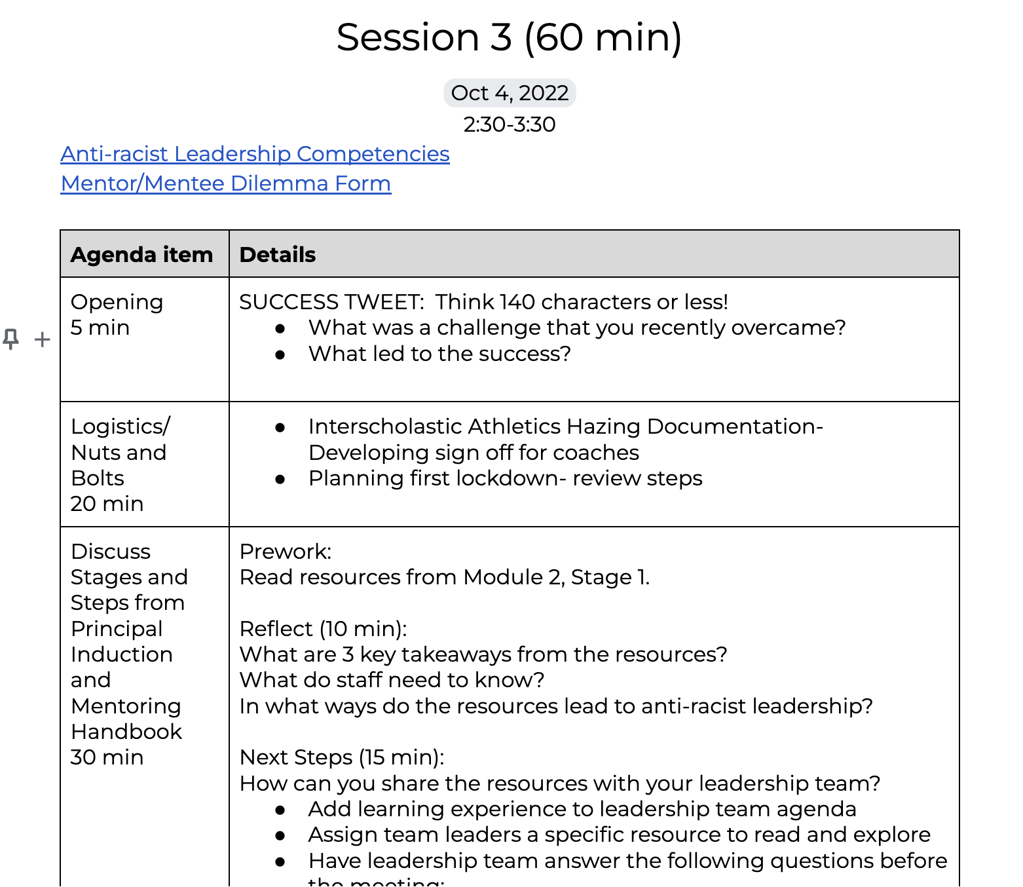
Meeting Agenda Template

Slide 28

Implementation Planning

Slide 29

Questions

Slide 30
THANK YOU

