Slide 1
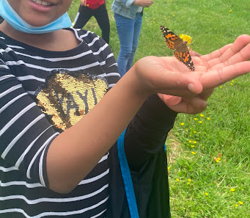
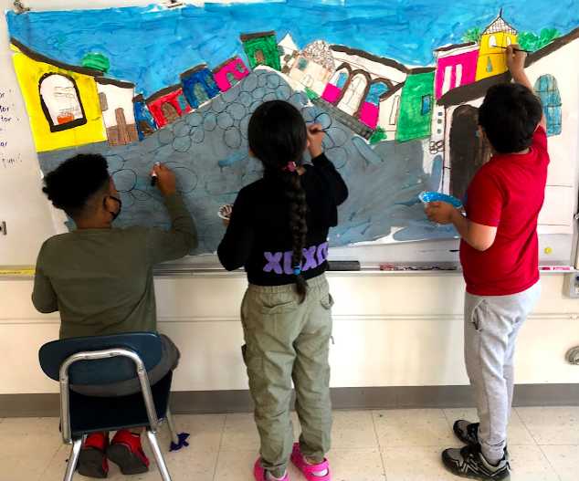
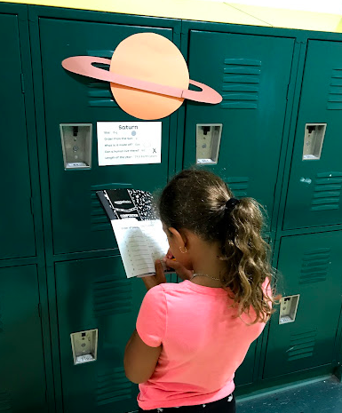
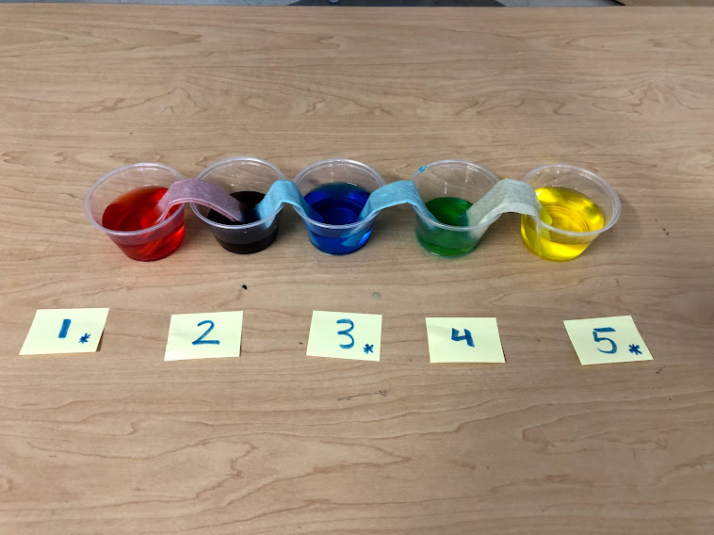
A lab!
Marta García - Massachusetts Teacher of the Year 2022
November 15th, 2022
“A look inside my world as a teacher of English to multilingual students”
I teach outdoors!
A museum!
In the hallway!

Slide 2
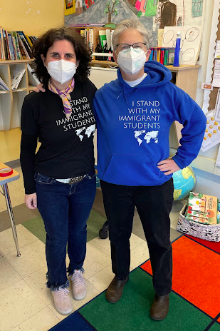
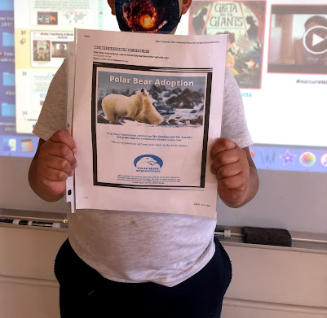
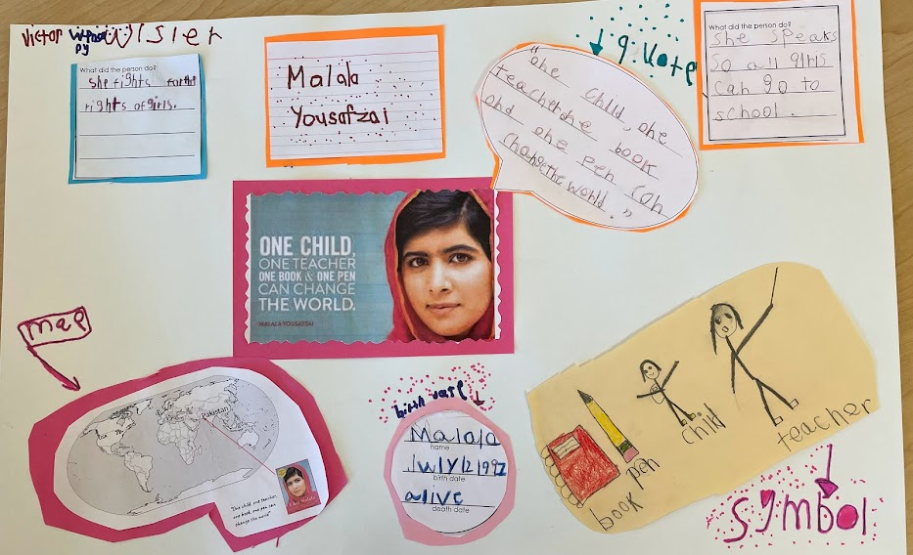
Teaching is ADVOCACY and ACTIVISM
As a class, we adopted a polar bear
We learn about young leaders who inspire us
“I stand with my immigrant students”

Slide 3
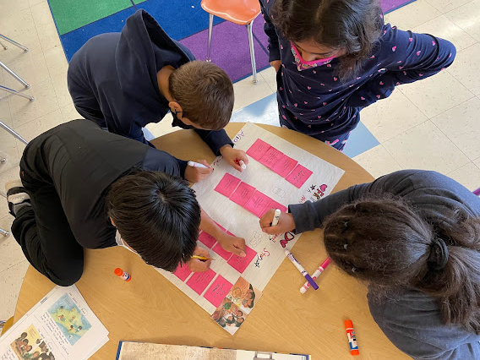
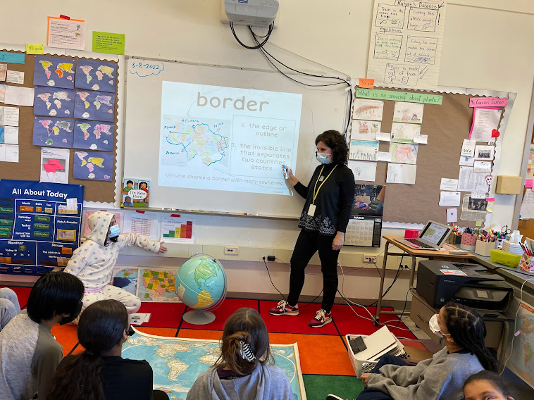
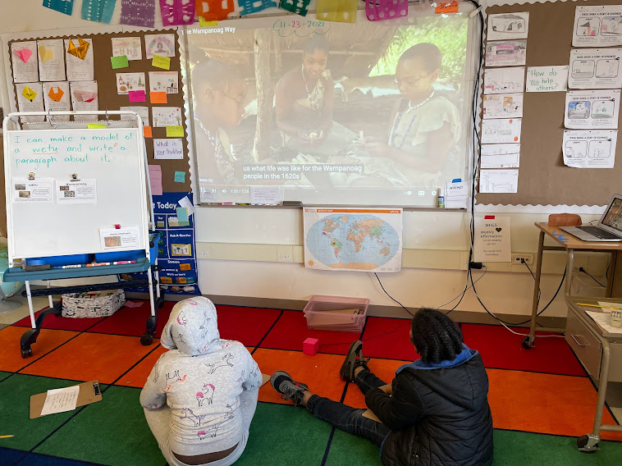
Do-Nows
Worksheets
Journaling
Structuring My Class To My Students’ Needs
You have to be open to switch the structures around based on circumstances and emotional needs
Reading or video on current unit or topic
Do-Now → Centers → Read Aloud → Group
or Video Discussion
Centers
Reading
Vocab
Hands-On activities
Whole group debrief

Slide 4
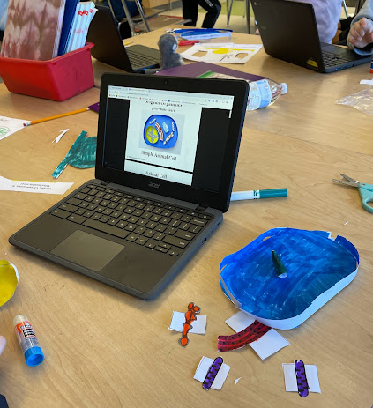
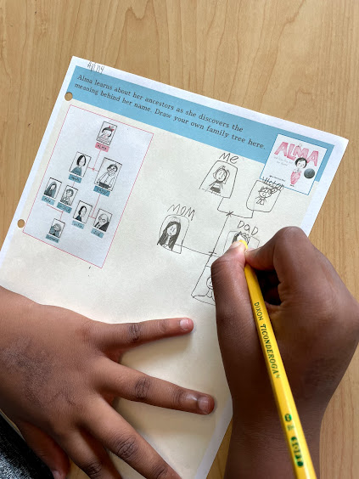
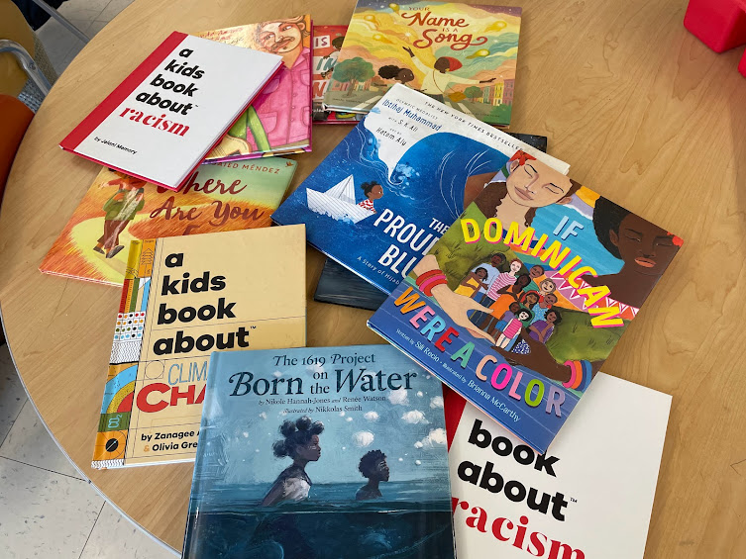
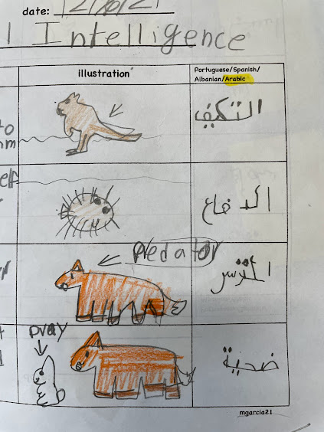
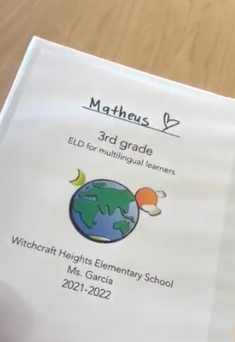
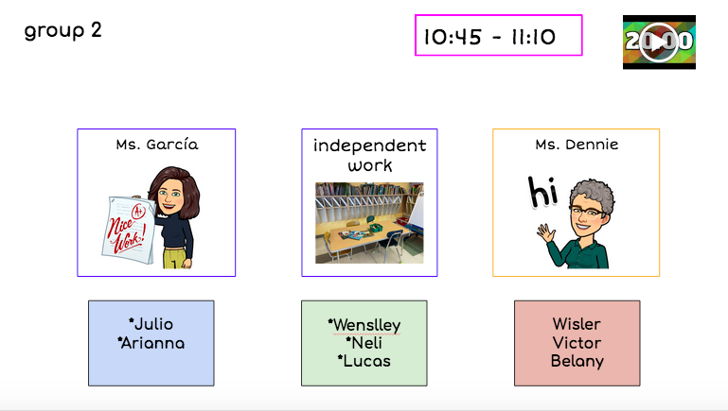
A Few of My Favorite Teaching Tools
in color
books
chromebooks/iPads
binders
visual centers
graphic
organizers

Slide 5
Albania 🇦🇱
Dominican Republic 🇩🇴
Guatemala 🇬🇹
Puerto Rico 🇵🇷
“The world is sitting in your classroom.”
-Emily Francis
@emilyfranESL

Slide 6
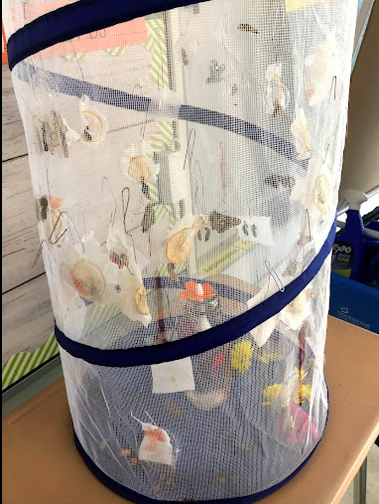
Carlos and His Butterflies
“Las mariposas se paraban en mi cabeza y en mis hombros y revoloteaban en mi habitación.”
Butterflies would stand on my head and on my shoulders and fly free in my bedroom.

Slide 7
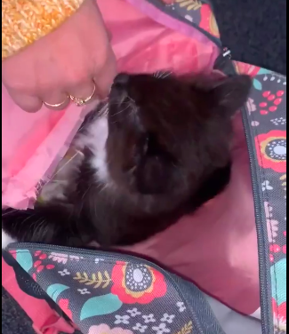
Emily: “the cat lady”
“I have a new kitten, her name is Bella, and I love her so much!”

Slide 8
Alex In The Desert
“The desert is really dark and cold at night, and you need to be careful because there are snakes and the migra/border patrol are looking for people crossing to the U.S.”

Slide 9
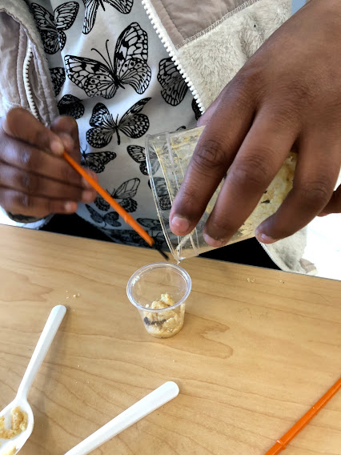
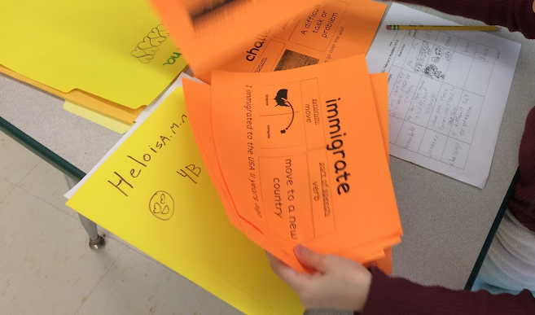
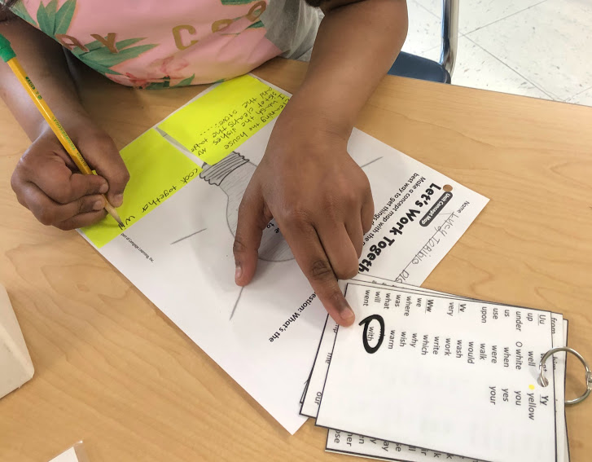
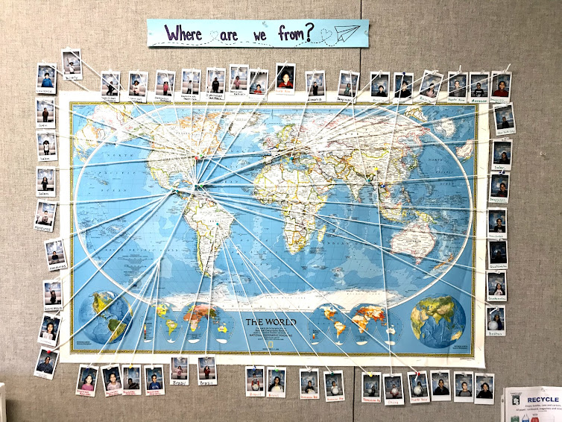
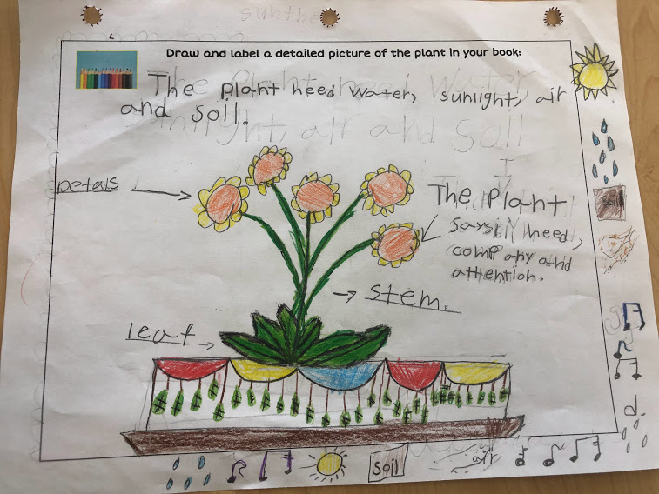
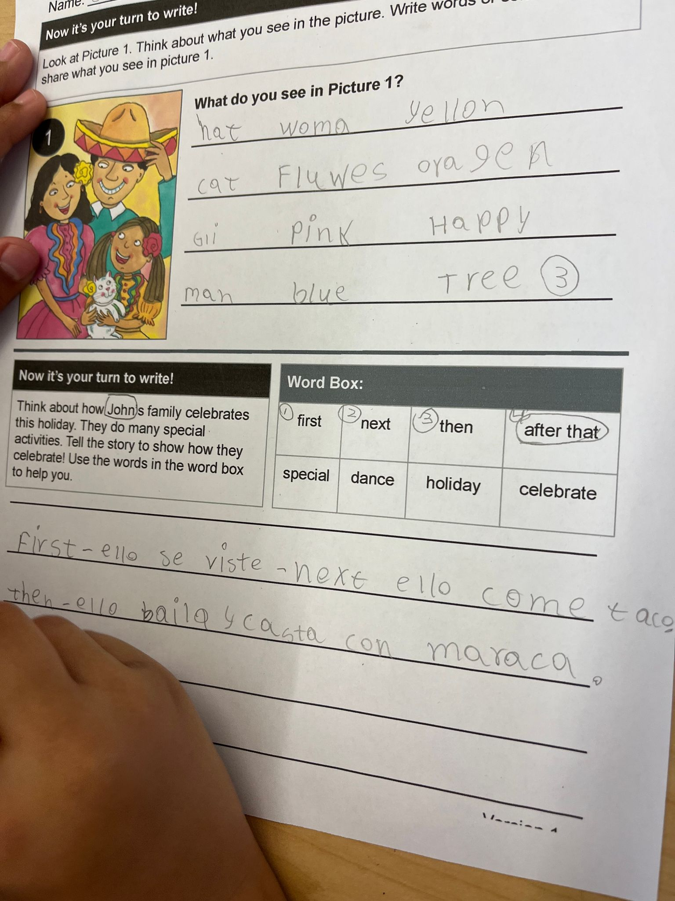
They are My “Why”

Slide 10
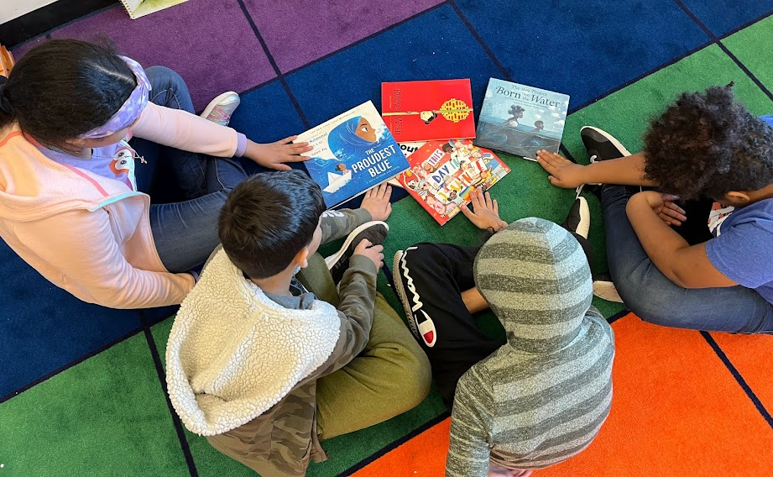
Thank you!
Marta Garcia
e-mail: mgarcia@salemk12.org
@martagcuasante
@marta.garcia2022

