Slide 1

Strengthening Partnerships
A Framework for Prenatal through
Young Adulthood
Family Engagement in
Massachusetts
Notes:
In these next few minutes we are going to provide you with an overview of the Massachusetts Family Engagement Framework

Slide 2

Federal Grants Convening
Tuesday, November 15, 2022
Presentation by:
Donna Traynham
MA Department of Elementary and Secondary Education – Office of Student and Family Support
Family Engagement Webinar

Slide 3
Purpose
To create a roadmap to family engagement, which:
builds on existing family engagement frameworks,
integrates principles of equity and cultural responsiveness, and
provides an aligned approach to engaging with families.
Notes:
This family engagement Framework was designed to provide a scaffold for the development of programs, policies and practices that support meaningful family engagement from prenatal to young adulthood across health, human services and education.
Before beginning the presentation on the framework, use this opportunity to connect Denise’s opening remarks with the concepts that will be presented in today’s discussion on the framework.

Slide 4
Polling Question
List a word or term that you think of when asked "What Does Family Engagement Mean to You?“
www.menti.com
Code: 55 75 35

Slide 5
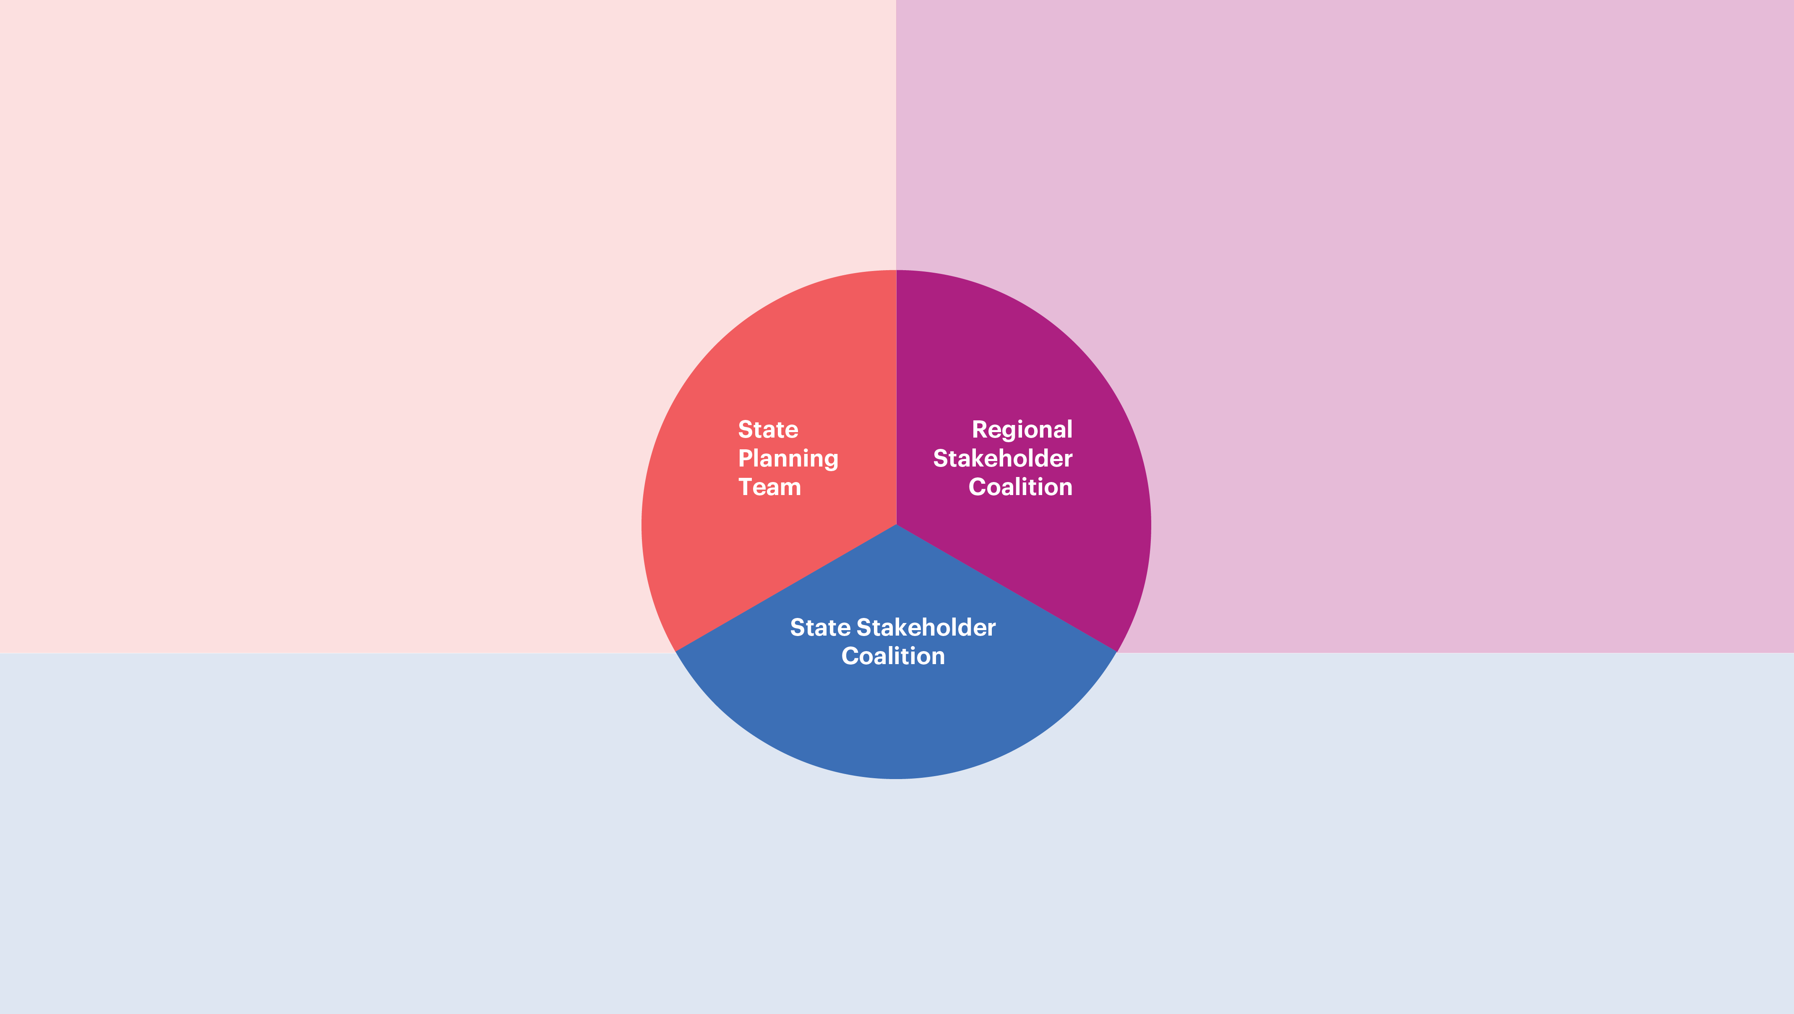
Background: MA Family Engagement Coalition
Early Intervention
Families and Parent Leadership
Networks
WIC
Regional DCG Offices
Department
of Early Education
and Care
Gail DeRiggi
Public schools
FCC
Home visiting
Regional DCF offices
CFCEs
Museums and Libraries
Department of
Public Health – Bureau of Maternal and Child Health
Suzanne Gottlieb
Roxanne Hoke-Chandler
Department of Elementary and Secondary Education
Kathy Rodriguez
Donna Traynham
Emily Taylor
Family Engagement and cultural Organizations
Head Start and EEC programs
Family Advocates and parent child home programs
Department of Public Health
Department of Children and Families
Department of Transitional Assistance
Department of Mental Health
Office of Refugees and Immigrants
Massachusetts Developmental Disabilities Council
Department of Early Education and Care
Department of Elementary and Secondary Education
Department of Higher Education
Children's Trust
University of Massachusetts
MA Board of Library Commissioners
Notes:
Who was engaged in creating the Framework? State agencies, youth and family serving agencies across education, health and human services and families.

Slide 6
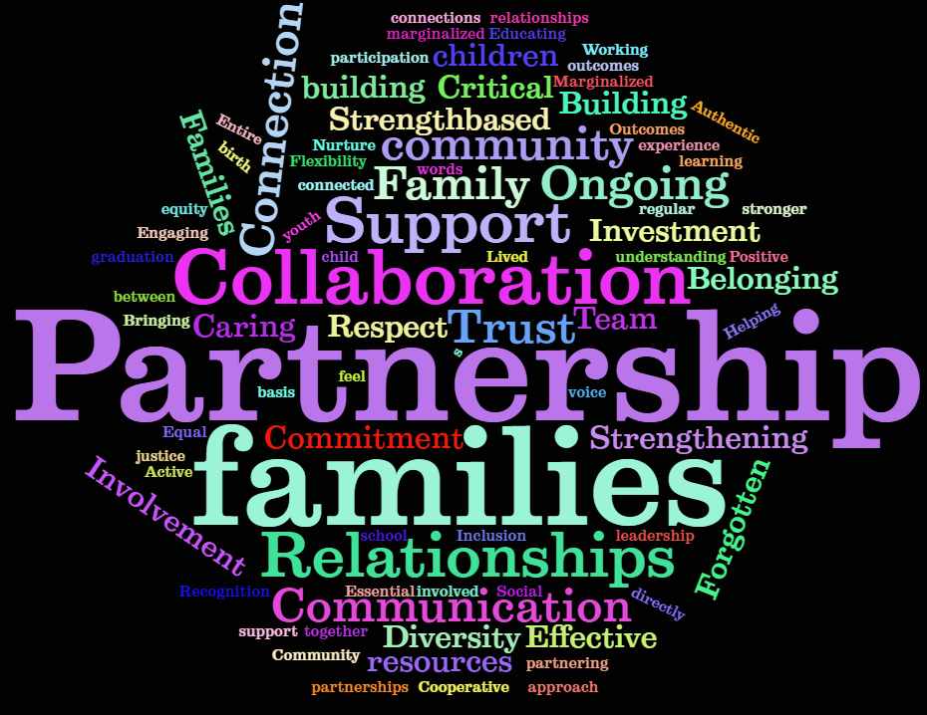
Where we started from….
Regional Family Engagement Coalition

Slide 7
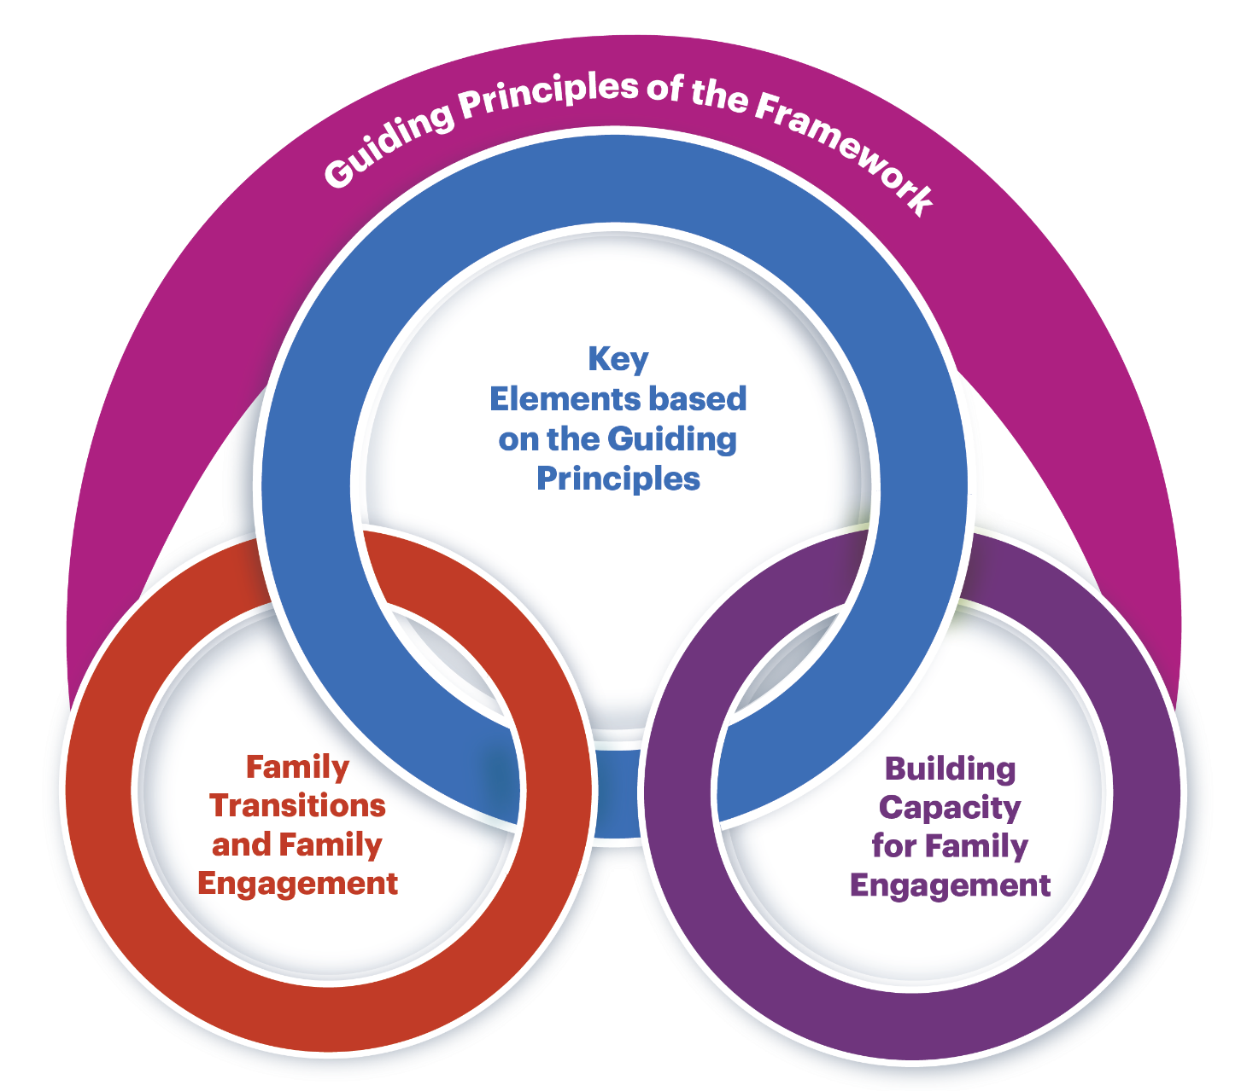
Framework Design
Notes:
Overview of the components
The Framework consists of multiple sections that include:​
Guiding principles​ overarching
Four key elements that translate the guiding principles into practice​
Focus area on transition​
Strategies for strengthening the family engagement capacity of organizations.
​
First, the principles that guide our understanding of family engagement are presented.
Next, are the four elements that provide the backbone for this Framework.
These elements translate the concepts outlined in the Guiding Principles into practice.
The next section focuses on the various transitions that families experience and seeks to guide practitioners, using the family engagement elements, as they assist families to navigate those transitions
The last section focuses on strengthening the family engagement capacity of the organization as a whole through staffing, resource development, professional development and evaluation.

Slide 8
Guiding Principle 1:
Each family is unique, and all families represent diverse structures. Family engagement includes genuine efforts to understand each family’s beliefs, values, priorities, goals and aspirations. Families and practitioners make joint decisions and share responsibility in a successful partnership.

Slide 9
Guiding Principle 2:
Diversity is expressed and experienced at multiple levels such as (but not limited to) race, religion, ethnicity, culture, language, family structures, ability, sexual orientation, socio-economic status, and educational level. Acknowledging and accepting the need to engage all families is essential for successful engagement of diverse families and includes recognizing the strengths that come from their diverse backgrounds.

Slide 10
Guiding Principle 3:
Building a respectful, trusting, and reciprocal relationship is a shared responsibility of families, practitioners, organizations, and systems. This positive relationship has the individual family’s strengths and assets at its center.

Slide 11
Guiding Principle 4:
Families are their child’s first and best advocate. This premier role puts families in a unique position to nurture their children’s growth and development and to help practitioners become knowledgeable about their child.

Slide 12
Guiding Principle 5:
Equity is the eradication of privilege, oppression, disparities, and disadvantage. Family engagement must be equitable. Equitable family engagement comprises intentional and meaningful engagement activities and systems for all families or groups of families irrespective of families’ level of or approach to engagement. Providing equity-based opportunities for family engagement can help family members become effective advocates for their children.

Slide 13
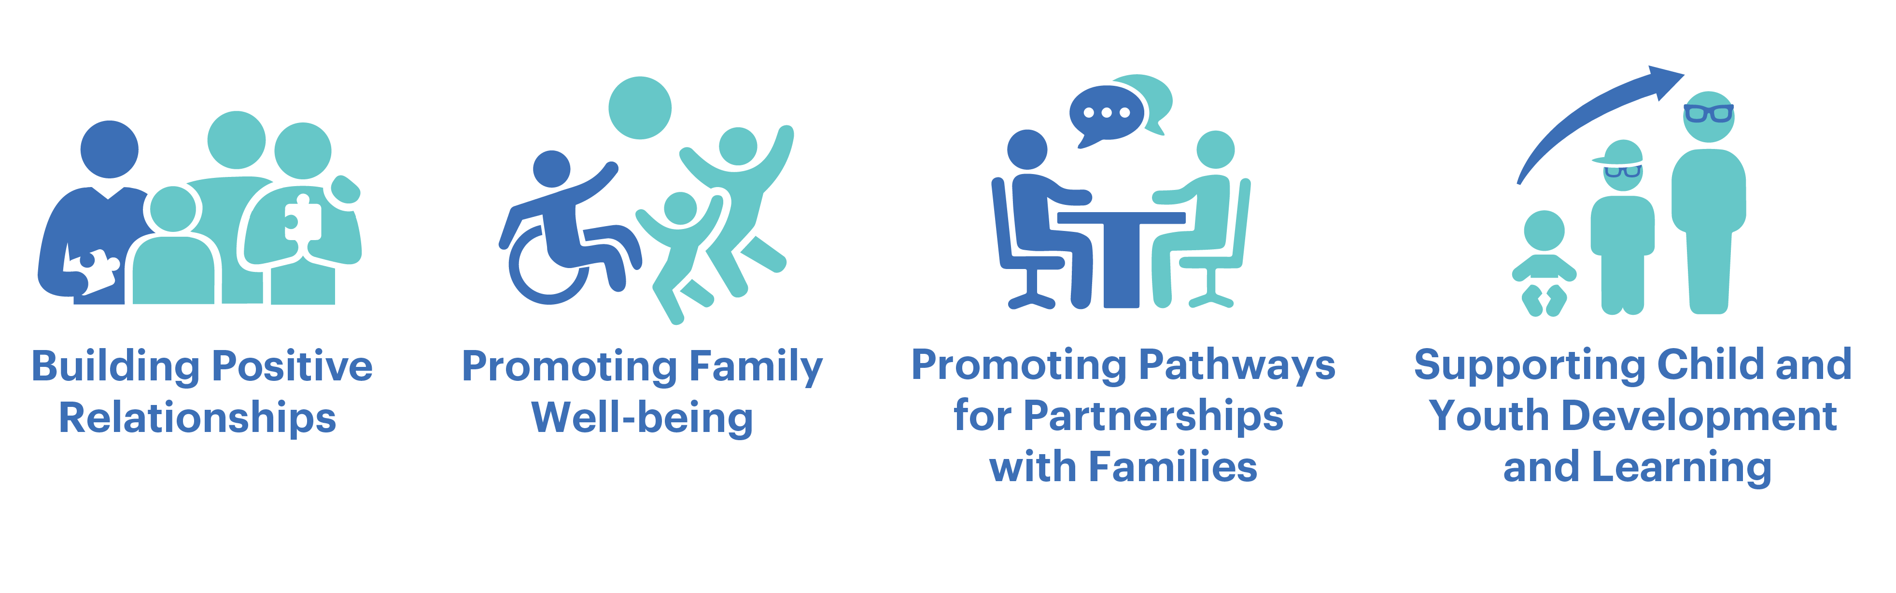
Framework Elements
Notes:
These sequential elements provide the foundation for the Framework. Each element builds on the one before. These elements translate the concepts outlined in the guiding principles into practice. Each element has specific goals and practices outlined in the Framework.
Building Positive Relationships: Mutual trust and respect lies at the core of these relationships
Family well-being, which comprises safety, health, and financial security is an important outcome for families.
Promoting Pathways: Everyone must recognize that there is a continuum of engagement Providing multiple pathways for the engagement of families helps to build trusting relationships with them and creates opportunities for them to determine the level of engagement where they are most comfortable.​
Supporting Child and Youth Development, Learning, Health and Well-Being​
Practitioners can support families in their relationships with their children by talking with them about their child’s development, learning, and behaviors​
​
Engagement opportunities should be accessible to proactively create pathways for engagement that are responsive to the needs of families. ​
​
It is also important to connect families with other families and community resources to enhance learning and development.​
.
Transitions: Following this section is one specifically focused on transitions, The transition section of the Framework guides practitioners using the family engagement elements, to assist families to navigate the range of transitions every day, systems, and those that are unexpected.

Slide 14
Framework Elements Pyramid
Supporting Child Development and Well-Being
Promoting Pathways for Partnerships with Families
Promoting Family Well-Being
Building Positive Relationships

Slide 15
Building Positive Relationships
Intentionally build and sustain relationships with all families
Build reciprocal and balanced communications with families
Collaborate with families to create and/or promote connections among families

Slide 16
Promoting Family Well-Being
Employ multiple strategies to connect families with resources to enhance family well-being
Engage community members/agencies/organizations in ways meaningful to the families
Identify and address barriers families experience in accessing community organizations and services

Slide 17
Promoting Pathways for Partnerships with Families
Use family-driven approaches to create varied opportunities for engagement
Provide opportunities for family contributions to the engagement process
Support families’ civic engagement efforts
Provide opportunities for family mentorship and voice
Share power and decision making
Partner with families in identifying and planning engagement activities

Slide 18
Supporting Child and Youth Development, Learning, Health and Well-Being
Develop multi-pronged systems of information exchange among families, schools and community organizations
Identify collaborative development and learning opportunities among families, schools and community organizations
Engage families through peer-to-peer interactions

Slide 19
Polling Question
To what extent do your family engagement initiatives align with the 4 elements of the family engagement framework?
www.menti.com
Code: 2187 9395

Slide 20
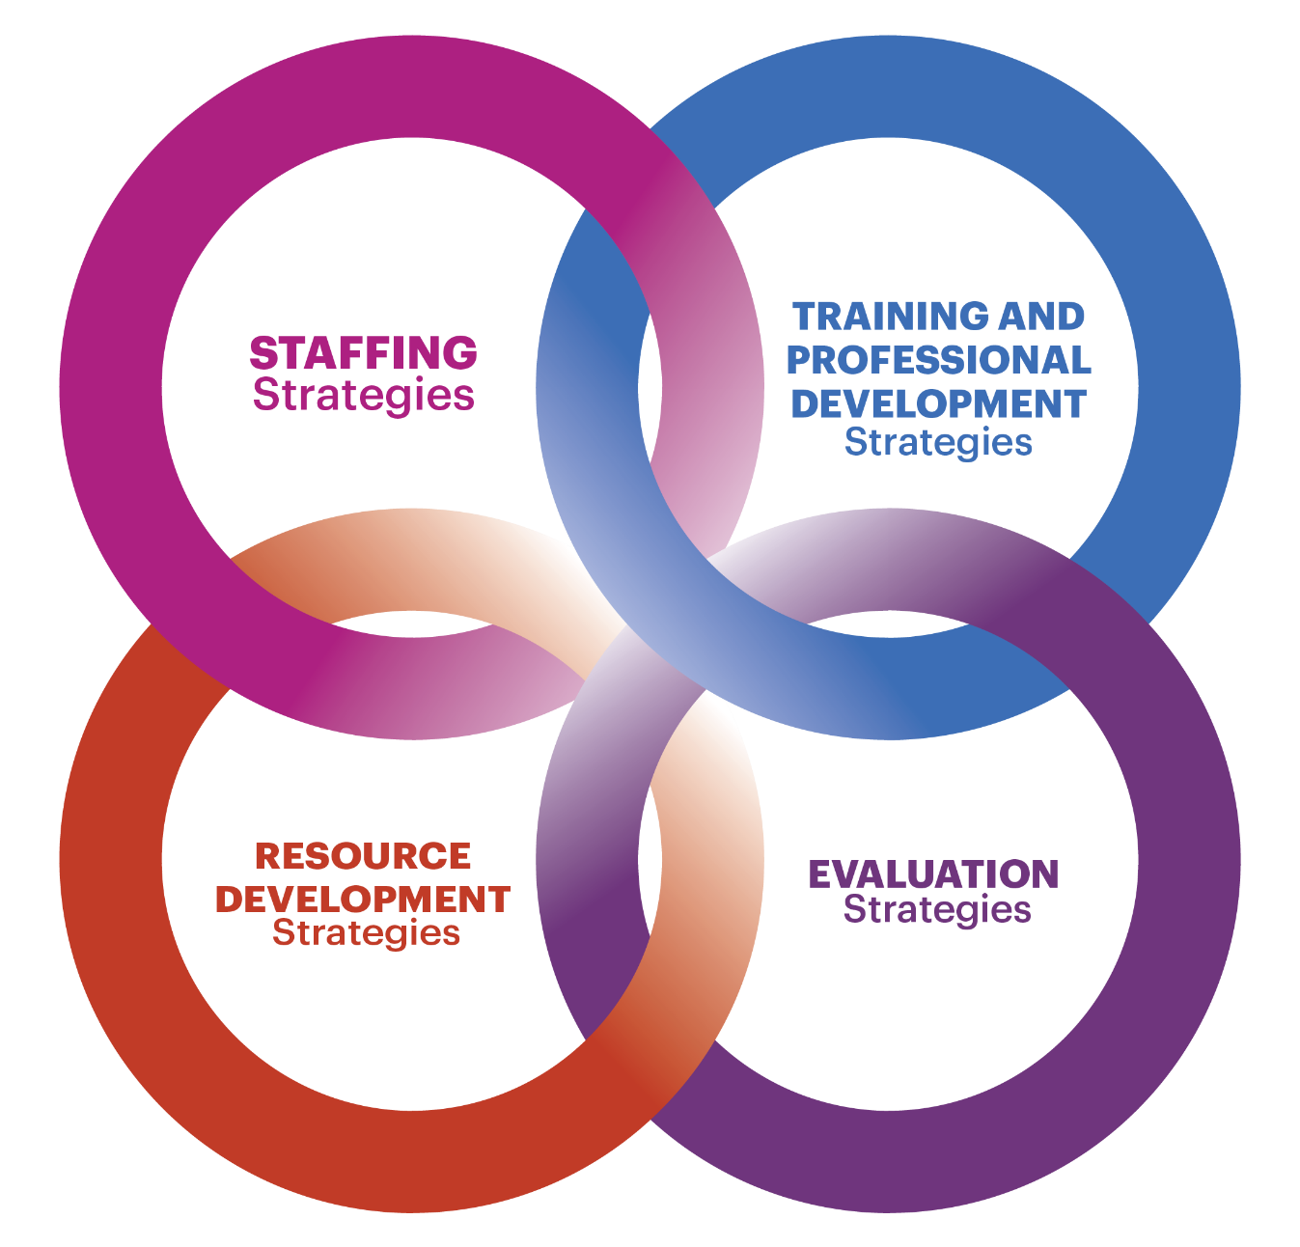
Strengthening Capacity
Notes:
An Integrated approach - This last section focuses on strengthening the family engagement capacity of communities and organizations as a whole through staffing, resource development, professional development and evaluation.

Slide 21
Break-Out Discussion Questions
Where does your family engagement align well with elements of the framework?
What elements of the framework do you want to dive more deeply into as part of your professional learning opportunities?
What resources would be helpful to advance and strengthen your family engagement initiatives?

Slide 22

Question and Answers

Slide 23
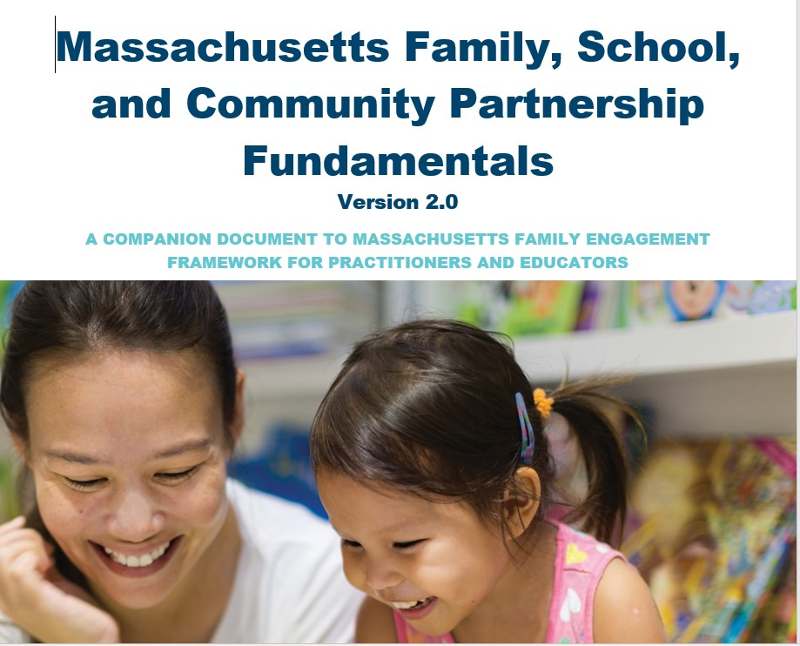
Fundamentals

Slide 24
MA Family, School and Community Partnerships Fundamentals – What Is It?
A self-assessment tool for districts and schools to utilize as they reflect on their current family engagement practices;
Developed by the Board of Elementary and Secondary Education’s Parent and Community Engagement and Involvement Advisory Council (PCEIAC);
Originally modeled after the National Parent Teacher Association (PTA) standards for successful family-school partnerships;
Defines guidelines and research-based practices for the engagement of families, schools, and communities in supporting equitable learning opportunities for students;
Revised in 2020 to align with our state’s new family engagement framework

Slide 25
Components of the Fundamentals Document
5 sections to the self-assessment
  Building Positive Relationships
  Supporting Family Well-Being
  Promoting Pathways for Partnerships with Families
  Supporting Child and Youth Development, Learning, Health and Well-Being
  Building Capacity of the Staff
Continuum of Development and Implementation
  Initiating
  Progressing
  Mastering
1-3 Indicators of Practice at Each Level of Development

Slide 26
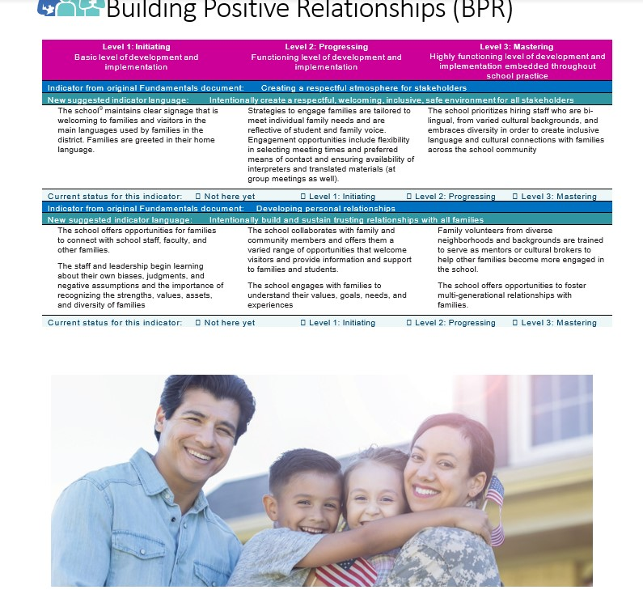
Format and Key Features

Slide 27
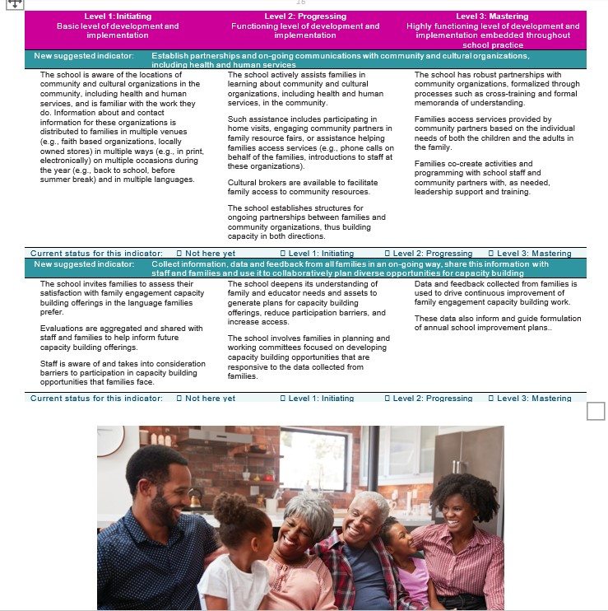
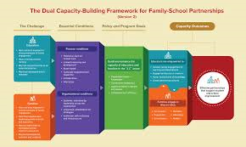
Building Capacity of Staff and Alignment with the Dual Capacity Framework

Slide 28
Implementation Examples and
Strategies for Consideration
Professional development
Community-Wide
Building the capacity of administrators, educators and families
Strategies:
Importance of multiple perspectives when reflecting on family engagement
Importance of leadership commitment
Starting small

Slide 29

What ideas do you have for using the Fundamentals and/or self-assessment in general?

Slide 30
Resources to Support the Fundamentals
Learning Module on how to use the Fundamentals (in design)
Partnership with School and Main Institute to support use of the Fundamentals
Online Tool use (in conceptual development)

Slide 31
Family Engagement Framework Resources
Family, School and Community Partnerships Fundamentals Online Application Form
Family Institute for Student Success (FISS)
Culturally Responsive Family Engagement webinars
Anti-Racist Family Engagement webinars
Family Friendly Tools:
  Provider version: What is Family Engagement? For Families | MASFEC
  Family version: What is family engagement? Archives | MASFEC

Slide 32
DESE Contact Information
Olga Lopez, Family Engagement Specialist
  Olga.M.Lopez@mass.gov
  781-338-6315
Donna Traynham, Early Learning Team Lead and Family Engagement Coalition Co-Coordinator
  Donna.J.Traynham@mass.gov
  781-338-6372
Karyl Resnick, 21st Century Community Learning Center Coordinator
  Karyl.A.Resnick@mass.gov
  781-338-3515

