Slide 1
Title I Targeted Assistance Programs
Federal Grants Conference
November 15, 2022

Slide 2
Targeted Assistance Programs
Targeted Assistance programs specifically serve those students who are failing or most at risk of failing to meet the state academic standards. The school must select those students based on set criteria determined by your district, and those students are considered your “Title I students”. The Title I funds can only serve those students or teachers of those students.
Typically, schools below 40% poverty are Targeted Assistance.

Slide 3
Targeted Assistance Programs
Fund use (based on needs assessment):
(not an exhaustive list)
Teachers working with Title I identified students (pull-out, in-class, extended day programs)
PD for teachers who work with Title I students
Family engagement activities for families of Title I students
Instructional materials for Title I students

Slide 4
Targeted Assistance Programs
The school or district will set the criteria to determine Title I student eligibility. The criteria that you use must meet certain requirements:
Multiple measures
Educationally related
Objective
Universally applied

Slide 5
Targeted Assistance Programs
Required documentation specific to TA programs:
Student selection procedure
Selection criteria sheets
Rank-ordered lists

Slide 6
Belchertown Public Schools

Slide 7
About Belchertown
Shawn Fortin
Assistant Superintendent for Teaching and Learning
2,200 students (26% Low-Income)
1 Title I school - Swift River Elementary School (grades 1-3)
Title I allocation: $250,471
Belchertown is a “semi-rural” community in western MA. Belchertown has one of the largest land areas in Massachusetts and lies adjacent to the Quabbin Reservoir, one of the largest man-made reservoirs in the country.

Slide 8
Belchertown’s Title I Program
2 Title I Teachers (+MTRS) $173,000
Professional Development $40,000
Textbooks/Related Materials $35,000
Equitable Services $1,800

Slide 9
Program Logistics
2 FTE Title I reading teachers service 7-8 flexible groupings per day (pull-out model) 5 times per week for 30 minutes per day.
Student groups of similar academic needs (3-6 students) meet every day.
Selection is based on weighted criteria (e.g., STAR, QPS, classroom assessment).
Instruction is based on assessments in phonics, phonemic awareness, comprehension, fluency and vocabulary, using leveled readers, and word study.

Slide 10
Program Logistics
This year’s Professional Development:
Support of Title I teachers’ role in the implementation of myView Literacy! in classrooms,
Use of high-quality supplemental/intervention materials in Title I,
Use and interpretation of assessments aligned to the Science of Reading.

Slide 11
Student Selection
All students are screened 3 times per year - Fall (before Nov), Winter (Feb), and Spring (May).
STAR Early Literacy is used each time.
The QPS is used with 1st grade in the fall.
Other assessments include phonogram and high-frequency word lists.
Student selection charts illustrate level of need at each grade level. Cut-off is based on level of need and how many students can be serviced during each block.

Slide 12
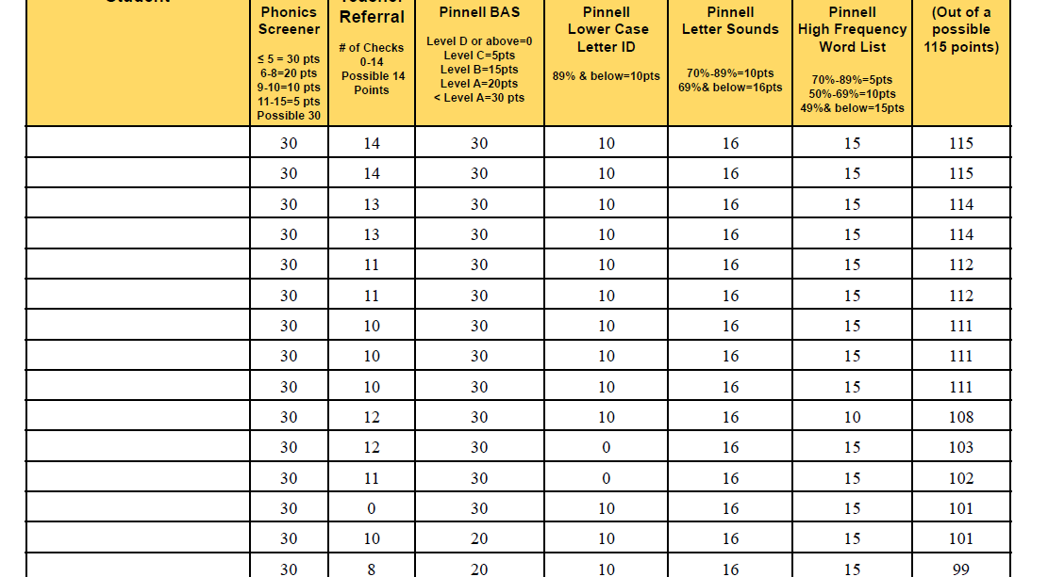
Student Selection

Slide 13
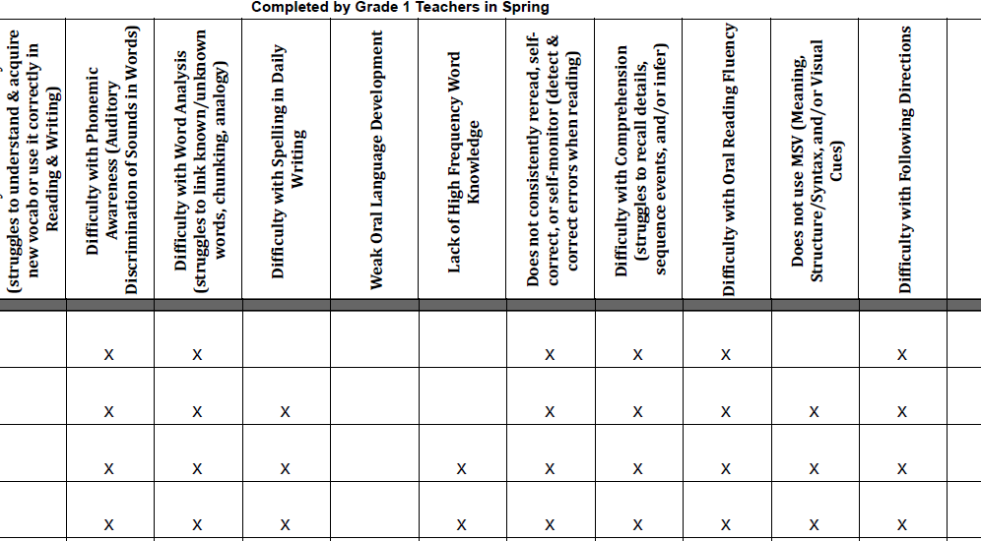
Student Selection

Slide 14
Student Selection
Caseloads are larger this year (the level of need have increased) - 30 students per teacher.
Flexible grouping allows teachers to move students between groups throughout the school year according to individual growth.
Students who meet benchmarks on assessments discontinue interventions and new students are picked up.

Slide 15
Family Communications
A letter is sent home to inform families that their child is selected to participate in the Title I Reading program and families receive the Parent Compact.
Teachers communicate with families at meetings, parent-teacher conferences, progress reports, emails, phone calls, Literacy Night, and monthly newsletters (which include tips for reading with their child at home).

Slide 16
Family Communications

Slide 17
Arlington Public Schools

Slide 18
About Arlington
Presenting today:
Julie Dunn, Director of Communications, Grants, and Title I
Sorelle Cohen, Reading Specialist, Thompson Elementary School
Abby Kaminsky, Math Interventionist, Thompson Elementary School
Current APS Enrollment - 5,991 (excluding OOD and services only)
District-Wide-Low-Income Percentage: 12.2%
Close-in densely populated suburb
FY23 Title I allocation - $157,062
3 Title I elementary schools, out of 7 total elementary schools
Thompson Elementary
Peirce Elementary
Hardy Elementary

Slide 19
Arlington’s Title I Program
FY23 Title I budget allocation:
1 part-time Title I math support Tutor at Thompson
2.5 FTE Title I ELA Tutors across 3 schools
Funding for summer tutoring by APS teachers - $175/day
Funding for Teaching Assistant - $75/day
Funding for 2 program coordinators/PD for summer program - $7,000
Stipend for Title I math supervisor (on site) - $1,000
Town Retirement benefits for tutors
Note: In summer 2022, unspent funds from FY21 were also allocated.

Slide 20
Arlington’s Summer Title I Program
Program Details
5 week program
15 days in total
Tuesday, Wednesday, and Thursday mornings
July 12, 2022 - August 11, 2022
Staff included a Math and Reading Coordinator, 8 Math Teachers, 8 Reading Teachers and 1 Teaching Assistant for both reading and math
Most groups had 3-4 students, no more than 5 students in a group
One hour sessions for reading and one hour sessions for math, some students get both supports
Ask families to commit to attending at least 12 of the 15 sessions.
Program Data
182 students were invited to math and 52 students attended math (29%). 83% chose in-person and 17% chose remote.
197 students were invited to reading and 62 students attended reading (31%). 82% chose in-person and 18% chose remote.

Slide 21
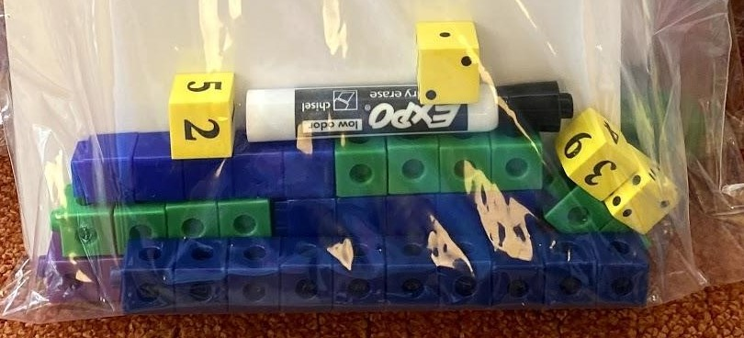
Timeline for Planning Summer Program
January:
Meet to discuss the past summer, review data and plan for the current summer. Participants invited include: Director of Communications, Grants and Title 1, Reading and Math Summer Coordinators, Assistant Superintendent, and Principals of Title 1 schools.
February:
Post the summer job description for teachers internally. Then correspond with teachers who previously taught in the program to see if they want to return. Follow up and review resumes of new candidates who expressed interest after job was posted, conduct interviews and officially offer the position to qualified candidates.
March:
Select students

Slide 22
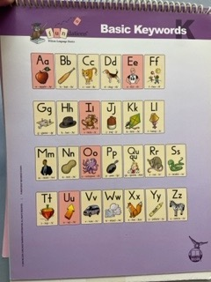
Student Selection Process
The reading and math summer coordinators select students who participated in any reading or math intervention (either RTI or IEP) during the school year. They also consider teacher recommendations of students not currently picked up by a specialist and those students not eligible for ESY that would benefit from additional targeted support. Assessment data from the Title 1 Schools is also analyzed to identify students who would benefit from additional summer support. Grade level fluency assessments (each school had a spreadsheet and shared the data with the liaison) were used to determine if students were eligible. Assessments used included:
Reading:
DIBELS (Dynamic Indicators of Basic Early Literacy Skills) DRA2 (Developmental Reading Assessment) Oral Reading Fluency scores
Math:
Kindergarten: Fluency within 5 addition and subtraction
Grade 1: Fluency within 10 addition and subtraction
Grade 2: Fluency within 20 addition and subtraction,
Grade 3: Multiplication 0,2,5,10’s
Grade 4/5 i-Ready and MCAS data

Slide 23
Timeline for Planning Summer Program (continued)
April/May: Send out a Google Survey to formally invite students to the program and give parents more specific information about what the district is offering. The program coordinators keep track of parent responses to see who signed up, who declined, who didn't respond and whether families wanted remote or in person support. They follow up via email and phone calls with parents who did not respond to summer reading program invitation or had questions.
June: Program coordinators train summer staff which involves giving pertinent information over email, time set aside to meet to go over specific materials and areas of instruction to focus on in sessions. The next step involves updating our spreadsheet to include enrolled students from all schools. Then we gather up the most recent assessment data so we can group students accordingly and assign times/teachers. There is a lot of communication between the math and the reading coordinators to make sure times don’t overlap and siblings times are coordinated.
July: Before the program starts, attendance sheets are prepped, payroll forms filled out, classroom spaces are made ready, and supplies are gathered for teachers. The program coordinators arrange for remote pick up of materials. Coordinators serve as point persons throughout the five weeks along with the teaching assistant assigned to the program. They follow up with parents whose children did not show up and check in with teachers throughout the summer to support them with their teaching and any student concerns.

Slide 24
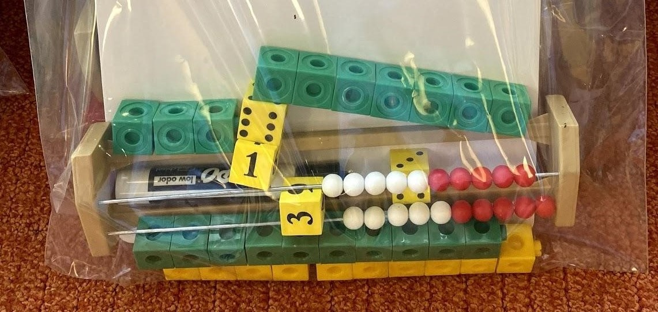
Summer Program Wins and Challenges
Wins:
Able to help many students who otherwise would not have summer plans, a free program, decreases summer academic slide, students gain confidence and bounce back faster into next grade.
Challenges:
Consistent attendance, schedule times due to parents having other summer plans (camps/vacations), program only being 1 or 2 hours of the day, and transportation. The coordinators noted that having food available for families on site brought more students into the buildings (Arlington Eats).

Slide 25
Q & A

Slide 26
Thank you!
Federal Grants Office
https://www.doe.mass.edu/federalgrants/titlei-a/
federalgrantprograms@mass.gov
781-338-6230
Shawn Fortin
sfortin@belchertownps.org
Julie Dunn
jdunn@arlington.k12.ma.us

