Slide 1

Family Engagement Webinar
Federal Grants Convening
November 1st /2023
Olga M. Lopez
Family Engagement Specialist
Office of Student and Family Support
Olga.m.lopez@mass.gov

Slide 2
Purpose
To create a roadmap to family engagement, which:
builds on existing family engagement frameworks,
integrates principles of equity and cultural responsiveness, and
provides an aligned approach to engaging with families.

Slide 3



Family Engagement Goal
The primary goal of family engagement:
Facilitate shared responsibility that contributes to the
healthy development, learning, and growth of children –
from the earliest ages into young adulthood;
Build authentic relationships between students, families, educators,
and the community; and
Develop these relationships into meaningful
partnerships rooted in the strengths and assets of all.
Family Engagement Framework
2.0 Fundamentals Document

Slide 4
Polling Question
List a word or term that you think of when asked “What Does Family Engagement Mean to You?”
menti.com
The code 9787 5087

Slide 5

Strengthening
Partnerships

Slide 6
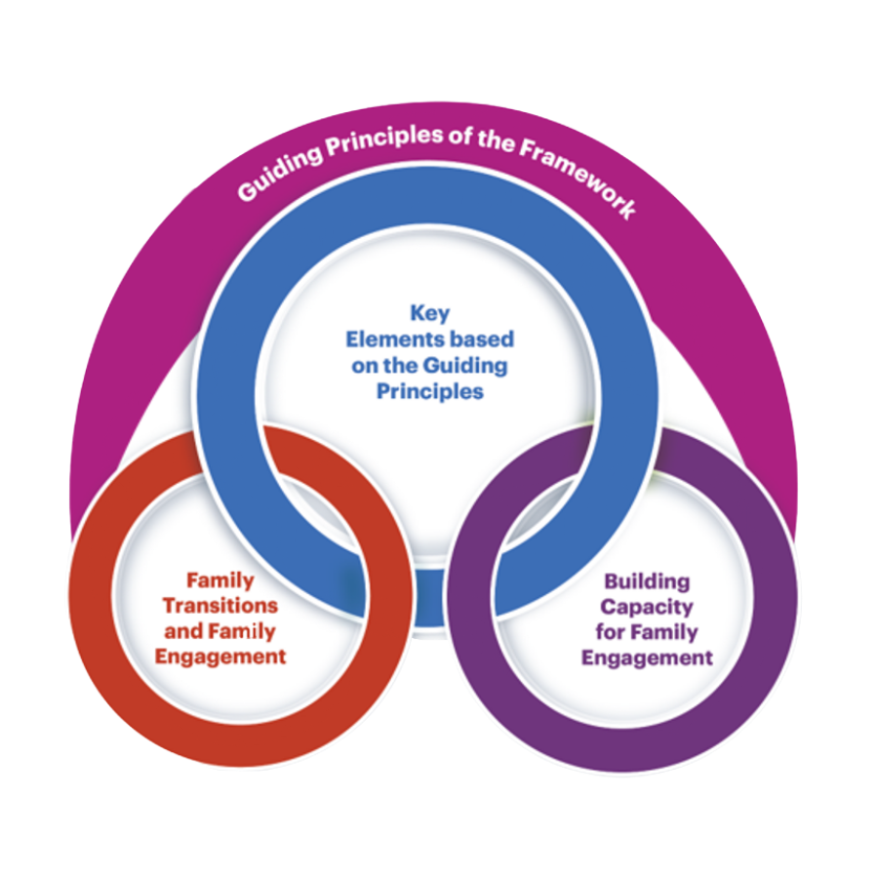
Framework Components
The Framework consists of multiple sections that include:
Guiding principles
Four key elements that translate the guiding principles into practice
Focus on transition
Section on strengthening the family engagement capacity of organizations.

Slide 7

Guiding Principles –Fundamental Practices
Guiding Principles
Best Practices
1. Each family is unique, and all families reflect diverse structures
Recognize and respect the uniqueness of each family
Keep families and youth voices and perspectives at the center
Plan and implement activities with families and youth, not for families and youth.

Slide 8

Guiding Principles –Fundamental Practices
Guiding Principles
Best Practices
2. Acknowledging and accepting the need to engage all families is essential for successful engagement of diverse families and includes recognizing the strengths that come from their diverse background
Recognize and respect the individuality of each family including the strengths it possesses, needs it has, and barriers it faces;
Acknowledge the diversity within and across families and within an organization, school, and/or community; and
Approach diversity from a strengths-based perspective.

Slide 9

Guiding Principles –Fundamental Practices
Guiding Principles
Best Practices
3. Building a respectful, trusting, and reciprocal relationship is a shared responsibility of families, practitioners, organizations, and systems.
Embracing the philosophy that builds positive goal-oriented relationships in a two-way process between everyone involved.
Recognizing and respecting diversity within and across families, striving to establish a positive relationship with all families; and
Acknowledging that for some families, due to prior experiences, trust may need to be rebuilt and dedicating the time needed to re-establish that trusting relationship.

Slide 10

Guiding Principles –Fundamental Practices
Guiding Principles
Best Practices
4. Families are their child’s first and best advocate.
Recognizing families as the best champions of their child’s success in all domains of health,
Development Honoring on families’ wealth of knowledge, experience, and expertise;
Engaging families in all decisions made with regards to their child. .

Slide 11

Guiding Principles –Fundamental Practices
Best Practices
Guiding Principles
Reflecting on and addressing inequities as well as implicit and explicit bias within individuals and organizations, when engaging with families;
Valuing opportunities to engage with all families to learn more about them, their experiences, culture, and goals; and
Recognizing the need to build and rebuild trust with families who experience inequities and bias.
5. Family engagement must be equitable.

Slide 12

Framework Elements

Slide 13

Building a Positive Relationship
The primary and fundamental element of family engagement is to build strong, positive, and effective relationships with families that can help children and families thrive.
Mutual trust and respect lie at the core of these relationships.
Healthy relationships develop through a series of authentic interactions over time that are meaningful to everyone involved.
Building trust with families includes open, on-going, and reciprocal communication.

Slide 14

Promoting Family Well-Being
Well-being includes, but is not limited to:
Having access to opportunities for educational advancement and economic mobility;
Physical and mental health services;
Housing and food assistance; and
Other family support services.
Community engagement allows practitioners to assist families in achieving their well-being goals and helps build positive relationships.

Slide 15

Promoting Pathways for Partnerships with Families
Promoting opportunities for establishing, maintaining, and enhancing partnerships with families is a required element for successful implementation of family engagement within organizations.
Partner with families in identifying and planning engagement activities
Use family driven approaches to engagement
Provide opportunities for family contributions to the engagement process
Share power and decision making
Support family's civic engagement effort

Slide 16

Supporting Child and Youth Development and Learning
Engagement opportunities should be accessible to proactively create pathways for engagement that are responsive to the needs of families.
It is also important to connect families with other families and community resources to enhance learning and development
Develop multi-pronged systems of information exchange among families, schools and community organizations to enhance child, youth, and family learning and development.
Identify collaborative development and learning opportunities among families, schools and community organizations.
Engage families in a process of learning and development through peer-to-peer interactions.

Slide 17
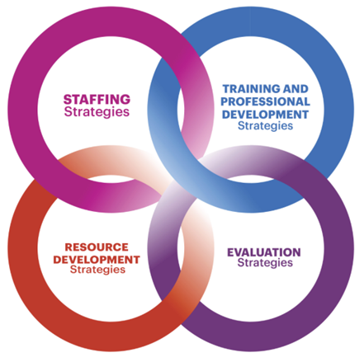
Defining Capacity Strengthening
Involves a cultural shift from understanding family of parent involvement to an intentional, ongoing, and consistent process;
Family engagement as a fundamental priority and builds on the involvement and support of every member within the organization in family engagement activities and endeavors.

Slide 18
Break-Out Discussion Questions
Where does your family engagement align well with elements of the framework?
What elements of the framework do you want to dive more deeply into as part of your professional learning opportunities?
What resources would be helpful to advance and strengthen your family engagement initiatives?

Slide 19

Massachusetts Family, School and Community Partnership Fundamentals
Version 2.0
A Companion Document to Massachusetts Family Engagement Framework for Practitioners and Educators

Slide 20
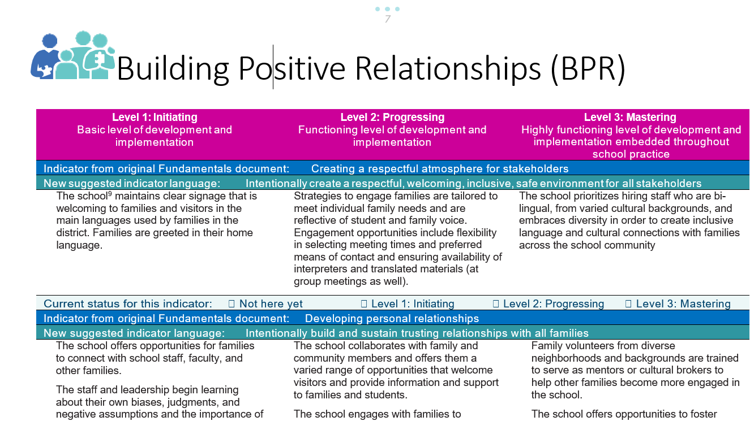

Slide 21

Examples of District Supports for Family Engagement
Guidance:
The Prenatal through Young Adulthood Family Engagement Framework for Massachusetts Family Engagement Framework
Family, School & Community Partnerships Fundamentals Self Assessment Tool
Parent and Community Education and Involvement Advisory Council (PCEIAC)
Professional Development
Family Engagement Professional Development (calendar)​
Better Together: Massachusetts Family School Partnership Fundamentals Reusable Learning Object (RLO)
Family Institute for Student Success FISS Application​
Grants:
Family Engagement Grants (anticipated in July 2023)

Slide 22

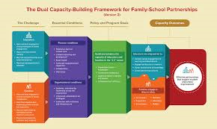
Building Capacity of Staff and Alignment with the Dual Capacity Framework

Slide 23
Culturally Responsive Family Engagement -
Role of District Leadership
Create district level Family Engagement Position
Regularly meet with families in neutral places within the community to build trusting relationships
3. Support building principals to:
  conduct outreach and welcoming activities pertaining to new or incoming families;
  provide interpretation/ translation in languages of students/families when needed for Tier II and III support;
  promote a family-friendly atmosphere that respects and honors student and family diversity within the school community;
  collaborate closely with Student Support Teams and others to identify families’ needs and interests, and enable access to community resources;
  provide wrap around services for families; and
  connect with community partners to support family well-being and other family needs.

Slide 24
Family Engagement Framework Resources​
Better Together: Family School Partnership Summit 2023Better Together Family Engagement Summit
Family Engagement Coordinators Network​ and Family Engagement Professional Development (calendar)​
Family Friendly Tools:​
Communication Tip-sheet
Family Portal developing
Welcoming Families Communication Toolkit
​

Slide 25

Question and Answers

