Slide 1
GEM$ FY24: Looking Back and Forging Ahead
2023 Federal Grants Fall Conference
November 1, 2023

Slide 2
Presenters: Kathy Cross, State and Federal Resource Coordinator, DESE Kathleen.Cross@mass.gov Alex Lilley, Federal Programs Coordinator, DESE Alex.J.Lilley@mass.gov

Slide 3
Agenda
Using the FY24 ESSA Consolidated funding application, provide pointers and tips for common mistakes and oversights.
Preview some options and improvements for FY25.
We welcome related questions as we discuss each section.
Notes:
Alex

Slide 4
GEM$ Navigating Tips
If you use two screens to view GEM$, use two browsers or Chrome and Chrome Incognito mode Do not use two tabs in the same browser
Avoid double-clicking on links when in GEM$
Application Supplements (Intent to Participate, Data Collections, Late Liquidation) will not be listed on your district homepage – use the left-hand menu, select “Funding”, then select “Application Supplements”. Coming Soon – Application Supplements will be a standalone choice on the left-hand menu
Notes:
Alex

Slide 5
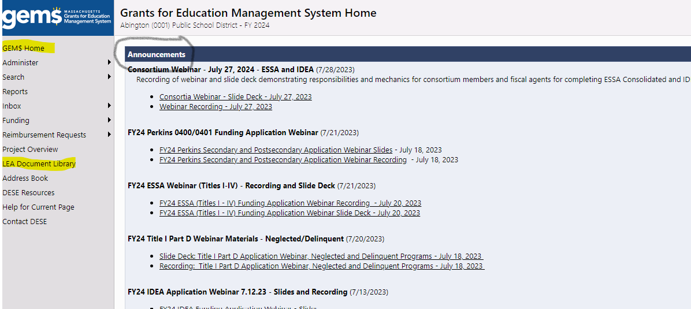
GEM$ Homepage and LEA Document Library
The GEM$ homepage has slides and recordings from training webinars posted...new resources will be added as they become available.
You'll find links to program specific resources within the application pages, e.g., quick reference guides (QRGs).
Federal Grant Assurances – must upload signed copy to LEA Document Library before we can approve any federal grants
Notes:
Alex

Slide 6
Program allocations and flexing
Flexing – lost opportunity – if not allowable in one grant, flex into another grant where it is allowable.
You can flex out of Titles IIA and IVA into any other the other Titles...fund use is flexed, not the funds (stays in budget of initial allocation)
In Sections, go to "ESSA: All Titles" section, then "Program Allocations and Flexing"
Notes:
Alex

Slide 7
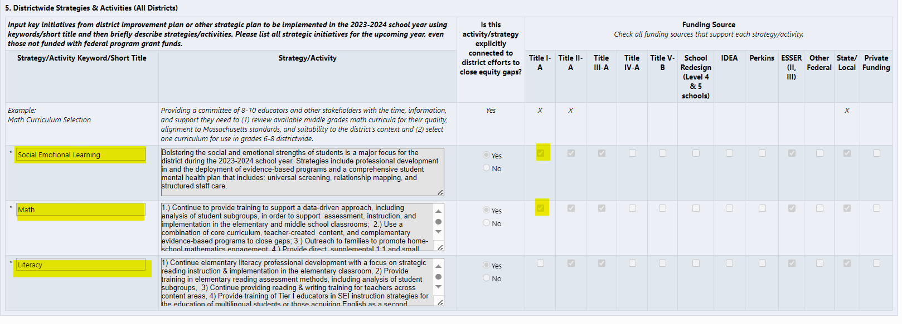
Districtwide Strategies and Narrative
Step 5 Districtwide Strategies and Activities page – Only the Short Title is transferred to the Narrative pages for each Title for which funds are checked.
Title I Narrative page: Make sure to choose each strategy from the dropdown on the narrative page and describe how that Title’s funds are being used to forward the strategy.
Notes:
Kathy

Slide 8
GEPA Questions: Addressing equity for students, educators and other program beneficiaries
New to the application this year...not new requirement...range of quality in responses
Worth checking statute for description and intent
Common checklist comments:
What barriers exist? If none, how addressed?
Match actions to barriers listed?
Timeline for actions to address each listed?
Notes:
Alex

Slide 9
Title I, Part A Non-profit private school participation (equitable services)
Private school dropdown lists populated from Directory
Select and add as needed...complete all columns
Loaded listing not necessarily complete and may be outdated – helpful or misleading?
Your selections will serve as baseline for next year
Note: If part of a consortium (assigning funds to another district/entity), must complete "Consortium Members Non-Profit Private School Participation" page in "ESSA: All Titles" section
Notes:
Alex

Slide 10
Title I, Parts A & D Reservations
Tips:
Make sure that your budget reflects expenses for these reservations – show the through line (can make a note in the narrative if not an obvious connection)
Scroll all the way to the right to record your reservations – otherwise you may receive validation errors
We will include the total remaining for allocation to schools on the FY25 Reservations page
Homeless reservation – This reservation is required. It can be used to serve homeless students, even if they are not attending a Title I school, and can support costs broadly to ensure homeless students are ready to learn. Note: These funds can be used to pay for your homeless liaison, which is required for all school districts by the McKinney-Vento Act. Please be sure this is a meaningful amount.
Family engagement reservation – Required (1%) for those receiving $500,000 or more.
Notes:
Kathy

Slide 11
School Ranking
Next year
How to reduce school allocation to $0 (budget small leftover in reservations)
<1000, one school per grade – flexibility to serve any school in any amount
If all schools above 35% poverty, minimum per-pupil will be suggested only
Clearer guidance/increased flexibility on gradespan for groupings/one-school-per-gradespan
Notes:
Alex

Slide 12
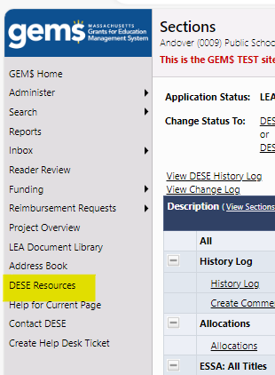
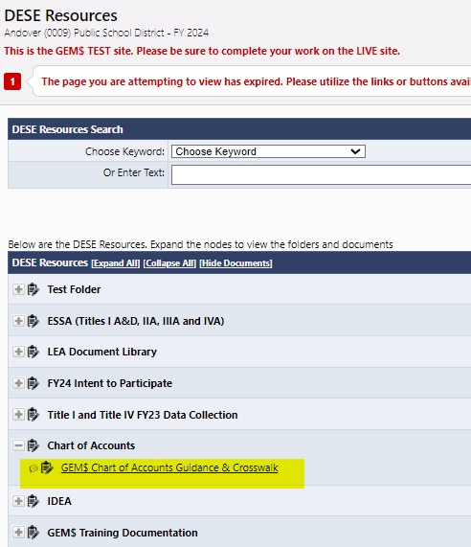
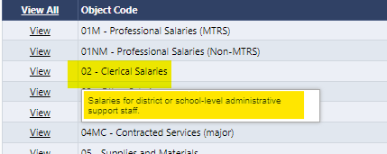
Budget
New Chart of Accounts has proved challenging. Remember:
Your best resource is your business office. Whoever files your end-of-year reports for all district spending is very familiar with this chart of accounts – ask for help rather than guessing.
Fiscal Agents should be reviewing COA Object/Functions as part of workflow.
Chart of account guidance on GEM$:
In DESE Resources (search = CTRL F; constantly updating with new notes)
On the Budget home page – use the hover definitions.
Also, administrative caps trump indirect cost rates. Example: a district’s indirect rate is 3.4% but for Title III there is an administrative cap of 2%, the district will only be able to take 2% as indirect, assuming there are no other administrative expenses. Indirect is, by definition, an administrative cost.
Notes:
Kathy

Slide 13
Using Checklists to best advantage
Numbered checklist items correspond to the Sections:
Best practice is to review checklists prior to submitting a funding application to see if you have met all requirements.
If you get a funding application returned “Edits Needed,” DESE liaisons have marked deficient sections “Attention Needed” and written comments directing
you to corrective actions.
If possible, use two screens (and two
browsers) to open the application twice.
That way, you can look at the checklist and
your application contents at the same time.
If you have questions, you can “Create a
comment” and send it back to your liaison
within GEM$.
If your liaison has taken the time to write
comments in the checklist, please read
them thoroughly before reaching out to
your liaison.
Notes:
Kathy

Slide 14
The Funding Application Workflow
Application/Revision Started
LEA Grantwriter Submitted
If Not Approved, returns to LEA Grantwriter
LEA Fiscal Representative Approved
DESE Program Reviewed
LEA Superintendent Approved
DESE Program Approved
If Not Approved, returns to DESE Program Reviewer
DESE Fiscal Budget Approved
Notes:
Kathy

Slide 15
Post-approval
For entitlements, once status changes to “DESE Fiscal Budget Approved”, you can start to draw down funds.
Your Grant Award Notification (GAN) will appear on the Sections page of your grant.
While you will get a start date generated by the approval of the LEA fiscal agent, which submits the grant to DESE, we do not recommend incurring expenses until your funding application has been fully approved, as your proposed expenses may not be approved.
The LEA Fiscal Representative role has authority to seek reimbursements in GEM$.
Once your funding application has reached DESE Fiscal Budget Approved, the workflow is complete.
Only Select “Application Revision Started” when you want to amend your grant
If you accidentally select Application Revision Started, you can leave it at that status until you need a revision (amendment). If there is an amendment open when you go to file your FER (FR-1), you can push it through the process then as a zero-change revision.
Notes:
kathy

Slide 16
Expected changes and new options for FY25
Private School Participation, N/D facility information will be copied from FY24 to FY25 (not uploads)
Budget uploads will be offered as an option (e.g., download FY24 grant budget, make changes, upload for FY25)
School Ranking page updates
Help for Current Page resources will be added based on FY23 experience
Rounding will be tweaked to avoid validation errors for .005 cents (e.g., MTRS, Equitable Services)
Possibly include an MTRS calculator for budget page (similar to indirect calculator)
Notes:
Kathy

Slide 17
Contact us:
For assistance, contact your Federal Grants Liaison:
https://www.doe.mass.edu/federalgrants/liaisons.xlsx
Or the Federal Grant Programs mailbox:
federalgrantprograms@mass.gov
Or call our office: 781-338-6230
Notes:
Alex

